Slide 1
The current state of the electron injection problem.
Artem Bohdan
Deutsches Elektronen-Synchrotron (DESY), Germany
PASTO2022, 5-7 September 2022

Slide 2
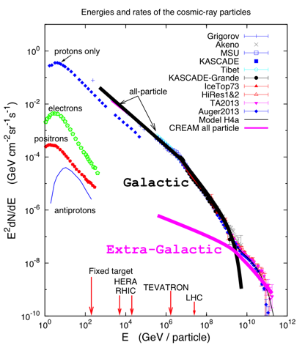
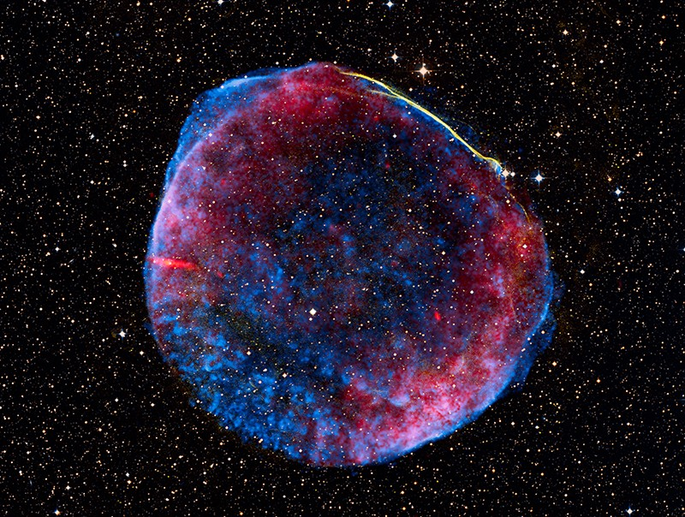
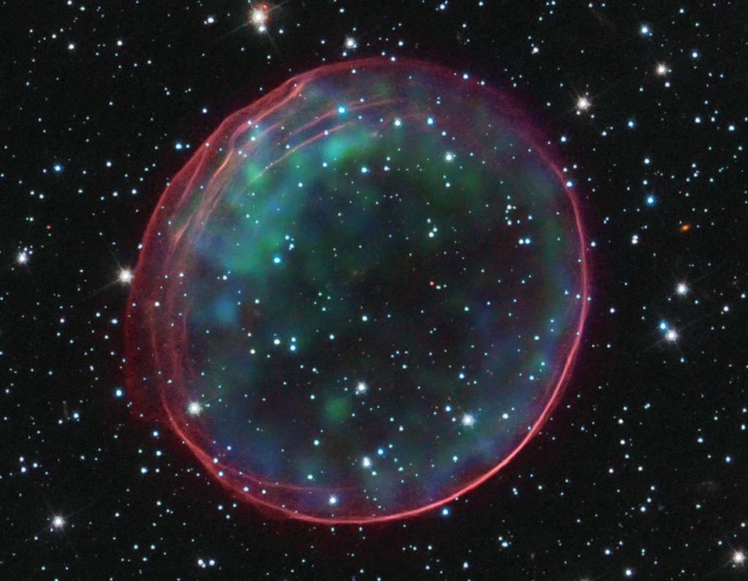
SNR paradigm of CR production
SNR SN 1006
SNR 0509-67.5
SNR G299
SNR Cassiopeia A

Slide 3
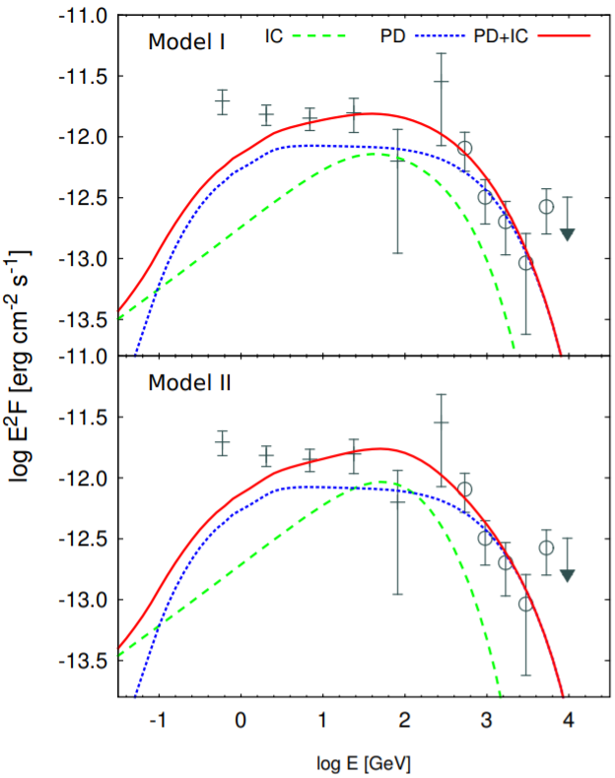
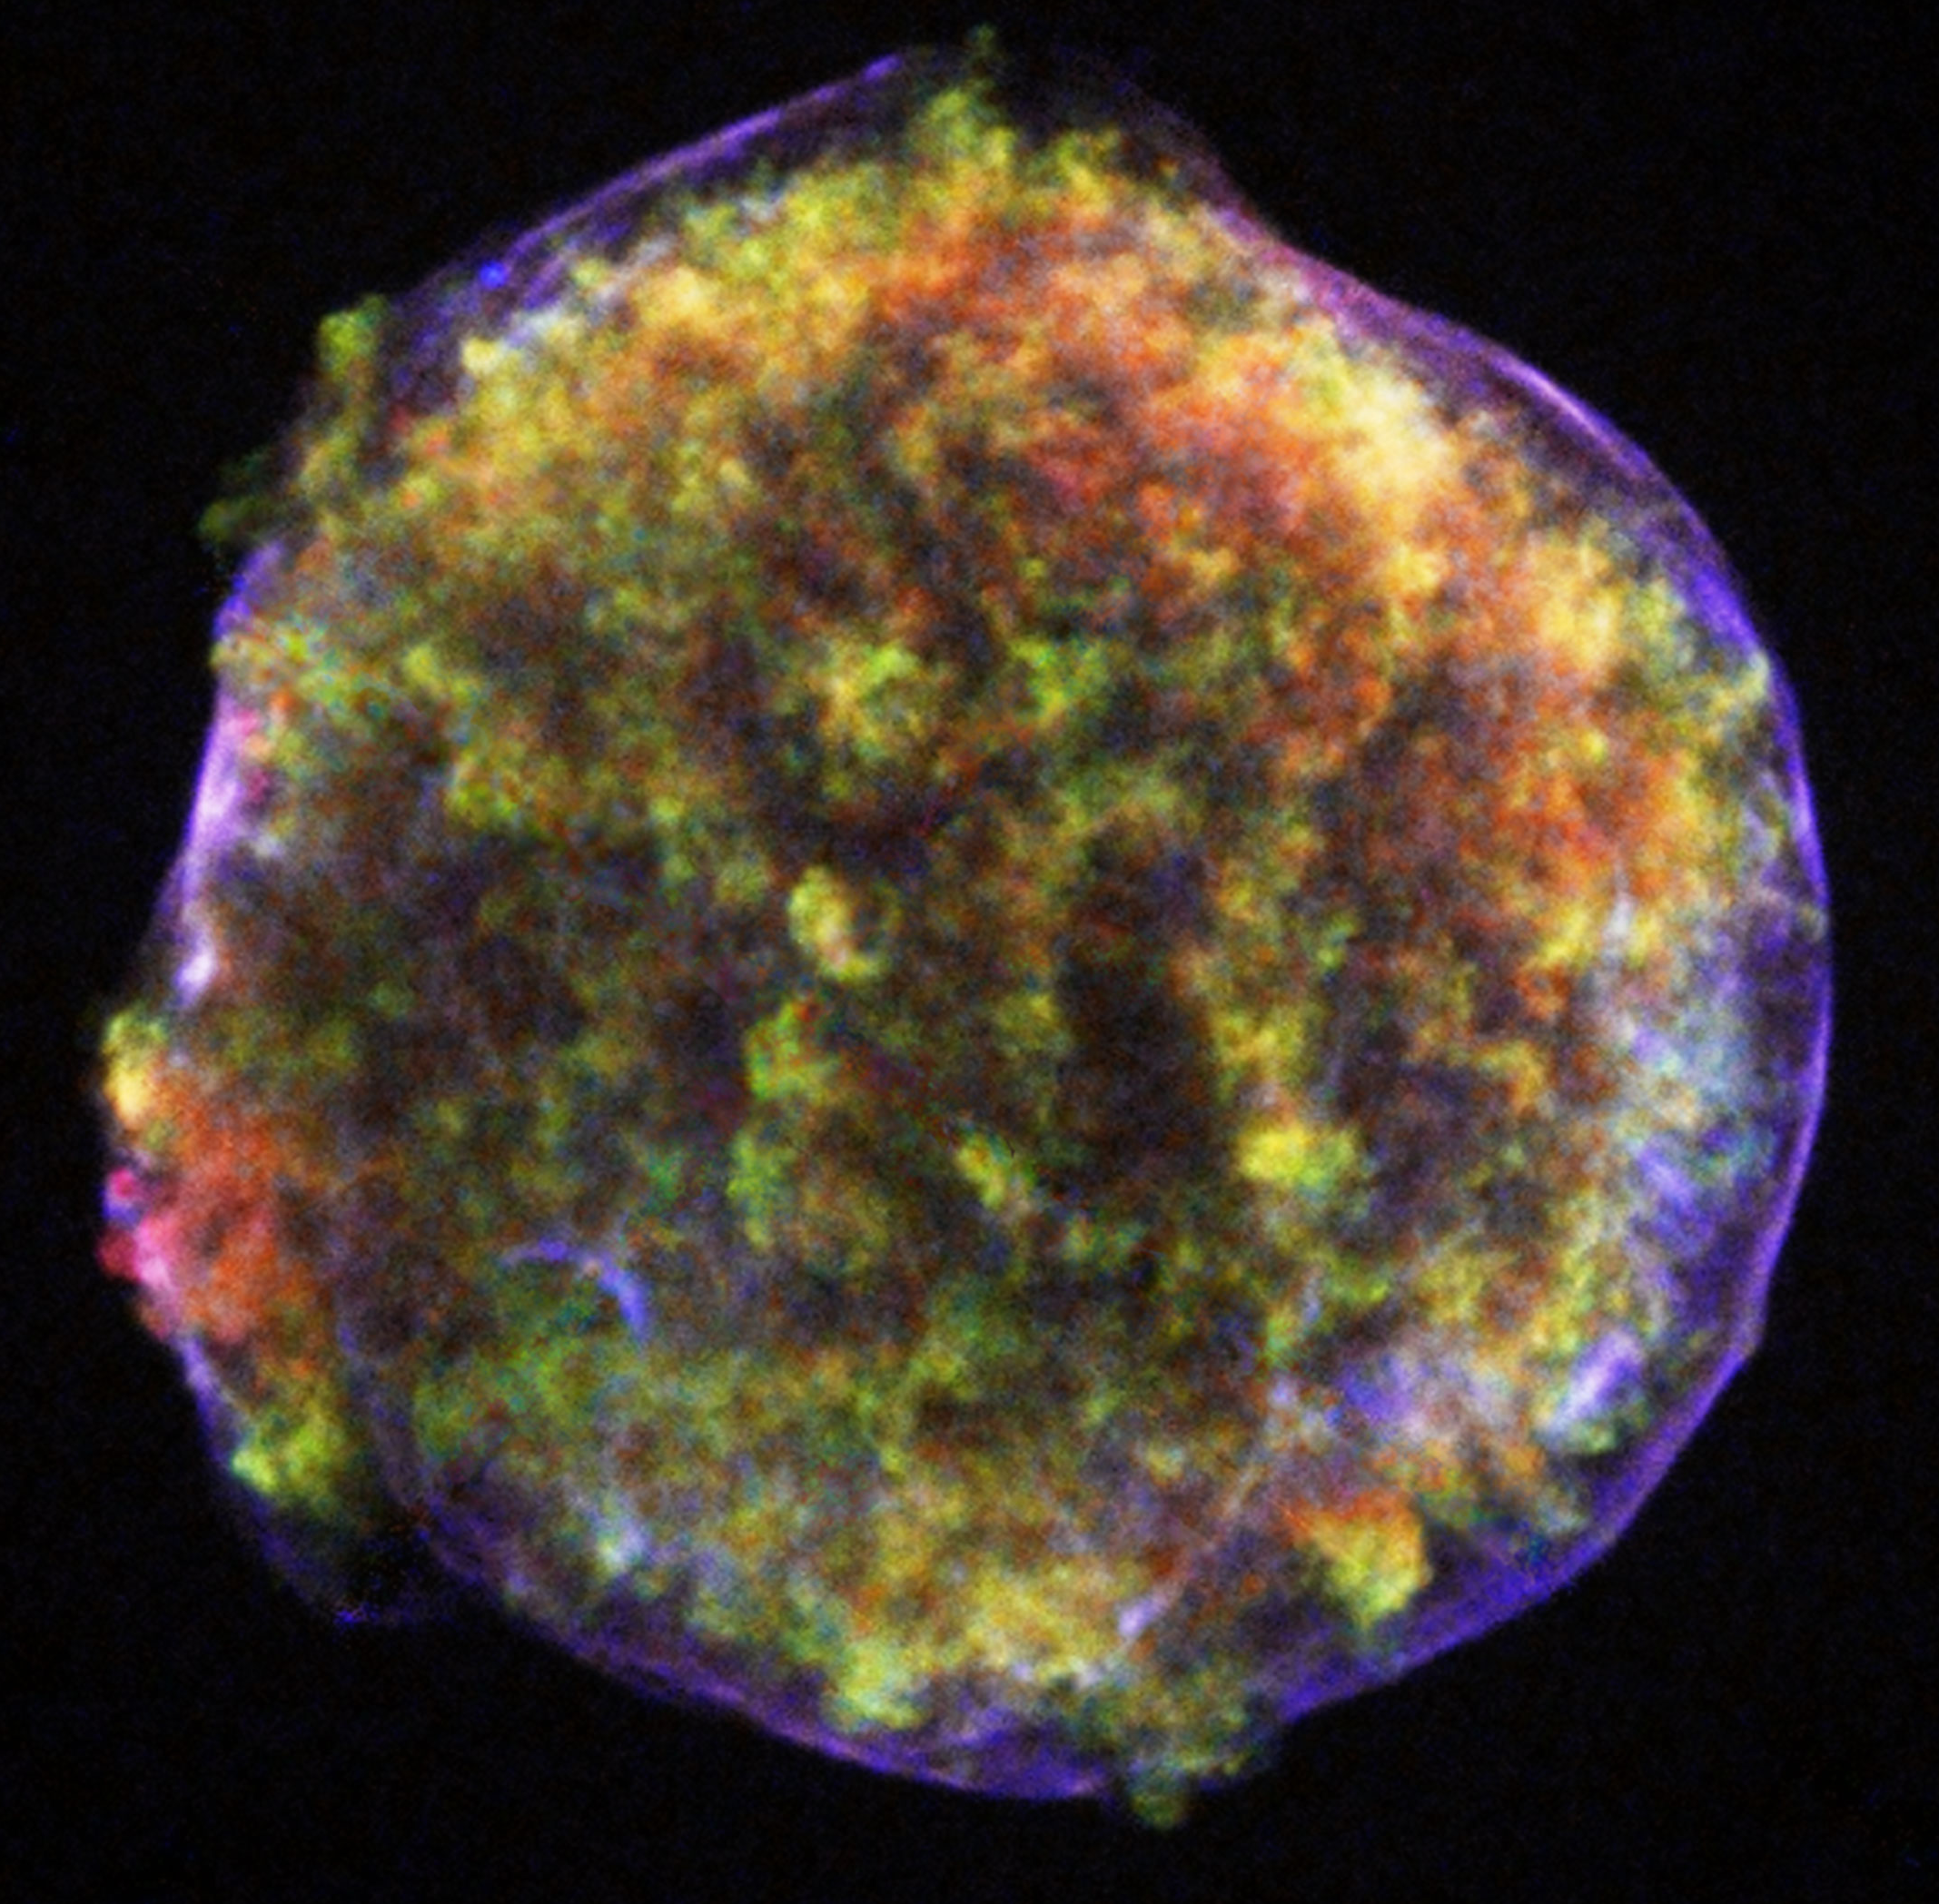
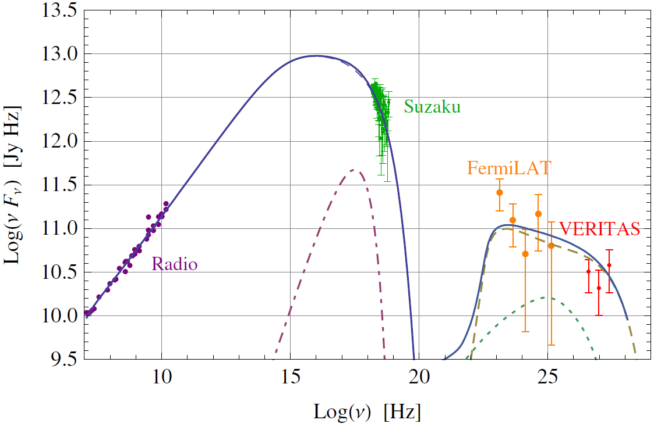
Hadronic vs leptonic model of nonthermal radiation. Tycho’s SNR
SNR SN 1006
SNR 0509-67.5
Nonthermal radiation consists of two bumps:
Radio and X-rays are synchrotron radiation produced by relativistic electrons
γ-rays emission is due to inverse-Compton scattering of relativistic electrons or/and decay of neutral pions produced in nuclear interactions between accelerated nuclei and the background plasma
However, even for closest SNRs, e.g., Tycho’s SNR, a preferable model of γ-ray radiation strongly depends on assumption behind models or even statistics and data binning.
Mix of hadronic and leptonic models (Wilhelm et al. 2020)
SNR Cassiopeia A
Hadronic model (Morlino & Caprioli 2012)

Slide 4
Relativistic particles responsible for nonthermal radiation
Relativistic particles (protons, electrons, etc.) are responsible for nonthermal radiation in all wavebands. Their energy spectra are represented by the power-law distribution (ε⁻²). However, the amount of particles involved in radiation processes is often treated as a free parameter. It is not constrained by the shock microphysics.
Understanding of particle acceleration processes is one of the key ingredients for explanation of nonthermal radiation coming from SNRs.
SNR SN 1006
SNR 0509-67.5
(Morlino & Caprioli, 2012)
SNR Cassiopeia A
N(ε)
∝ ε⁻²
ε

Slide 5
Diffusive shock acceleration
Diffusive Shock Acceleration (DSA) is the first-order Fermi acceleration process at young SNR shocks assumed to provide the main part of Galactic cosmic-ray flux.
Particles are bouncing between upstream and downstream plasmas
Particle scattering process has diffusive nature
Predicted spectrum: N(ε) ∝ ε⁻²
Only high-energy particles are involved in DSA, therefore the so-called injection is needed (easy for ions, difficult for electrons)
Upstream Shock Downstream
u₁
u₂
B₁
Scattering
magnetic turbulence
θ_{Bn}
B₂
n
Particle accelerated via DSA

Slide 6
The injection problem
Upstream Shock Downstream
u₁
u₂
DSA works only for high-energy particles which energy is larger than the injection energy $ε_{inj}$, and which gyroradius is few times larger than the width of the shock transition layer. Therefore, particles should be preaccelerated or, in other words, injected into the DSA process.
Ion injection
ε_{inj,p}/ε_{0,p} ≈ 10
Electron injection
ε_{inj,e}/ε_{0,e} ≈ 10⁵ – 10⁶ !!!
Particle accelerated via DSA
Shock
p⁺
e⁻
d_{sh} ~ r_{gp}

Slide 7
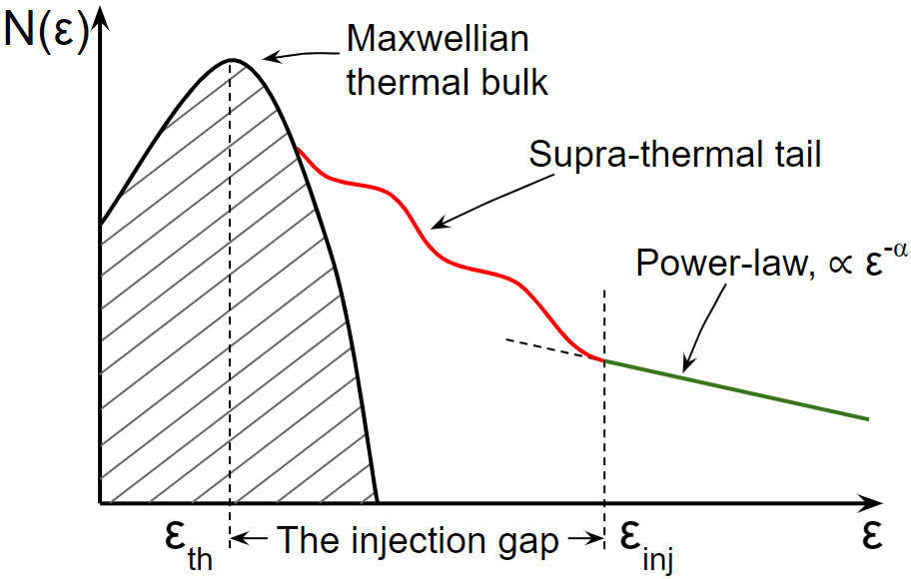
The electron injection problem
The particle energy distribution at a shock with an efficient particle acceleration mechanism consists of three particle populations: heated at the shock thermal Maxwellian bulk, the supra-thermal tail of preaccelerated particles (red curve), and high-energy particles with energies above $ε_{inj}$ and which are represented by a power-law distribution (green line).
ε_{inj}/ε₀ ≈ 5 (m_{p}/m_{e}) c /v_{sh} ≈ 10⁵ - 10⁶
Injection usually occurs in two stages:
(1) thermalization ε_{th}/ε₀ ≈ 10²
(2) pre-acceleration ε_{inj}/ε_{th} ≈ 10⁴

Slide 8
The electron injection problem
Shock structure
Electron heating
Electron acceleration

Slide 9
SNR shock physics
SNR SN 1006
Nonrelativistic shocks: v_{sh} ≪ c
Sonic Mach number: M_{S} = v_{sh}/c_{s} > 10
Alfvén Mach number: M_{A} = v_{sh}/v_{A} > 10
If physical parameters of the shock are defined, the most important
remaining parameter is the shock obliquity, θ_{Bn} , the angle between
the upstream magnetic field and the shock normal vector.
Perpendicular (θ_{Bn} ≈ 90º) Oblique (θ_{Bn} ≈ 50º- 70º ) Quasi-parallel (θ_{Bn} < 50º)
e⁻
p⁺
B
B
e⁻
B
n
n
n

Slide 10
SNR shock physics
SNR SN 1006
Nonrelativistic shocks: v_{sh} ≪ c
Sonic Mach number: M_{S} = v_{sh}/c_{s} > 10
Alfvén Mach number: M_{A} = v_{sh}/v_{A} > 10
If physical parameters of the shock are defined, the most important
remaining parameter is the shock obliquity, θ_{Bn} , the angle between
the upstream magnetic field and the shock normal vector.

Slide 11
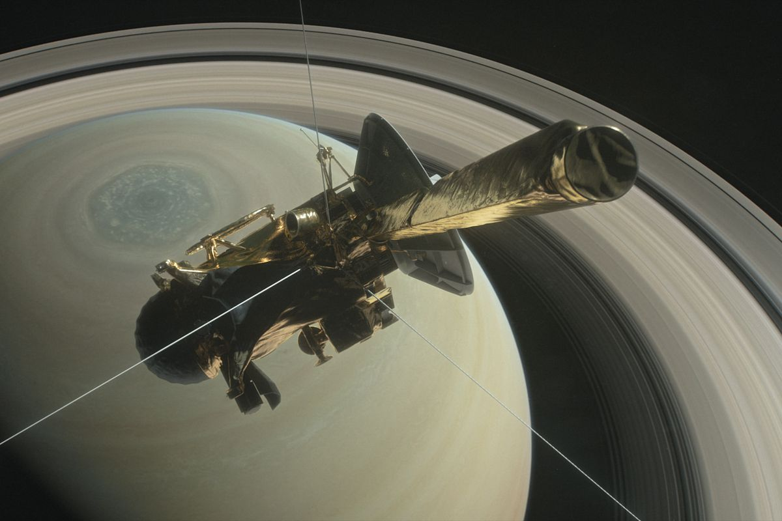
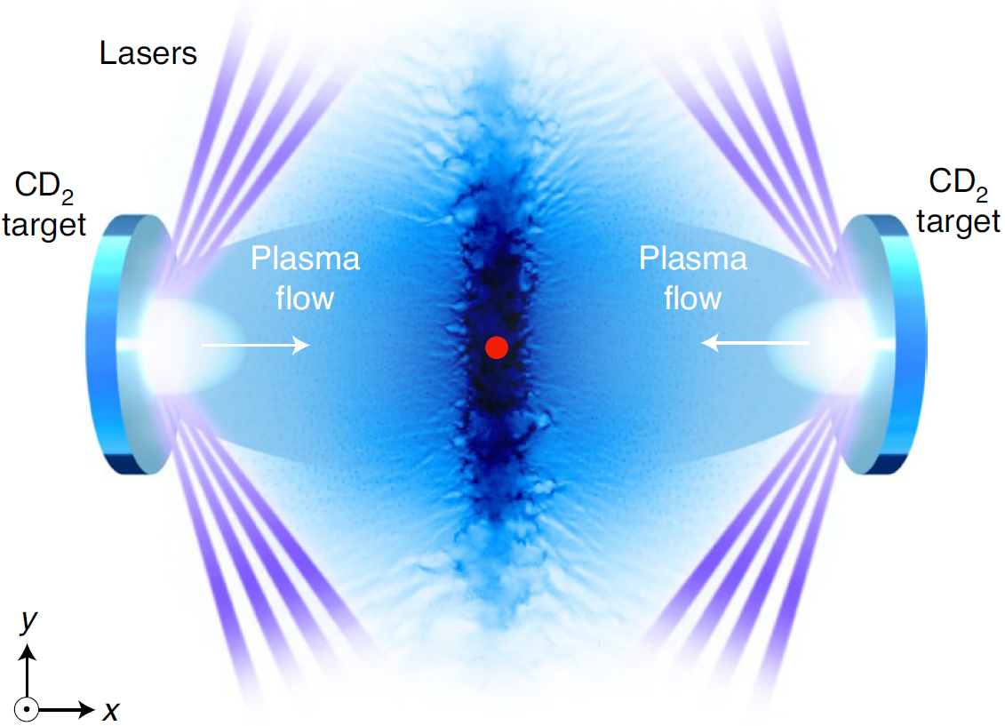
Ways to study the shock physics
Scales and corresponding methods:
Macro (0.01*light year, 10¹⁴ m); telescope observations in radio, X-ray, γ-ray wavebands
Meso (ion skin-length, 10⁴ m); in-situ measurements of planetary bow shocks (Cassini, MMS, Cluster) or laboratory experiments
Micro (sub electron skin-length, 10 m); kinetic simulations (Particle-In-Cell)

Slide 12
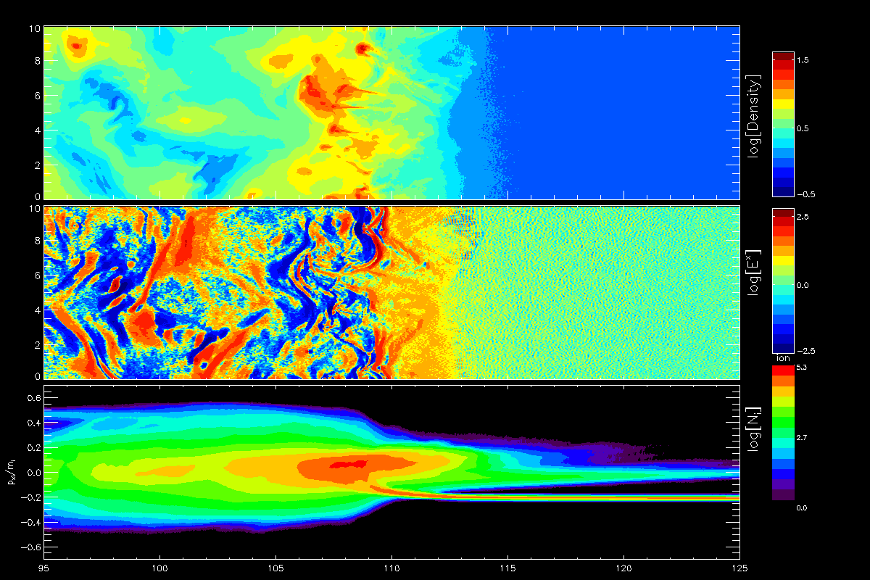
Kinetic simulations of SNR shocks
Particle-In-Cell (PIC) modeling - an ab-initio method of Vlasov equation solution. PIC simulations treat both ions and electron as particles. It is designed to explore cases when self-consistent treatment is needed, electron dynamic is important (electrostatic waves, instabilities generated by electrons), electron acceleration or heating processes are investigated

Slide 13
Kinetic simulations vs real shocks
Advantages:
Self-consistent description of highly nonlinear systems
Correct representation of the shock microphysics
We know everything at any point in space and time
Disadvantages:
Huge difference between real and simulated scales
Simulation data rescaling (v_{sh}, m_{i}/m_{e})
Data postprocessing, analysis and interpretation
PIC simulation
capabilities

Slide 14
Kinetic simulations of SNR shocks
SNR SN 1006
Nonrelativistic shocks: v_{sh} ≪ c
Sonic Mach number: M_{S} = v_{sh}/c_{s} > 10
Alfvén Mach number: M_{A} = v_{sh}/v_{A} > 10
If physical parameters of the shock are defined, the most important
remaining parameter is the shock obliquity, θ_{Bn} , the angle between
the upstream magnetic field and the shock normal vector.
Perpendicular (θ_{Bn} ≈ 90º) Characterized by the narrow shock transition, particles can not escape the shock
(Kato & Takabe 2010; Matsumoto et al. 2012,2013,2015; Wieland et al. 2016;
Bohdan et al. 2017, 2019a,b, 2020a,b , 2021)
Oblique (θ_{Bn} ≈ 50º- 70º ) Electrons can escape the shock transition region forming the electron foreshock
(Matsumoto et al. 2017; Xu et al. 2020; Morris et al. 2022; Bohdan et al. 2022)
Quasi-parallel (θ_{Bn} < 50º) Ions can escape the shock transition region forming the ion foreshock
(Park et al. 2015; Arbutina et al. 2020, 2021; Hanusch et al. 2020)

Slide 15
Perpendicular shocks
θ_{Bn} ≈ 90º

Slide 16
Perpendicular shocks. Structure of supercritical shocks (M_{s}≳3)
N
Overshoot
v_{sh}
Downstream
Ramp
u₁
Undershoot
E_{x}
Foot
Upstream
X
v_{x,i}
Ion ring
0
u₁
X
Shock width (d_{sh})

Slide 17
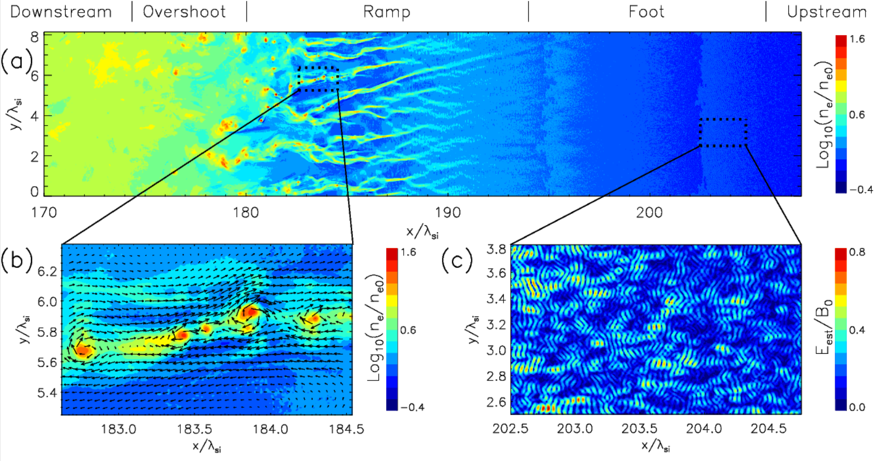
Perpendicular shocks. Structure
Downstream | Overshoot | Ramp | Foot | Upstream
Weibel instability
Magnetic reconnection
Buneman instability
(shock surfing acc.)
s
s
s
s

Slide 18
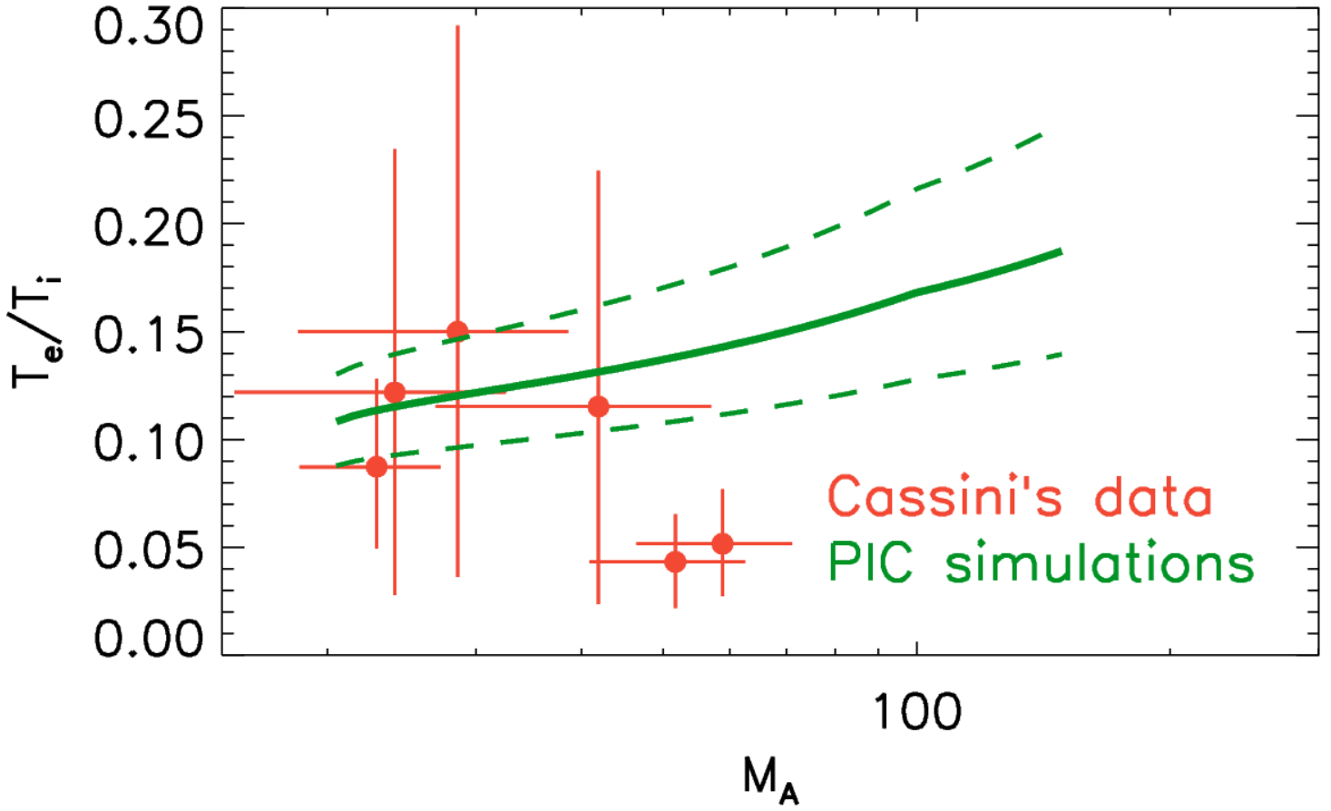
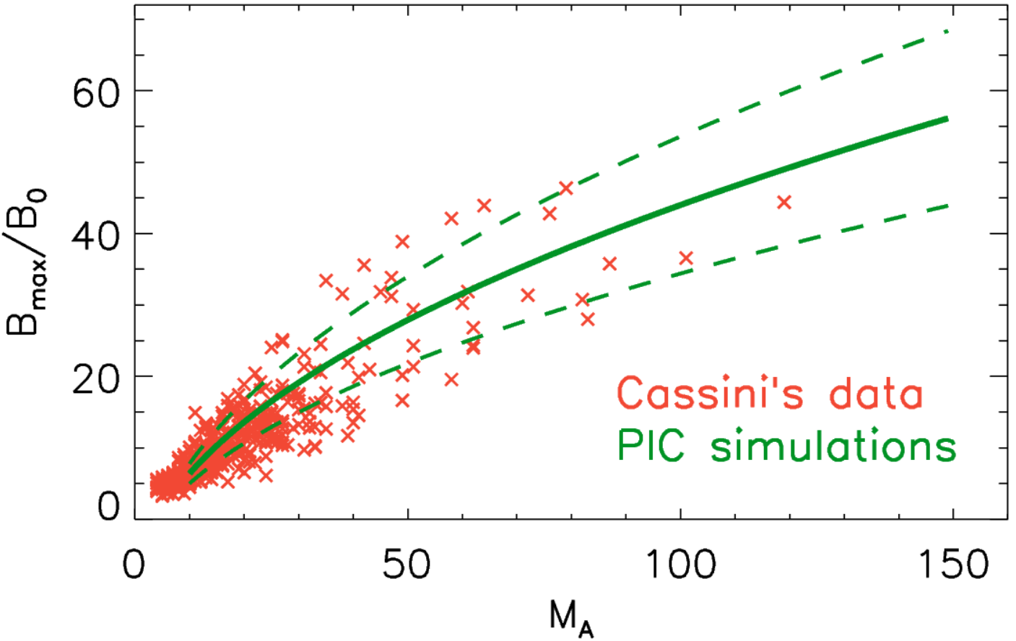
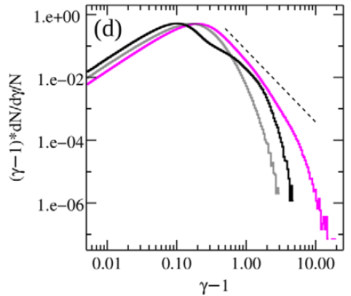
Perpendicular shocks. Why this structure is physically correct?
3D PIC simulations
(Matsumoto et al. 2017)
Laboratory experiment
(Fiuza et al. 2020)
2D PIC vs in-situ
(Bohdan et al. 2020b, 2021)
s
s
s

Slide 19
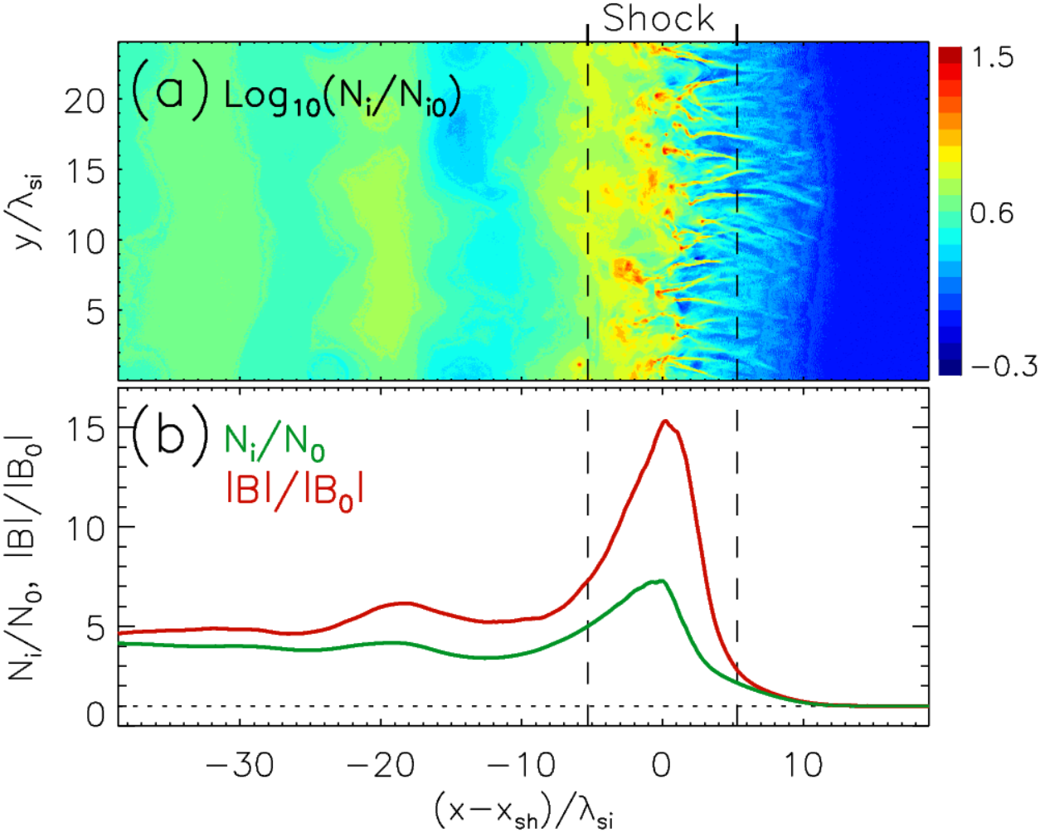
Perpendicular shocks. PIC simulation vs in-situ measurements
(Bohdan et al. 2021)
Magnetic field is amplified by Weibel instability in the shock foot. PIC simulations results and analytical calculations suggest that B_{max}/B₀ defined by Alfven Mach number M_{A} and it doesn’t depend on the shock velocity (v_{sh}< 0.25c), the ion-to-electron mass ratio (m_{i}/m_{e}>50) and the upstream plasma beta (β = 0.001-1).
s
s
s

Slide 20
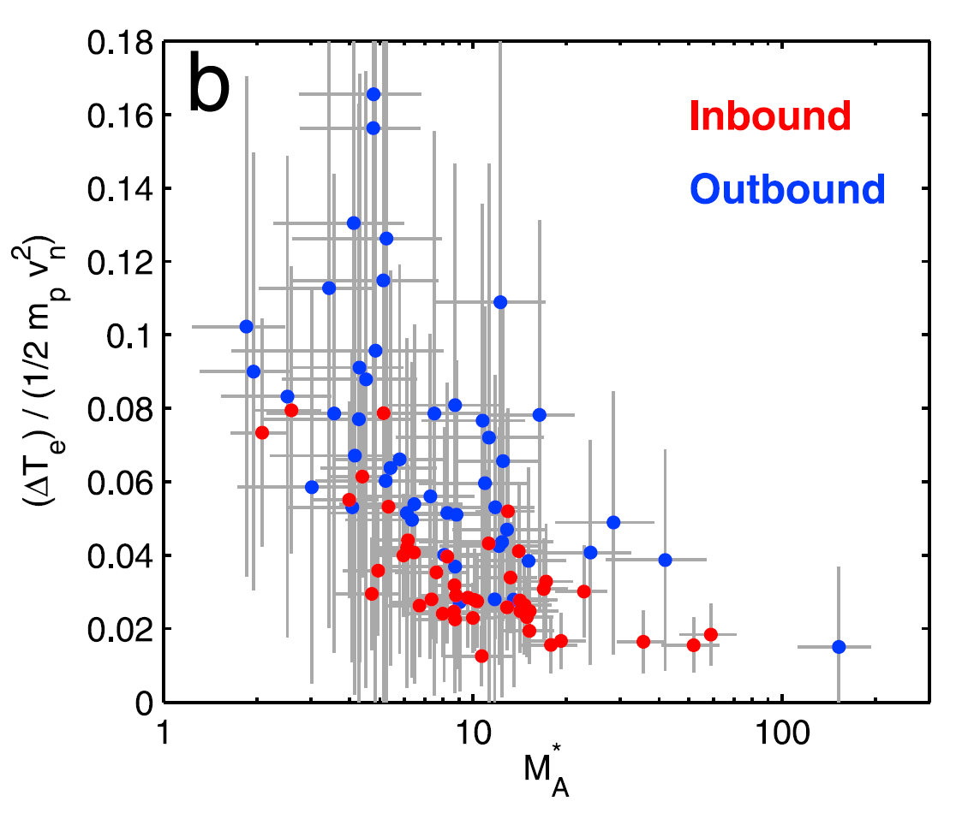
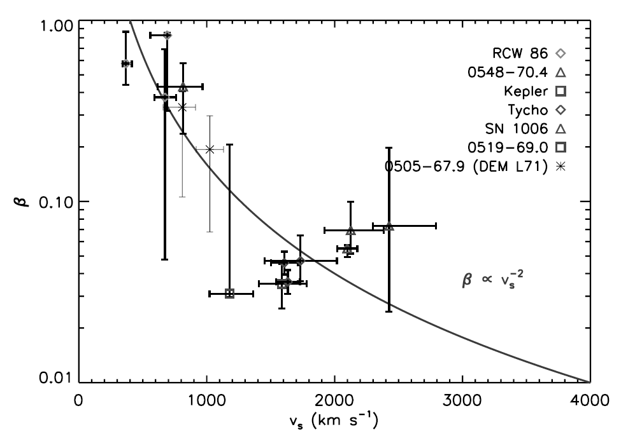
Perpendicular shocks. Electron heating, RH prediction
A part of the upstream kinetic energy is converted to the thermal particle energy.
Rankine-Hugoniot relations read (Г_{p}= 5/3):
ρ₁/ρ₂ ≈ 4
T₂/T₁ = 5 /16 M_{s}²
If there is no energy exchange between ions and electrons then
T_{2,e}/T_{2,i} = m_{e}/m_{i}
Saturn’s bow shock
(Masters et al. 2011)
Upstream Shock Downstream
u₁
u₂
B₁
ρ₁,T₁,P₁
ρ₂,T₂,P₂
ϑ₁
ϑ₂
B₂
n
SNR shocks
(van Adelsberg et al. 2008)
d_{sh} ~ (1-100) λ_{gi}
Observed temperature ratio: T_{2,e}/T_{2,i} ≈ 0.03 - 0.5

Slide 21
Perpendicular shocks. Electron heating model
(Bohdan et al. 2020b)
The downstream electron energy ε_{e} ≈ (0.1-0.2)⋅m_{i} v_{sh}² and
can be expressed as
Three stages of modeling:
1. Find all heating processes: shock-surfing acceleration, shock potential, magnetic reconnection, stochastic Fermi acceleration, compression
2. Determine scaling properties:
3. Calculation of efficiency coefficients using simulation data:

Slide 22
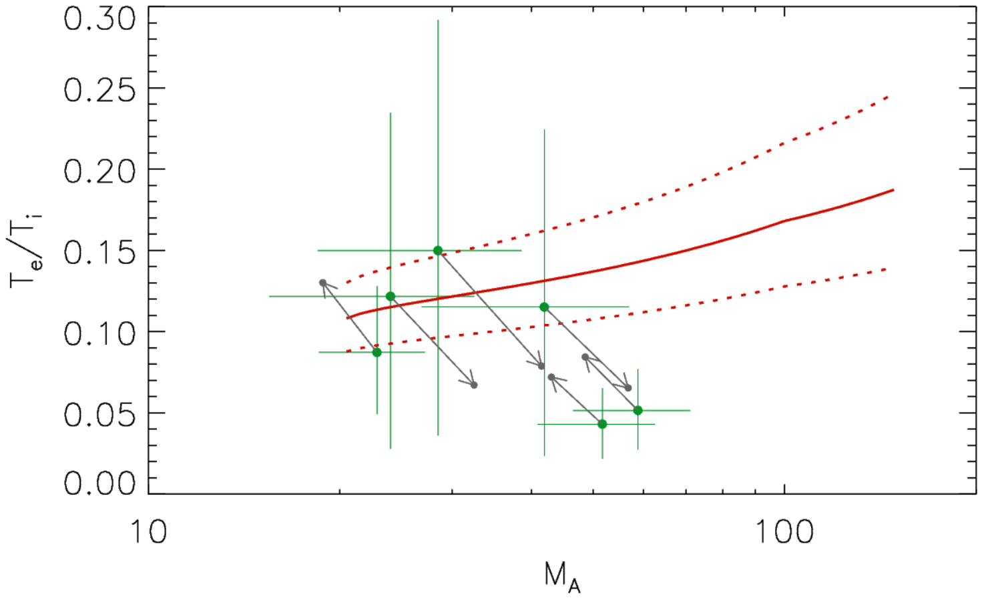
Perpendicular shocks. Electron heating, PIC vs in-situ
The Saturn’s bow shock
(Bohdan et al. 2020b)
SNR shocks
(van Adelsberg et al. 2008)
M_{A} > 20
θ_{Bn}> 45º

Slide 23
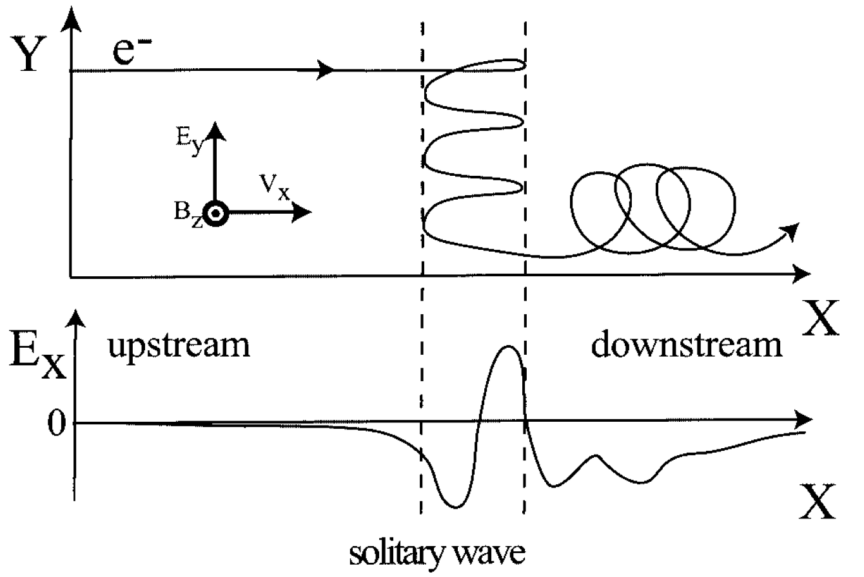
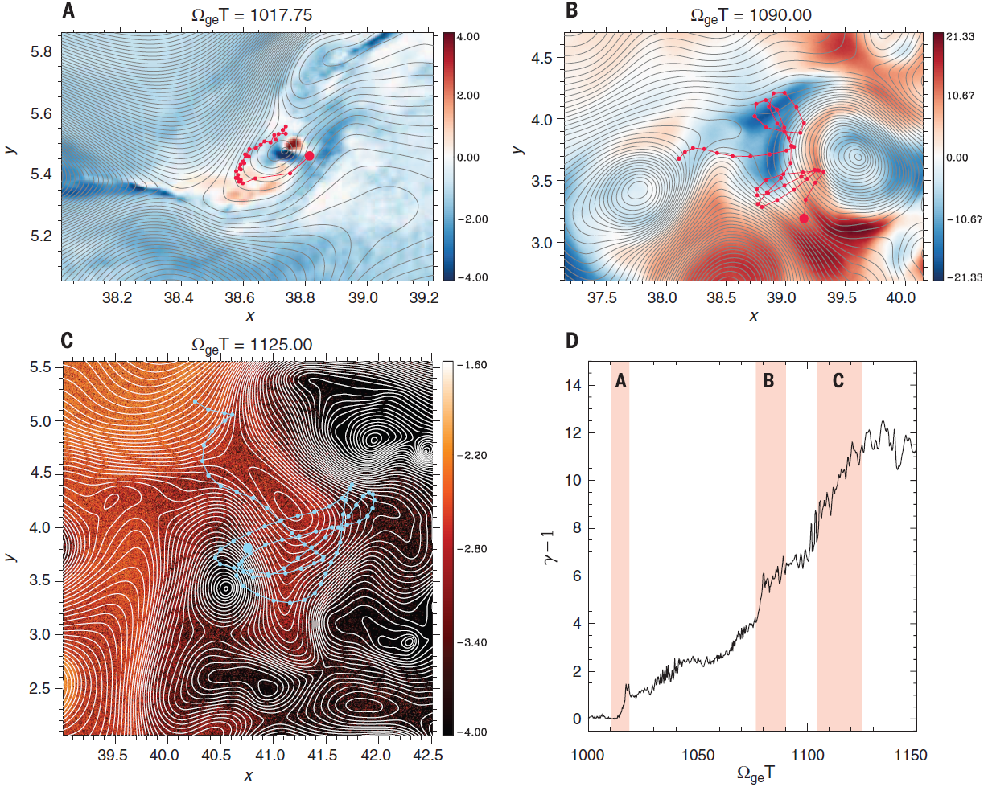
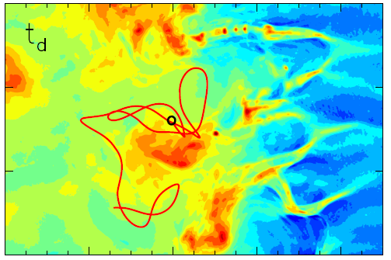
Perpendicular shocks. Acceleration processes
Shock-surfing acceleration (SSA)
(Shimada & Hoshino 2000; Hoshino & Shimada 2002)
2. Magnetic reconnection
(Matsumoto et al. 2015)
3. Stochastic Fermi acceleration (SFA)
(Bohdan et al. 2017; Matsumoto et al. 2017)

Slide 24
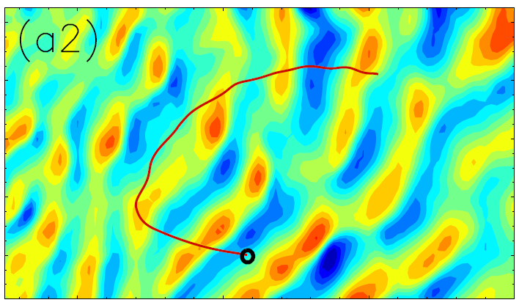
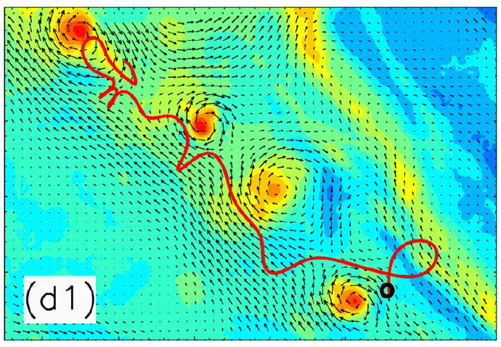
Perpendicular shocks. Acceleration vs heating
Shock-surfing acceleration (SSA) (Bohdan et al. 2019a,b)
Acceleration is more efficient at high M_{A}, however the trapping time limits maximal acceleration energies and
ε_{SSA}/ε₀≈ 10 - 100
Therefore SSA is quite effective at low mass ratio case, but at realistic shocks thermalization may spoil SSA accelerated electrons because
ε_{th,e}/ε₀ ≈ 100
Magnetic reconnection
(Matsumoto et al. 2015; Bohdan et al. 2020a)
Electrons are accelerated via interaction with X-points, contracting vortices, pitch-angle scattering, etc.
MR is very active at high M_{A} due to highly non-linear development of Weibel instability.
At realistic mass ratio magnetic reconnection start to compete with thermalization.

Slide 25
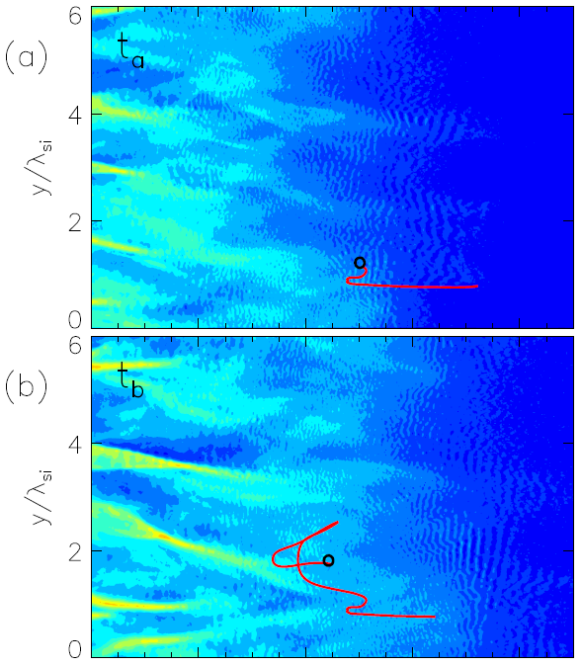
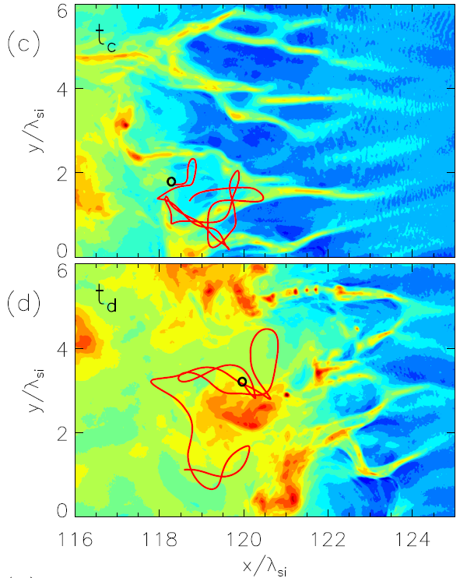
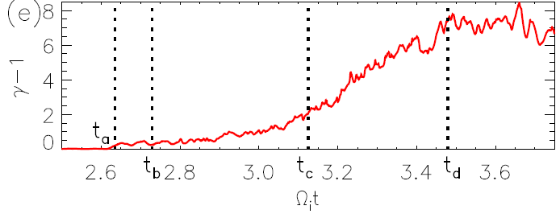
Perpendicular shocks. “Unlimited”acceleration
The most efficient process and what is more important ε_{max} ∝ m_{i}/m_{e}, therefore SFA remains among the most efficient even in realistic mass ratio case.
Stochastic Fermi acceleration (SFA)
(Bohdan et al. 2017; Bohdan et al. 2019b)

Slide 26
Oblique shocks
θ_{Bn} ≈ 50º- 70º

Slide 27
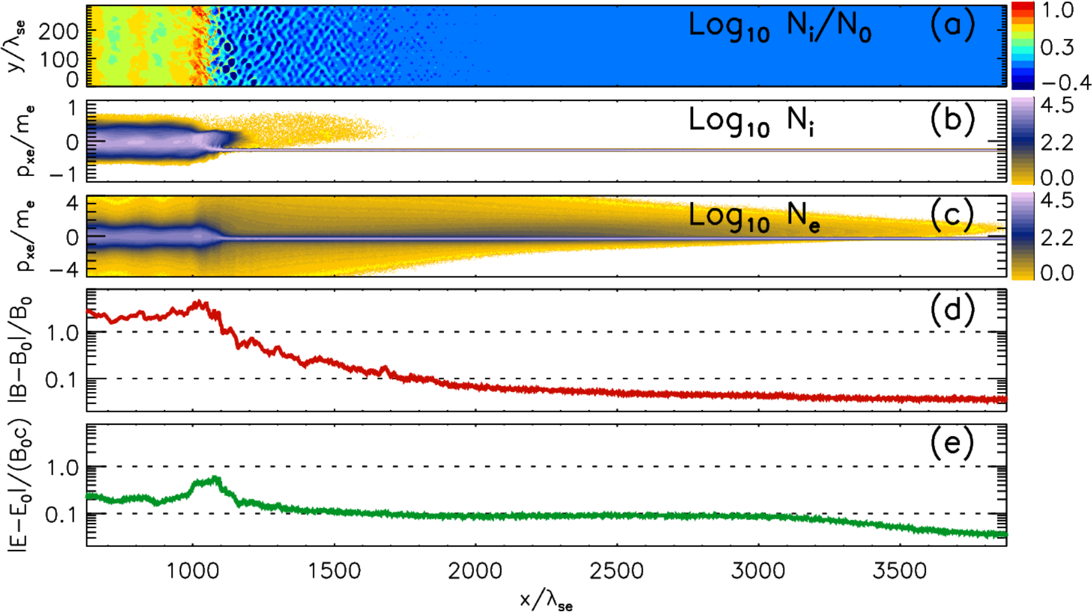
Oblique shocks. Structure
(Bohdan et al. 2022)
θ_{Bn} = 60º, M_{A} = 30
The structure is very similar to perpendicular shocks. However, propagating upstream reflected electrons generate additional electrostatic electron-acoustic waves far upstream and Whistler waves closer to the shock.
s
s

Slide 28
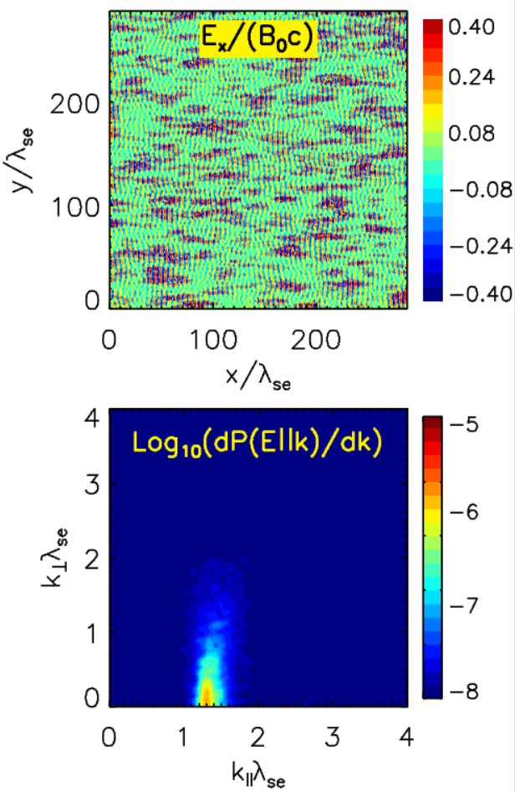
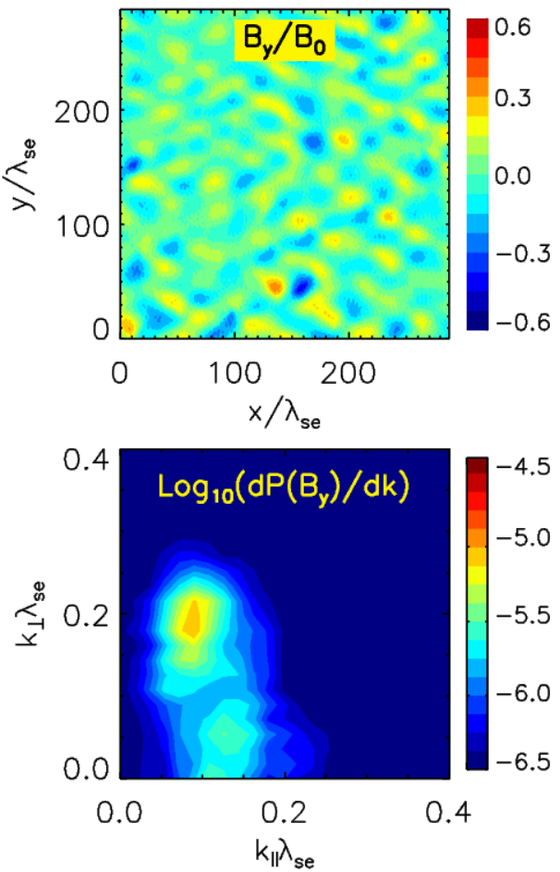
Oblique shocks. Structure of the foreshock
(Bohdan et al. 2022)
The phase-space distributions in the near and far upstream of a shock are derived with the shock simulation and used as initial conditions for simulations with periodic boundary conditions. We find that the observed electron-beam instabilities agree very well with the predictions of a linear dispersion analysis: the electrostatic electron-acoustic instability dominates in the far upstream of the foreshock, while the denser electron beams in the near upstream drive the gyroresonant oblique-whistler instability.
Far upstream region
Near upstream region
s

Slide 29
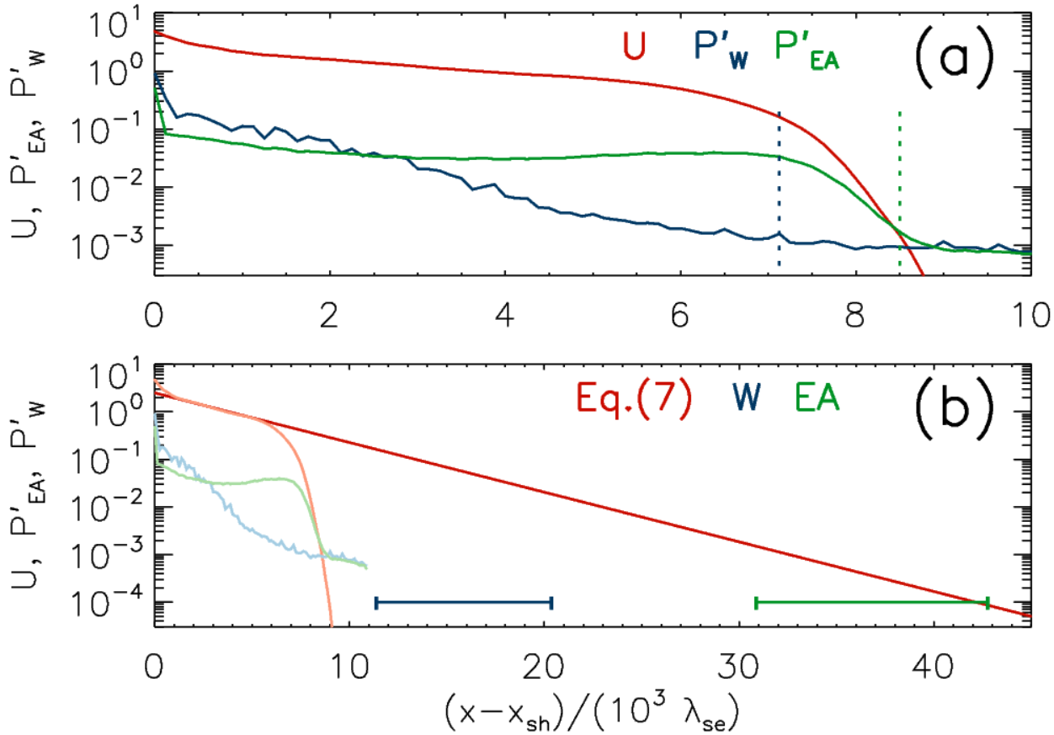
Oblique shocks. Steady state of the foreshock
(Bohdan et al. 2022)
The shock reflected electrons propagate back upstream forming the extended foreshock. At the end of the shock simulation (t ≈ 50 Ω_{i}⁻¹) the fastest electrons have reached the distance of ~10⁴λ_{se} from the shock position. The energy density of the corresponding modes by summing the Fourier power in the k-space around the expected peak intensity:
About 125 Ω_{i}⁻¹ is required to fully cover the whistler region and about 270 Ω_{i}⁻¹ to cover the entire electron foreshock and reach the steady-state stage of the shock evolution.
s

Slide 30
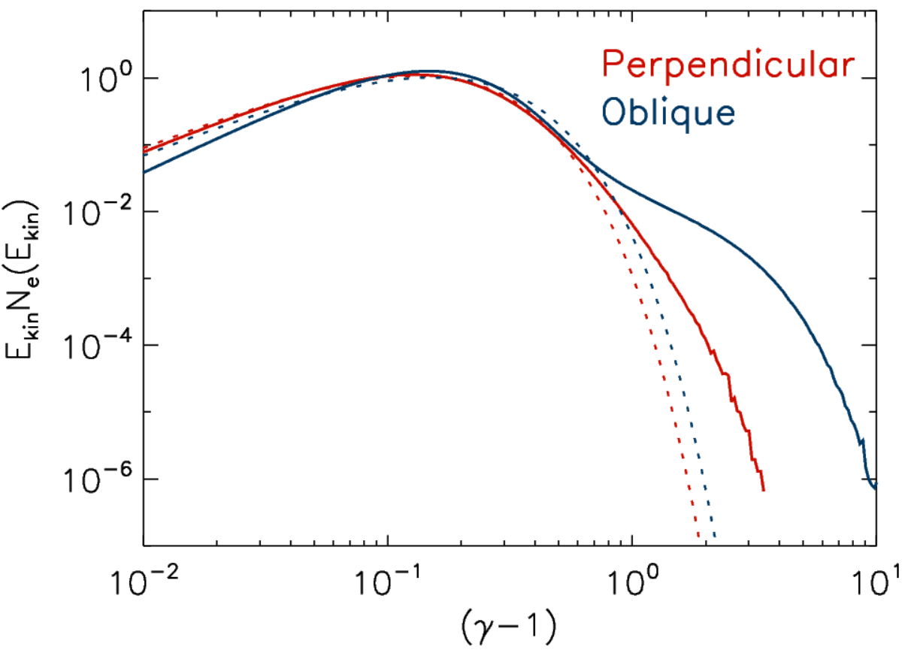
Oblique shocks. Electron heating
PIC simulations and in-situ measurements demonstrate that the downstream electron temperatures in oblique and perpendicular shocks are similar.
3D and 2D simulations
(Matsumoto et al. 2017)
2D simulations
(Bohdan et al. 2019b + unpublished data)
PIC vs in-situ
(Bohdan et al. 2020b)
θ_{Bn}> 45º
s
s
80º
3D
2D
75º
50º
60º
75º
70º

Slide 31
Oblique shocks. Acceleration processes
1. Shock-surfing acceleration (SSA)
2. Magnetic reconnection
3. Stochastic Fermi acceleration (SFA)
4. Stochastic shock drift acceleration (SSDA)
(Matsumoto et al. 2017; Katou et al. 2019; Amano et al. 2020, 2022)
5. Interaction with electron-acoustic waves
(Morris et al. 2022)
6. Interaction with whistler waves
(Xu et al. 2020; Bohdan et al. 2022)

Slide 32
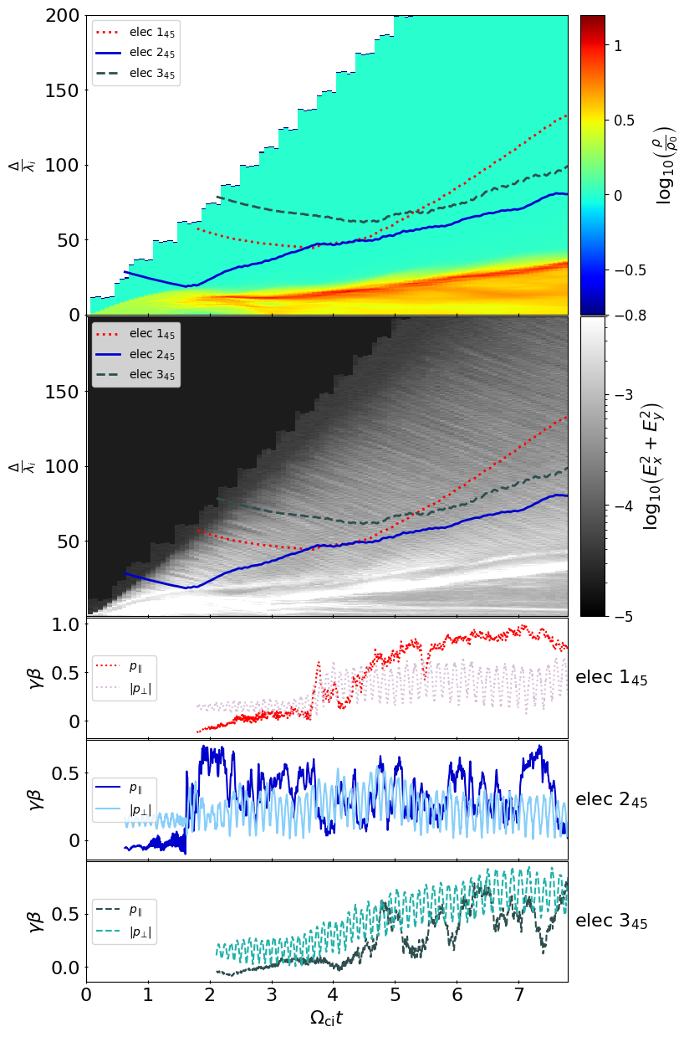
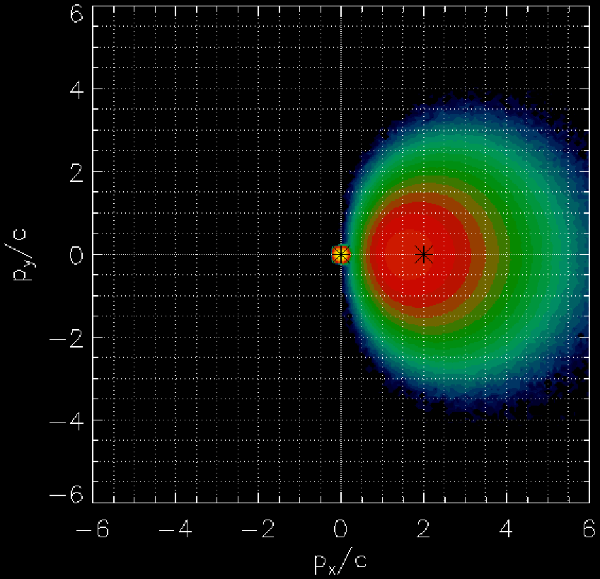
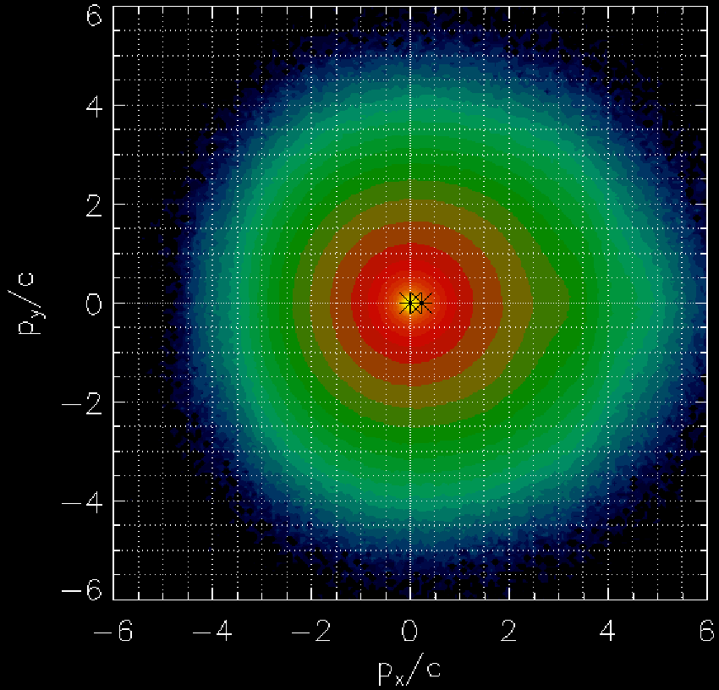
Oblique shocks. Interaction with foreshock instabilities
Electron acoustic waves
(Morris et al. 2022)
Electron can be reflected by electrostatic waves far ahead of the shock, however the reflection chance is ~1%.
Whistler waves
(Xu et al. 2020; Bohdan et al. 2022)
Whistles thermalize reflected electrons via pitch-angle scattering creating “halo” distribution.

Slide 33
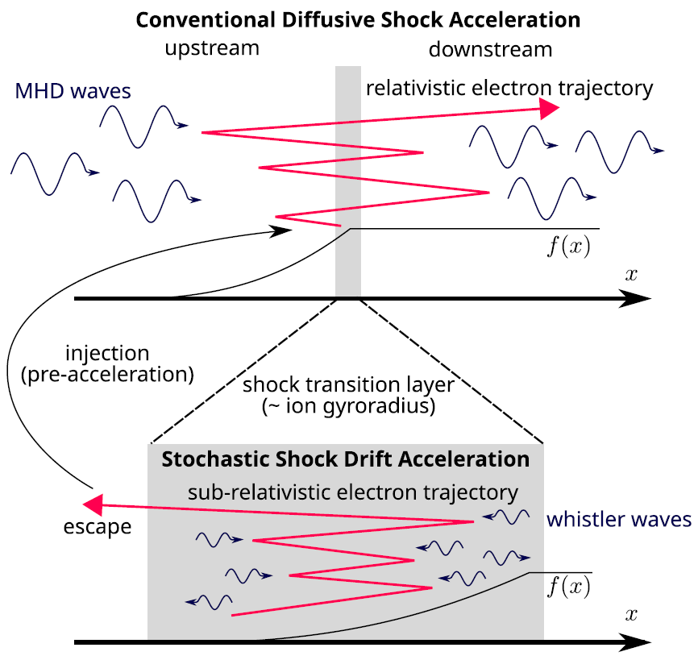
Oblique shocks. Stochastic shock drift acceleration
(Matsumoto et al. 2017; Katou et al. 2019; Amano et al. 2020,2022)
The most efficient process, factor of 10 more efficient than SFA
Confirmed with simulations and in-situ measurements
Maximal energy > 1 MeV at SNR shocks
✖
3D
2D
✖

Slide 34
Parallel shocks
θ_{Bn} < 50º

Slide 35
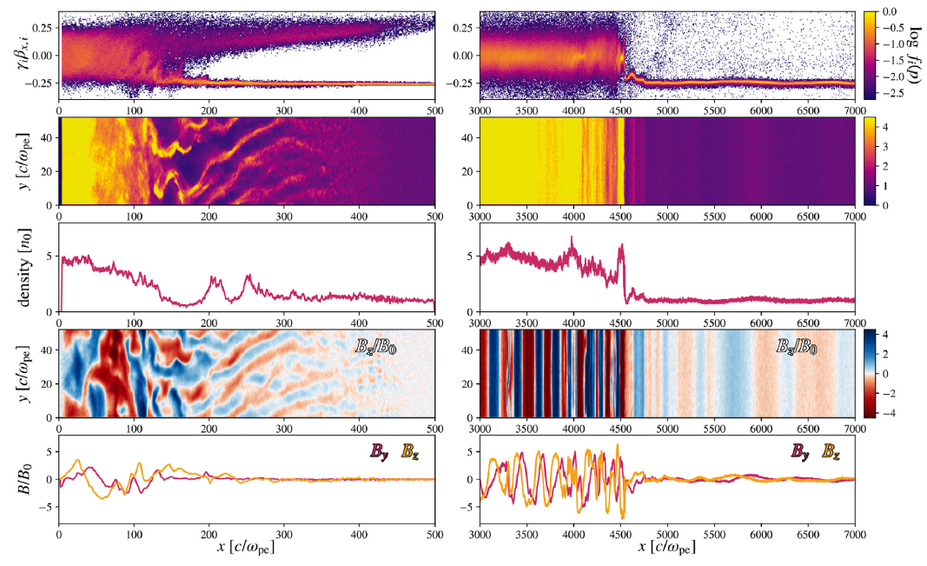
Parallel shocks. Structure
(Arbutina et al. 2020)
θ_{Bn} = 0º m_{i}/m_{e}= 50,
M_{A} = 11 v_{sh} = 0.33c
At the early stage (left panels) the shock is mediated by Weibel instability. At the late stage (right panels) the shock is purely mediated by the Alfvenic-like modes (Bell’s or CR streaming instability) and become quasi-1D (as in Park et al. 2015) because of a small simulation box.
s
s

Slide 36
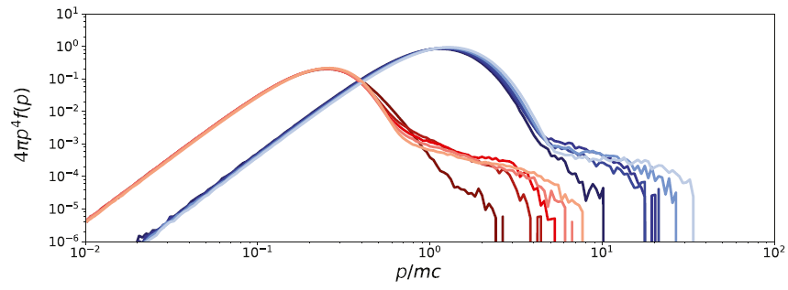
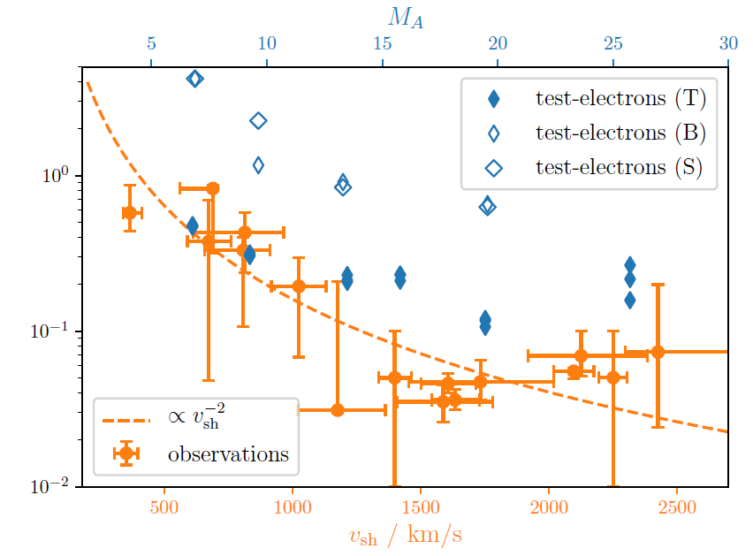
Parallel shocks. Electron heating
2D PIC simulations
(Arbutina et al. 2020)
M_{A} = 16 M_{s} = 35 v_{sh} = 0.4c m_{i}/m_{e}= 16
T_{e}/T_{i} ≈ 1
2D hybrid simulations with test particle electrons
(Hanusch et al. 2020)
M_{A} = 7-25 m_{i}/m_{e}= 64-100
T_{e}/T_{i} ≈ 0.1-0.5
However, there is no explanation how it happens and results can not be rescaled.
e
p

Slide 37
Parallel shocks. Electron acceleration
(Arbutina et al. 2020)
θ_{Bn} = 0º m_{i}/m_{e}= 16
M_{A} = 16 v_{sh} = 0.4c
Nonthermal tails of accelerated particles are building up.
Electrons are accelerated up to the injection energy.
Such easy injection is due to
ε_{inj,e}/ε₀ < 100
e
p

Slide 38
Summary
 | Structure | Heating | Acceleration
Perpendicular
Oblique |  | -
Parallel | - | - | -

Slide 39
Thank you
Contact
Deutsches
Elektronen-Synchrotron
www.desy.de
Artem Bohdan
Astroparticle Physics
artem.bohdan@desy.de
+49 33762 7-7193

