Slide 1
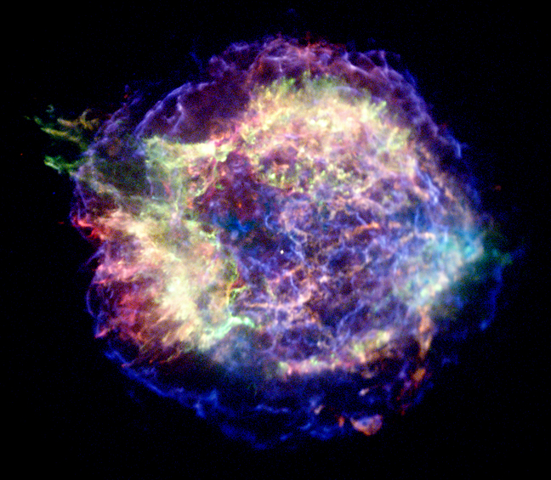



Non-thermal emission from supernova remnants in the circumstellar medium
North-West University
South Africa
Astronomical Observatory
Ivan Franko University of Lviv
Ukraine
Powered by
Iurii Sushch
Robert Brose
Martin Pohl
Samata Das
Pavlo Plotko
Dominique Meyer

Slide 2
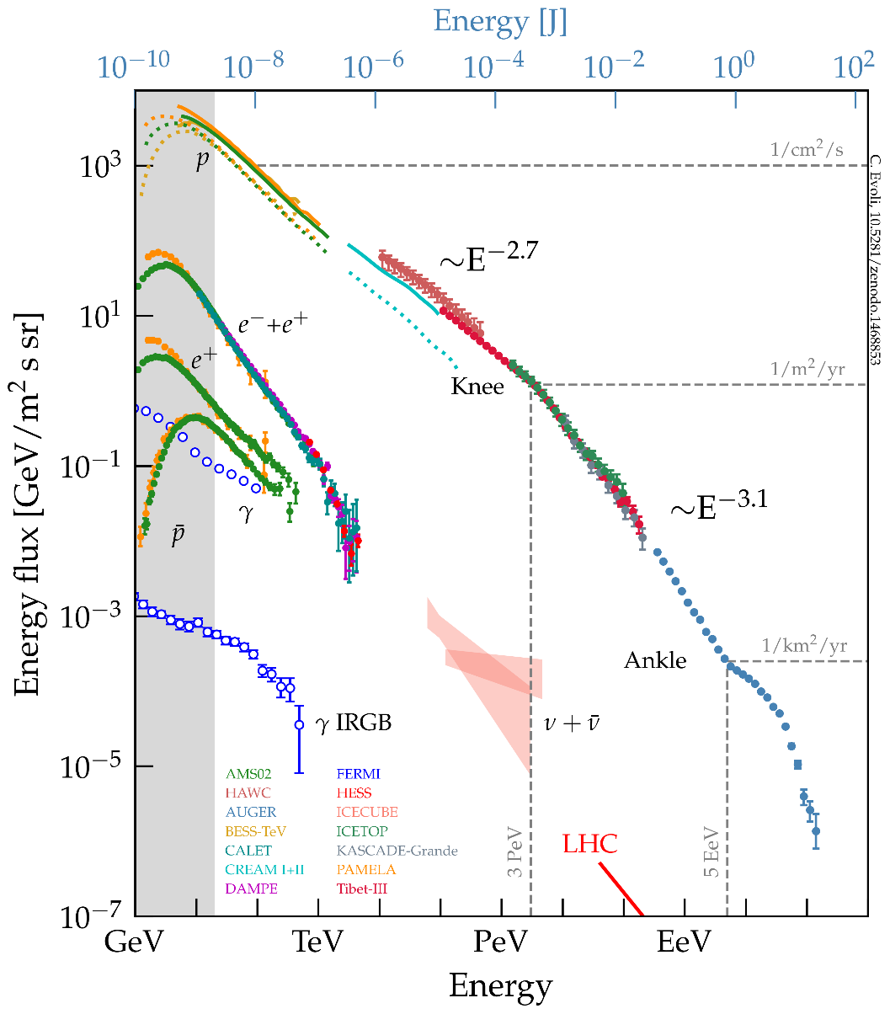
SNRs are sources of Galactic CRs - or are they?
Evoli, 2018

Slide 3
SNRs are sources of Galactic CRs - or are they?
Main argument: enough energy
Evoli, 2018

Slide 4
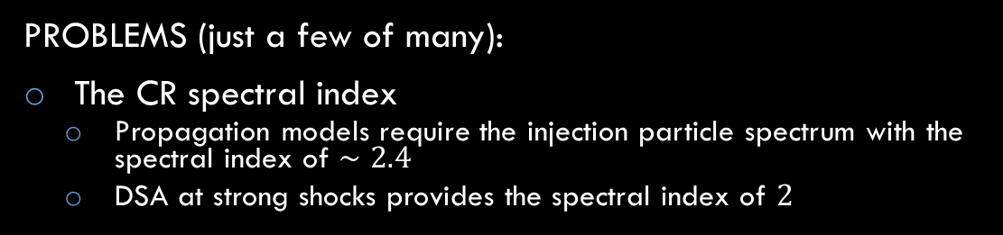
SNRs are sources of Galactic CRs - or are they?
PROBLEMS (just a few of many):
The CR spectral index
  Propagation models require the injection particle spectrum with the spectral index of $∼2.4$
  DSA at strong shocks provides the spectral index of $2$
Evoli, 2018

Slide 5
SNRs are sources of Galactic CRs - or are they?
PROBLEMS (just a few of many):
The CR spectral index
  Propagation models require the injection particle spectrum with the spectral index of $∼2.4$
  DSA at strong shocks provides the spectral index of $2$
Will be discussed in the talk by Robert Brose
Evoli, 2018

Slide 6

SNRs are sources of Galactic CRs - or are they?
PROBLEMS (just a few of many):
The CR spectral index
  Propagation models require the injection particle spectrum with the spectral index of $∼2.4$
  DSA at strong shocks provides the spectral index of $2$
Observational evidence
  Synchrotron X-rays indicate that electrons can be accelerated to hundreds of TeV
  Not so clear about protons – gamma-ray emission can be explained by both hadronic and leptonic processes and in those cases where it’s for sure hadronic, spectra do not extend to high enough energies
Evoli, 2018

Slide 7

SNRs are sources of Galactic CRs - or are they?
PROBLEMS (just a few of many):
The CR spectral index
  Propagation models require the injection particle spectrum with the spectral index of $∼2.4$
  DSA at strong shocks provides the spectral index of $2$
Observational evidence
  Synchrotron X-rays indicate that electrons can be accelerated to hundreds of TeV
  Not so clear about protons – gamma-ray emission can be explained by both hadronic and leptonic processes and in those cases where it’s for sure hadronic, spectra do not extend to high enough energies
How do we accelerate protons to PeV energies?
  Hard to explain theoretically
  No observational evidence
Evoli, 2018

Slide 8
SNRs are sources of Galactic CRs - or are they?
PROBLEMS (just a few of many):
The CR spectral index
  Propagation models require the injection particle spectrum with the spectral index of $∼2.4$
  DSA at strong shocks provides the spectral index of $2$
Observational evidence
  Synchrotron X-rays indicate that electrons can be accelerated to hundreds of TeV
  Not so clear about protons – gamma-ray emission can be explained by both hadronic and leptonic processes and in those cases where it’s for sure hadronic, spectra do not extend to high enough energies
How do we accelerate protons to PeV energies?
  Hard to explain theoretically
  No observational evidence
Check our paper “Core-collapse supernovae in dense environments - particle acceleration and non-thermal emission”
Brose, R., Sushch, I., & Mackey, J. (2022)
MNRAS, Volume 516, Issue 1, pp.492-505
Evoli, 2018

Slide 9
Detailed modeling of particle acceleration
We need to consider:
Injection
  How are particles injected in the acceleration process?
Hydrodynamics
  SNR may evolve in very complex and inhomogeneous environments
Time dependence
  We are not in steady state! Injection rate and acceleration conditions change with time
Spatial dependence
  Particles diffuse, advect downstream, escape upstream
Magnetic turbulence
  Determines the maximum energy and at the same time depends on how many particles are accelerated

Slide 10
RATPaC
Radiation Acceleration Transport Parallel Code
Powered by
Cosmic-ray transport equation
Hydro equations
(solved with PLUTO)
Transport equation for magnetic turbulence

Slide 11
RATPaC
Radiation Acceleration Transport Parallel Code
Powered by
Cosmic-ray transport equation
See the talk by Robert Brose for details on this block
Hydro equations
(solved with PLUTO)
Transport equation for magnetic turbulence
(not used in this study)

Slide 12
RATPaC
Radiation Acceleration Transport Parallel Code
Powered by
Cosmic-ray transport equation
Output:
Spectrum of CRs as a function of location and time
Hydro equations
(solved with PLUTO)
Transport equation for magnetic turbulence

Slide 13
Very brief description
(more in backup slides)
Powered by
We solve all equations numerically
  Time-dependently
  In 1D with spherical symmetry
Thermal particles are injected at the same injection momentum (multiple of thermal momentum) at every time step at the shock
Then we evolve those particles in space and time
Magnetic field:
  Amplification – either by hand or self-consistently from turbulence transport
  Diffusion – either Bohm-like or self-consistently from turbulence transport
  Passively transported downstream solving induction equation

Slide 14
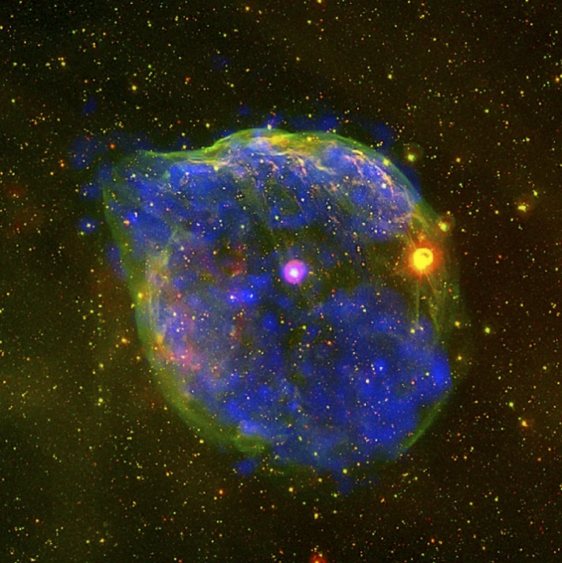
Circumstellar medium
About 80% of all SNRs are core-collapse evolving in stellar wind bubbles of progenitor stars
A bubble blown by the massive Wolf-Rayet star HD 50896, the pink star in the centre. Credit: ESA
Does it change anything?

Slide 15
Circumstellar medium
About 80% of all SNRs are core-collapse evolving in stellar wind bubbles of progenitor stars
Mostly based on the paper:
“Leptonic Nonthermal Emission from Supernova Remnants Evolving in the Circumstellar Magnetic Field”
Sushch, I., Brose, R., Pohl, M., Plotko, P., and Das S. (2022)
The Astrophysical Journal, Volume 926, id. 140, 14 pp.
A bubble blown by the massive Wolf-Rayet star HD 50896, the pink star in the centre. Credit: ESA
Does it change anything?

Slide 16
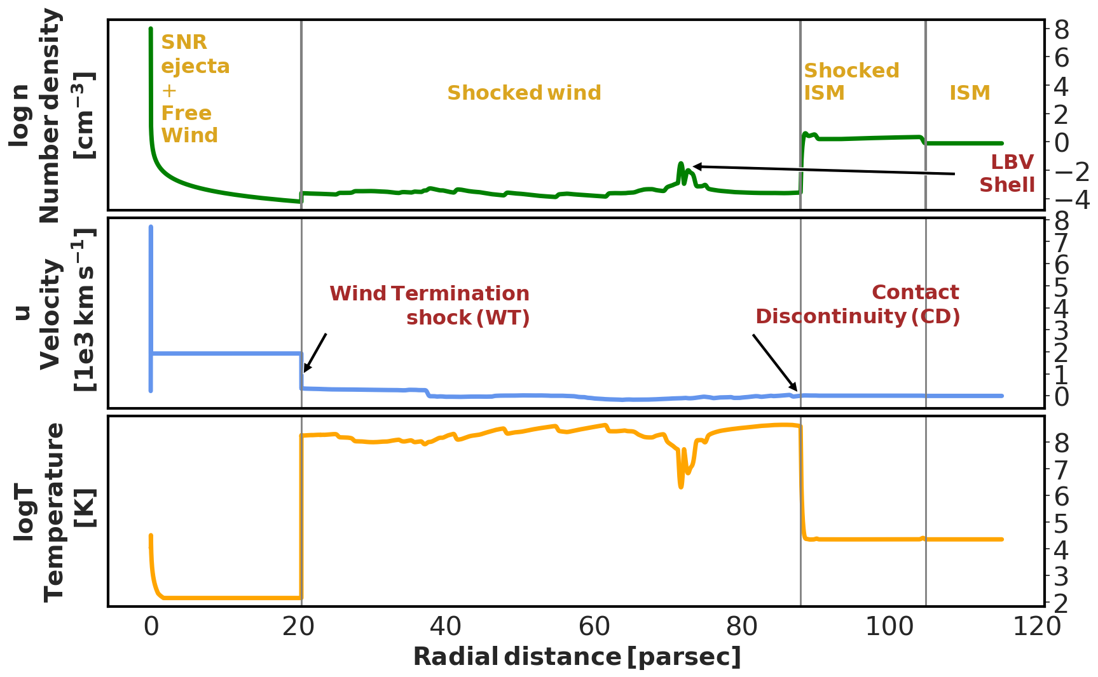
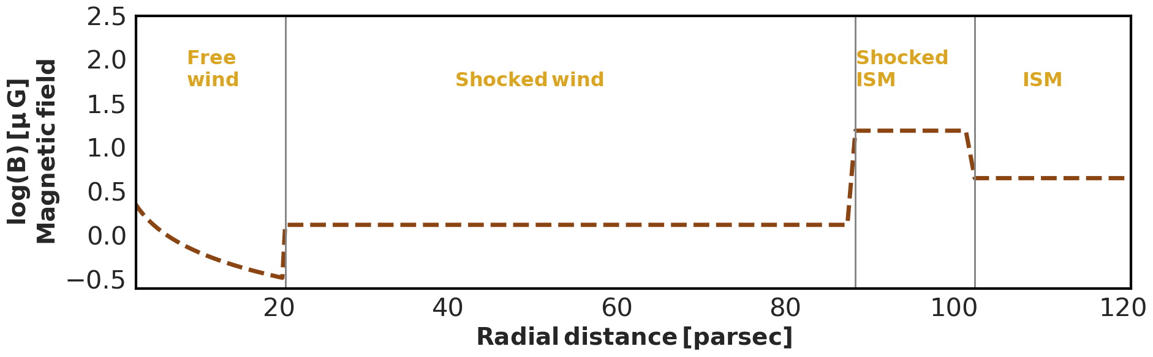

Complex MHD profiles of the medium
MHD profiles right after the explosion of the 60 $M_{⊙}$ star with WR as a final stage (Das et al., 2022):
Hydro profiles are obtained from 1D numeric simulations following the stellar evolution track
Magnetic field – prescribed approximation following the idea of frozen field
Stellar winds throughout the stellar evolution shape strongly inhomogeneous environments in which later evolve SNRs
This should have a strong impact on the spectrum of accelerated particles and on emission spectrum

Slide 17
Complex MHD profiles of the medium
MHD profiles right after the explosion of the 60 $M_{⊙}$ star with WR as a final stage (Das et al., 2022):
Hydro profiles are obtained from 1D numeric simulations following the stellar evolution track
Magnetic field – prescribed approximation following the idea of frozen field
Check our paper for full time-dependent simulations of particle acceleration at the shock of the SNR expanding into this medium:
“Spectral softening in core-collapse supernova remnant expanding inside wind-blown bubble”
Das S., Brose, R., Meyer, D., Pohl, M., Sushch, I., and Plotko, P.
Astronomy & Astrophysics, Volume 661, id.A128, 13 pp.
Stellar winds throughout the stellar evolution shape strongly inhomogeneous environments in which later evolve SNRs
This should have a strong impact on the spectrum of accelerated particles and on emission spectrum

Slide 18
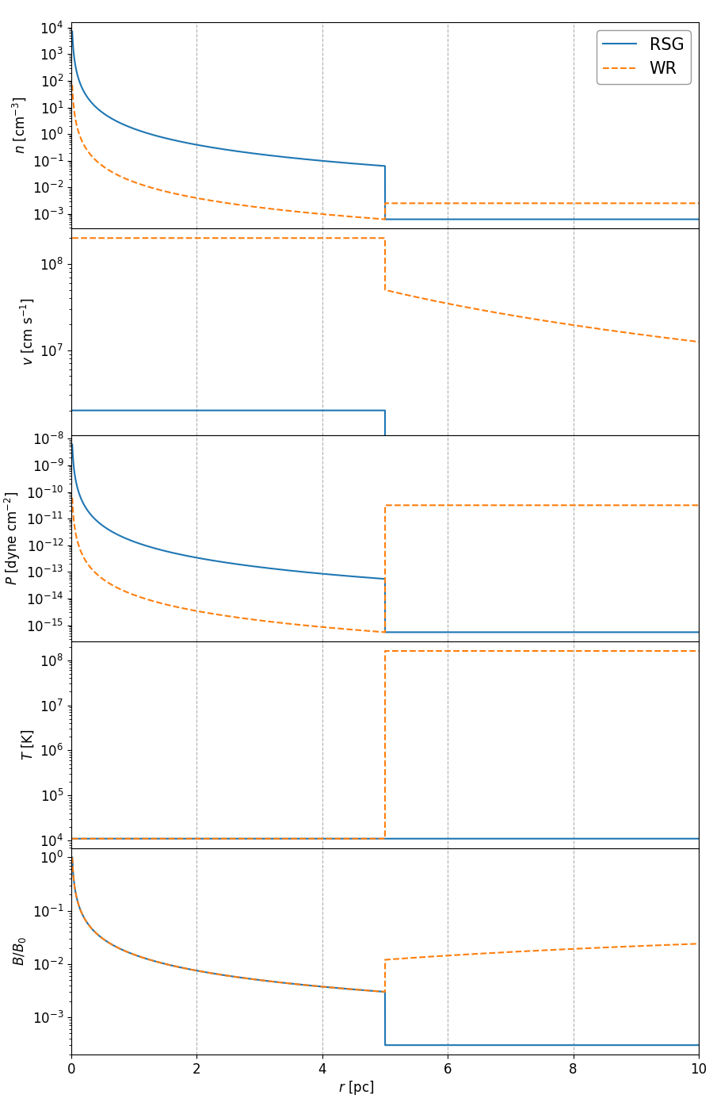
Simplified setup
Red Supergiant:
describing the inner part of the stellar wind bubble for RSG and WR cases
transition from the free wind to the shocked wind is assumed to be at 5 pc
corresponds to the early stages of the SNR evolution
Wolf-Rayet:

Slide 19
Simplified setup
Red Supergiant:
describing the inner part of the stellar wind bubble for RSG and WR cases
transition from the free wind to the shocked wind is assumed to be at 5 pc
corresponds to the early stages of the SNR evolution
Wolf-Rayet:

Slide 20
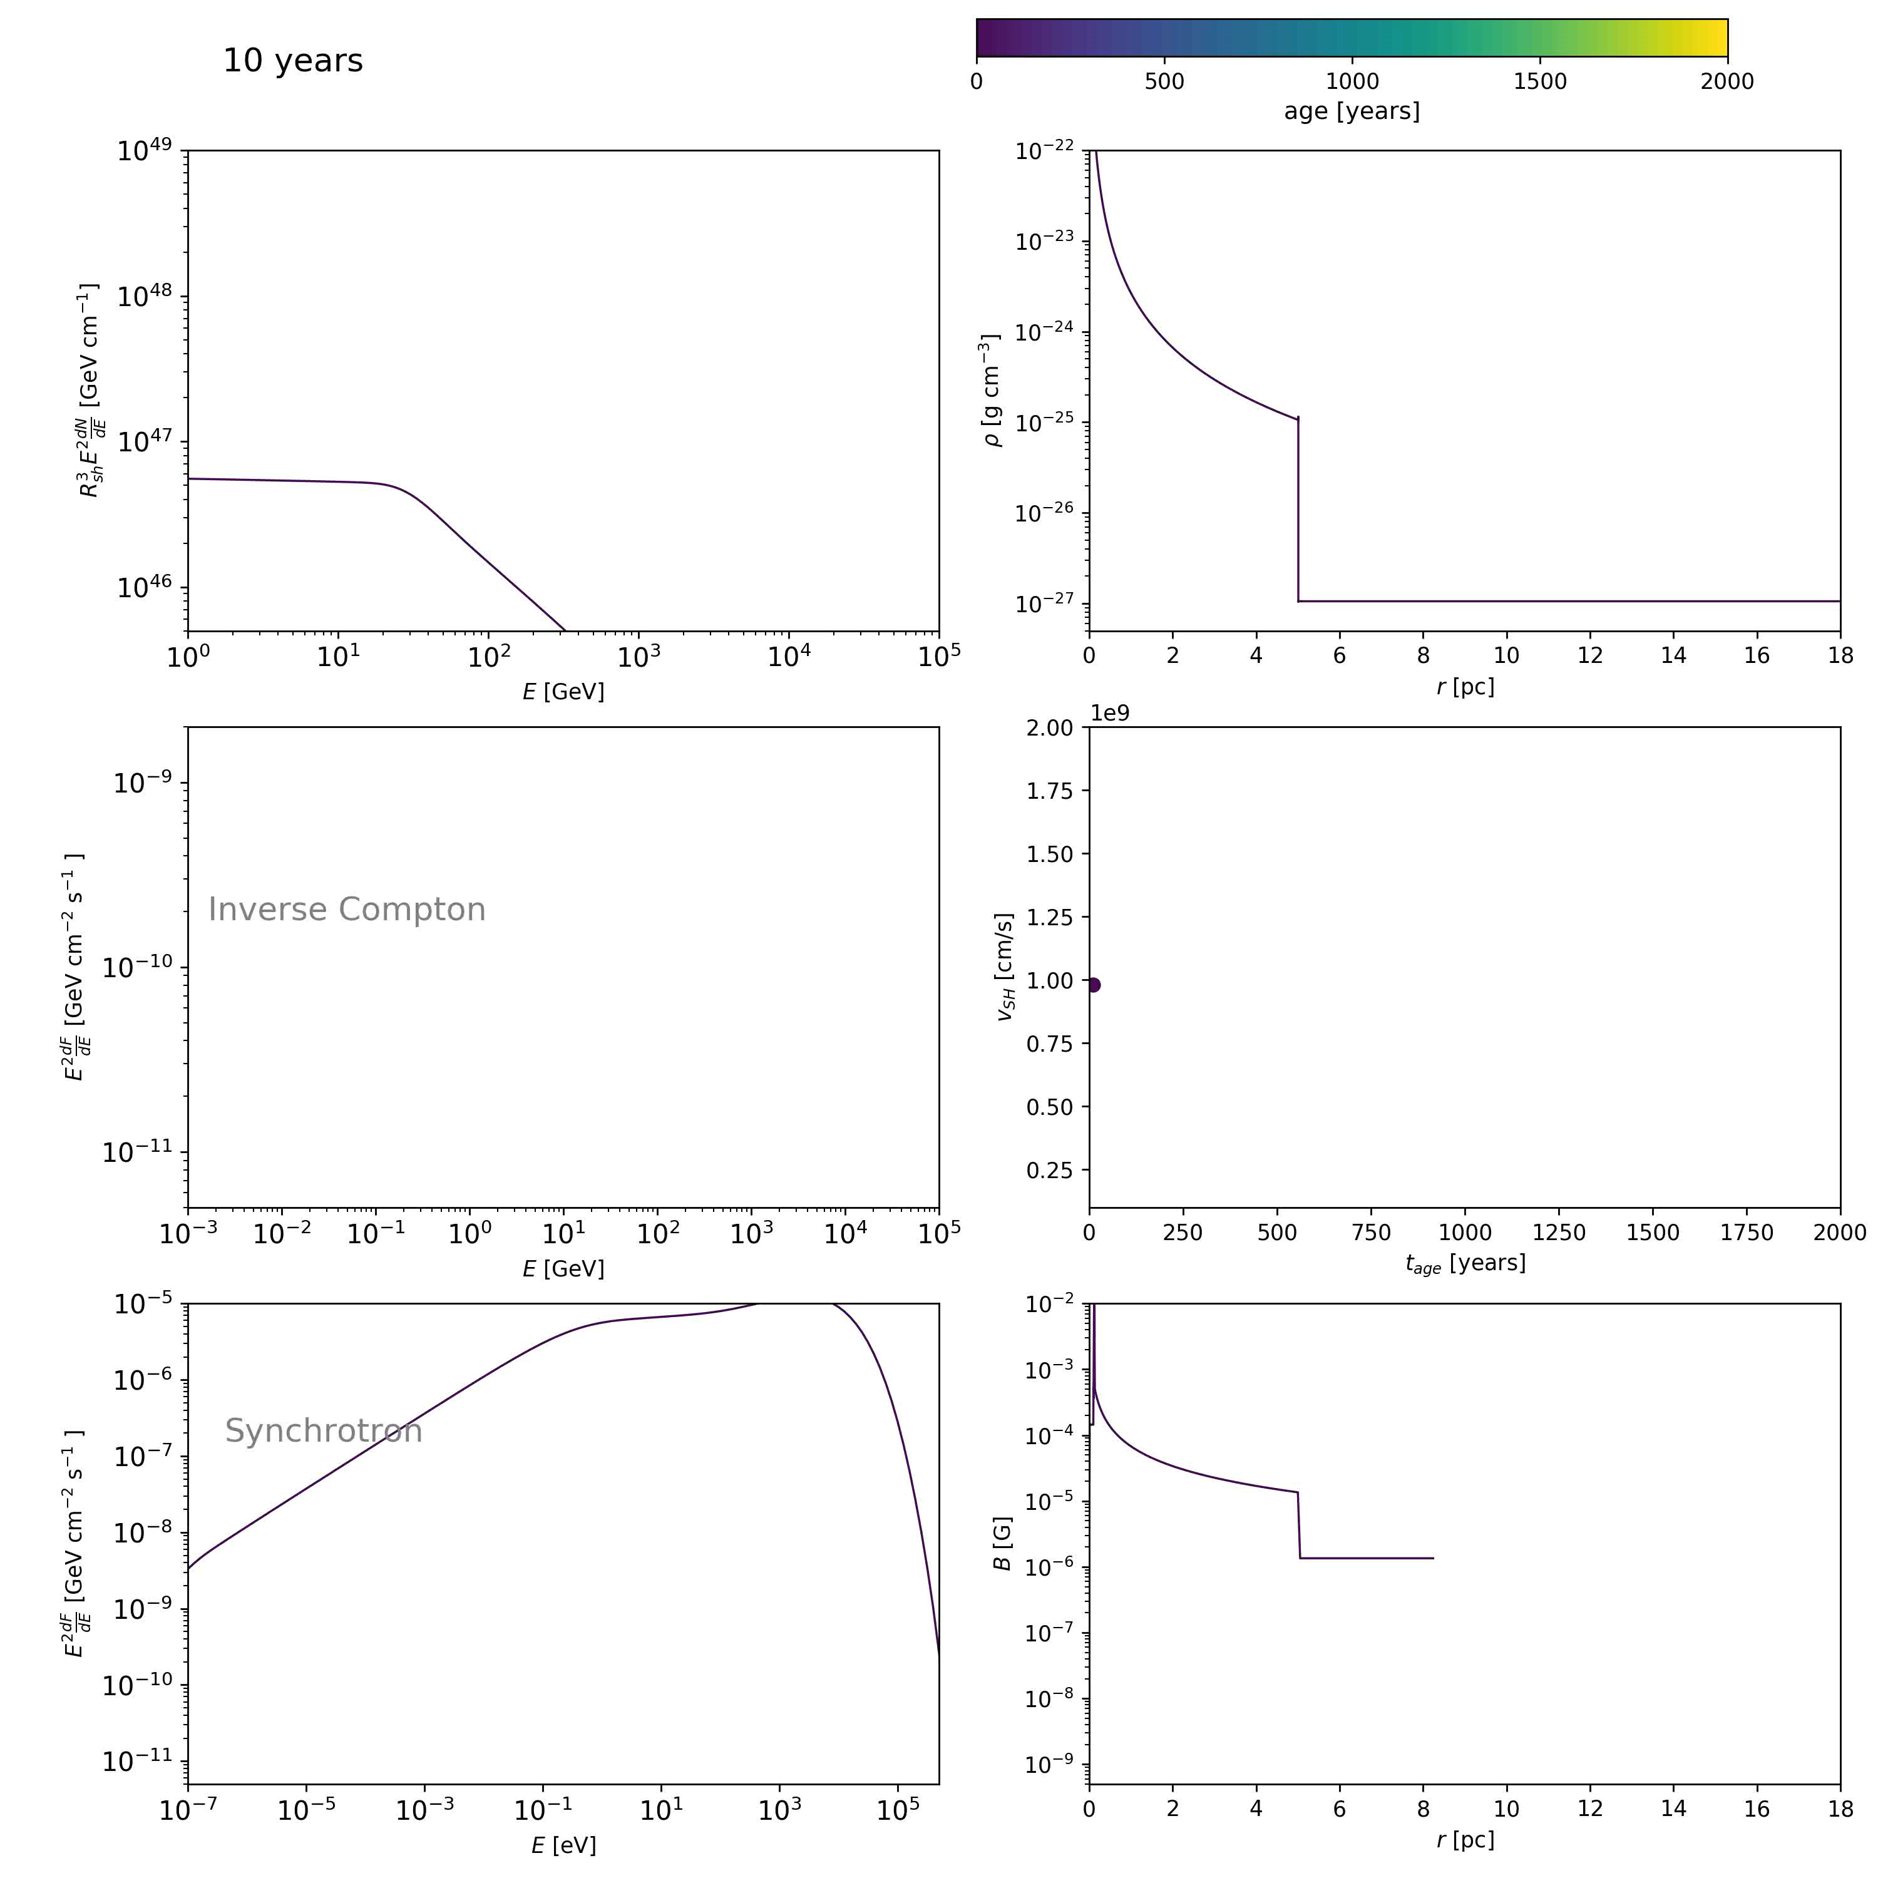
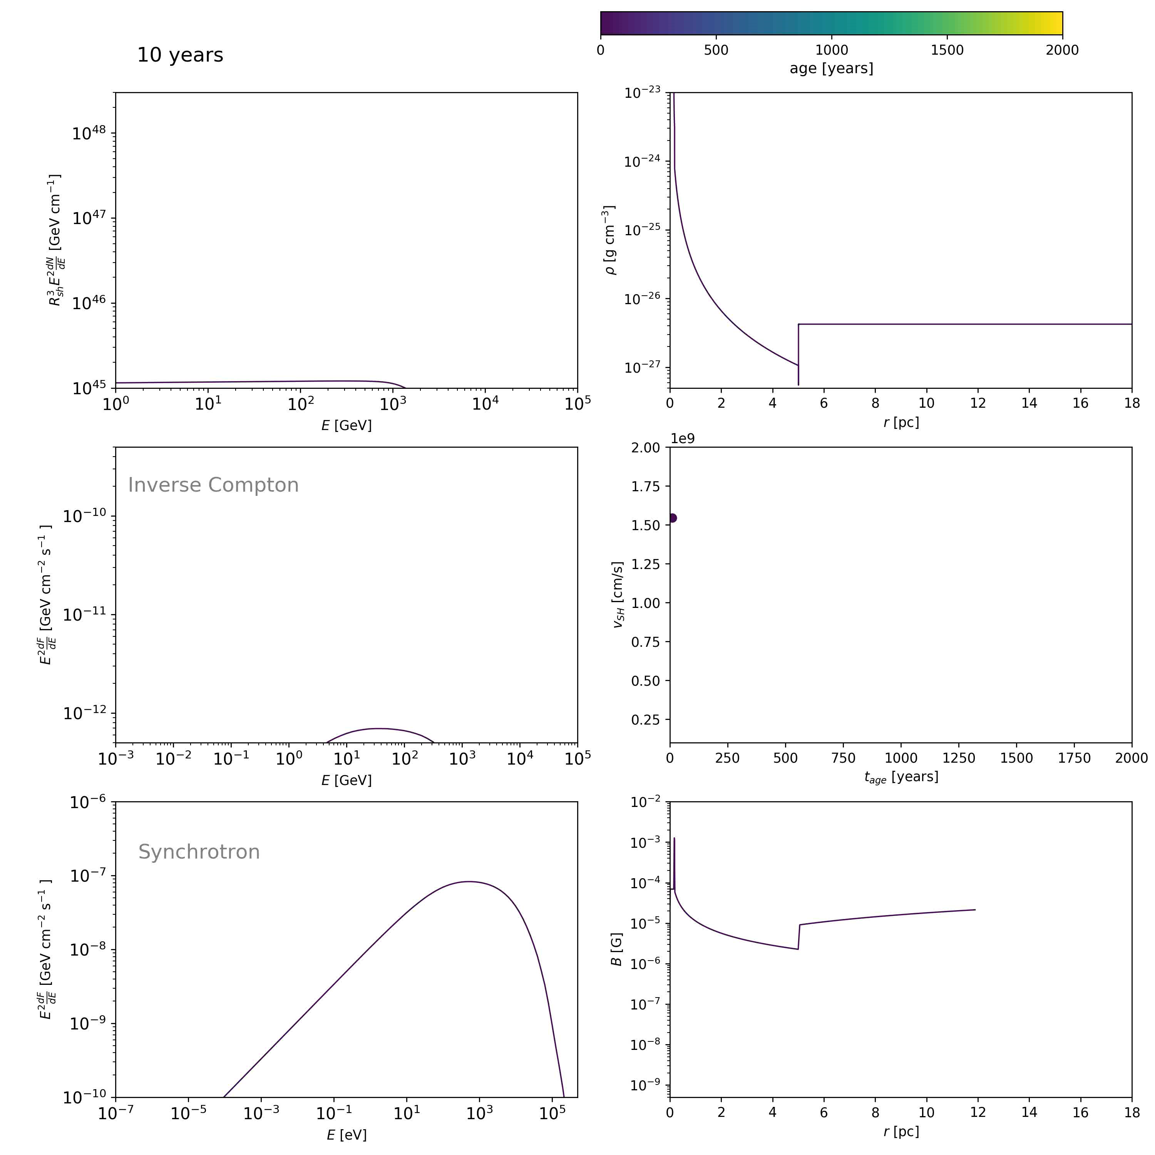
Simulations for electrons
RSG
WR

Slide 21
Main features
Strongly cooled spectrum at the early stages due to the high magnetic field

Slide 22
Main features
Strongly cooled spectrum at the early stages due to the high magnetic field
Formation of two energetically distinct and spatially separated components of particles as the shock passes the transition point
  Caused by a combination of cooling and confinement effects and the change of the shock velocity
  Results in concave particle and emission spectra and complex morphologies

Slide 23
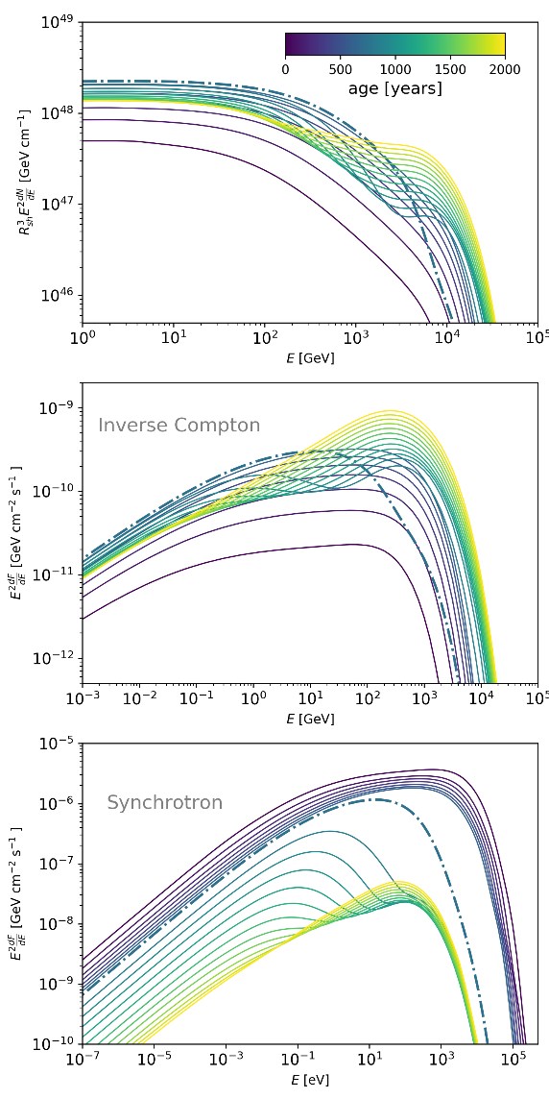
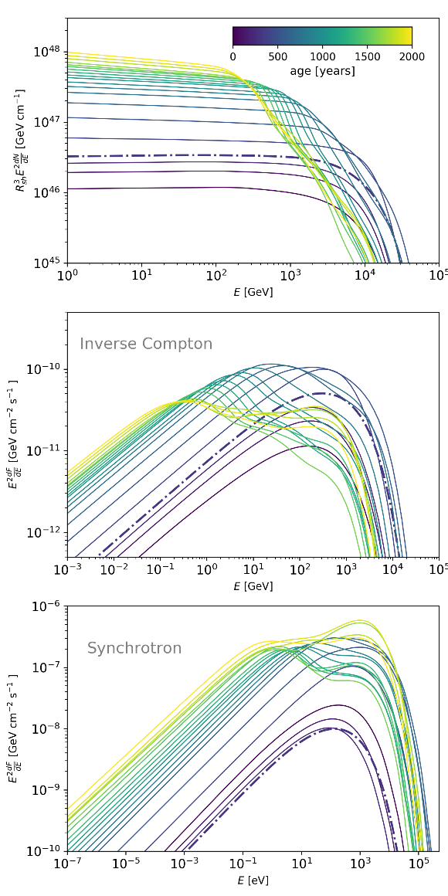


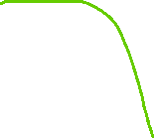

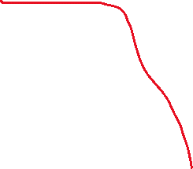
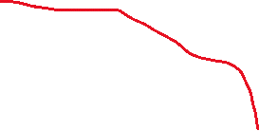
Spectra
RSG
WR
“new” effectively cooled particles close to the shock
SUM
“old” cooled particles farther downstream
“old” particles farther downstream with lower
maximum energy
SUM
“new” particles close to the shock accelerated to higher energies

Slide 24
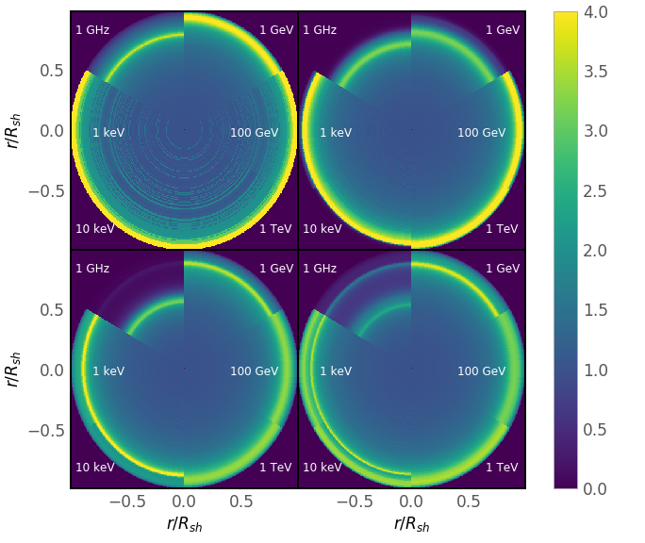
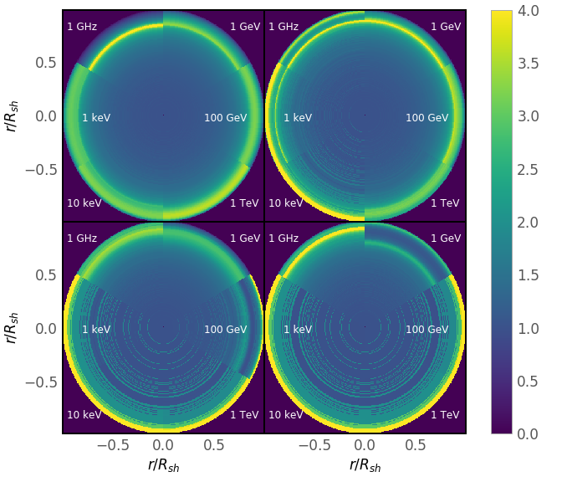
Morphology
Formation of two spatially separated components of electrons is reflected in formation “double-ring” morphologies at different enegies
RSG
WR
* emission is normalized to the projected emission from the centre

Slide 25
Main features
Strongly cooled spectrum at the early stages due to the high magnetic field
Formation of two energetically distinct and spatially separated components of particles as the shock passes the transition point
  Caused by a combination of cooling and confinement effects and the change of the shock velocity
  Results in concave particle and emission spectra and complex morphologies
Strong and fast change of luminosity at the transition point, especially in X-rays

Slide 26
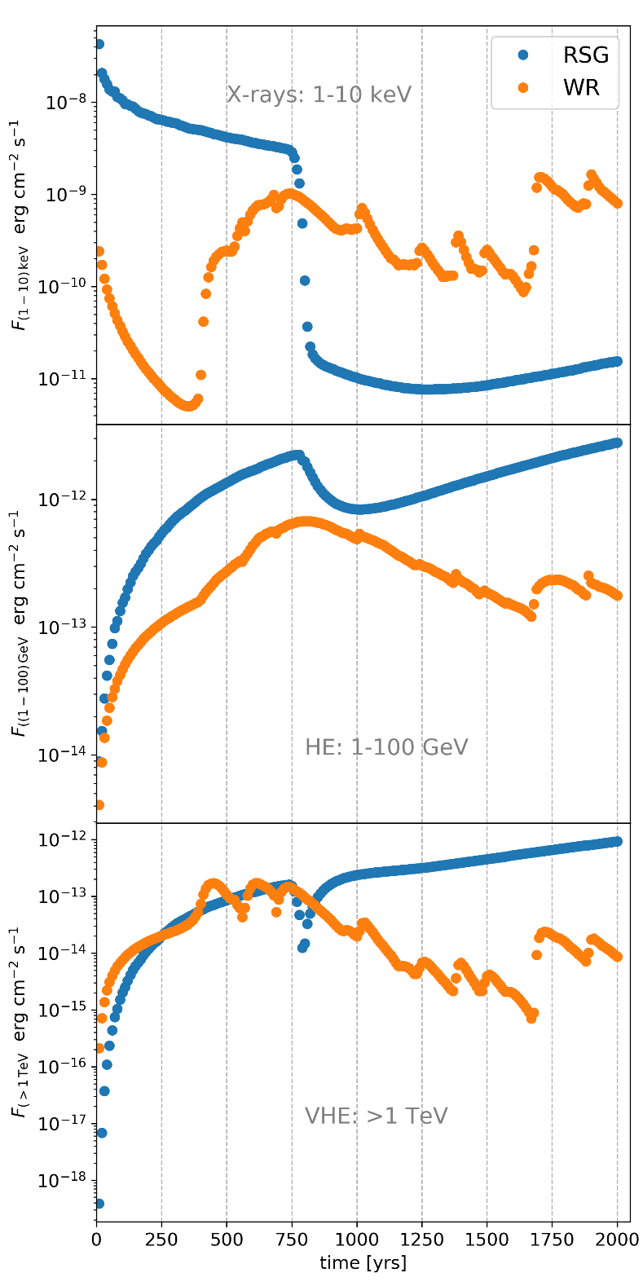
Light curves
Rapid decrease/increase of the X-ray and gamma-ray emission during the transition stage that can be well detectable on a 10-years time scale
The average rate of dimming in the RSG case is about 1.5 % per year

Slide 27
Cas A: observed decrease of X-ray flux
Patnaude, et al. 2011
Believed to be a result of the explosion of the RSG
Decline of the X-ray emission at the level of 1.5% per year

Slide 28
Main features
Strongly cooled spectrum at the early stages due to the high magnetic field
Formation of two energetically distinct and spatially separated components of particles as the shock passes the transition point
  Caused by a combination of cooling and confinement effects and the change of the shock velocity
  Results in concave particle and emission spectra and complex morphologies
Strong and fast change of luminosity at the transition point, especially in X-rays
Formation of a reflected shock that propagates and get deflected back and forth in the downstream
  Results in sporadic boosts of the forward shock velocity that increases the maximum energy and hence also X-ray and very high energy gamma-ray emission

Slide 29
Spectra
WR
Interaction of the reflected shock with the forward shock speeds the latter one up which results in an instantaneous increase of the maximum energy
“Heart-beat” behavior of the spectrum

Slide 30
Light curves
Sporadic spikes in WR light curves connected to the interaction of the reflected shock with the forward shock. Should be detectable in both X-rays and gamma-rays

Slide 31
Time variability of X-ray stripes in Tycho
Observed brightening of the knot is accompanied by hardening of the spectrum
Okuno et al., 2020
This is exactly what you expect in the event of the forward shock boosting by the reflected shock

Slide 32
Main features
Strongly cooled spectrum at the early stages due to the high magnetic field
Formation of two energetically distinct and spatially separated components of particles as the shock passes the transition point
  Caused by a combination of cooling and confinement effects and the change of the shock velocity
  Results in concave particle and emission spectra and complex morphologies
Strong and fast change of luminosity at the transition point, especially in X-rays
Formation of a reflected shock that propagates and get deflected back and forth in the downstream
  Results in sporadic boosts of the forward shock velocity that increases the maximum energy and hence also X-ray and very high energy gamma-ray emission
  Additional acceleration at the reflected shock?

Slide 33
Main features
Strongly cooled spectrum at the early stages due to the high magnetic field
Formation of two energetically distinct and spatially separated components of particles as the shock passes the transition point
  Caused by a combination of cooling and confinement effects and the change of the shock velocity
  Results in concave particle and emission spectra and complex morphologies
Strong and fast change of luminosity at the transition point, especially in X-rays
Formation of a reflected shock that propagates and get deflected back and forth in the downstream
  Results in sporadic boosts of the forward shock velocity that increases the maximum energy and hence also X-ray and very high energy gamma-ray emission
  Additional acceleration at the reflected shock?
See the talk by Kobus Le Roux

Slide 34
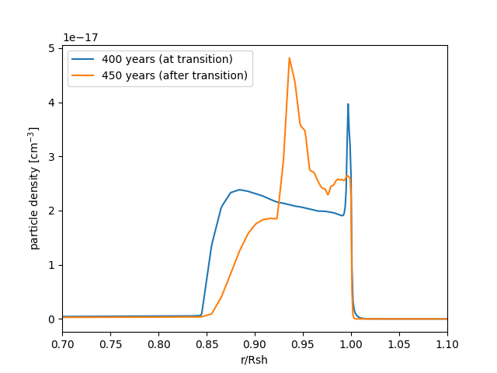
Reflected shock
Radial profile for 1 TeV electrons
The pile up of particles corresponds to the location of the reflected shock

Slide 35
Main features
Strongly cooled spectrum at the early stages due to the high magnetic field
Formation of two energetically distinct and spatially separated components of particles as the shock passes the transition point
  Caused by a combination of cooling and confinement effects and the change of the shock velocity
  Results in concave particle and emission spectra and complex morphologies
Strong and fast change of luminosity at the transition point, especially in X-rays
Formation of a reflected shock that propagates and get deflected back and forth in the downstream
  Results in sporadic boosts of the forward shock velocity that increases the maximum energy and hence also X-ray and very high energy gamma-ray emission
  Additional acceleration at the reflected shock?
Softening of the spectrum as the forward shock propagates into the hot medium

Slide 36
Softening of the spectrum
Shock propagates in the hot shocked wind → Mach number decreases → compression ratio decreases → the particle spectrum becomes softer

Slide 37
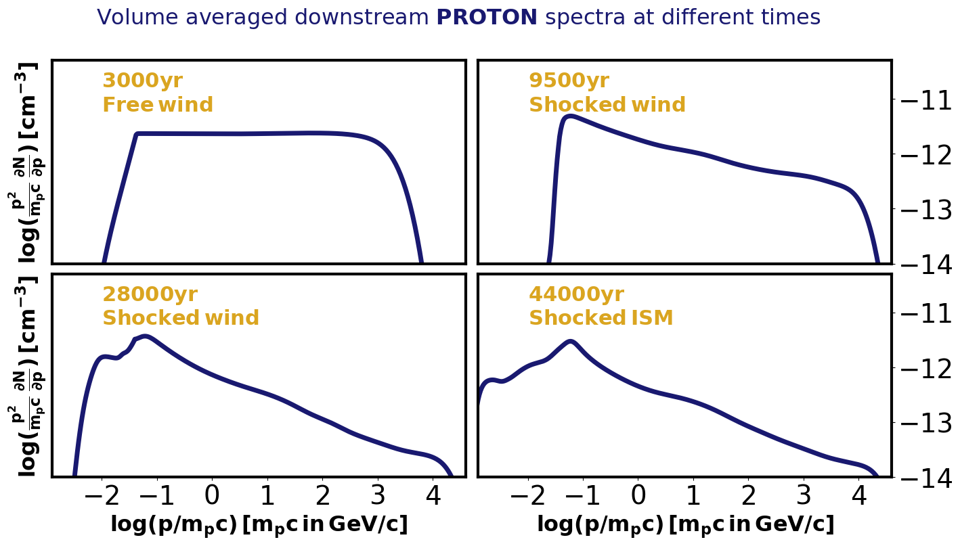

Softening of the spectrum
Even more prominent at later stages!
Up to the spectral index of 2.5
The plot from simulations for the SNR evolving in the stellar wind bubble of the 60 $M_{⊙}$ star (Das et al. 2022)

Slide 38
Softening of the spectrum
Even more prominent at later stages!
Up to the spectral index of 2.5
Recall the spectral index problem mentioned at the beginning
The plot from simulations for the SNR evolving in the stellar wind bubble of the 60 $M_{⊙}$ star (Das et al. 2022)

Slide 39
Summary
Formation of energetically distinct and spatially separated components of particles that results in a concave emission spectrum and complex morphology
Potential strong brightening/dimming of the X-ray/gamma-ray emission. Possibly what we see in Cas A.
Sporadic spikes in X-ray/gamma-ray light curves connected to reflected-forward shocks interaction
Propagation of the forward shock in the hot shocked wind medium results in a softer particle spectrum

Slide 40



#StandWithUkraine !
Donate to:
Charity foundation “Come back alive”
Organization launched back in 2014 providing support to the Armed forces of Ukraine
www.comebackalive.in.ua
UNITED24 – a charity fund launched by the President of Ukraine to cover most pressing needs: https://u24.gov.ua/

Slide 41
BACKUP slides

Slide 42

Hydrodynamics
Numerically solve standard gas-dynamical equations (Pluto) for the SNR propagating in the pre-defined medium
1D and spherically symmetric
The choice of ejecta/medium profiles is based on the type of he SN
$$\frac{∂}{∂t}\left(\begin{matrix}ρ \\ m \\ E\end{matrix}\right)+∇{\left(\begin{matrix}ρv \\ mv+PI \\ \left(E+P\right)v\end{matrix}\right)}^{T}=\left(\begin{matrix}0 \\ 0 \\ 0\end{matrix}\right)$$
$\frac{ρv^{2}}{2}+\frac{P}{γ−1}=E$

Slide 43
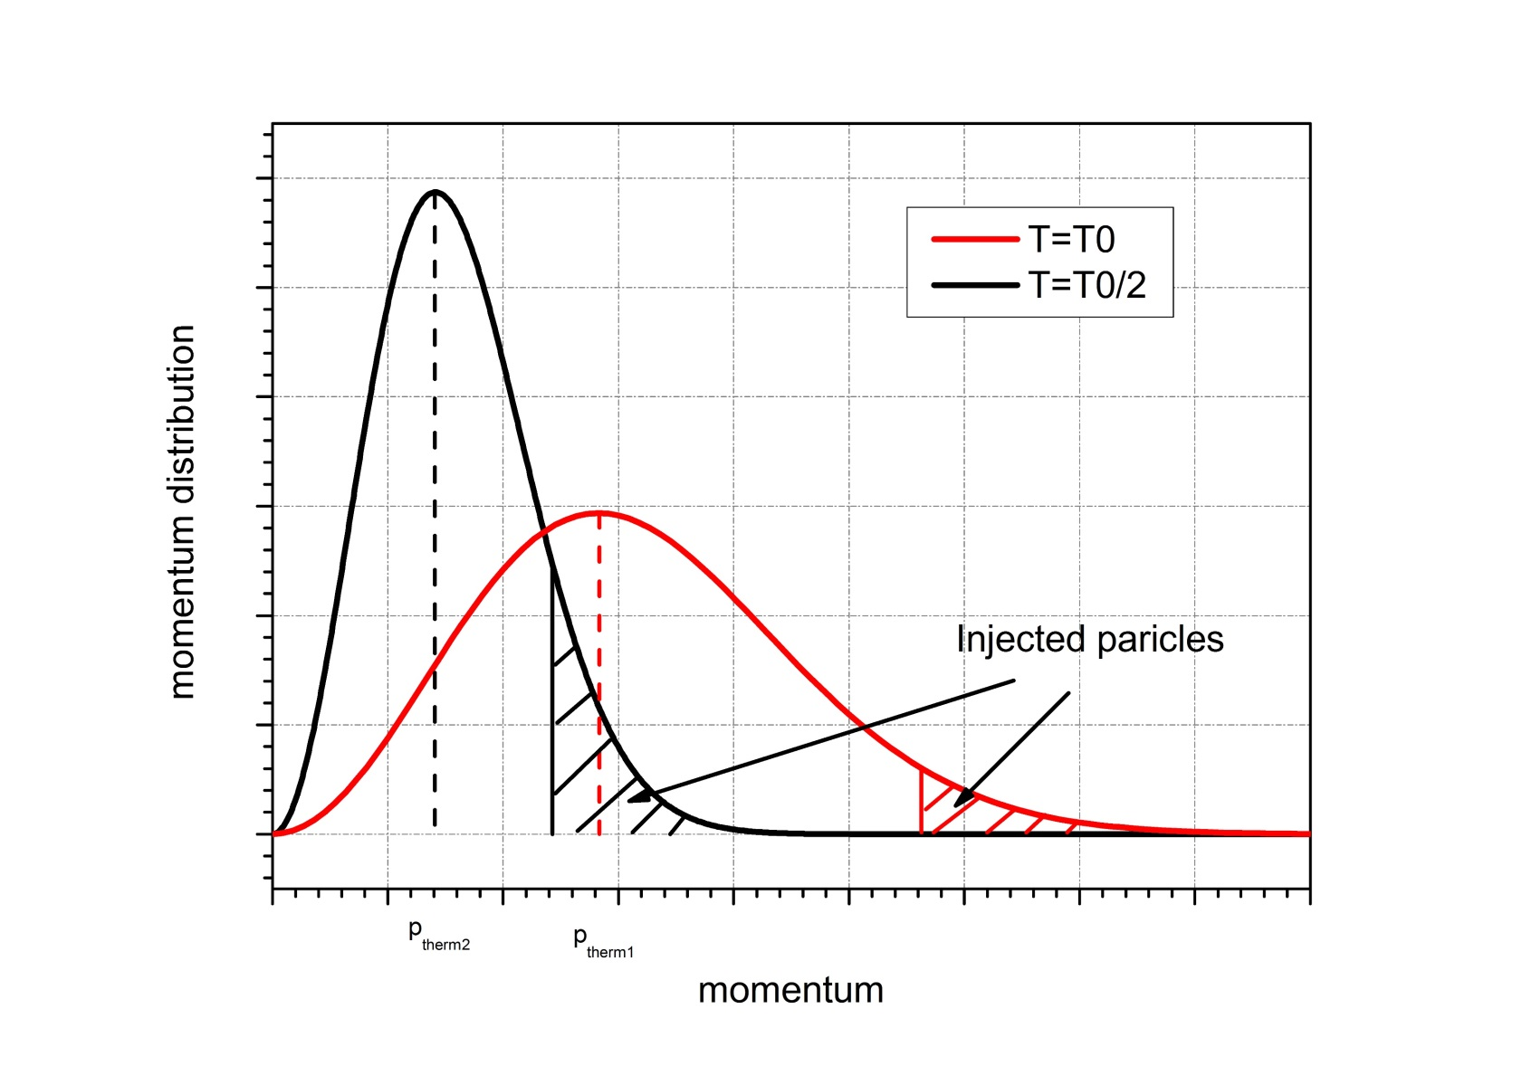
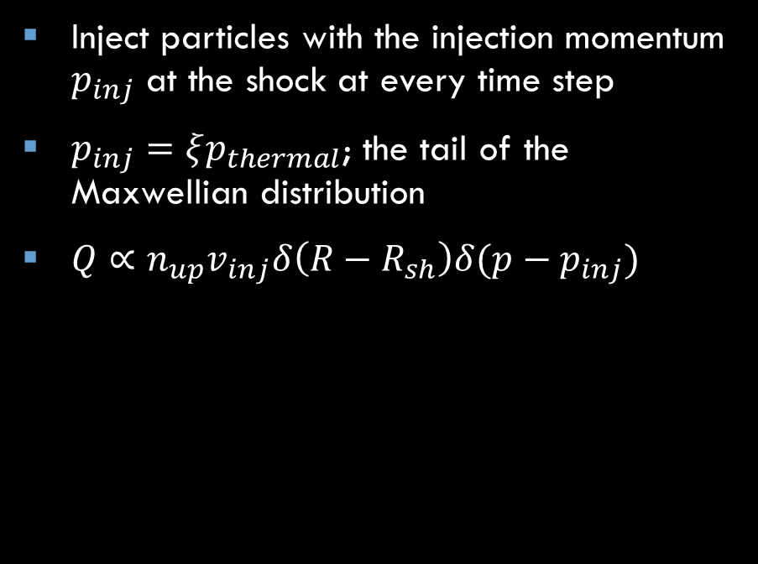
Injection
Inject particles with the injection momentum $p_{inj}$ at the shock at every time step
$p_{inj}=ξp_{thermal}$; the tail of the Maxwellian distribution
$Q∝n_{up}v_{inj}δ\left(R−R_{sh}\right)δ(p−p_{inj})$

Slide 44


Transport equation for particles
$$\frac{∂N}{∂t} = ∇\left({ D}_{r}∇N − vN\right) − \frac{∂}{∂p}\left(N\dot{p} − \frac{∇v}{3}Np\right) + Q$$
Diffusion Advection Cooling Acceleration Injection
1D in spherical symmetry
Test-particle
Synchrotron cooling for electrons
On a co-moving, expanding grid → no free escape boundary, all particles are kept in simulations
Change of variables: ${x−1=\frac{r}{R_{sh}}−1= (x_{∗}−1)}^{3}$ → fine resolution at the shock

Slide 45
Magnetic field/Amplification/Diffusion coefficient
Two ways
Prescribed large-scale magnetic field Amplification of the magnetic field upstream by a linear scaling factor Compression at the shock Passively transported downstream; induction equation solved Bohm-like diffusion | Prescribed large-scale magnetic field Turbulent magnetic field due to resonant streaming instability The transport equation for the magnetic turbulence assuming Alfven waves is solved in parallel to the transport equation of particles Amplification and diffusion coefficient are calculated self-consistently

Slide 46
Magnetic field/Amplification/Diffusion coefficient
Two ways
Prescribed large-scale magnetic field Amplification of the magnetic field upstream by a linear scaling factor Compression at the shock Passively transported downstream; induction equation solved Bohm-like diffusion | Prescribed large-scale magnetic field Turbulent magnetic field due to resonant streaming instability The transport equation for the magnetic turbulence assuming Alfven waves is solved in parallel to the transport equation of particles Amplification and diffusion coefficient are calculated self-consistently
This is what we used for this study

Slide 47
Magnetic field/Amplification/Diffusion coefficient
Two ways
Prescribed large-scale magnetic field Amplification of the magnetic field upstream by a linear scaling factor Compression at the shock Passively transported downstream; induction equation solved Bohm-like diffusion | Prescribed large-scale magnetic field Turbulent magnetic field due to resonant streaming instability The transport equation for the magnetic turbulence assuming Alfven waves is solved in parallel to the transport equation of particles Amplification and diffusion coefficient are calculated self-consistently
See more details in the talk by Robert Brose

Slide 48
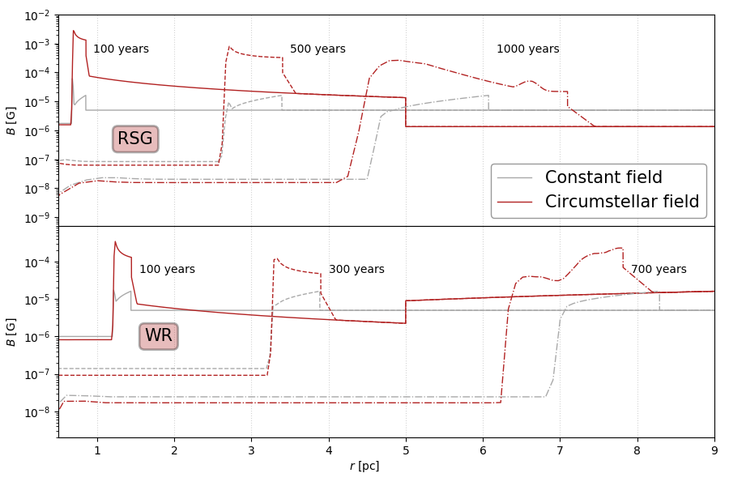

Circumstellar magnetic field
Amplified upstream of the shock
Compressed at the shock and transported downstream following the induction equation
Constant ambient magnetic field of 5 $μG$which is not amplified upstream is shown for reference
Sushch+, 2022
Notes:
Illustration of magnetic field profiles

Slide 49
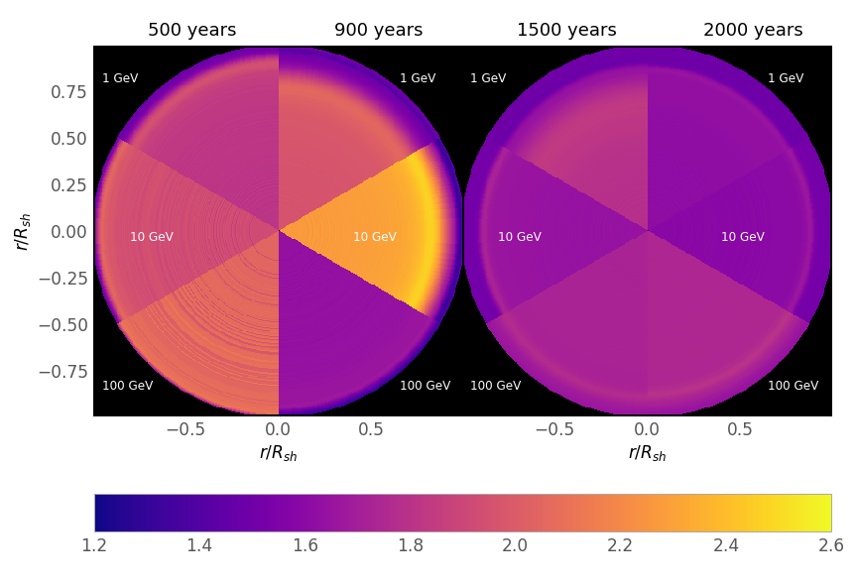
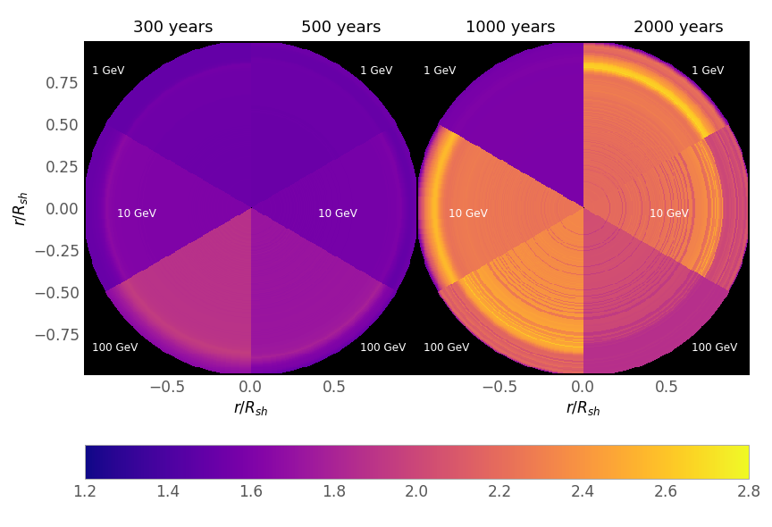


Spectral morphology
RSG
WR
Formation of two components
$$Δα∼1$$
well detectable!
Formation of two components
$$Δα∼0.3$$
$∼$detectable…

Slide 50
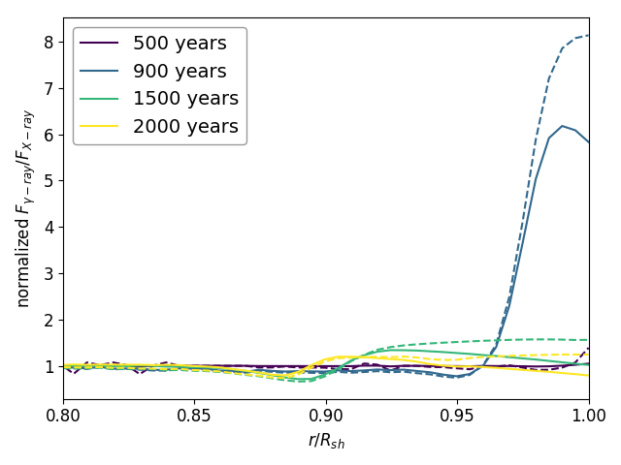
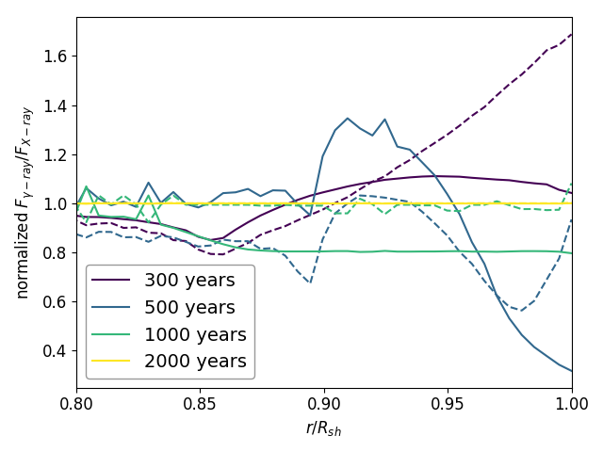
X-ray/gamma-ray correlation?
RSG
Conventionally:
We expect X-rays and gamma-ray to come from the same regions in the leptonic scenario as the emission is created by the same electrons
Lack of correlation suggests hadronic scenario
In reality:
X-ray and gamma-ray morphologies do not necessarily have to correlate as the former one strongly depends on the distribution of the magnetic field
WR
Sushch+, 2022

