Slide 1
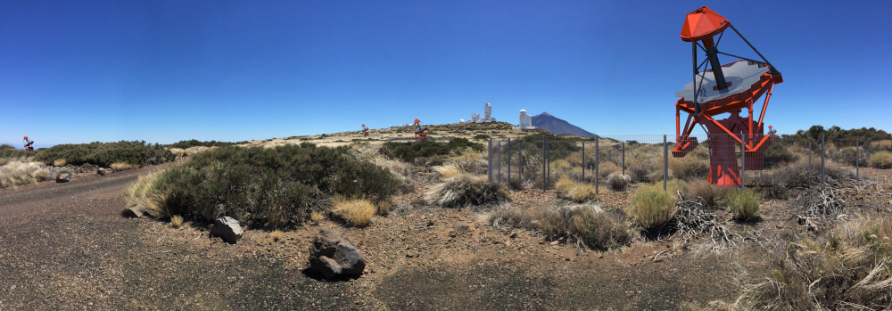
The ASTRI Mini-Array
S. Scuderi – IASF Milano
OAS Very High Energy meeting: towards ASTRI and CTA, 08-09 June 2022

Slide 2
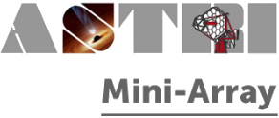
Layout of the presentation
The ASTRI Mini-Array project
      Architecture of ASTRI Mini-Array
      Teide infrastructure
Status of production:
          Mechanical structure & mirrors
          Telescope’s auxiliaries
          Cherenkov cameras
          ICT
          Software
Operation concept
Mini-Array implementation
S. Scuderi, OAS VHE meeting, 08/06/2022

Slide 3
The ASTRI Mini-Array Project
ASTRI (Astrofisica con Specchi a Tecnologia Replicante Italiana) was born as “Progetto Bandiera” funded by MIUR with the initial aim to design and realize an innovative end-to-end prototype of the 4 meters class telescopes in the framework of the CTA observatory
The ASTRI Mini-Array is the second step of project whose purpose is to construct, deploy and operate an array of 9 Cherenkov telescopes of the 4 meters class at the Observatorio del Teide in Tenerife (Spain) in collaboration with IAC.
More than 150 hundred researchers belonging to
  INAF institutes (IASF-MI, IASF-PA, OAS, OACT, OAB, OAPD, OAR)
  Italian Universities (Uni-PG, Uni-PD, Uni-CT, Uni-GE, PoliMi)
  International institutions (University of Sao Paulo – Brazil, North-West University – South Africa, IAC – Spain).
Italian and foreign industrial companies are and will be involved in the ASTRI Mini-Array project with important industrial return.
S. Scuderi, OAS VHE meeting, 08/06/2022

Slide 4
The ASTRI Mini-Array Project
The ASTRI mini-array can be considered a new pathfinder of the arrays of Cherenkov telescopes
Hosting agreement foresees 4 + 4 years of operations for the ASTRI Mini-Array starting from beginning of operations
During the first 3/4 years of operations the array will be run as an experiment
The ASTRI Science team will develop a strategy to concentrate the observational time on a limited number of programs with clearly identified objectives (Vercellone’s talk)
After this initial period the project will gradually move towards an observatory model in which a fraction of the time will be assigned to scientific proposals through a Time Allocation Committee procedure
S. Scuderi, OAS VHE meeting, 08/06/2022

Slide 5
Mini but not small…
Largest Imaging Atmospheric Cherenkov Telescopes facility until CTAO will start to operate
Expected performance
Sensitivity: better than that of current IACTs (E > a few TeV):
  Extend the spectra of already detected sources and/or measure cut-offs
Energy/Angular resolution: ∼ 10% / ∼ 3‘ (E > a few TeV)
  Characterize the morphology of extended sources at the highest VHE
Wide FoV (≥ 10°), with almost homogeneous off-axis acceptance
  Optimal for multi-target fields, surveys, and extended sources
  Enhanced chance for serendipity discoveries
Lombardi, S., Antonelli, L. A., Bigongiari, C., et al., Proc. 37th ICRC, Berlin, PoS(ICRC2021)884 (2021)
Wide-field stereoscopic observations in the 1 – 300 TeV energy band
  Restricted number of targets/deep exposures (≥ 200 h)
  Galactic sources: wide FoV → multi-target fields
  Extragalactic sources: survey of a few promising targets at > ∼10 TeV scale
  Fundamental physics: studies on LIV, EBL, Axion-Like Particles, …
Stellar Hambury-Brown intensity interferometry in the visible band
Direct measurements of cosmic rays
The ASTRI science team is developing a core science program (see Vercellone’s talk)
S. Scuderi, OAS VHE meeting, 08/06/2022

Slide 6
Operation modes
Normal (science) observation mode: this is used to observe the targets as defined by the Science Operation Plan. Usually science observations require dark time, although it is also possible operate also during moderate moonlight conditions. Calibration activities are included in the normal operation mode.
ToO Mode: the science operation plan will identify some astrophysical targets (either a specific object or a class of objects) that, giving raises to transient phenomena, will require a response from the night operator and a change in the night schedule. This means that no dedicated automatic software procedure to react to these transient phenomena is foreseen. Depending on the type of transient object the reaction time will vary from 1 hour to 1 day.
Coordinated Mode: Synergies with the current VHE arrays (MAGIC, LST) in the northern hemisphere are foreseen in the science operation plan. This means that simultaneous observations will be possible. Usually, those observations, will be scheduled well in advance.
Maintenance mode: this mode deals with all activities necessary for the maintenance of the telescopes, the on-line control software, the monitoring, characterization and calibration devices, and the infrastructures (e.g. network, data center, etc). This is the only daytime operation mode.
S. Scuderi, OAS VHE meeting, 08/06/2022

Slide 7
Science Operations
No real time analysis of the data is foreseen but only a data quality check. Data analysis policy adopted will then be next day processing.
No array trigger (stereo trigger) will be implemented at the site. Any search for Cherenkov events detected in coincidence by more than one telescope will be performed via software off-line at the Rome Data Centre.
No subarray operation is foreseen.
Night science operations will be controlled remotely from La Laguna @ IAC → no people required at the site during the night.
The local control room at the Themis Observatory will be used during commissioning and science verification phase, during maintenance activities or in case of other special activities.
Other Array Operation Centers (control room) from Italy.
S. Scuderi, OAS VHE meeting, 08/06/2022

Slide 8
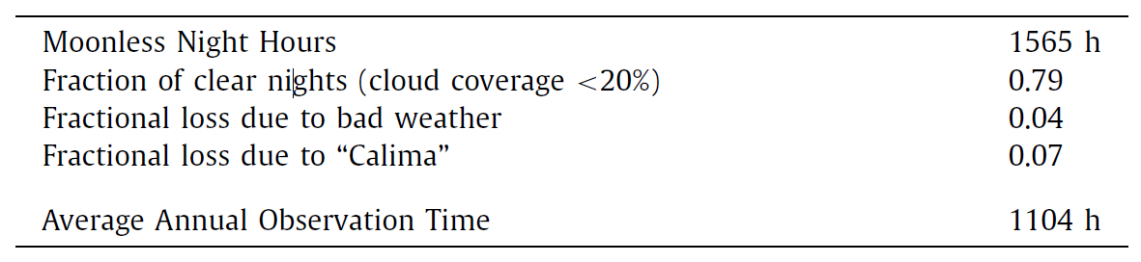
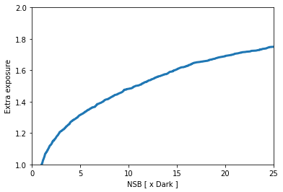
Duty cycle for Cherenkov observations
Computed for Crab nebula
Setting 15 NSB as limit → AAOT ∼ 1800 h
Duty cycle: 21%
S. Scuderi, OAS VHE meeting, 08/06/2022

Slide 9
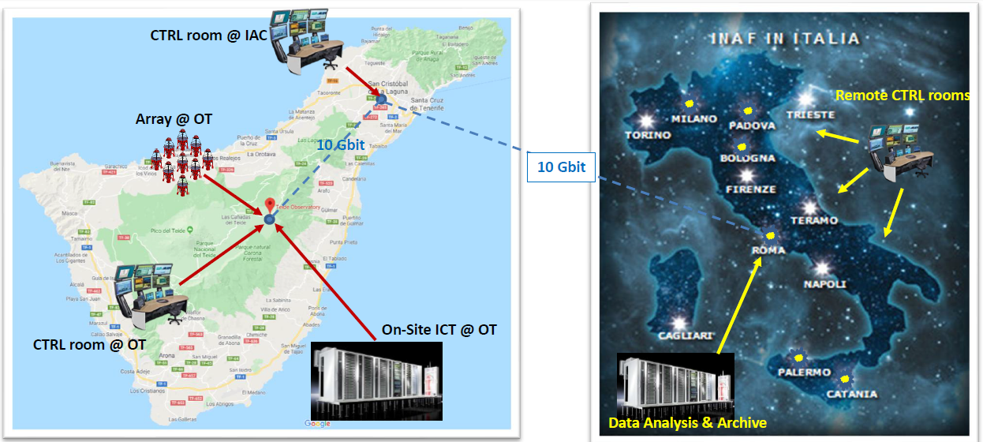
The ASTRI Mini-Array locations
The ASTRI Mini-Array in Tenerife
Telescope Array & auxiliaries (Observatorio del Teide - OT)
Local Control Room @ THEMIS building (OT)
On site Data Centre @ IAC Teide Residencia (OT)
Array operation center @IACTEC in La Laguna
The ASTRI Mini-Array in Italy
Data Centre in Rome
Remote Array operation centers
S. Scuderi, OAS VHE meeting, 08/06/2022

Slide 10
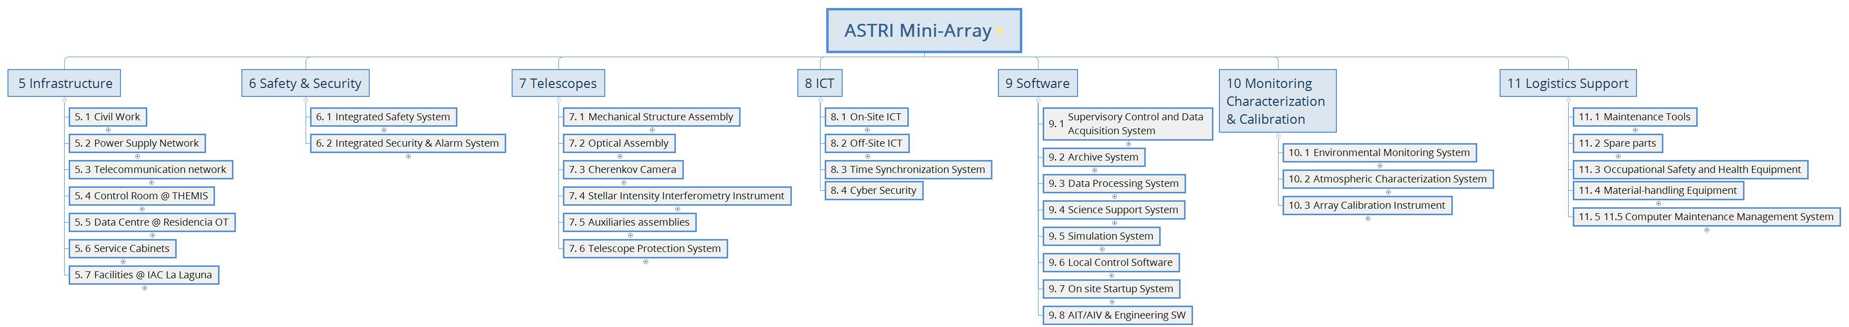
The ASTRI Mini-Array architecture: PBS
Infrastructure: composed by all those parts needed to make the observational site suitable to host the telescopes of the ASTRI Mini-Array.
Safety & Security: an independent system for the protection of people and site assets
Telescopes: include mainly the hardware used to collect and image Cherenkov light from air showers and the auxiliary assemblies needed to support this function.
ICT: includes all computing/storage hardware, the overall networking infrastructure (including cabling and switches) and all system services (operating system, networking services, name services, etc.) necessary on site and off site to control and monitor the array and to archive and analyse the scientific and engineering data.
Software: The Mini-Array software will provide to the user a set of tools from the preparation of an observing proposal to the execution of the observations, the analysis of the acquired data online and the retrieval of all the data products from the archive.
Monitoring, Characterization and Calibration: the set of devices that allows the environmental monitoring the atmospheric characterization and the array calibration.
Logistics Support: includes all the hardware & software necessary for the preventive and corrective maintenance of the ASTRI Mini-Array.
S. Scuderi, OAS VHE meeting, 08/06/2022

Slide 11
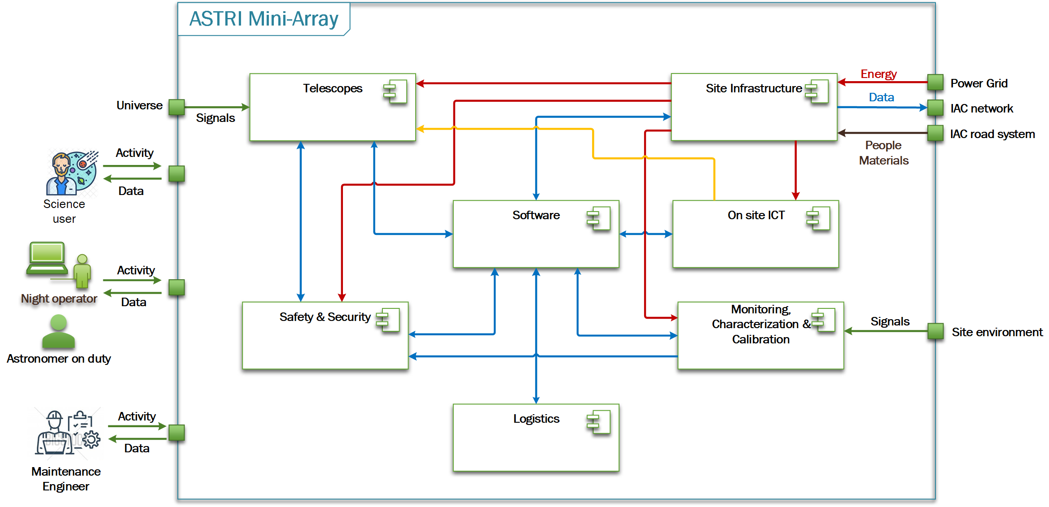
The ASTRI Mini-Array architecture: context diagram
Power
Data & commands
Time
S. Scuderi, OAS VHE meeting, 08/06/2022

Slide 12
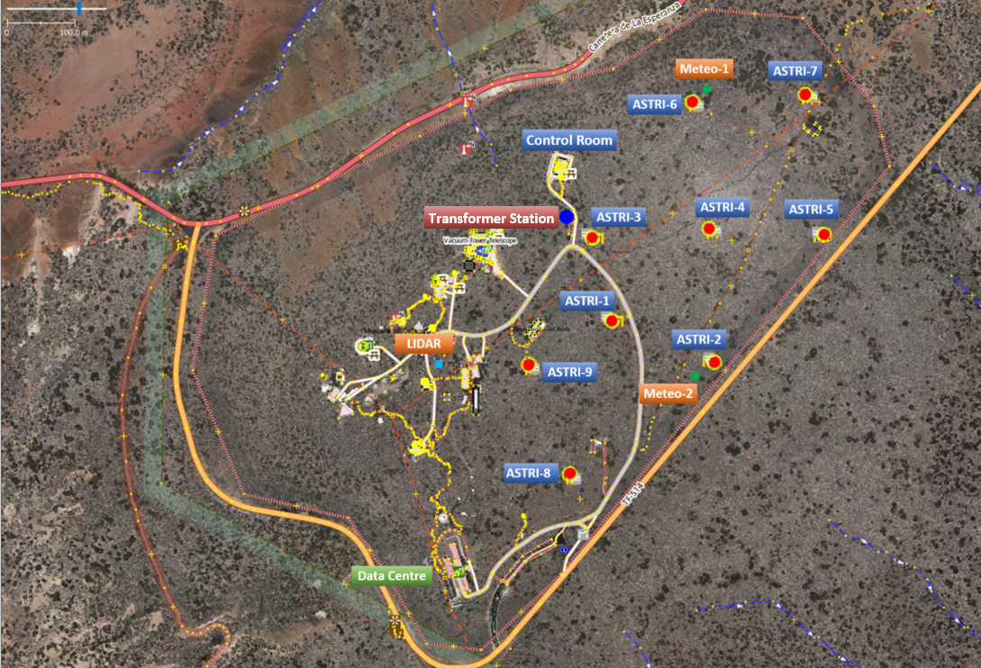
The Teide Infrastructure
Civil Work (including foundations for telescope and auxiliaries, roads, trenches)
Power supply network (including transformer station, UPS and emergency power generator)
Telecommunication network
Control room @ Themis
Onsite Data Centre
Service cabinets
Facilities in La Laguna
S. Scuderi, OAS VHE meeting, 08/06/2022

Slide 13
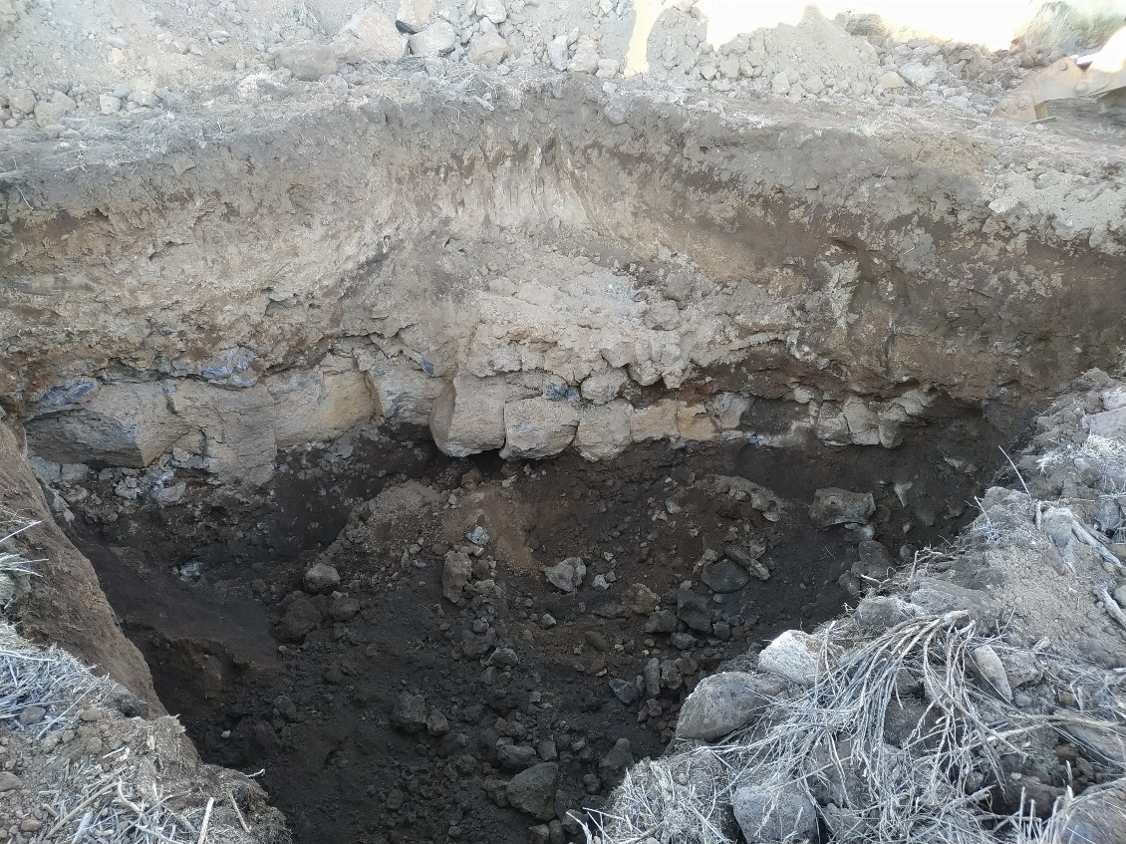
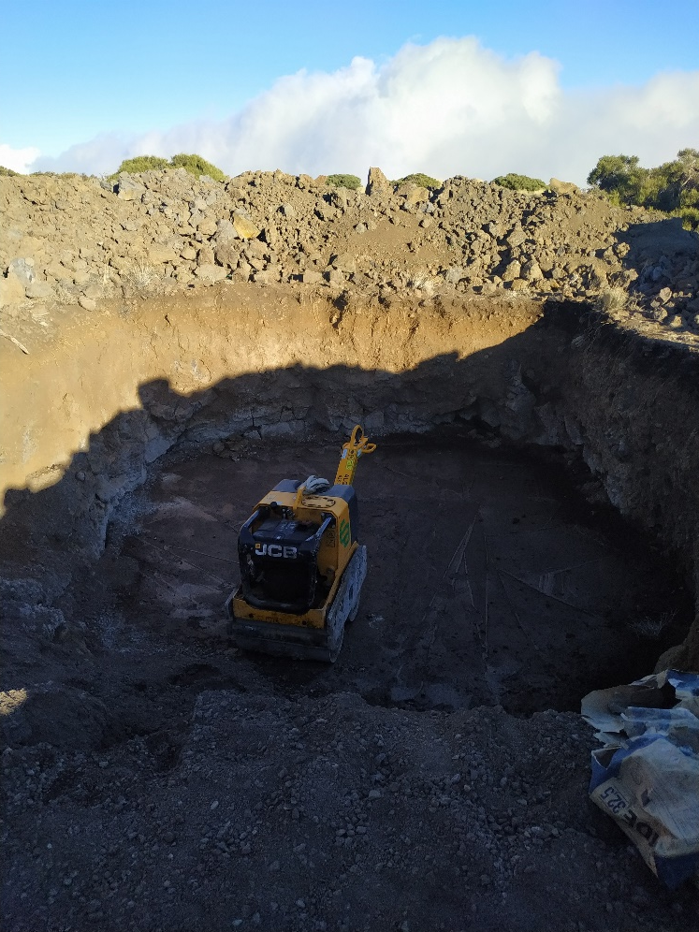
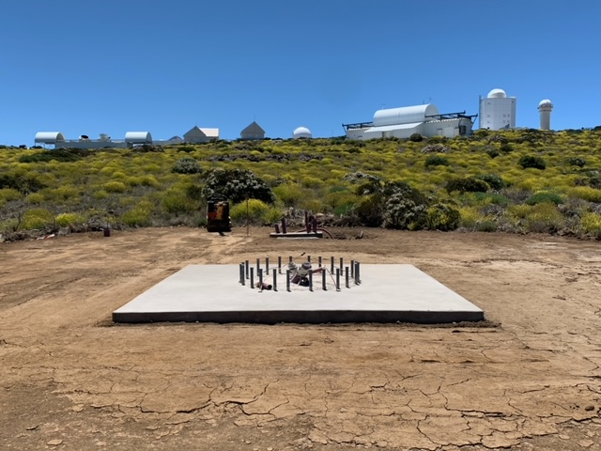
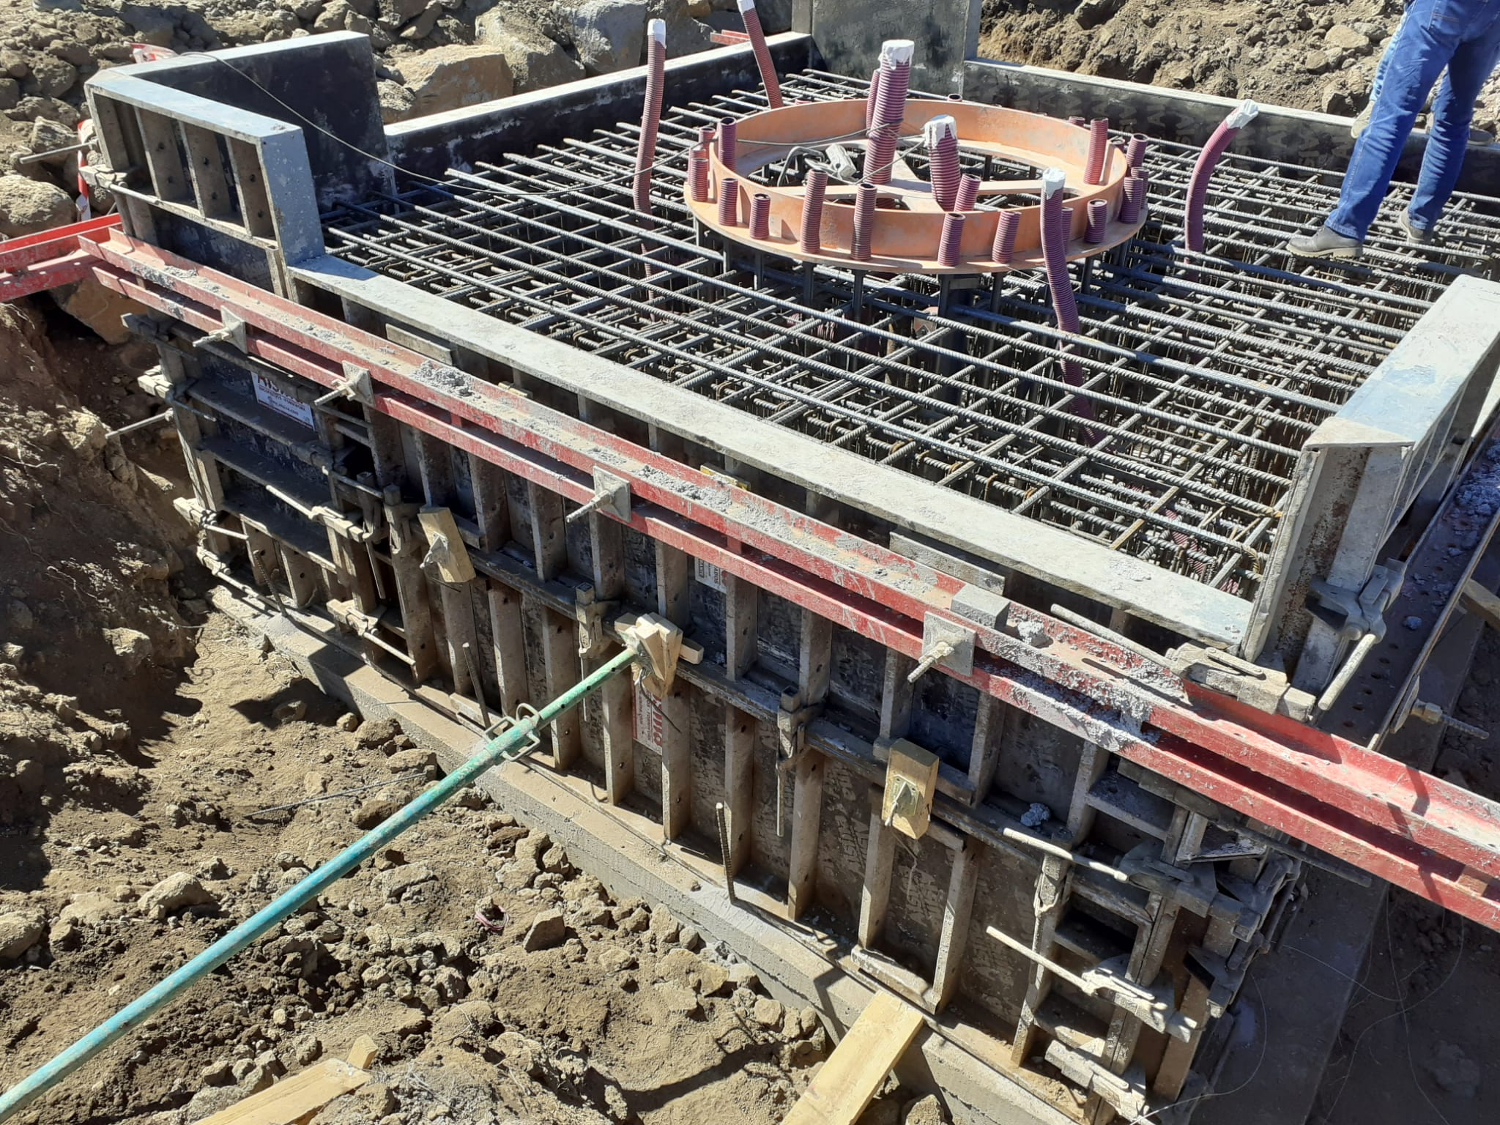
Infrastructure: foundations
S. Scuderi, OAS VHE meeting, 08/06/2022

Slide 14
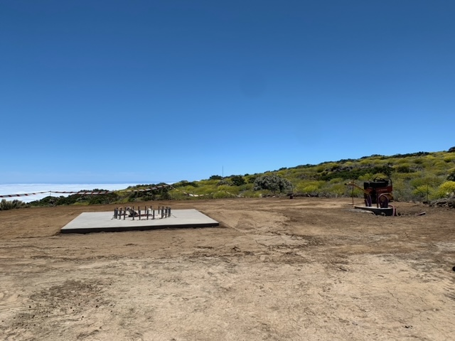
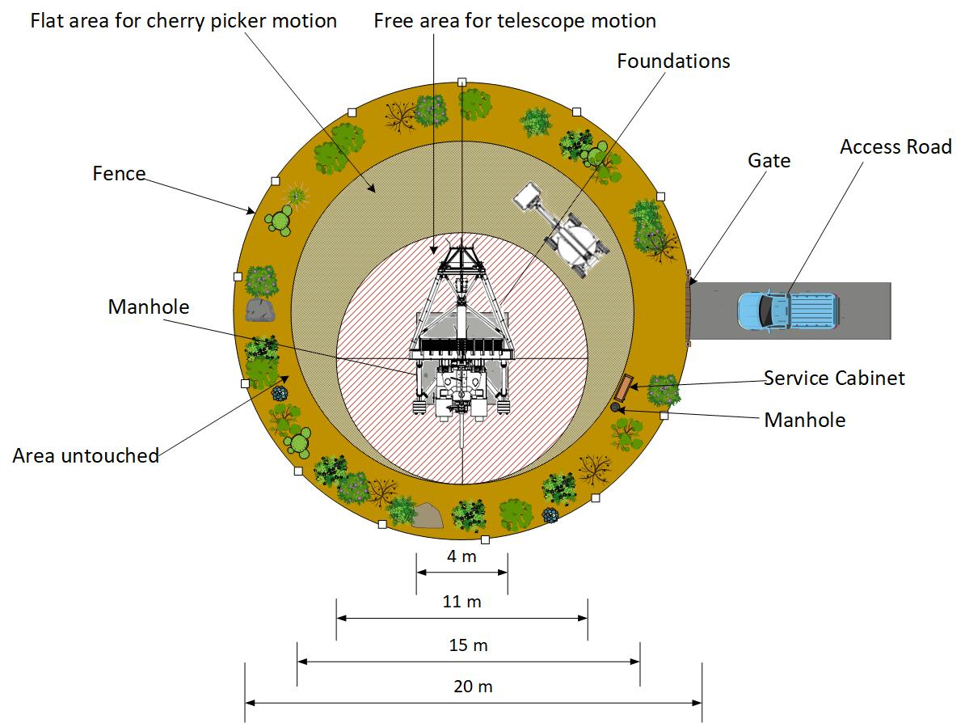
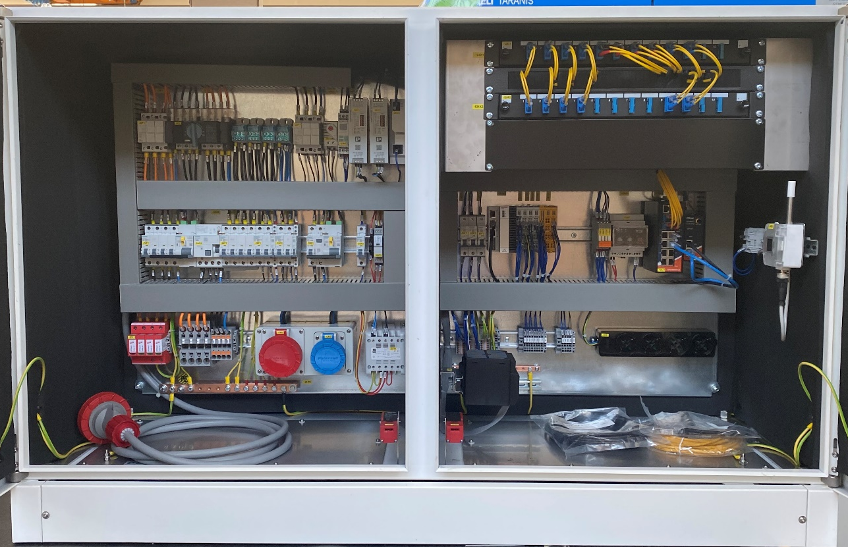
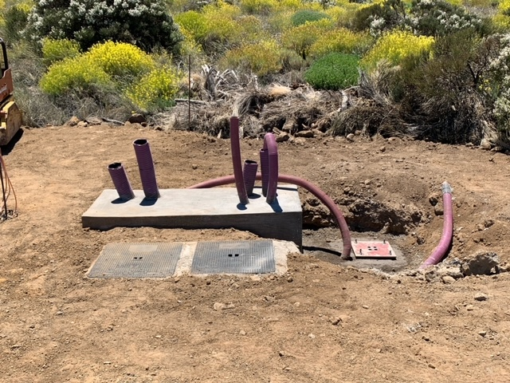
Infrastructure: Telescope’s area
Service cabinet
S. Scuderi, OAS VHE meeting, 08/06/2022

Slide 15
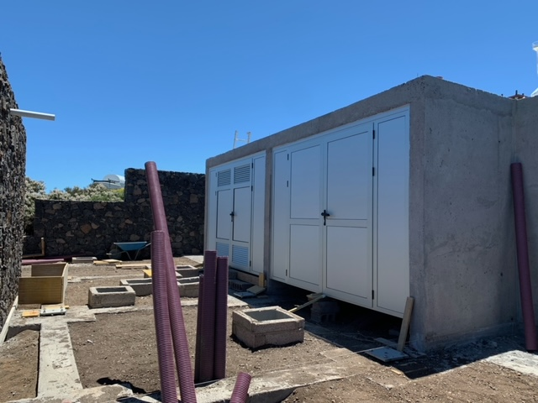
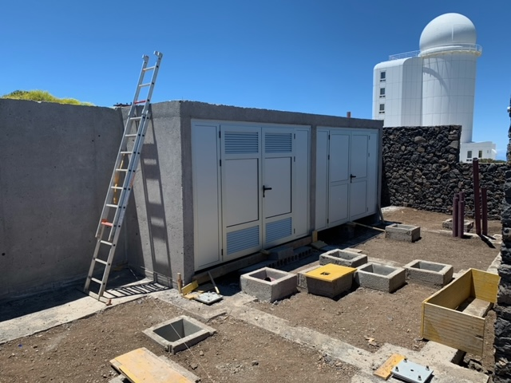
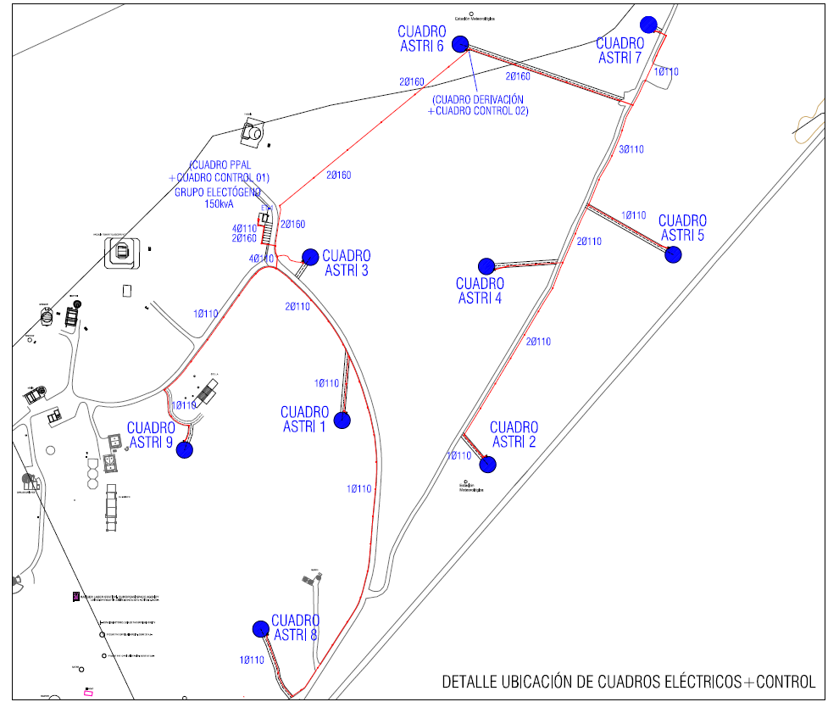
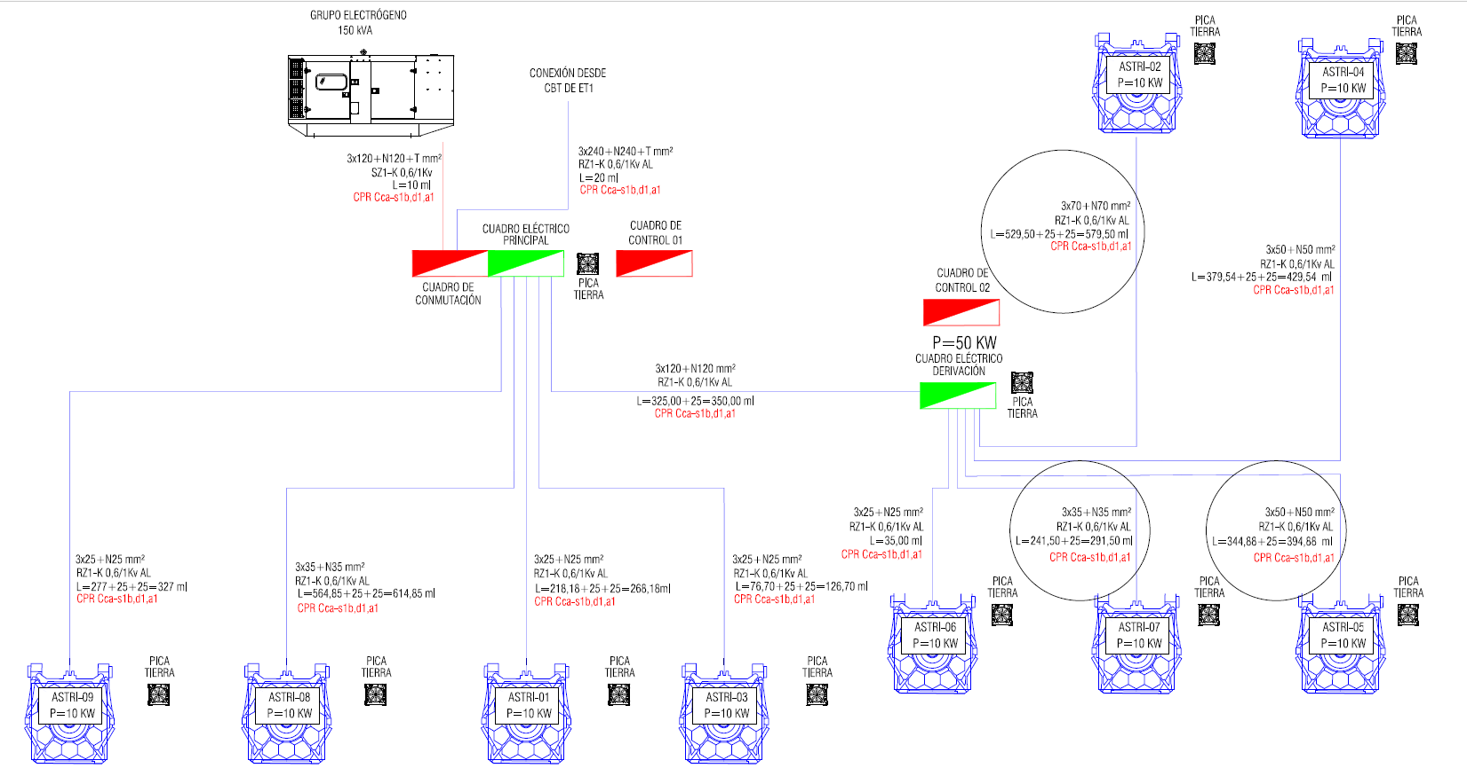
Infrastructure: Power network
S. Scuderi, OAS VHE meeting, 08/06/2022

Slide 16
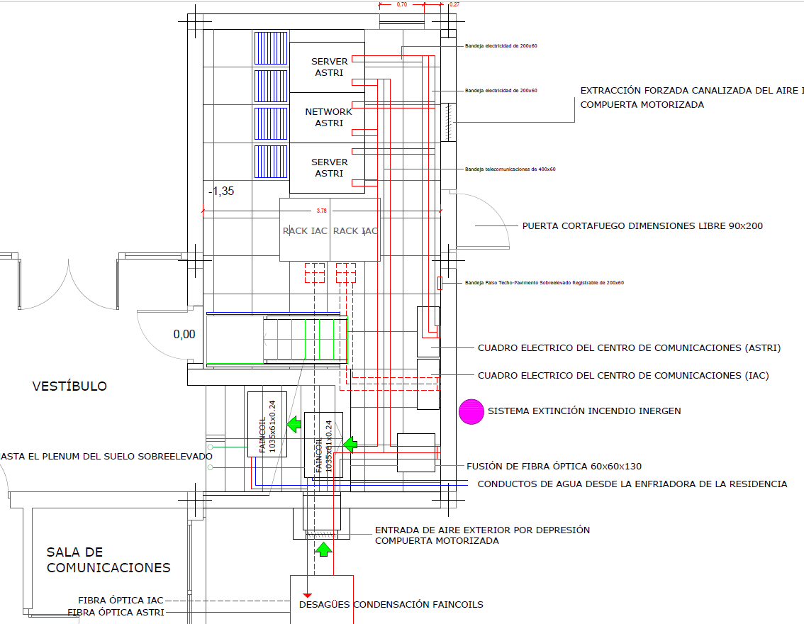
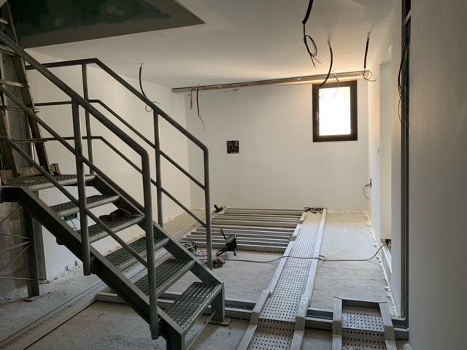
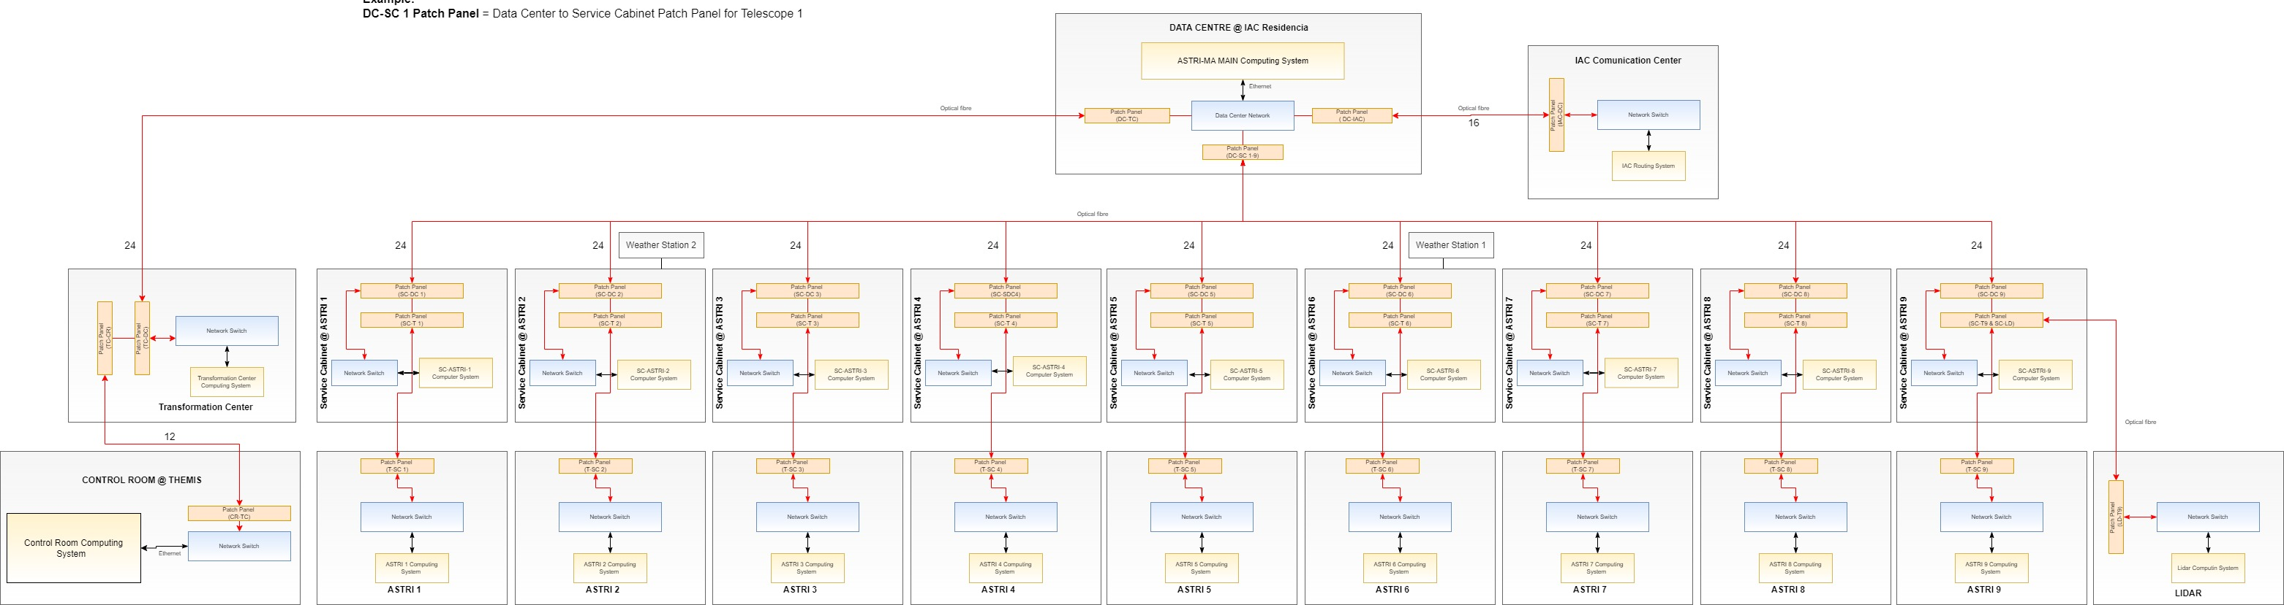
Infrastructure: Telecommunication network
S. Scuderi, OAS VHE meeting, 08/06/2022

Slide 17
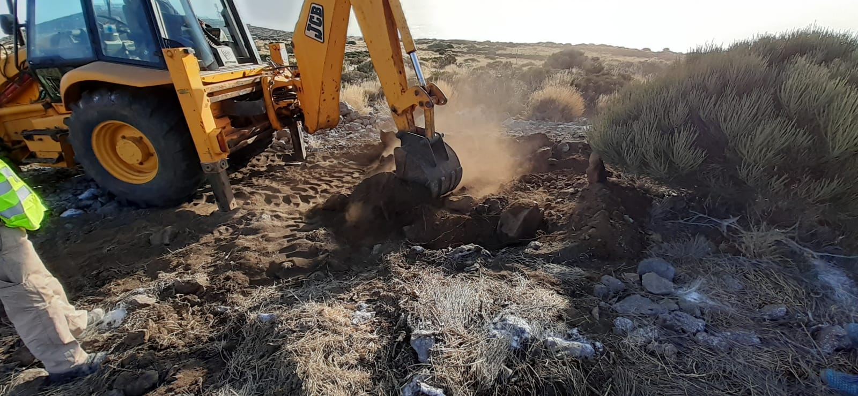
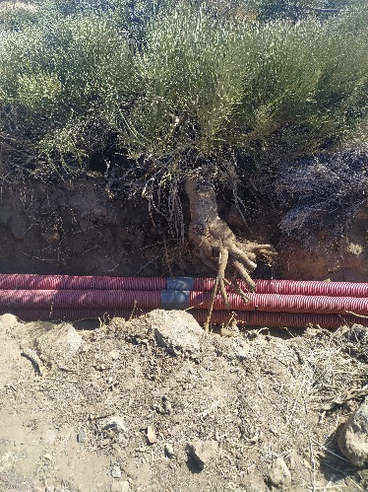
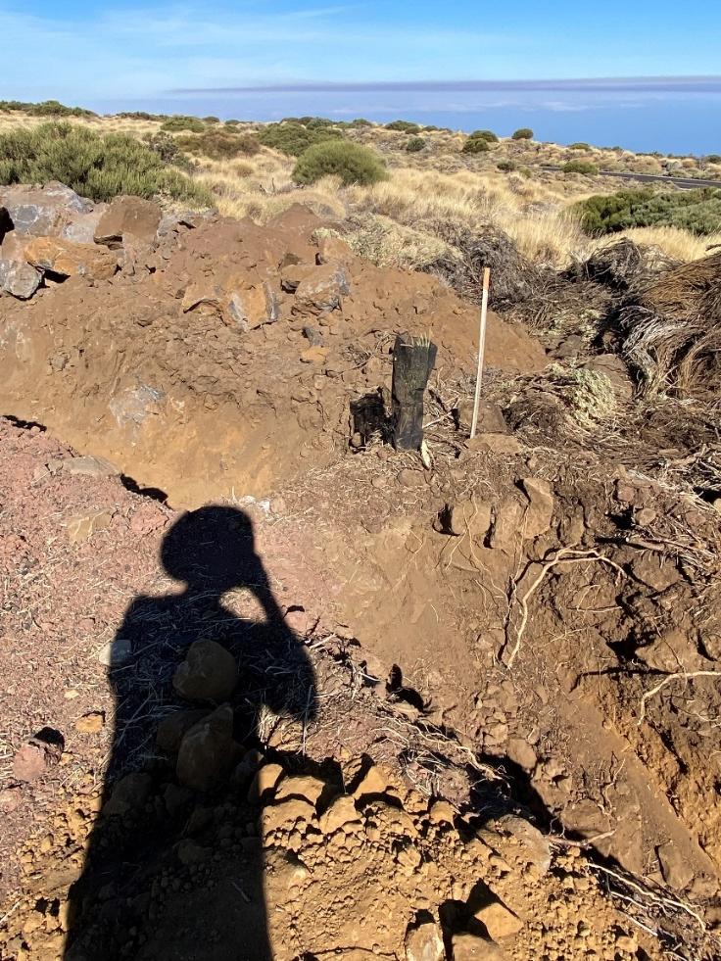
Infrastructure: Care of environment
Replanting
Treat roots
Continuous contact with botanist of Medio Ambiente to address and resolve any issue related to protected species of plants (Retama) in the areas of construction.
Replanting (young plants)
Keeping in place (treat affected roots and branches)
Removing (old plants > 4 years)
Planting new specimen
S. Scuderi, OAS VHE meeting, 08/06/2022

Slide 18
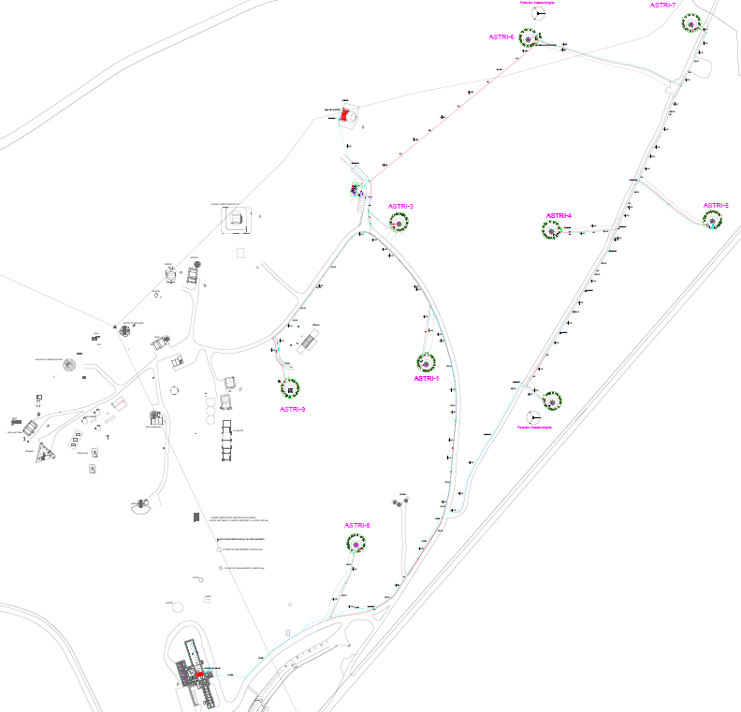
Status of the infrastructure
All telescope foundations completed
Excavations and tubes for power and data network completed
Control room @ Themis completed
Data Centre completed by half June
Transformation Centre to be completed by the end of June with UPS and Power diesel generator
Electric cables & optical fibres being laid
S. Scuderi, OAS VHE meeting, 08/06/2022

Slide 19
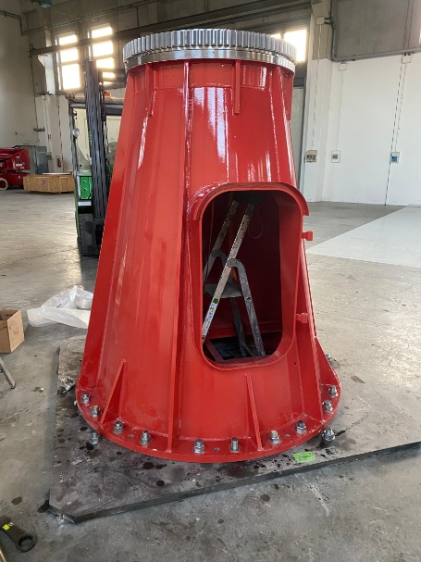
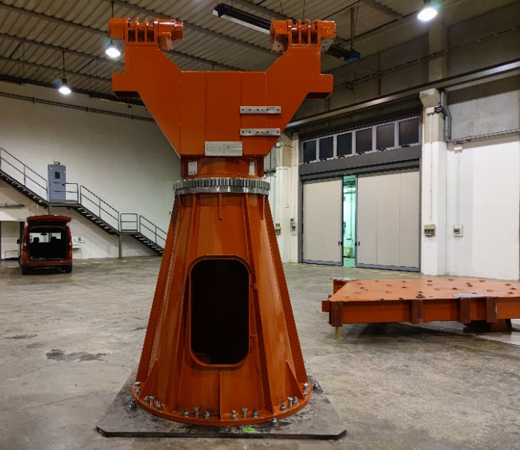
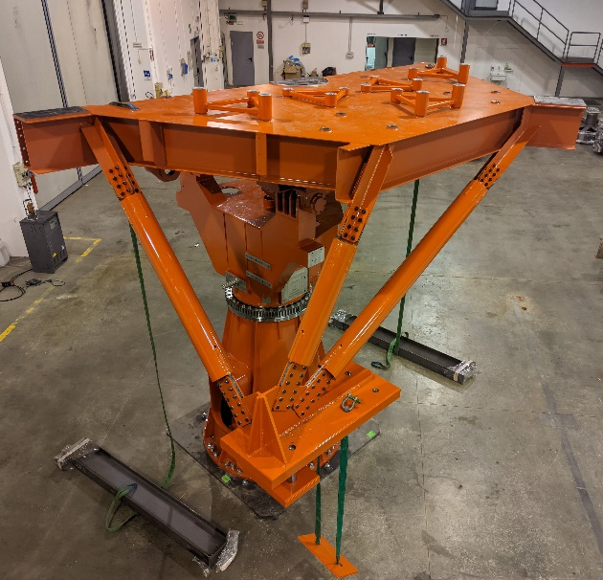
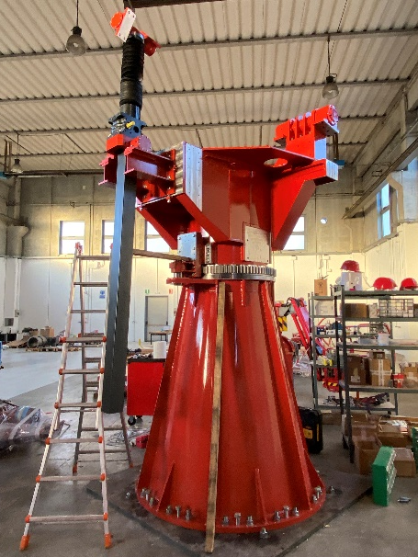
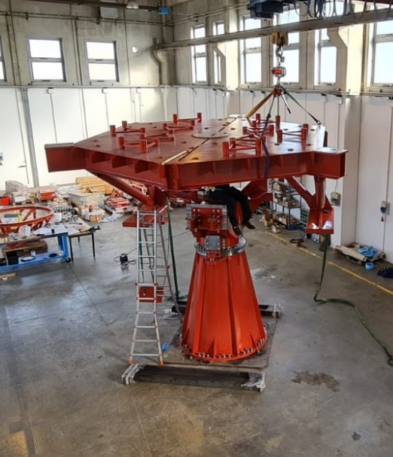
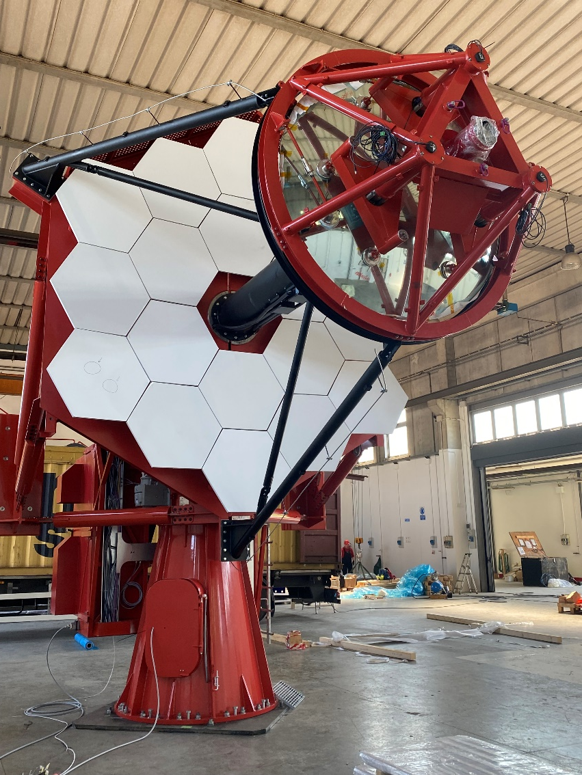
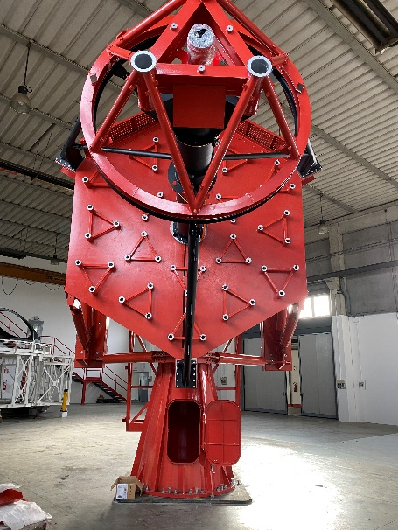
Status of production: ASTRI-1 integration
S. Scuderi, OAS VHE meeting, 08/06/2022

Slide 20
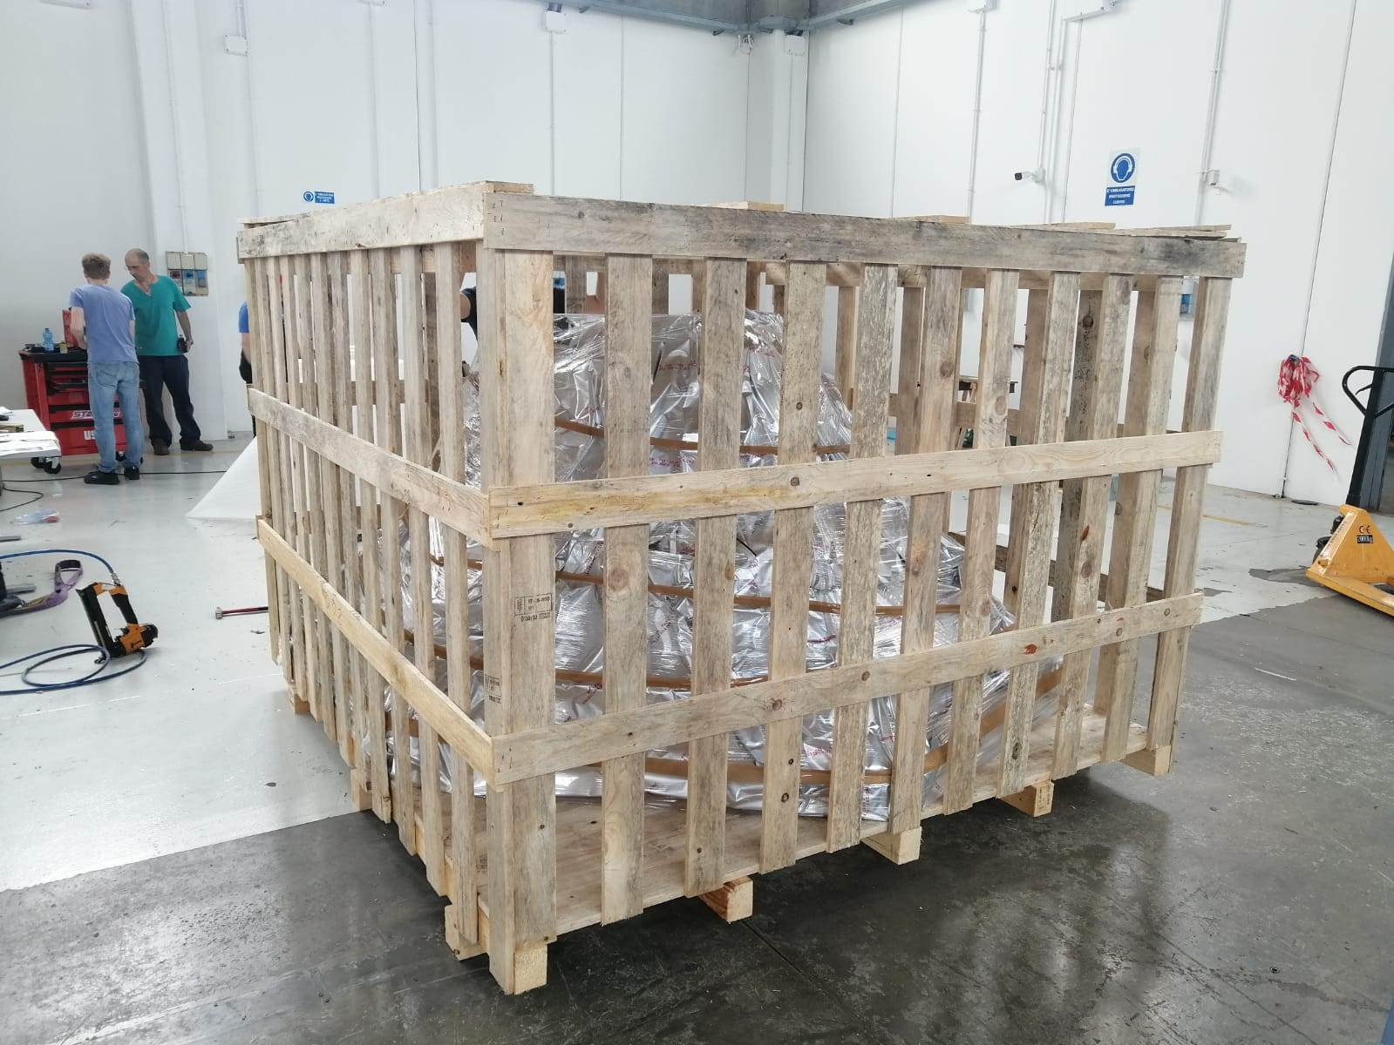
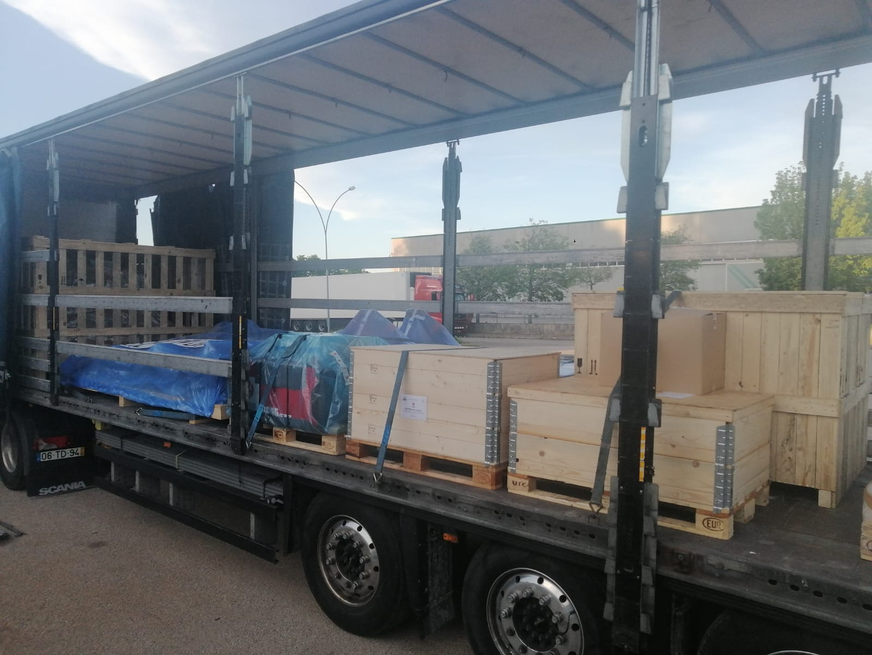
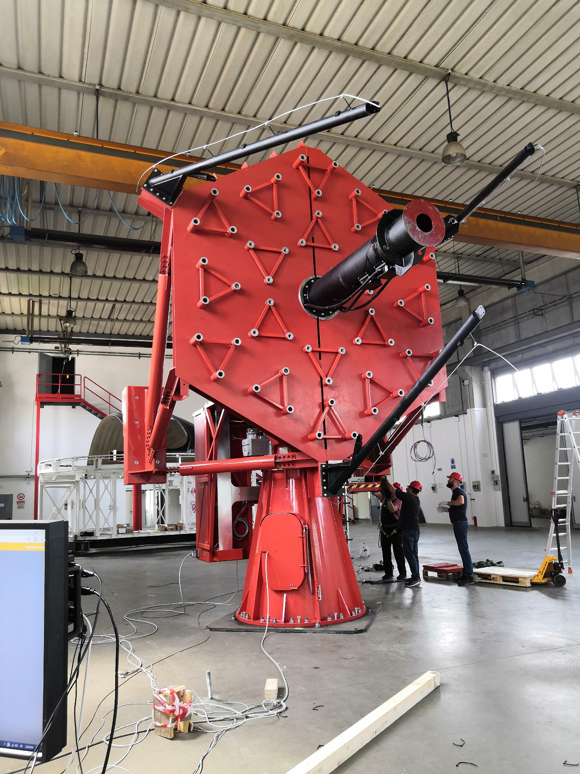
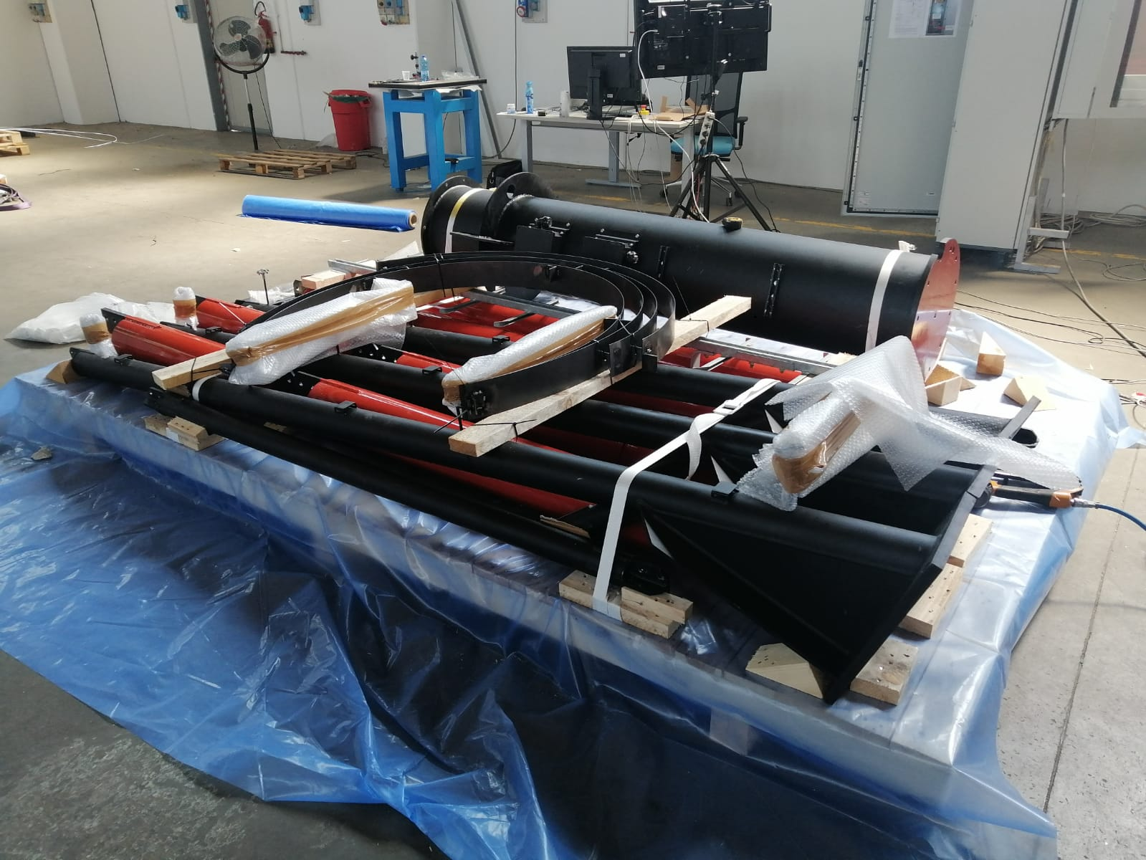
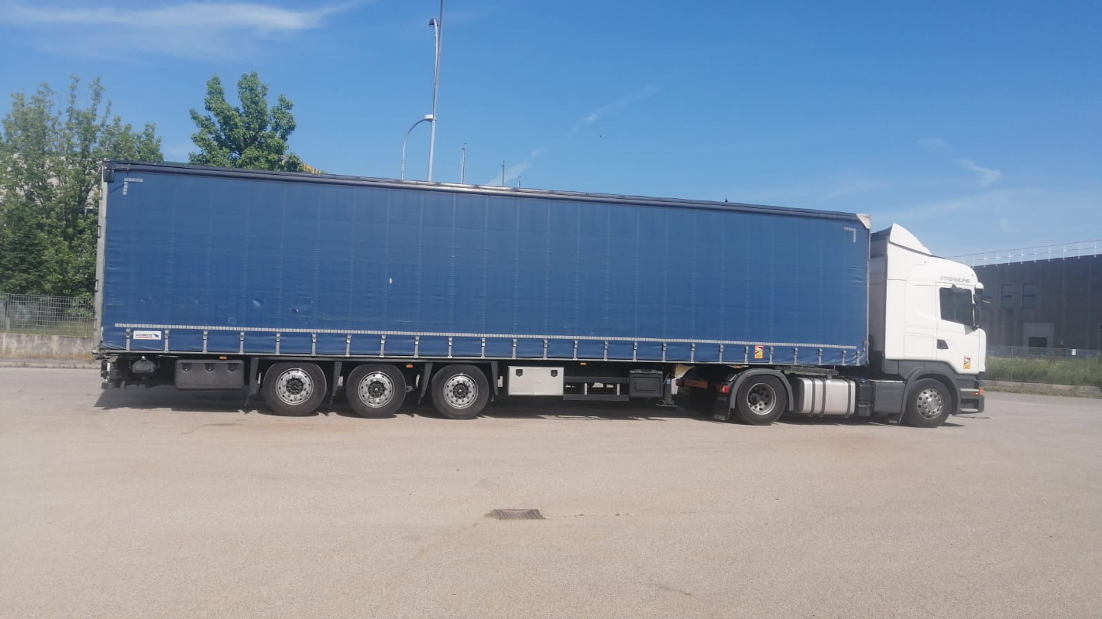
ASTRI-1: disassembling, packing and transportation
M2 support structure with mirror
Dismounting the telescope
Truck no. 2 loaded
Optical support structure
1st truck leaving 6/6/2022
S. Scuderi, OAS VHE meeting, 08/06/2022

Slide 21
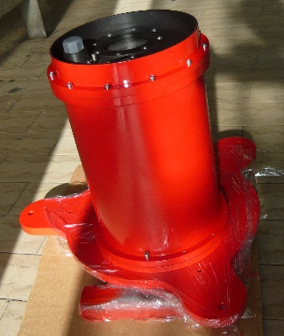
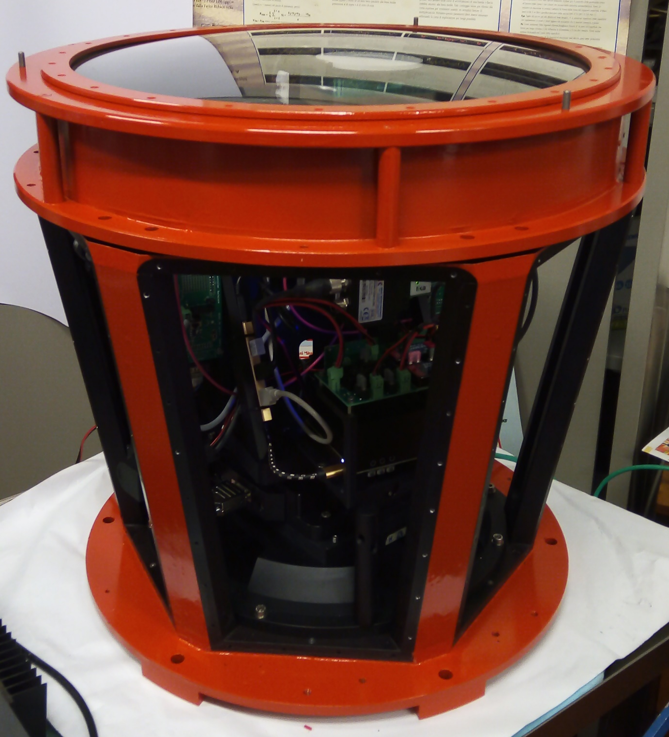
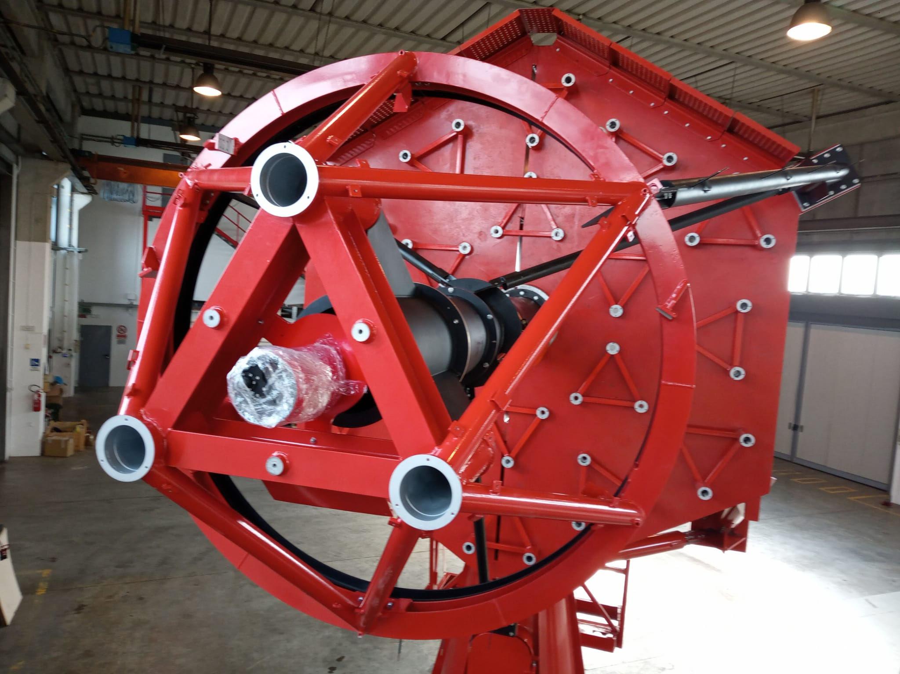
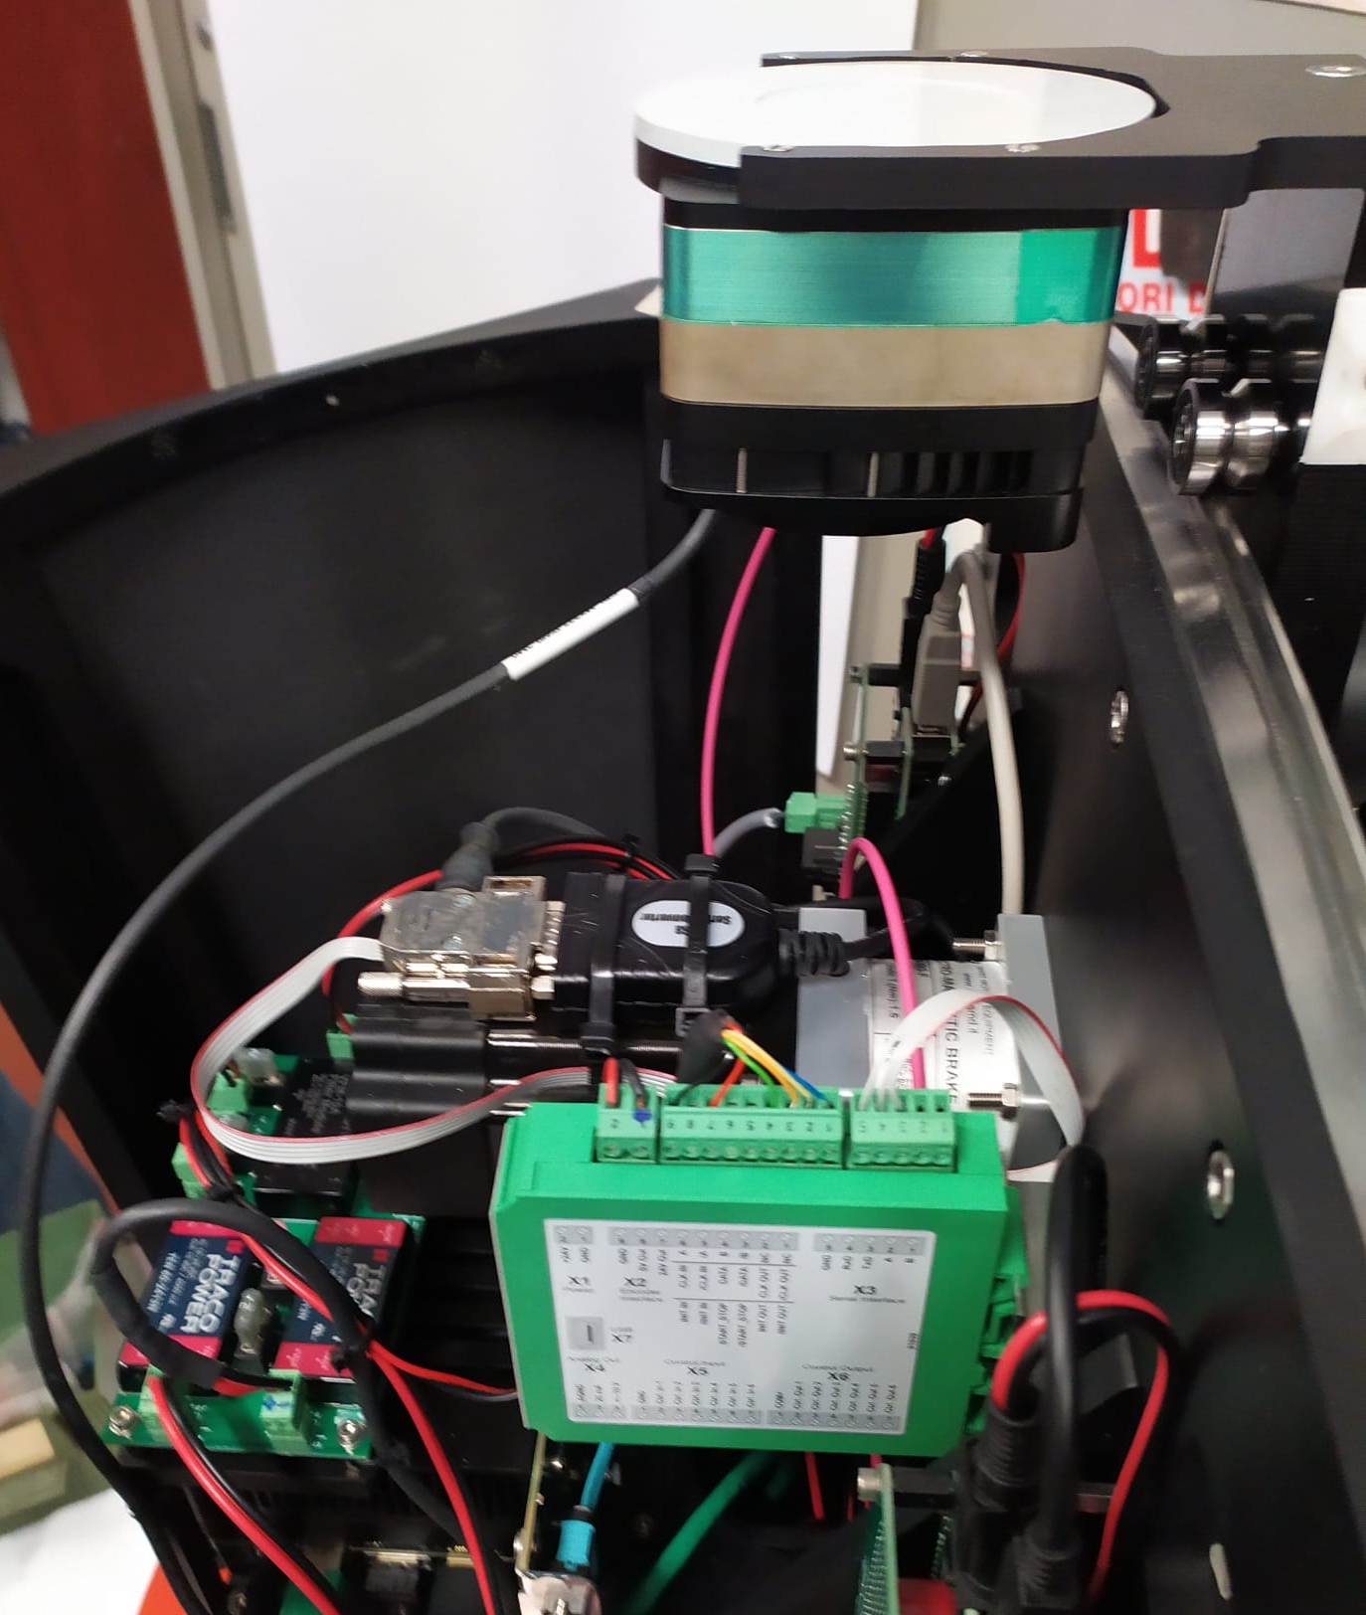
Telescope’s auxiliaries
Pointing Monitoring Cameras (Uni-PG)
First three delivered at Italy integration site
PMC of ASTRI-1 shipped mounted on the telescope
Optical Camera (IASF-MI, OAPD, OACT, OA Brera)
→ Ready to ship
CCD camera placed on the M2 support structure used to monitor pointing and tracking performances of the telescope.
CCD camera placed on the telescope focal plane to align the panel of M1
S. Scuderi, OAS VHE meeting, 08/06/2022

Slide 22
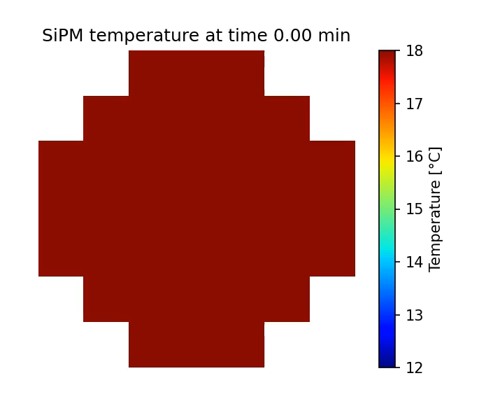
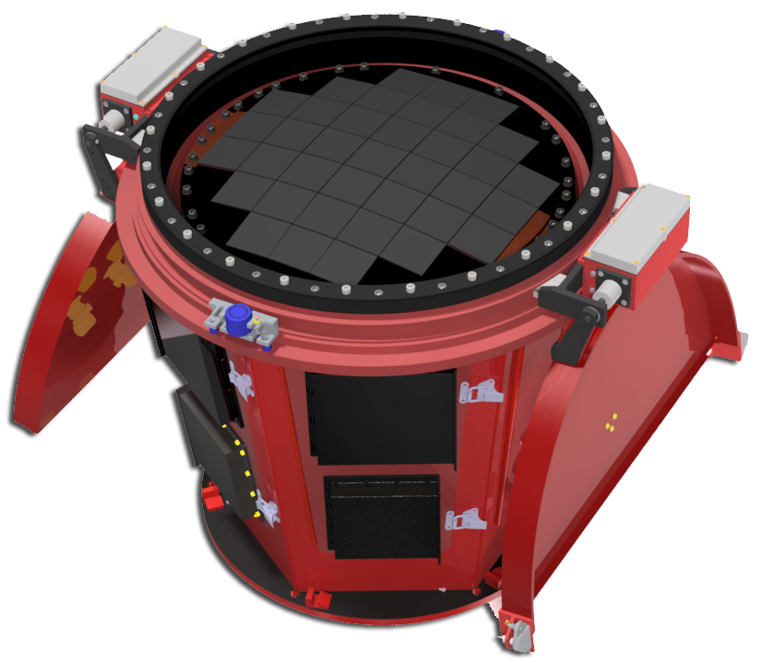
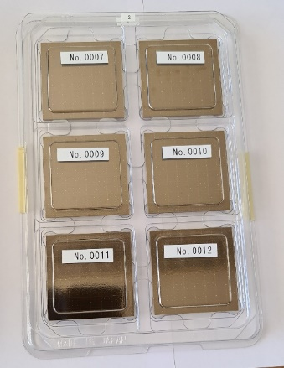
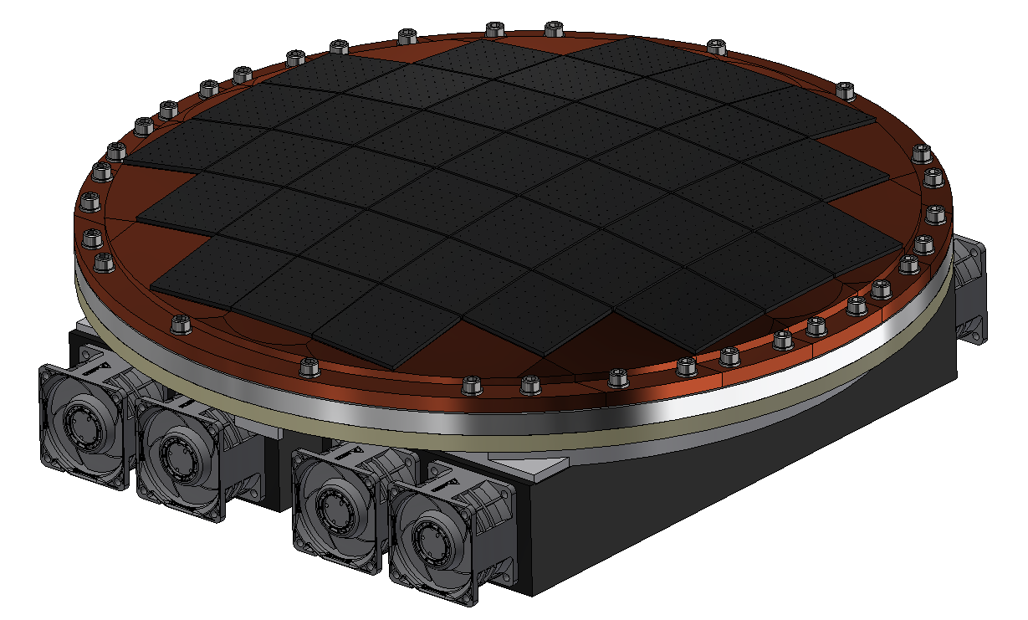

Cherenkov Cameras
Design & simulation
Ongoing contract for the construction of 11 Cherenkov Cameras
Prototyping
Production
VDB board
ASIC board
Camera thermal model: evolution of SiPM temperature (T_{env}=25 °C)
FPGA board
SiPM matrices
Delivered 346 out of 450
Focal plane support structure
Internal calibration system
S. Scuderi, OAS VHE meeting, 08/06/2022

Slide 23
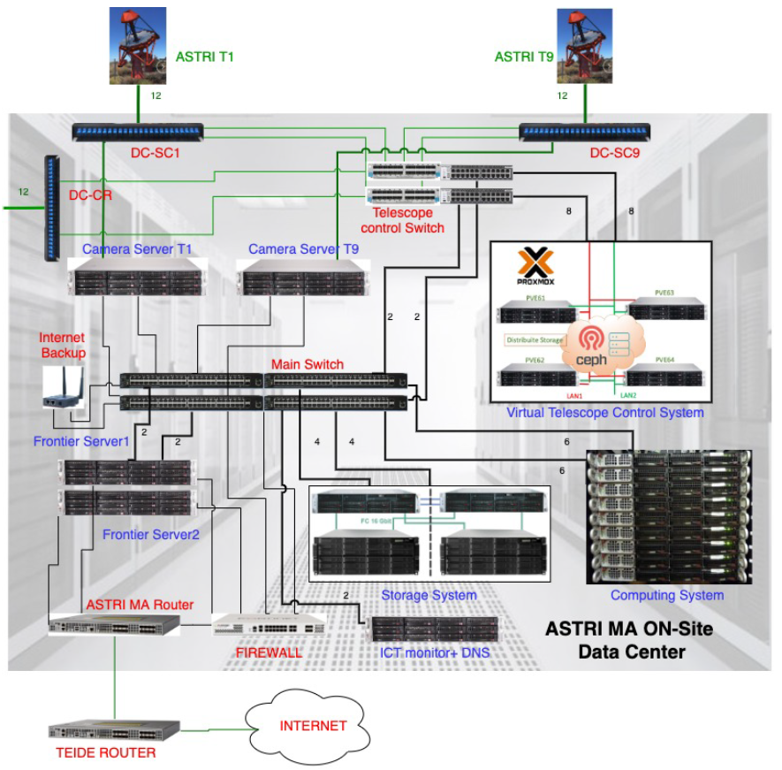
ICT – On site Data centre
Virtual Telescope Control System: the system hosting the virtual machines that will be used for the telescopes control.
Camera Servers: are the physical servers, one for each telescope, for the Cherenkov camera and stellar intensity interferometry data acquisition.
Computing System: is the set of physical servers dedicated to the on-line analysis of scientific data for quality check and of monitoring data for the alarm management.
Storage System: is the collection point of the raw scientific data, of the monitoring and of the alarm data. It also the location from where all these data are accessible for remote transfer and for all on-site uses.
Network System: is the set of devices responsible for internal and external network connections.
Tender still to be issued → documentation ready
S. Scuderi, OAS VHE meeting, 08/06/2022

Slide 24
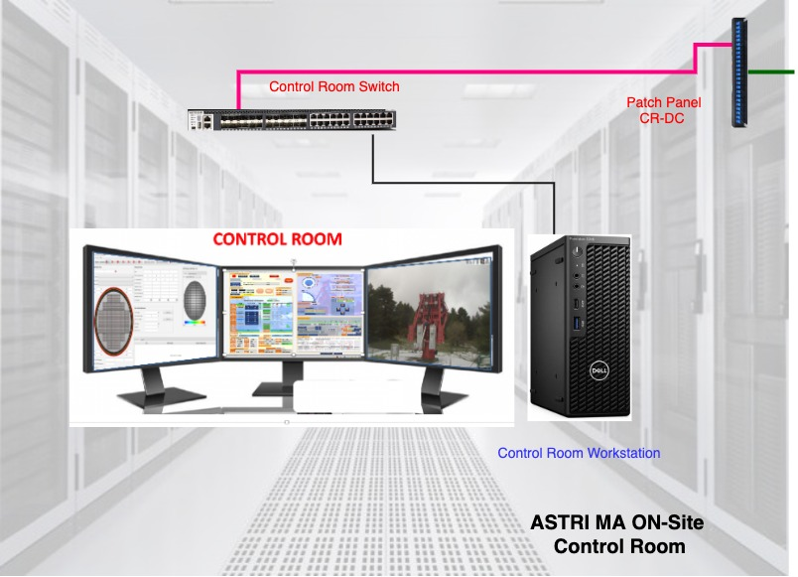
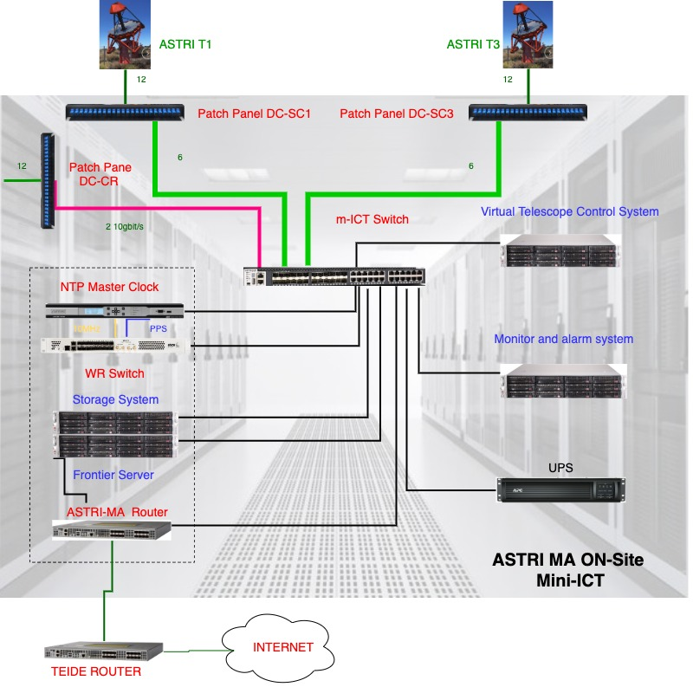


mini-ICT
m-ICT
Reduced version of the onsite ICT
Allow to run single telescopes
Preliminary installation @ Themis completed (F. Gianotti & coll.)
Final installation @ data centre → week of 13th of June
Control room ICT architecture
S. Scuderi, OAS VHE meeting, 08/06/2022

Slide 25
ICT – Offsite data centre
A distributed archive solution will be adopted for the ASTRI Mini-Array archive with three main nodes
INAF – OAR: central storage and computing nodes
INFN – LNF: for access to Data Grid infrastructure
ASI – SCDC: to interface high level ASTRI Mini-Array science archive with multiwavelength SCDC facilities and science tool services
S. Scuderi, OAS VHE meeting, 08/06/2022

Slide 26

Software: architecture
Supervisory Control And Data Acquisition (SCADA) System The software system devoted to control all the operations carried out at the Mini-Array site, including the startup of the Mini-Array system. SCADA is a central control system which interfaces and communicate with all equipment and dedicated software installed On-Site.
Archive System The software service that provides storage and organization for all data, data products, and metadata generated for and by the Mini-Array, and defined by the Mini-Array Data Models.
Data Processing System The software system used to calibrate and reduce the data acquired. This software is also used to check the quality of the final data products.
Science Support System The software system which provides the main point of access for the exchange of science-related data and information with the ASTRI Science Users, and which supports the whole science-related workflow, from the Observing Project submission to the access to the archived high-level Mini-Array science data products and the corresponding Science Tools to support data analysis.
Simulations System The software system that runs Monte Carlo simulations to provide simulated data for the development of reconstruction algorithms and for the characterization of real observations.
Local Control Software Firmware and low-level software dedicated to the low-level hardware control operations.
S. Scuderi, OAS VHE meeting, 08/06/2022

Slide 27

Software: data & information flow
The ASTRI Mini-Array software is envisioned to handle an observing cycle, i.e. the end-to-end control and data flow system. The observing cycle can be divided into the following main phases:
Observation preparation
Observation execution
Data Processing
Dissemination
Software development mainly by INAF
Support by external companies/research institutions on specific aspects as for example:
Central Control System by Universidad Tecnica Federico Santa Maria (SCADA)
Operator Human Machine Interface by University of Geneve (SCADA)
S. Scuderi, OAS VHE meeting, 08/06/2022

Slide 28
Implementation phases: schedule
Phase 0
Phase 1
Phase 2
1 Telescope Structure
3 Telescope Structures
3 Telescope Structures + Cameras
Phase 3
Full Array
m-ICT
June 2022
Autumn 2022
Late Spring 2023
Autumn 2023
End of 2024
S. Scuderi, OAS VHE meeting, 08/06/2022

Slide 29

Implementation phase 0 - Summer 2022
ASTRI-1
Transformer Station
Control Room
Data Center (m-ICT)
Meteo station 1
Power & Telecommunication Network
Transformer Station
S. Scuderi, OAS VHE meeting, 08/06/2022

Slide 30

Implementation: populating the array
ASTRI-7
ASTRI-6
ASTRI-3
ASTRI-4
ASTRI-5
ASTRI-1
ASTRI-2
ASTRI-9
ASTRI-8
S. Scuderi, OAS VHE meeting, 08/06/2022

Slide 31

ASTRI Mini-Array
Thank you
View from Vacuum Tower Telescope
S. Scuderi, OAS VHE meeting, 08/06/2022

