Slide 1
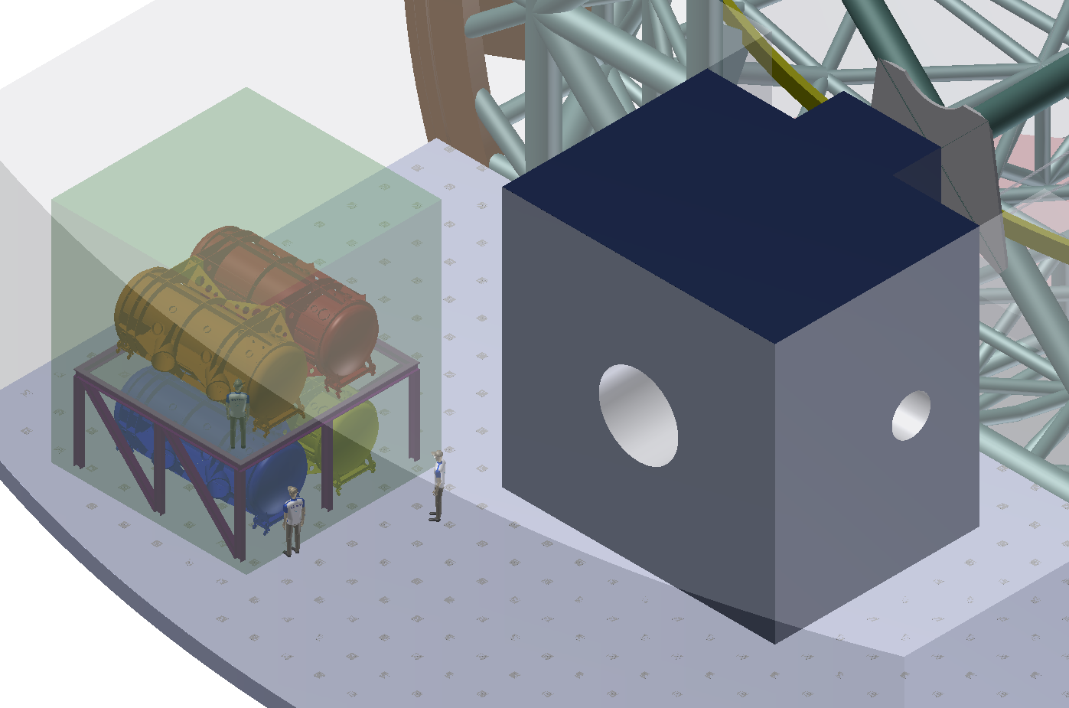
HIRES: System summary

Slide 2
Outline
Modular configuration
Instrument Description
System Architecture
Cost estimation
Conclusions
Notes:
Software architect could be superseded by SW system engineer or being under SW Engineers supervision

Slide 3
Top level requirement
Requirement | HR Single Obj. Mode | HR Single Obj. Mode | MR Multiplexed Mode | HR AO-assisted IFU | Polarimetry mode
Spectral Res | >= 150’000 | >= 100’000 | 10’000-20’000 | >= 100’000 | n.a.
Multiplexing | 1 | 1 | 1-10 (few arcmin FoV) | IFU | 4
Spectral coverage (mm) | 0.37-2.5 |  |  |  | 0.39-2.4
Min Blue wavel | 370 nm |  |  |  | 390 nm
Allowed wavel gaps | No substantial |  |  |  | No substantial
Wavelength calibration | Espresso template for the VIS TBD for IR |  |  |  | Espresso template for the VISible, TBD for IR
Stability | 10cm/s for VIS (goal 2cm/2), TBD for IR |  | n.a. | 10cm/s | n.a.
throughput | Espresso template for the VIS (12%), ECHO template for IR (8mag s/n 10’000 per res element in 100min or better) |  | Espresso template for the VIS(12%), ECHO template for IR (8mag s/n 10’000 per res element in 100min or better) | Espresso template for the VIS(12%), ECHO template for IR (8mag s/n 10’000 per res element in 100min or better) | 80% (BVRIYJH) 20% (K)

Slide 4
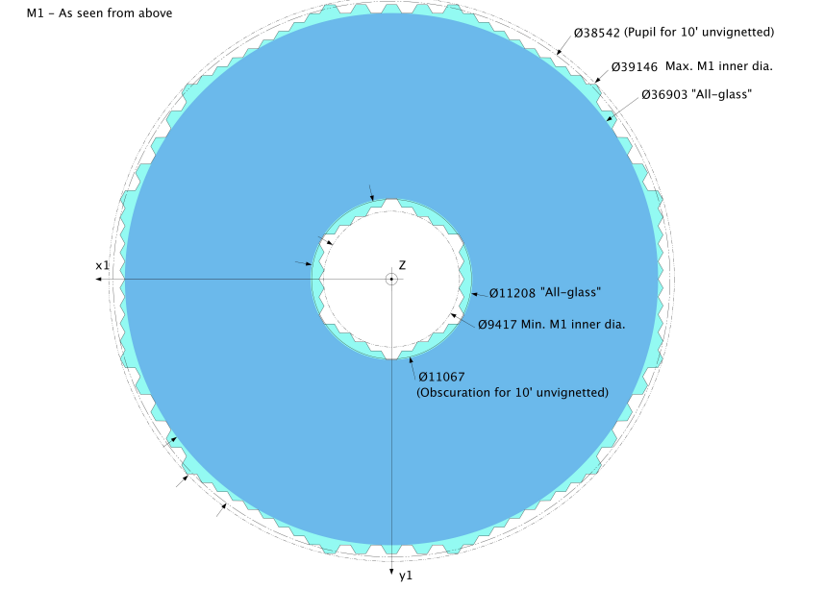
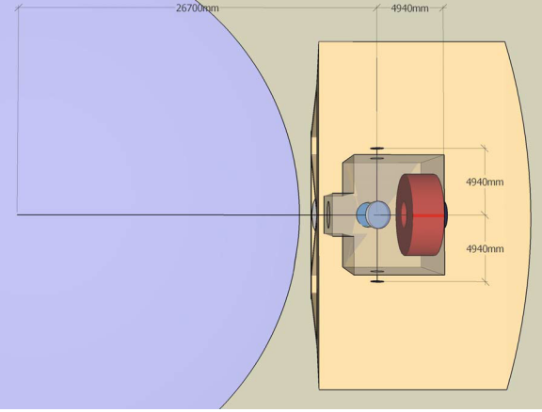
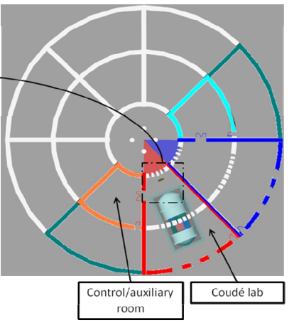
E-ELT I/F
EELT Interfaces for Scientific Instruments | E-TRE-ESO-586-0252 | 3.0 | 29/07/10
Optical
  Linear FOV Ø1957.7 mm
  Focal length 673878 mm
  Focal ratio F/17.48
  Plate scale 0,3 Asec/mm
  Stability
    0.3 arcsec rms
    With GLAO 10-50mas rms

Slide 5
Fiber Efficiency

Slide 6
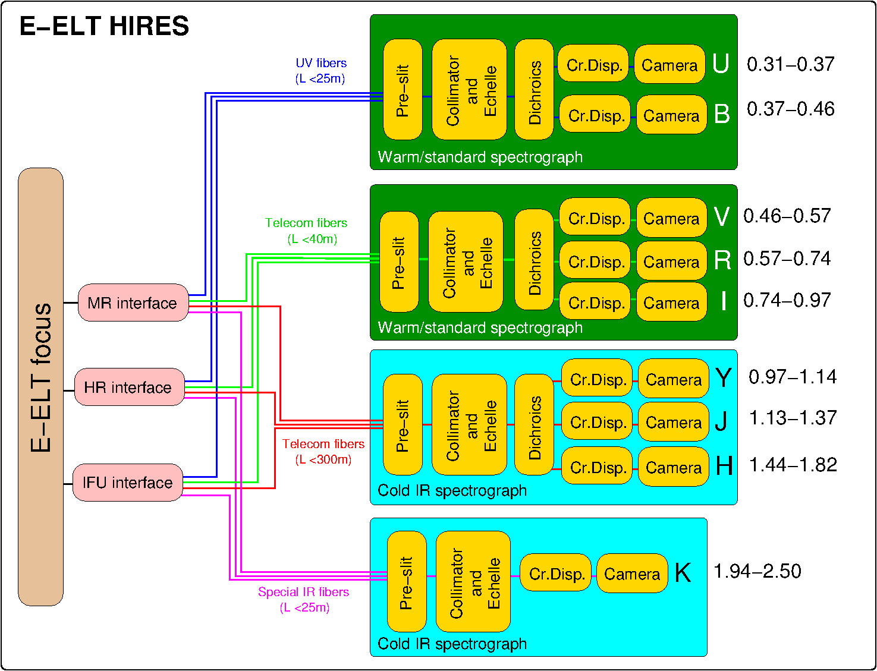
Instrument Layout

Slide 7
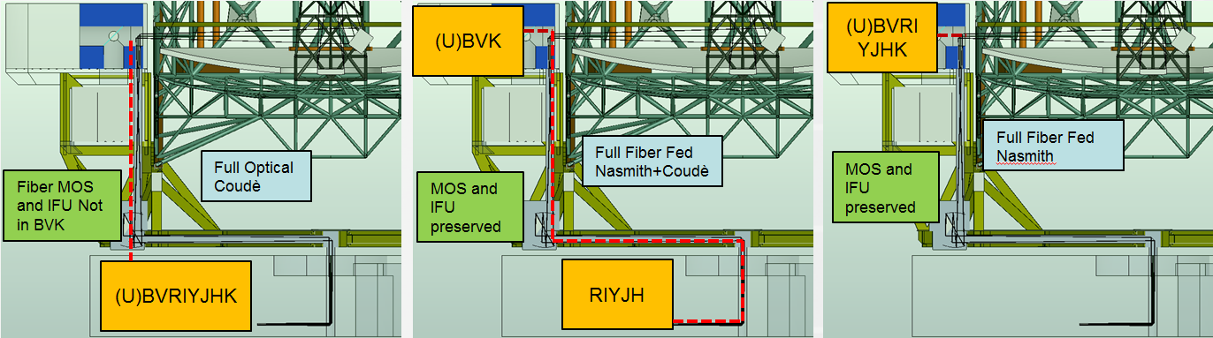
Configurations
Fiber MOS and IFU only in YJH

Slide 8
Configurations
UB + VRI +K
MOS and IFU Preserved
YJH

Slide 9
Configurations

Slide 11
HIRES Instrument Product Tree
HIRES Instrument
B Spectrograph
YJH Spectrograph
K Spectrograph
VRI Spectrograph
common elements
Calibration
Software
Polarimetric pickoff
Spectrograph Modulae
Fiber optics
Front end
Exposure Meters
Notes:
Check BV or UBV?

Slide 12
Instrument Layout

Slide 13
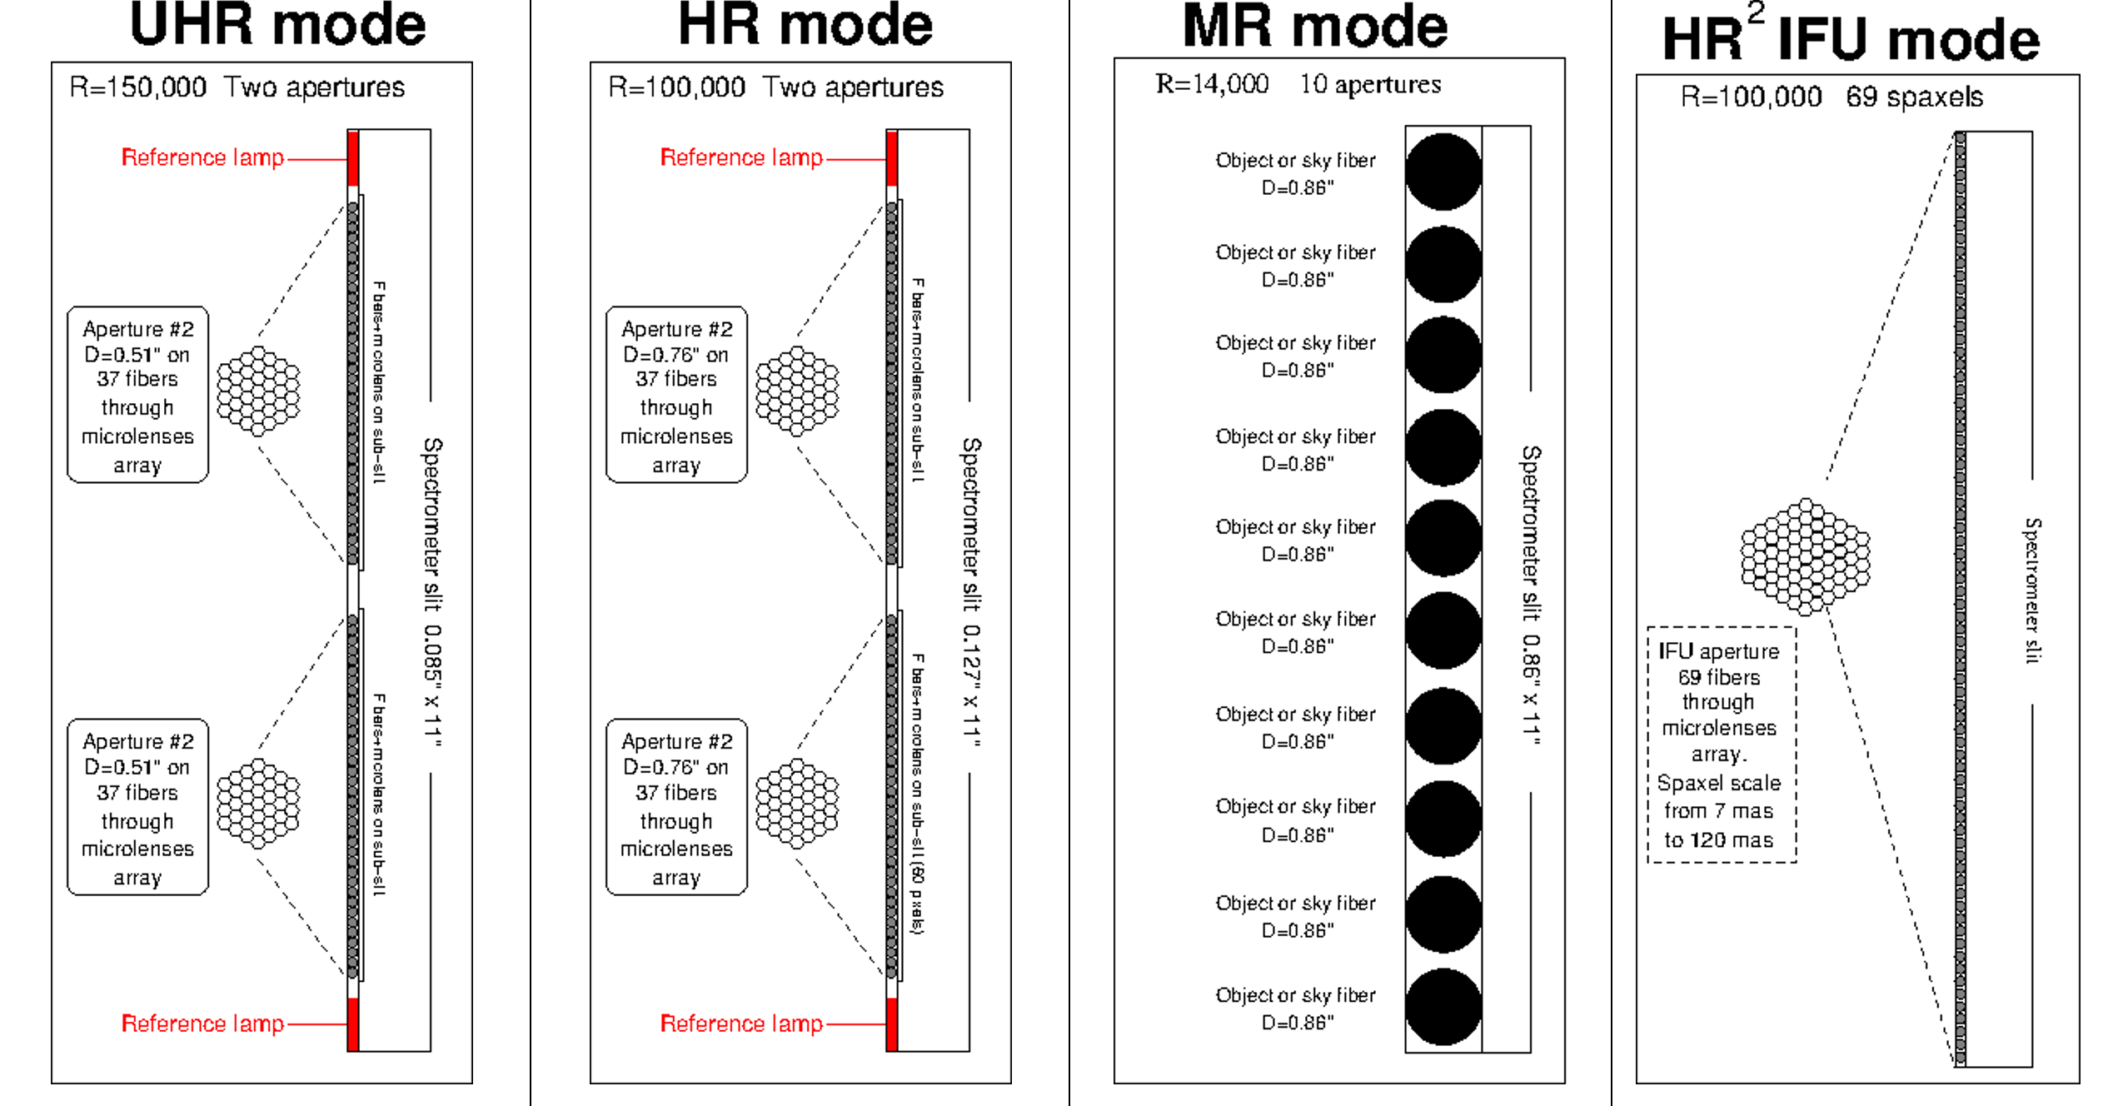
Slit illumination

Slide 14
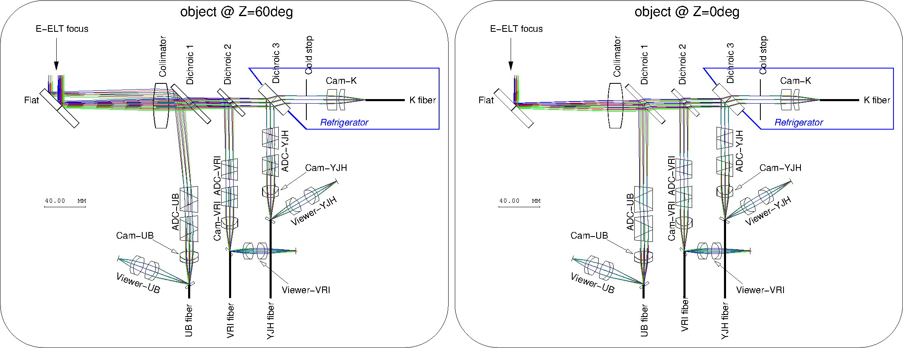
Front end

Slide 15
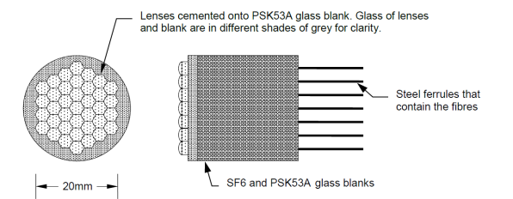
Slicing

Slide 16
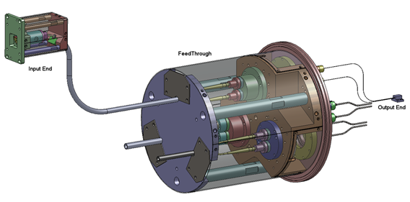
Scrambling

Slide 17
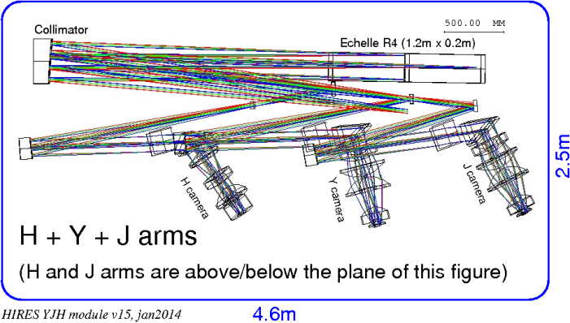
Spectrographs

Slide 18
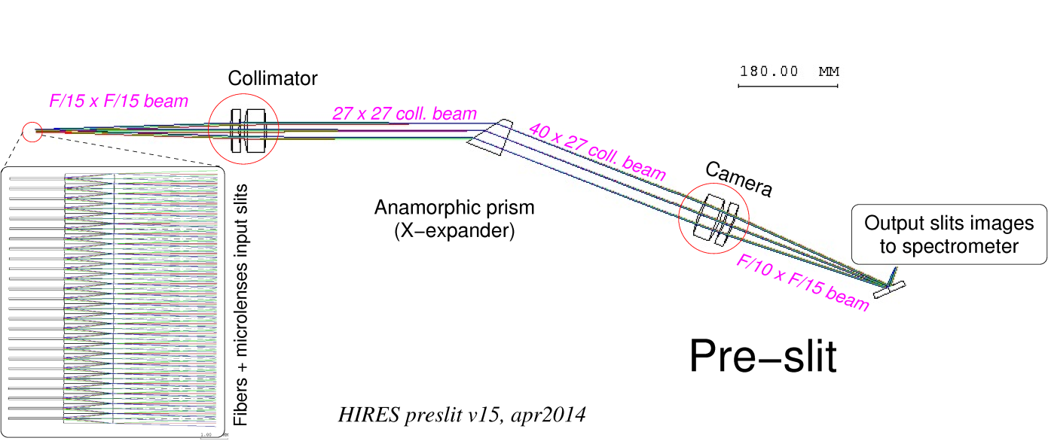
preslit

Slide 19
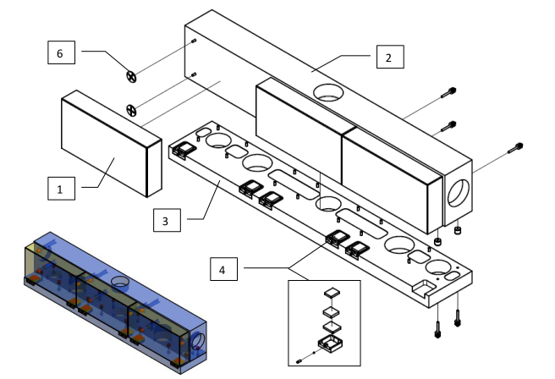
Mosaic Gratings

Slide 20
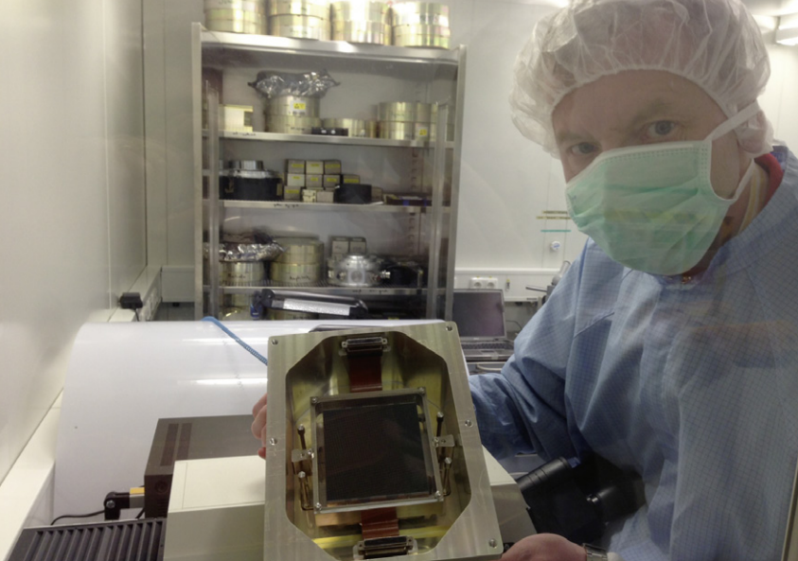
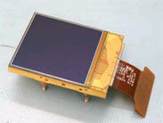
Detectors
e2v 9k X 9k used in ESPRESSO
HAWAII 4RG

Slide 21
Main Parameters
Parameter | ESPRESSO-VLT | HIRES
Input slit length | 10 mm | 31 mm
Beam aperture at slit | F/10 x F/15
Main collimator | Parabola f=3m double pass
Collimated beam on main disperser | 300mm x 200mm
Main disperser | R4 echelle, 1.2m x 0.2m
Dichroics and field lenses/mirrors | Close to the intermediate focus
Transfer collimator | Sphere f=1.5m | Parabola f=2.25m
Collimated beam after transfer collimator | 150mm x 100mm | 225mm x 150mm
Collimated beam after cross-disperser | 150mm x 150mm | 120mm x 205mm
Beam on detector | F/2.6 x F/2.6 | F/1.7 x F/1.0 (IR) F/2.2 x F/1.3 (VIS)
Detector | 9k² 9cm x 9cm | 4k² 6cm x 6cm (IR) 9k² 9cm x 9cm (VIS)

Slide 22
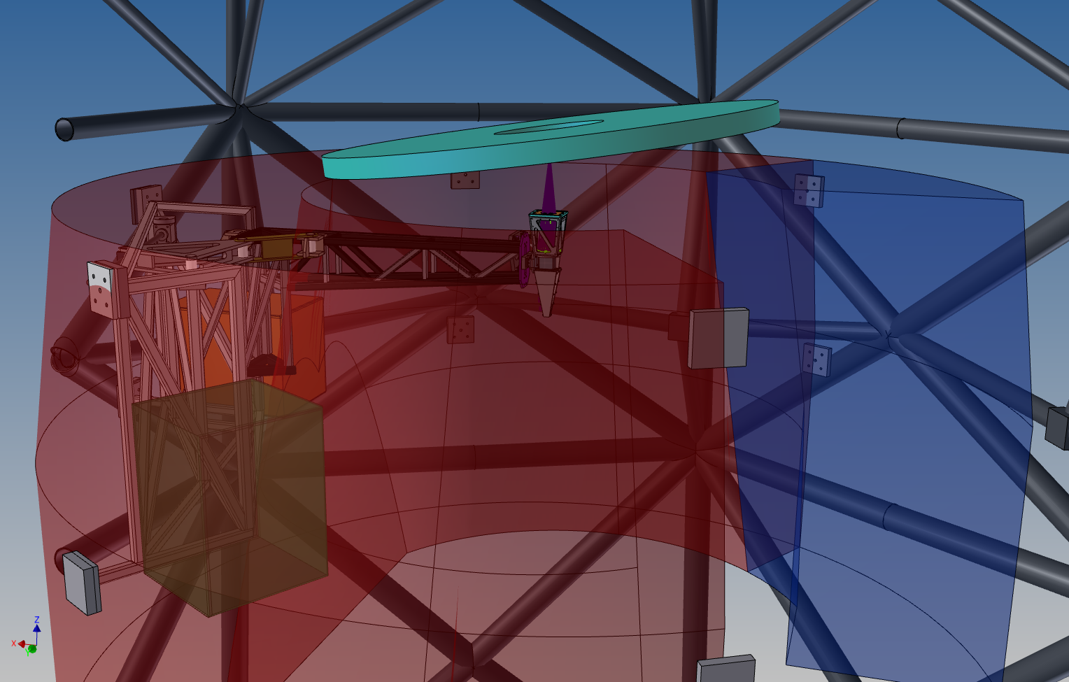
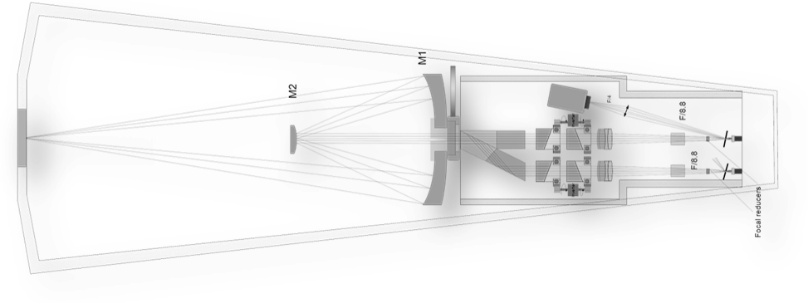
Polarimetric arm

Slide 23
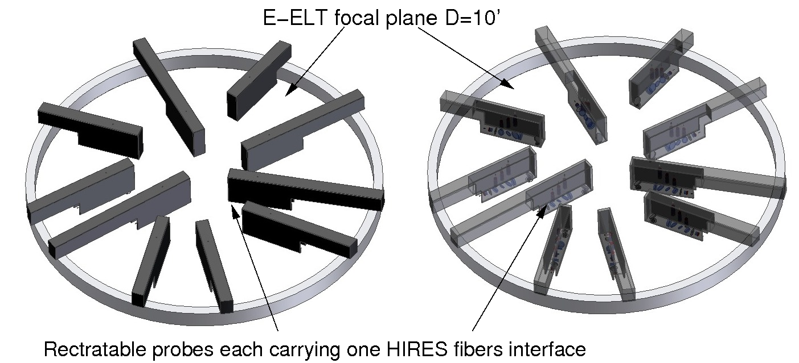
MOS

Slide 24
System Team
It is integral part of the HIRES Project Office
It is lead by the HIRES System Engineer and SW System Engineer
It is composed by
  Architects (depending on project phase)
    Optical, Mechanical, Electrical, Thermal, Software
  AIV manager
  SW team
  Sub-System Engineers
Notes:
Software architect could be superseded by SW system engineer or being under SW Engineers supervision

Slide 25
Polarimetric pickoff
Product Breakdown Structure
Software
SS Project Management
Optical Architecture
SS Project Management
Optical Architecture
SSystem Engineering
Mechanical Architecture
Mechanical Architecture
PA/QA
SW System Engineering
Electronical Architecture
Electronical Architecture
AIV
OPS
Software Architecture
Optical Components
Software Architecture
DRS
Thermal Architecture
Thermal Architecture
Optical Bench
DAS
# Spectr
Front End
Deployment mech
#: B, VRI, YJH, K
Fiber Link
Fibers
SS Project Management
SS Project Management
SSystem Engineering
SSystem Engineering
Calibration
SS Project Management
PA/QA
PA/QA
SSystem Engineering
AIV
AIV
PA/QA
Science Support
Dichroics
SS Project Management
AIV
SSystem Engineering
Fibers
Slit Subsystem
ADC
Optical Components
PA/QA
Scrambler
Optical Components
AIV
Shutter
Exposure Meters
Optical Bench
Science Support
Optical Bench
Optical Components
Echelle
SS Project Management
TCCD
Optical Bench
SSystem Engineering
Dewar and Detectors
Thermal sys.
Calib Lamp
PA/QA
Laser Comb
AIV
Vacuum Vessel
Toggling Mechanicsm
Optical Components
Fabry Perot
TCCD
Thermal sub-sys.
MOS?
Optical Bench
Fibers
Notes:
This slides shows the complexity of HIRES instrument development, along with its integration.
Within enclosing boxes, Product Tree is depicted in Violet (high level) and in yellow (elements), activities (WBS) in red, functions/responsibilities in light blue
Check BV or UBV?

Slide 26
Hardware cost estimation
Unit | Cost | Reduced (2 mod)
FE | k€ 3.710,00 | k€ 2.710,00
B | k€ 4.712,50
VRI | k€ 7.992,50 | k€ 7.992,50
YJH | k€ 9.422,50 | k€ 9.422,50
K | k€ 5.587,50
Calibration unit | k€ 2.620,00 | k€ 1.320,00
SW (ICS+DRS) | k€ 100,00 | k€ 100,00
Adds on | k€ 3.100,00
Total | k€ 37.245,00 | k€ 21.545,00
Contingency (20%) | k€ 7.449,00 | k€ 4.309,00
Gran total | k€ 44.694,00 | k€ 25.854,00
              Full Optical Coudè will require 7-8 M€ in addition

Slide 27
Technical Readiness Level
Requirement | Compliance | TRL | Heritage
Spectral Resolution | C | 9 | Harps, Espresso, X-Shooter, Crires
Wavelength range | C | 7 (there are a lot of examples of reduced wavelength the modular concept preserves the high level of TRL) | Harps, Espresso, X-Shooter, Crires, Giano
Spatial Resolution | C | 7 | ??
Entrance Aperture | C | 9 for the 2 point sources 7 for the 10 sources | Harps, Espresso K-mos
Wavelength precision and Accuracy | C | 7 for the Visible 6 for the Infrared | Espresso Carmenes
Stability | C | 9 | Crires,Carmenes
Sky subtraction | C | 9 | Harps
Polarimetry | C | 6 | Pepsi
Other | C | 6 | Harps Espresso

Slide 28
Conclusion I: feasibility
An Instrument able to provide High resolution spectroscopy (100000) in a wide wavelength range (0.37 to 2.5 um) IS FEASIBLE with the current available technology.
It is anyway possible to foreseen dedicated R&D to maximize performances and or reduce the cost.
  Larger Detector (mainly IR side)
  Larger Pixel size
  Curved Detector
  Grating Ruling processes
  Laser Frequency Comb
  Stabilized Fabry-Perot
  Fibers throughput

Slide 29
Conclusion II: time adaptability
Hires modularity will guarantee TO FULLFILL ALL THE TLR REQUIREMENT in the best way. On the other hand will also allow different timeline for the different spectrographs and add-on pending on the available money. It is possible to consider an early delivery of one or two arms, with a lighter front end; the other arms and full capabilities (polarimetric, MR and HR² modes) can be added later.

Slide 30
Conclusion III: layout adaptability
Hires modularity will also allow DIFFERENT CONFIGURATIONS on the telescope, namely different location of the modules on the platform (Nasmith and Coudè) within the boundary defined by the fibers throughput. This means for example that the location of the different modules may also adapt with the development of the telescope.
The telescope I/F are evolving, so it is necessary to be involved in the discussion at least as auditor.

Slide 31
Conclusion IV: telescope pupil
Beeing Hires a fiber fed instrument its main performances will NOT BE INFLUENCED by reduced telescope M1 without inner rings (except for the observation depth).

Slide 32
Conclusion V: AO dependance
In addition for the science cases that needs Single targets where there are no background sources that could contaminate the observation, at short wavelength observations , observations of extended sources, the AO will not increase significantly the performances. This means that Hires is able to provide the required performances even without it.

Slide 33
Conclusion VI: Mass issue
Critical point can be found in the Overall Mass of the Instrument which could be between 30 and 40 Ton. Despite of that the modularity of the System will help allowing a distribution of the masses that can be optimized to minimize the impact on the platforms.

Slide 34
Conclusion
All this conclusions drive to the main good results that Hires can be modulated to provide reasonable fraction of the required science with almost ANY early 1st light of ANY ELT.

Slide 35
Grazie!

Slide 36
Ub echellogram

Slide 37
VRI echellogram
Figure 72 Updated VRI echellograms

Slide 38
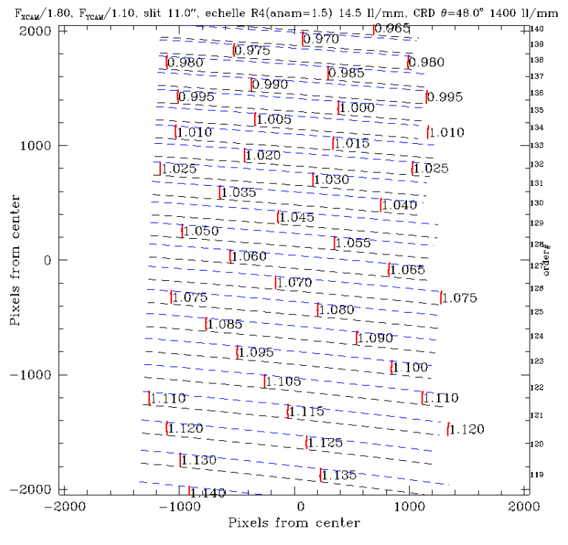
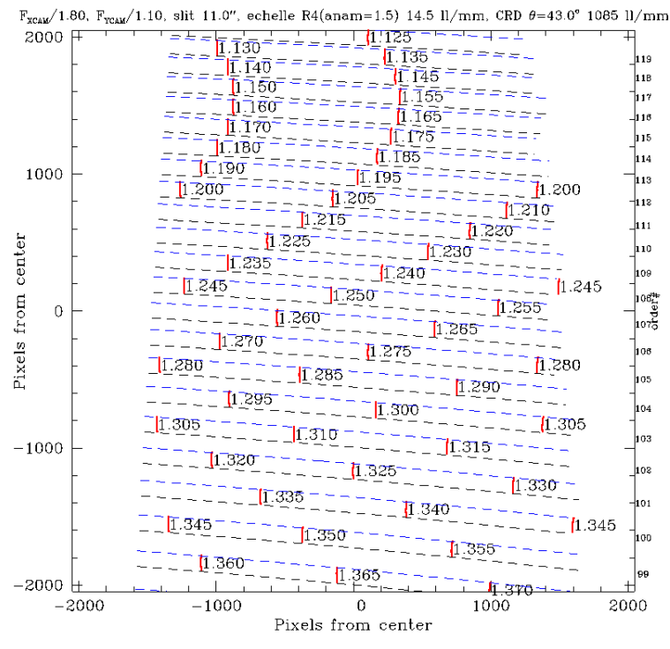
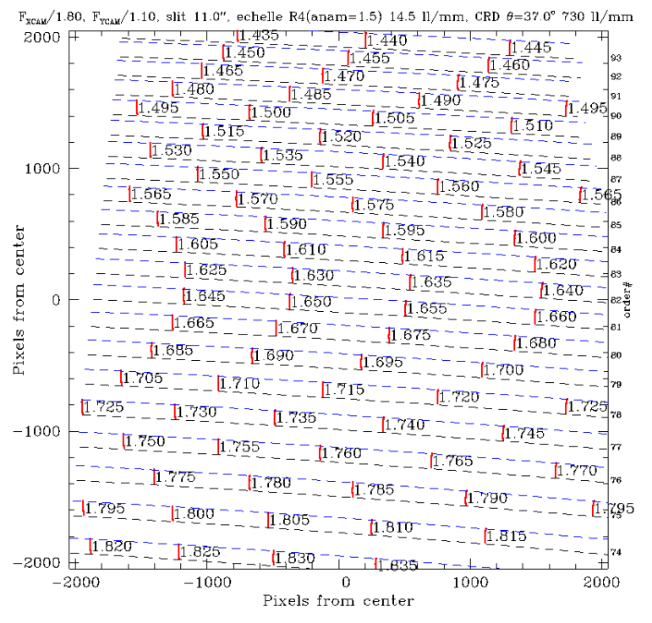
YJH echellogram
Figure 72 Updated VRI echellograms

Slide 39
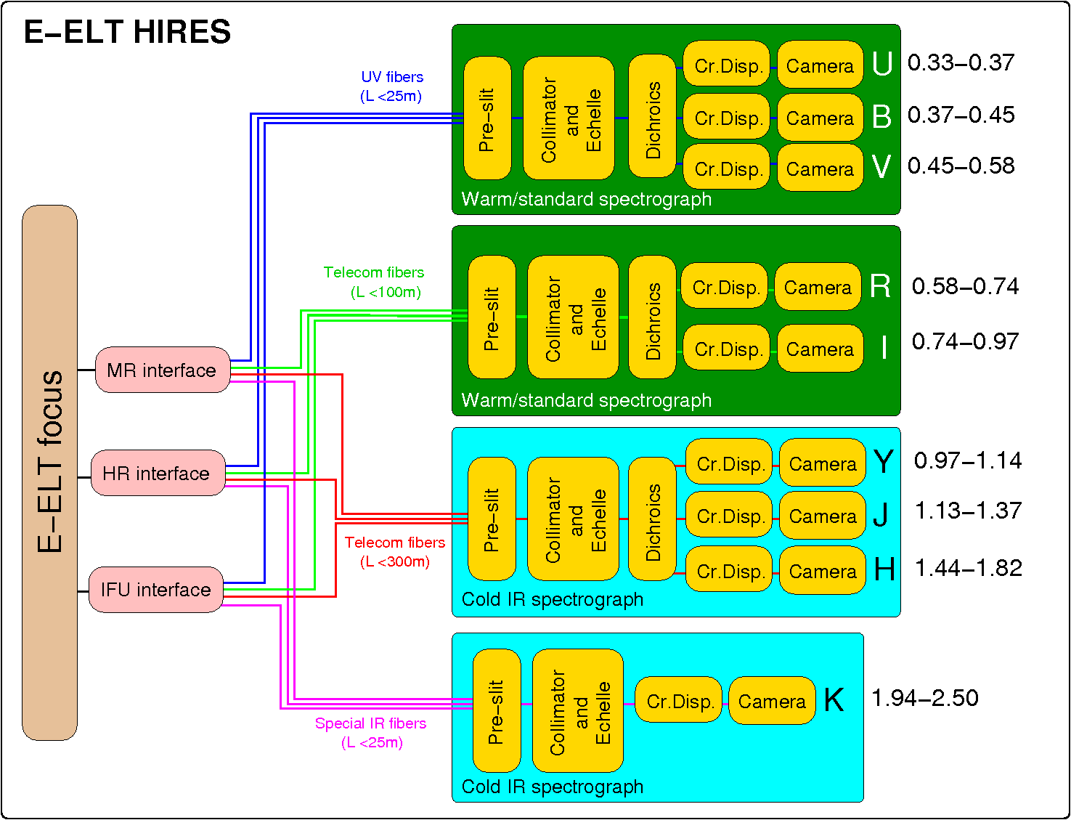
Instrument Layout

Slide 40
