Slide 1
PANCAM Sistema di Monitoraggio di Luoghi Pubblici
con Lente Panoramica Bifocale
Claudio Pernechele, Luigi Lessio, Lorenzo Paoletti
INAF
Nicola Grandis
ASC27 - https://www.asc27.com/

Slide 2
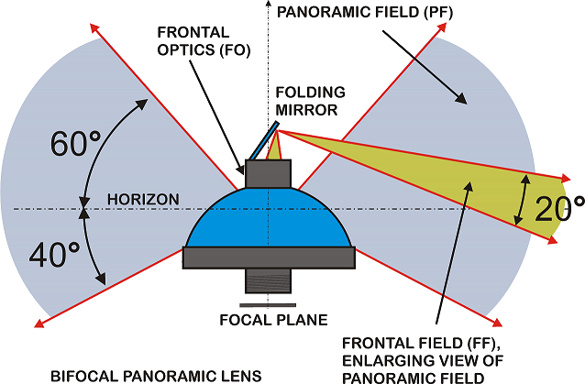
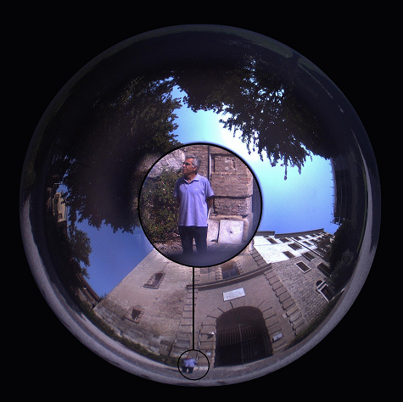
PANCAM Key Technology: The Bifocal Panoramic Lens
How works the Bifocal Panoramic Lens.
Panoramic (contest) field of view = 360° x 100°
Frontal (zoomed) field of view = 20° round
⎬
Two tasks with a unique lens,
an unique image sensor and without moving parts

Slide 3
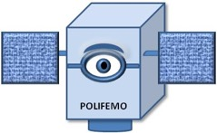
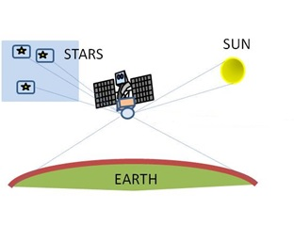
PANCAM POLIFEMO: Wide Field Star Tracker for Mini/Micro Satellites
Users: Space Agencies
Partners: Uni Federico II, POLIMI, Lobre srl, SBS srl
POLI-FUNCTIONAL STAR TRAKER
Suitable for deep space navigation and
situational awareness.
Business Plan available
Pernechele, C., et al. “Hyper hemispheric lens application in small and micro satellites”, Advances in Space Reasearch, 2018
Opromolla, R., et al. “A new star tracker concept for satellite attitude determination based on a multi purpose panoramic camera”, Acta Astronautica, 2017
Funded by EU H2020-SMEINST-1-2015

Slide 4
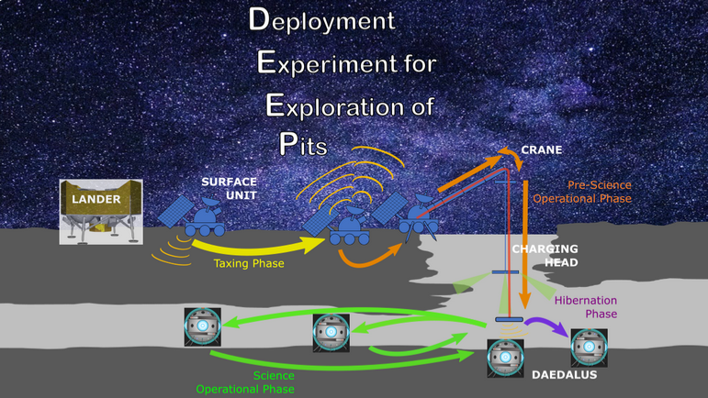
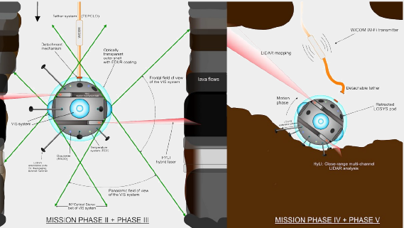
PANCAM DAEDALUS: Exploring the Lunar Caves
Users: Uni PD, Uni Jacobs, Vigea srl
Developers: Uni Wurzburg, Uni Vigo, Uni Oviedo, POLIMI, SBS srl
Credits Navarro-Medina UniVigo
Robotic autonomous exploration of Lunar Caves with panoramic stereoscopy
https://www.esa.int/Enabling_Support/Preparing_for_the_Future/Discovery_and_Preparation/ESA_plans_mission_to_explore_lunar_caves
Funded by ESA EXPRO+ Program
Funded by ESA CDF Program
Credits R. Pozzobon UniPD

Slide 5
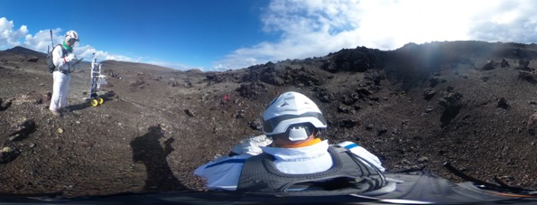
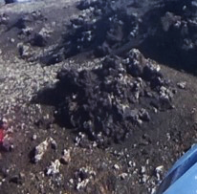
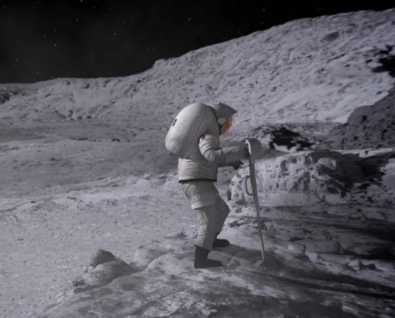
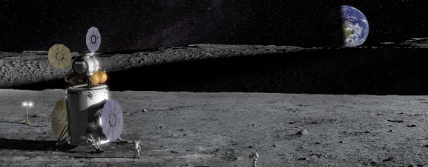
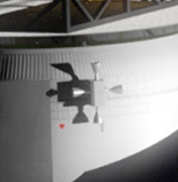
PANCAM Moon Human Exploration
→ For Situational Awareness
For science
Enhancing assessments and guidance in future Moon surface exploration activities
For operations
[OVERVIEW] [DETAIL]

Slide 6
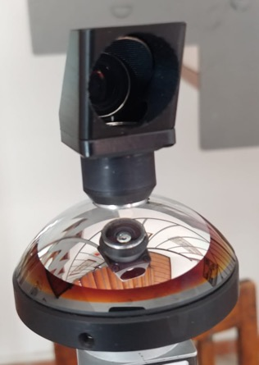
PANCAM Lens Protoype
Optical Concept:
The lens is able to record a field of view of 360° x 100 ° (panorama) plus an enlargement part of it, with a given magnification factor, using just one image sensor.
The Realized Lens

Slide 7
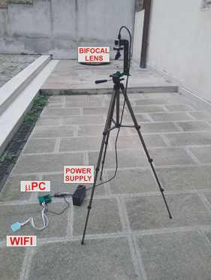
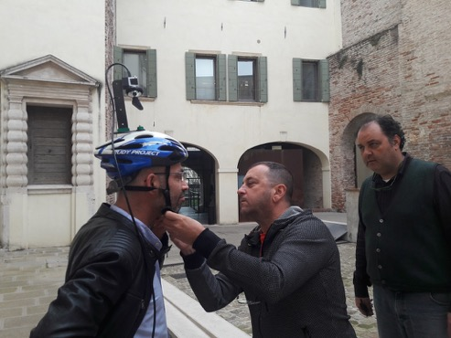
PANCAM ACQ System Prototype
Static
set-up
Mobile
set-up

Slide 8
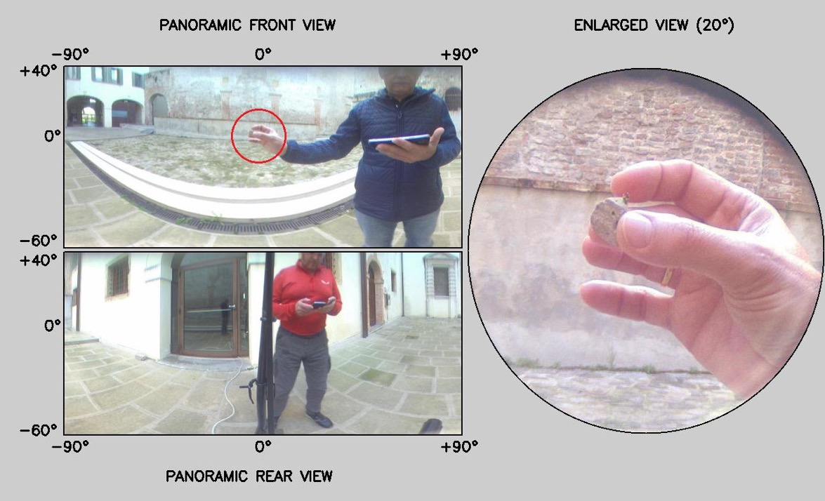
PANCAM Prototype: ACQ Example #1
See full movie @ https://sites.google.com/inaf.it/panoramic-lenses/home/environmental-monitoring?authuser=0

Slide 9
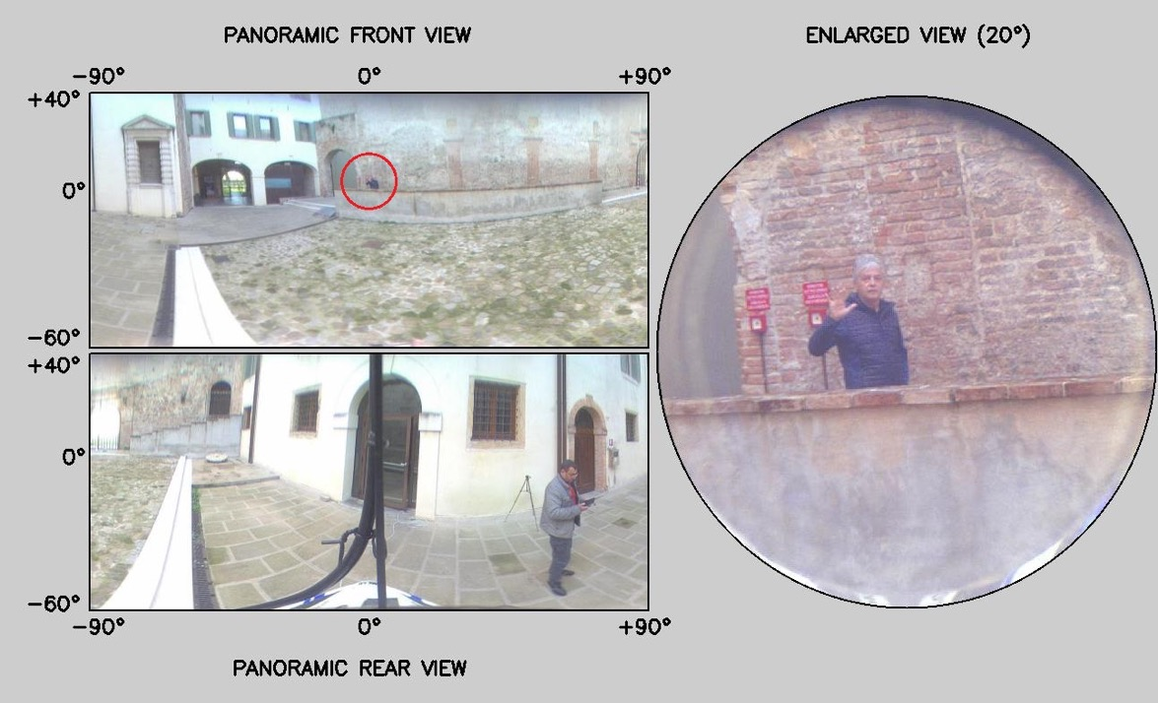
PANCAM Prototype : ACQ Example #2
See full movie @ https://sites.google.com/inaf.it/panoramic-lenses/home/environmental-monitoring?authuser=0

Slide 10
PANCAM Application in Video Surveillance
Users: Public Entities
Partners: ASC27 srl
We are exploring the possibility of use the Pancam as a bifocal panoramic camera for Video surveillance, integrating the optical capabilities with smart codes to increase its functionality.
We start a collaboration with the ASC27 srl SME, specialized in developing artificial intelligent codes for video surveillance.
web page: https://www.asc27.com/
Company profile: https://www.asc27.com/pdf/Company_Profile_rev_2_0_ENG.pdf

