Slide 1
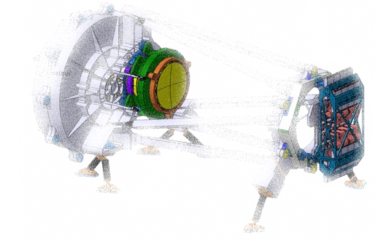
AIT@LAM - NISP S/S NI-XX -

Slide 2
Summary
1- Organizational AITm needs for DM
2- AITm needs for DM before delivery to LAM
3- AITm needs for DM at delivery to LAM
4- Health & functional tests at LAM
How to fill this document:
Replace any text in green with the appropriate information
Notes:
I will talk about the operational constraints concerning the Subsystem integration.

Slide 3
1- Organizational AITm needs for DM
Subsystem interface: subsystem dedicated person with whom AITm can communicate / exchange (data, documents, schedule, …)
Interface name: xx
Interface function: xx
Interface institute: xx
Interface email: xxx.xxx@xxx.xx
Notes:
Concerning the AIT needs, each subsystem will have to designate a person with whom we will communicate and exchange schedule, documents and data about the subsystem integration. Before the delivery at LAM, we need to have the following documents and information :
The mounting and operating instructions,
The MGSE user manual,
And how much space, how much people and how long for the storage, the MGSE mounting and the integration of the subsystem.
At the delivery at LAM, we need to have the following documents:
Subsystem As built drawings,
Subsystem dimensional control report,
Subsystem parts Material certificate,
Subsystem surface and heat treatments certificate,
Cleanliness control and verification report for both the subsystem and the MGSE.

Slide 4
2- AITm needs for DM before delivery to LAM
Before delivery to LAM
Subsystem documents
Mounting and operating instructions: to be done / in progress / completed
(EUC document reference)
Drawing with handling I/F definition: to be done / in progress / completed
(drawing number)
MGSE (dedicated integration tool(s)) documents
User manual: to be done / in progress / completed
(EUC document reference)
Drawing with handling I/F definition: to be done / in progress / completed
(drawing number)
Storage / mounting / integration
Space needed: xxm²
People number: xx
Duration: xx days
Specific needs
Network, specific handling tool (other than those available at LAM),…
Heaters for TBT, …
Notes:
Concerning the AIT needs, each subsystem will have to designate a person with whom we will communicate and exchange schedule, documents and data about the subsystem integration. Before the delivery at LAM, we need to have the following documents and information :
The mounting and operating instructions,
The MGSE user manual,
And how much space, how much people and how long for the storage, the MGSE mounting and the integration of the subsystem.
At the delivery at LAM, we need to have the following documents:
Subsystem As built drawings,
Subsystem dimensional control report,
Subsystem parts Material certificate,
Subsystem surface and heat treatments certificate,
Cleanliness control and verification report for both the subsystem and the MGSE.

Slide 5
3- AITm needs for DM at delivery to LAM
At delivery to LAM
Subsystem & MGSE (dedicated integration tool(s))
Subsystem documents
As-built drawings
Dimensional control report
Material / surface and heat treatments certificate
Cleanliness control and verification report
MGSE documents
Cleanliness control and verification report
Notes:
Concerning the AIT needs, each subsystem will have to designate a person with whom we will communicate and exchange schedule, documents and data about the subsystem integration. Before the delivery at LAM, we need to have the following documents and information :
The mounting and operating instructions,
The MGSE user manual,
And how much space, how much people and how long for the storage, the MGSE mounting and the integration of the subsystem.
At the delivery at LAM, we need to have the following documents:
Subsystem As built drawings,
Subsystem dimensional control report,
Subsystem parts Material certificate,
Subsystem surface and heat treatments certificate,
Cleanliness control and verification report for both the subsystem and the MGSE.

Slide 6
4- Health & functional tests at LAM
Health & functional tests at LAM
At delivery: none / planned
Along AIT flow sequence: none / planned
During tests at NISP level (TBD): none / planned
Notes:
Concerning the AIT needs, each subsystem will have to designate a person with whom we will communicate and exchange schedule, documents and data about the subsystem integration. Before the delivery at LAM, we need to have the following documents and information :
The mounting and operating instructions,
The MGSE user manual,
And how much space, how much people and how long for the storage, the MGSE mounting and the integration of the subsystem.
At the delivery at LAM, we need to have the following documents:
Subsystem As built drawings,
Subsystem dimensional control report,
Subsystem parts Material certificate,
Subsystem surface and heat treatments certificate,
Cleanliness control and verification report for both the subsystem and the MGSE.

