Slide 1
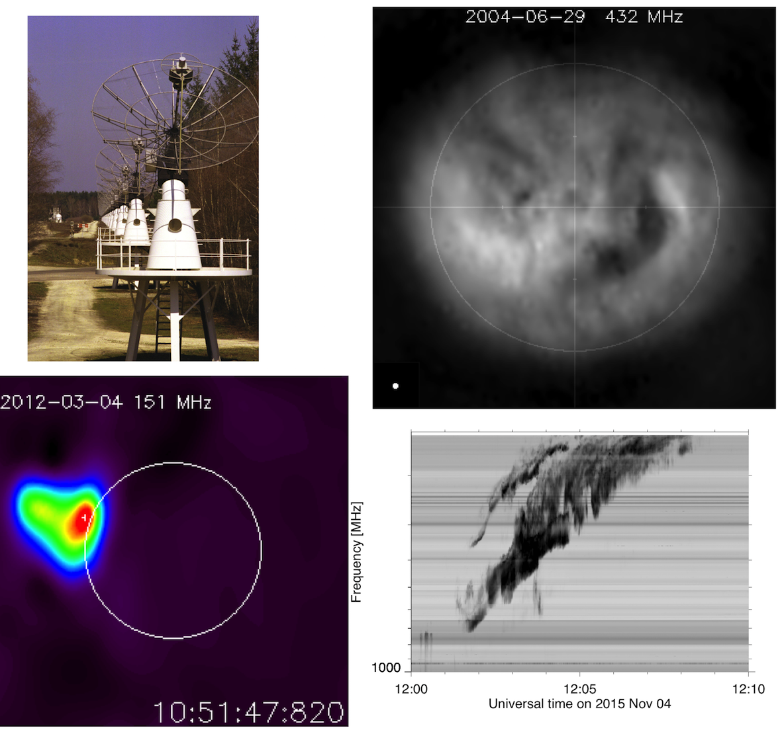
Solar observations with the Nancay Radioheliograph in support of the Solar Orbiter and Parker Solar Probe missions
Karl-Ludwig Klein, Abdallah Hamini, Sophie Masson (LESIA)
Christian Fabrice, Gabriel Auxepaules,
USN Nançay team
(ludwig.klein@obspm.fr)

Slide 2
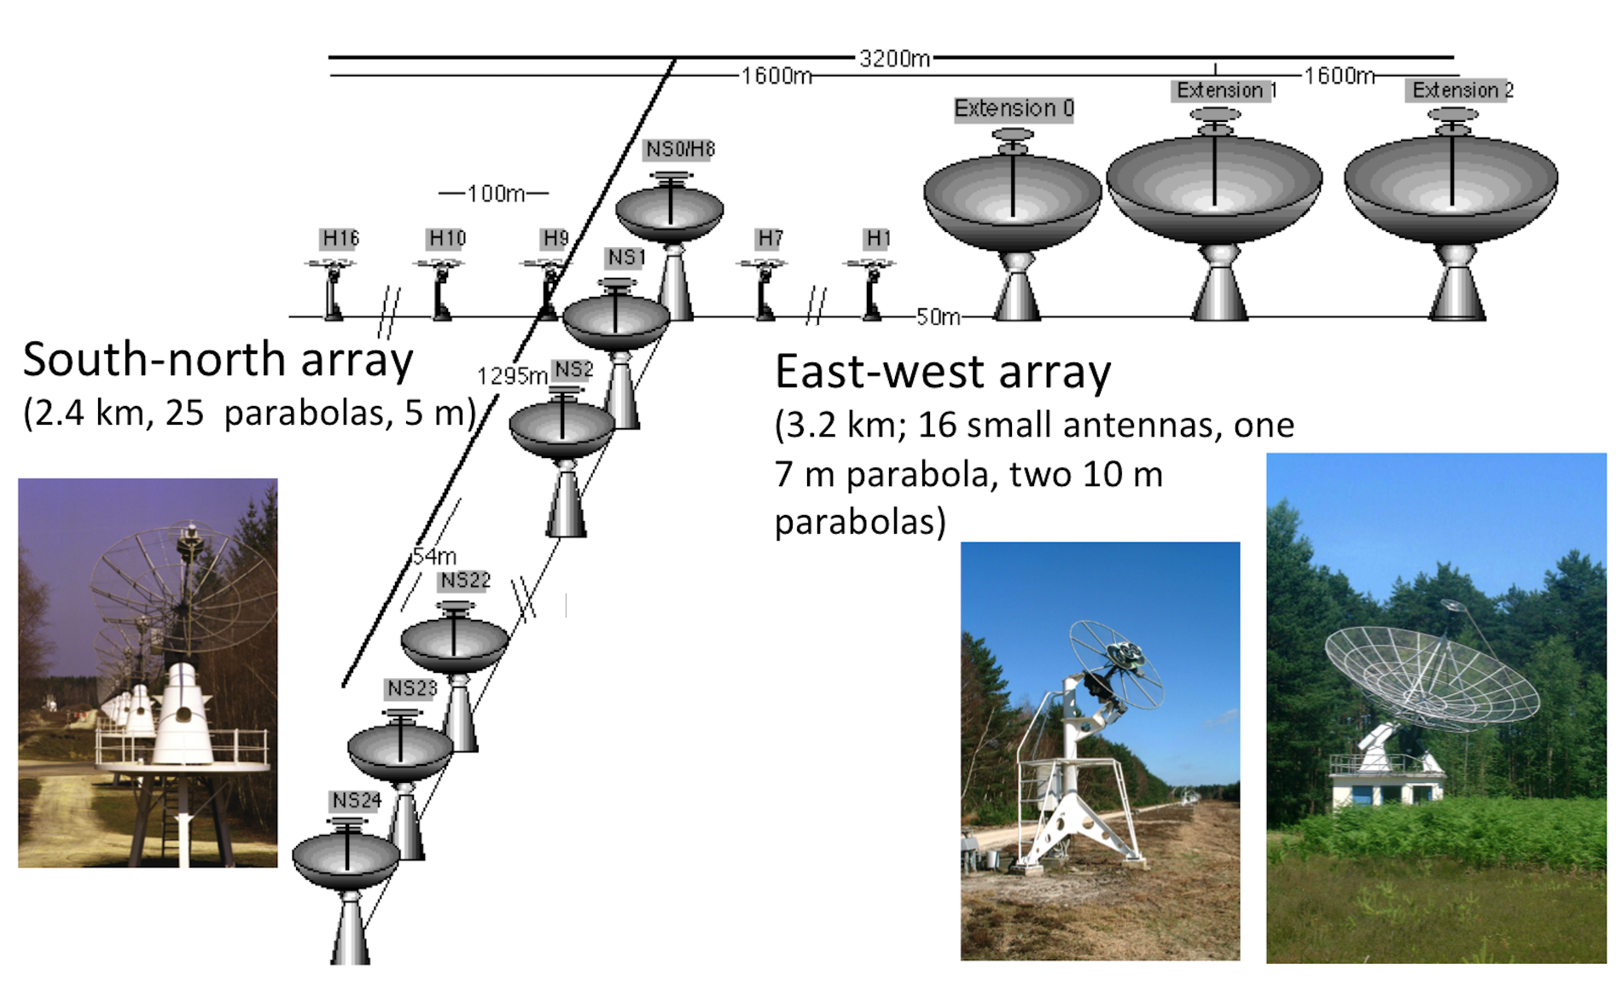
The Nançay radioheliograph
Refurbishment 2015-2020 and future plans
Operations 2015-2020 (phase 1):
Replacement of the correlator (update technology, use all 1128 baselines)
Replacement of the data acquisition system
Operations 2021-2024 (phase 2): partially funded
Renewal of the focal systems: SN array (funded), EW array
Renewal of the antenna pointing system
Maintenance/replacement of equipment: geared motors and reducers
Electricity supply to the antenna arrays
Anti-corrosion treatment of the antennas

Slide 3
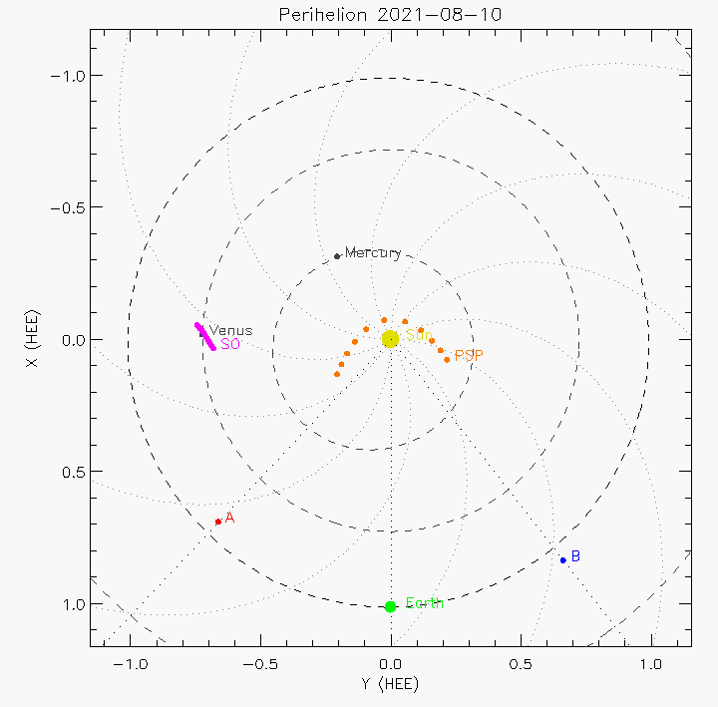
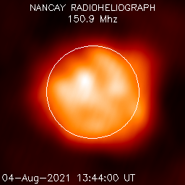
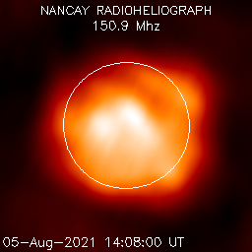
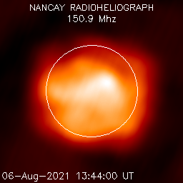
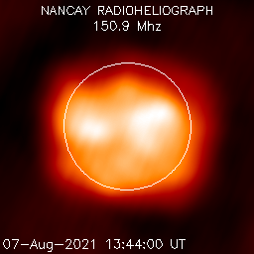
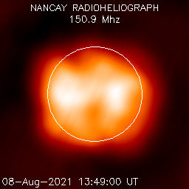
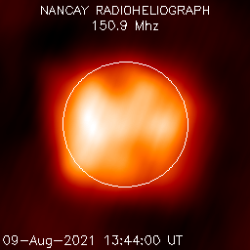
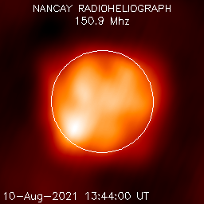
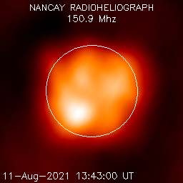
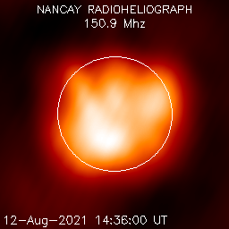
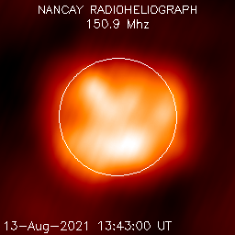
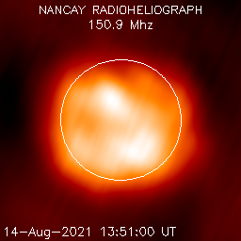
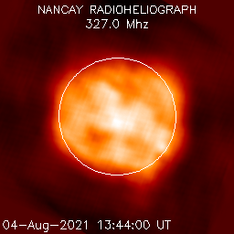
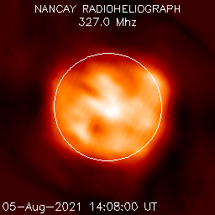
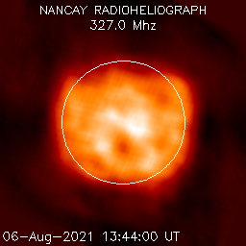
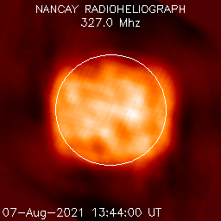
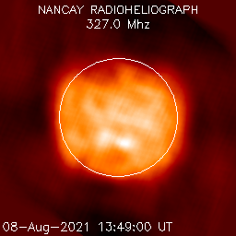
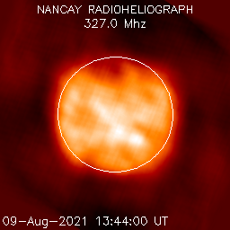
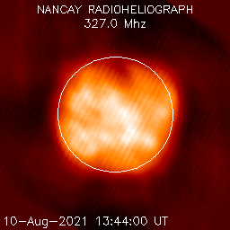
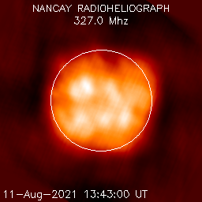
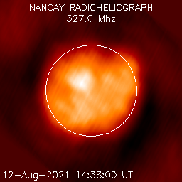
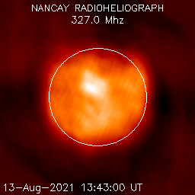
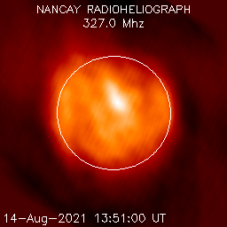
NRH observations around the PSP perihelion passage 2021 Aug 09
Overview
NRH, Aug 04-14:
151 MHz 327 MHz
1 image / day (bass2000.obspm.fr)
quiet Sun
appearance of an AR (noise storm) at E limb on Aug 23

Slide 4
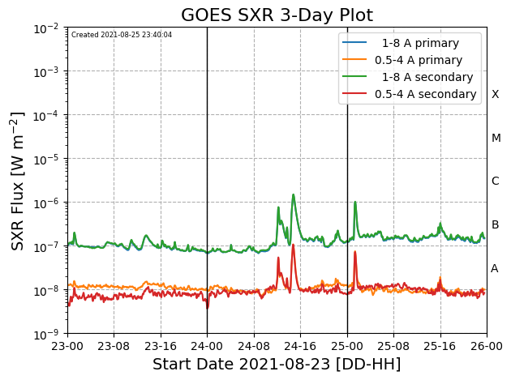
Type IV burst 2021 Aug 24
Radio spectrum and associated activity
Source: http://secchirh.obspm.fr/
www.solarmonitor.org
a succession of solar flares (SXR)
dm-m-λ: impulsive phase followed by several (3) phases of moving sources and a stationary long-lived source

Slide 5
Type IV burst 2021 Aug 24
Radio spectrum and associated activity
Source: http://secchirh.obspm.fr/
408 MHz 327 MHz 151 MHz
Salas Matamoros et al., in prep.
a succession of solar flares (SXR)
dm-m-λ: impulsive phase followed by several (3) phases of moving sources and a long-lived source (stationary type IV)

Slide 6
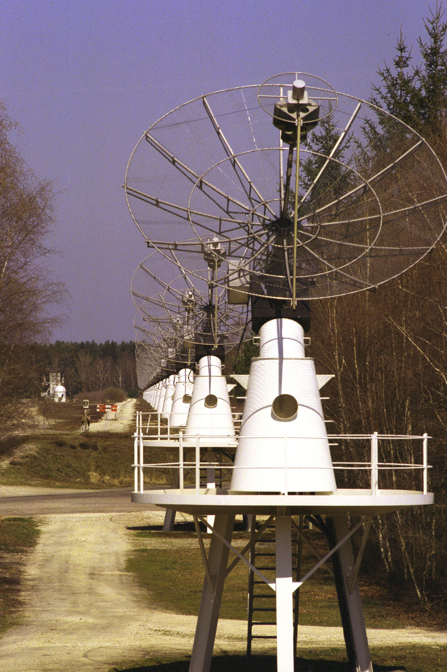
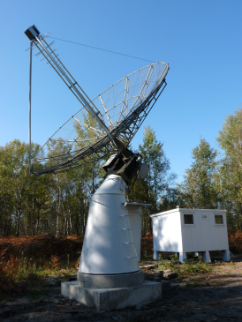
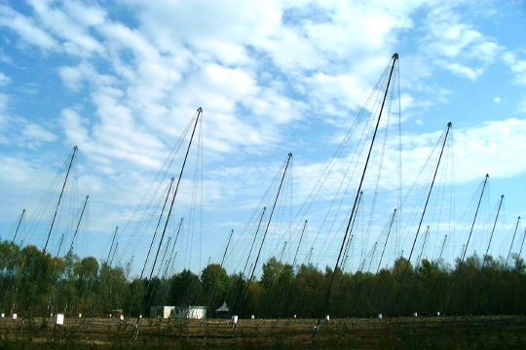
Solar observations at the Nançay radio observatory
Overview
Radioheliograph
Continuous monitoring, ~8:30-15:30 UT,
1 GHz – 20(10) MHz (ionosphere permitting)
A unique combination of complementary instruments
Radioheliograph (NRH; imaging up to 10 frequencies, 150-450 MHz),
Spectrography low/middle corona (<0.5 solar radii; 1 GHz – 144 MHz; ORFEES, since 2012)
Spectrography high corona (20-80 MHz; Decametre Array, Jupiter or Sun)
NRH operates again since 3/2021 (for the time being up to 9 frequencies, Stokes I):
some data 11/2020-2/2021
all but 13 observing days since March
Quicklook plots and data available via http://secchirh.obspm.fr/
ORFEES
Decametre Array

