Slide 1
Magnetoseismology for the solar corona: from ~10 Gauss to coronal magnetograms
Zihao Yang¹, Hui Tian^{1,2}
¹School of Earth and Space Sciences, Peking University
²Key Laboratory of Solar Activity, National Astronomical Observatories, Chinese Academy of Sciences
Email: yangzihao96@pku.edu.cn
In collaboration with C. Bethge, S. Tomczyk, R. Morton, G. Del Zanna, S. W. McIntosh, B. Binay Karak, S. Gibson, T. Samanta, J.-S. He, Y.-J. Chen, X.-Y. Bai, L.-H. Wang

Slide 2
Magnetized solar atmosphere
Due to magnetic coupling between different atmospheric layers, understanding many physical processes requires information on the magnetic field of the whole atmosphere
Routine measurement of solar magnetic field is limited to photospheric level, measuring coronal magnetic field is still very difficult
The difficulty of global coronal magnetic field measurements impedes our complete understanding of the solar magnetism and its interaction with the solar plasma
Magnetic field of the Sun calculated from the PFSS model (Yang, Tian, et al. 2020, Sci China Tech Sci)
Notes:
由于太阳大气各层次中的磁场实际上是一个整体，磁场将各层大气耦合在一起，这导致太阳上最重要的物理过程大多跟磁场的三维结构及其演化有关，因此日冕磁场测量的困难极大地制约了太阳物理学科的发展。
也有一些对日冕磁场进行测量的尝试，包括偏振观测、射电观测、冕震学或磁震学方法等
发生在太阳大气中的物理过程
日冕磁场测量的困难，目前都没有有效方法，世纪难题
最后说成像光谱也可以实现常规测量

Slide 3
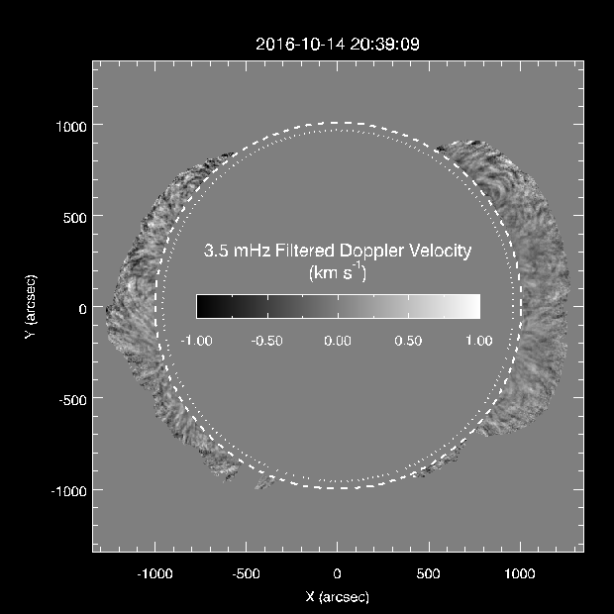


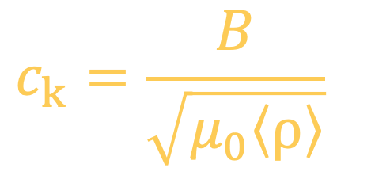
Magneto-seismology using CoMP coronagraph
CoMP: Fe XIII 1074.7/1079.8 nm spectral imaging from ~1.05-1.35 R_{s}
Propagating velocity fluctuations (Tomczyk et al. 2007) appear almost everywhere in the FOV: identified as kink waves
Under coronal condition (low beta in corona):
$$B_{i}\sim B_{o}$$
$$c_{k}=\sqrt{\frac{B_{i}^{2}+B_{o}^{2}}{μ_{0}(ρ_{i}+ρ_{o})}}$$
$$c_{k}=\frac{B}{\sqrt{μ_{0}〈ρ〉}}$$
Notes:
kink waves at the long-wavelength limit: restoring force is dominated by magnetic tension, nearly imcompressible
Alfvenic waves: including kink waves (at long-wavelength limit) and torsional Alfven waves
First attempt: Long et al. 2017；我们首先将过去局限于部分区域的波动追踪方法拓展到整个视场范围，从而获得这些波动传播方向和速度大小的全球性分布。

Slide 4
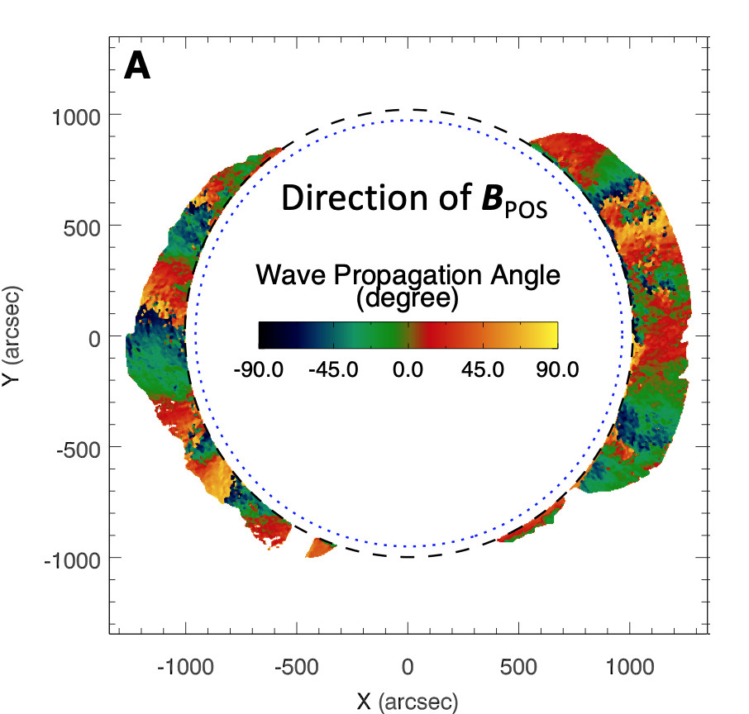
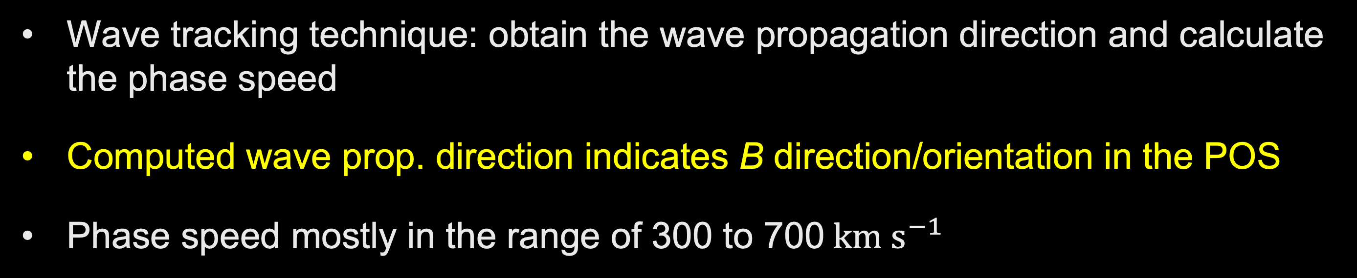
Prevalent transverse waves in the global corona
Wave tracking technique: obtain the wave propagation direction and calculate the phase speed
Computed wave prop. direction indicates B direction/orientation in the POS
Phase speed mostly in the range of 300 to 700$km s^{−1}$
Notes:
FFT to the time series at each pixel and filter it using a Gaussian window centered at 3.5 mHz with a FWHM of 1.5 mHz

Slide 5
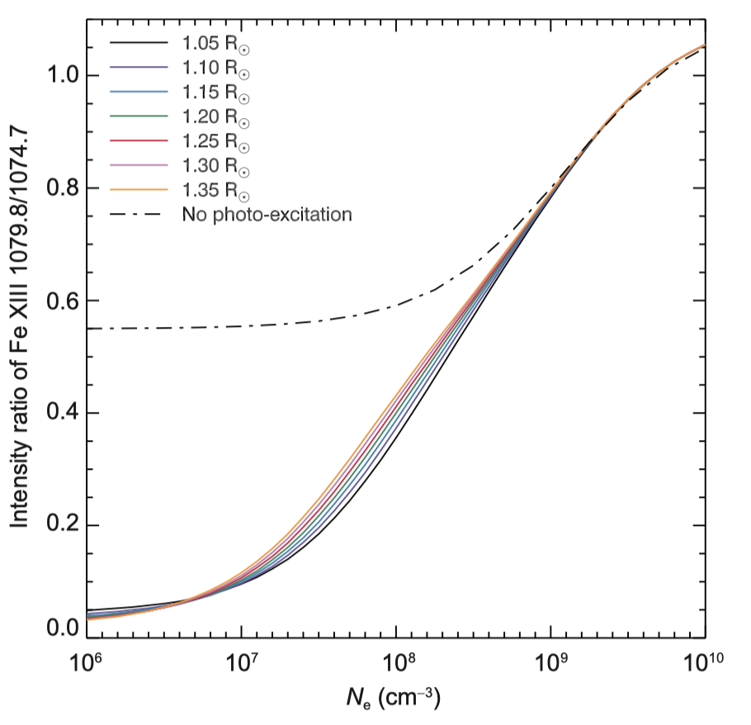
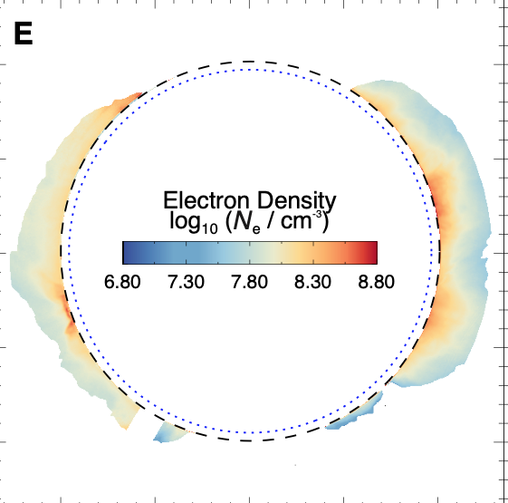
Global map of electron number density
Fe XIII 10798/10747: sensitive to electron density
Considering the contribution of photo-excitation at different heights

Slide 6
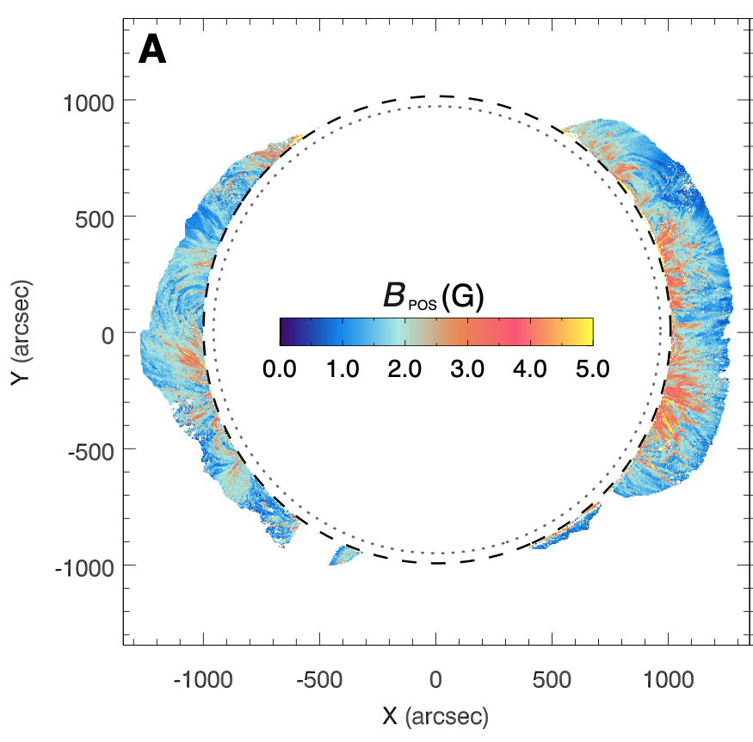
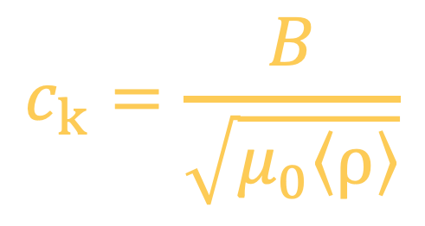
Global map of magnetic field strength
$$c_{k}=\frac{B}{\sqrt{μ_{0}〈ρ〉}}$$
Measured phase speed: kink speed projected onto POS
Approximate the average density in the vicinity of POS with the derived density (Magyar & Van Doorsselaere 2018)
Obtain POS component of coronal magnetic field strength
Notes:
在波动追踪和密度诊断的基础上，我们首次基于日冕观测获得了日冕磁场的全球性分布。磁场在天空平面的分量
The derived density, phase speed and magnetic field strength are all weighted by the emissivity along the LOS. Because the density generally decreases with distance from the solar limb, the LOS weighting favors magnetic structures in the vicinity of the plane of sky (POS).

Slide 7
Summary
Using CoMP observations, we have determined the spatial distribution of the plasma density in the corona and the phase speed of the prevailing transverse MHD waves within the plasma.
Combing these, we have measured the global coronal magnetic field (POS component) for the first time. The derived field strengths in the corona from 1.05 to 1.35 solar radii are mostly 1-4 Gauss.
These results demonstrate the capability of imaging spectroscopy in coronal magnetic field diagnostics. With this technique, global coronal B maps could in principle be routinely obtained, filling in the missing part of the measurements of the Sun’s global magnetism.
(1) Z.-H. Yang, C. Bethge, H. Tian, S. Tomczyk, R. Morton, G. Del Zanna, S. W. McIntosh, B. Binay Karak, S. Gibson, T. Samanta, J.-S. He, Y.-J. Chen, L.-H. Wang, Global maps of the magnetic field in the solar corona, Science, 369, 694 (2020).
(2) Z.-H. Yang, H. Tian, S. Tomczyk, R. Morton, X.-Y. Bai, T. Samanta, Y.-J. Chen, Mapping the magnetic field in the solar corona through magnetoseismology, Sci China Tech Sci, 63, 2357 (2020).

