Slide 1
Thermal modeling of the middle solar corona
Thanassis Katsiyannis⁽¹⁾ & Joseph Lemaire ⁽²⁾
Royal Observatory of Belgium
Royal Belgian Institute for Space Aeronomy

Slide 2
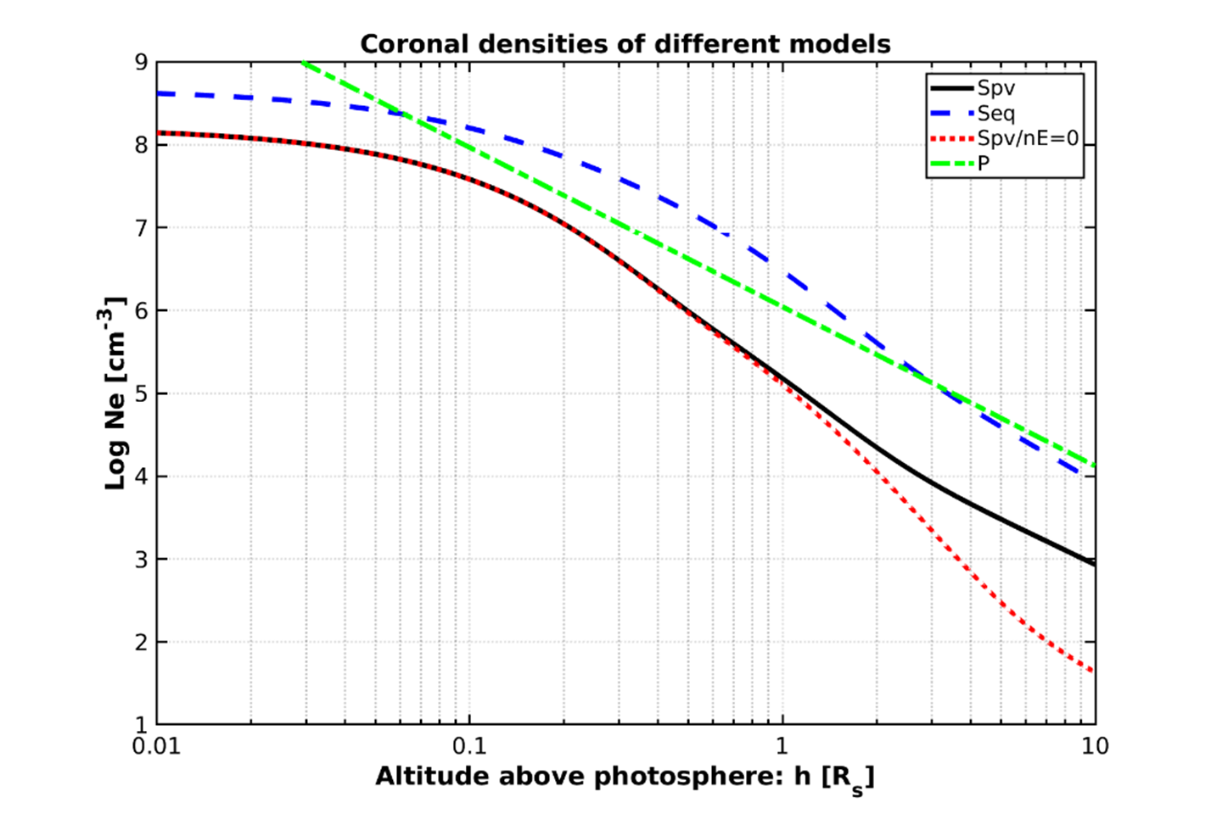
The DYN model
Pottach (1960), Brandt et al (1965) and Gibson et al (1999) used Parker’s hydro-dynamical model with T(∞)=0 and P(∞)=0.
Lemaire & Stegen (2016) added the m_{H}*ne(r)*du/dt factor to Parker’s (1958) model:
dT(r)/dr + [d(ln n_{e})/dr]⁻¹ + m_{H}*g * R_{S}² / (k r² ) + m_{H}*n_{e}(r)*du/dt = 0
Lemaire & Stegen (2016) also added a term to Saito (1970)’s fit. This was to correct for n_{e}(1AU). Saito (1970)’s fit was for h < 3 R_{S}
n_{e}(r)= 10⁸ [3.09 r⁻¹⁶ (1-0.5 sin(φ)) + 1.58 r⁻⁶ (1-0.95 sin(φ)) +
0.0251 r^{-2.5} (1-√sin(φ))] + n_{e}(1AU) (215/r)²

Slide 3
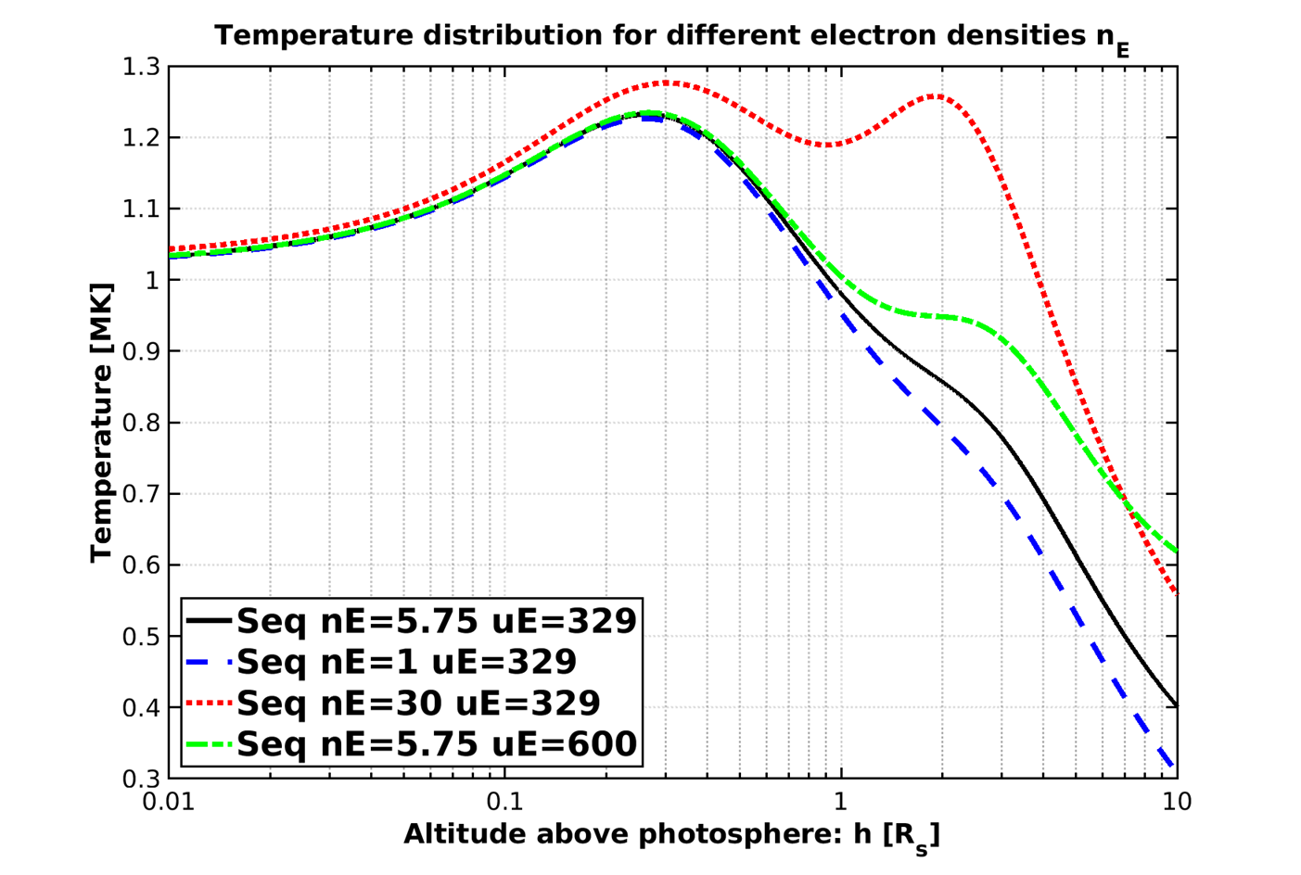
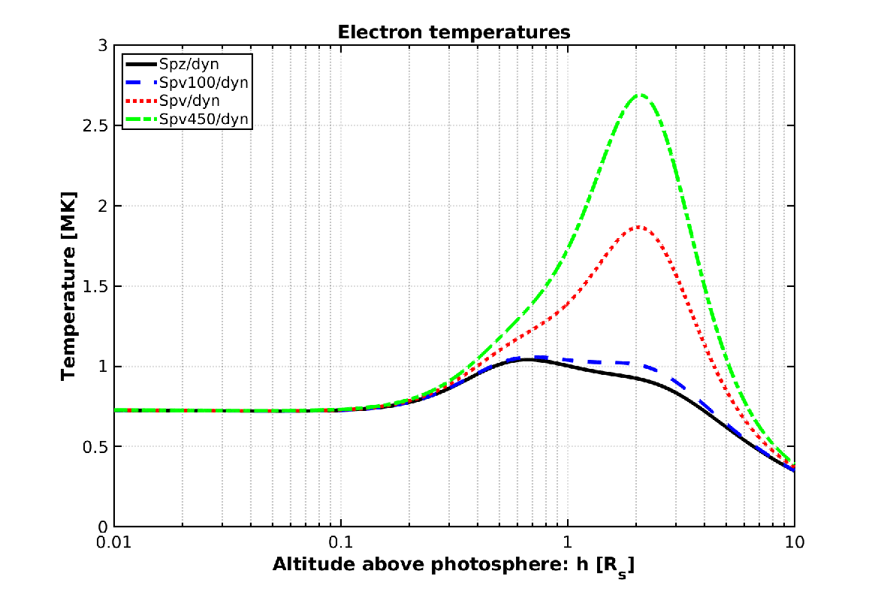
Temperature distributions / Model limitations
T(r)= $\frac{T∗}{n(r)}$ $\int_{r}^{∞}{\frac{n(x)}{x2}}$ dx, where 𝑇∗ = m_{H}*g * R_{S}² / (k r² )

Slide 4
Future Work
Use different n_{e}(r) observations as input to the model
Use T(r) observations as boundary conditions
Calculate the energy flow for all radial distances

