Slide 1
Catalogue of hot jets in the solar corona
Kaltman T. I.¹, Stupishin A. G. ², Anfinogentov S. A. ³,
Shendrik A.V.¹ , Nakariakov V. M.^{1,4} , Loukitcheva M. V. ^{1,2,5},
¹Special astrophysical observatory of RAS, St. Petersburg, Russia
²Saint Petersburg State University, Saint Petersburg, Russia
³Institute of solar-terrestrial physics SB RAS, Irkutsk
⁴Centre for Fusion, Space and Astrophysics, Physics Department, University of Warwick, UK
⁵Max-Planck-Institut fur Sonnensystemforschung, Gottingen, Germany
We present a catalogue of plasma jets in the solar corona with a temperature above 0.5 MK, containing primary information about the events and basic parameters of jet
https://solar.sao.ru/coronal-jets-catalog/
The study of plasma jets in the solar atmosphere is an actively developing scientific field both in the context of fundamental plasma physics and in the field of plasma astrophysics. This direction is also of great importance for the development of methods for predicting space weather. Coronal jets are phenomena regularly observed on the Sun at all phases of the solar activity cycle, both in the quiet Sun and in coronal holes and active regions.

Slide 2
Catalogue content
The сatalogue includes: primary information about the event from HEK (Heliophysics Events Knowledge base), observed jet parameters, and associated eruptive phenomena.
The сatalogue contains data obtained with the SDO/AIA high-precision EUV telescope, the results of extrapolation of magnetic fields based on photospheric observations of the magnetic field using the SDO/HMI instrument, and the data from the ground-based radio telescopes and spectrometers, including RATAN-600, Siberian Radioheliograph (SRH), and NoRH.
https://solar.sao.ru/coronal-jets-catalog/
Solar-Terrestrial Physics, vol. 7, issue 2, pp. 3-10

Slide 3
Workflow of catalogue filling:
Magnetic field reconstruction from SDO/HMI magnetograms
Manual analysis of selected events
Coronal jets events from Heliophysics Events Knowledgebase
Automated identification of jets in SDO/AIA data
data base, observational data, images and videos
Other observations (SRH, RATAN-600, NoRH, SDO/HMI)
Coronal jets catalog at https://solar.sao.ru/coronal-jets-catalog/

Slide 4
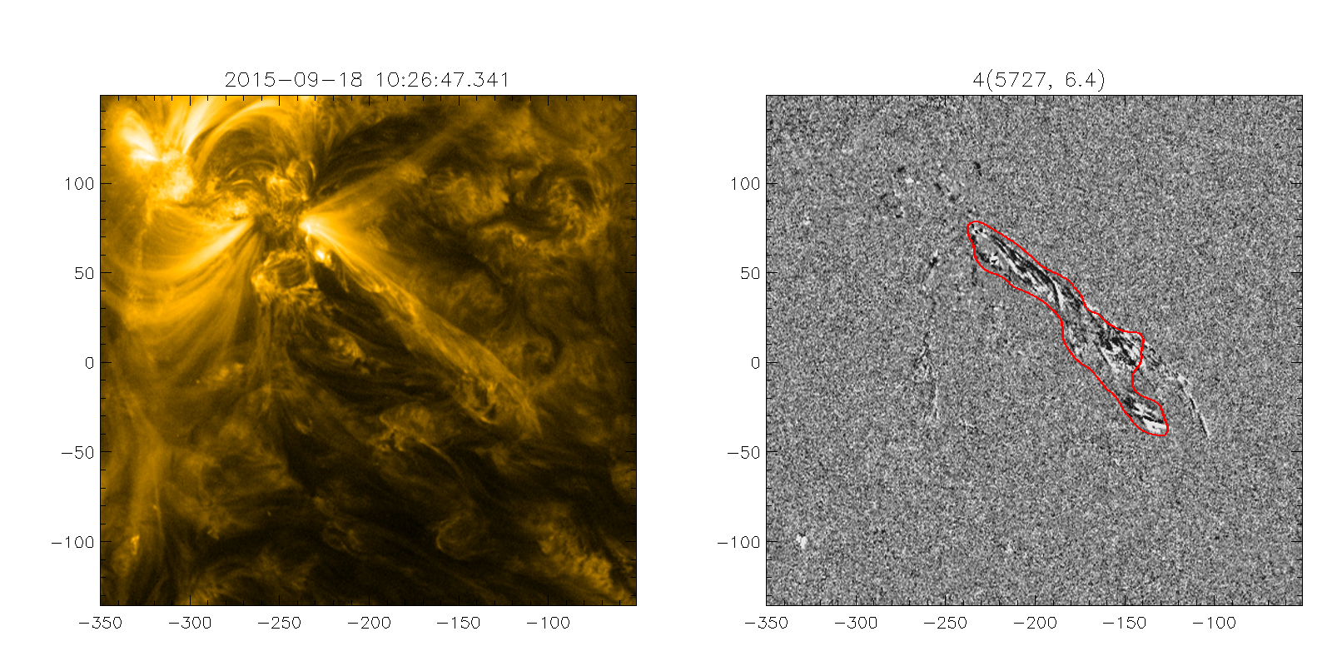
Examples of automatic identification of a coronal jet in SDO/AIA images in the 171 Å channel

Slide 5
Radio maps of microwave radiation at a frequency of 17 GHz obtained by NoRH on September 13, 2017 for differ- ent stages of jet development and superimposed on SDO/AIA 171 Å images as contours. The radio brightness contours corre- spond to values from 10500 to 15000 K with an increment of 500 K
Example of radio observation at Nobeyama Radio Heliograph from Catalogue

Slide 6
Radio images of the Sun (left) from SRH for September 13, 2017. The active region in which the jet was observed is marked with a white rectangle. Microwave flux light curves for this region in the right (RCP, blue) and left (LCP, red) polarization are shown in the right panels
Example of radio observation at Siberian Radio Heliograph from Catalogue

Slide 7
RATAN-600 scans of antenna temperatures of polarized radiation in AR 12738 on April 17, 2019 at frequencies of 5.25, 8.25, and 11.20 GHz. Different colors indicate observations in different azimuths: 31 records in a time span 07:11–11:15 UT with a step of 8 min. The left-to-right shift of the scans is a projection effect associated with the Earth rotation and depending on the orientation of a radio telescope antenna. Jet passage time corresponds to a radiation increase in blue scans
Example of radio observation at RATAN-600 (Radio telescope of Russian Academy of Sciences)
from Catalogue

Slide 8
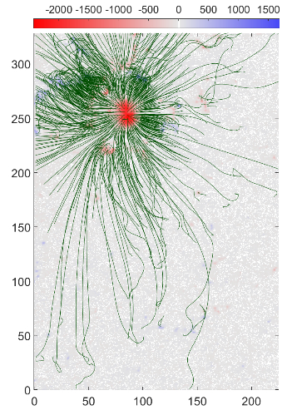
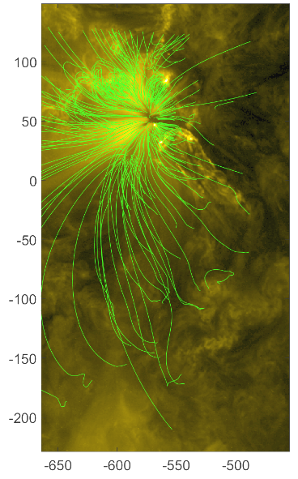
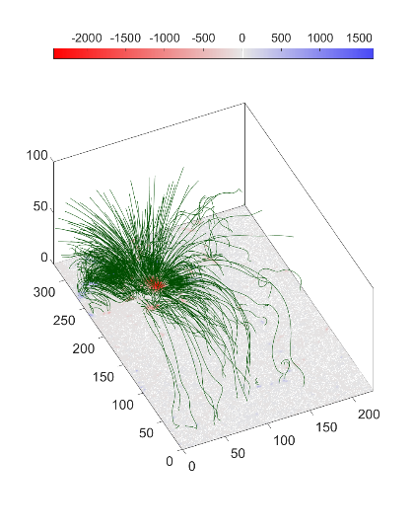
Examples of potential reconstruction magnetic field:
Examples of Nonlinear force-free field (NLFFF) approach:

Slide 9
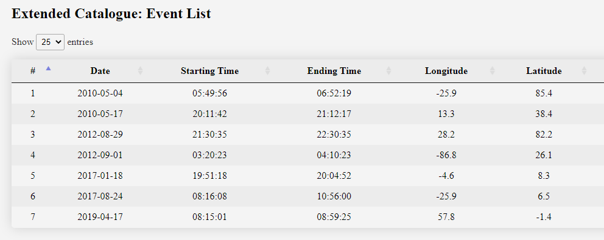
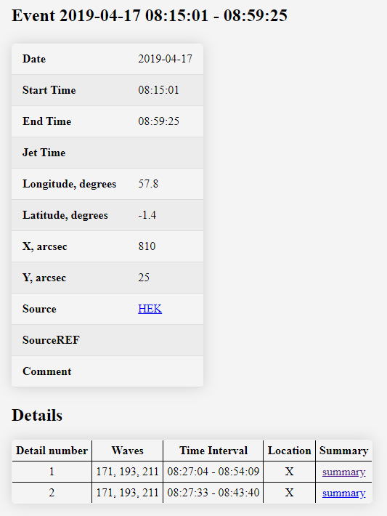
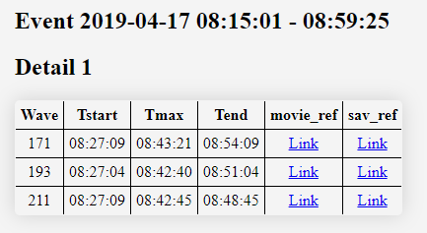
Catalogue: database with navigation (web interface)

Slide 10
Conclusions
A multi-wavelength Catalogue of plasma jets with temperatures above 0.5 MK ("hot jets") in the Sun's corona has been created.
To the moment, the catalogue is based on the data for the period of 2010-2020, which almost completely covers the 24th cycle of solar activity.
The catalogue includes primary information about the event, observed jet parameters, and associated eruptive phenomena.
The catalogue contains data obtained with the SDO/AIA high-precision EUV telescope, the results of extrapolation of magnetic fields based on photospheric observations of the magnetic field using the SDO/HMI instrument, and the data from the ground-based radio telescopes and spectrometers, including RATAN-600, SRH, and NoRH.
A new method of automatic jet detection in homogeneous time series of AIA images is developed. The method is applied to all of events in the catalogue. Currently wavelength 171Å is proceeded, other wavelengths will be proceeded in the nearest future.
The catalogue is in open access and available at https://solar.sao.ru/coronal-jets-catalog.

