Slide 1
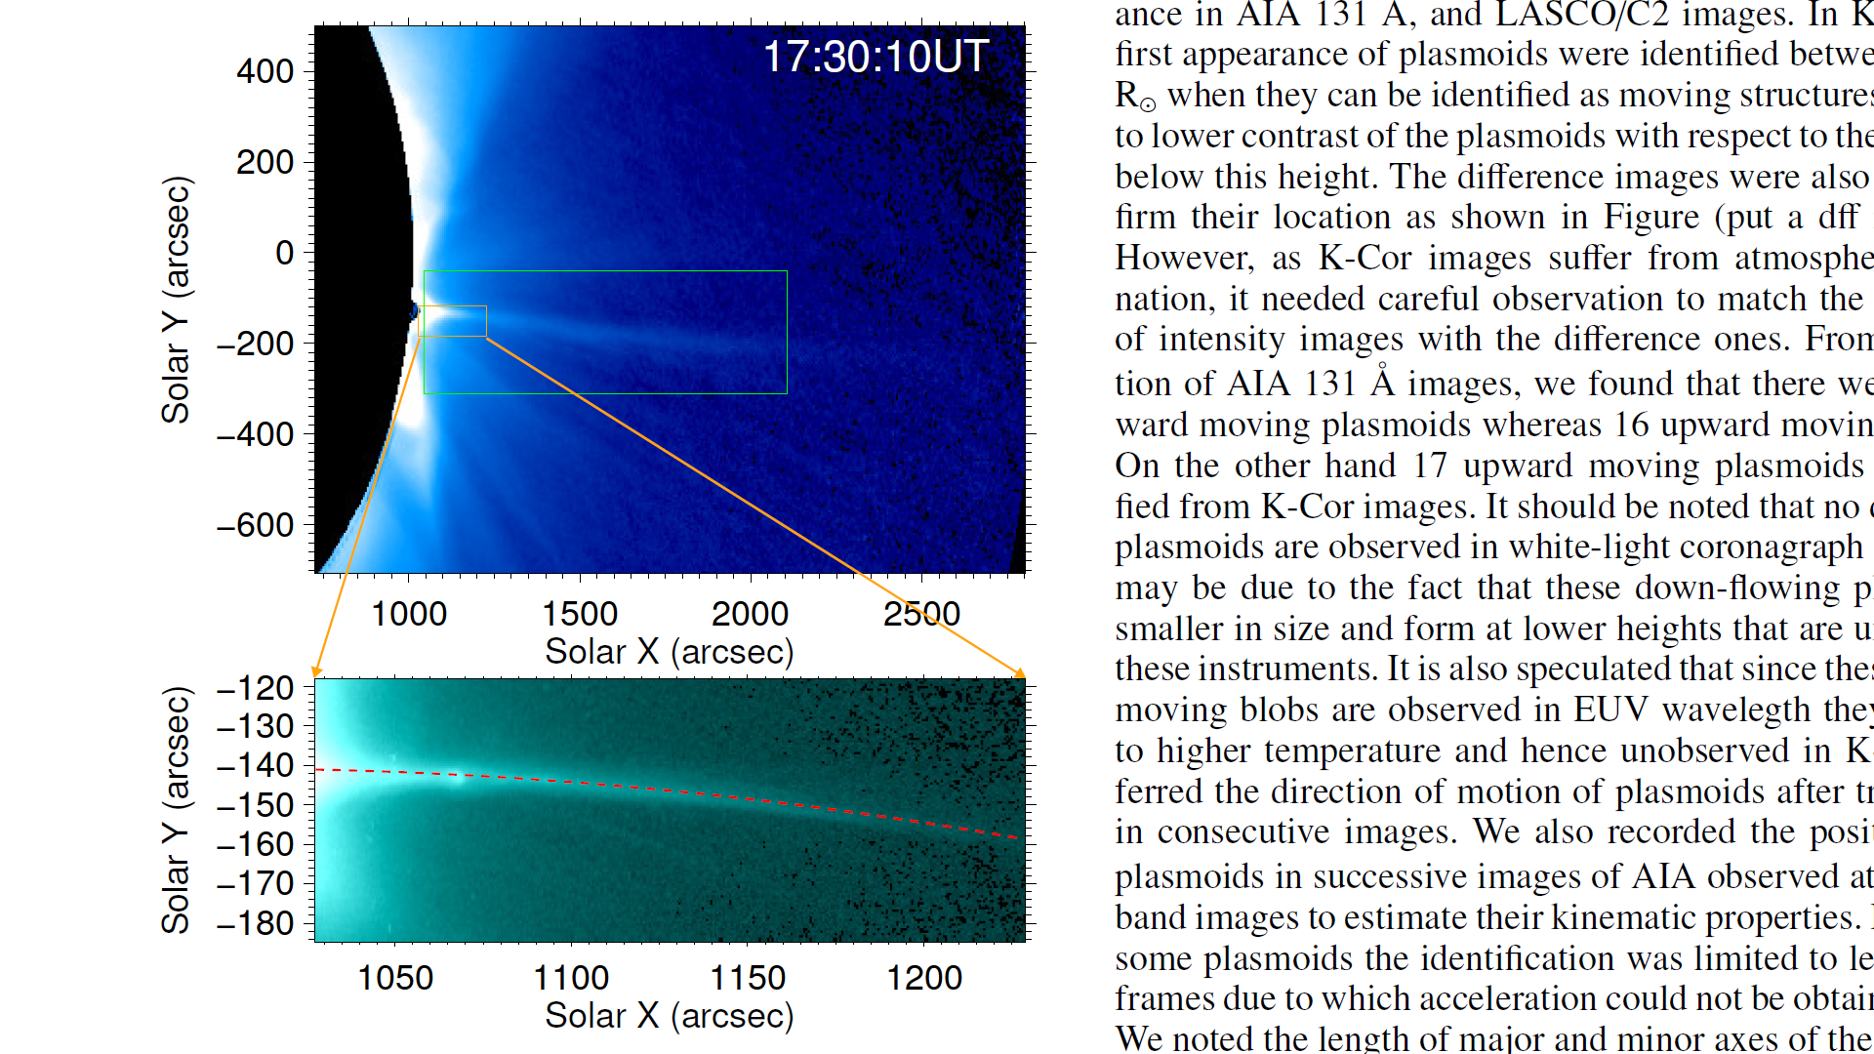



A Statistical Study of Plasmoids associated with Post-CME Current Sheet of September 10, 2017
Ritesh Patel, Vaibhav Pant, Chandrashekhar K., Dipankar Banerjee

Slide 2
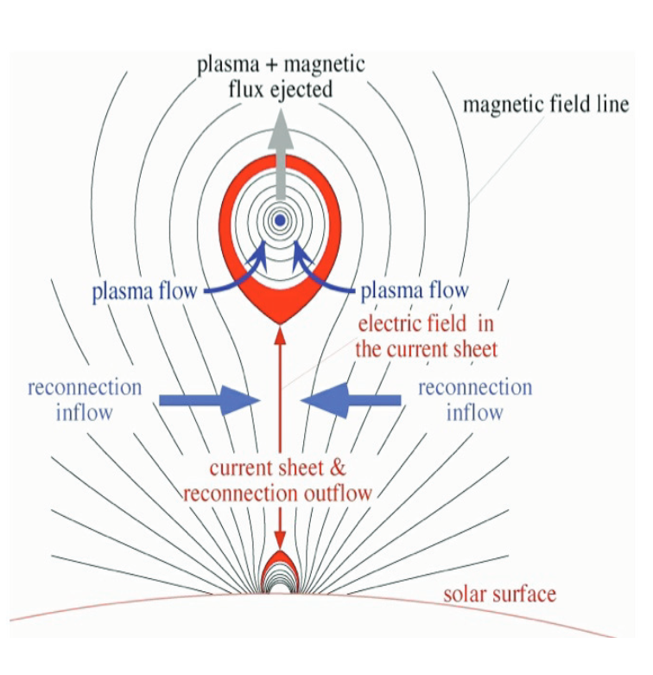
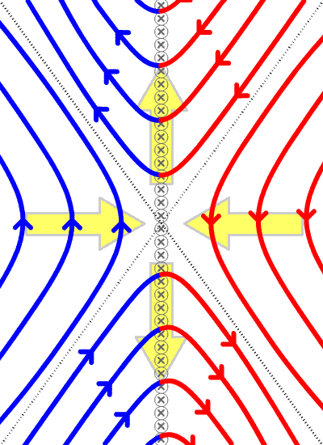
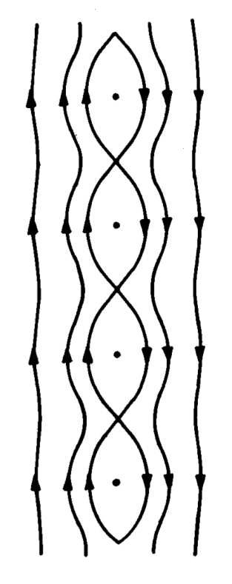
What is a Current Sheet?
A current sheet is a thin current-carrying layer across which the magnetic field changes either in direction or magnitude or both. (Priest E. and Forbes T. 2000).
In plasmas, null points typically give rise to current sheets.
Standard flare-CME model depicting a CS between the post-flare loops and the ejecting flux rope.
(Yuan-Kuen Ko et al. 2010)
Credit: Wikipedia; Physics of fluids and plasma

Slide 3
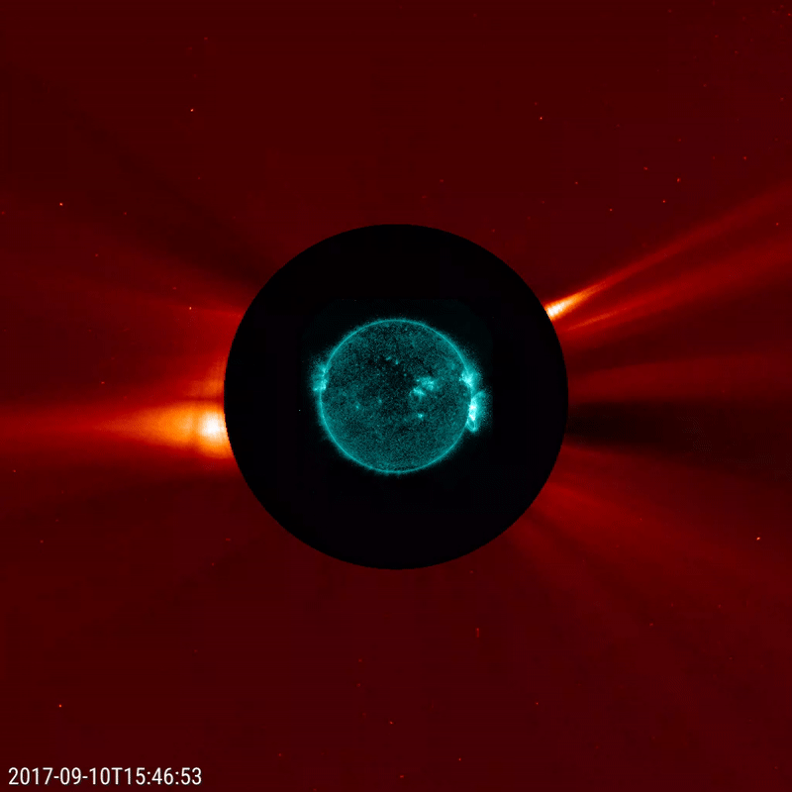
September 10, 2017 Event

Slide 4
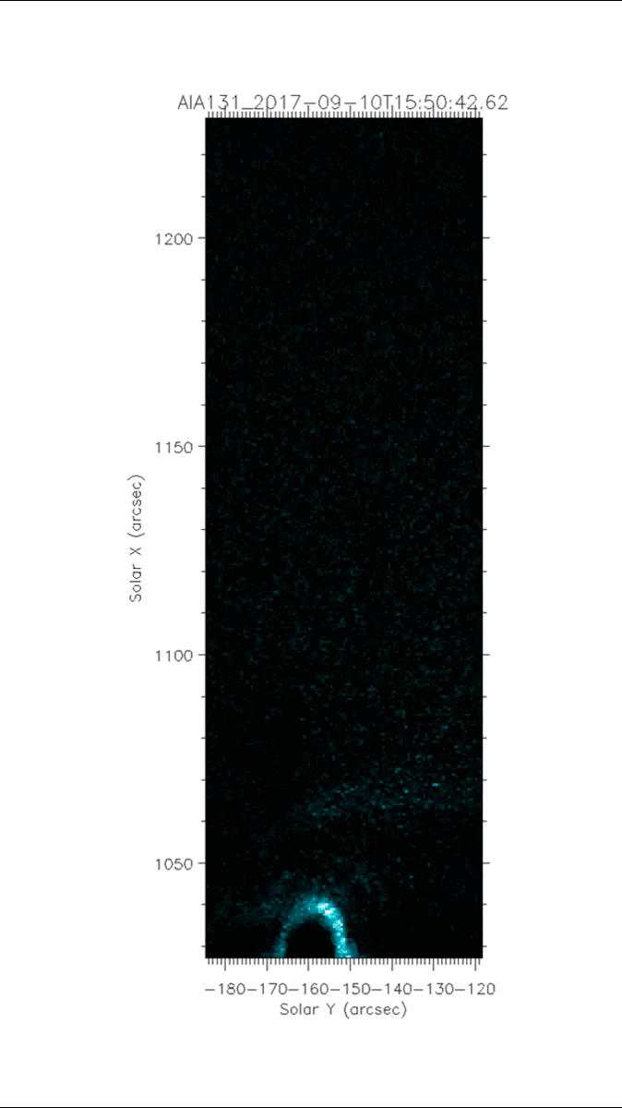
16
AIA 131 Å
K-Cor
LASCO/C2
20

Slide 5
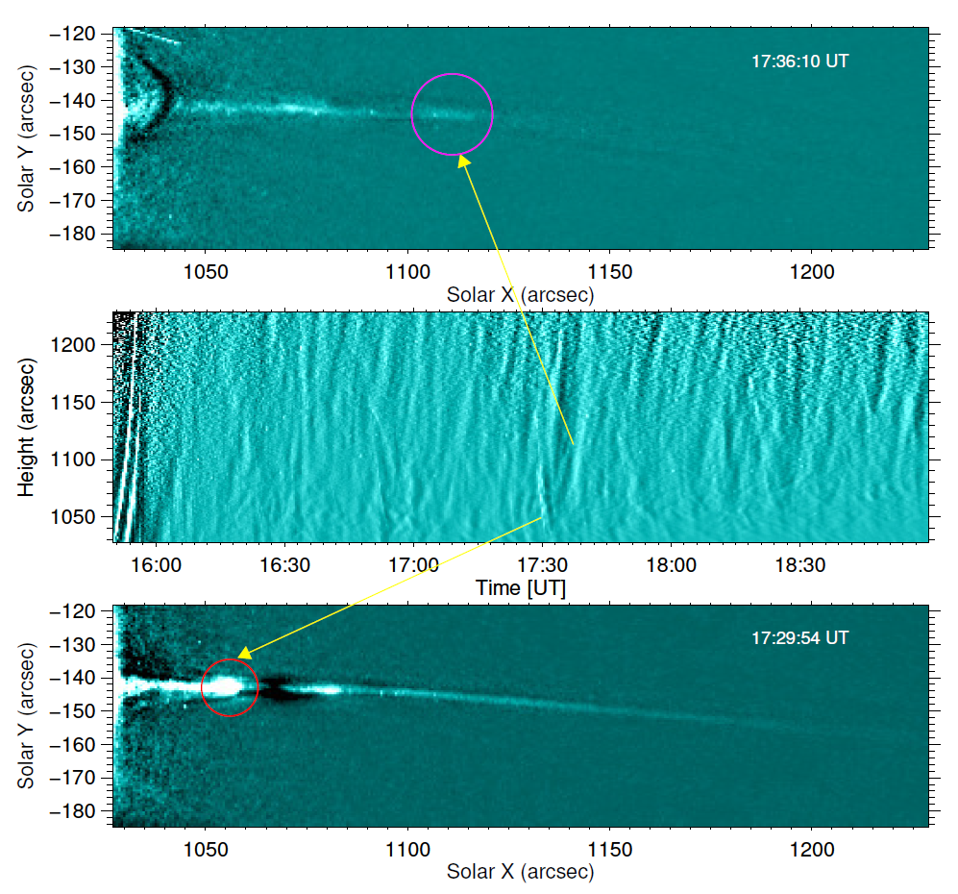
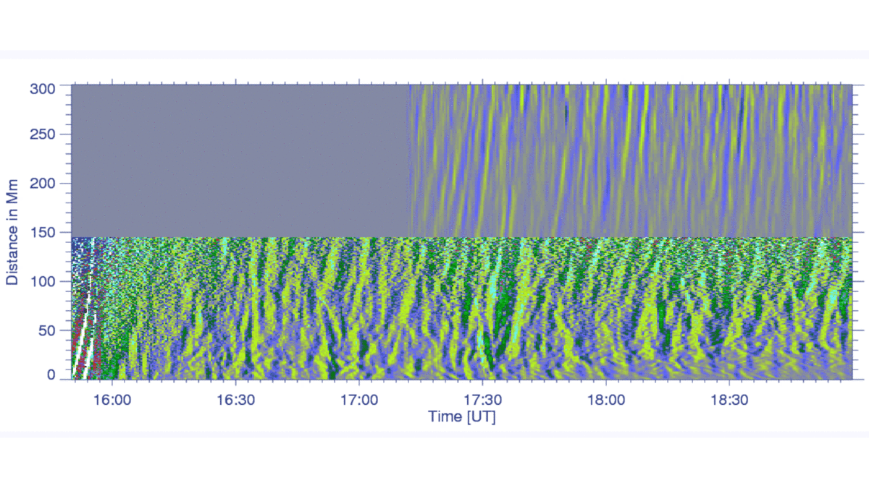
Identification of Plasma Blobs
16
20

Slide 6
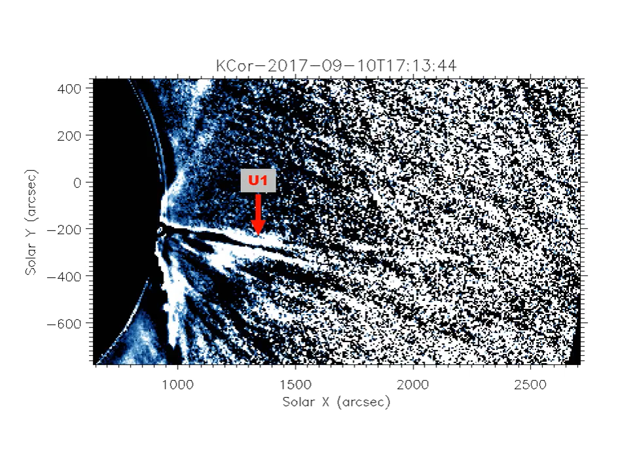
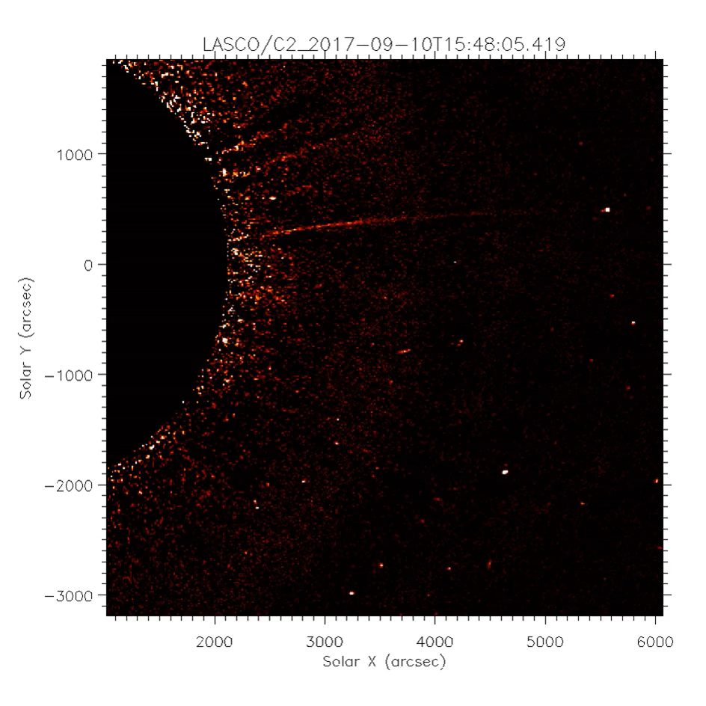

Slide 7
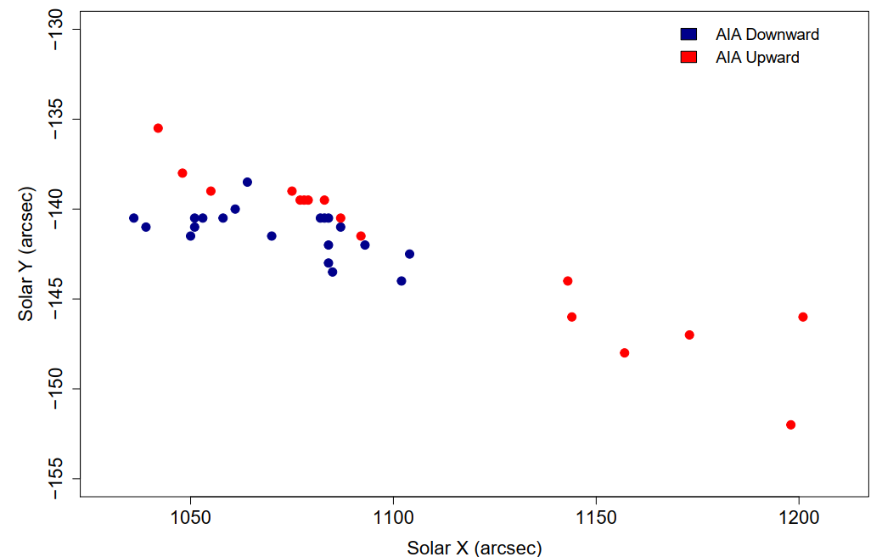
Identification of Disconnection Point
1.15 R_{ʘ}

Slide 8
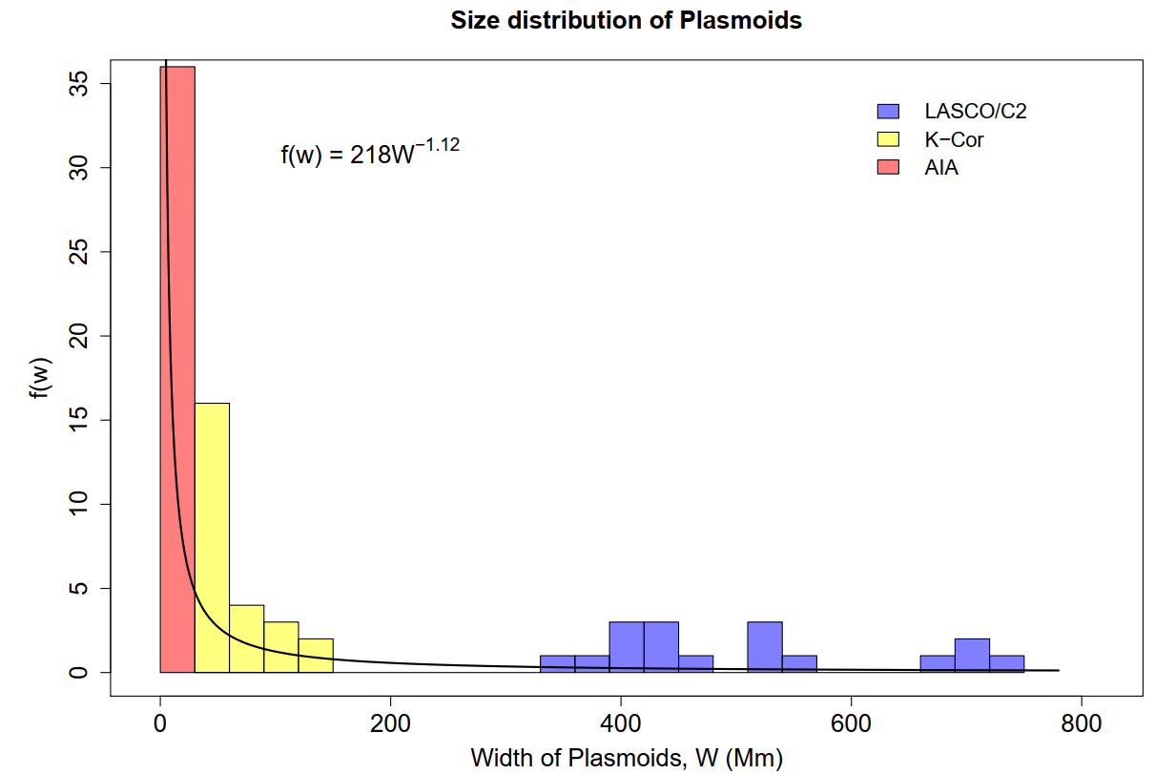
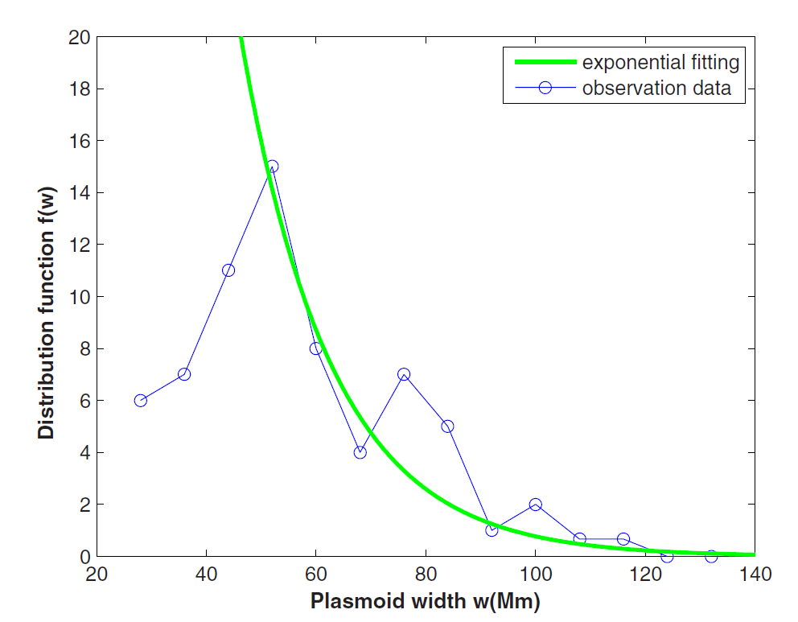
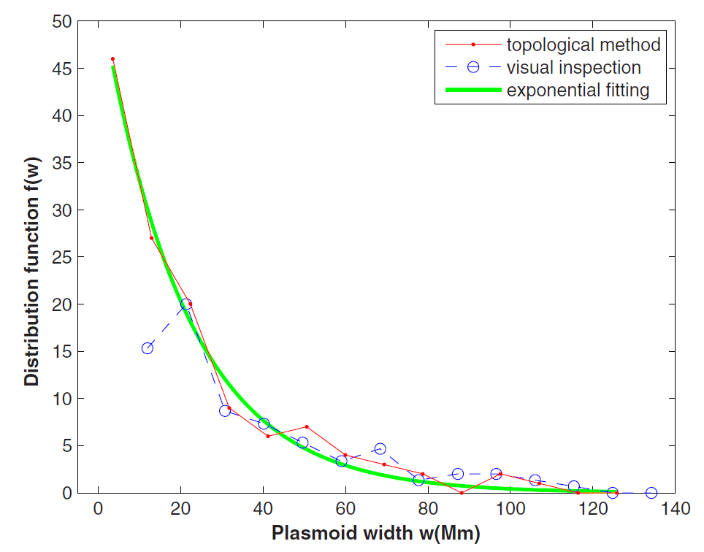
Statistical Properties of Observed Plasma Blobs
Plasmoid scale distribution in a CME event (Guo et al. 2013)

Slide 9
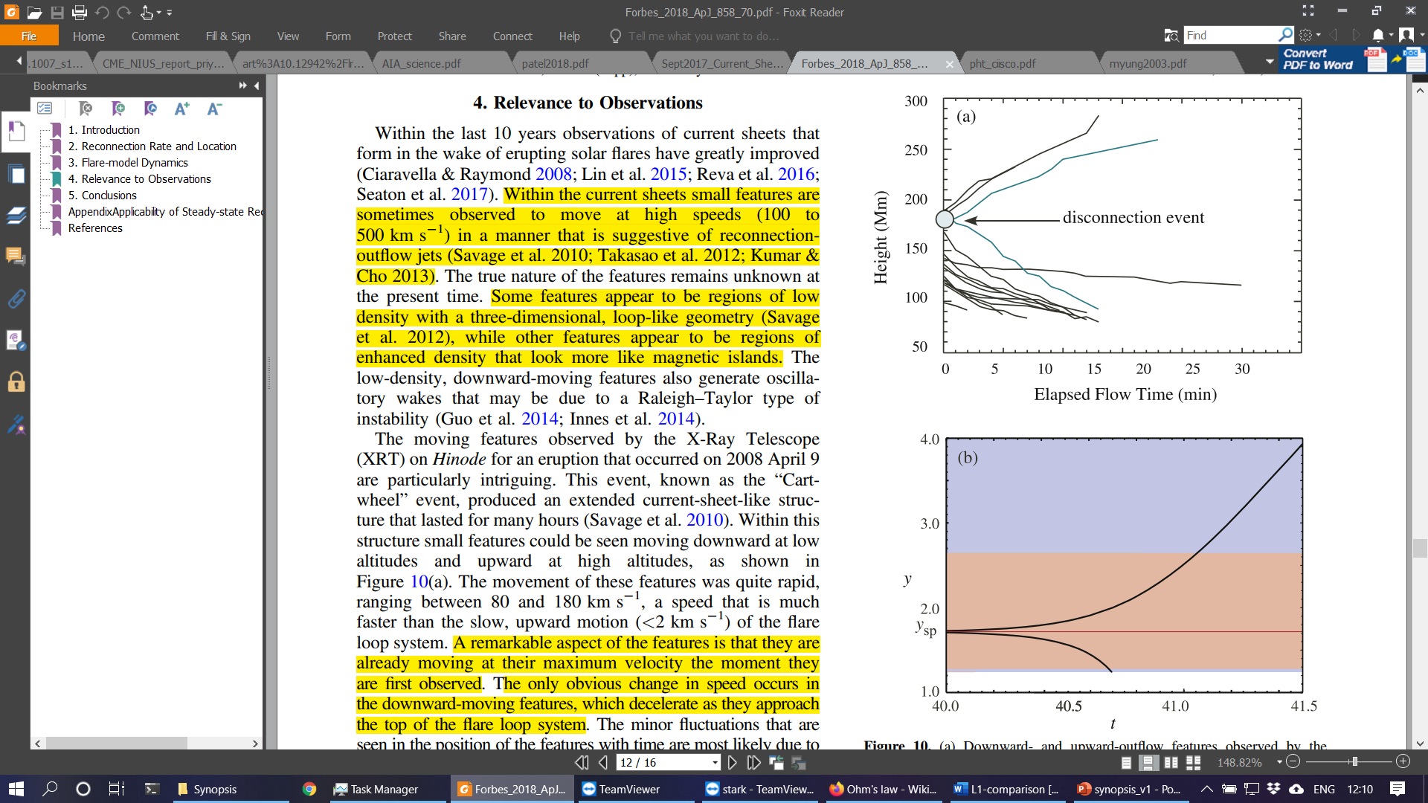
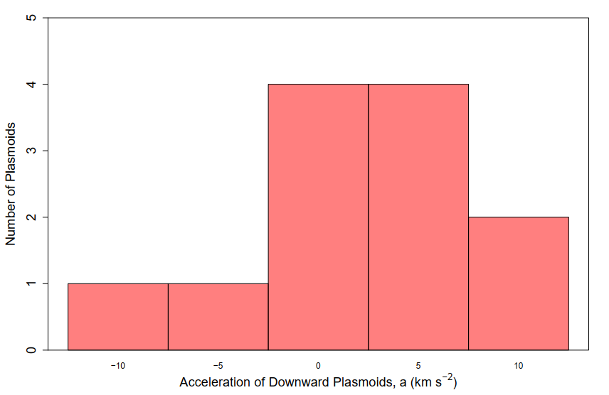
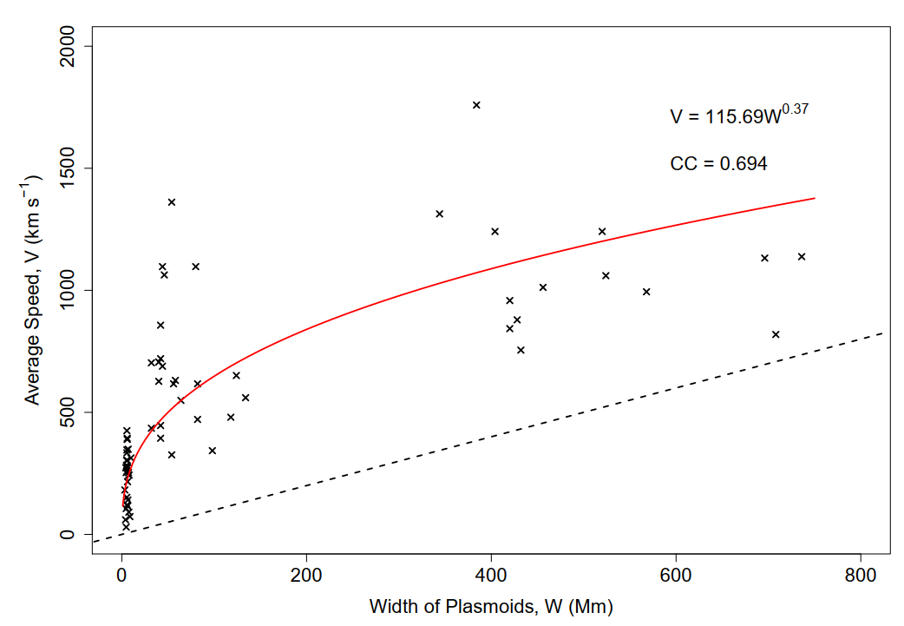
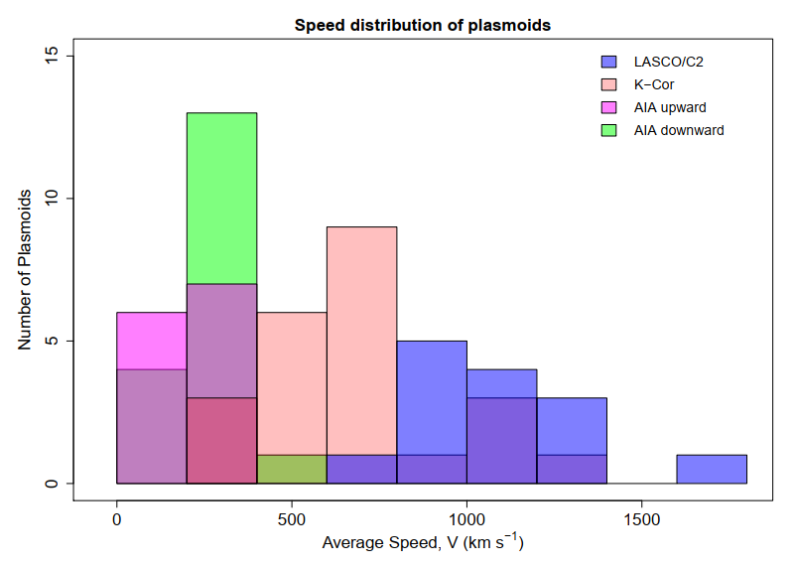
Statistical Properties of Observed Plasma Blobs
Forbes et al. (2018)
Savage et al. (2010)

Slide 10
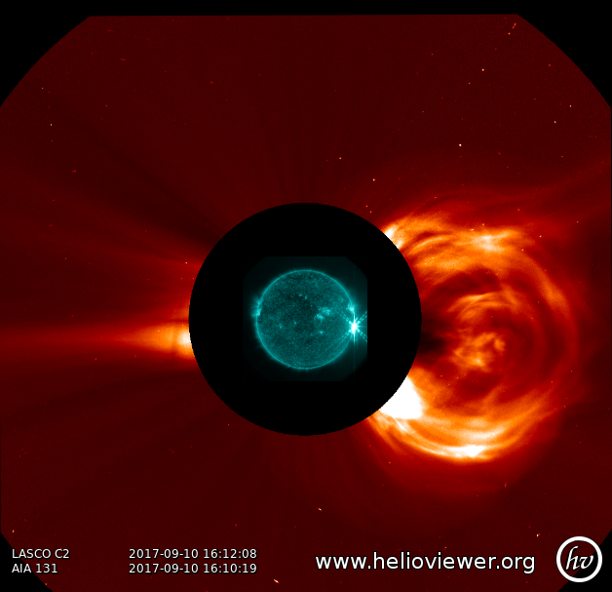
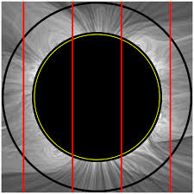
Why is it interesting for VELC?

Slide 11
Summary
16 Upward and 20 Downward moving plasmoids identified in AIA FOV while 24 and 17 upward moving plasmoids in KCor and LASCO/C2 FOV respectively.
First observational evidence of a power law distribution of width in support of predictions by simulations.
The kinematics of plasmoids provide observational support to the models of Barta et. al 2008 and Forbes et. al 2018.
First empirical relation to define the evolution of plasmoids.

