Slide 1
Large-amplitude prominence oscillations following the impact by a coronal jet
Manuel Luna^{1,2} & Fernando Moreno-Insertis^{3,4}
(1) Universitat de les Illes Balears (UIB), Palma de Mallorca, Spain
(2) Institute of Applied Computing & Community Code (IAC3), UIB, Spain
(3) Instituto de Astrofísica de Canarias (IAC), La Laguna, Spain
(4) Universidad de La Laguna, La Laguna, Spain

Slide 2
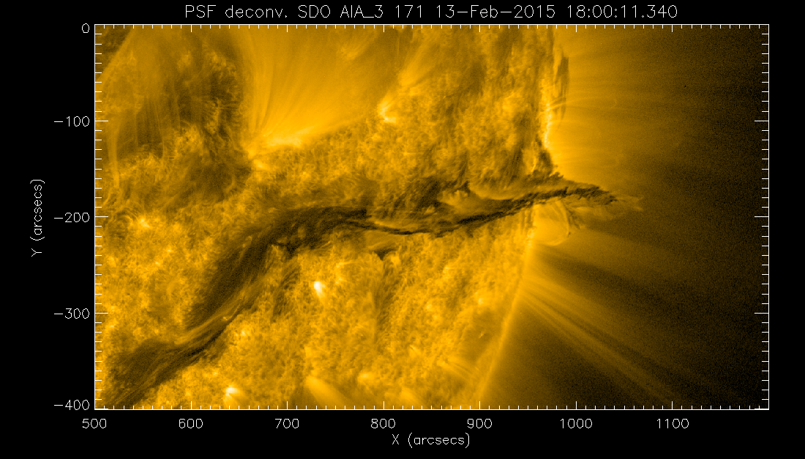
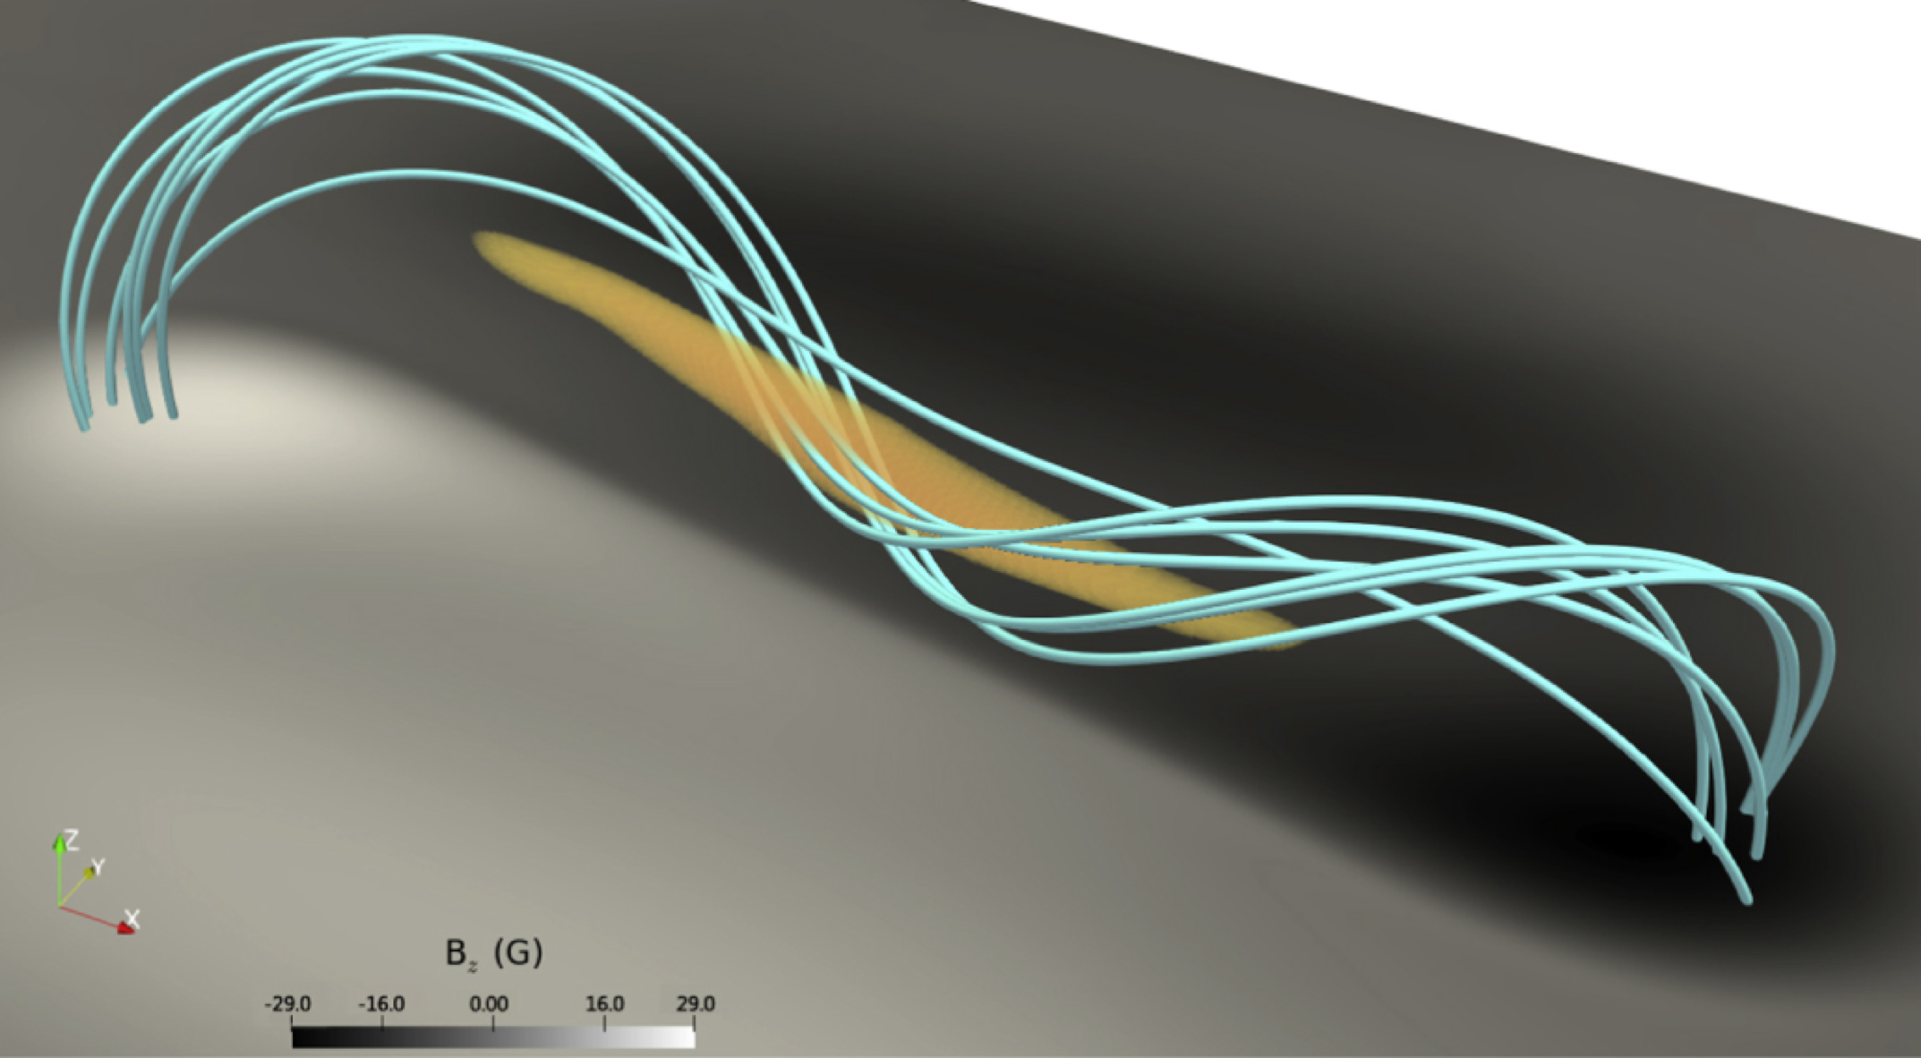
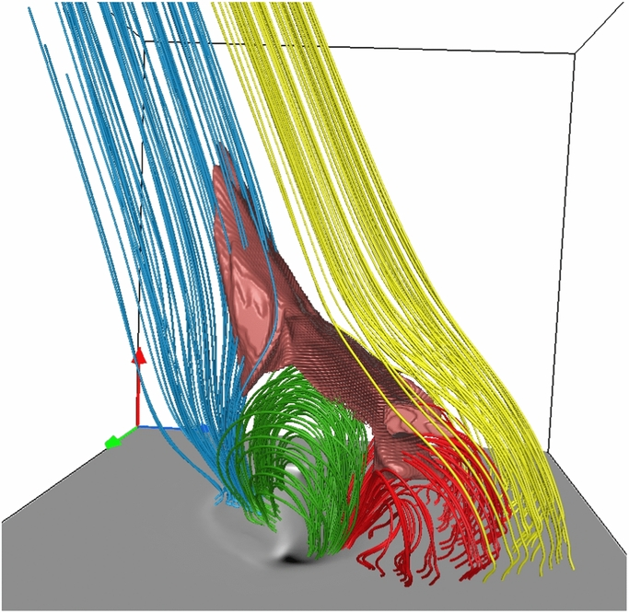
The ingredients: Solar Prominences & Coronal Jets
Solar prominences: clouds of cool plasma supported against gravity by the filament channel (FC).
SDO/AIA 171
From Zhou et al. (2018)
Jets are collimated plasma ejections produced by magnetic reconnection.
From Wyper et al. (2018)
From Moreno-Insertis & Galsgaard (2013)
Notes:
The FC is the magnetic skeleton of the prominence.
Theoretical modeling of jets focuses on ejections in open field structures (e.g. Yokoyama & Shibata 1996, Moreno-Insertis et al. 2008, Archontis & Hood 2008).
Jets formed by: ambient magnetic field, embedded dipole (null point), energizing the system by shearing dipole footpoints.

Slide 3
Motivation
What will happen if a jet is produced within the FC?
+
From Zhou et al. (2018)
There are already several observations reporting the apparent impact of a jet onto a prominence
Luna et al. (2014) and later Zhang et al. (2017) showed a jet in the FC hitting the prominence producing substantial oscillations in a large fraction of the filament.

Slide 4
Large-Amplitude Oscillations (LAOs) triggered by Jets
Luna et al. (2014) reported a clear example event.
Jet speed around 100 km/s
Prominence oscillations up to 40km/s
Periods around 50 minutes

Slide 5
The numerical setup
Filament channel + parasitic dipolar structure: null-point (NP)
Stratified atmosphere with chromosphere, transition-region and corona
2.5D simulations with MANCHA3D code developed at IAC.
The generation of the jet: photospheric driving is applied to the footpoints of the magnetic arcade (y-component of the velocity during 20 minutes.
Z
X
Y

Slide 6
Two phases reconnection
jet
jet
Breakout reconnection in BCS
(QUIESCENT JET)
Reconnection in vertical current sheet
(ERUPTIVE JET)

Slide 7
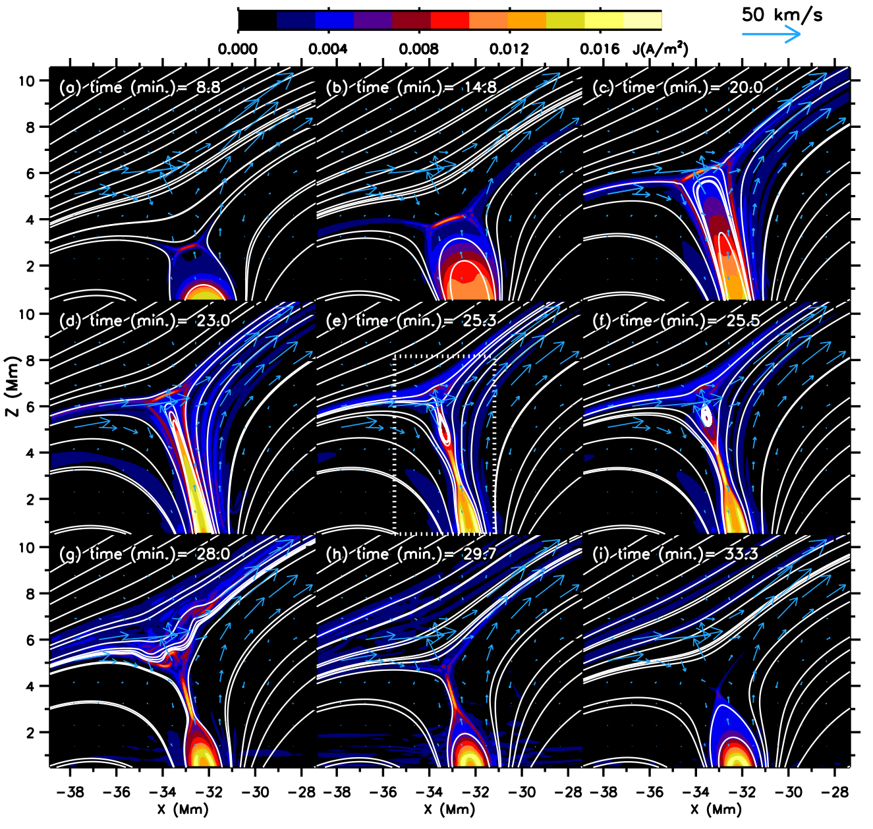
The generation of the Jets
}
Breakout reconnection in BCS
(QUIESCENT JET)
}
Reconnection in vertical current sheet
(ERUPTIVE JET)
Electric current around the shear region
Similar to Moreno-Insertis & Galsgaard (2013), Archontis & Hood (2013) and Wyper et al. (2018)

Slide 8
What disturbances emanate from the jet source and propagate along the FC?
Is it a complex combination of magnetic field and plasma moving together?
?
Alfvénic front: it moves faster than plasma flows
Quiescent jet flows
Eruptive jet flows

Slide 9
1- Alfvénic front
The magnetic field changes propagate along the FC.
Fast Alfvénic front propagating slightly above Alfvén speed: switch-on front
Behind Ahead
See Priest (2014)
Switch-on shock
The Alfvénic front reaches prominence earlier than the jet.
It excites string or hybrid modes (Roberts 1991; 463 Joarder & Roberts 1992; Oliver et al. 1993)

Slide 10
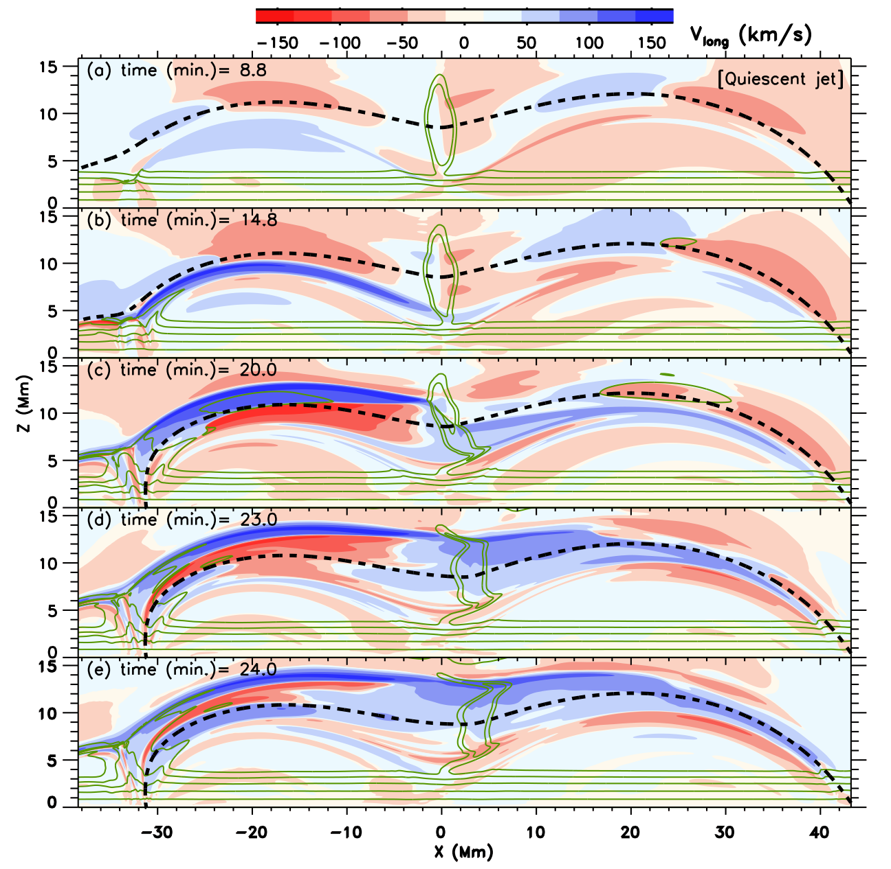
2- Quiescent Jet
Supersonic shock: 260km/s
Propagates along already perturbed field
Plasma flow exceeds 150km/s
Jet reaches increasingly higher levels of the prominence

Slide 11
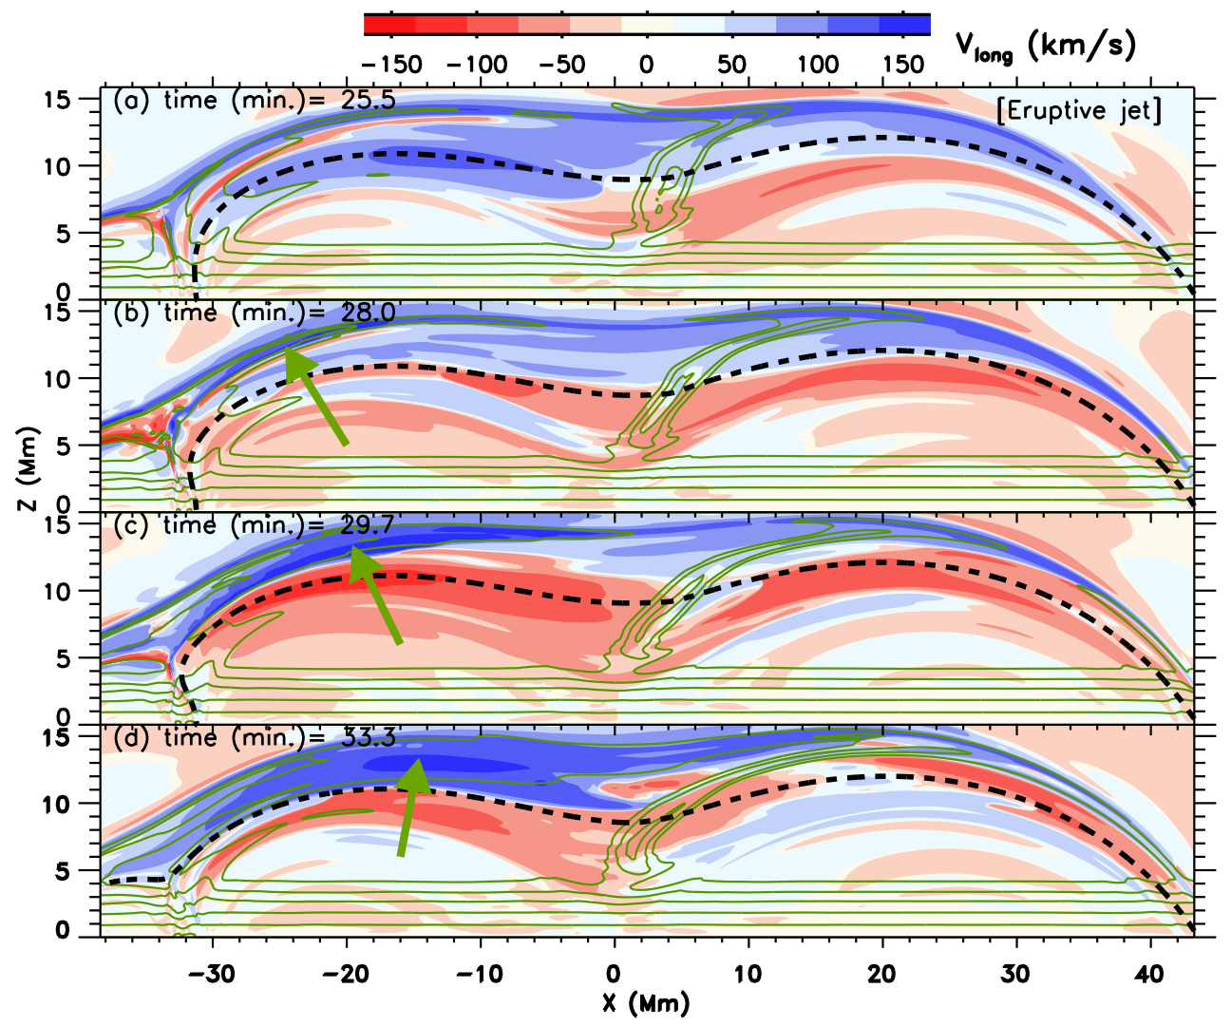
3- Eruptive Jet
Supersonic shock: 170km/s
Plasma flow: 150km/s
Jet successively lower heights

Slide 12
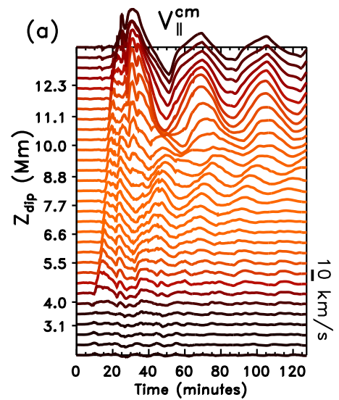
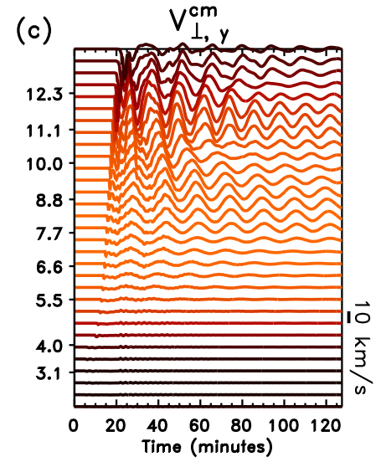
Evolution after the jet: oscillations
Vlong up to 30 km/s with periods from 20 to 40 minutes (Luna et al. 2018)
Vy up to 20 km/s with periods around 15 minutes (Mazumder et al. 2020)
The reconnection produces large-amplitude oscillations (>10 km/s), simultaneously with longitudinal and transverse polarizations (Zhang et al. 2017)

Slide 13
Summary
First study of the jet-prominence interaction
Alfvénic disturbance ahead of jet flows
Two stages jet: quiescent and eruptive
The ‘jet’ produces large-amplitude longitudinal and transverse oscillations
Luna & Moreno-Insertis, ApJ (2020), 912, id.75
Access to the publication

