Slide 1
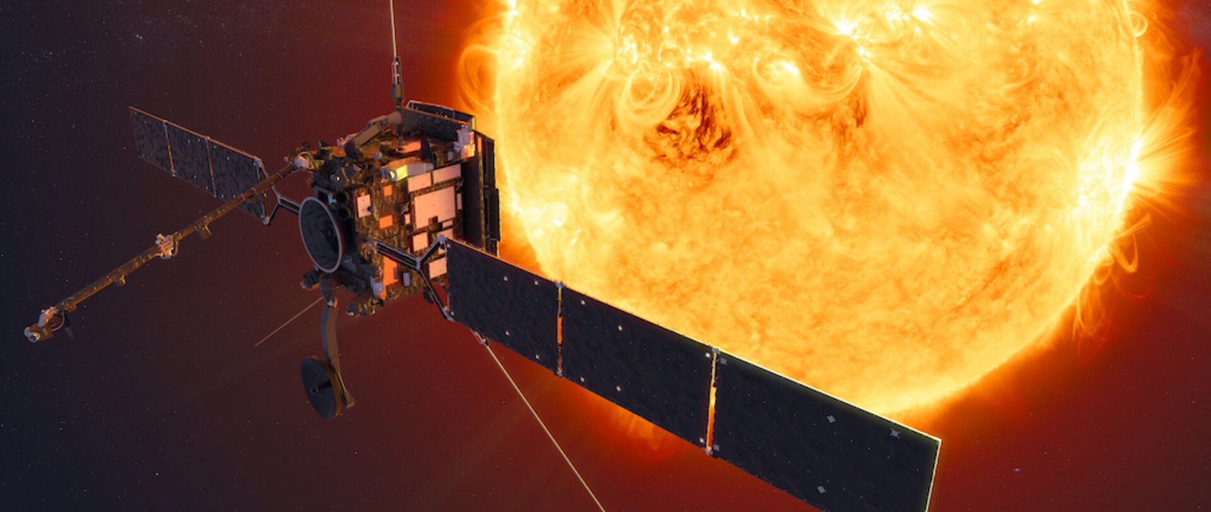
Multi-instrument microflare study J. Saqri¹, A. Veronig¹, E.C.M. Dickson^{1,2} A. Warmuth³ , A. F. Battaglia^{2,4}, S. Krucker^{2,5}, M. Battaglia², H. Xiao² , G. Hurford² and the STIX Team
¹Institute of Physics, University of Graz;²University of Applied Sciences and Arts Northwestern Switzerland;³Leibniz-Institut für Astrophysik Potsdam (AIP);⁴ETH Zürich;⁵Space Sciences Laboratory, University of California
jonas.saqri@uni-graz.at
https://pub023.cs.technik.fhnw.ch/static/images/so1.jpg

Slide 2
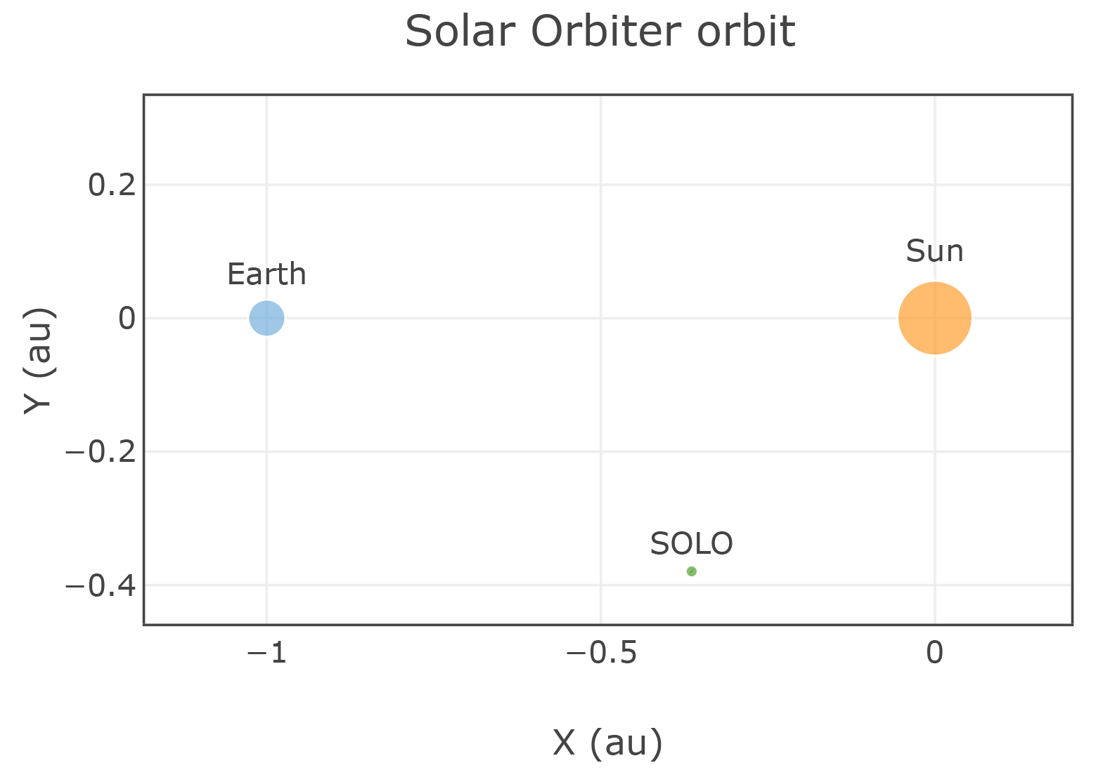
Introduction
Event with highest countrate during STIX‘s comissioning phase
GOES B6 flare on June 7th, 2021
Solar Orbiter was 0.53 AU from the sun
Simultaneously seen from earth
STIX, GOES, AIA observations available

Slide 3
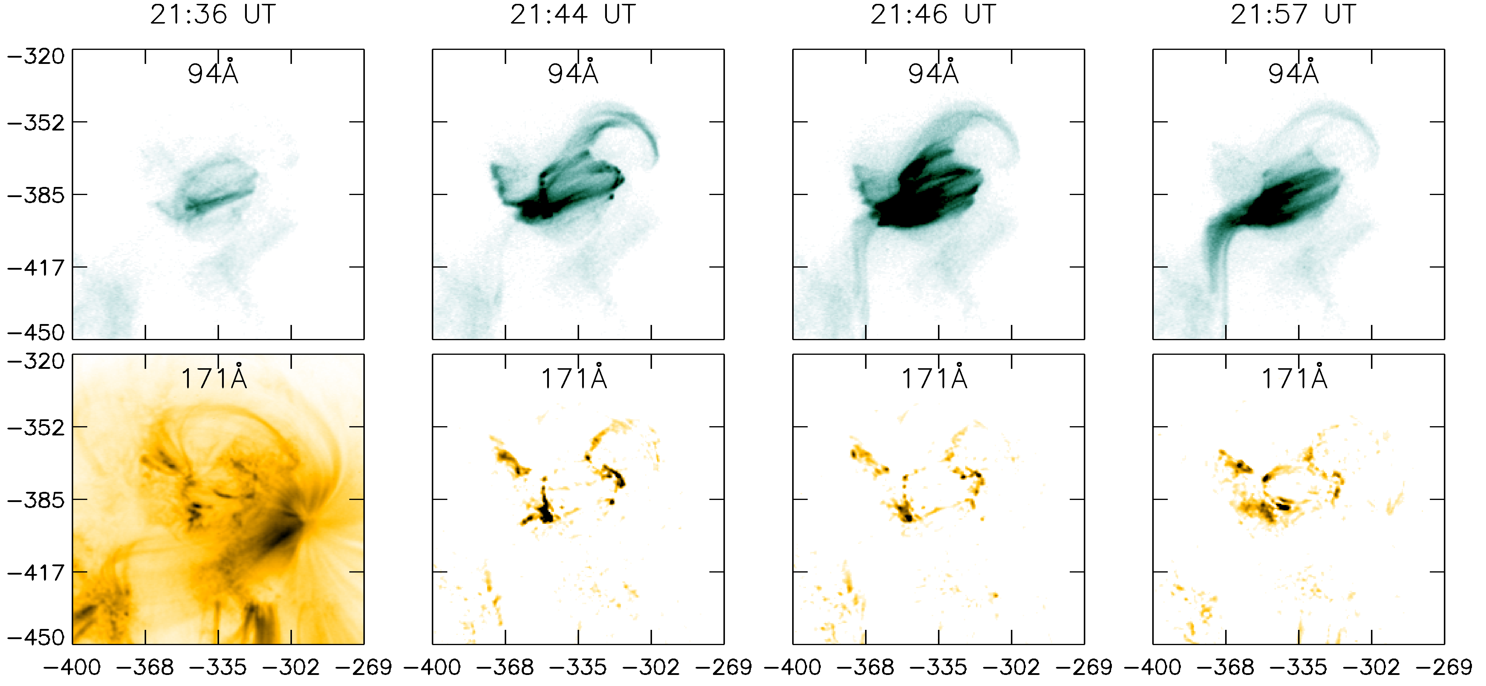
AIA imaging

Slide 4
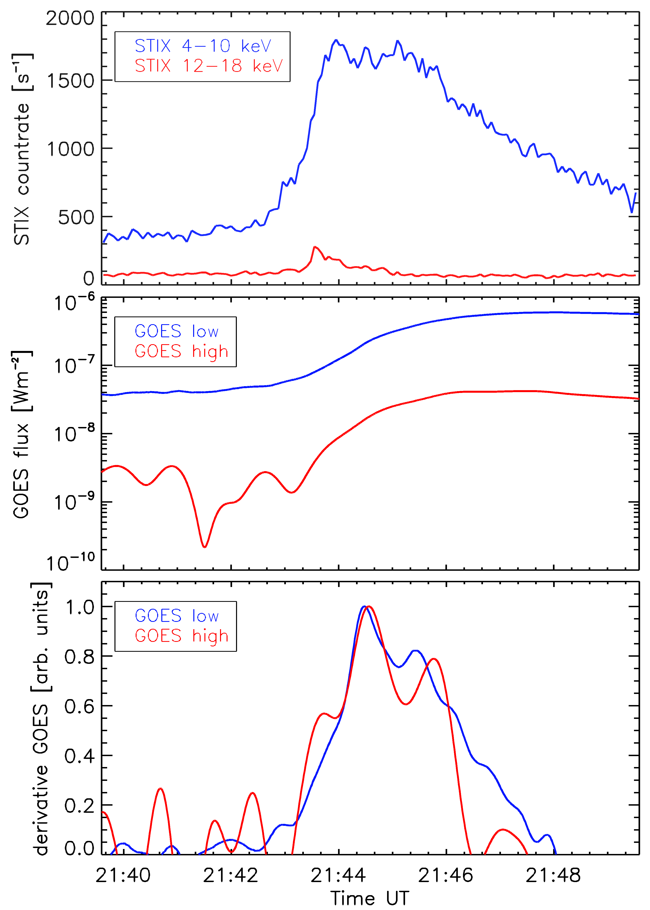
SXR, HXR observations
Neupert effect expected in standard flare model
Comparison of STIX 12-18 keV with smoothed GOES data roughly shows neupert effect

Slide 5
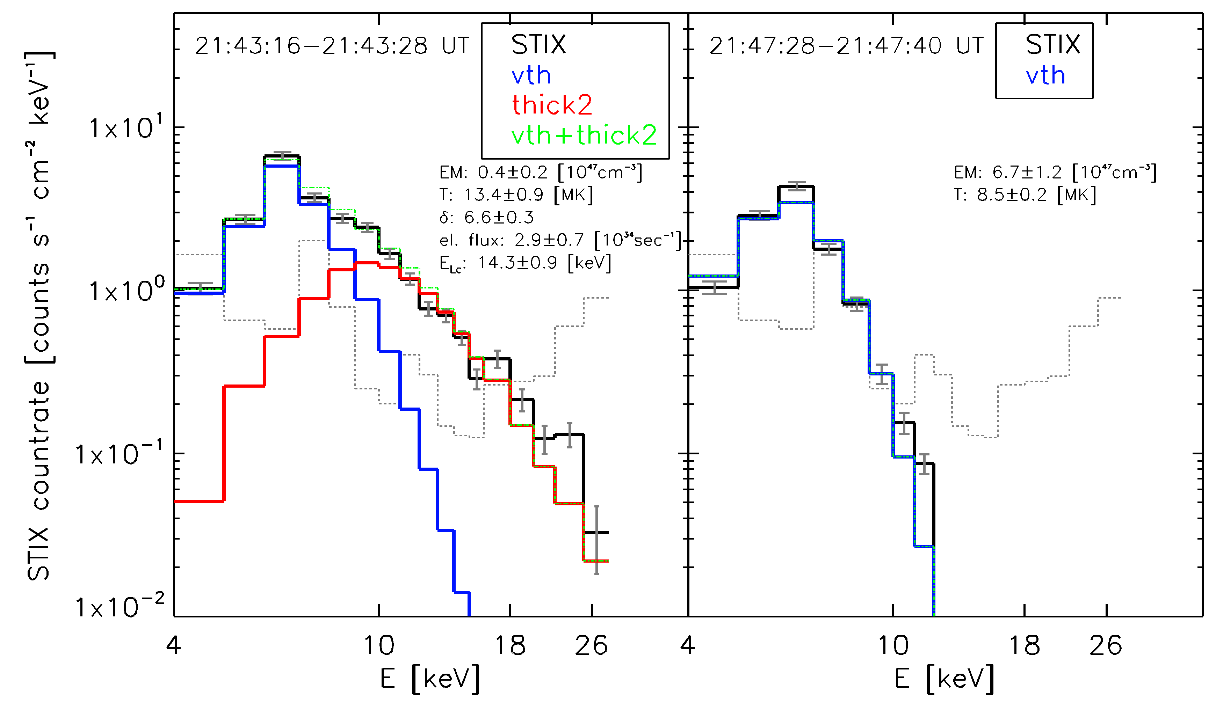
Stix Spectroscopy
Impulsive phase: thick target emission above background
Followed by thermal decay phase

Slide 6
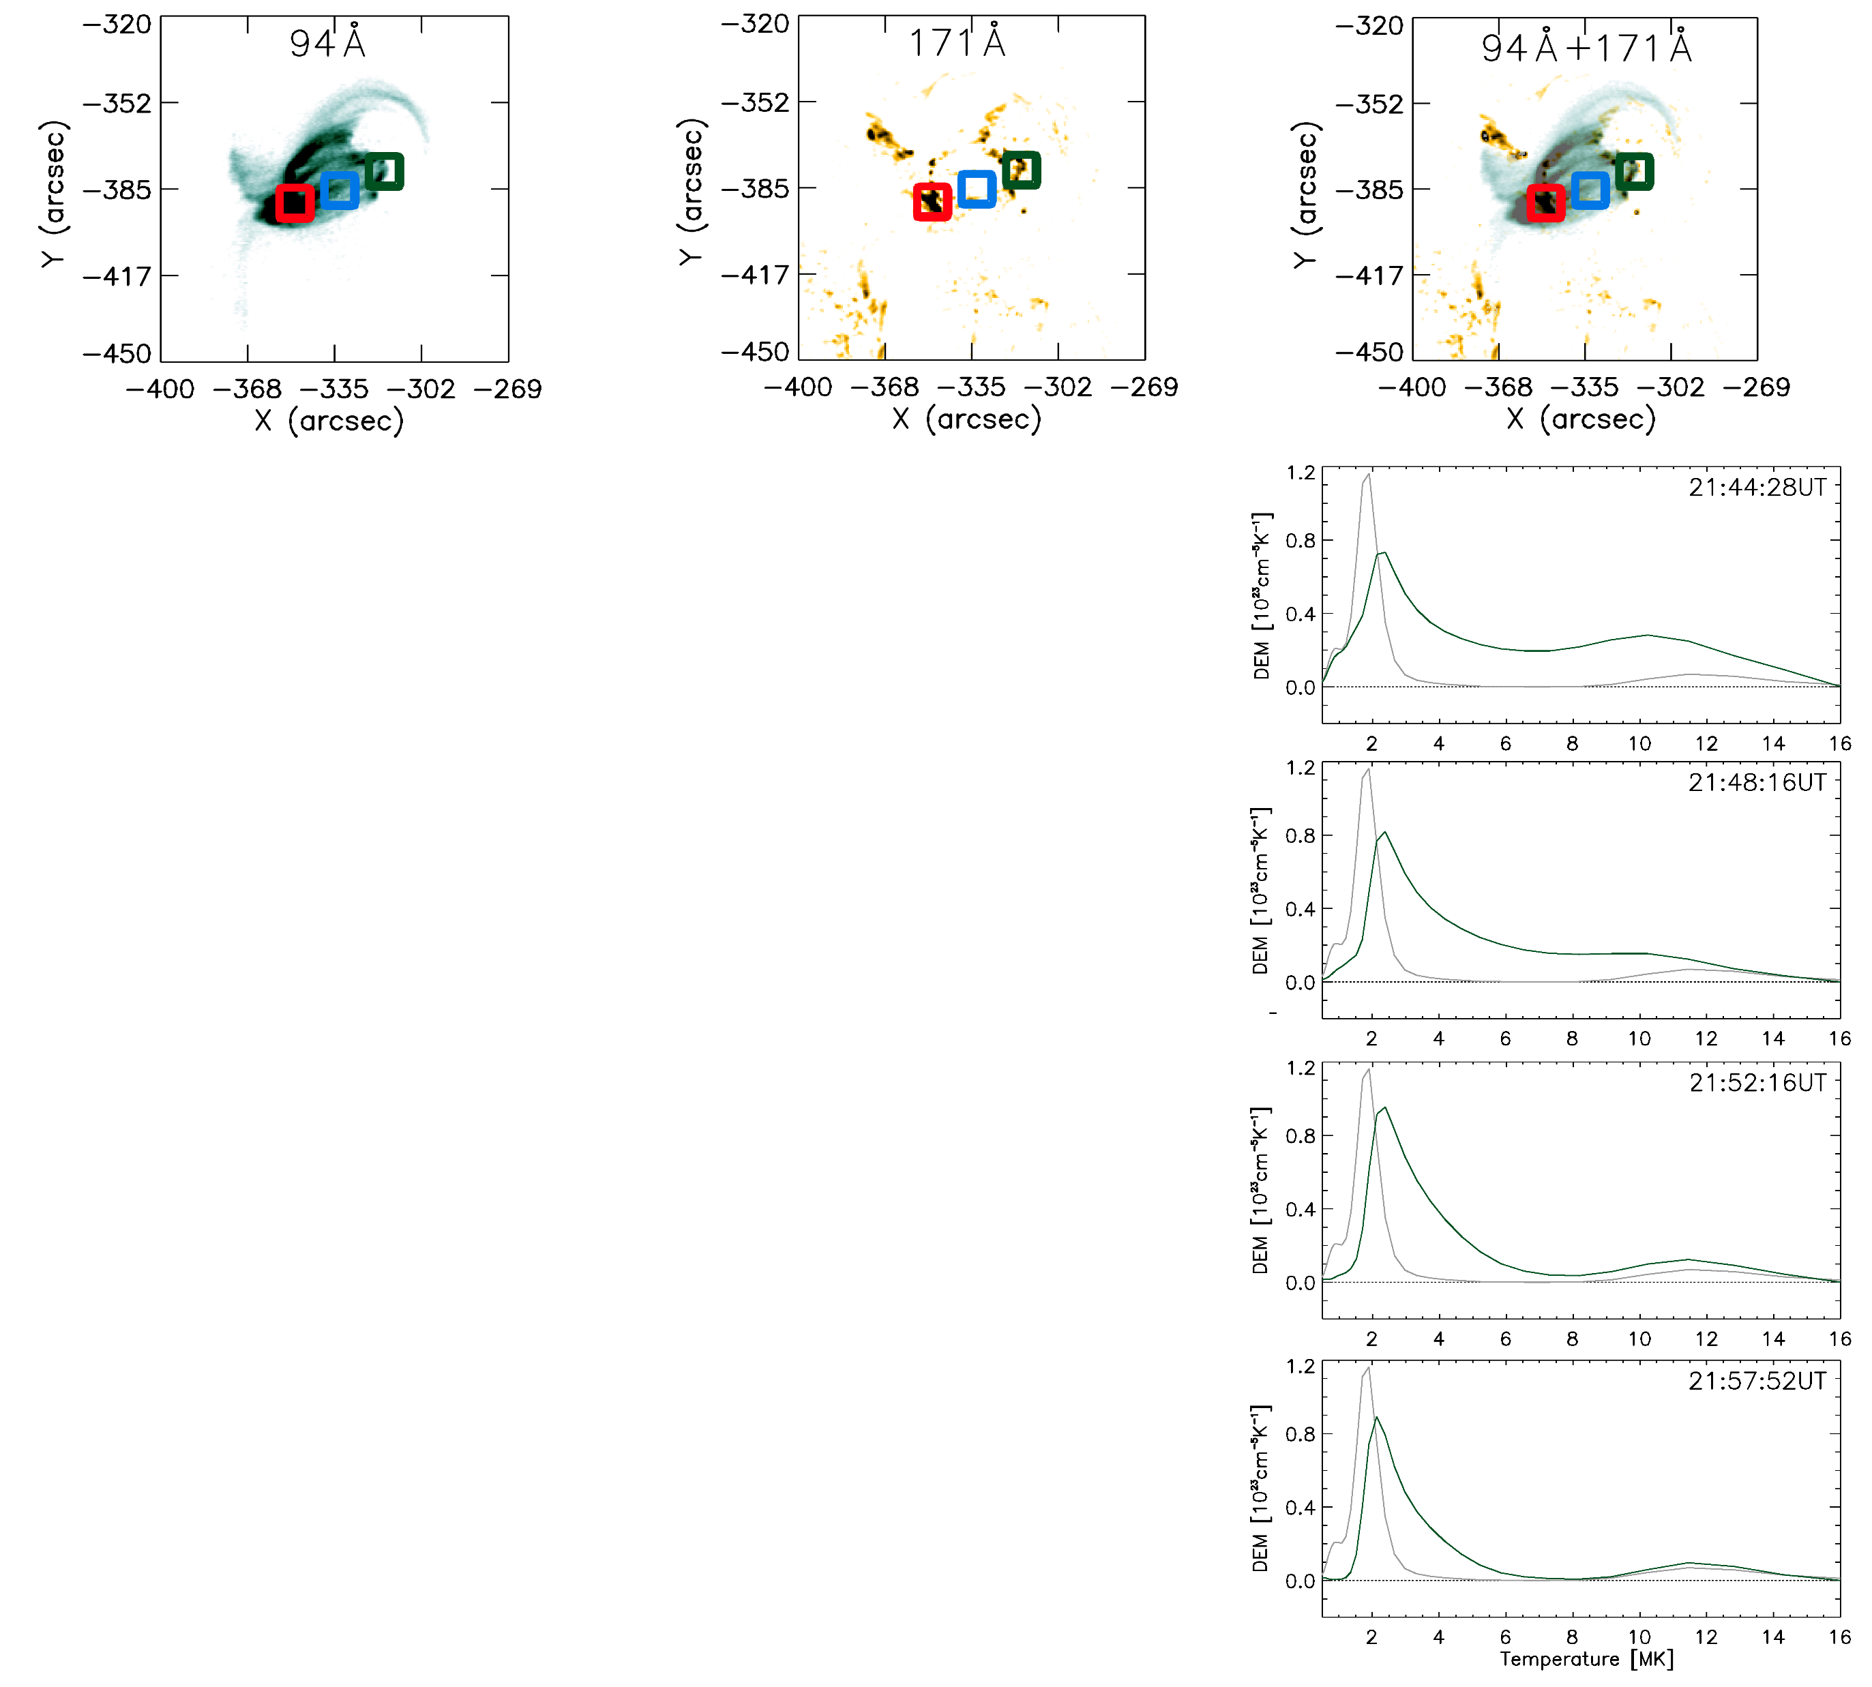
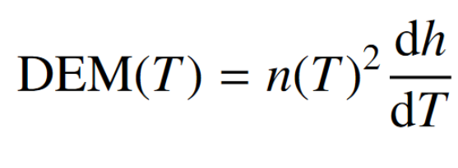
DEM Analysis
Western kernel: DEM centered around 3 MK

Slide 7
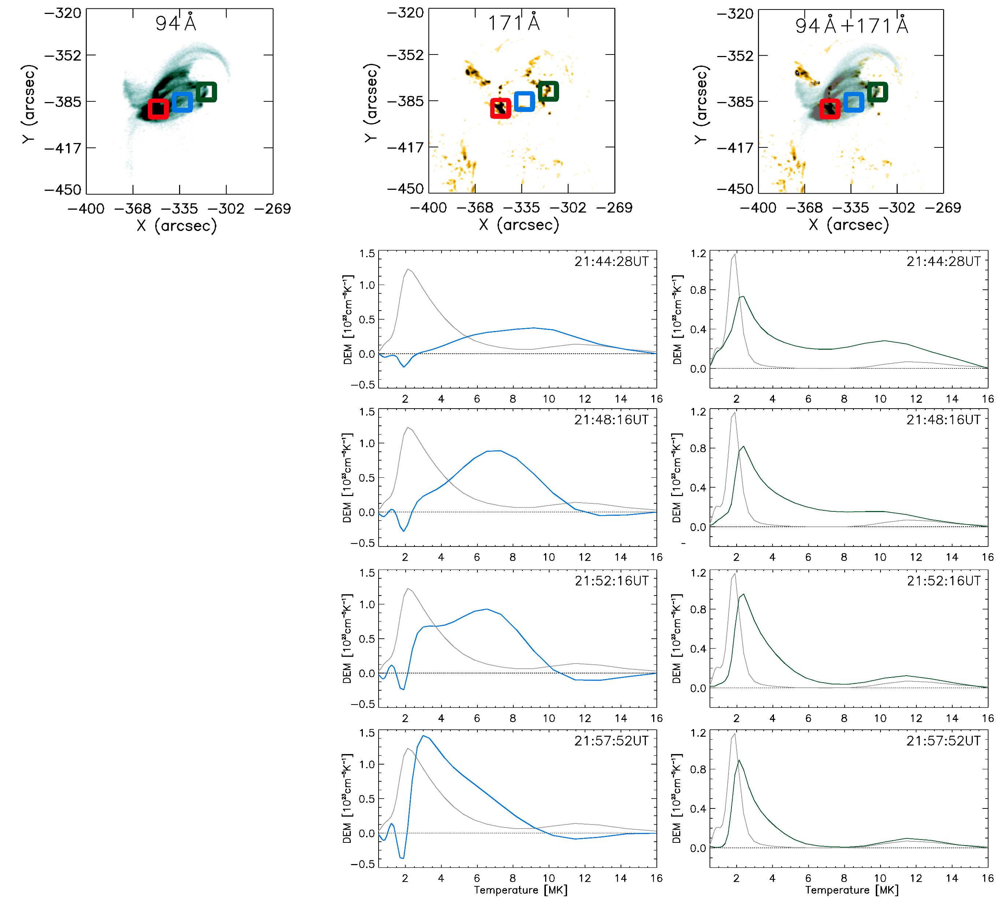
DEM Analysis
Flare loop: rising 8 MK plasma
Subsequent cooling

Slide 8
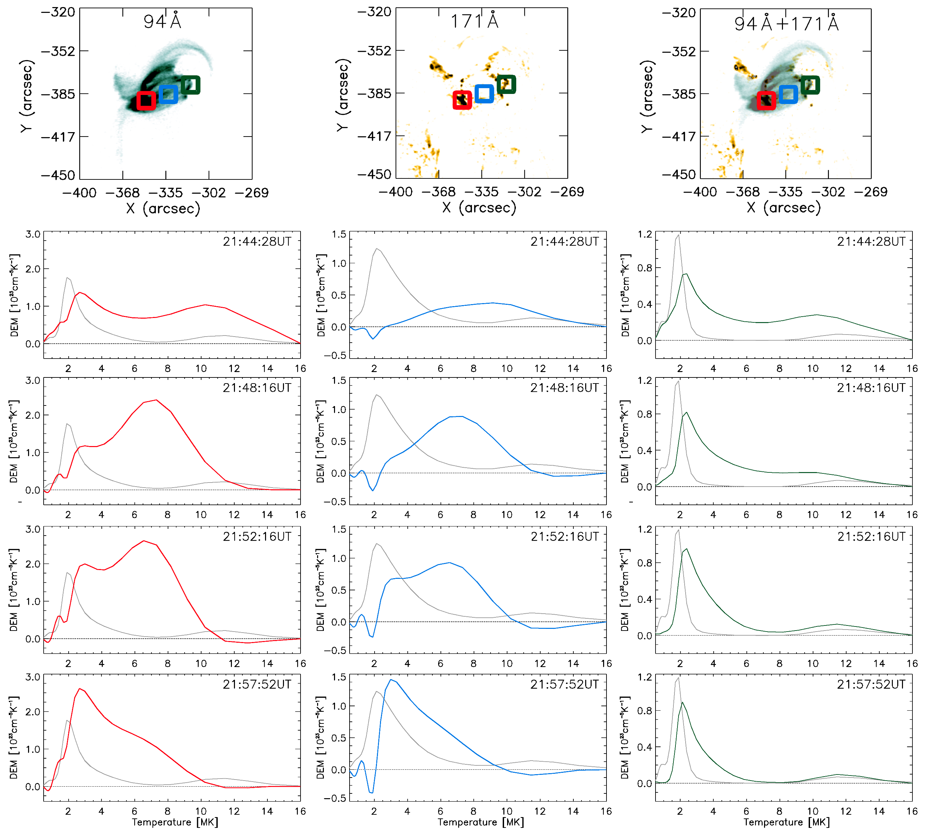
DEM Analysis
Combination of previously shown behaviours due to LoS effects

Slide 9
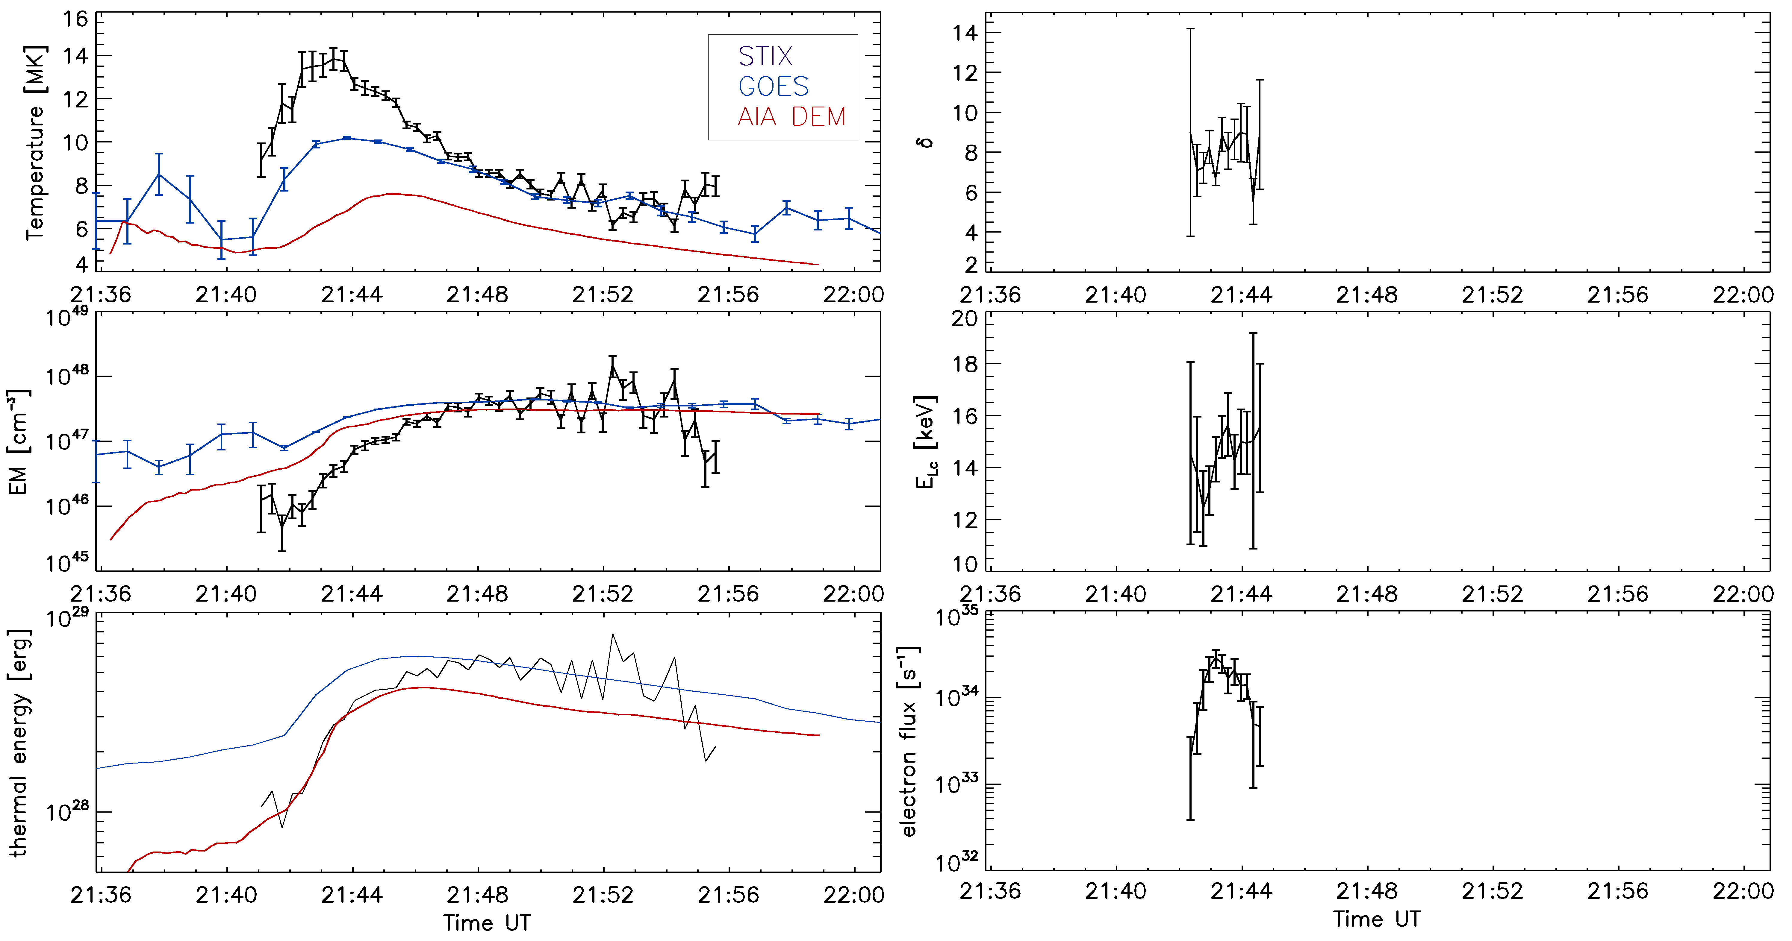
Evolution of plasma and spectral fit parameters
Discrepancies between instruments due to different response functions
3 minutes of nonthermal emission
EM, T, δ in agreement with previous studies from RHESSI era ( Hannah et al.,2008, ApJ, 677, 704)

Slide 10
Summary
STIX spectra show nonthermal + thermal emission
~ Neupert effect
Spatially resolved thermal plasma diagnostics from DEM Analysis
T, EM values roughly agree with previous flare studies

Slide 11
Thank you
jonas.saqri@uni-graz.at
https://pub023.cs.technik.fhnw.ch/static/images/so1.jpg

