Slide 1
Estimating uncertainties in the back-mapping of the fast solar wind
Alexandros Koukras, Rony Keppens, Laurent Dolla
Contact details: alexandros.koukras@kuleuven.be

Slide 2
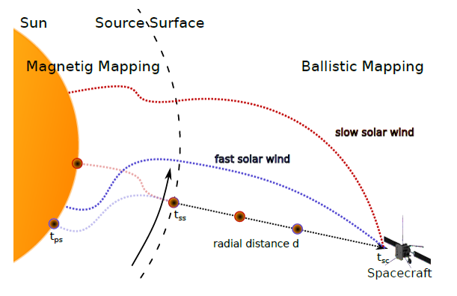
Introduction
What is solar wind back-mapping?
From S/C to solar surface
Ballistic mapping + Magnetic mapping
Magnetic topology from PFSS extrapolation
Why we want to back-map the solar wind?
Locate the source region of the solar wind
Linkage analysis: combine in-situ and remote sensing observations
4 “Events” of fast solar wind stream
Coronal holes at low latitudes
CHs with different morphologies
Sampling over different phases of the solar cycle
Peleikis et al. 2017
ESPM - 16

Slide 3
Sources of uncertainty
Radial velocity profile in ballistic mapping
Source surface height
Magnetogram noise
Uncertainty in measured solar wind velocity
Uncertainty in spacecraft position
Significant effect
Small effect
ESPM - 16
Notes:
Add effects

Slide 4
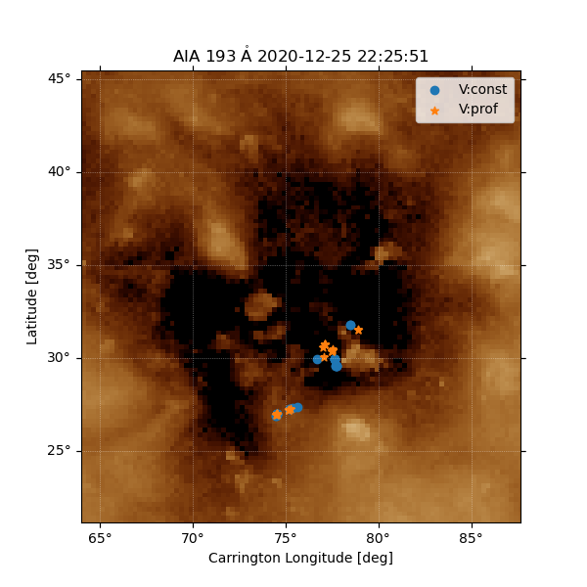
Velocity in ballistic mapping
Typical approach in literature: radial solar wind velocity = constant
We create custom velocity profiles based on a parametrization of analytical approximations of the Parker transonic solution (small/large distances)
Constrained by the measured velocity at 1 AU and by UVCS observations near the Sun (Miralles et al. 2004, Dolei et al. 2017, Bemporad 2017)
This way we can examine the 2 extreme cases:
v = constant -> shortest travel time
v = velocity profile -> longest travel time
Average uncertainty (Source Surface Height=2.5 Rs):
Lon: 0.30 ± 0.33 (deg)
Lat: 0.48 ± 0.61 (deg)
Event 4
Event 4
ESPM - 16
Notes:
“V profile that agrees with observations and provides the longest travel time”
Based on the distribution of the differences in position for the 2 extreme cases, we can derive an estimate for the average uncertainty.

Slide 5
Source Surface height
Event 4
Compute the solar surface position (lon-lat) for every back-mapped point in the fast solar wind stream, for SS height: 1.5-3.5 Rs
Select only the points that connect to the coronal hole
The standard deviation of the positions of the selected points provides the associated uncertainty
Average uncertainty:
Lon: 1.99 ± 0.34 (deg)
Lat: 3.07 ± 0.42 (deg)
Event 4
ESPM - 16

Slide 6
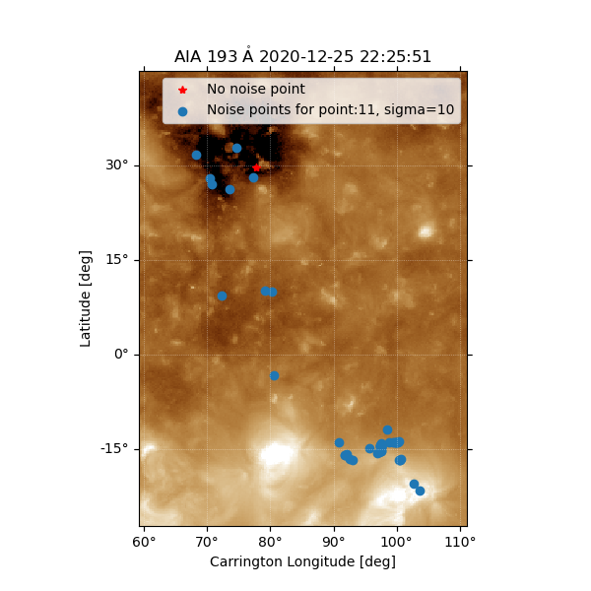
Magnetogram Noise
Event 4
Disturb input magnetogram by adding Gaussian noise
50 noise realizations per back-mapped point (SS height=2.5Rs)
For every back-mapped point, calculate the difference with the ‘no-noise’ position. The standard deviation of these differences is the associated uncertainty.
Average uncertainty:
Lon: 7.91 ± 3.49 (deg)
Lat: 13.3 ± 4.83 (deg)
Sigma=10 G
ESPM - 16

Slide 7
Conclusions
Analysis still in progress…
Flexible framework that can investigate in depth multiple sources of uncertainty
Initial evidence show case dependence
Different uncertainty estimates for longitude and latitude
A ‘general’ uncertainty estimate (per source) can be derived from all events
Example for ballistic velocity
Similar accuracy with the Magnetic Connectivity Tool (IRAP, Rouillard et al. 2020), but with ability to estimate uncertainty per source
 | Event 1 | Event 2 | Event 3 | Event 4 | General Estimate
Longitude (deg) | 0.82 | 0.39 | 0.18 | 0.3 | 0.42 ± 0.24
Latitude (deg) | 0.28 | 1.21 | 0.54 | 0.48 | 0.63 ± 0.35
ESPM - 16

Slide 8
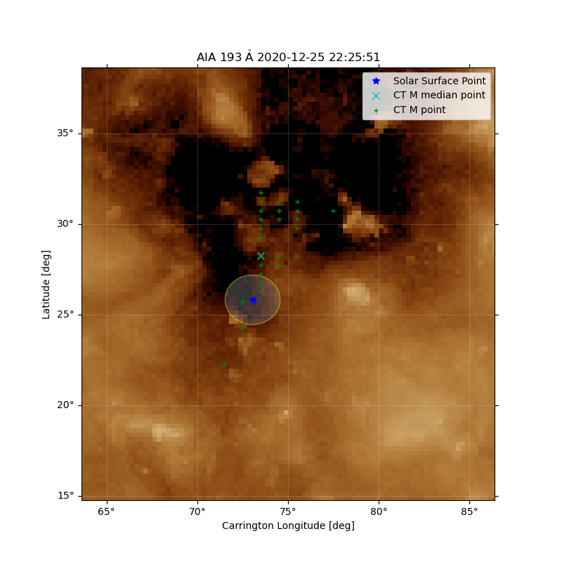
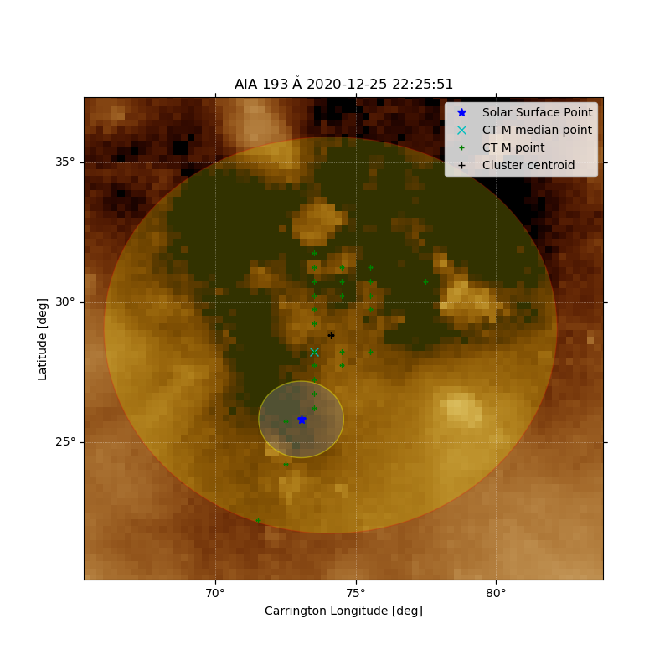
Comparison with Connectivity Tool (IRAP)
Similar accuracy
Potentially better precision
Identification of uncertainty per source
ESPM - 16

Slide 9
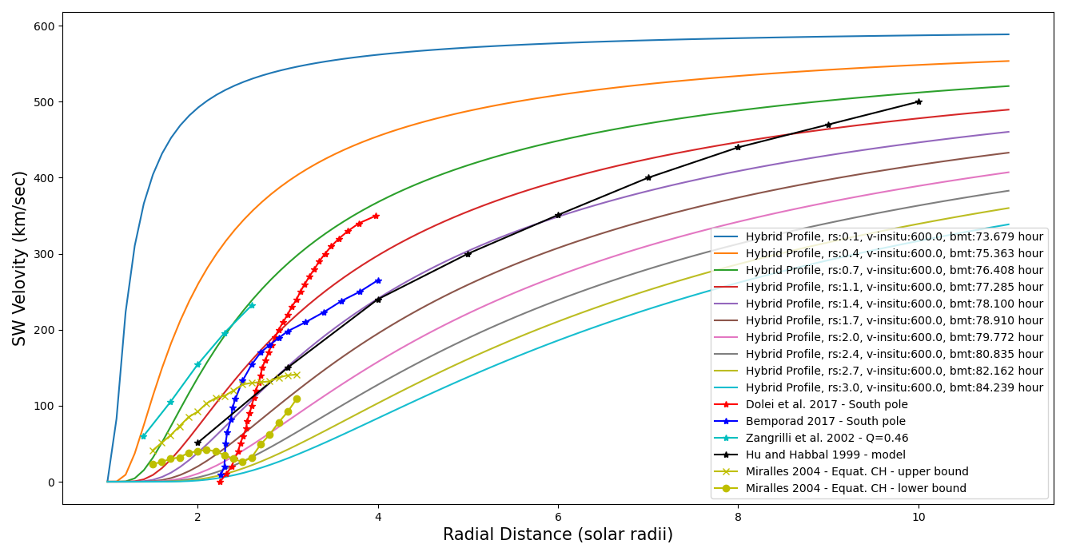
Additional material for slide 4
The custom velocity profiles are controlled from 2 free parameters
One is the measured velocity in-situ (1AU or Earth), which imposes that they should reach this speed at this distance
The next is the rs variable, which controls the shape of the velocity profile close to the Sun, and essentially the location of the sonic point
ESPM - 16

Slide 10
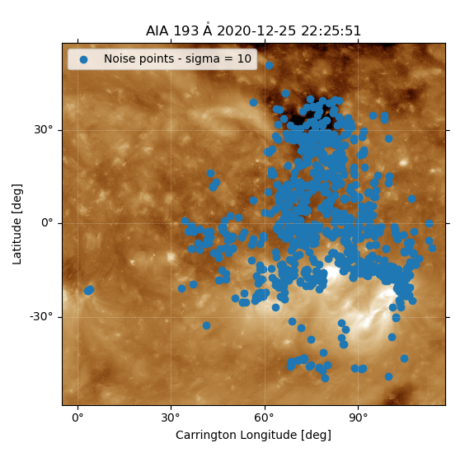
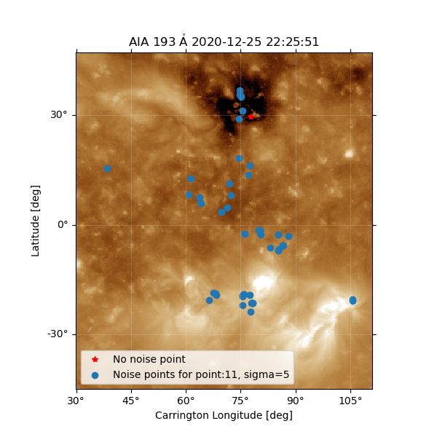
Additional material for slide 6
First results show that the extrapolation is very sensitive to the initial conditions
Tested multiple noise levels
ESPM - 16

