Slide 1
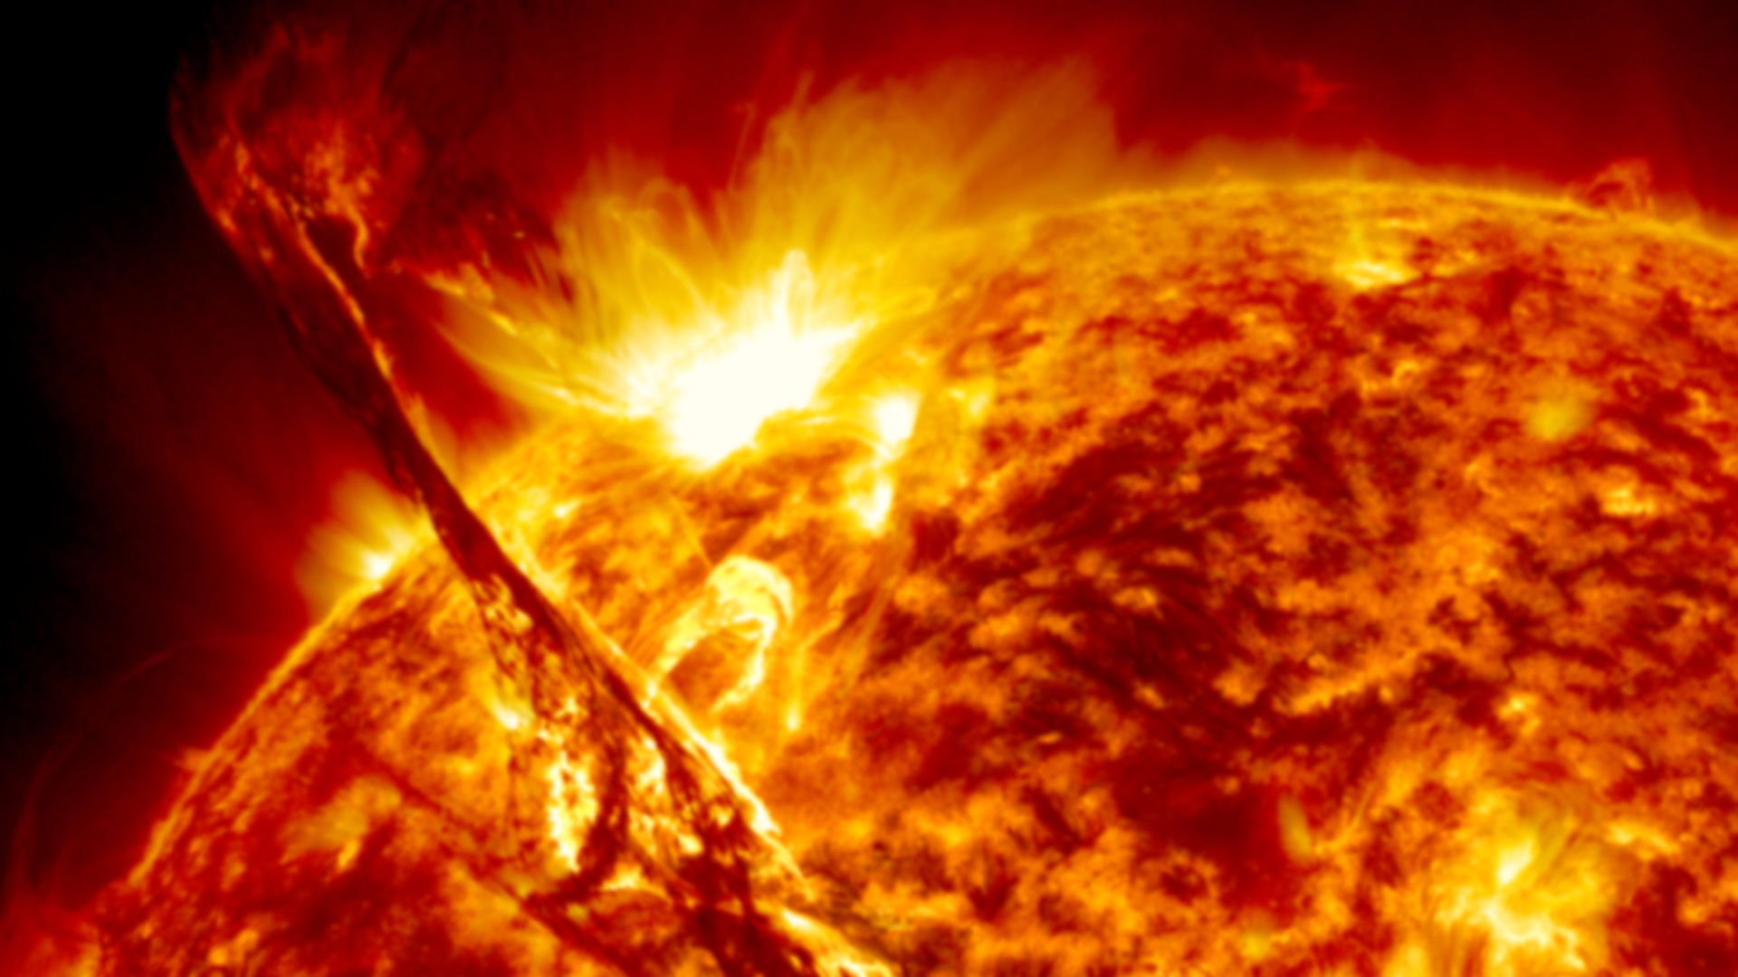

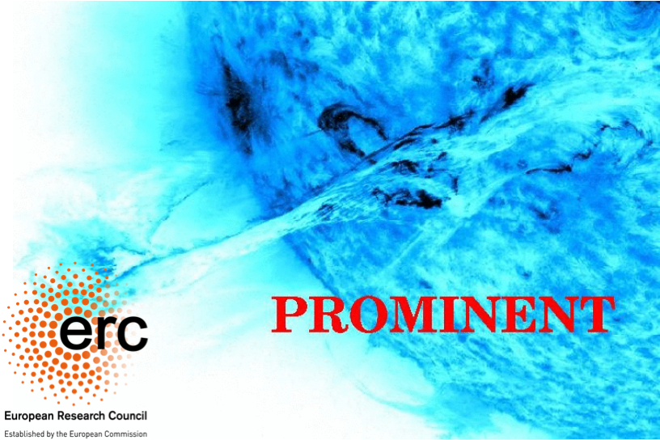



16th European Solar Physics meeting, 2021
Simulating Rayleigh-Taylor induced magnetohydrodynamic turbulence in Solar Prominences
Madhurjya Changmai¹ , Rony Keppens¹
(madhurjya.changmai@kuleuven.be)
¹Centre for mathematical Plasma-Astrophysics, KU Leuven,
07.09.2021

Slide 2
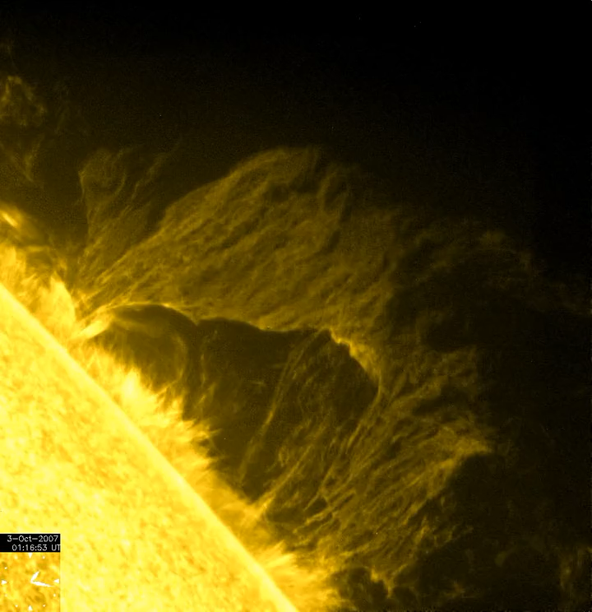
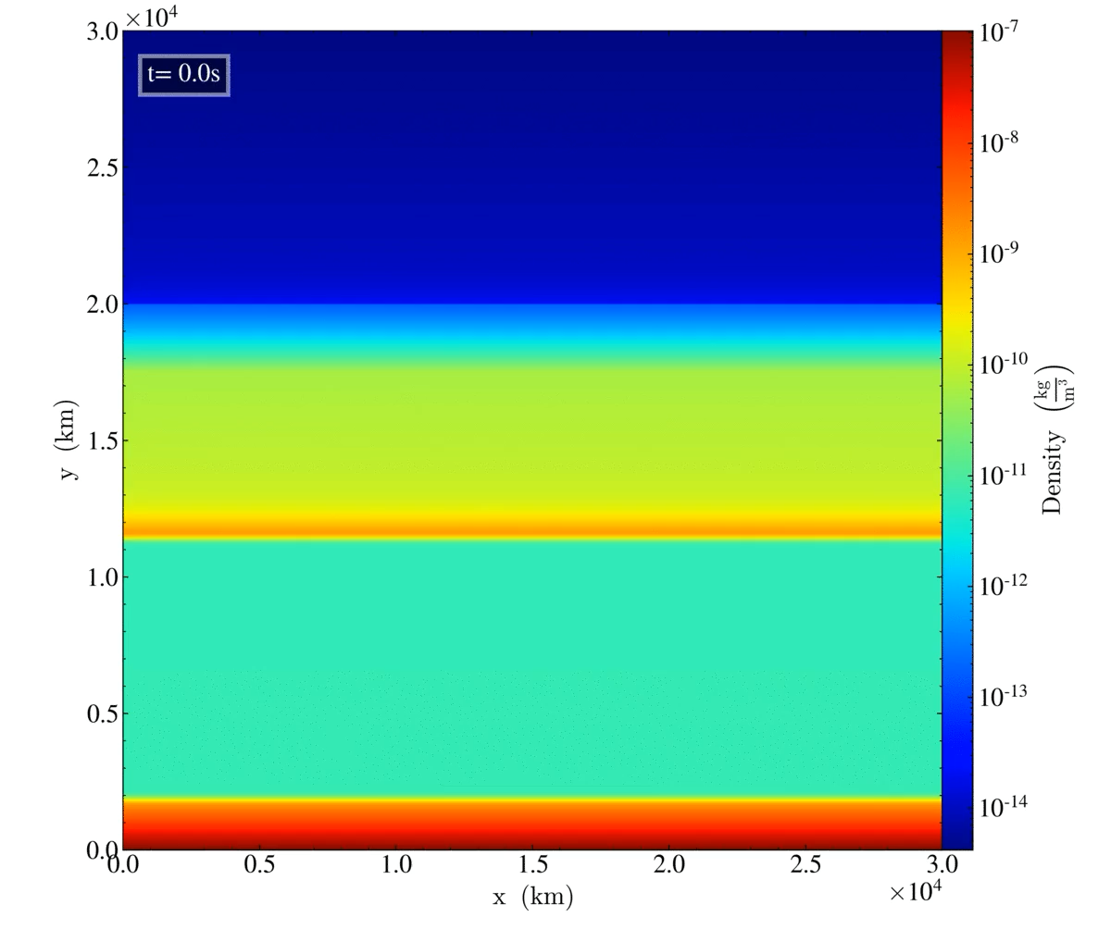
Solar Prominences
FROM OBSERVATIONS TO SIMULATIONS
Quiescent prominences display a wide range of dynamic processes over an equally wide range of scales.
Magnetic Rayleigh-Taylor Instability (RTI) is one of the fundamental processes driven by gravity which drives upflow plumes and descending pillars.
Turbulence is one of the key mechanism responsible for efficiently mixing and transporting matter and energy across the wide range of scales in prominences.
Study of turbulent signatures in solar prominences- Leonardis et al. (2012), Freed et al. (2016), and Hillier et al. (2017)
Hinode 2007
2.5D RTI Simulation

Slide 3
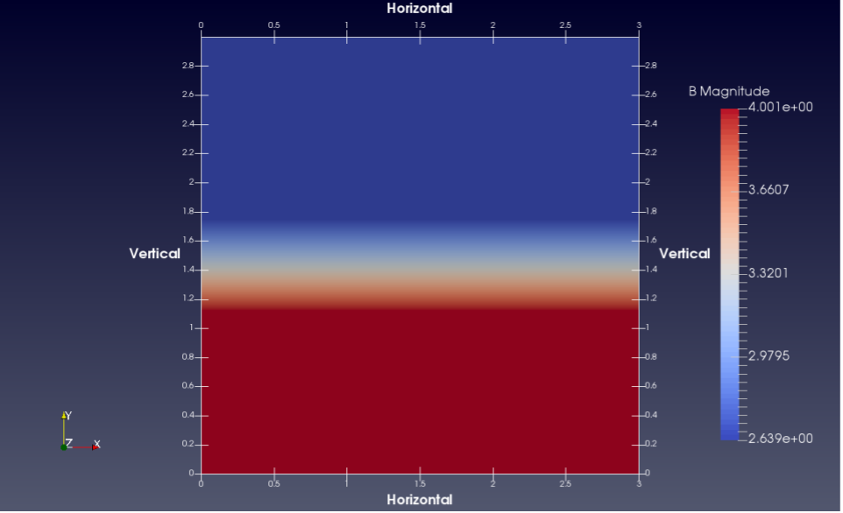
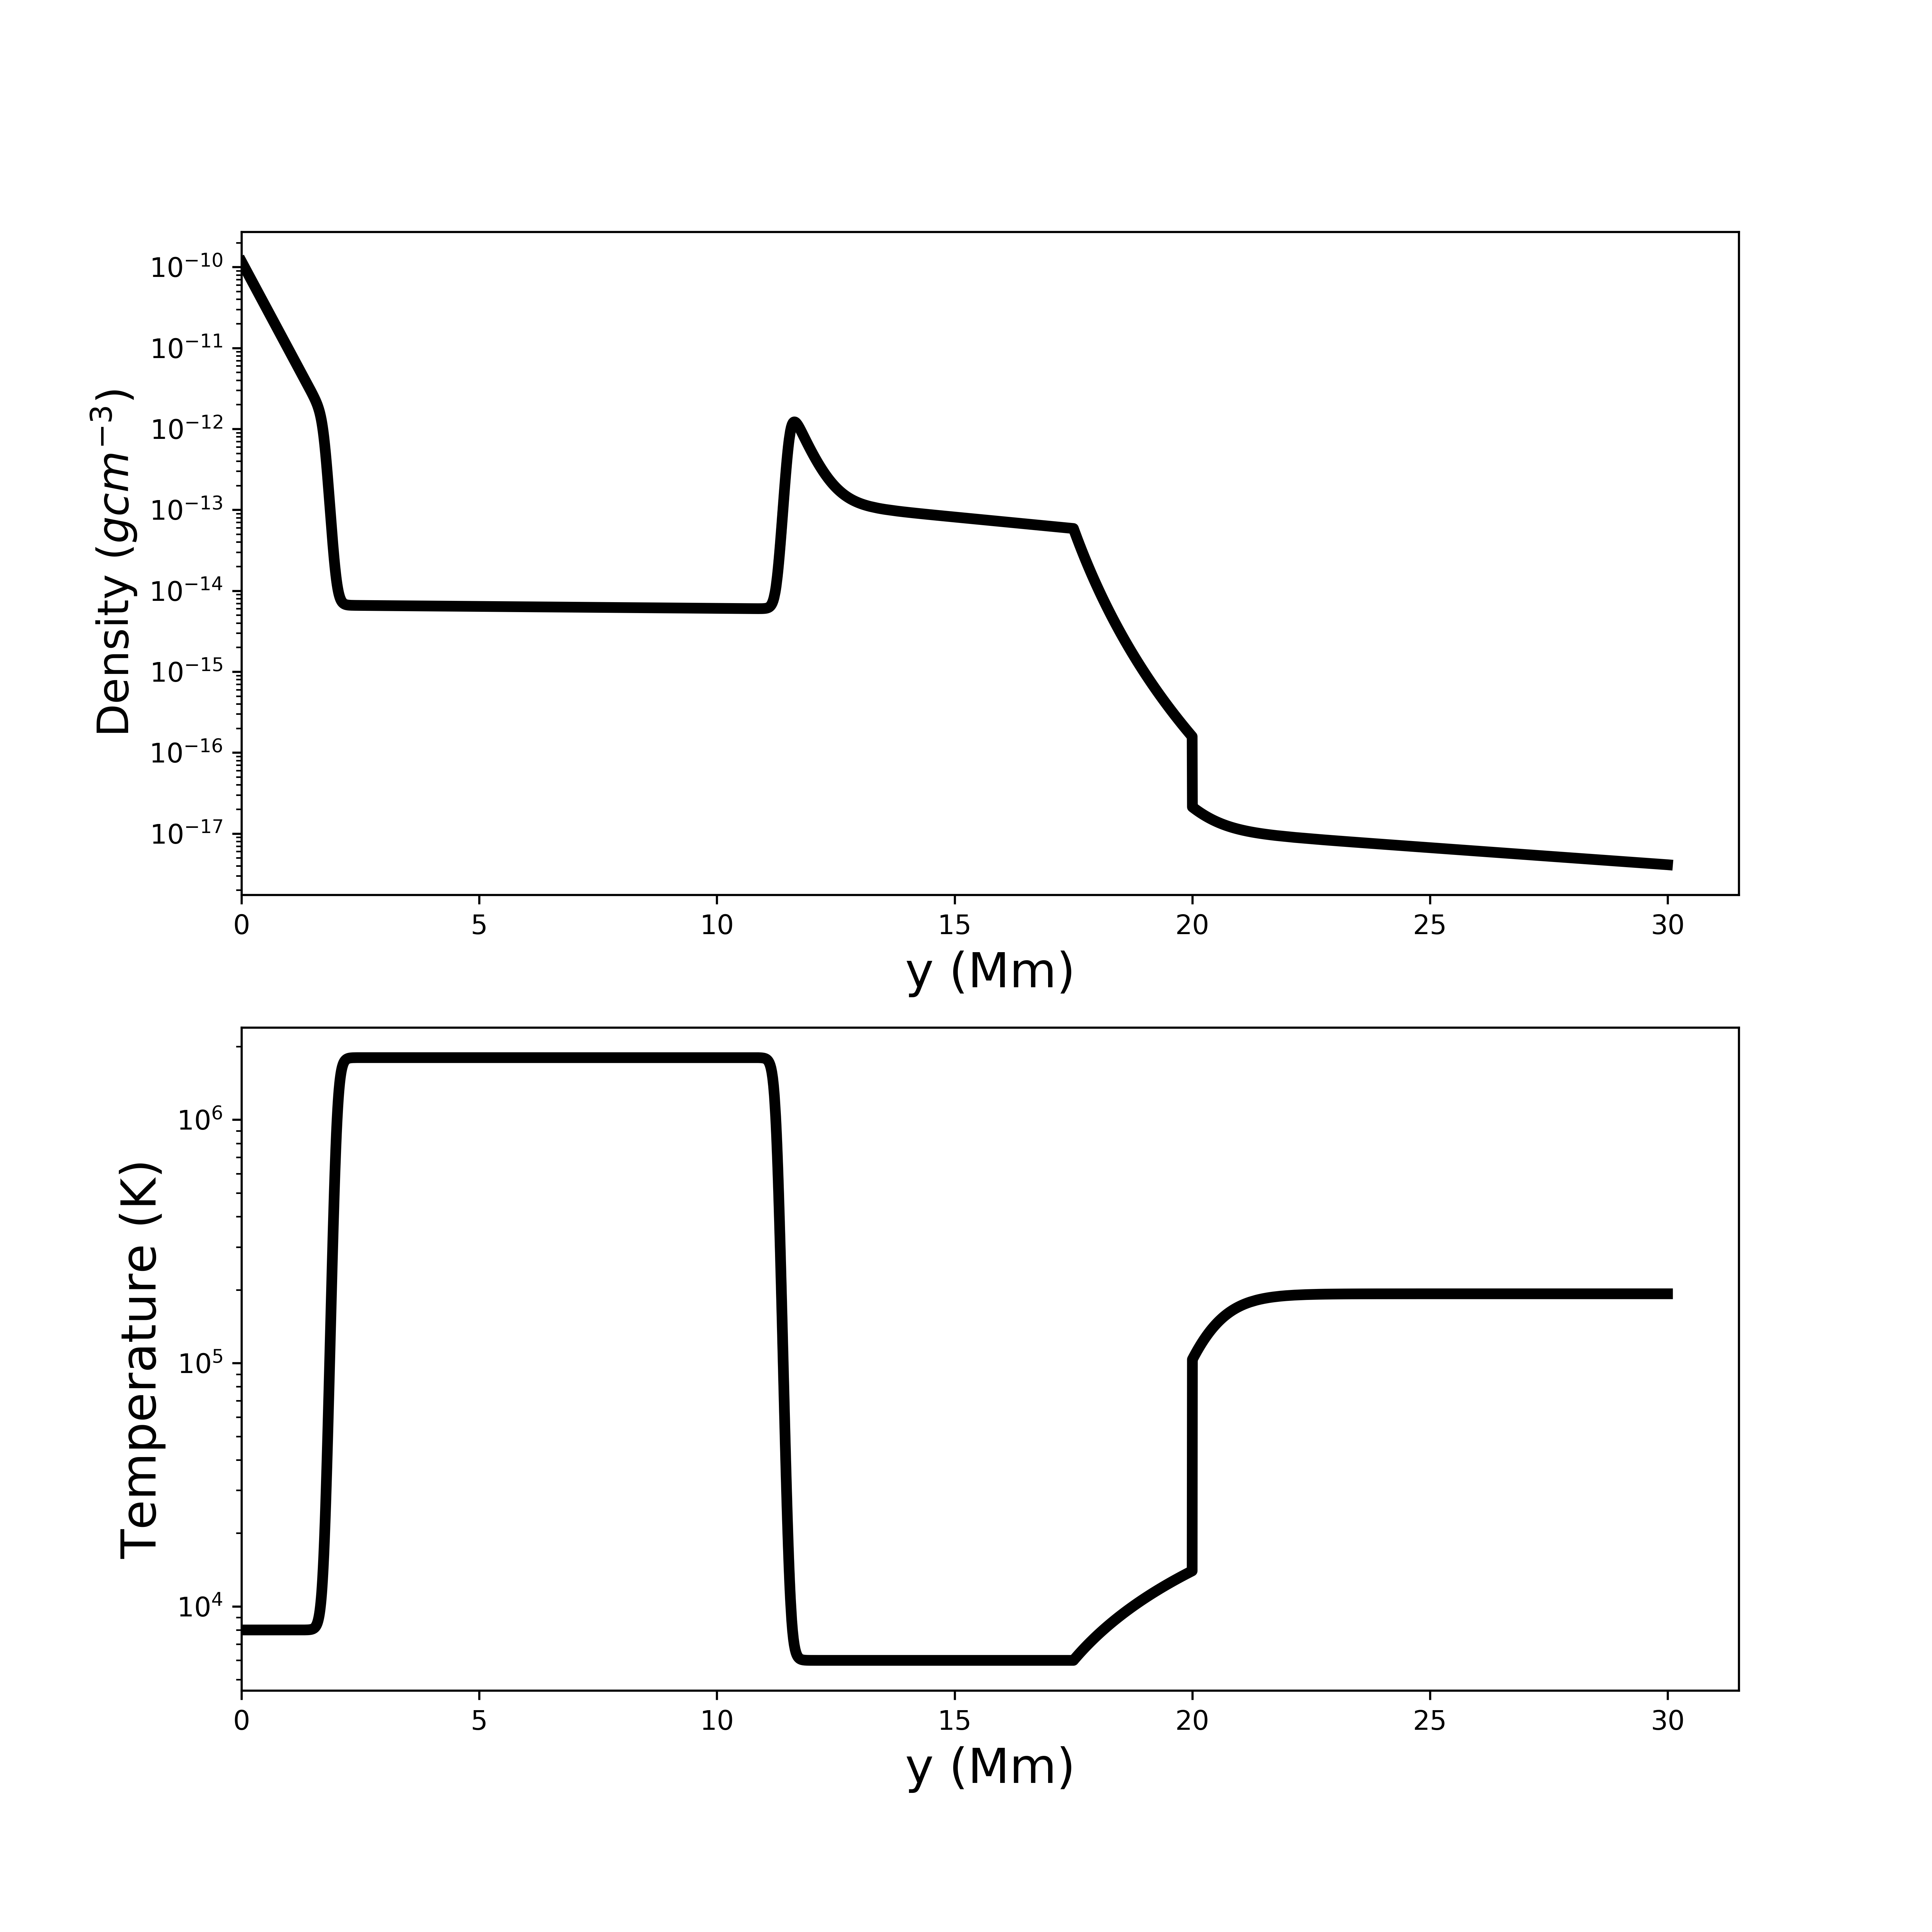
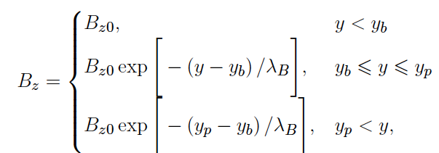
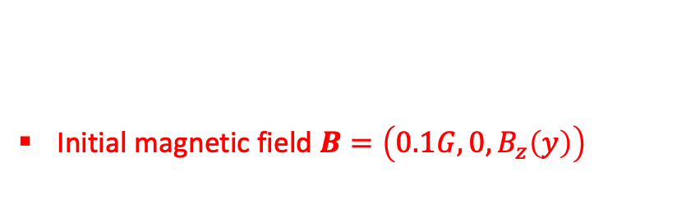
Solar Prominences Simulation
OBJECTIVE: To understand the turbulence that arises from the Rayleigh-Taylor Instability and leads to the formation and evolution of a quiescent prominence.
2.5 D Ideal MHD Simulation in MPI- AMRVAC
30 Mm x 30 Mm (Solar Prominence height x Solar Surface)
Initial magnetic field $B=\left(0.1G,0,B_{z}\left(y\right)\right)$
Setup follows Keppens et al. (2015), In ApJL, 806, L13
Resolution ≈(23 km x 23 km)
Mean magnetic field 4 G into the plane ≈ 88.5º with horizontal x-axis
Initial vertical equilibrium (includes the chromosphere, a coronal part below the prominence, the prominence, and the corona above)
y_{p} = 17.5 Mm
y_{b} = 11.25 Mm

Slide 4
Solar Prominences Simulation
TIME EVOLUTION OF 2.5D PROMINENCE
Linear to non-linear phase and then to turbulence evolution of the 2.5D Ideal MHD RTI simulation

Slide 5
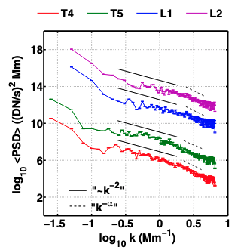
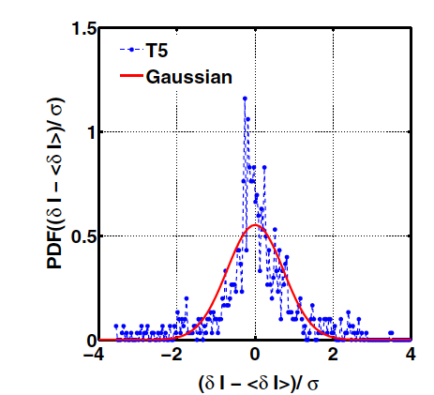
Solar Prominences Simulation
Turbulence Statistics: Power Spectral Density (PSD), Probability Density Function (PDF)
Energy Cascade
(PSD)
Observation plots Leonardis et al. 2012
Figure: PSD in the wavenumber domain for strips L3, L5, T3, and T5. Power-law spectra have slope scaling k^{-5/3} and k⁻² for the velocity (left) and the magnetic fields (right) at smaller wavenumbers, going to k^{-3.5} at larger wavenumbers in the inertial range
Intermittency (PDF)
Figure: PDF of velocity fluctuations for L3 in the longitudinal direction and T3 strip in the transverse direction (A and B respectively) with increasing lags, and magnetic field fluctuations (C and D respectively)
Observations (intensity maps)
2.5 D RTI Simulations (Velocity (V) and Magnetic (B) fields

Slide 6
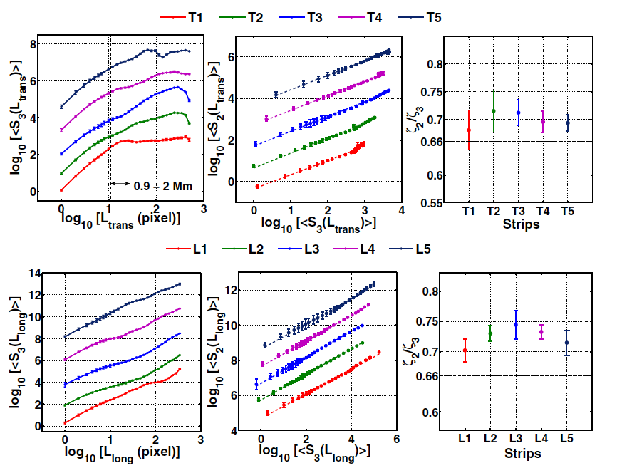
Solar Prominences Simulation
Turbulence Statistics: Structure Functions (SF)
Figure: SF (log-log) third order for longitudinal, L1-L5 (left) and transverse strips, T1-T5 (right) of the velocity field (A and B), and for the magnetic field (C and D).
Figure: The scaling exponent 𝜁(p)/𝜁(3), inferred from the different slopes for the longitudinal and transverse strips
Multifractality (SF)
Panel A and B: Velocity Fields
Panel C and D: Magnetic Fields
Observation plots Leonardis et al. 2012
(intensity maps)
2.5 D RTI Simulations (Velocity (V) and Magnetic (B) fields

Slide 7
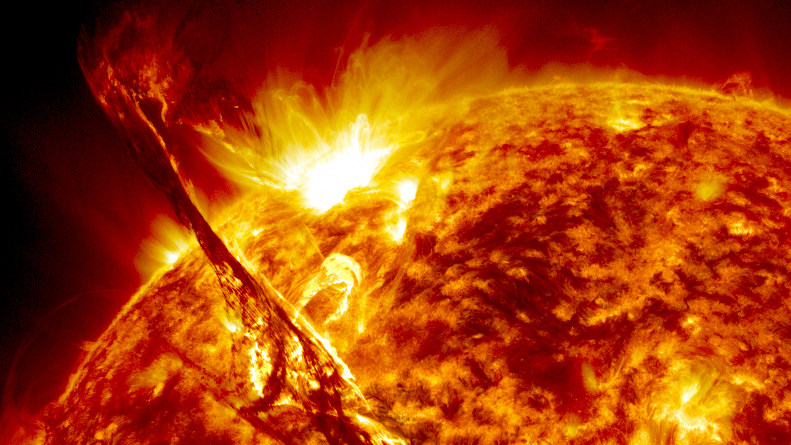
Summary
PSD has Kolmogorov -5/3 scaling for velocity fluctuations while magnetic fields shows -2 scaling for the same range of wavenumbers (0.32-3.2 Mm⁻¹). Presence of a secondary scaling -3.5 in the inertial range is seen.
Presence of intermittency evident from the PDFs of velocity and magnetic field fluctuations which departs from Gaussian. Increase in lag/Δ (larger scale), approach Gaussian shape, less coherent. Smaller scales, more non-Gaussian, highly intermittent
SF gives a measure of correlation of fluctuations to length scale. Non-linearity of high order scaling exponents suggests multifractal behavior of turbulence.

Slide 8




THANK YOU
Madhurjya Changmai
madhurjya.changmai@kuleuven.be
Rony Keppens
rony.keppens@kuleuven.be

