Slide 1
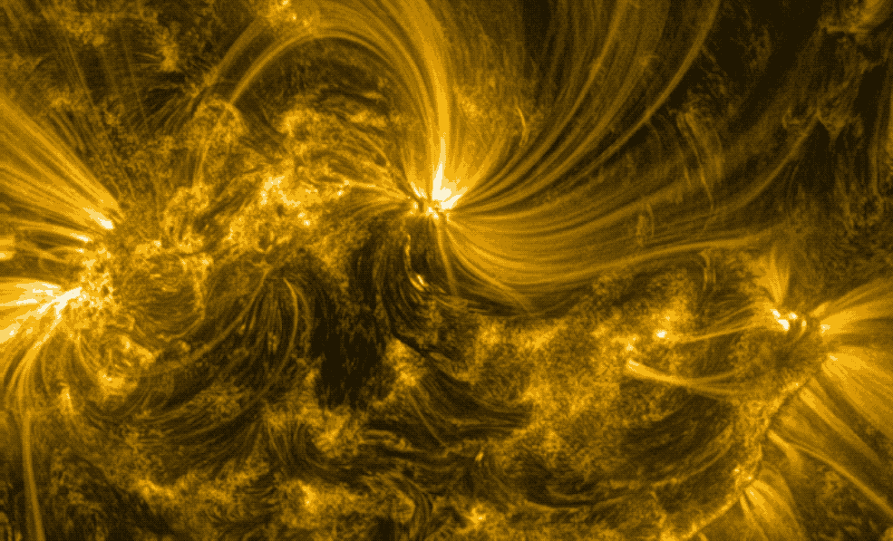
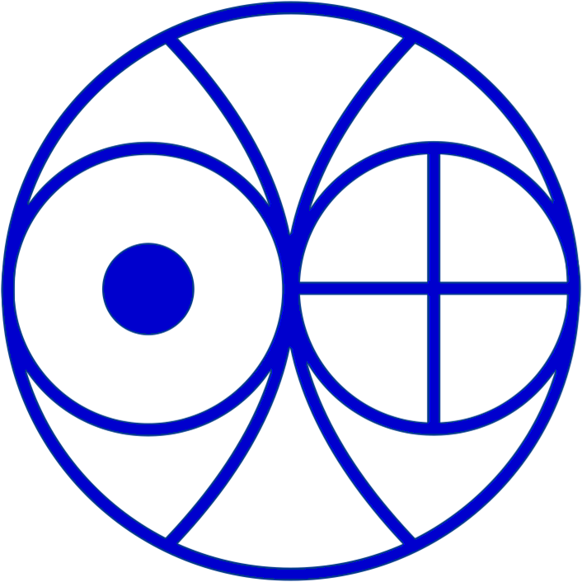
Impact of Hall MHD on the evolution of 3D
complex magnetic structures
Kamlesh Bora
Contact: kamleshb@prl.res.in
In collaboration with: Ramit Bhattacharyya¹ and P.K. Smolarkiewicz²
¹Udaipur Solar observatory, Physical Research Laboratory, India
²National Center of Atmospheric Research, Boulder, USA
ESPM-16, 6-10 September 2021

Slide 2
Motivation:
Advection Resistive diffusion Hall
Hall term is important and effective when the magnetic reconnection is under consideration.

Slide 3
Objectives
Develop a Hall MHD module using EULAG numerical model of CFD
Benchmarking the extended 3D Hall EULAG MHD model
Exploring a solar-like flux rope dynamics during Hall MHD evolution

Slide 4
Benchmark results : MHD and Hall MHD simulations
MHD
Hall MHD
Faster and complex reconnection in the Hall MHD
Generation of an out-of-plane magnetic field component along with the generation of magnetic islands.
K. Bora et al. 2021 ApJ 906 102

Slide 5
Benchmark Results : cont……
Figure : Domain average evolution for MHD (dash curve) and Hall MHD (solid curve) simulations
Greater degree of Impulsiveness ----sharp changes in the rate of change of current densities in Hall simulations.
Animation: Hall MHD evolution of MFLs on a 2D plane
K. Bora et al. 2021 ApJ 906 102

Slide 6
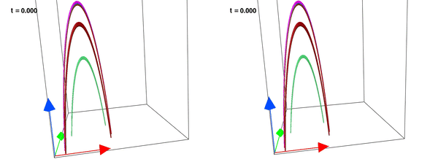
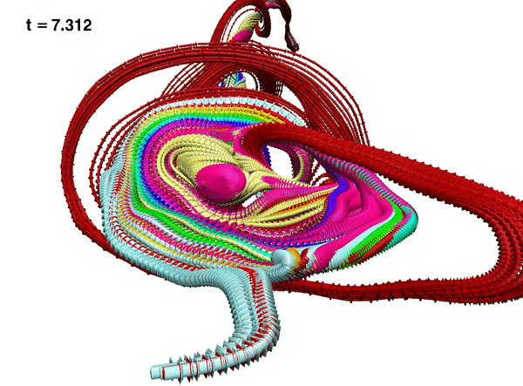
Flux Rope dynamics: Hall MHD and MHD
MHD
Hall MHD
Zoomed reconnection in HMHD
K. Bora et al. 2021 ApJ 906 102

Slide 7
Summary :
-Faster reconnection and richer complexity in the magnetic field lines during the Hall MHD evolution.
-Small scale changes during magnetic reconnection affect the large scale dynamics in the Hall MHD evolution.
-Greater degree of impulsiveness is evident in the Hall MHD simulations.
Thanks!

