Slide 1
A Babcock-Leighton type solar dynamo working in the bulk of the convection zone
Zebin Zhang & Jie Jiang
Beihang University, China
Key points
The toroidal fields are produced in the bulk of the convection zone by the latitudinal shear
The tachocline is unimportant in our model
Notes:
10s

Slide 2
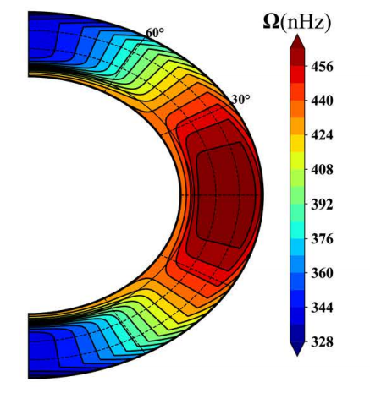
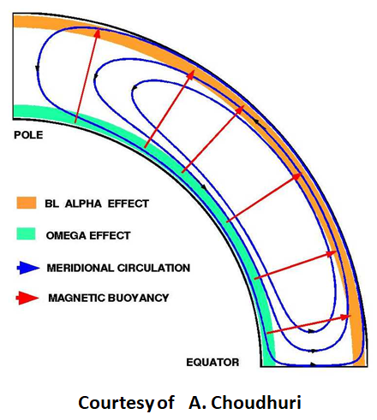
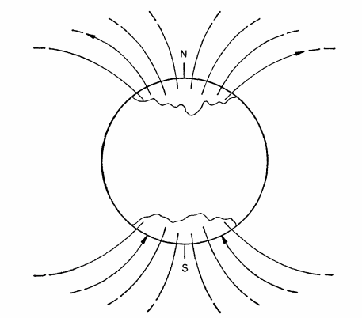
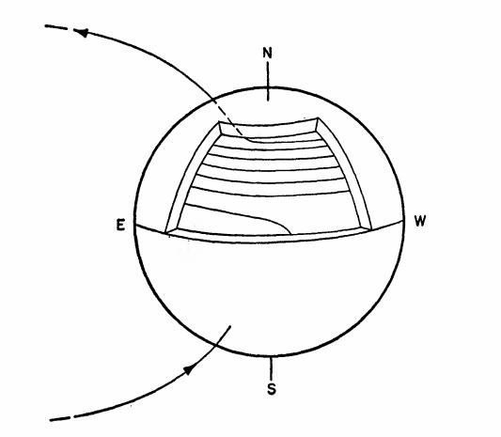
How is the toroidal field produced
Source term of the toroidal field in dynamo equations:
Differential rotation
effect
Radial shear
Latitudinal shear
In the tachocline and near surface shear layer
In the bulk of the convection zone
Popular opinion
?
Original Babcock’s scenario
The toroidal field is produced in the tachocline by the radial shear. E.g., flux transport dyanmo (FTD) model.
effect
Scenario of FTD
Latitudinal shear
supported by
Thin flux tube simulations (for reviews, see Fan 2009)
Babcock (1960)
Notes:
40s

Slide 3
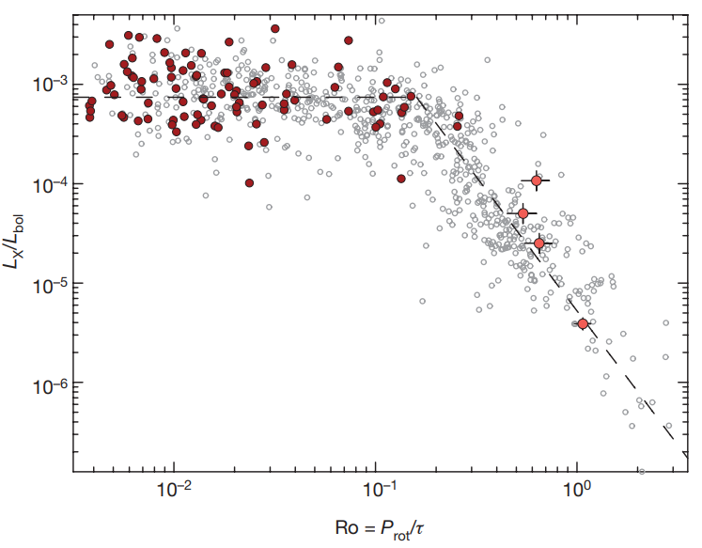
How is the toroidal field produced
Wright & Drake(2016)
In the tachocline by the radial shear ?
Fullly convective stars have the same rotation-activity relationship with the partially convective stars.
If the tachocline is important
Such relationship should not exist
?
Dynamo may not operate in the tachocline
In the bulk of the convection zone by the latitudinal shear
The latitudinal shear is the dominant generator of net toroidal flux (Cameron & Schüssler 2015)
Nelson et al. (2013): Rope-like structures of magnetic flux could be produced in the bulk of the convection zone
Nelson et al.(2013)
Notes:
20s

Slide 4
Objective
Aims of our work
Developing a Babcock-Leighton type solar dynamo working in the bulk of the convection zone
Regeneration process of the toroidal field is consistent with original Babcock’s scenario
Babcock (1960)
latitudinal shear
Global dipolar poloidal fields
Toroidal fields
Global dipolar poloidal fields are stretched by the latitudinal shear to produce the toroidal fields in the bulk of the convection zone
Notes:
50s

Slide 5
Model
Dynamo equations:
BL-type source term
Differential rotation and meridional circulation
Turbulent diffusivity
BL-type dynamo model
Near-surface pumping
Cameron et al. (2012)
consistent
Vertical outer boundary condition
Surface flux transport model
(More details in Zebin Zhang, and Jie Jiang, A Babcock-Leighton type solar dynamo working in the bulk of the convection zone, to be submitted)
Notes:
30s

Slide 6
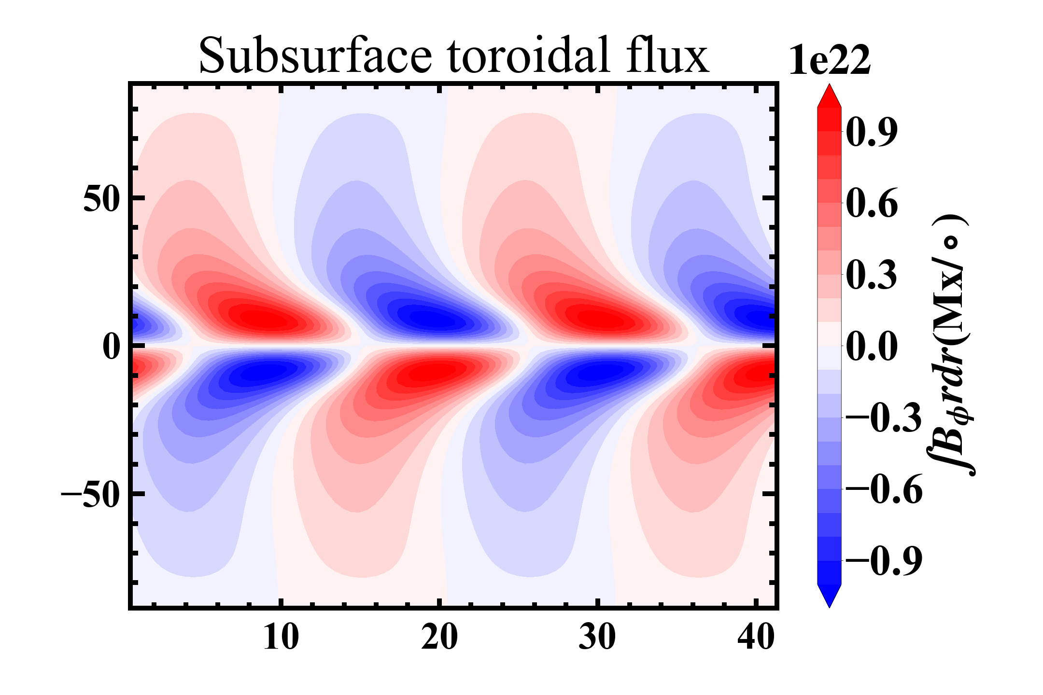
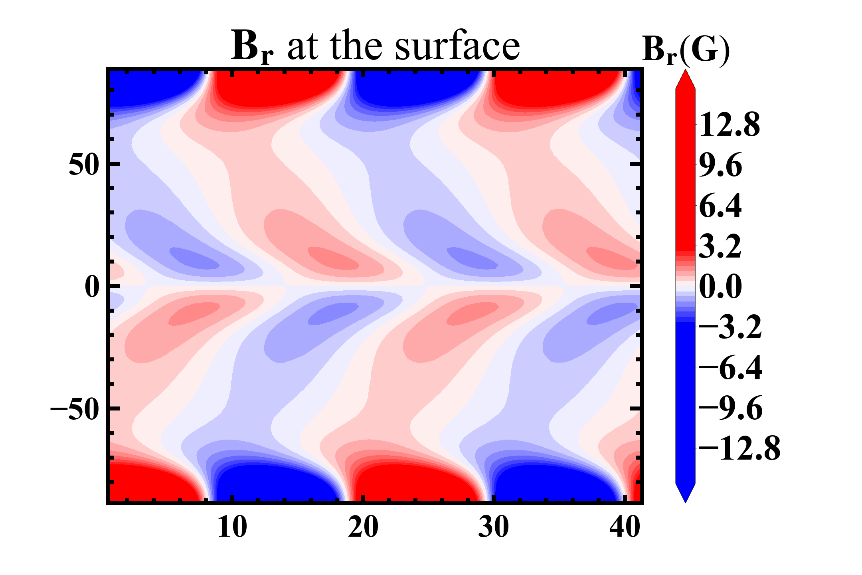
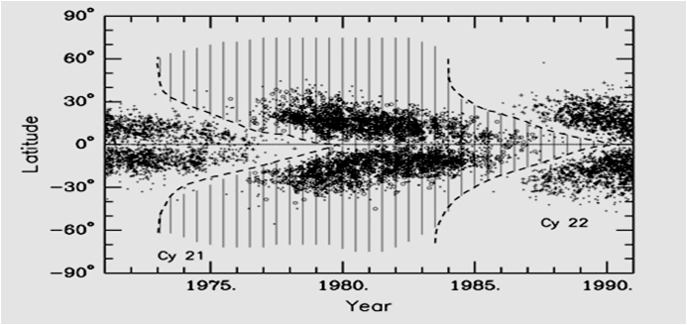
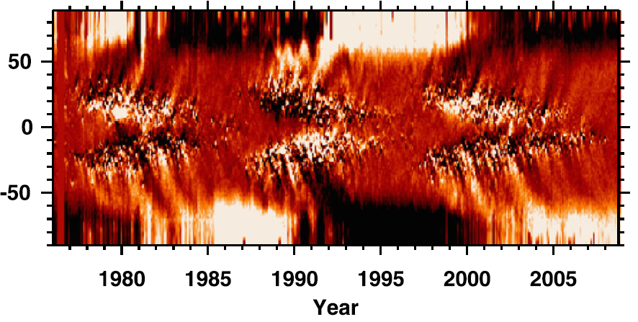
Reference solution
A
B
active regions
ephemeral regions
K, Harvey (2000)
Notes:
1min20s

Slide 7
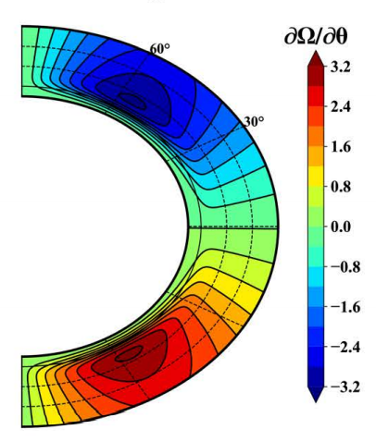
Evolution of the poloidal and toroidal fields
Simple configuration of the poloidal field
Purely radial fields at the surface, B_{θ}≈0.
(consistent with SFT simulations)
Purely latitudinal fields in the bulk of the convection zone, Br≈0.
Latitudinal shear works on the global dipole
Source term of B$φ$:
The toroidal fields are generated in the bulk of the convection zone by the latitudinal shear
Notes:
1min20s

Slide 8
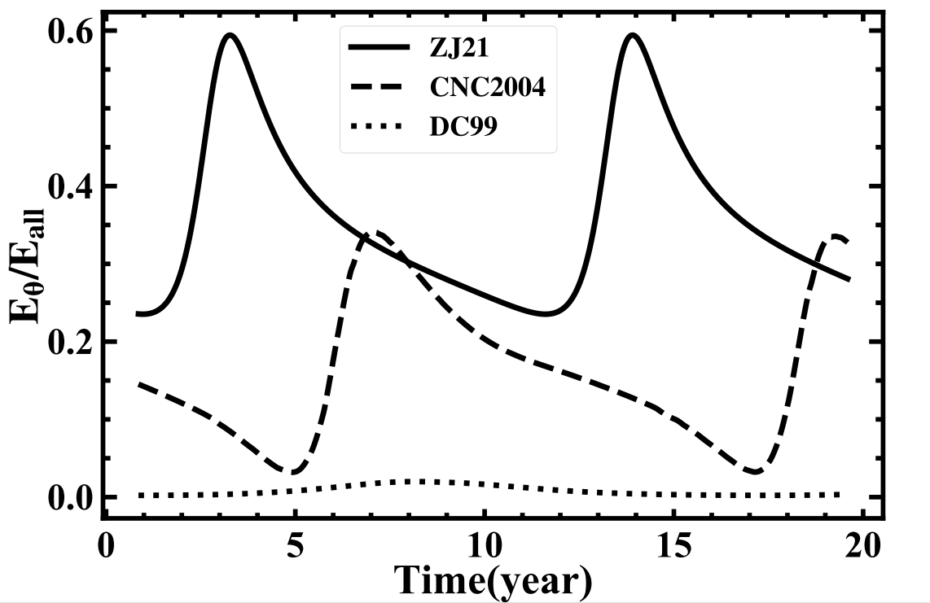
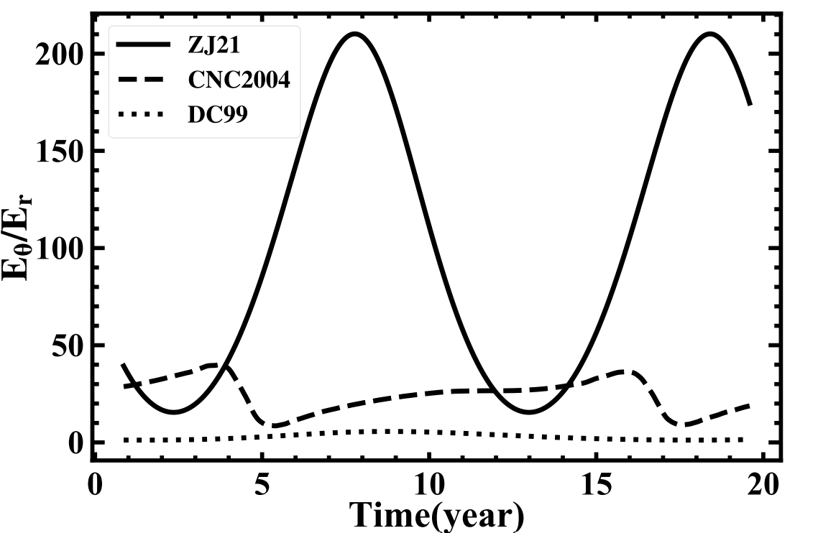
Comparison with previous representative models
Dikpati et al.(1999)
Chatterjee et al.(2004)
Notes:
50s

Slide 9
Conclusion
We develop a new BL-type dynamo model which is independent of the tachocline
The poloidal field has a simple dipolar configuration.
Latitudinal shear works on the global dipole to produce the toroidal fields in the bulk of the convection zone.
Notes:
20s

