Slide 1
Large-scale spectroscopic surveys management
Paolo Franzetti
& the PANDORA team
INAF - IASF Milano

Slide 2
background

Slide 3
mantra
background
In recent years, thanks to the evolution of the astronomical instrumentation,
the size of spectroscopic surveys at all redshifts has greatly increased.
This trend will surely continue with the next generation of instruments
posing new challenges for the management of such huge amounts of data.
Information that can be potentially obtained from these surveys is enormous,
but to extract it, the data organisation and reduction, the survey advancement
monitoring at all stages and the data distribution within the collaboration
and to the whole community must be performed at an unprecedented level
of efficiency and with minimum human intervention.

Slide 4
mantra
background
In recent years, thanks to the evolution of the astronomical instrumentation,
the size of spectroscopic surveys at all redshifts has greatly increased.
This trend will surely continue with the next generation of instruments
posing new challenges for the management of such huge amounts of data.
Information that can be potentially obtained from these surveys is enormous,
but to extract it, the data organisation and reduction, the survey advancement
monitoring at all stages and the data distribution within the collaboration
and to the whole community must be performed at an unprecedented level
of efficiency and with minimum human intervention.

Slide 5
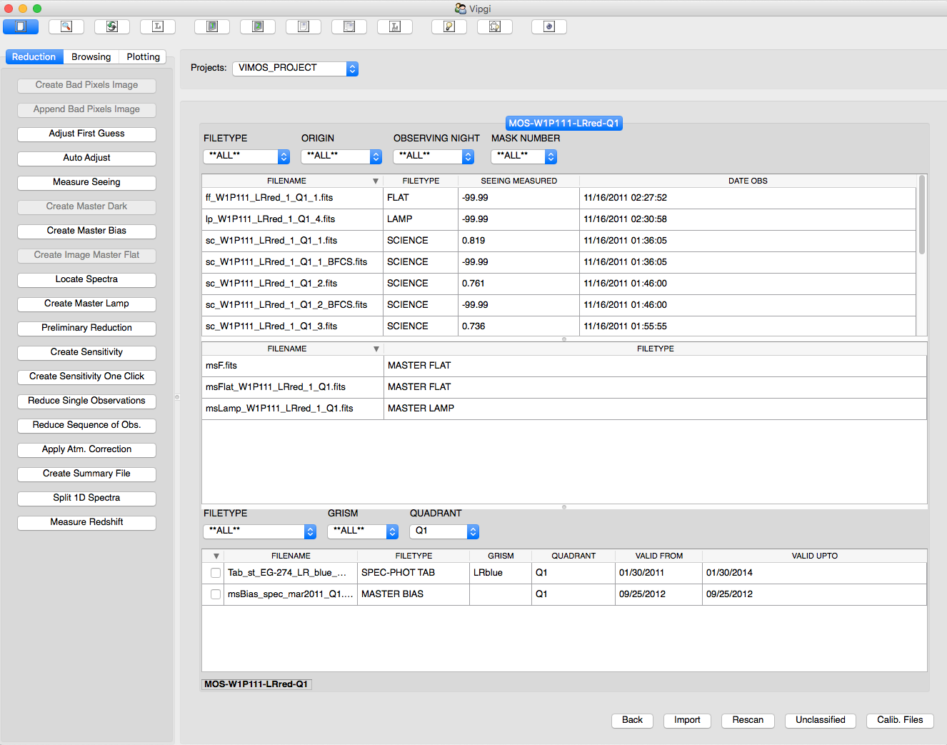
vipgi
background

Slide 6
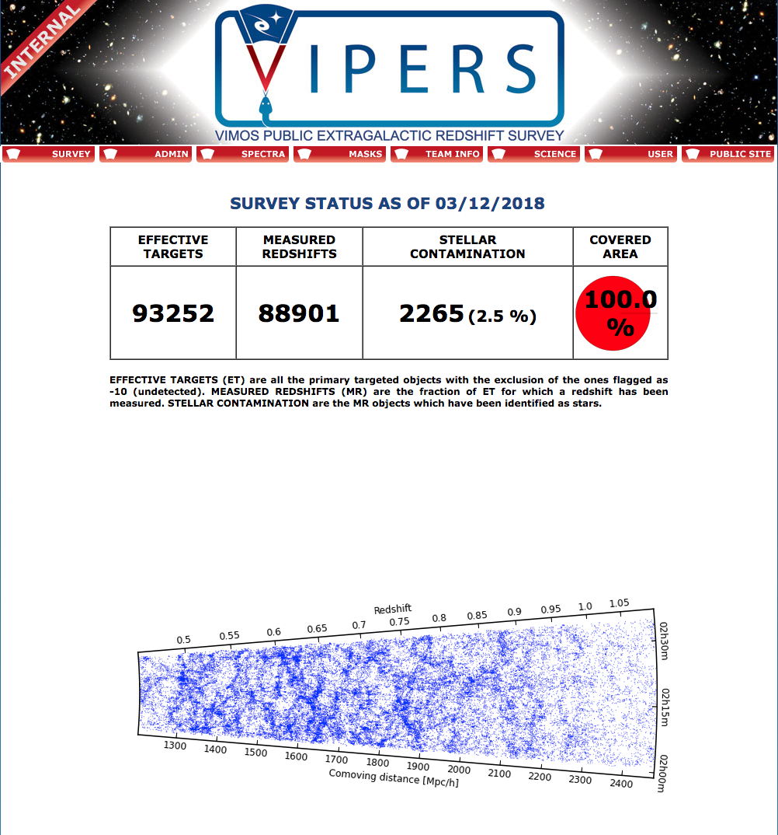
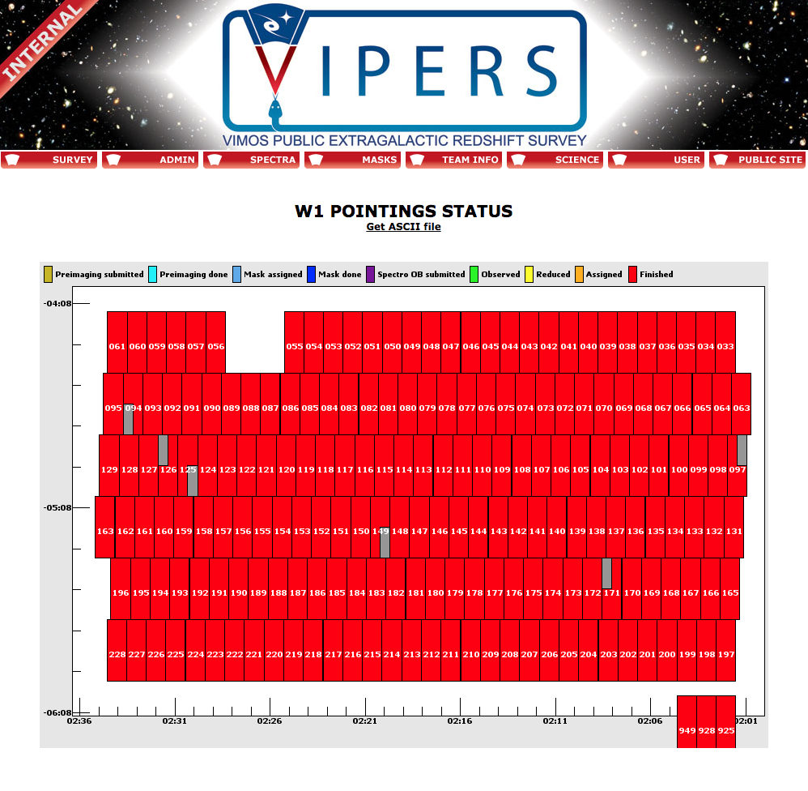
vipers
background

Slide 7
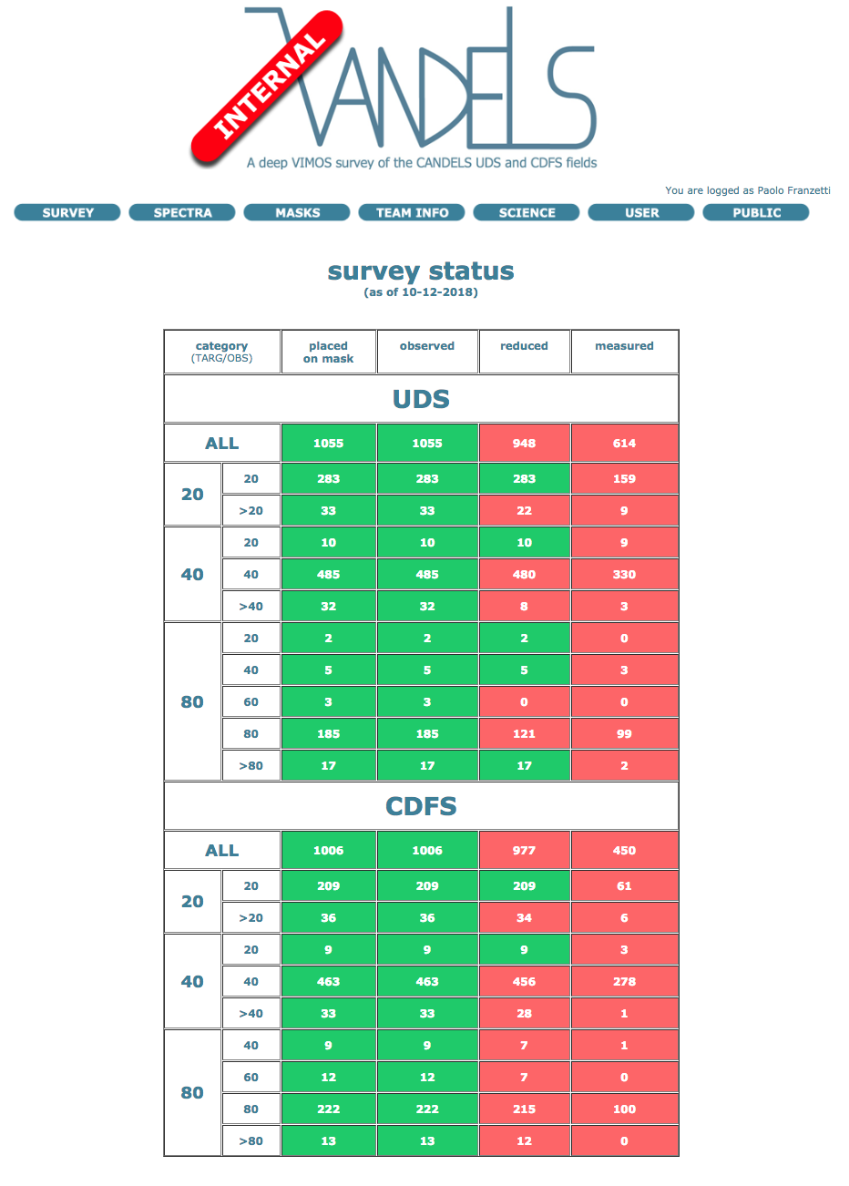
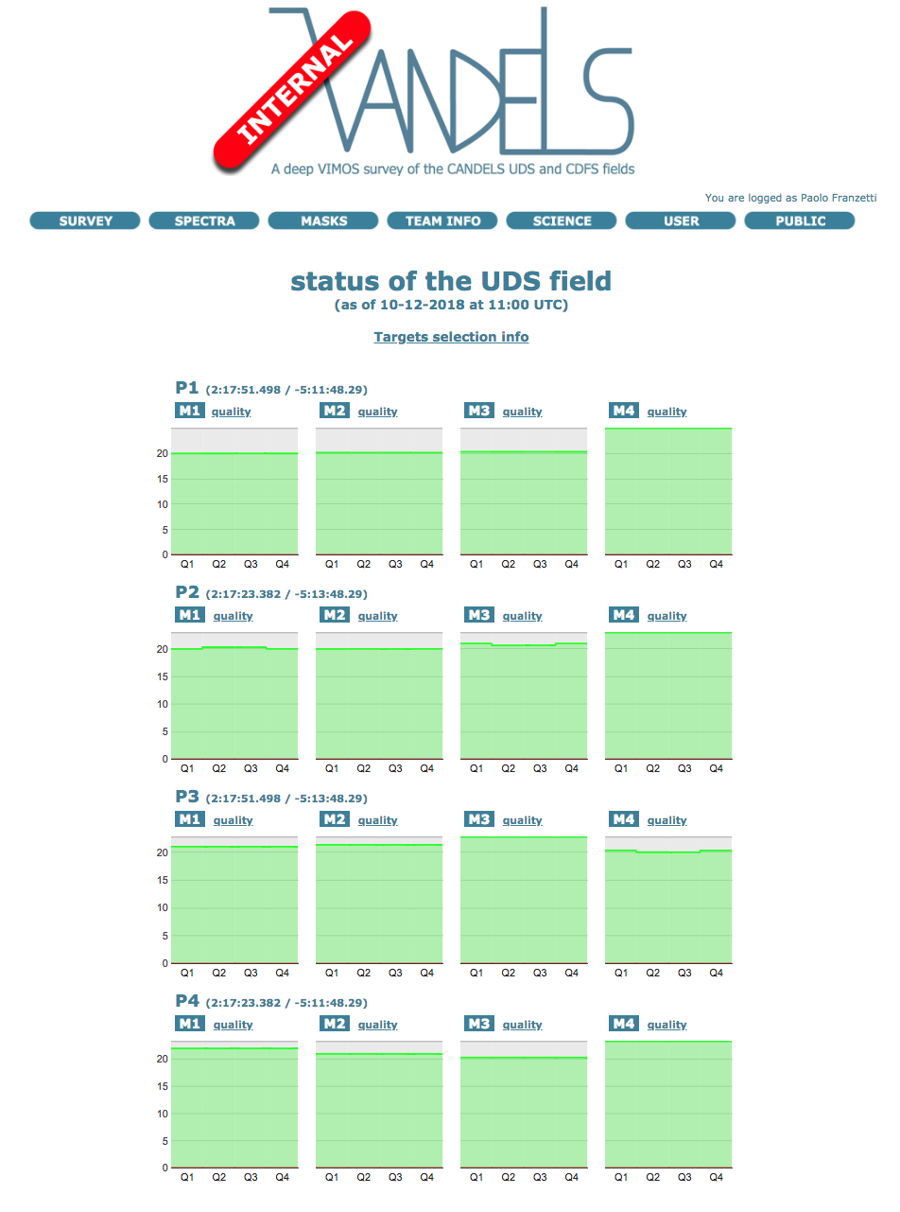
vandels
background

Slide 8
design

Slide 9
in a nutshell
design
design
implementation

Slide 10
core
design
database

Slide 11
core
design
database
users
contacts
team roles
public

Slide 12
core
design
database
users
parent catalog(s)

Slide 13
core
design
database
users
parent catalog(s)
ancillary data

Slide 14
core
design
database
users
parent catalog(s)
ancillary data
masks
targets
OBs

Slide 15
core
design
database
users
parent catalog(s)
ancillary data
masks
observations

Slide 16
core
design
database
users
parent catalog(s)
ancillary data
masks
observations
spectra
status
measures

Slide 17
core
design
database
users
parent catalog(s)
ancillary data
masks
observations
spectra
derived data

Slide 18
website
design
database
website
users
public
database
info
parent catalog(s)
ancillary data
internal
database
wiki / workgroups
team info
mailing lists
measurements assignments
data releases
abstracts / papers
masks
observations
spectra
derived data
test

Slide 19
data processing
design
pipeline(s)
data organization
data reduction
database
users
parent catalog(s)
ancillary data
masks
observations
spectra
derived data

Slide 20
management
design
pipeline(s)
data organization
data reduction
database
users
parent catalog(s)
management
masks /OBs preparation
observations monitoring and raw retrival
data distribution for measurements
data distribution for analysis
ancillary data
masks
observations
spectra
derived data

Slide 21
easylife
design
pipeline(s)
data organization
data reduction
database
website
users
public
database
info
parent catalog(s)
management
masks /OBs preparation
observations monitoring and raw retrival
data distribution for measurements
data distribution for analysis
ancillary data
internal
database
wiki / workgroups
team info
mailing lists
measurements assignments
data releases
abstracts / papers
masks
observations
spectra
derived data
test

Slide 22
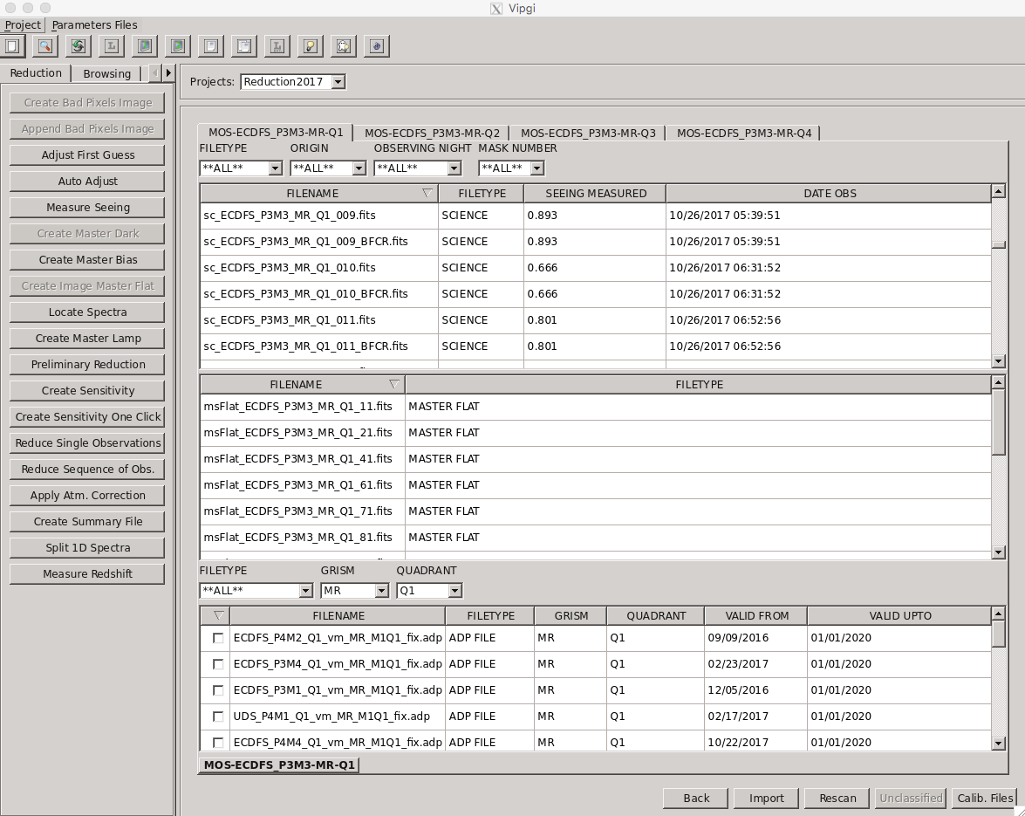
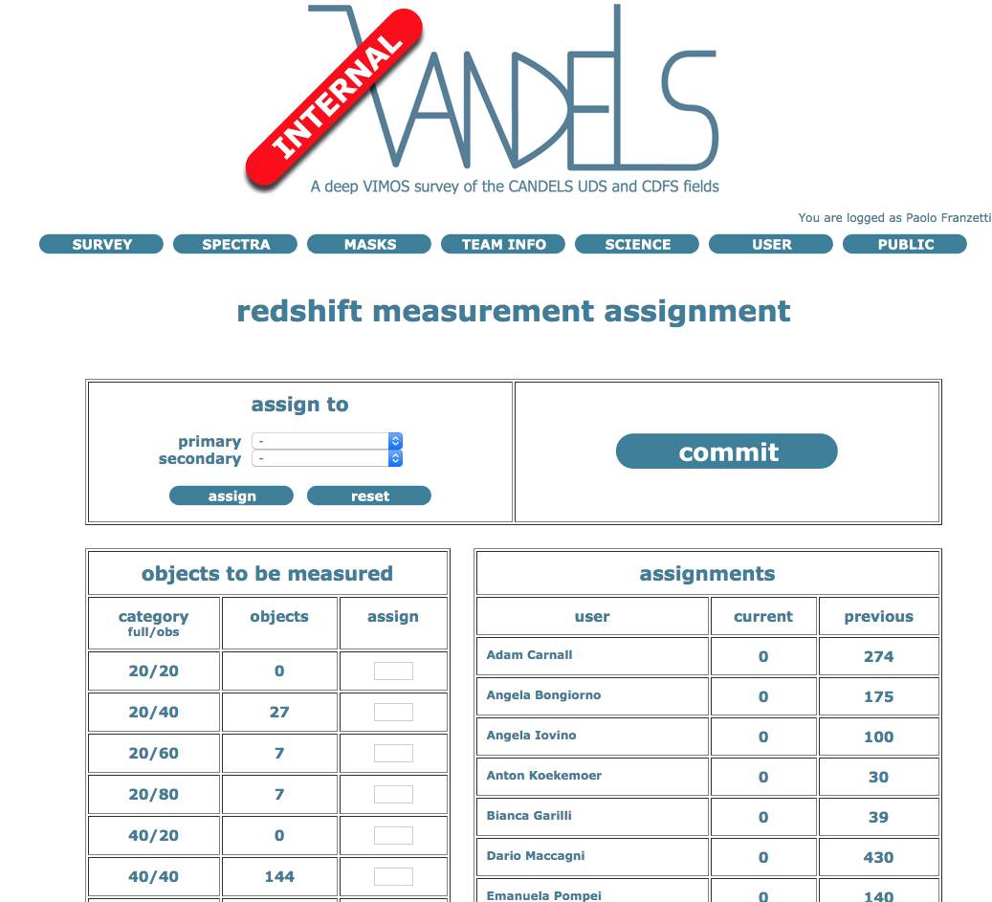
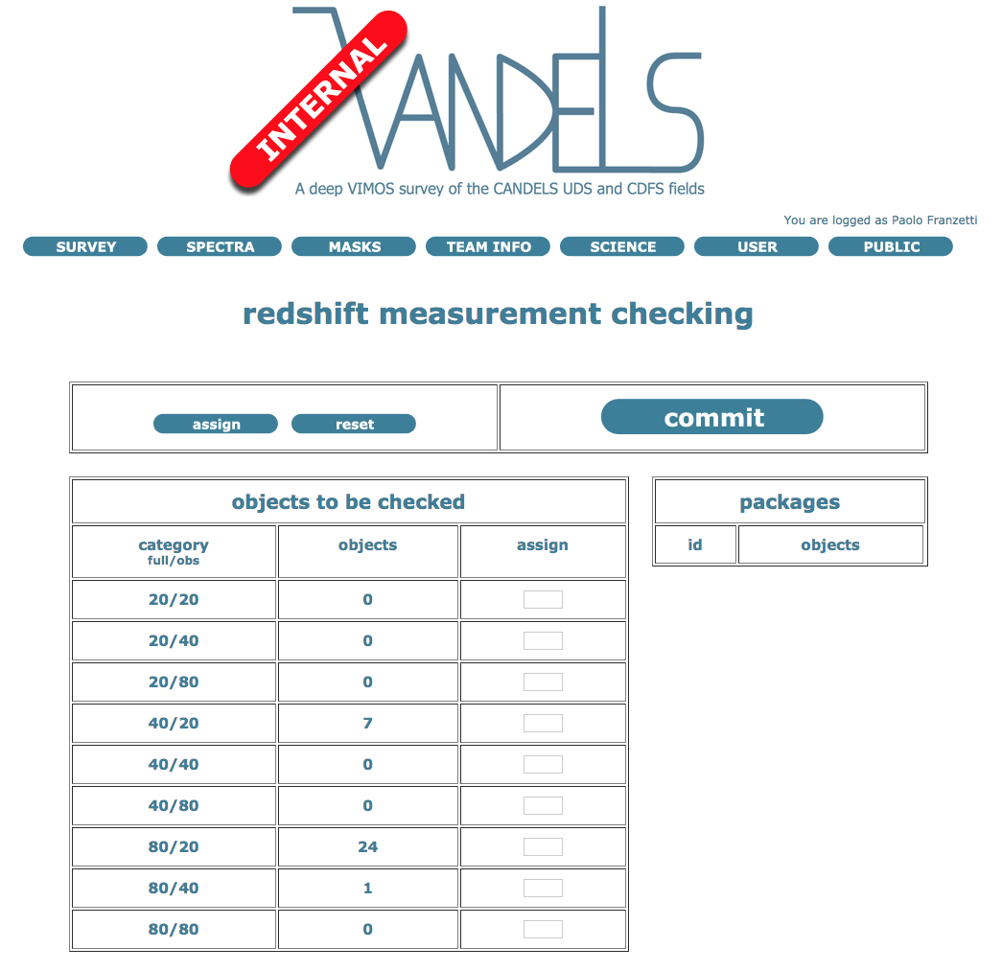
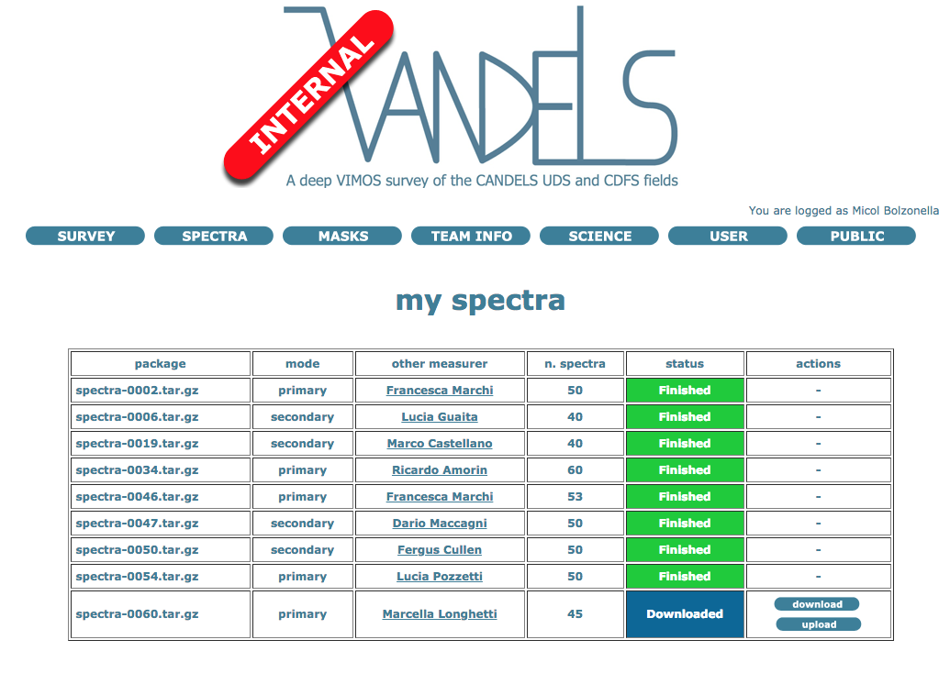
workflow
design
database

Slide 23
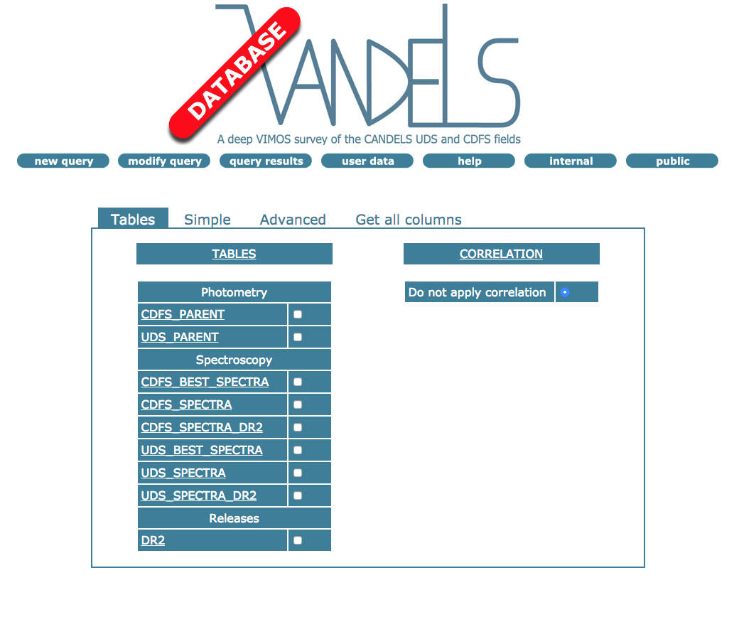
workflow
design

Slide 24
code
design
database:
database interface:
website:
pipelines: C /
management:

Slide 25
spectra format

Slide 26
final user
spectra format
database
website
users
public
database
info
user
parent catalog(s)
FITS files
programs
scripts
ancillary data
internal
database
wiki / workgroups
team info
mailing lists
measurements assignments
data releases
abstracts / papers
masks
observations
spectra
derived data
test

Slide 27
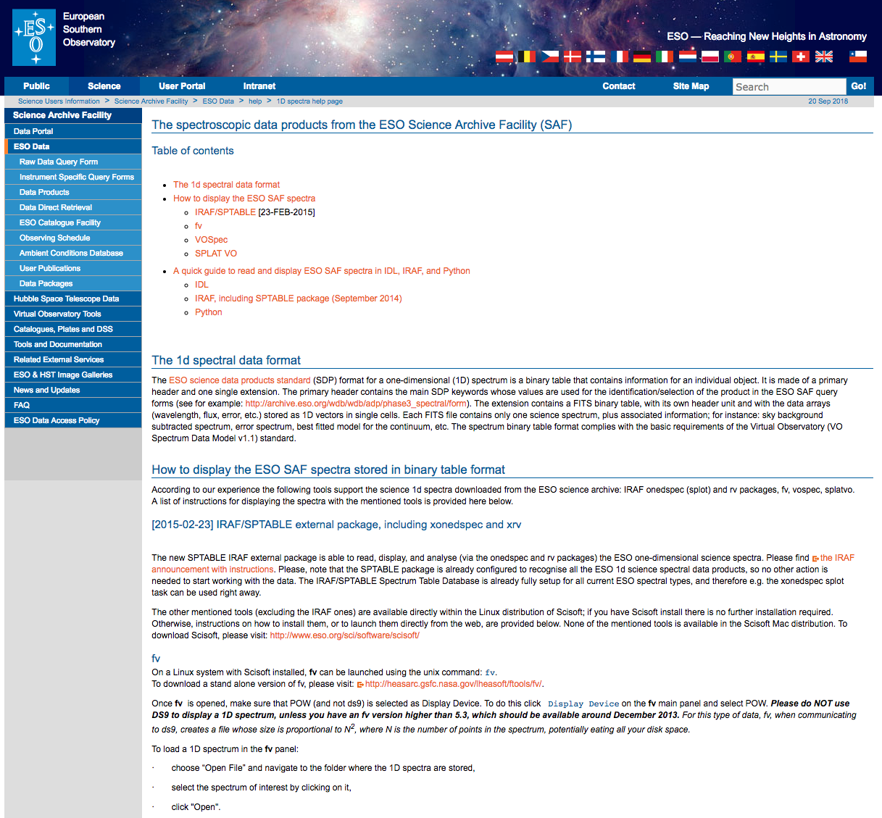
VO ?
spectra format
http://archive.eso.org/cms/eso-data/help/1dspectra.html

Slide 28
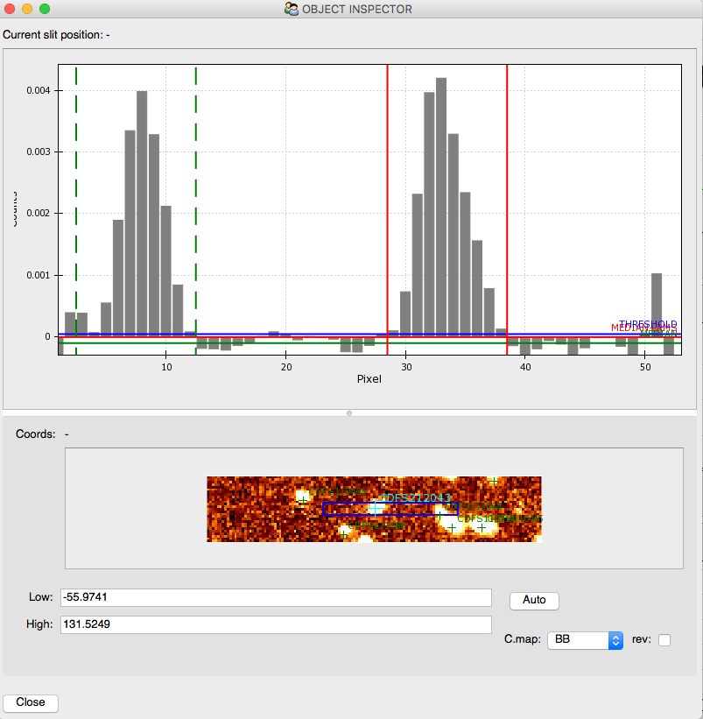
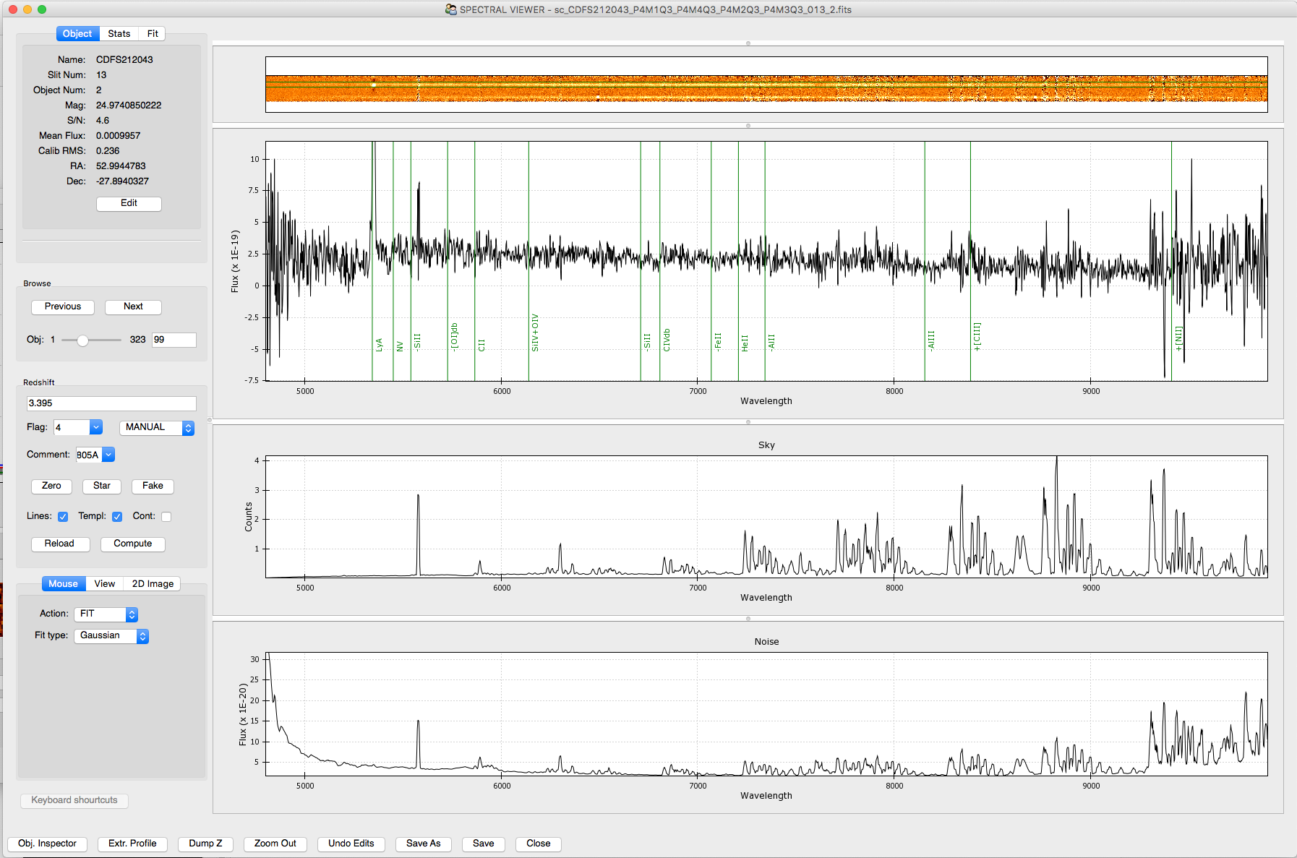
PND files
spectra format

Slide 29
future

Slide 30
feedback
future
spectra format
capabilities requests

Slide 31
code
future
database:
database interface:
website:
pipelines: C /
management:

Slide 32
waiting for a mail…
future
I have a survey, a Linux server
and a post-doc
and I am not afraid to use them
<insert survey name> PI

