Slide 1

SKA and its precursors surveys: stellar
G. Umana and the Galactic EMU team
Science with multi-object spectrographs:
perspectives and opportunities for the Italian community
Milano, 12-13 dicembre 2018

Slide 2
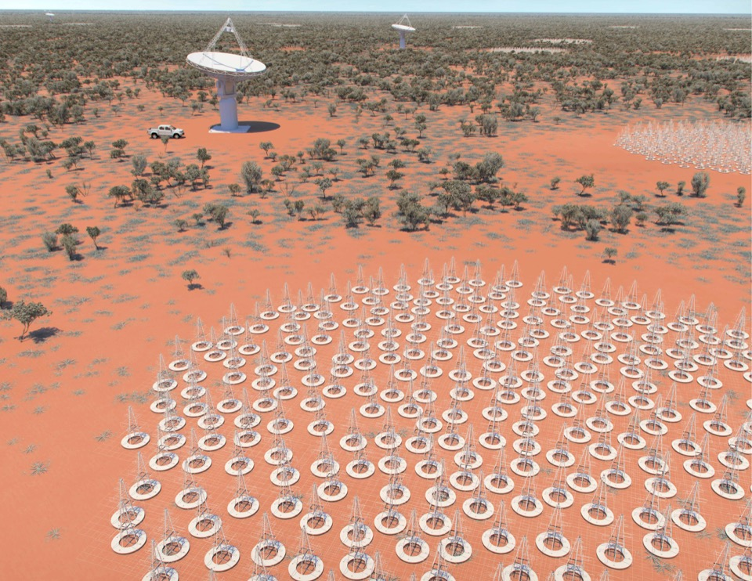
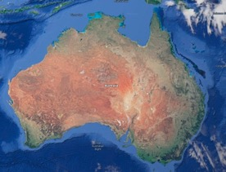
Not clear if ASKAP will part of SKA
enabling ASKAP to provide an early survey
capability for SKA1
SKA1-LOW: Australia
50 – 350 MHz
Phase 1: ~130,000 antennas distributed over a 40km radius region
Phase 2: ~ 500,000
Construction 2019

Slide 3
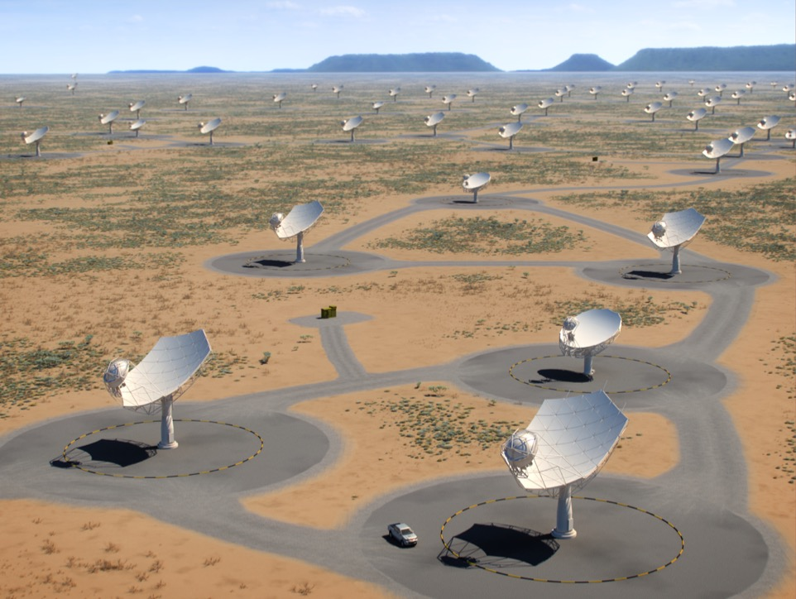
Phase 1: 133 15-m + 64 MeerKAT 13.5m dishes across 150 km
Phase 2: ~2,000 dishes across southern Africa
SKA1-MID: Africa
350 MHz – 15 GHz
Construction 2019
(Adapted from Dewdney ,2016)
Notes:
Frequency extended to 15GHz due to the split of banda 5°+banda 5b; expandable to 24 GHz)

Slide 4
The impact of SKA on Galactic Science
Large area Surveys
Statistical studies of different populations of radio emitting Galactic Objects
All-sky/deep
The place where you look at makes the difference:
most of the Galactic sources localised in/close the GP
The concept of generic surveys:
Maximize the return for “priority Science”
Maximize the commensality
Better angular resolution and sensitivity (Continuum & Spectral) than
any ongoing/planned survey of the Galactic Plane

Slide 5
The concept of Generic Surveys
SKA1_MID-A Generic Survey @ Band 2b (Full BW)
(rms 5μJy/b, 0.8”), ≈8000 hrs, All-sky
SKA1_MID-D Generic Survey @ Band 5 (Full BW)
(rms 6μJy/b, 0.2”), ≈2000 hrs, 480 deg²/GAL
The most complete catalogue of the Galactic Plane to date
Much deeper and higher resolution than any other survey
Will bridge the gap in sensitivity and resolution between available GP surveys
High angular resolution, limited areas:
CORNISH (Purcell and Hoare, 2010) 6cm, 1-6 arcsec, ≈100 deg², few mJy
MAGPIS (Helfand et al., 2006) 20/6cm “ “
Lower angular resolution, wide areas:
CGPS (Taylor et al., 2006), 20cm, arcmin, several 100 deg², few mJy
SGPS (McClure-Griffiths et al., 2005)

Slide 6
The impact of SKA on Galactic Science
A SKA-survey results will address several science topics:
(list not exhaustive!)
Massive stars formation
A census of the early stage of massive stars formation in the GP
Giant HII and interaction with their environments: triggered star formation
Evolved stars
Detection of SNRs
Detection of PNs
Radio Stars
Serendipitous discoveries
To derive accurate space density and rate formation
Radio needed for robust identification
Providing the most complete catalog of Galactic Sources to date
Notes:
SKA will give the opportunity to create a sensitiv atlas of discrete radio sources and to address sevaral science topics
LIST IS NOT EXHAUSTIVE

Slide 7
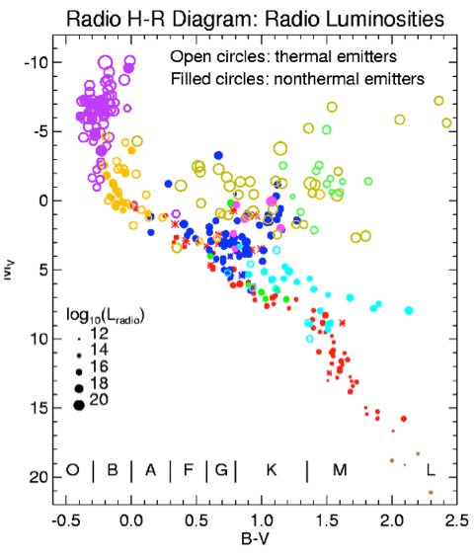
Stellar Evolution: from the cradle to grave
Currently few hundreds detected in radio
L_{radio} a small fraction of L_{TOT}
Radio probes astrophysical phenomena non detectable by other means:
B field & topology in flare stars,RS CVn
HII region in dust enshrouded sources
Wind-wind interactions
Stellar magnetospheres
Important for:
Stellar evolution & Physical processes in a wider context.
Gudel, 2002

Slide 8
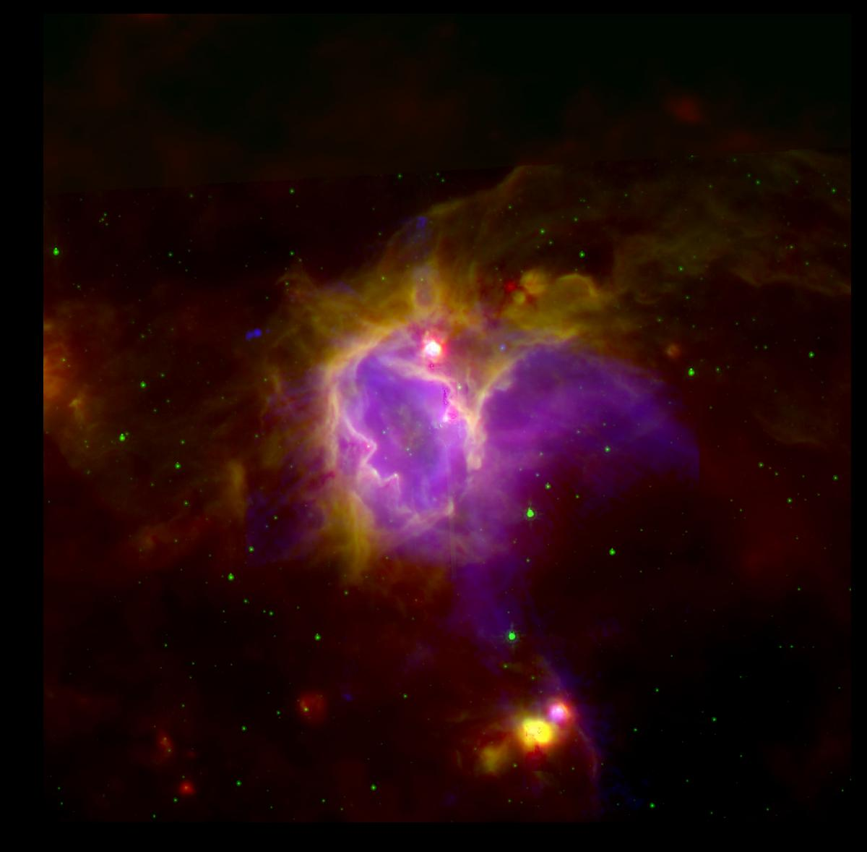
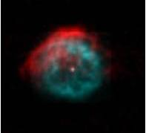

Stellar radio emission: what we know
Large emitting surface Thermal
First phases of stellar evolution From ISM → Stars
Ionisation of ISM by new born OB stars: HII/UCHII/HCHII regions
Winds from MS OB stars
Umana +, 2015
Late phases of stellar evolution From Stars → CSE/ISM
Winds/ejecta from hot massive stars
WR, LBVs, Symbiotic systems
Ionisation CSE/ISM by hot evolved stars
Planetary Nebulae, WR, LBVs
Buemi +, 2012
“Normal” stars Atmospheres
Chromospheric/Coronal emission in MS stars
Photospheric emission Red giants/supergiants
O’Gorman +, 2017

Slide 9
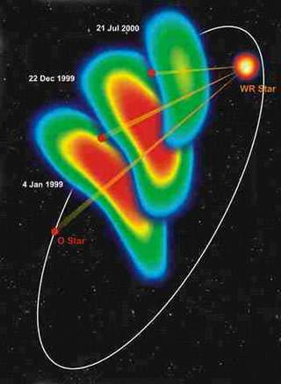
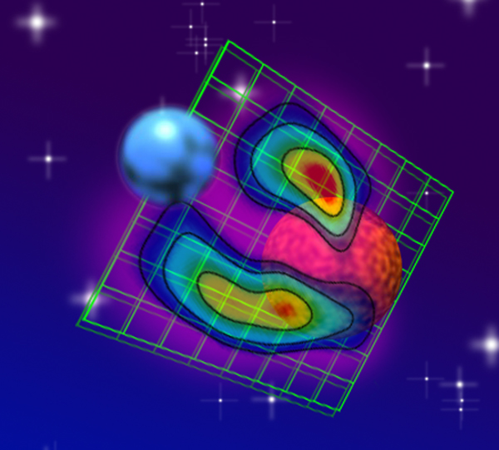
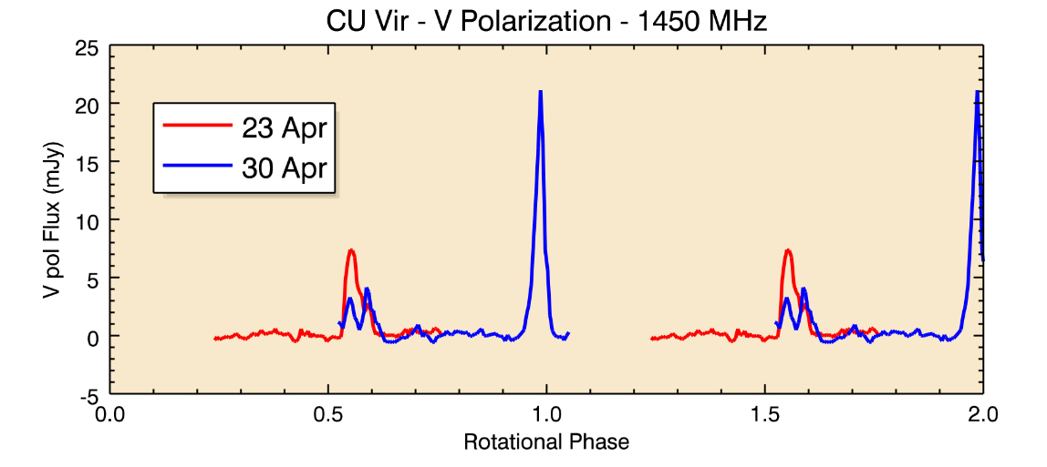
Stellar radio emission: what we know
High Brightness Temperature:
non-Thermal: Magnetic fields, Shocks
Shocks, Magnetic activity
Pre main sequence stars
Wind-Winds Interaction
Dougherty+, 2005
Stellar Activity Solar-Type activity, variable
topology of B
Flare stars
Active binary systems (Algols, RS CVn…)
T Tau
Mutel +, 2009
Magnetospheres Stable magnetospheres
Chemically Peculiar stars
Brown Dwarf
Trigilio +, 2011

Slide 10
Stellar radio emission: what we don’ t know
The actual knowledge of stellar radio emission suffers of:
-limited sensitivity:
Very few radio star with radio luminosity similar
to the quiescent Sun (L_{6cm} ≈ 10^{10.7} erg sec⁻¹ Hz⁻¹)
detected @ cm λ, with long integrations time (several hrs)
-selection bias:
based on targeted observations aimed at addressing
specific astrophysical problems
However, starting from some information on radio luminosity………
Flares stars (and late-M) Seaquist, 1993; Gudel 2002; Berger et al. 2005
PMS Gudel, 2002
Active binary systems Moris and Mutel, 1988, Umana et al., 1993
OB-WR Seaquist, 1993; Bieging et al., 1989
CP Leone et al., 1992; Trigilio et al., 1994

Slide 11
Radio Stars Detection Forecast
SKA1
Quiescent Sun @10 pc
Umana et al., 2015
SKA1 all WR, and OB stars of the Galaxy will be detected
CP, PMS, RSCNS and SG up to the GC
SKA2 All of the above classes of stars in the Galaxy and in the nearby
Galaxies; Solar analog up to 50pc

Slide 12
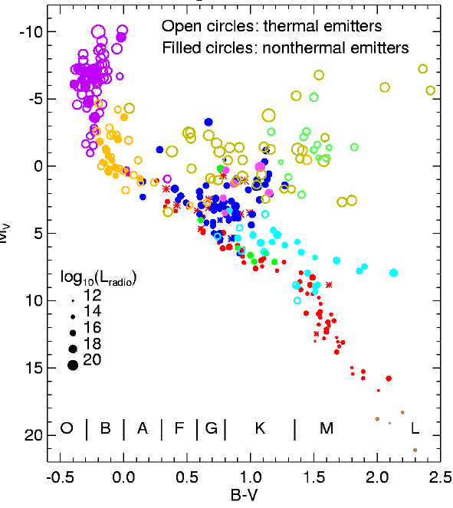
The SKA Radio HR Diagram
A real REVOLUTION
in Stellar Astrophysics
No more biased,
targeted observations
But real Population Studies
Large samples
Radio Proprierties vs
Stellar mass
Age
Chemical composition
Rotation rate

Slide 13
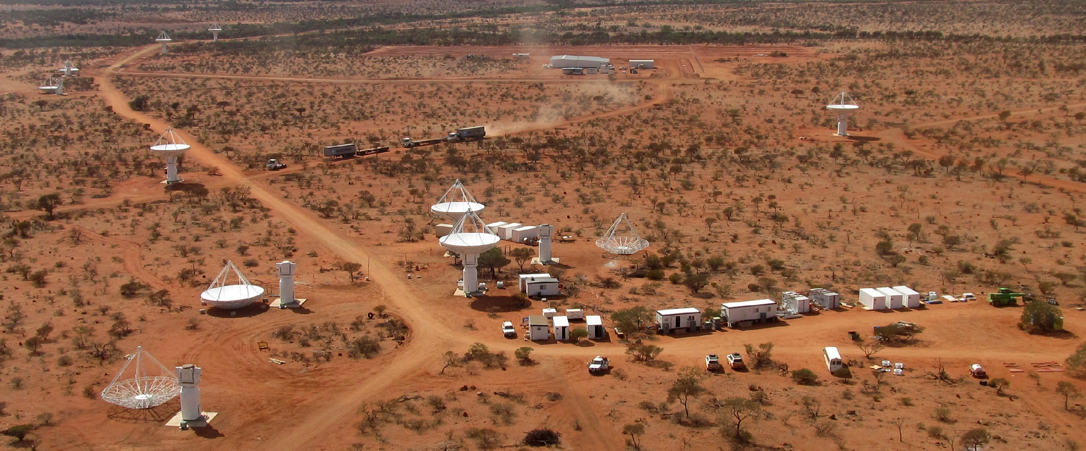
ASKAP
Number of dishes 36
Dish diameter 12m
Field of view 30 deg²
Maximum baseline 6 km
Resolution 10” @1250MHz
Sensitivity 37 μJy/bm
(288 MHz, 1 hr, 10”)
Survey speed 220 deg²/hr
(288 MHz, 100 μJy)
Observing freq. 700-1800 MHz
Bandwidth 288 MHz
Spectral channels 16384
Australian SKA Pathfinder
Design specifications:
Design goals:
High dynamic-range imaging
Wide field of view science
→ SURVEYS
Building ASKAP, 2011
Notes:
-- Processed data volume = 70 PB/year

Slide 14
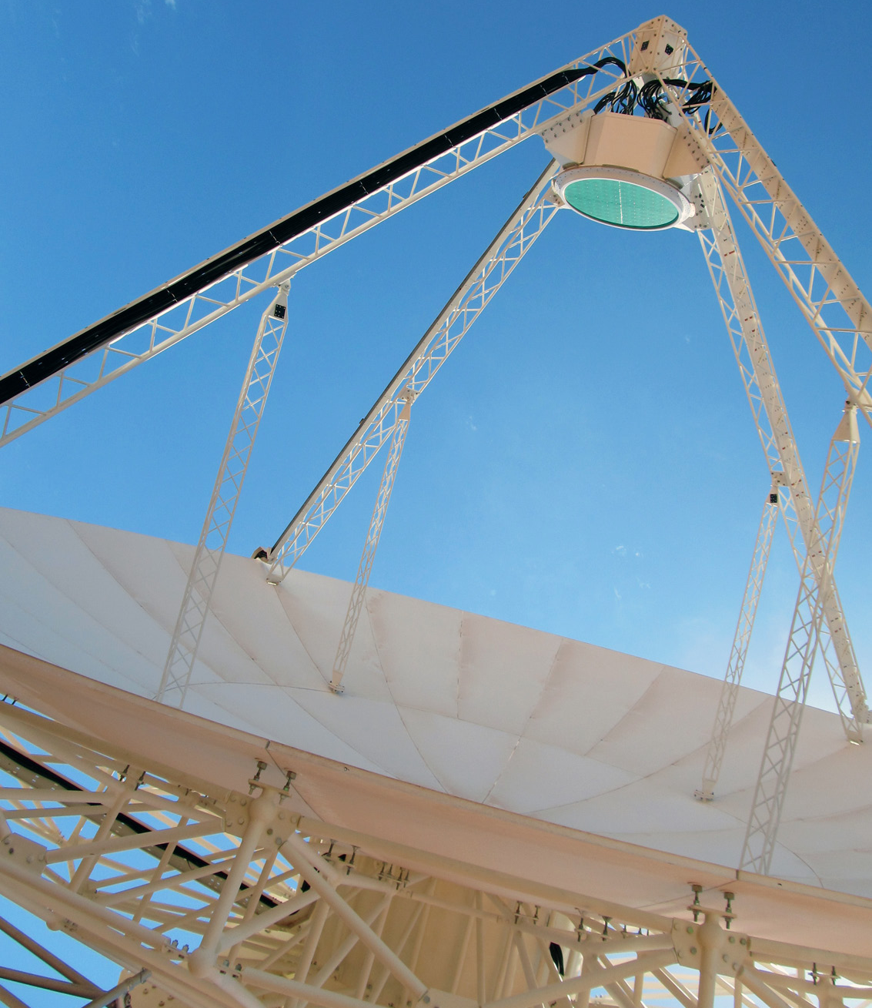
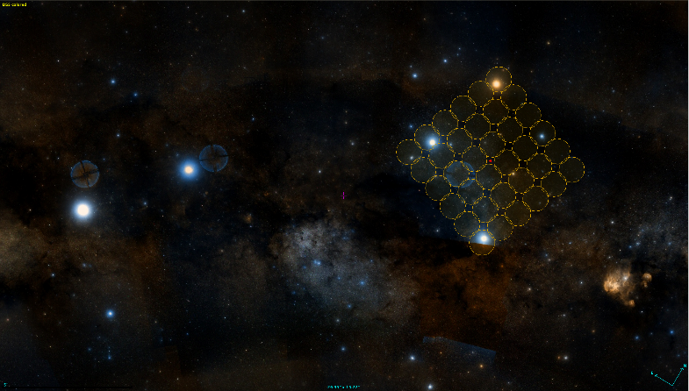
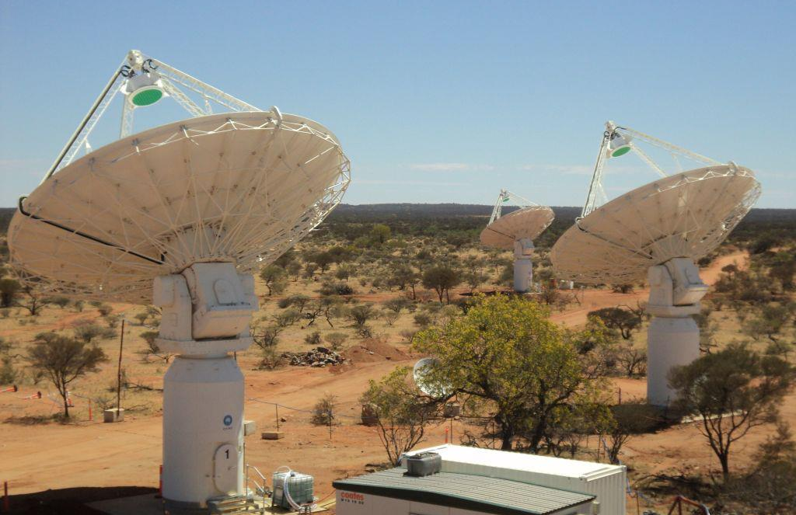
ASKAP
Phased Array Feeds (PAF) give 30 sq deg FOV and an amazing survey speed
All 36 antennas & infrastructure completed
All 36 PAFS complete and installed
Currently debugging and commissioning backend and processing pipeline

Slide 15
ASKAP
2009 | Project initiated
2014-2016 | BETA operational (6 antennas)
2017-mid 2018 | Early Science Phase 1 (12-14 antennas) plus commissioning and debugging
mid-late 2018 | Early Science Phase 2 (28 antennas) plus commissioning and debugging
Jan 2019 | Commissioning of final survey array 36 antennas, 36 beams, 300 MHz bandwidth Pilot survey projects
Mid 2019? | Full surveys start (for ~ 5 years)
ASKAP TIMELINE
Notes:
Wins:
All 36 antennas now equipped with PAFs
Backends complete for most of them
Can currently observe with up to 16 antennas at 288 MHz BW
Band 3 commissioning (1.5-1.8 GHz) completed
Need more work:
Significant processing limitation because of limited throughput and disk space on galaxy at the Pawsey Centre
RFI flagging not yet optimum
Beam-forming and calibration not yet optimum

Slide 16

ASKAP Deep radio image of 75% of the sky (up to declination +30°),1130-1430 MHz, 10 μJy/b, 10 arcsec .
Norris +, 2011
Will detect and image ~70 million galaxies
Primary science goal: How did galaxies form and evolve?
But…..will provide a “good view” of the Galactic Plane @ L-band
All data to be processed in pipeline
Images, catalogues, cross-IDs, to be placed in public domain
EMU team currently involved in the ASKAP Early Science Programm

Slide 17
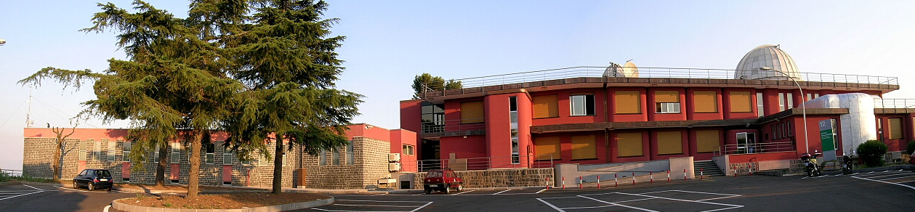



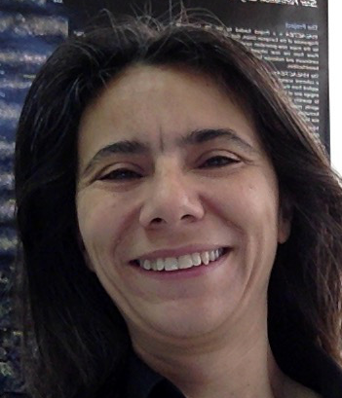




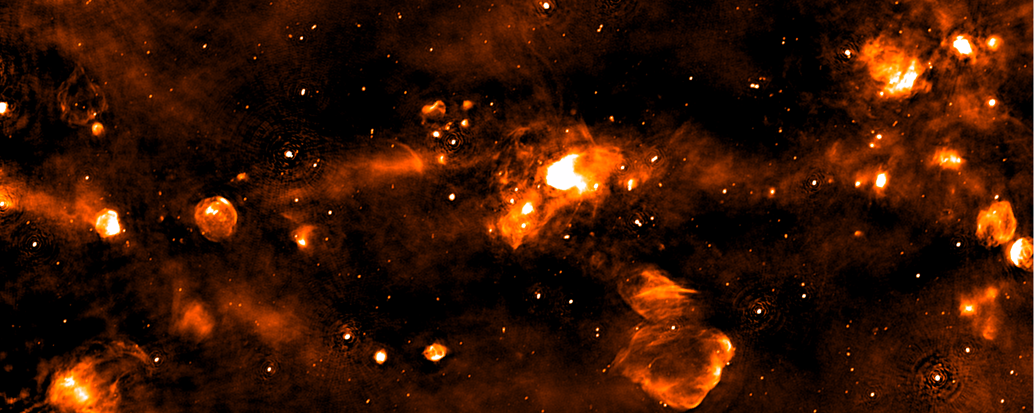
The Team
The SCORPIO Team
INAF-Osservatorio Astrofisico di Catania
Stellar Continuum Originating from Radio Physics In Ourgalaxy
INAF-Osservatorio Astrofisico di Catania
Corrado Trigilio Milena Bufano Francesco Cavallaro Carla Buemi
Corrado Trigilio Milena Bufano Francesco Cavallaro Carla Buemi
Grazia Umana Adriano Ingallinera Simone Riggi Paolo Leto
6 Staff and 2 post-doc members
Collaborators: Claudia Agliozzo, Luciano Cerrigone,
Ray Norris, Thomas Franzen, Joshua Marvil
+ EMU Collaboration

Slide 18
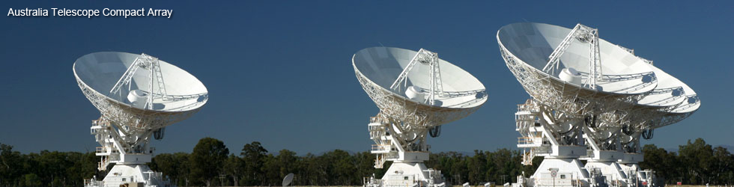
SCORPIO
The project
A deep radio survey in the GP with the ATCA
Frequency L-Band, comparable to EMU
High Sensitivity: approaching future radio facilities
At low Galactic latitude (well suited for stellar work)
Same observing strategy as ATLAS (to capitalize on previous experience)
In the tail of SCORPIO
2 x 2 deg² @ l=343.5, b=0.75

Slide 19
SCORPIO
Stellar Continuum Originating from Radio Physics In Ourgalaxy
Two aims:
Provide a good estimation of the scientific potential of deep radio surveys in the field of stellar/Galactic radio astronomy.
Catalogues of different population of Galactic radio sources
Define detection rates for different classes of radio stars.
Prove the importance (uniqueness) of radio observations in the field of Stellar Astrophysics
Scientific
Test bed for the EMU/SKA surveys: strategy for the GP section
Source complexity: issues due to complex structures in the GP
Source variability: issues due to the variable sources in the GP
Source finding: issues due to the diffuse emission in the GP
Source identification: how to identify/discriminate different populations (e.g. Galactic vs Extragalactic, different type of stars)?
Technical

Slide 20
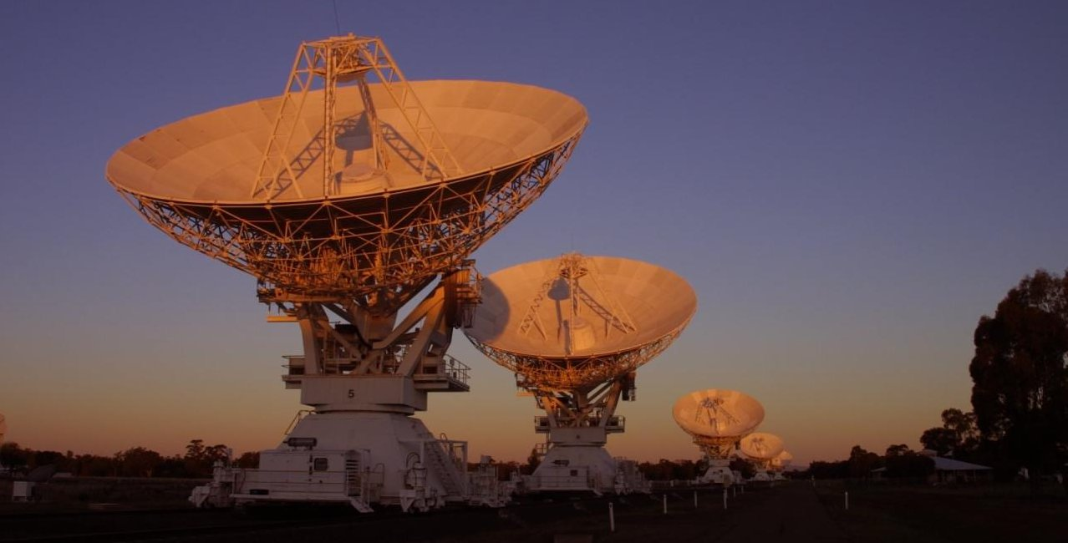
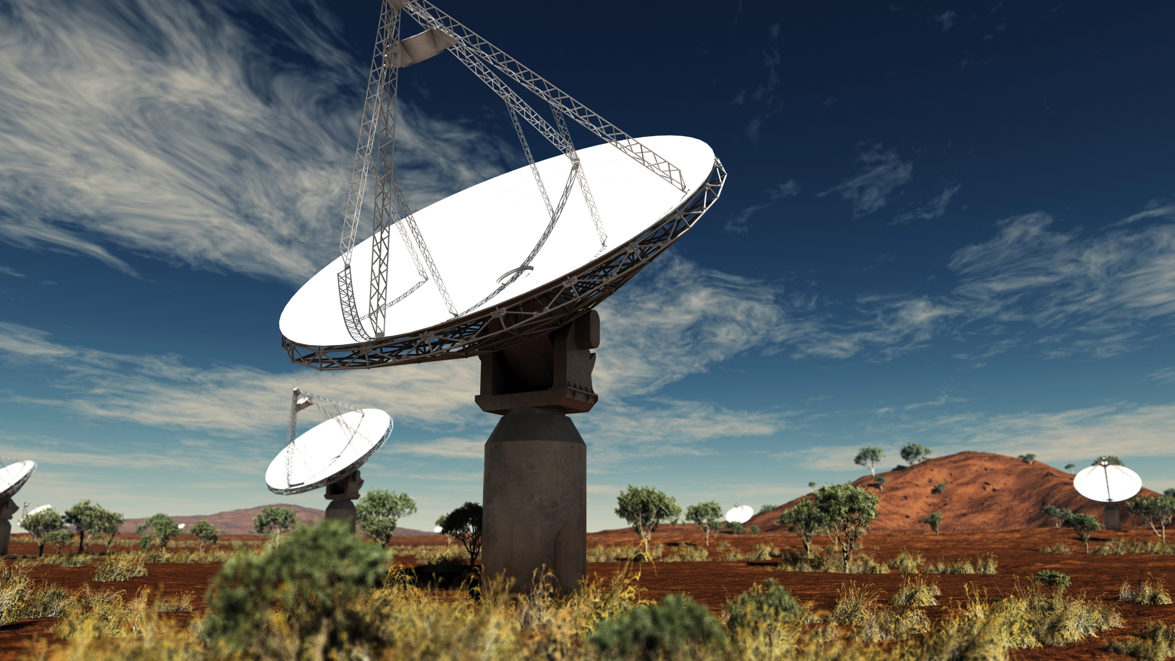
The SCORPIO field with ASKAP ASKAP Early Science
A much larger region of SCORPIO field
observed during ASKAP Early Science
Freq: 792-1032 MHz (240MHz)
Ang. Res. 24.1x 21.1 arcsec²
Total integration time: 32 hrs
(including overheads for calibration)
rms ≅ 130μJy (outside GP)
<rms> ≅ 500μJy
ATCA- 133 pointings, 3σ= 90 μJy, 4 deg²
ASKAP-12 1 pointing! 40 deg²
Jan 2018- 3 pointings
Umana, in prep.

Slide 21
The SCORPIO field ASKAP map
Field center 343.8 -0.2
Dimensions 5.4x1.3 deg²
Band 1 (792-1032 MHz)
Got new data @ 1630MHz, waiting for the third obs block within 2018

Slide 22
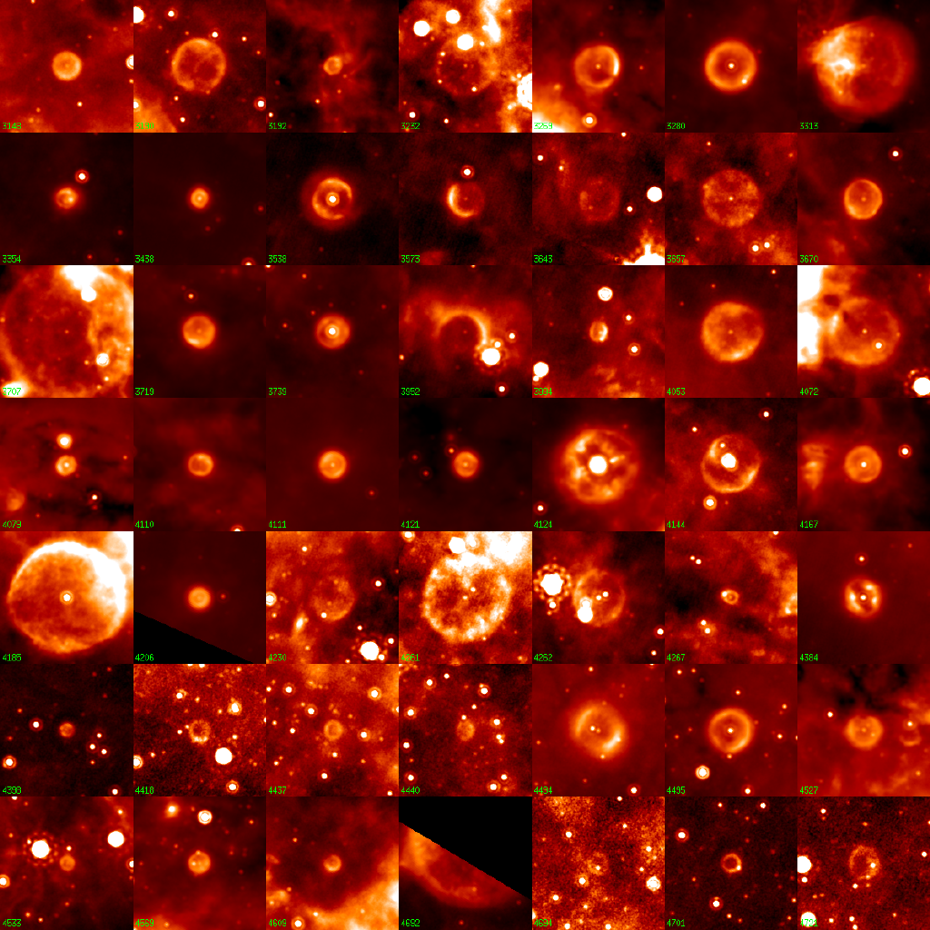

Synergies:The Bubbling Galactic Plane
Radio observations provide:
Morphological
Spectral index
Polarization
to discriminate
LBV, PN, WR (thermal)
from SNR (non-thermal)
Ingallinera et al., 2014; 2016
From SCORPIO and then GalacticEMU:
Synergies with SCIP (Stellar, Circumstellar
and Interstellar Physics) survey of WEAVE?
for the common sky
About 400 “bubbles” found
in MIPSGAL (24 μm)
Carey et al., 2009, Mizuno et al 2010
Possibly related to late stages
of Stellar evolution
only 10% have been identified
24 μm
Credit: Spitzer MIPSGAL Legacy Team
Notes:
This is just an example on how the sinergies between IR and radio can help in classifing galactic object.

Slide 23
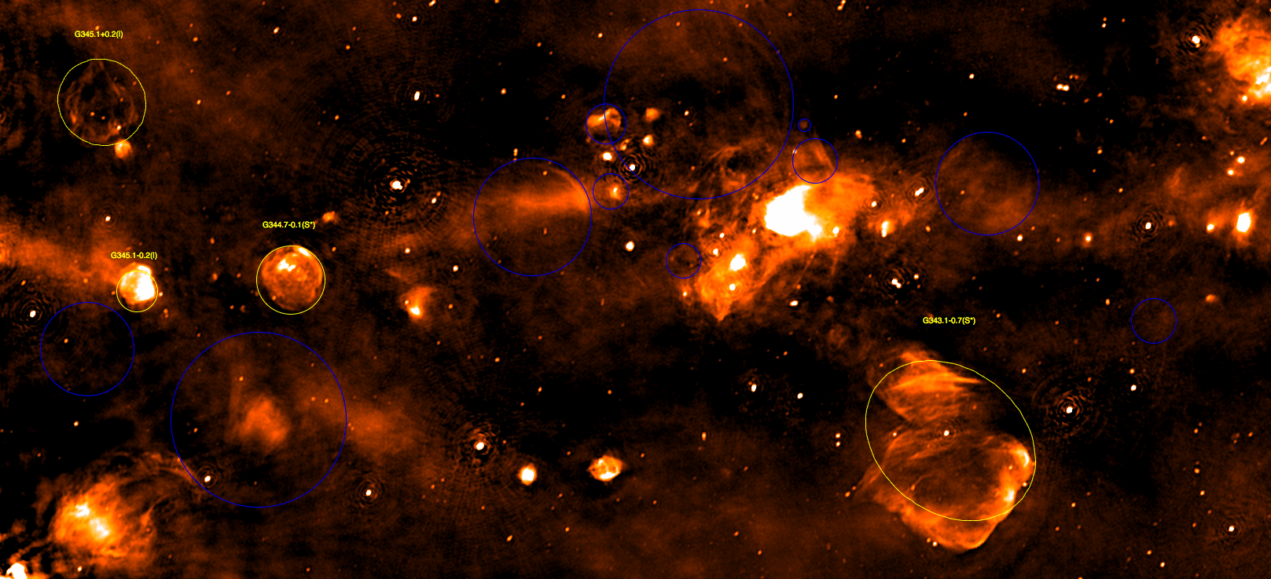
The SCORPIO field ASKAP map
Field center 343.8 -0.2
Dimensions 5.4x1.3 deg²
Yellow – 17 Known SNRs from Green et al. 2014
Blue – 23 new SNRs candidates (Umana+ in prep.)
Notes:
SCORPIO_SNR

Slide 24
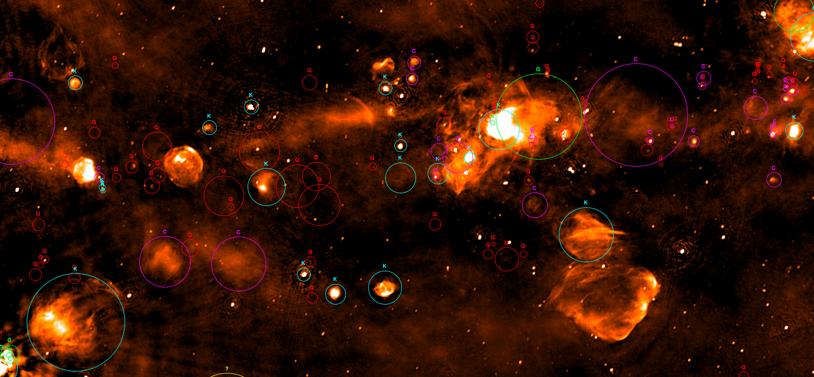
The SCORPIO field ASKAP map
Field center 343.8 -0.2
Dimensions 5.4x1.3 deg²
HII Regions as from the WISE catalog (Anderson+2014)
Light-blue K Known HII
Green G Group
Purple C Candidate
Red Q radio quite
A total of 388 HII are included in ASKAP map
220/388 are Q HII regions
99/220 (45%) are detected in ASKAP

Slide 25
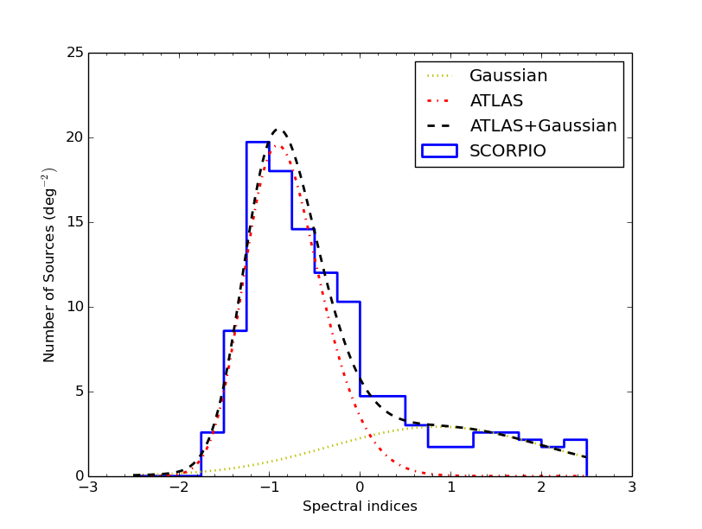
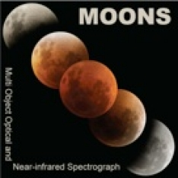
Synergies: new radio sub-mJy radio population in the GP
Radio spectral index analysis to characterize the point source emission
-disentagle between Galactic and extragalactic population?
Comparison with ATLAS:
no difference for α << 0
source excess for α ≥ 0
Above 1 mJy, the source density in SCORPIO (ATCA)
is 20% greater than in a typical extragalatic field
From SCORPIO and then GalacticEMU:
Catalogs for deep spectroscopic follow-up by
MOONS- Multi Object Optical and Near-infrared Spectrograph for the VLT
for classification of this new kind of GP radio population
NIR capability essential to explore heavely-obscured regions of the Galaxy
Cavallaro + 2018

Slide 26
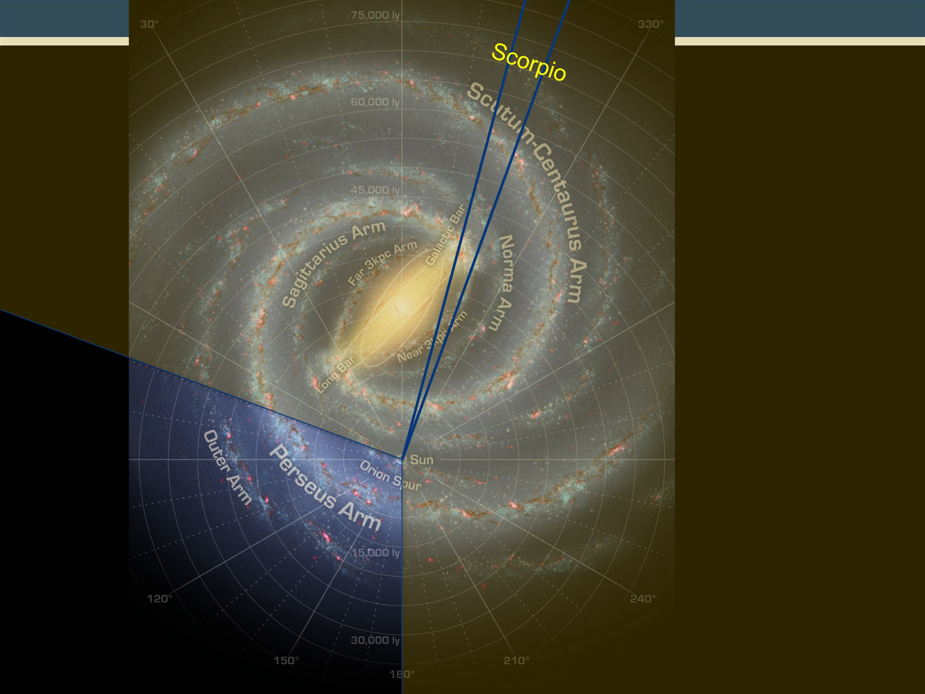
The SCORPIO field ASKAP map
Field center 343.8 -0.2
Dimensions 5.4x1.3 deg²
Green 8μm GLIMPSE
Red 70μm Hi-GAL
Blue ASKAP 912MHz

Slide 27
Access to SKA (principles))
Mainly via Key Science Projects
(50%-70% of first 5 years SKA1)
KEY SCIENCE PROJECTS (KSPs)
Large programs (>1000 h), performed over multiple semesters
PI & management team from SKA-member countries; co-Is from any country
Expected to provide added-value data products and tools back to SKAO.
PRINCIPAL INVESTIGATOR (PI) PROJECTS
Small programs (<1000 h) performed within a single semester
PI and majority of co-Is from SKA-member countries
OPEN TIME
Small programs led by PI from any country, performed
within a single semester.

Slide 28

Scientific community engagement
a regular sequence of Science Meetings,
both broad and focused ones.
a regular sequence of KSPs workshops,
aimed at providing:
A forum for the keys areas of interest
Development of objectives and
collaborations
Next Science+ KSPs meeting to be held at SKA HQ on 8-12 April 2019

Slide 29
Timeline- Key dates
Adapted from J. Wagg et al., 2017
2019/2020 End of design phase, start construction
2022 Science Commissioning begins
Shared Risk Science begins
2027/2028 Large Projects (KSPs) begin

Slide 30
Take home message
What to do in the meantime?
Be involved in projects using SKA precursors/pathfinders:
MeerKAT open call for PI projects
http://www.ska.ac.za/science-engineering/meerkat/observing-programme/open-time/
ASKAP in Early Science Phase:
KSP –Galactic Plane (chairs: G. Umana/R. Kothes)
processed map available to the community soon
Be involved in SKA SWGs
just send an email to the chairs: to me for Our Galaxy
Be ready for the SKA!!!!!!!

Slide 32
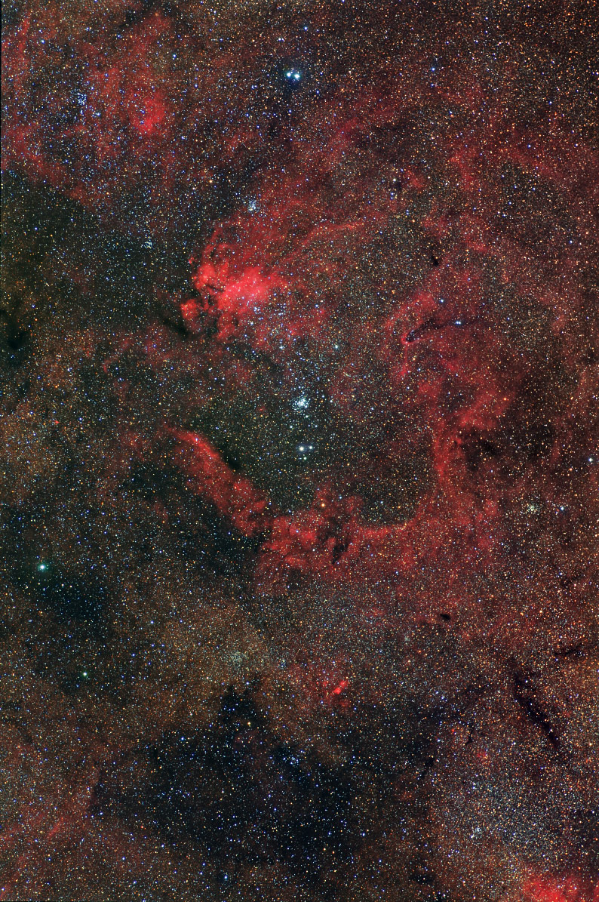
SCORPIO with ATCA
Specifics Required:
Frequency L-Band, comparable to EMU
High Sensitivity: similar to new radio facilities
At low Galactic latitude, well suited for stellar work
2 deg
Field Selected:
Close to the GP, extending to higher b
A “sufficient” number of stars, good spread in potentially radio emitting objects.
Few radio sources already detected in it: to be used as check
Multi-λ observations available for comparative studies.
GP
In the tail of SCORPIO
2 x 2 deg² @ l=343.5, b=0.75

Slide 33
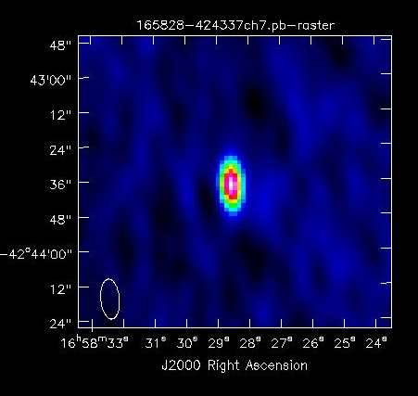
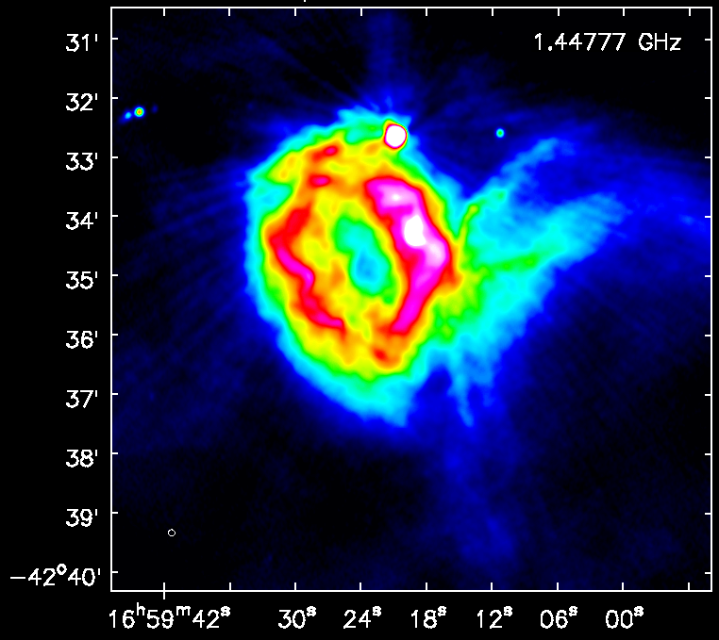
The SCORPIO zoo
Found 2206 “point-like sources”, with a cut of 5σ
614 in the pilot experiment (Umana et al., 2015)
matches with SIMBAD
Stars
PNe
Pulsars
IR
HII
1Variable (ζ¹ Sco)
2 WR
3 in Open Cluster (in NGC6231)
1 YSO
1 Be
1 Cp star
13 stars with no references
Point Sources
6 pulsars
30 UCHII/HCHII
6 PNe
≈ 1900 without classification
Expected many extragalactic
“contaminants”
Extended Sources
49 classified classical HII
4 PNe
4 SNRs/candidates
2 WR/LBV candidates
24 without classification

