Slide 1

Pioneering Panoptic Spectroscopy
all-sky spectroscopy
optical & near IR
multi-epoch (2-50)
mostly stars and AGN
Dan Maoz
for the SDSS-V Team
(Kollmeier et al arXiv:1711.03234)
Notes:
SDSS-V is in the tradition of the Sloan surveys, but it aims to pioneer a new, and quite different regime:
All-sky, multi-epoch spectroscopy. Creating a first spectroscopic all-sky, time-domain capability, that exists manyfold for imaging

Slide 2
The Rationale behind SDSS-V
all-sky spectroscopy
  the new space imaging surveys are all-sky: Gaia, ROSITA, TESS,..
  spectral followup paramount
optical & near IR
  R=2,000 (BOSS) across 3600Å - 9700Å
  R=22,000 (APOGEE) H-band, dust-penetrating
multi-epoch
  pioneer systematic time-domain spectroscopy
  at least two epochs across entire sky
  (many) more at low latitude and e.g. ecliptic poles
Notes:
Let’s elaborate a bit what’s behind these terms describing SDSS-V; these are generic capabiliuty arguments; we’ll fill in the science in a minute.
all-sky, imaging surveys abound, and homogeneous spectroscopic data to get the science out is a perennial, severe problem
For much of the sky, and for much science optical spectroscopy is the tool of choice; but for understanding the galaxy and young stars, dust penetrating IR spectroscopy is indispensible
While time-domain imaging surveys abound, systematic multi-epoch spectroscopy across the sky is lacking; here we can offer 20min to 20 years;
the MANY-epoch regime will be at low-latitudes and across selected (>1000sqdeg) areas

Slide 3
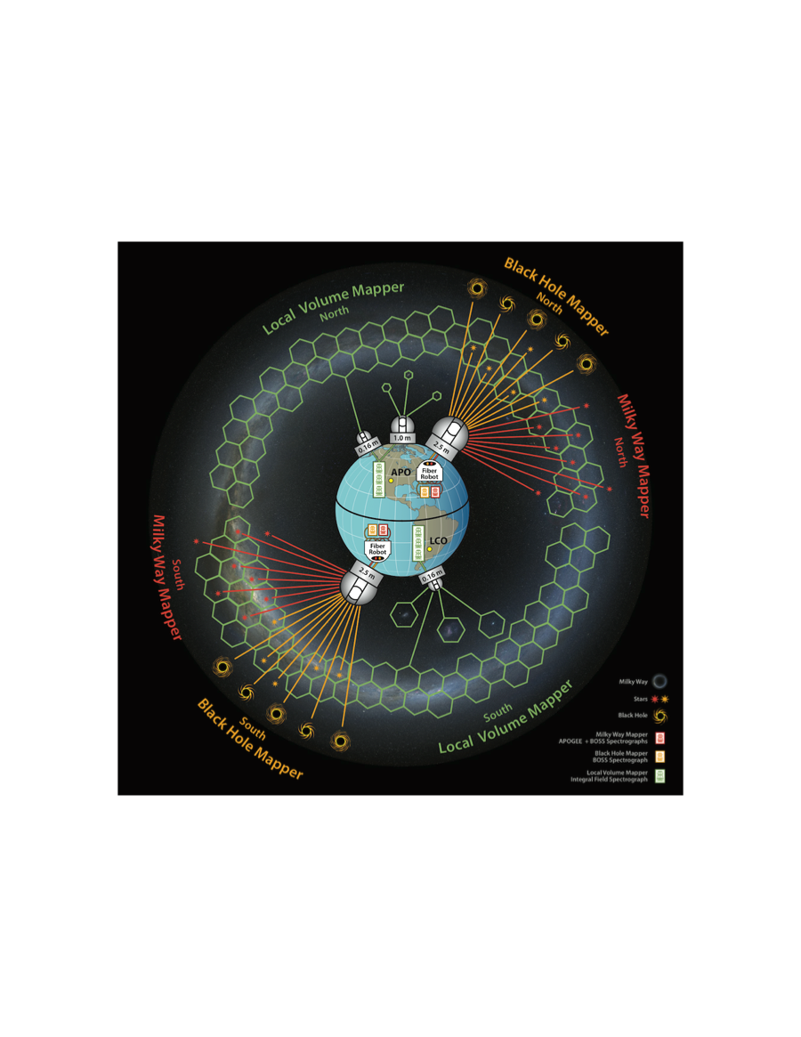
What will SDSS V be?
an observing facility:
  telescopes, hardware, software
a science survey program:
  panoptic spectroscopy
a consortium and collaboration
in implementation and fund-raising phase
  to start 2020 (4-5 years)
Courtesy: Mark Seibert
Notes:
The right hand picture shows:
-- observations at APO and LCO
-- BOSS & APOGEE spetcrocopy in both memispheres
-- and LVM (ultra-wide IFU spectroscopy), which I will only mention briefly here.

Slide 4

How can SDSS-V survey so fast, widely and repeatedly?
(multi-object spectroscopy surveys)
7deg² (N) + 3.5deg² (S) FOV
(new) robots for fast fiber reconfiguration
  2x ( 300 near-IR, 500 optical )
    on a total of 2x 500 robots
~15 min exposure time quantum
  H<11.5 @R=20.000 APOGEE
  G<17.5 @R=2.000 BOSS
Repeat visits to field can
  Boost target density
  Create time-domain data
  Get more S/N

Slide 5
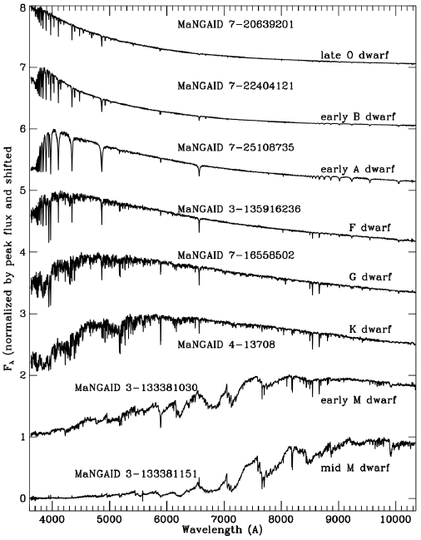
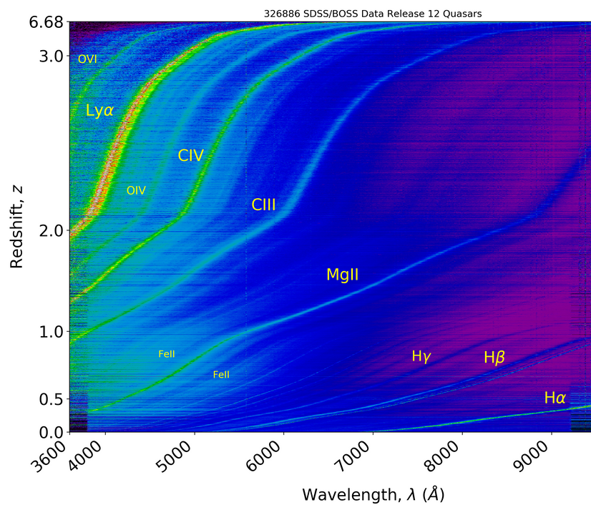
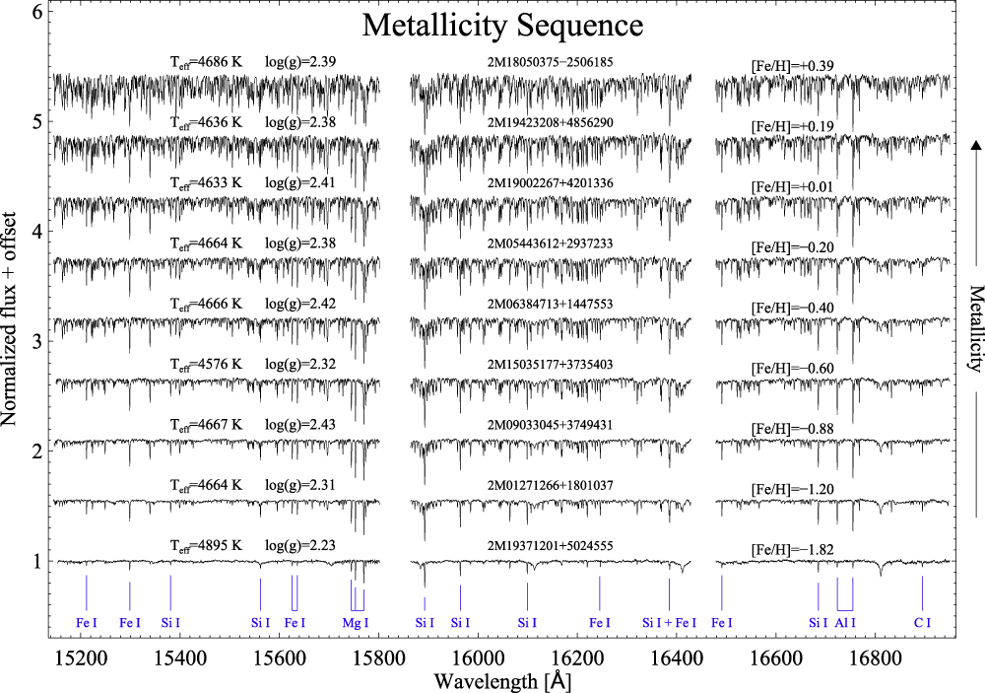
SDSS-V multi-object data spectra & parameters
BOSS Spectra of stars
APOGEE Spectra of stars
BOSS Spectra of AGN

Slide 6
Science: the “Mappers”
SDSS-V Panoptic Spectroscopy Survey Programs
Black Hole Mapper (>400,000 targets & monitoring)
  QSO reverberation & variability
  eRosita (X-ray survey) follow-up
Milky Way Mapper (>6,000,000 targets & multi-epoch)
  Galactic Genesis: map disk chemistry+kinematics
  All-sky stellar spectral complement to Gaia, TESS
Local Volume Mapper (>25,000,000 spectra & >3000 sqdeg)
  Ultra-wide field IFU spectroscopy 6”-37” spaxels and 1650-fiber bundles
  the ISM physics of MW, LMC/SMC, M31

Slide 7
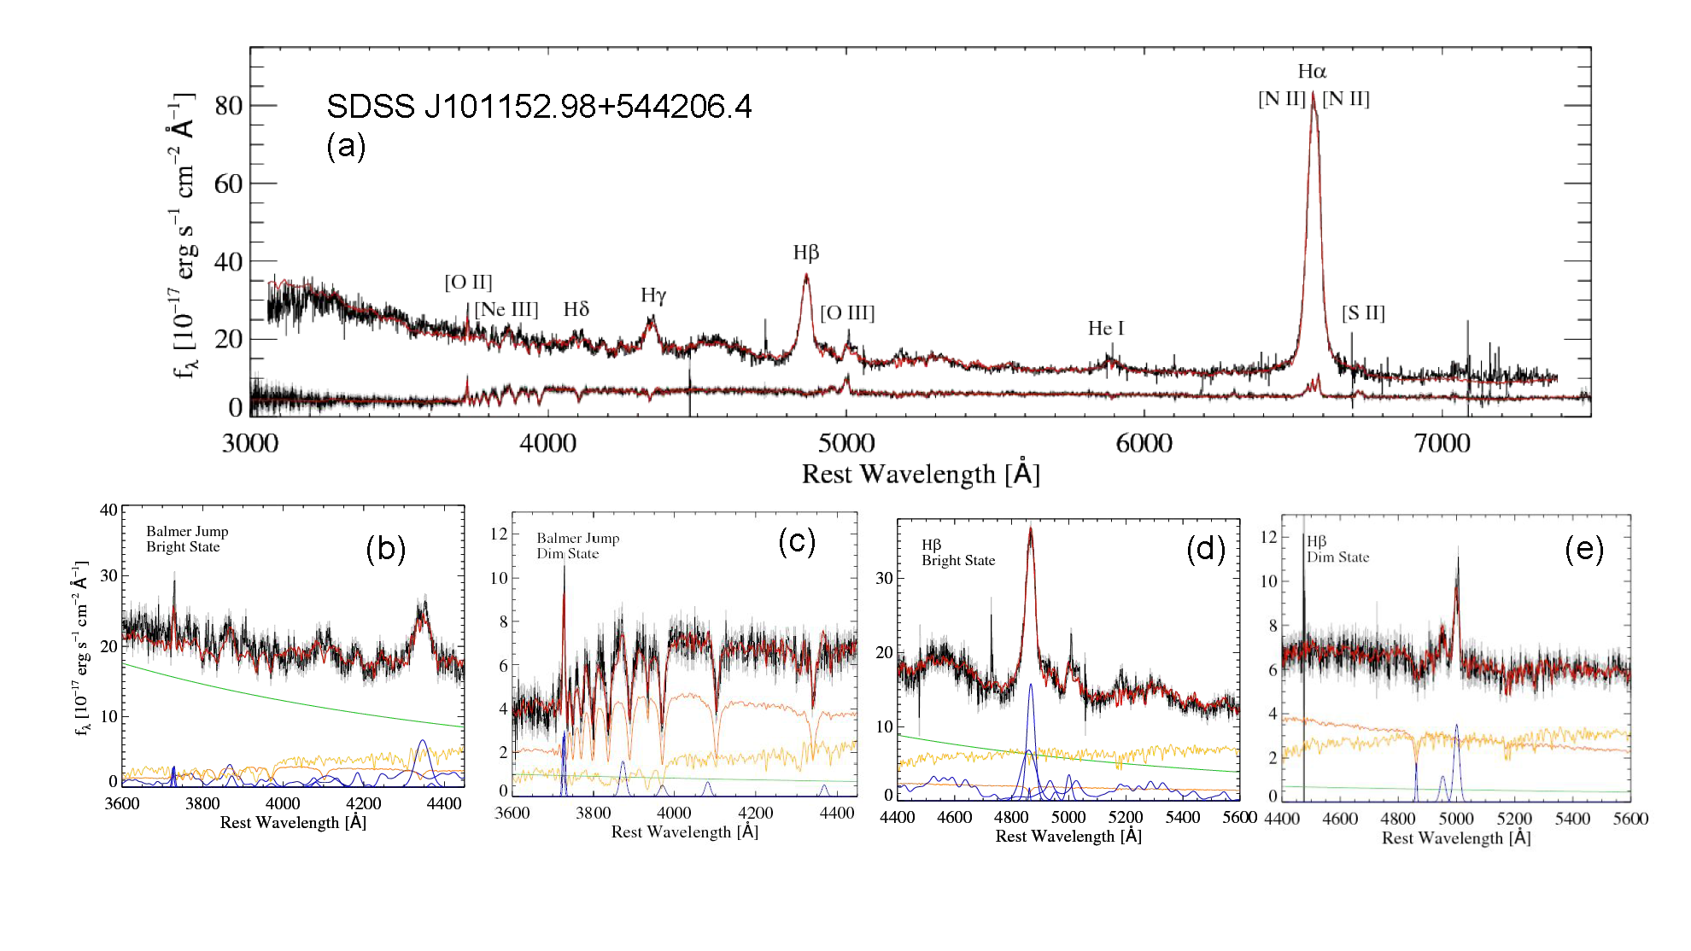
QSO Time-Domain with the “Black Hole Mapper” the statistics and physics of changing-look QSO expect to 100-fold the current sample

Slide 8
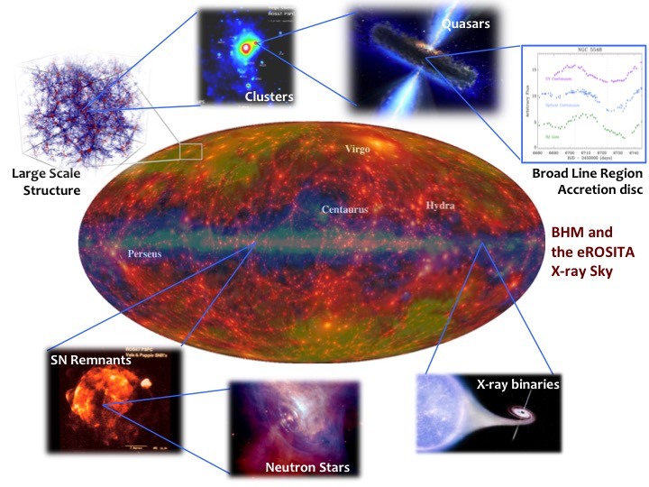
eROSITA and the SDSS-V Black Hole Mapper
Notes:
35min

Slide 9
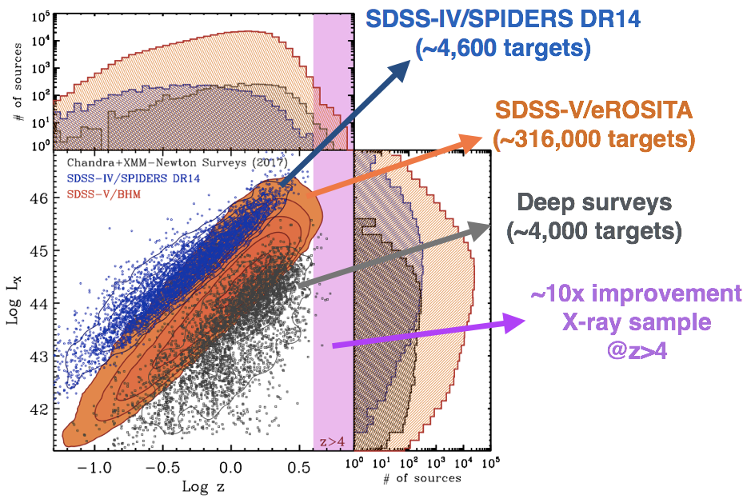
SDSS V follow-up on eROSITA QSO

Slide 10
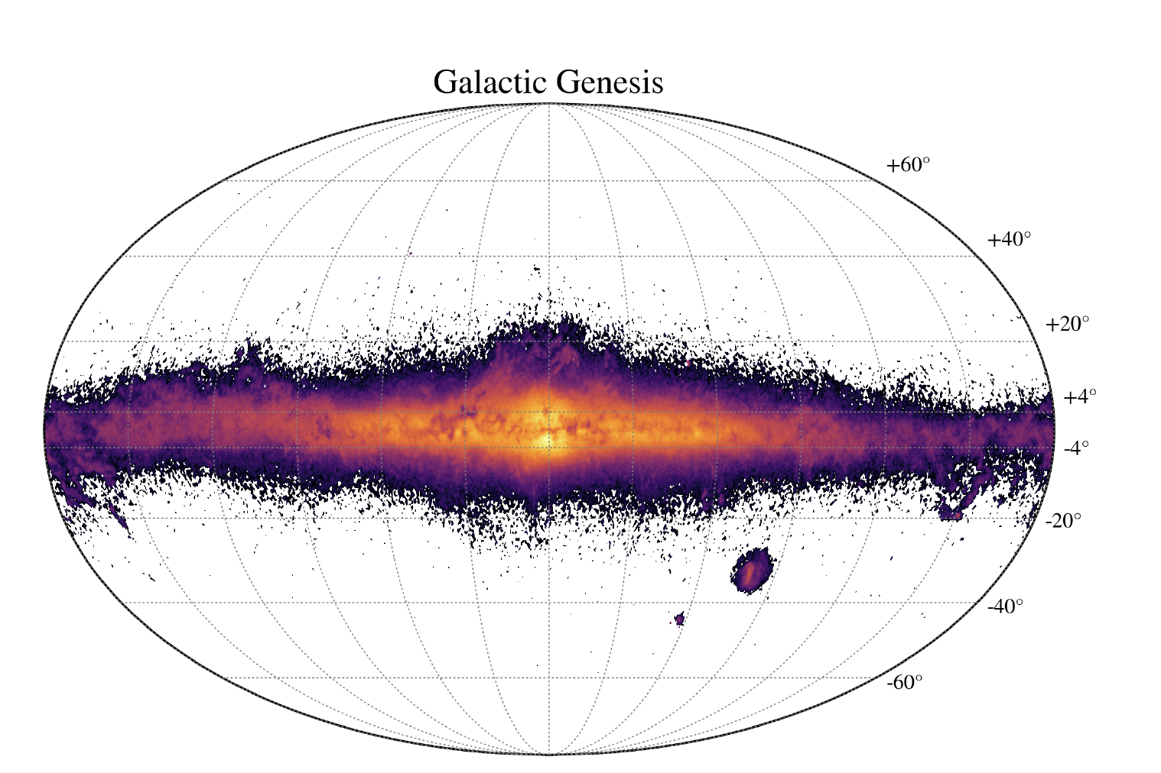
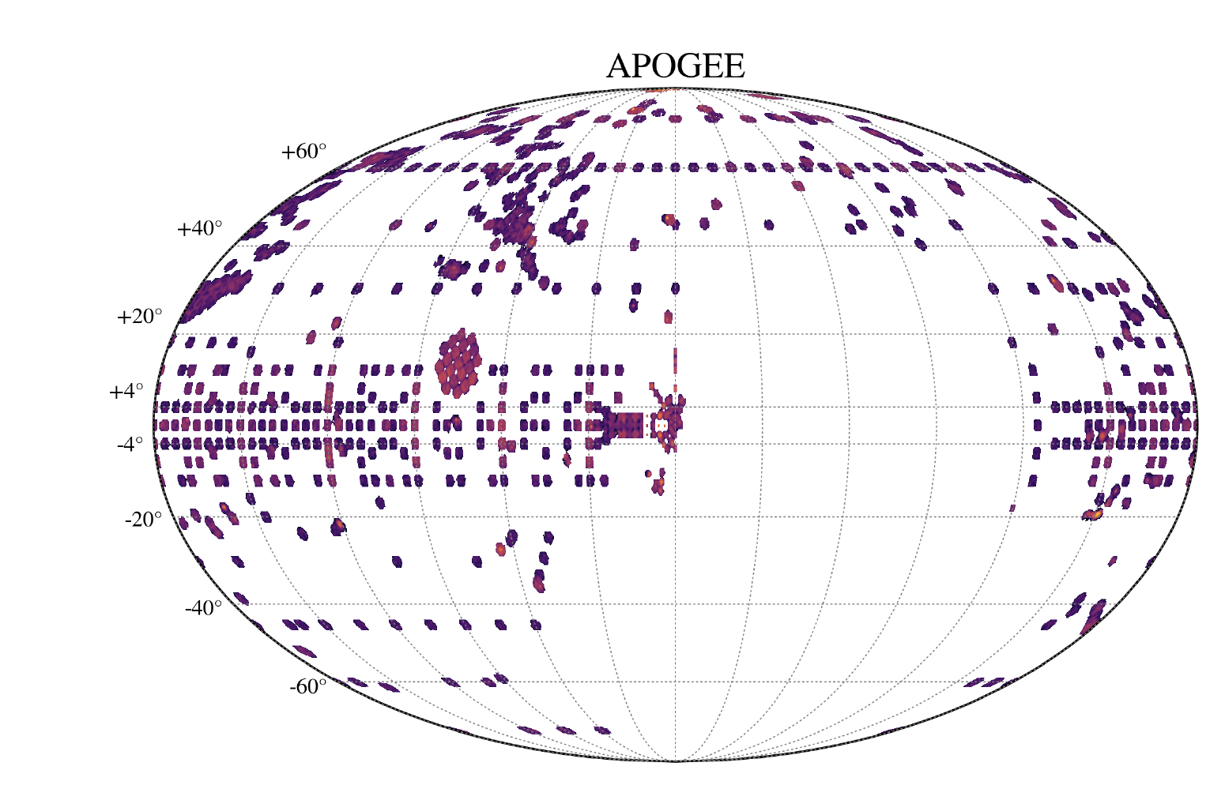
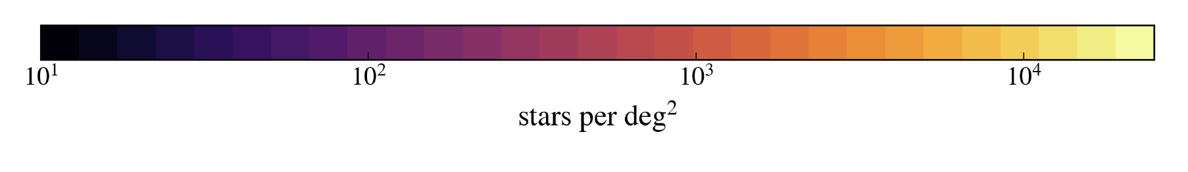
SDSS V Milky Way Mapper
Targeting:
  Galactic Genesis: all stars in the MW with H<11, G-H>3.5
    >10.000 stars on the ``far” side of the Galaxy
    Contiguous coverage across the entire disk, dust-penetrating spectroscopy
High-res., near-IR spectroscopy for 5M stars

Slide 11
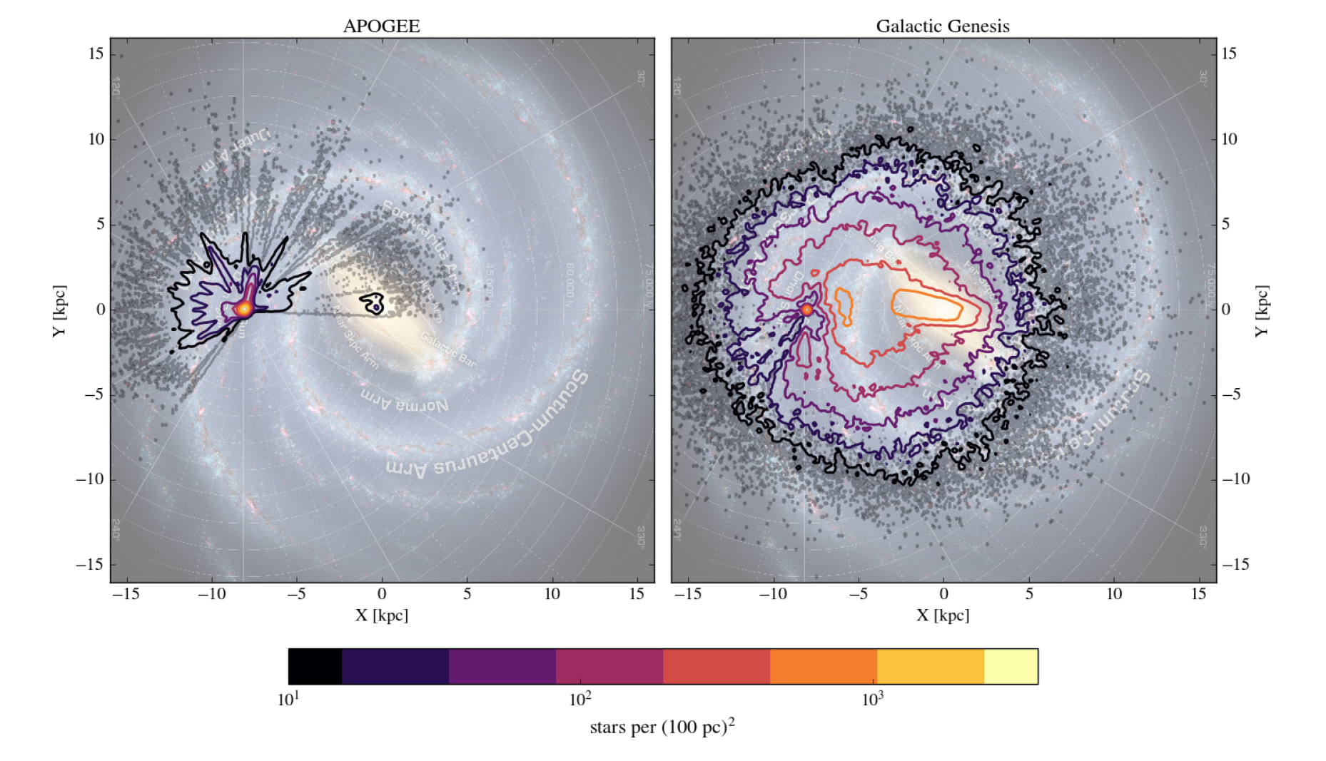
IR spectra for 4 million stars, including the center and the ``far side” of the Milky Way
SDSS IV APOGEE (2017)
SDSSV Galactic Genesis
>100,000 stars beyond the GC
Notes:
11

Slide 12
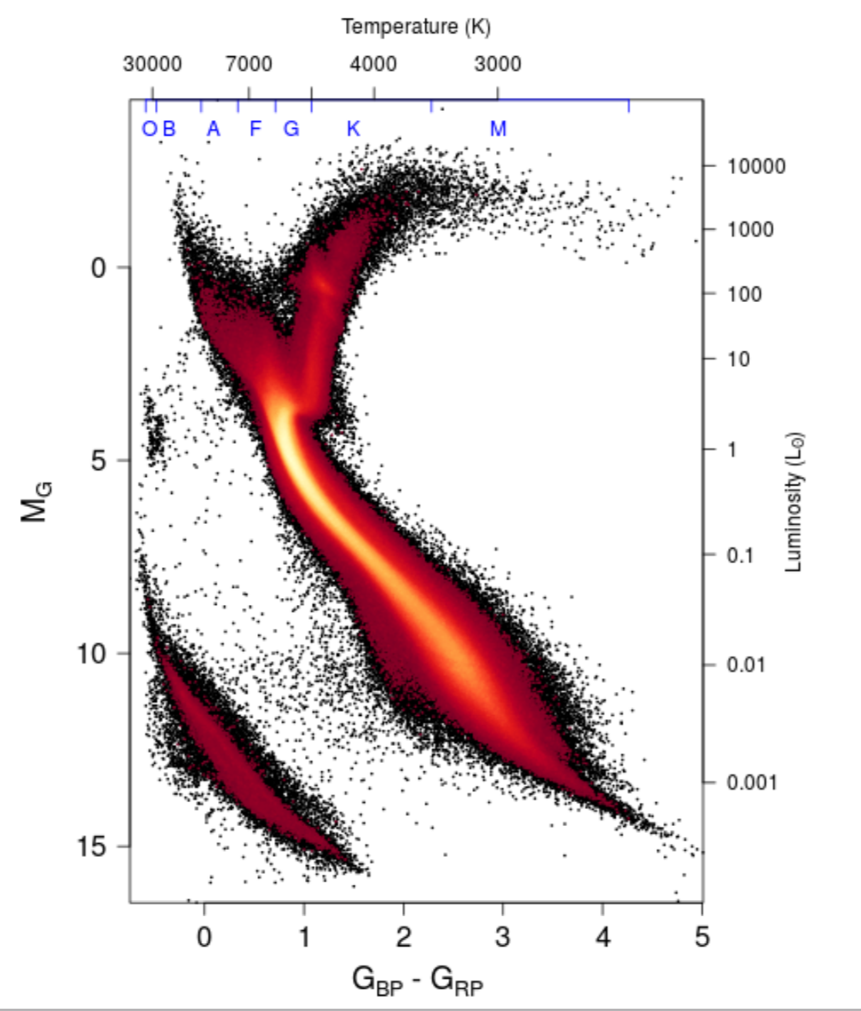
Stellar astrophysics
Multi-epoch optical spectra of ALL 300,000 Gaia-selected stars within 100 pc
Multi-epoch IR spectra of all H<12 massive stars
Spectra for all:
100,000 Gaia common proper motion multiple stars
200,000 TESS prime stars (2min cadence)
10,000 TESS TOIs
50,000 TESS ellipsoidal binary variables
20,000 YSOs with H<12
Multi-epoch optical spectra of 200,000 Gaia-selected white dwarfs

Slide 13
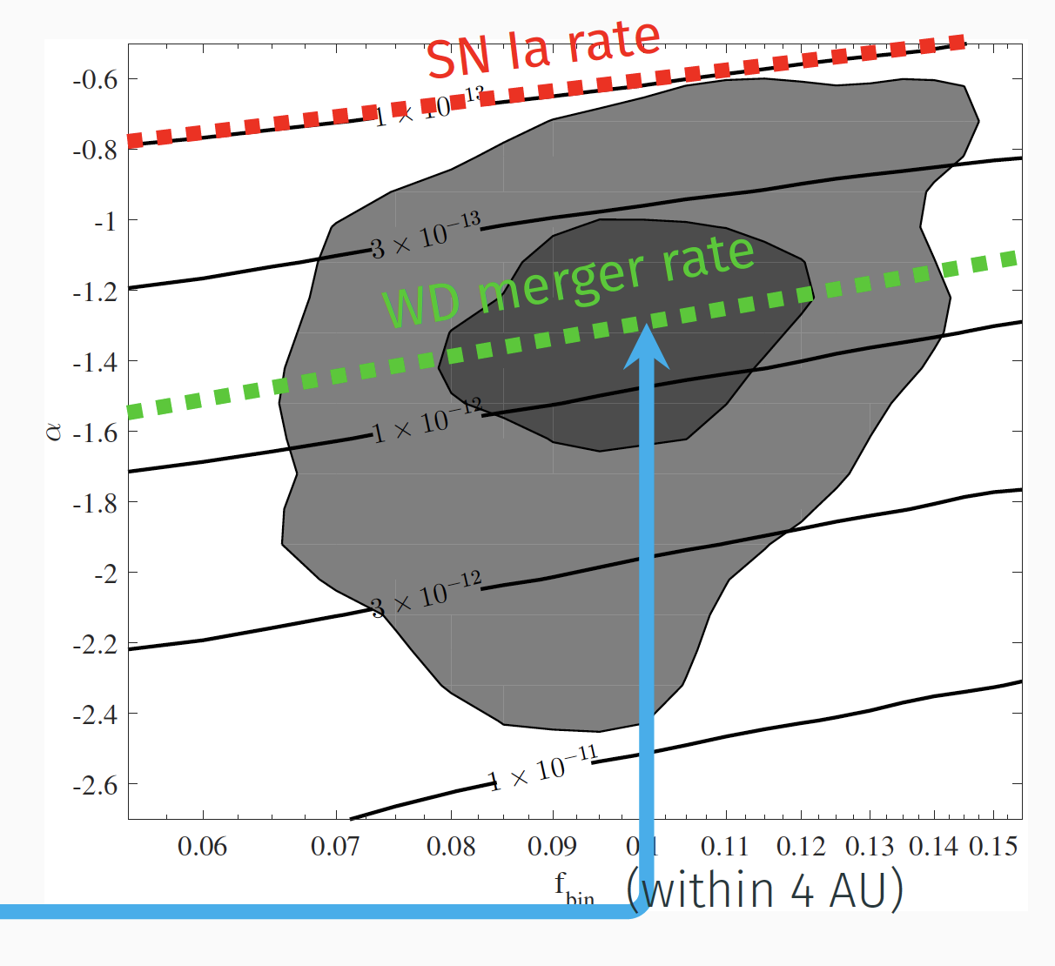
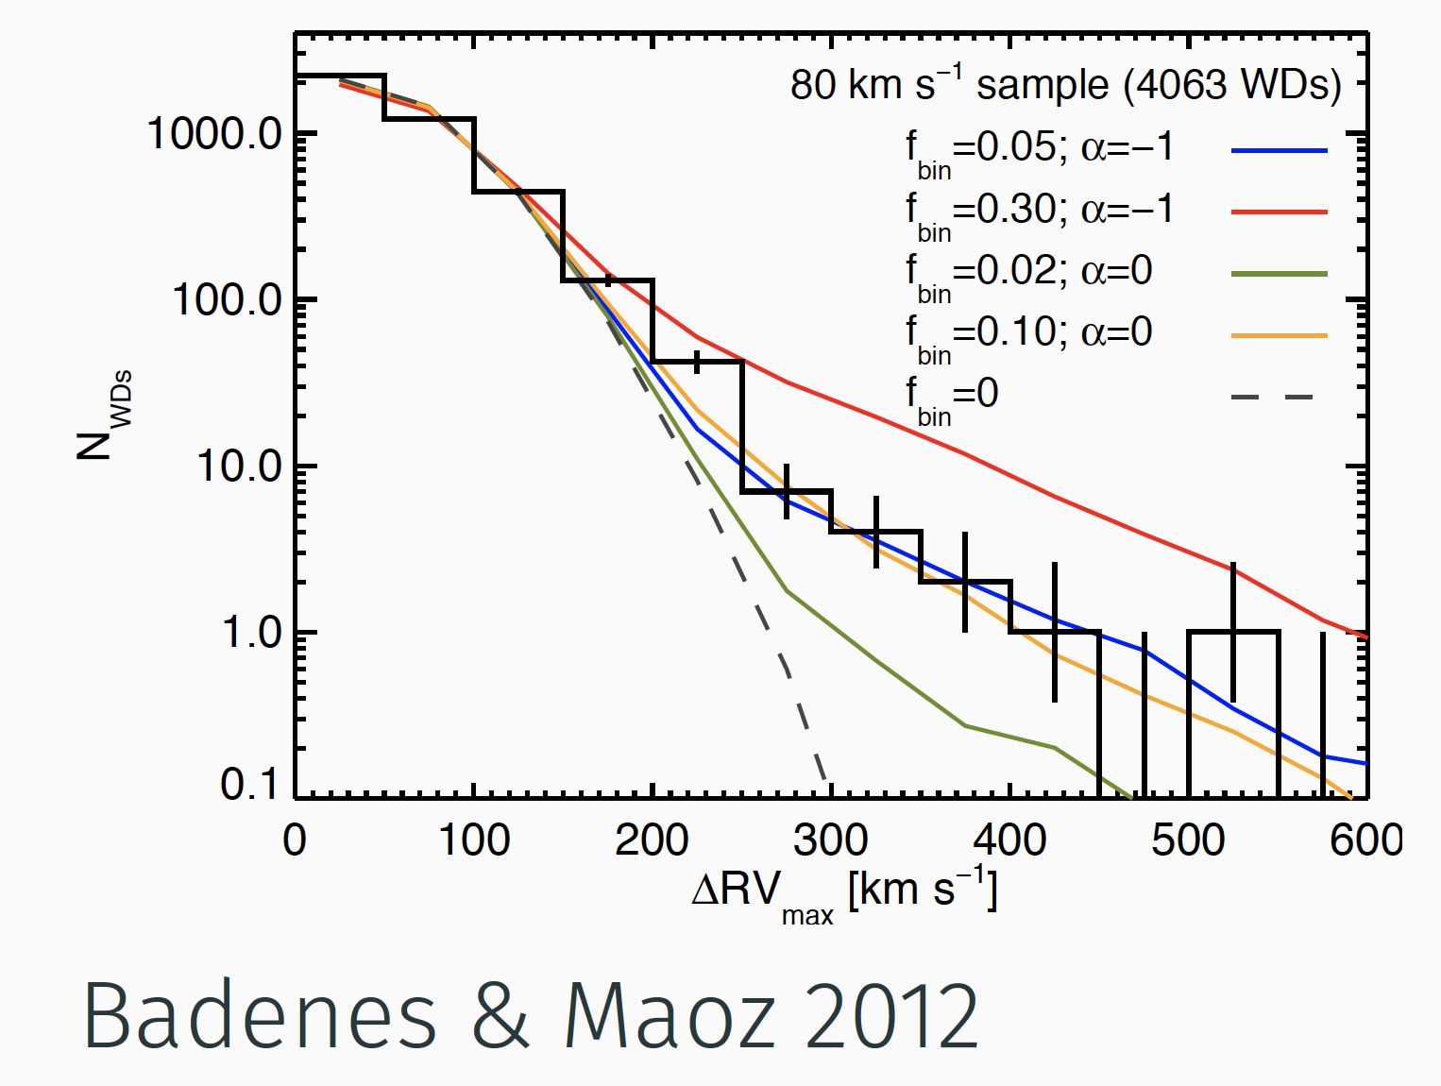
What causes SN Ia?
a comprehensive census of tight WD binaries
velocity differences, within ~1 hour
→ close WD-WD binaries (Badenes & Maoz, 2012)
More WD mergers than SN Ia, but how many can make SN Ia?
→ SDSS V to get multi-epoch spectra for 200.000 WDs

Slide 14
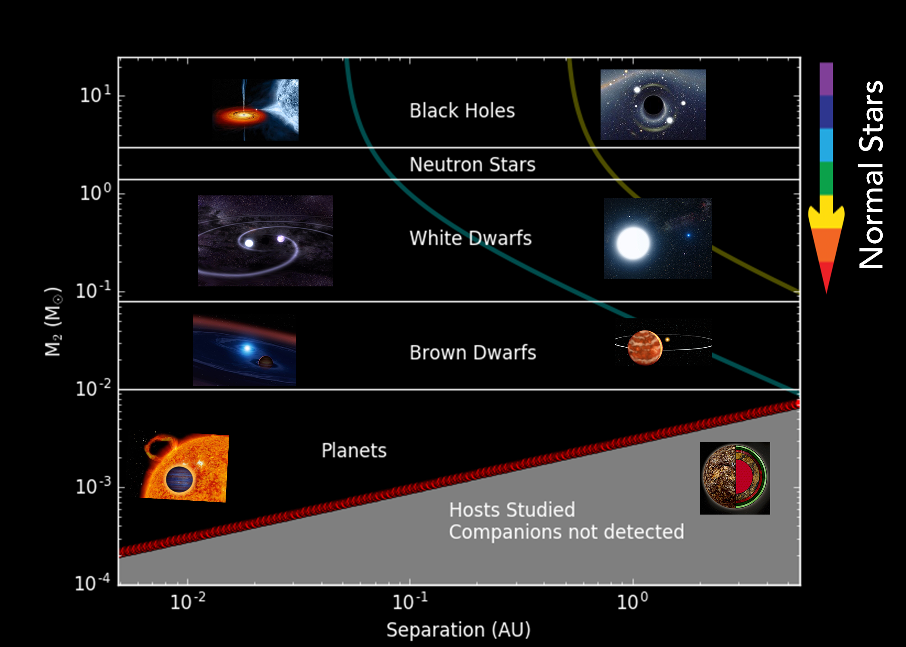
RV changes between epochs will reveal the Galactic population of
BH, NS and WD companions to normal stars
Known stellar mass BH’s are in mass-transfer binaries. What is beyond?

Slide 15
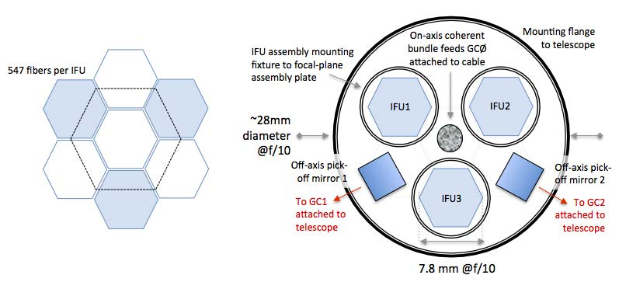
The Local Volume Mapper Instrument (LVM-I): new Hardware for Ultra-wide-field IFU
Push IFU spectroscopy to new regime:
  0.5deg² mosaic → 3000deg² mosaic
  huge pixels, small telescopes
3 bundles of 550 fibers
3 DESI-type spectrographs (each)
  R=2,000-5,000
  λ = 3600Å - 9800Å
fed by two x16cm & one 1m telescopes
  5.7” to 37” spaxels

Slide 16
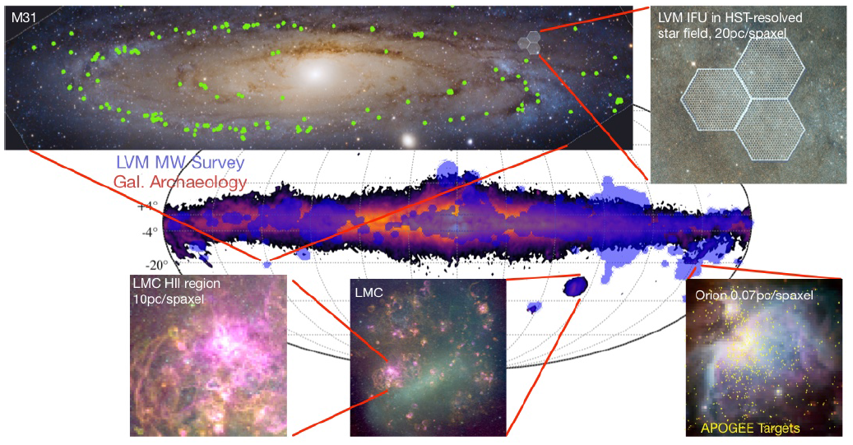
2 x 1650 fibers (bundle), 10” to 37” spaxels, 16cm – 100cm Telescopes 3 x DESI-type spectrographs (R=2000; λ ~ 3700 – 9000Å)

Slide 17
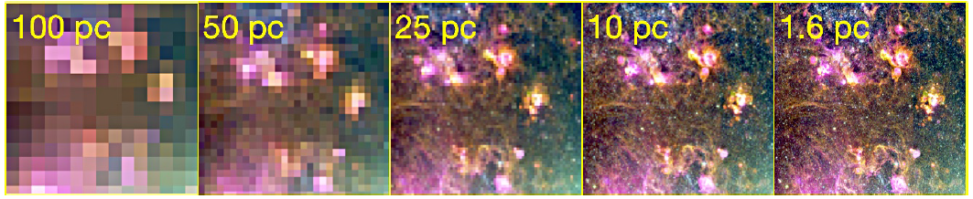
SDSS V: Local Volume Mapper
need to map the ISM at high physical resolution
push for high angular resolution, or go nearby
Can we make global maps of the physical properties (T,ρ, excitation, etc.) of the ISM in the Milky Way, Magellanic Clouds and M31

Slide 18
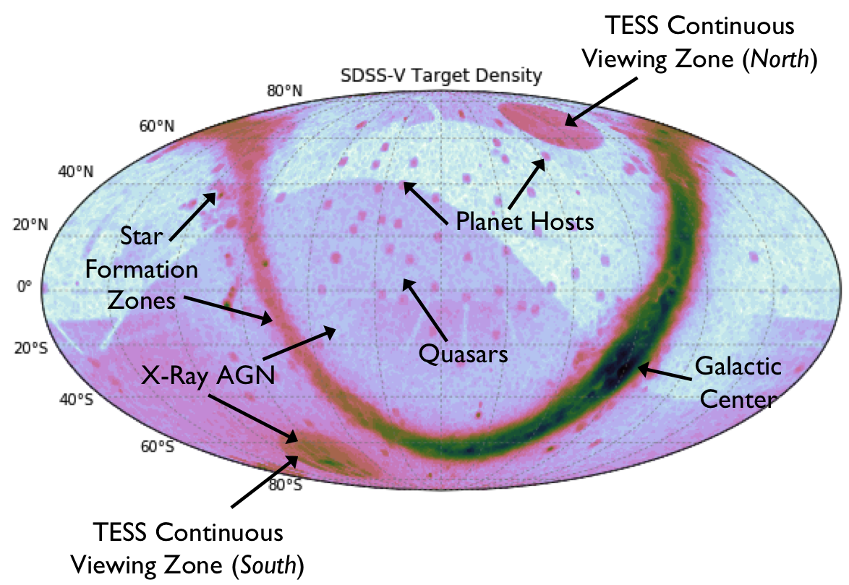
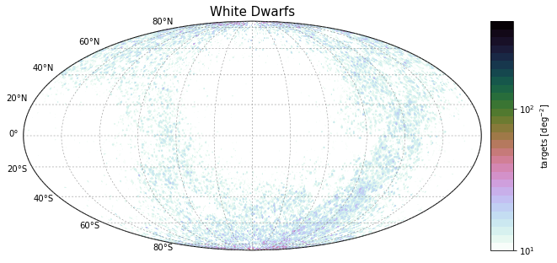
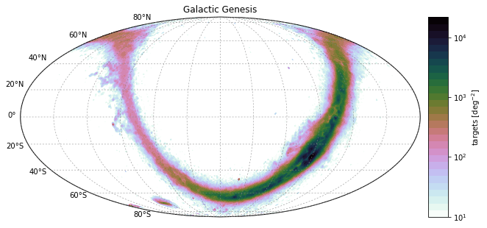
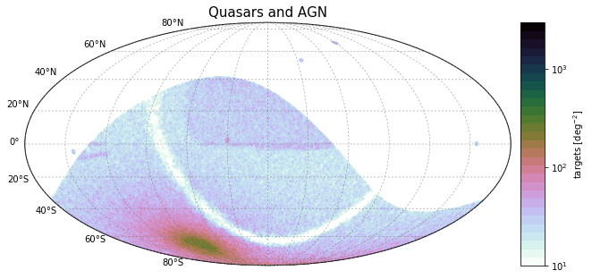
SDSS V’s Targets across the Sky

Slide 19
SDSS-V and others
Survey | All-Sky | systematic time-domain | optical | (near-)IR 1-2μ
SDSS-V
WEAVE
Gaia RVS
4MOST
MOONS

Slide 20
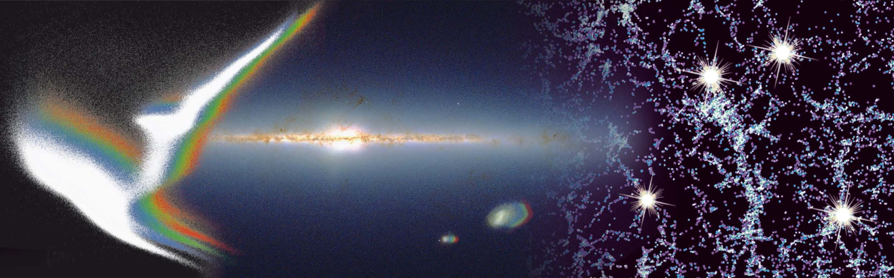
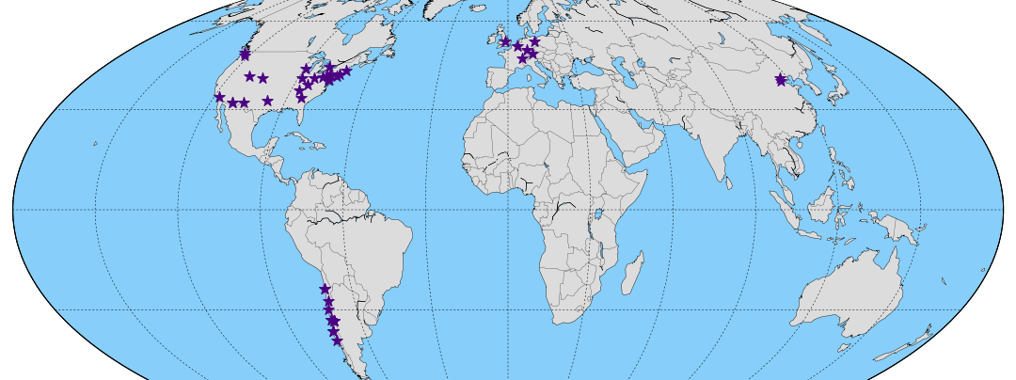
SDSS V
Pioneering Panoptic Spectroscopy all-sky, often, fast, bright 2020+
http: //www.sdss.org/future
Understand the Galaxy, its ISM and the
Physics of Stars and of Accreting Black Holes
… to create this unparalleled, global resource,
we need partner institutions to join
Notes:
ENORMOUS POTENTIAL (ORDER OF MAGNITUDE IMPROVEMENTS)
Milky Way: from small scale structure to full-scale in a homogeneous fashion
what scales drive evolution, over what scales does feedback act?
[What are we glossing over in other galaxies] AS4 complementing Gaia
Stellar physics:
stars and planets
how do stars work
what makes SN Ia blow up etc..
BH physics sics:
measure high-z BH masses
how do QSO change
Complement space missions
Pioneer panoptic spectroscopy (all-sky, mega-IFU, time-domain)
Bring industrialization and open collaboration to fields where craftsmanship reigns
Major fund-raising effort ahead; this will not just happen

Slide 23
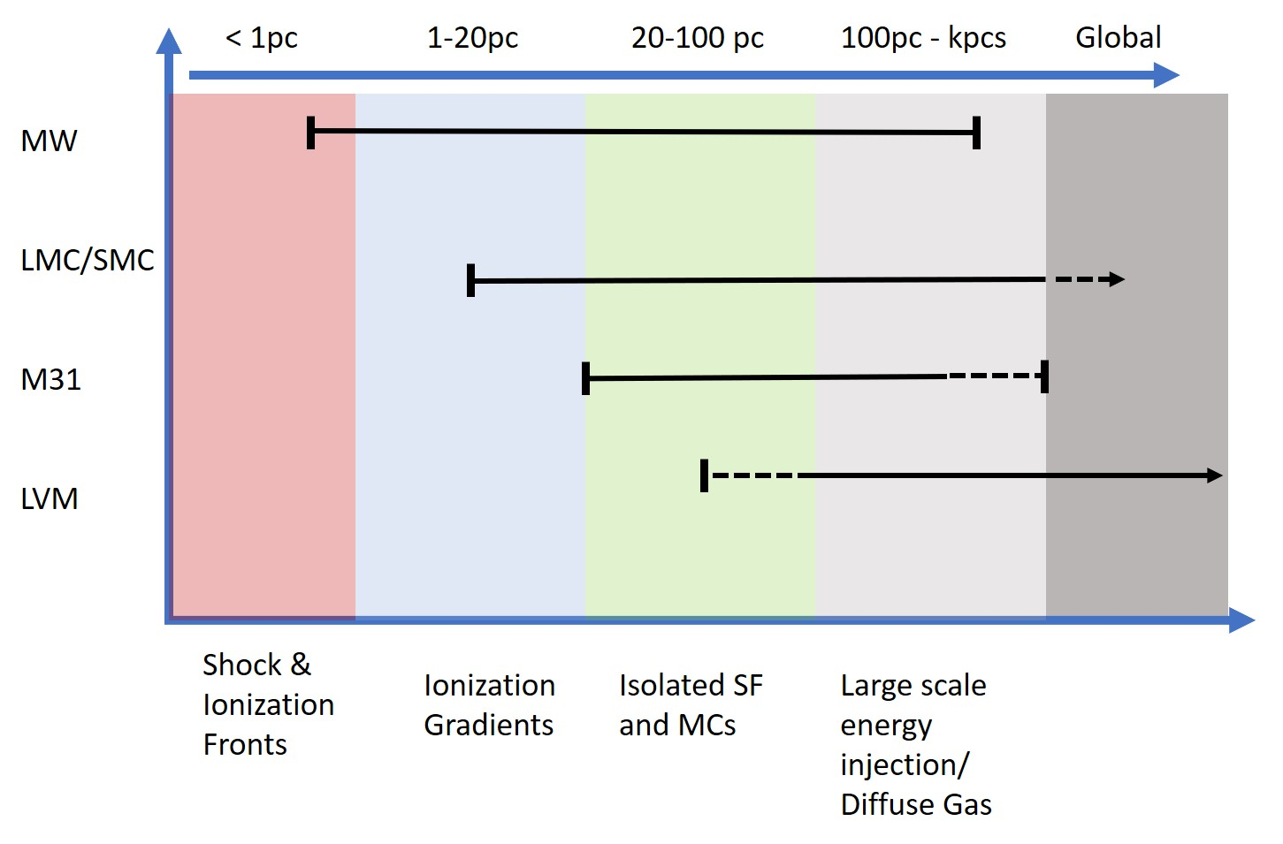
What scales and processes of the
(ionized) ISM will the Local Volume Mapper probe?
Courtesy: Eric Pellegrini, ZAH, Heidelberg

Slide 24
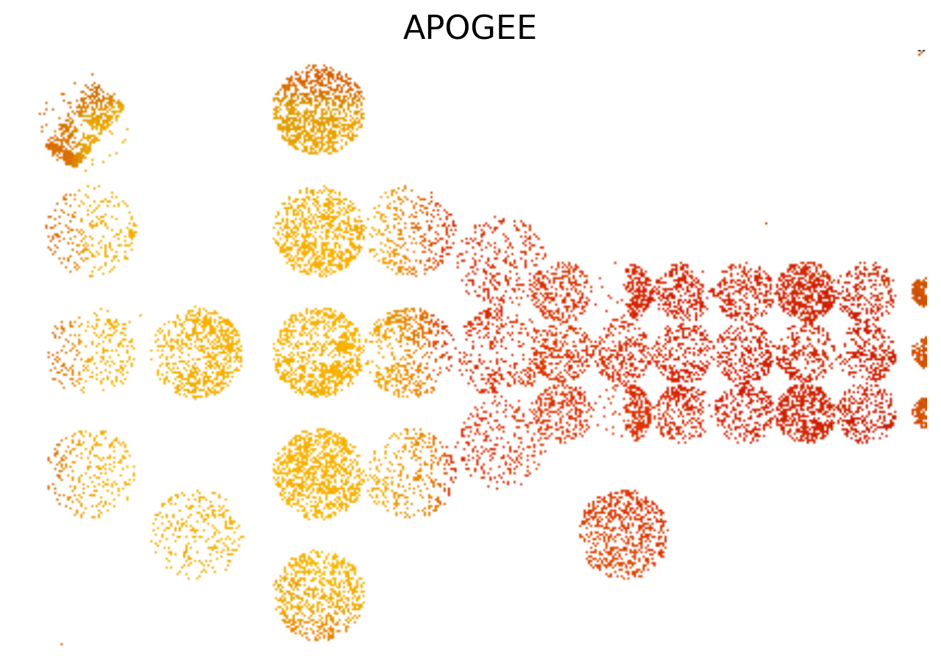
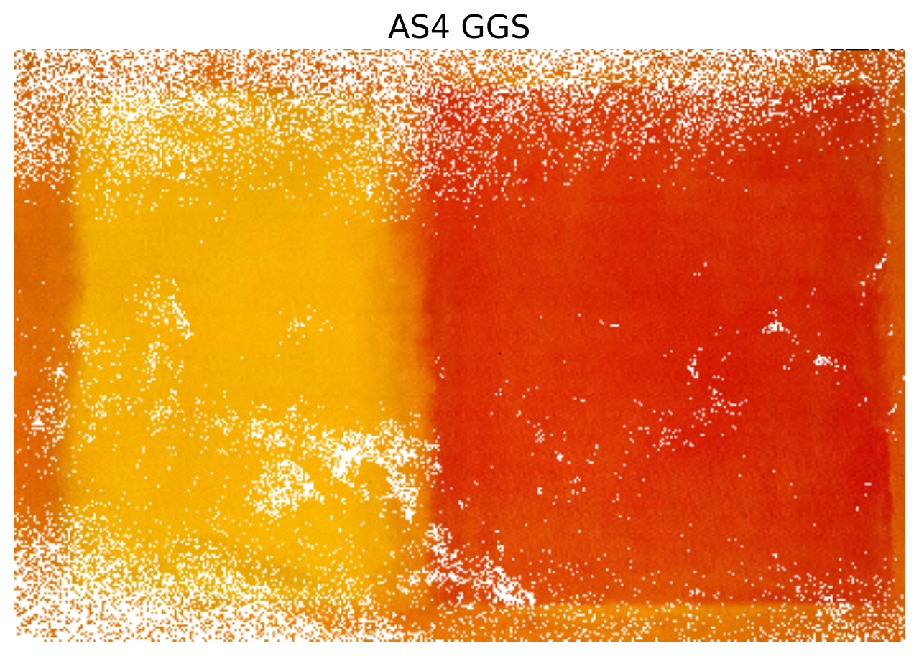
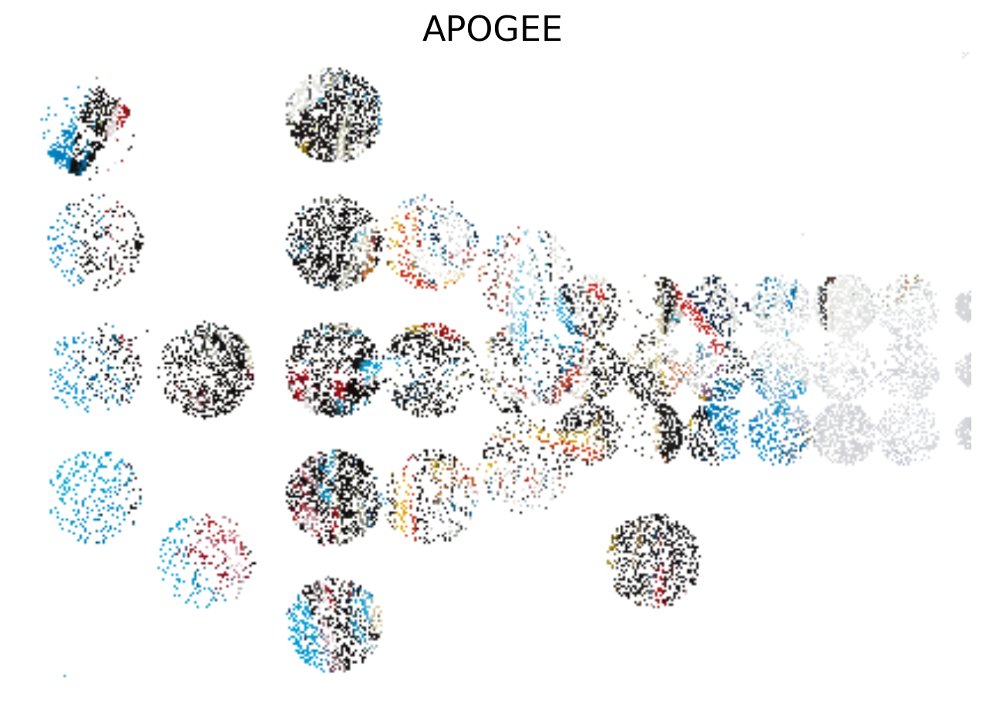
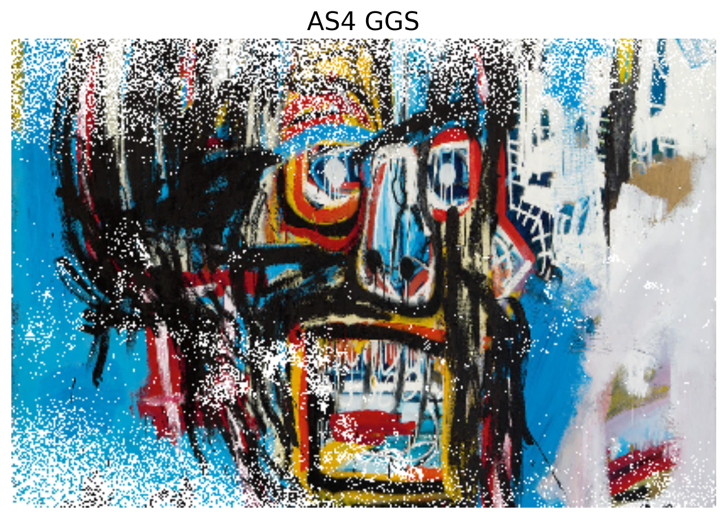
Densely sampling galactic stars matters
courtesy: Jon Bird
Notes:
If the Milky Way were as simple as a Rothko painting, we might not need dense sampling.
But, it may be more like a Basquiat painting
24

Slide 28
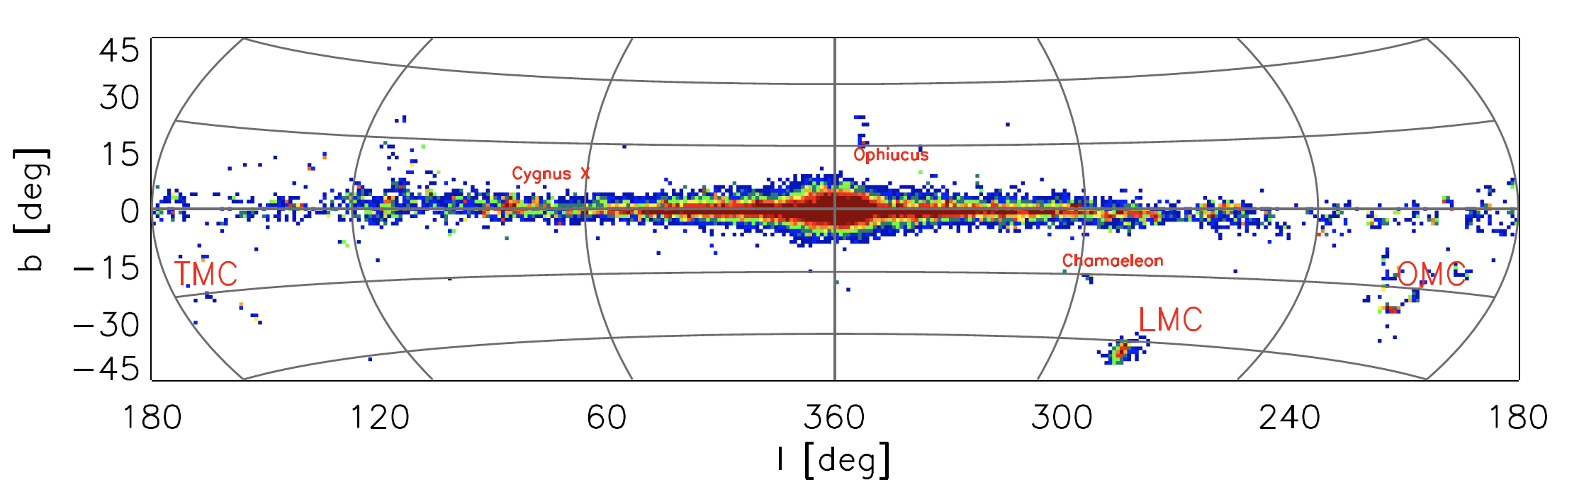
Mapping the Young Stars Across our Galaxy
“all” YSO and M>8M_{o} with H<11
>2 epoch
~100,000 objects WISE-selected all-sky
Binarity among massive stars is prevalent
… and matters for GW and even for cosmic re-ionization

Slide 29
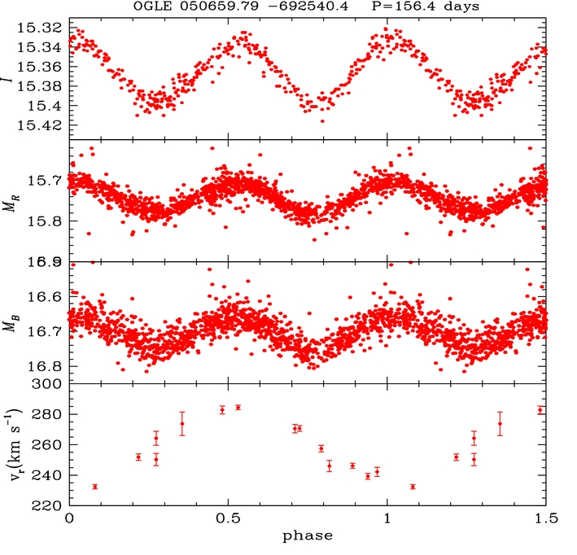
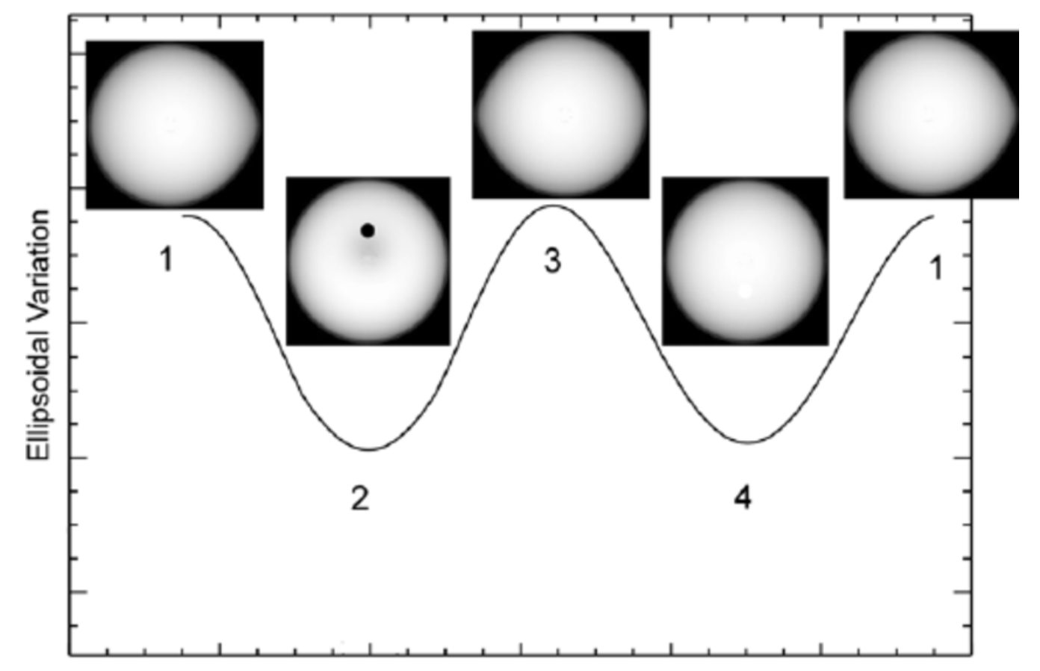
A Gaia & SDSS-V census of
(non-contact) BH & NS binaries
What is p(M_{BH})?
What is p(M_{BH}/M*)?
What is p(a)?
  recoil?
  direct collapse?
What is M_{max}(NS)?
→ equation of state
Combine photometric candidates with massive spectroscopic multi-epoch follow-up

Slide 30
SDSS V probes the center and the ``far side” of the Milky Way
SDSS IV APOGEE (2017)
SDSSV Galactic Genesis
>100,000 stars beyond the GC

Slide 43
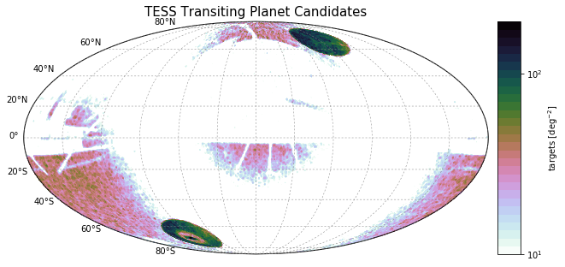
SDSS V’s Targets across the Sky

Slide 44
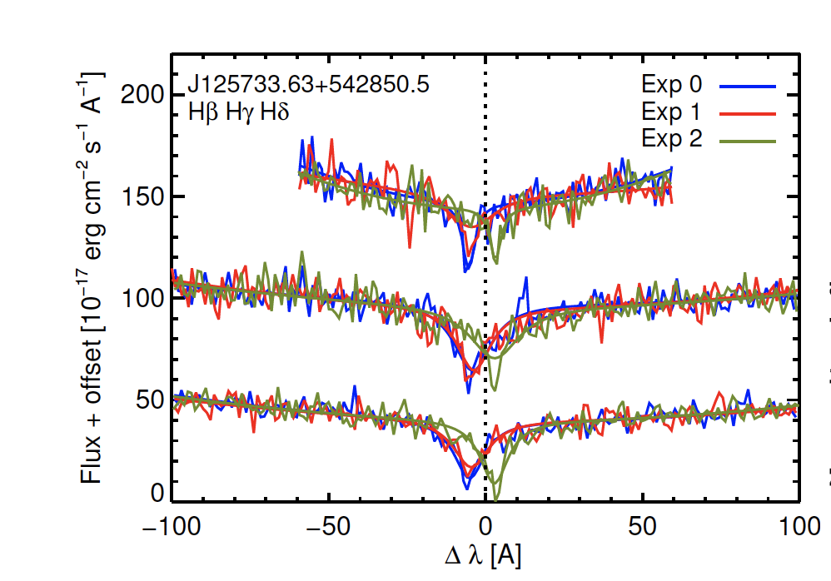
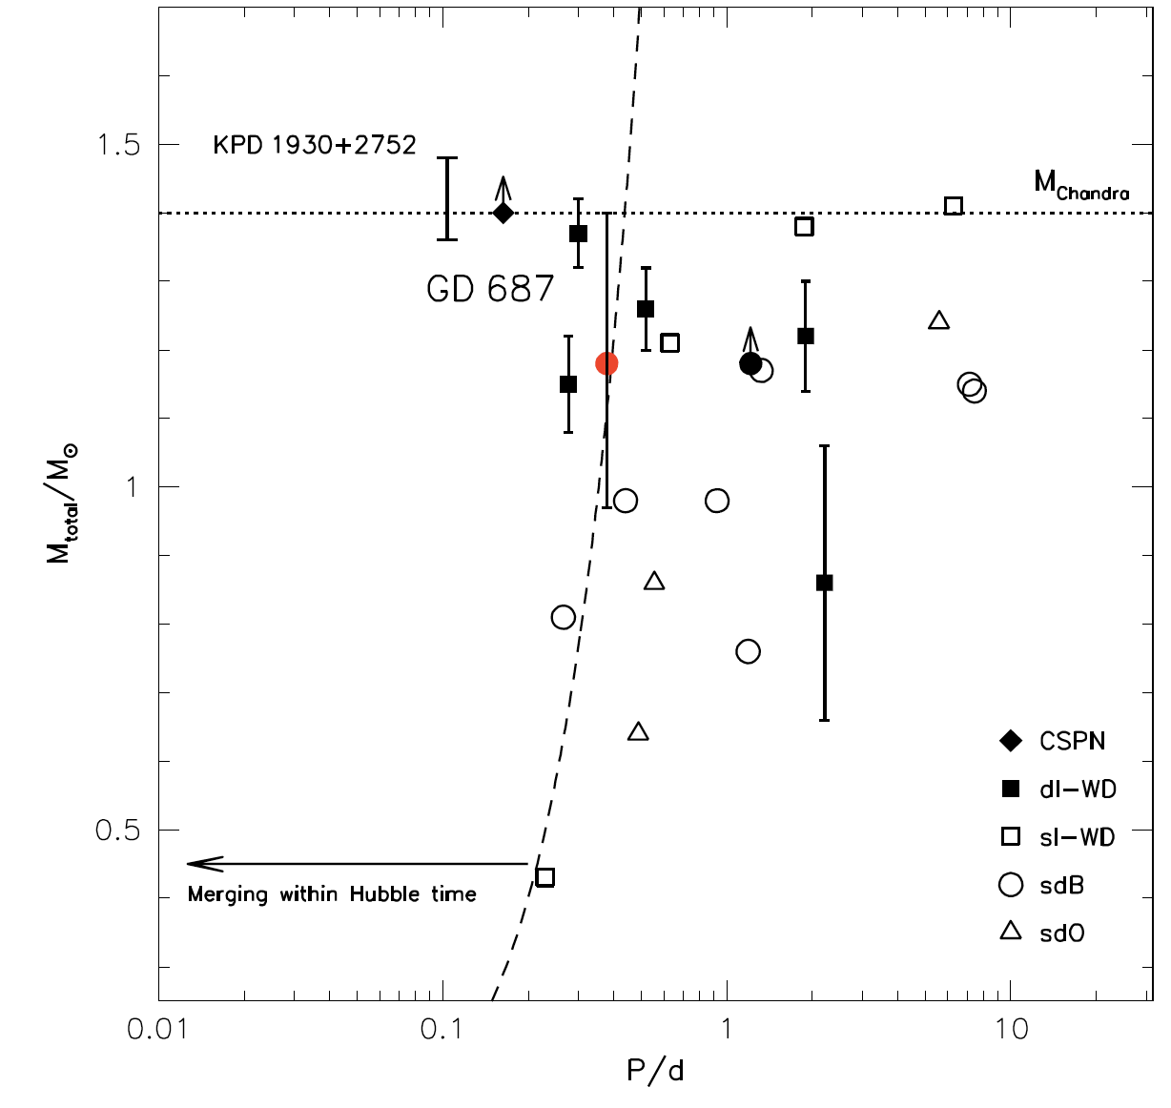
A Census of SN Ia Progenitors

Slide 45
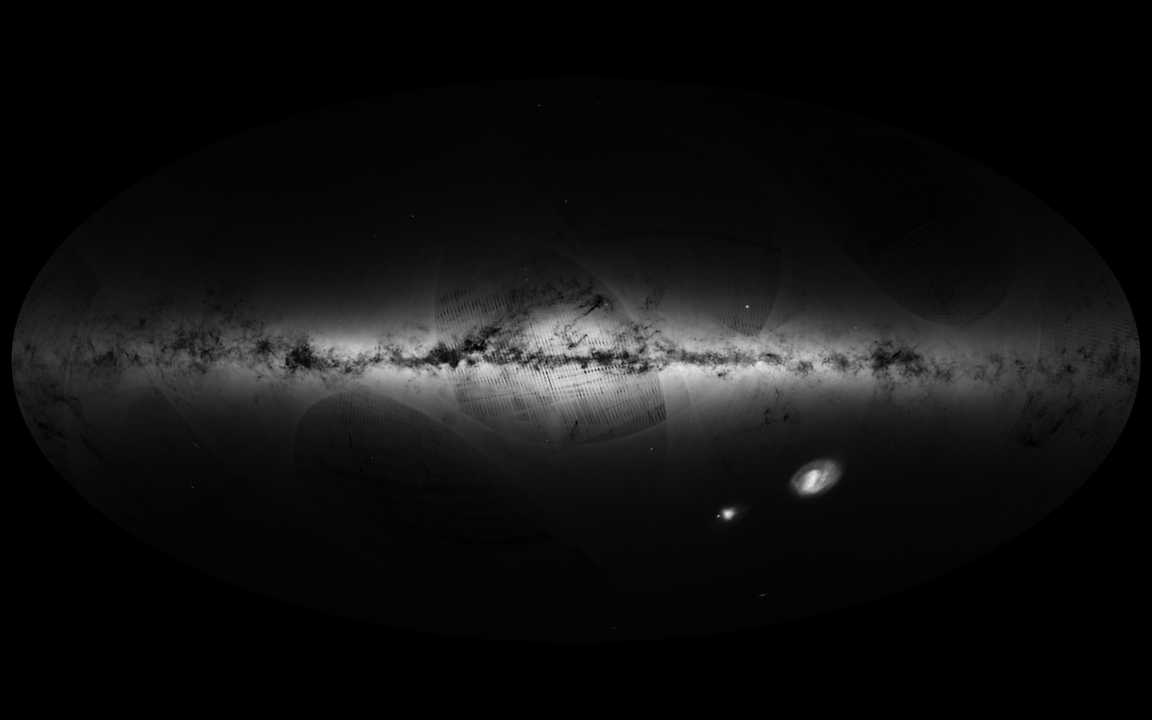
SDSS-V Galactic Genesis & Gaia
Gaia sources
Gaia and SDSS-V will go a long way towards a comprehensive
p(M, R, L_{bol}, [X_{i}/H], τ_{age}, orbit(r,v), p_{mult},..) ,
in the regime that matters for Galactic (star) formation
SDSS-V IR spectroscopy targets (>5 Million)

Slide 46
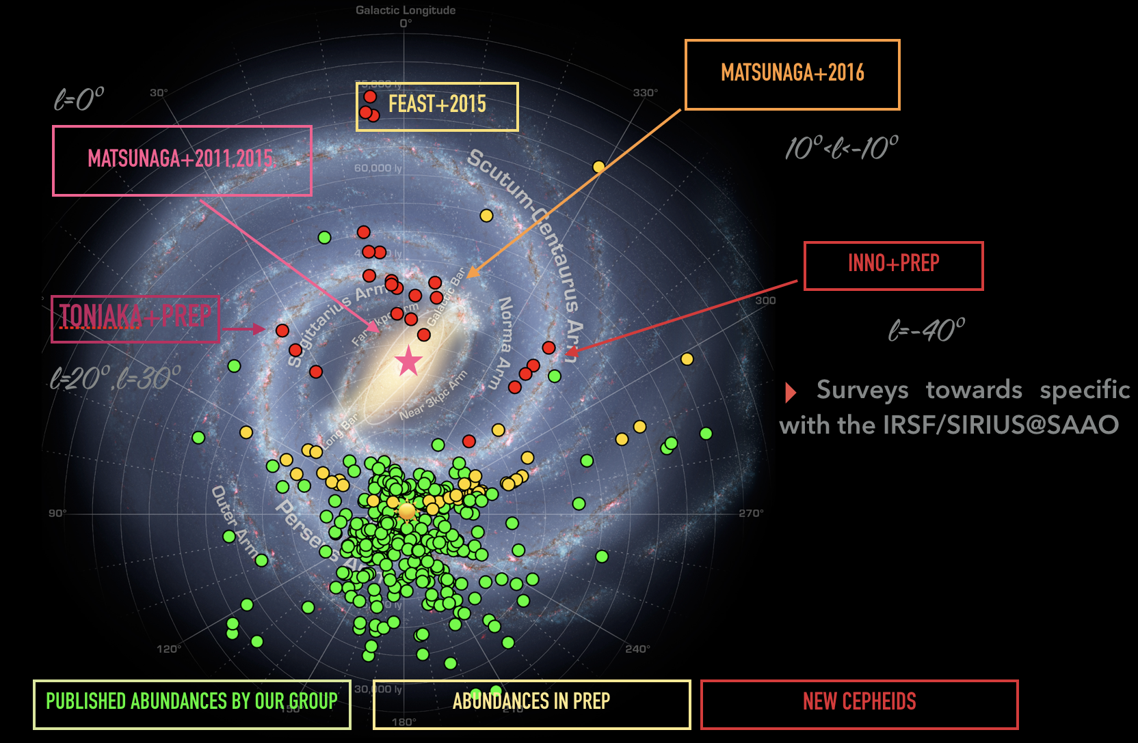
SDSS V will spectroscopize thousands of Galactic Cepheids: young, age-dateable, known-distances,
T_{eff} lends itself to diagnosing many abundances
5000+ accessible to H-band spectroscopy (90% undiscovered)
Courtesy Laura Inno

Slide 47
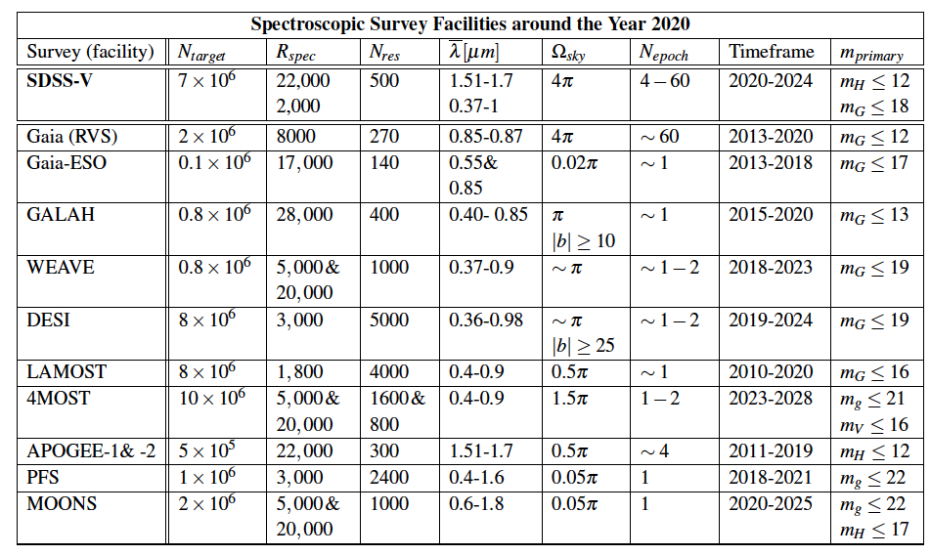
Surveying stars in the Galaxy
There is a bewildering plethora of spectroscopic surveys (>10 deg²) out there,
but only few matter for surveying young stars
many look in ‘boring’ directions
most look at unsuitable wavelengths
p(M, R, L_{bol}, [X_{i}/H], τ_{age}, orbit(r,v), p_{mult},..)
AS4
Notes:
15 minutes

Slide 48
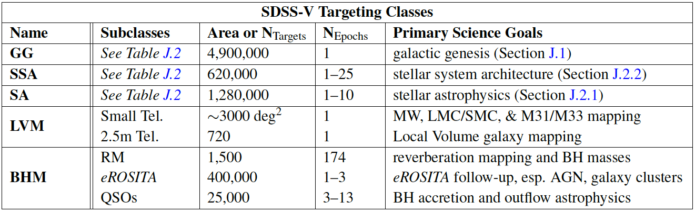

Slide 49
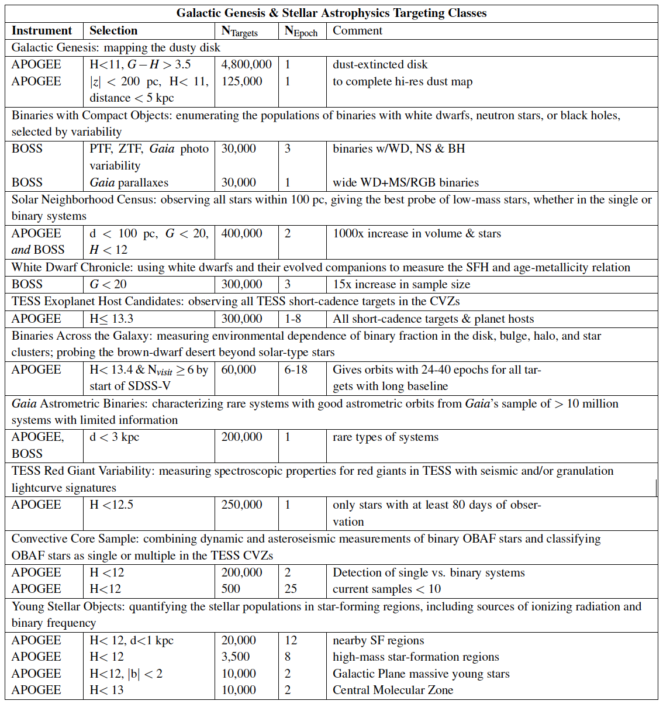

Slide 50
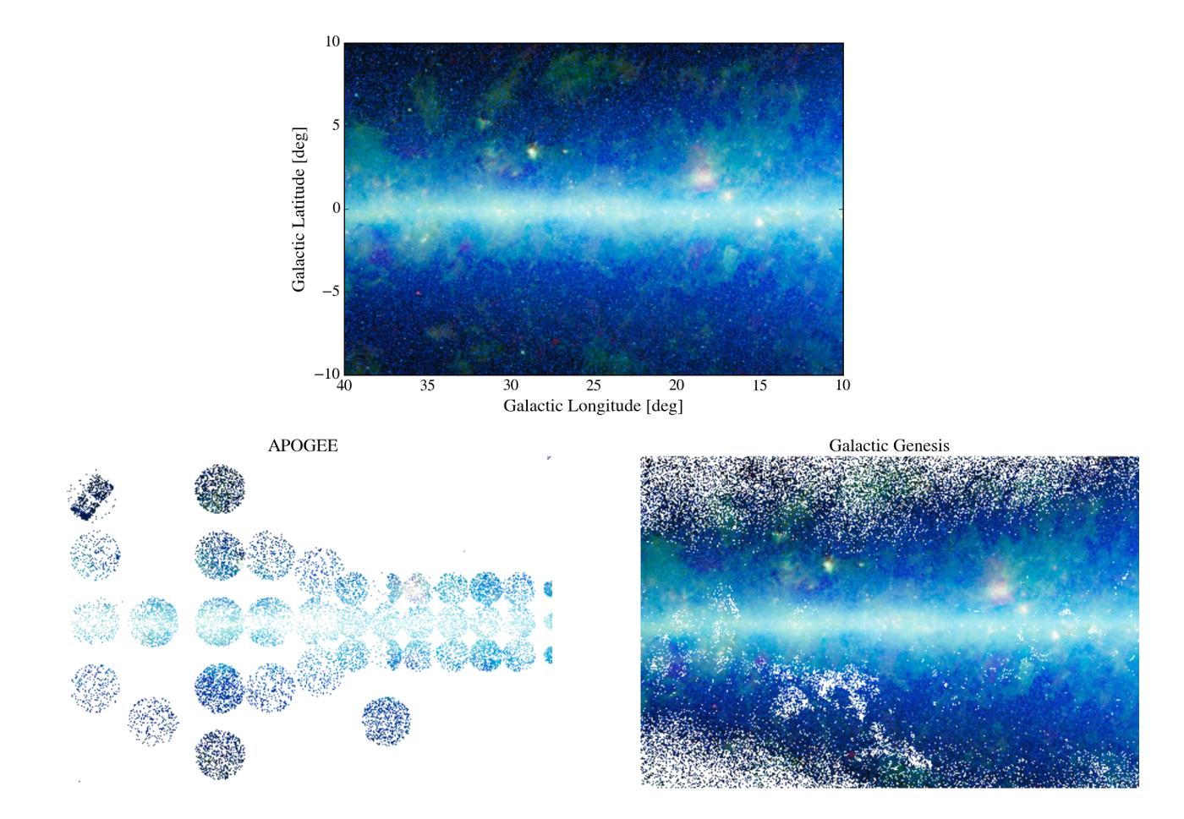
The benefits of dense and contiguous sampling

Slide 51
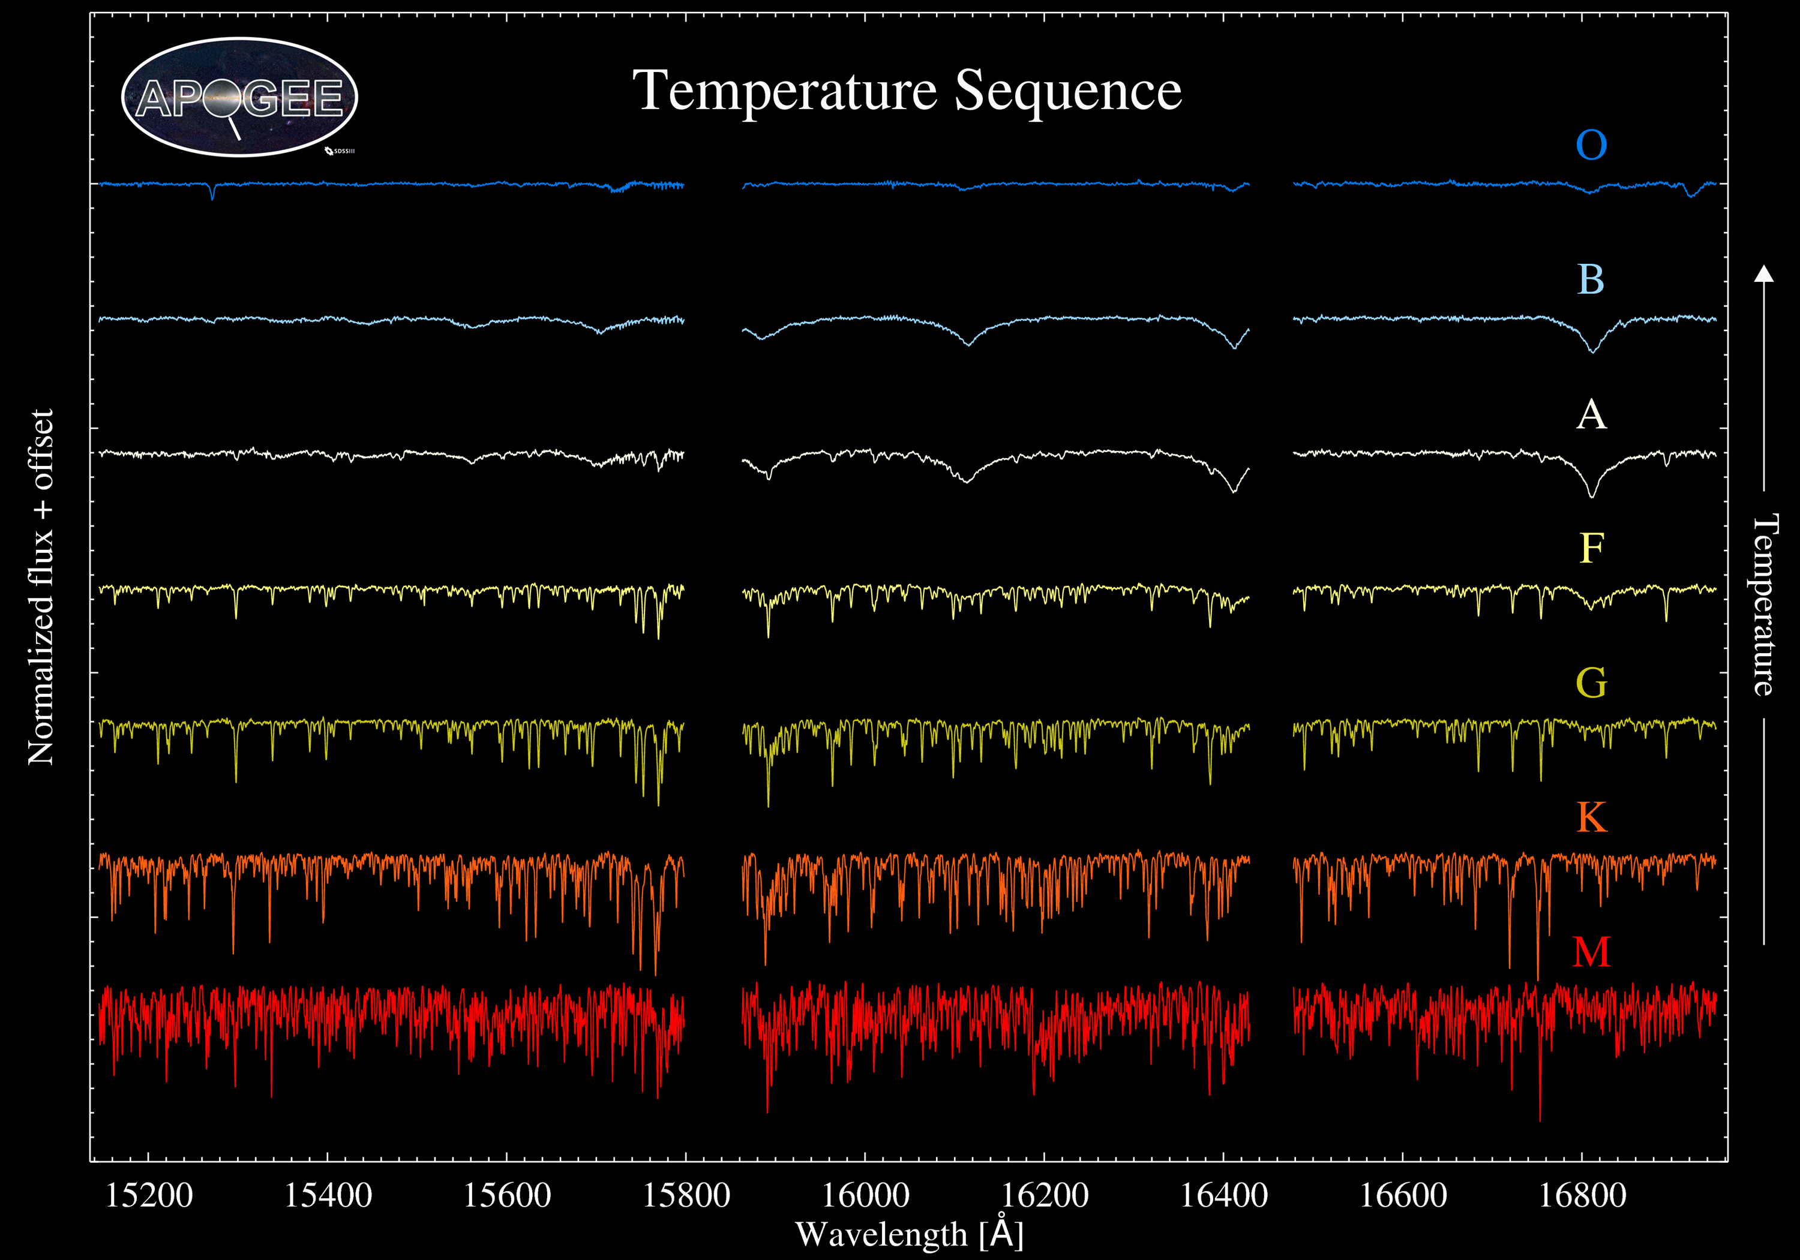
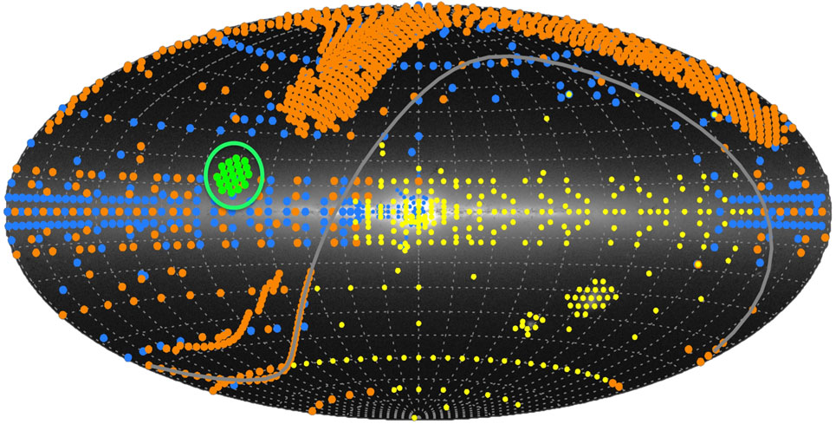
SDSS III & IV: Apogee
(PI: S. Majewski)

Slide 52
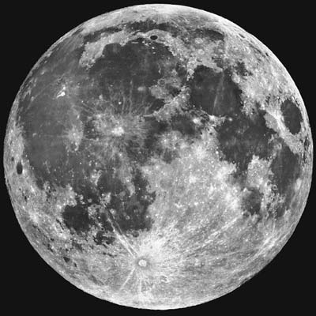
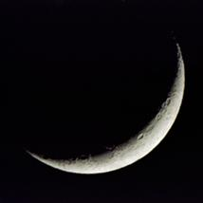
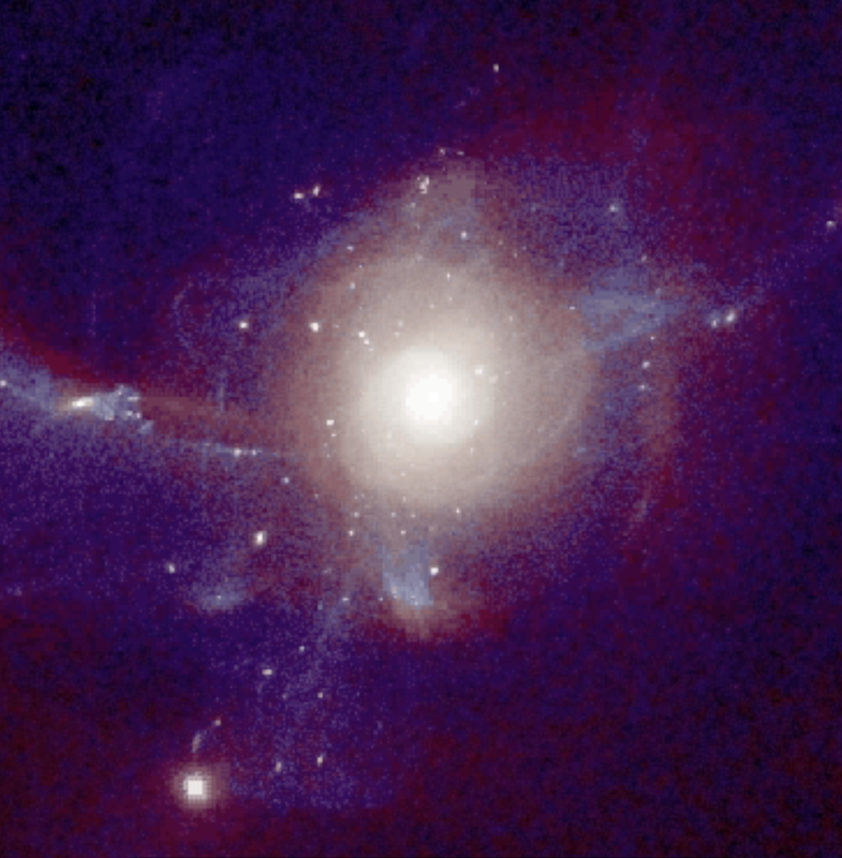
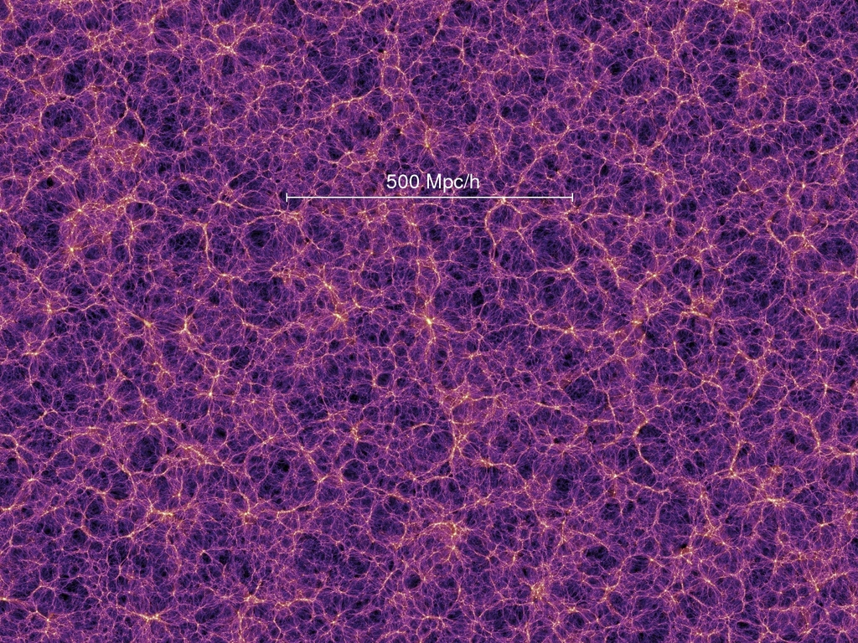
ongoing SDSS IV surveys:
near-IR and optical fiber (bundle) spectroscopy
APOGEE-2
MaNGA
eBOSS
100s of thousands of individual stars in the Milky Way
Maps thousands of nearby galaxies
Map of the Universe
Stellar physics, origin of the elements, galaxy evolution & dark matter
dark energy & cosmology
Notes:
- SDSS-IV aims to look at the evolution of the Universe both on the smallest and the largest scales
- Three surveys: APOGEE-2, within our Milky Way, MaNGA, mapping in detail nearby galaxies, and eBOSS, which maps the Universe on its largest scales
- APOGEE-2 and MaNGA concentrate on how galaxies form and their internal structure
- eBOSS concentrates on understanding cosmology and dark energy
- they all take advantage of the SDSS facility

Slide 53
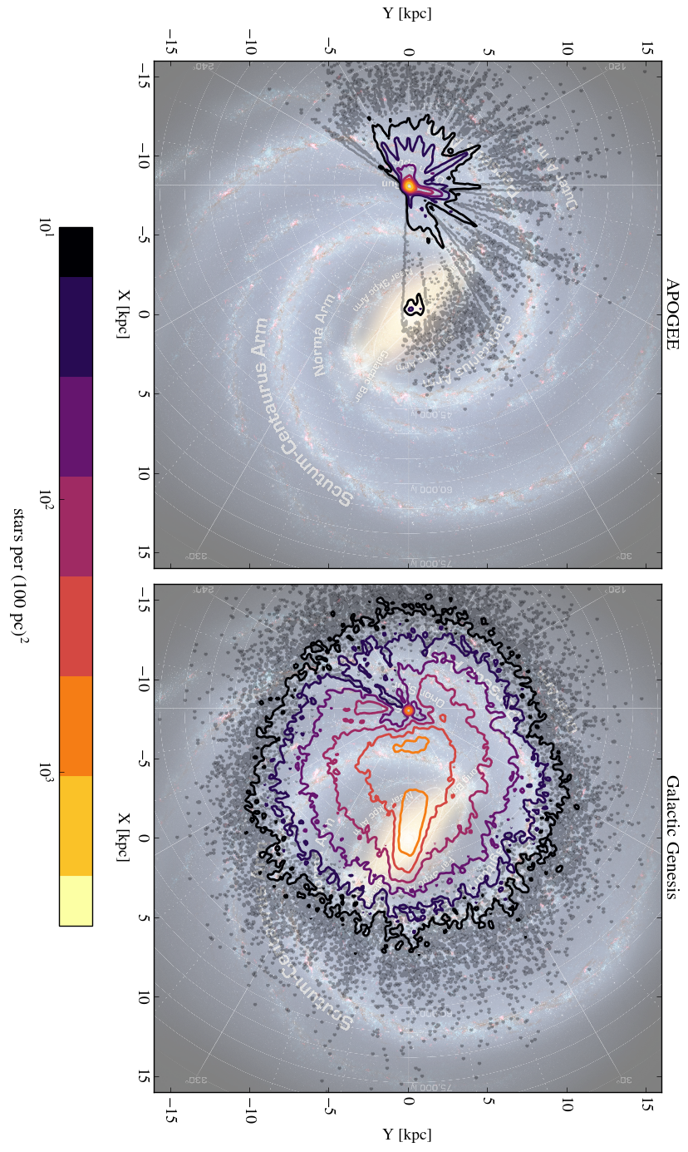

Slide 54
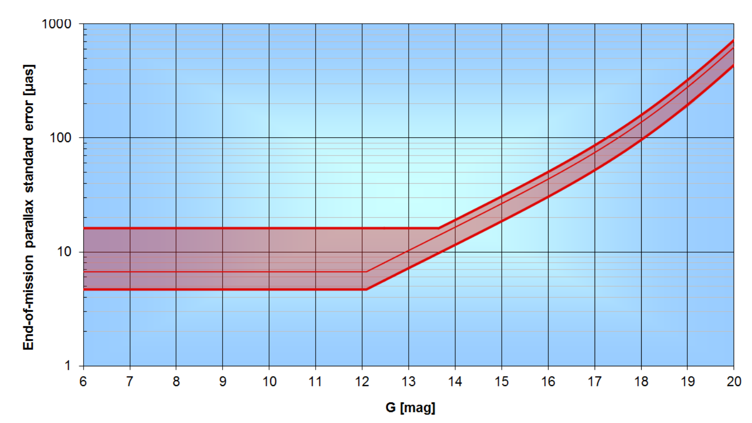
Current (ground-based) all-sky precision
Expected final precision
DR2 (April 2018) 1.7x (5x) worse
DeBruijne et al 2015
Photon noise
Calibration
Gaia’s astrometric precision
Notes:
20

Slide 55
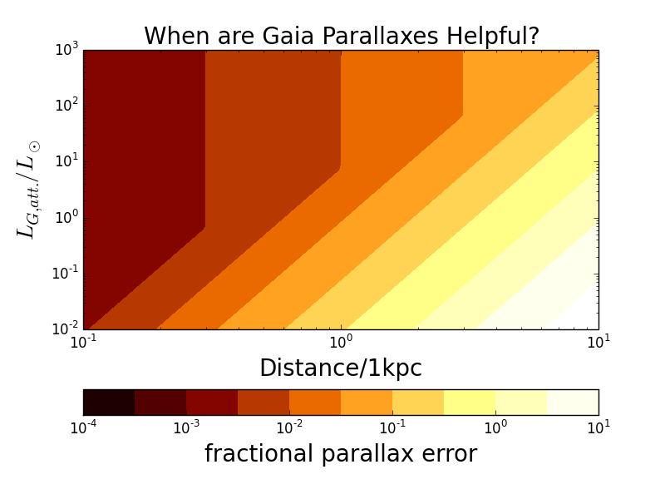
L_{G,att} = L × e^{-Av}
10% parallax error
Galactic Center
Taurus
Orion
NB: fractional parallax errors >20% have divergent variance in their distance estimate Bailer-Jones 2015

Slide 56

L_{G,att} = L × e^{-Av}
1 km/s
5 km/s
Galactic Center
Taurus
Orion

Slide 57

Gaia and astrometric binary orbits
binaries to P≈15 years
light-centroid orbit of unresolved binary
no sin i ambiguity
S/N_{binary solution}≈ 18 × a[AU] (L/L_{o})^{1/2} (D/1kpc)⁻²
Need single-epoch spectra/colors to precisely estimate m₁, presumed to dominate the light

Slide 58
Cepheids: young, age-dateable, known-distances,
T_{eff} lends itself to diagnosing many abundances
5000+ accessible to H-band spectroscopy (90% undiscovered)
Courtesy Laura Inno

Slide 59

BOSS (2009-2014)
10,000 sq deg.
  1.6 million LRGs (z < 0.7)
  200,000 QSOs (2.15 < z < 3)
Baryon Oscillations
Large-scale structure
Massive galaxy evolution
Quasar evolution

Slide 60

New Hardware for Ultra-wide-field IFU (LVM)
Large, abuttable fiber bundles
3 DESI-type spectrographs
  R=2,000-5,000
  λ = 3600Å - 9800Å
fed by 16cm & 1m telescopes
  5.7” to 37” spaxels

Slide 61
QSOs change with time
..sometimes dramatically..

Slide 62



Mapping SF Regions with Apogee e.g. IN-SYNC (Tan, Covey et al..)
Slingshot ejection?
Stutz and Gould, 2016

Slide 63
What scales and processes of the
(ionized) ISM will the Local Volume Mapper probe?
Courtesy: Eric Pellegrini, ZAH, Heidelberg

Slide 64

Exploring ``stellar architecture”
15min < Δt < 15yr 1 < N_{epoch} < 100
Notes:
Find BH’s and NS that are not in mass transfer binaries
Make a census of all binary WD that will merge within a Hubble time (→ SN Ia)
Get a complete spectral census of TESS stars (planet hosts and asteroseismology)

Slide 65
What causes SN Ia? a comprehensive census of tight WD binaries

