Slide 1
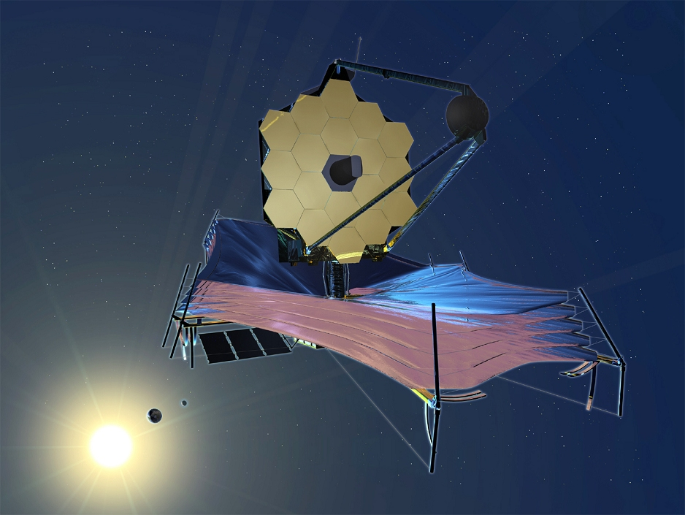




Overview of the JWST-NIRSpec
GTO programme
Roberto Maiolino
Kavli Institute for Cosmology
Cavendish Laboratory
University of Cambridge

Slide 2
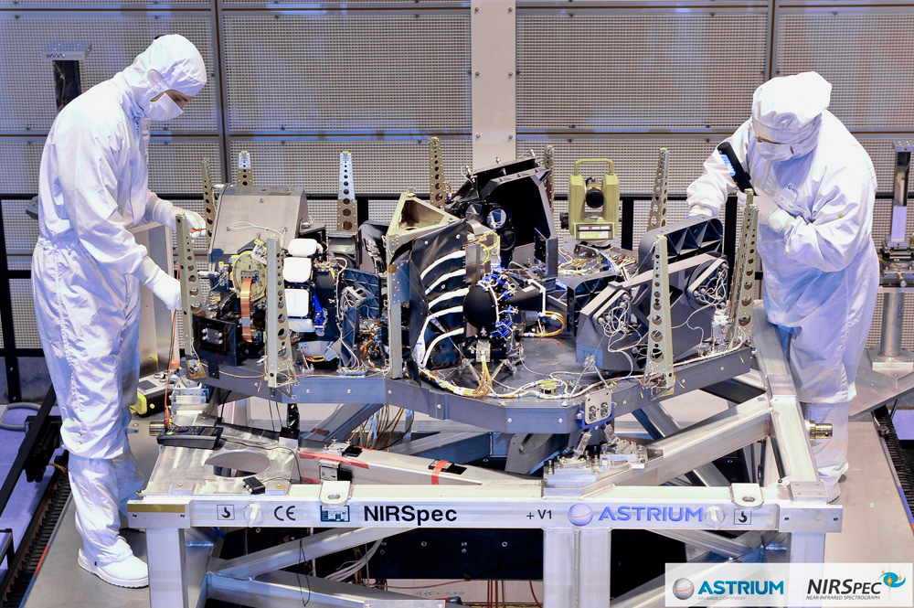
NIRSpec: the first multi-object spectrograph in space
(the largest and most complex instrument of JWST)

Slide 3
NIRSpec spectral resolution and wavelength coverage:
3 high resolution gratings (R~2700)
3 medium resolution gratings (R~1000)
1 low resolution prism (R~100)

Slide 4
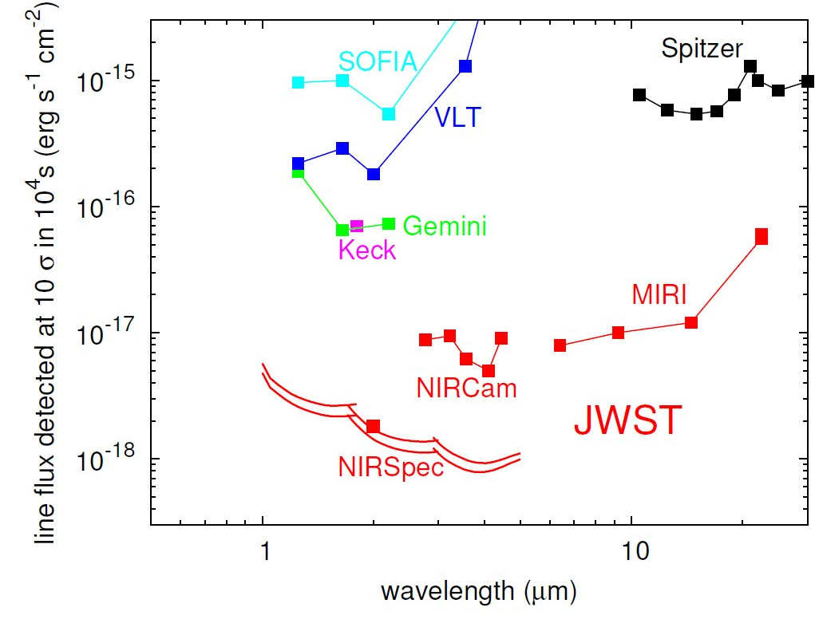
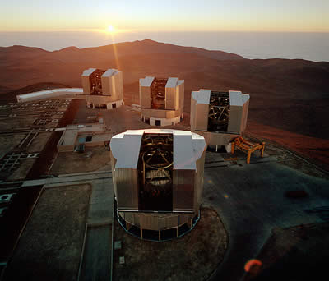
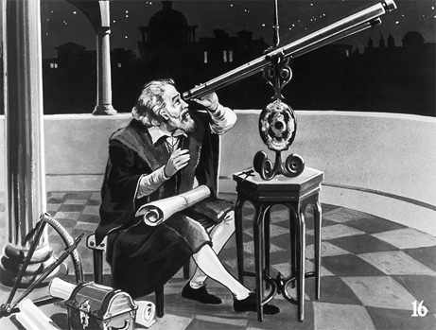
Huge leap in sensitivity
...has happened very rarely in history of science
2,000 x more sensitive
than current telescopes
Equivalent to suddenly passing
from Galileo’s telescope to
modern large telescopes

Slide 5
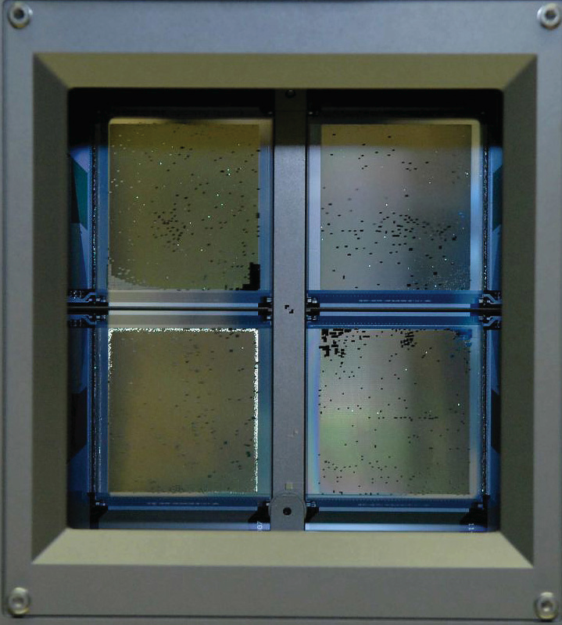
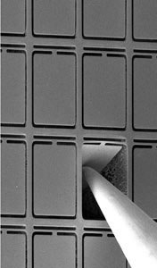
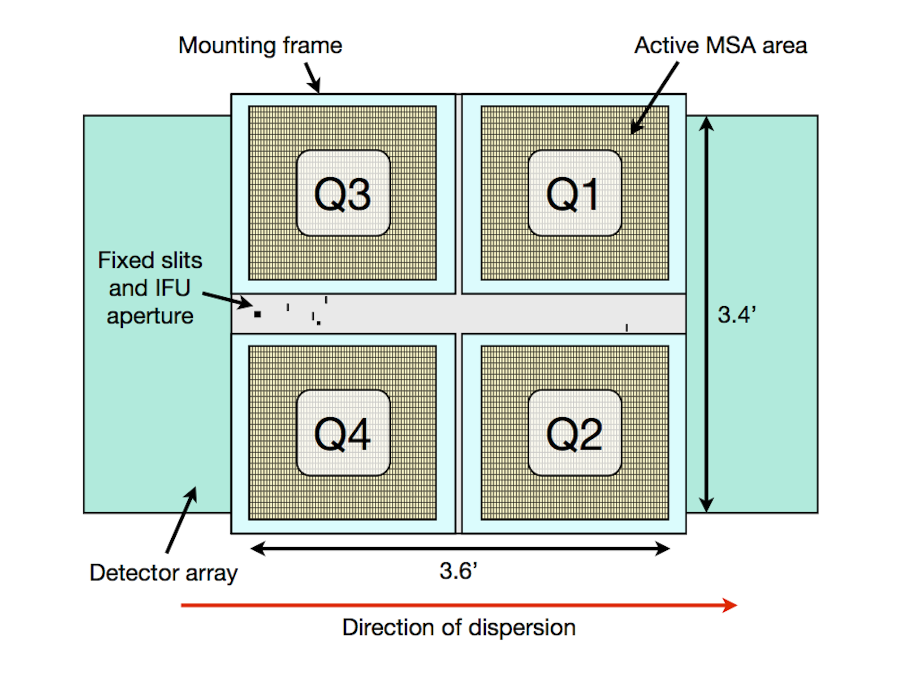
Micro Shutter Array
0.2”
4 quadrants, each with 171 rows of 365 shutters, totaling ~250,000 shutters
Each shutter is 0.46” x 0.2”
RIGID ARRAY
implications
for observing plan

Slide 6
Micro Shutter Array
0.2”
4 quadrants, each with 171 rows of 365 shutters, totaling ~250,000 shutters
Each shutter is 0.46” x 0.2”
RIGID ARRAY
implications
for observing plan

Slide 7
Micro Shutter Array
0.2”
4 quadrants, each with 171 rows of 365 shutters, totaling ~250,000 shutters
Each shutter is 0.46” x 0.2”
RIGID ARRAY
implications
for observing plan

Slide 8
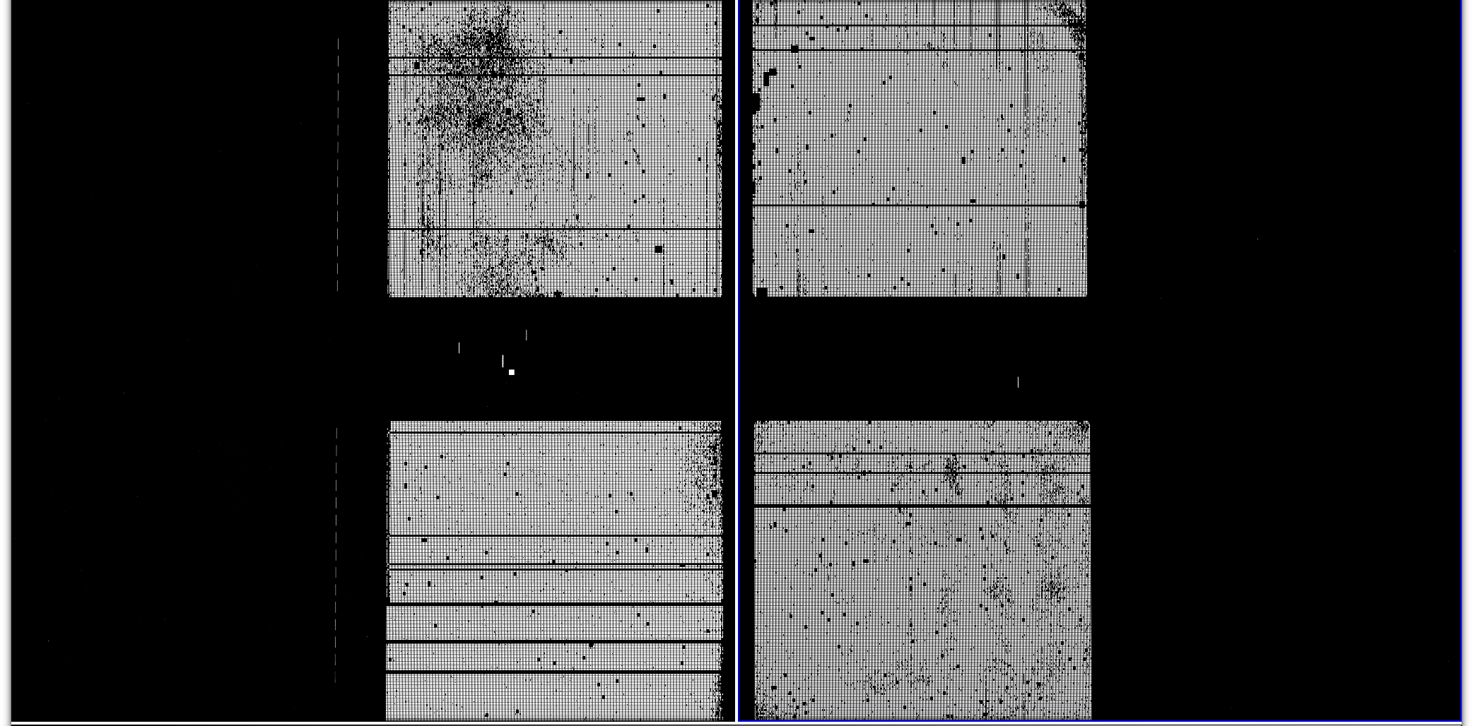
MSA images of uniform illumination with “all” shutters open
Detectors Gap (~20”)
Detector NRS1
Detector NRS1
Quad 3
Quad 1
Failed Closed Shutters
Quad 4
Quad 2
Spectral direction

Slide 9
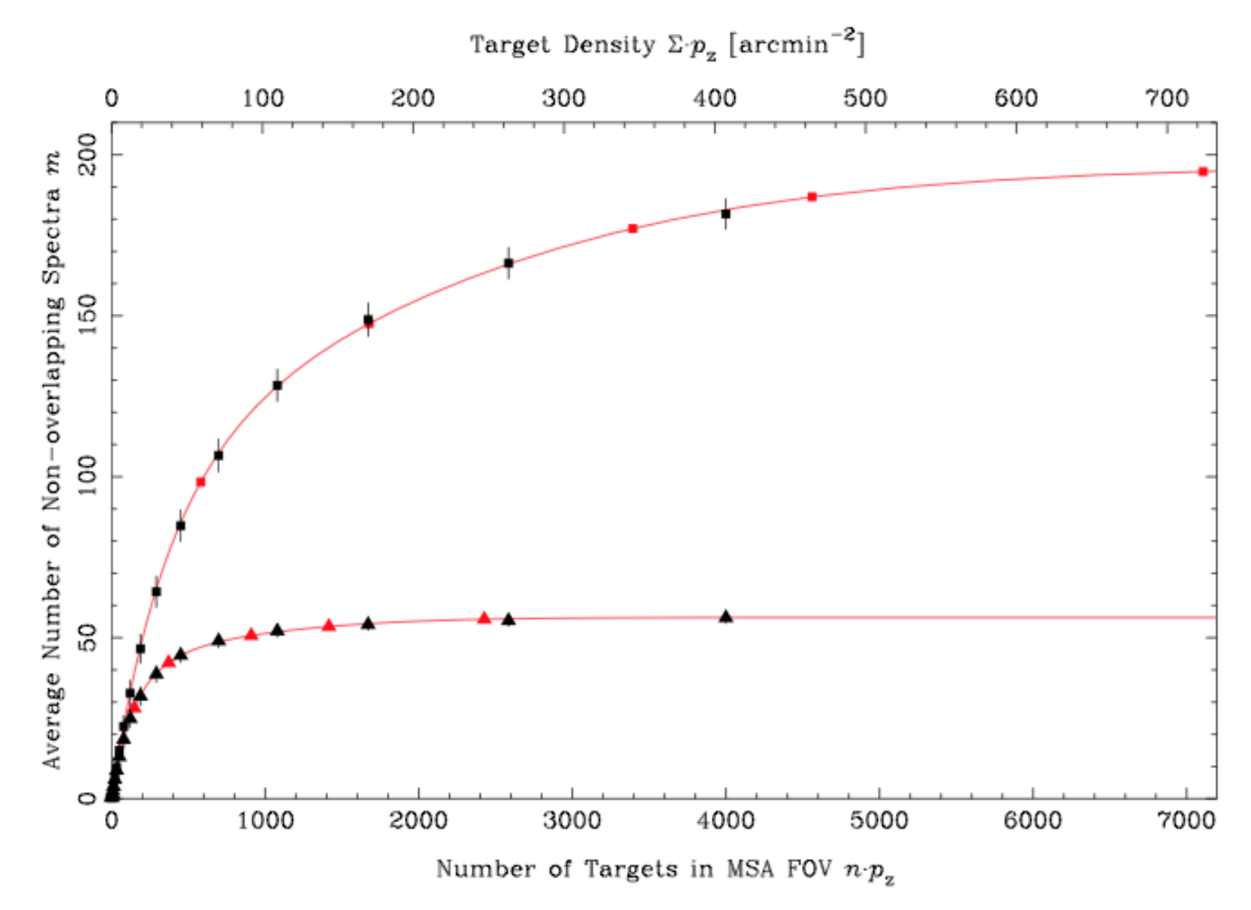
Rigid MSA structure => cannot freely select any target
Allocation becomes more efficient if the input catalog is vastly oversized
R=100
R=1000

Slide 10
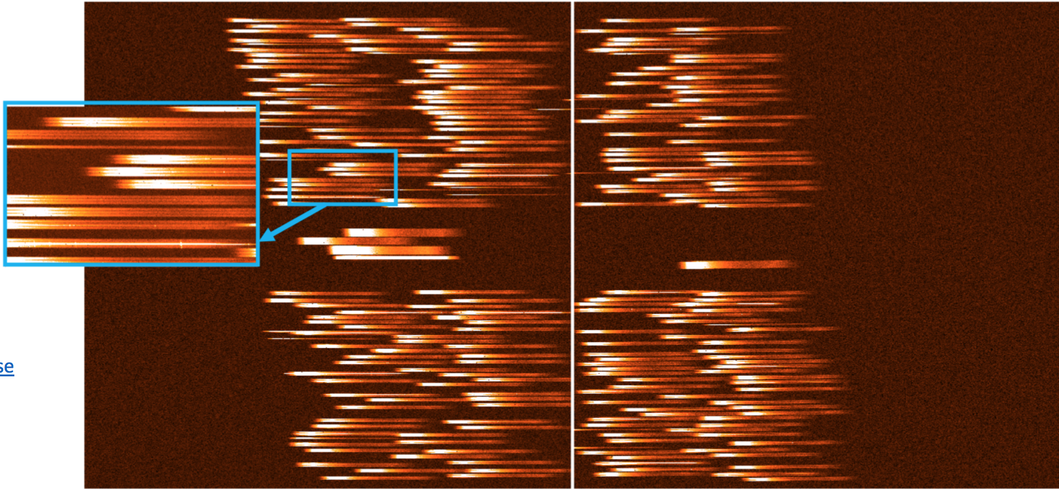
NIRSpec simulation in HUDF in 45min (~10% of total of a deep pointing)
R=100
214 galaxies allocated (with non-overlapping spectra)
0.6μm
5.2μm

Slide 11
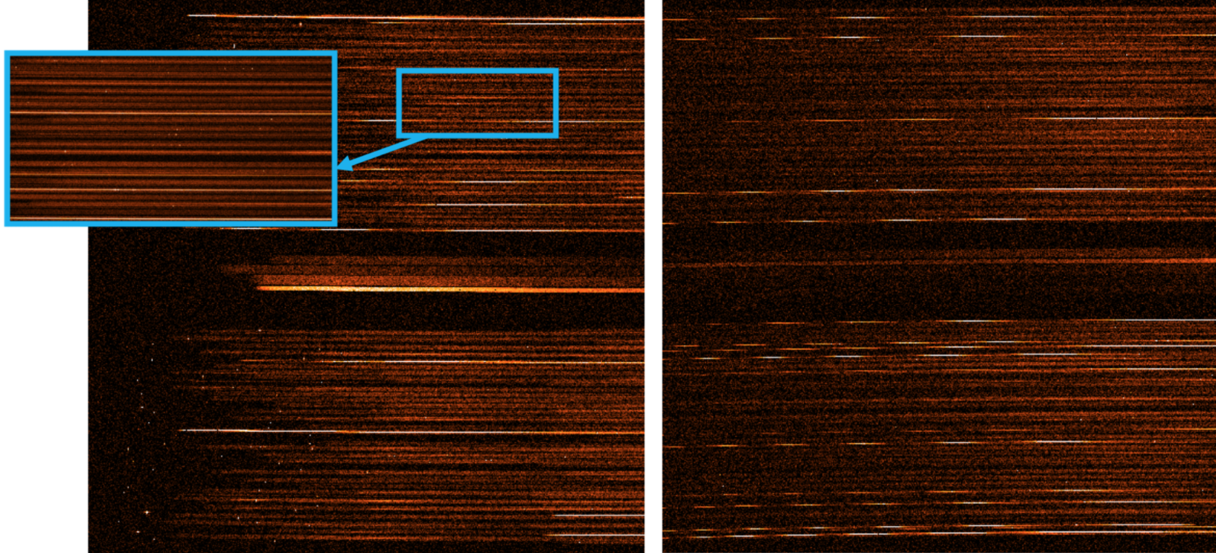
NIRSpec simulation in HDF in 45min (~10% of total of a deep pointing)
R=1000 (one out of three grating)
same 214 galaxies selected at R=100 -> at R=100 overlapping spectra
but ok because interested in nebular lines (most continua too low S/N)
At R=2700 spectra are ~2.7 times longer most of them are truncated
(on the blue side)

Slide 12
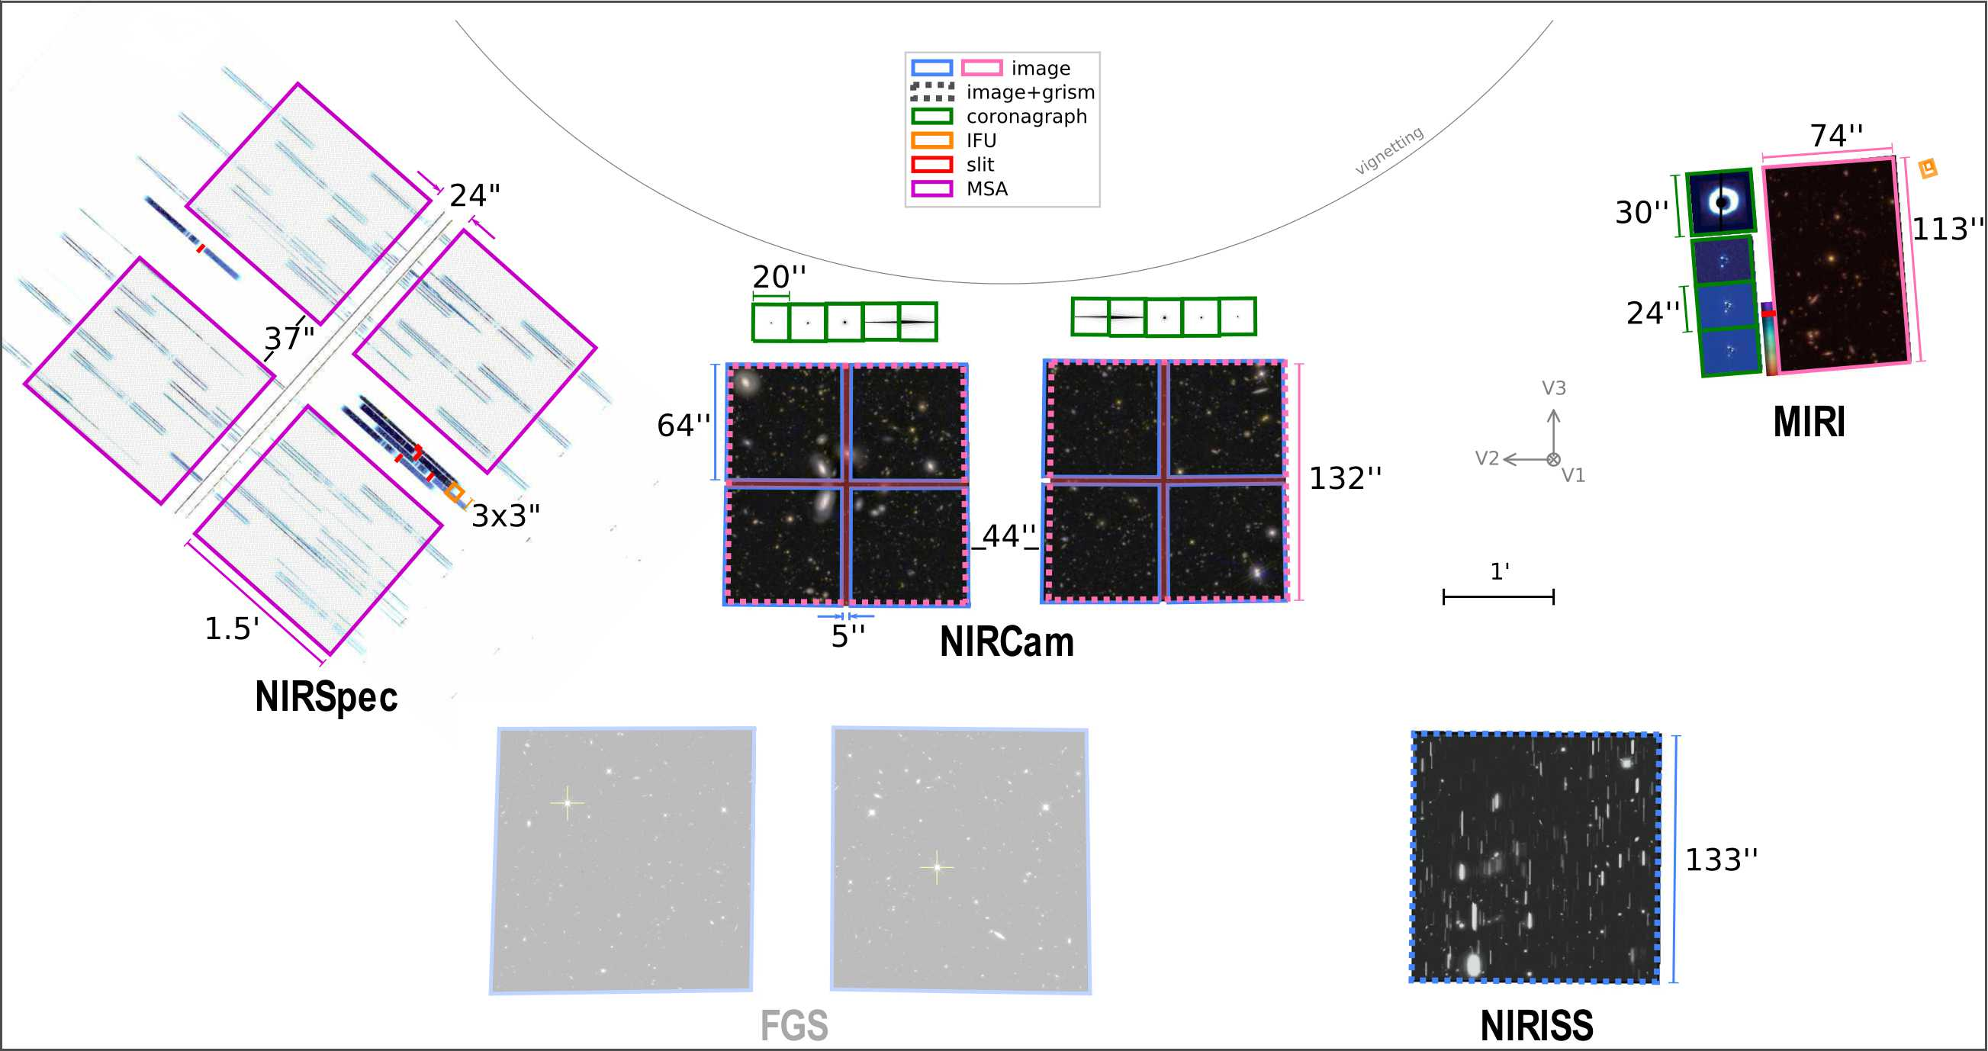
JWST focal plane
In Cycle 1 NIRSpec’s only allowed coordinated parallel:
NIRSpec MSA mode with NIRCam
(“pure” parallels many more combinations)

Slide 13
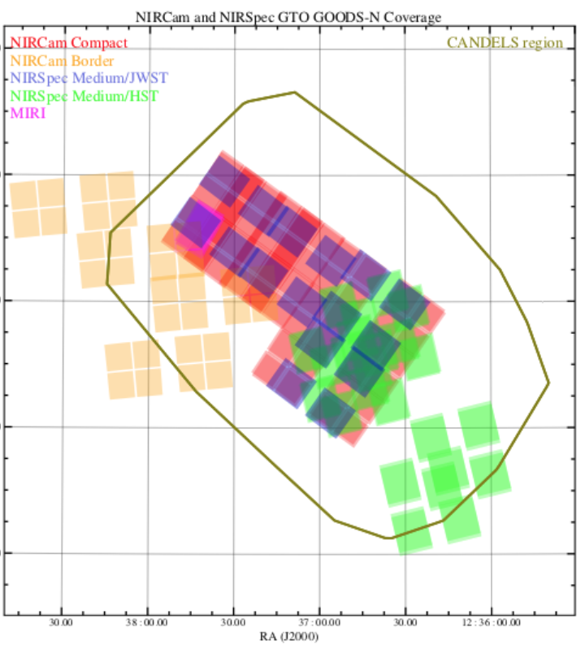
NIRSpec MOS programme
in parallel with NIRCam:
combining GTOs in
the GOODS fields
GOODS-N

Slide 14
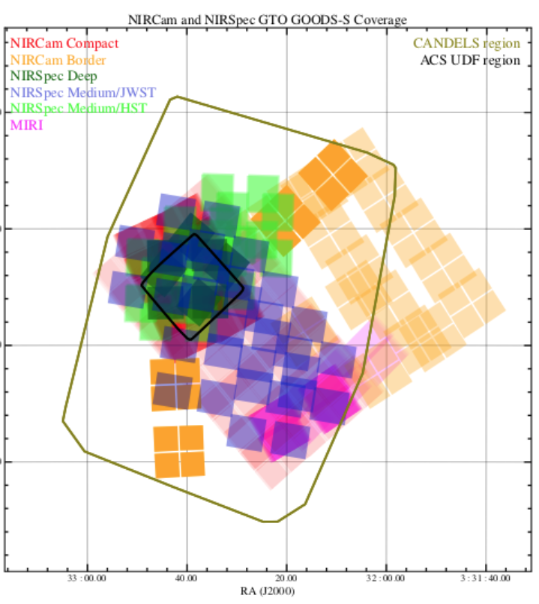
NIRSpec MOS programme
in parallel with NIRCam:
combining GTOs in
the GOODS fields
GOODS-S

Slide 15
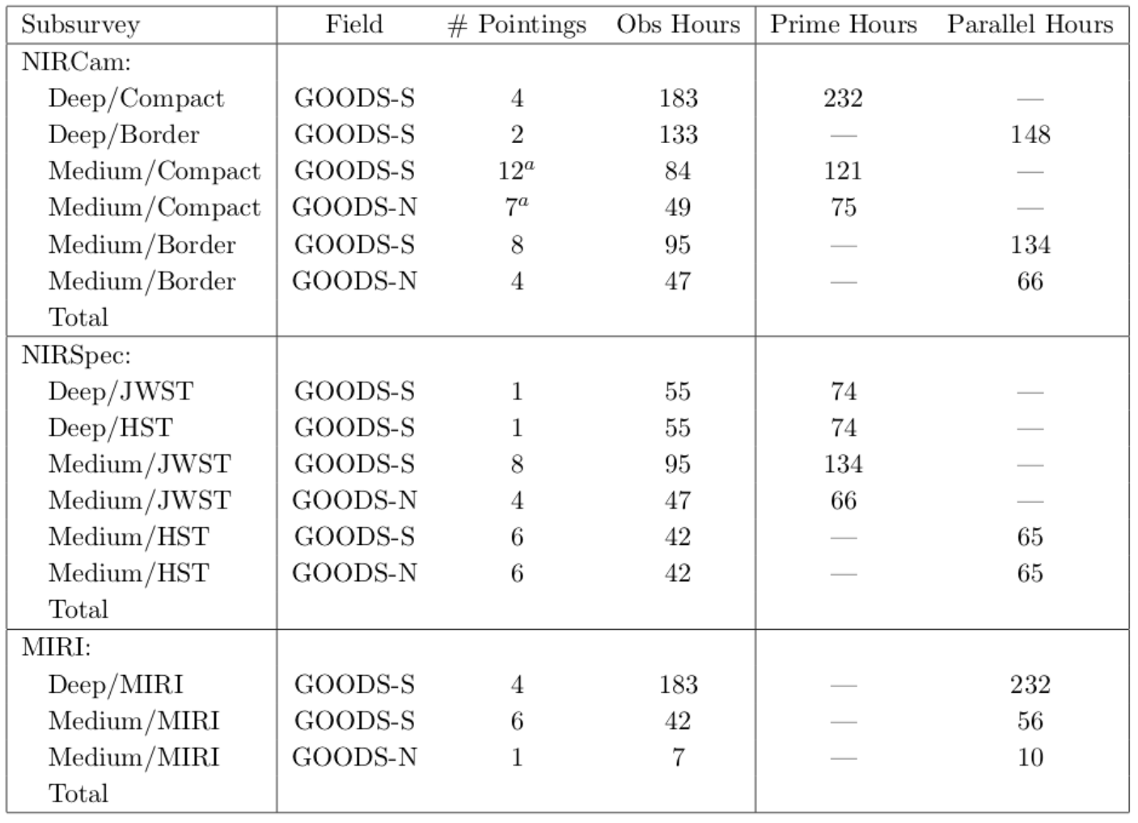
Summary of pointings and times allocations
_
Wide/HST
CANDLES
32
71
106
HST: spectra on HST-selected targets
JWST: spectra of NIRCam-selected targets
Total: 586 hr
Deep/HST + first Wide pointing: immediately public
(+ a few IFU spectra immediately public)

Slide 16
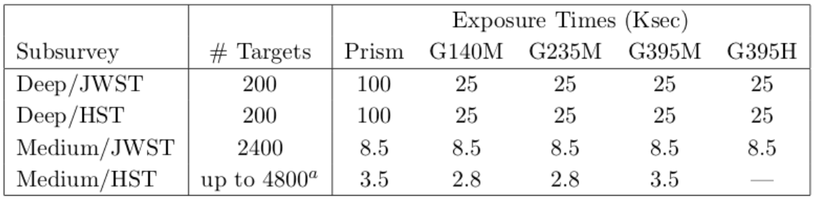
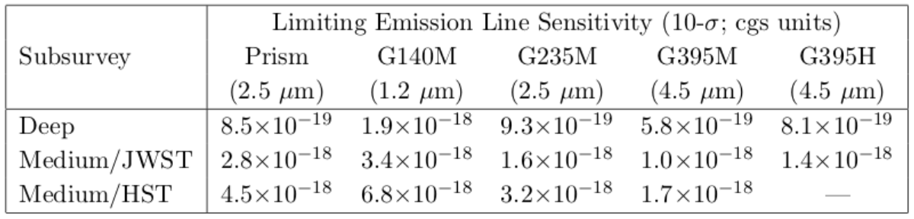
Statistics and observing modes
R=100
stellar continuum
& redshift
R=1000
nebular lines
full band
R=2700
kinematics
Wide/HST
6400
0.8
1.3
+ G235H
Total ~ 14,000

Slide 17
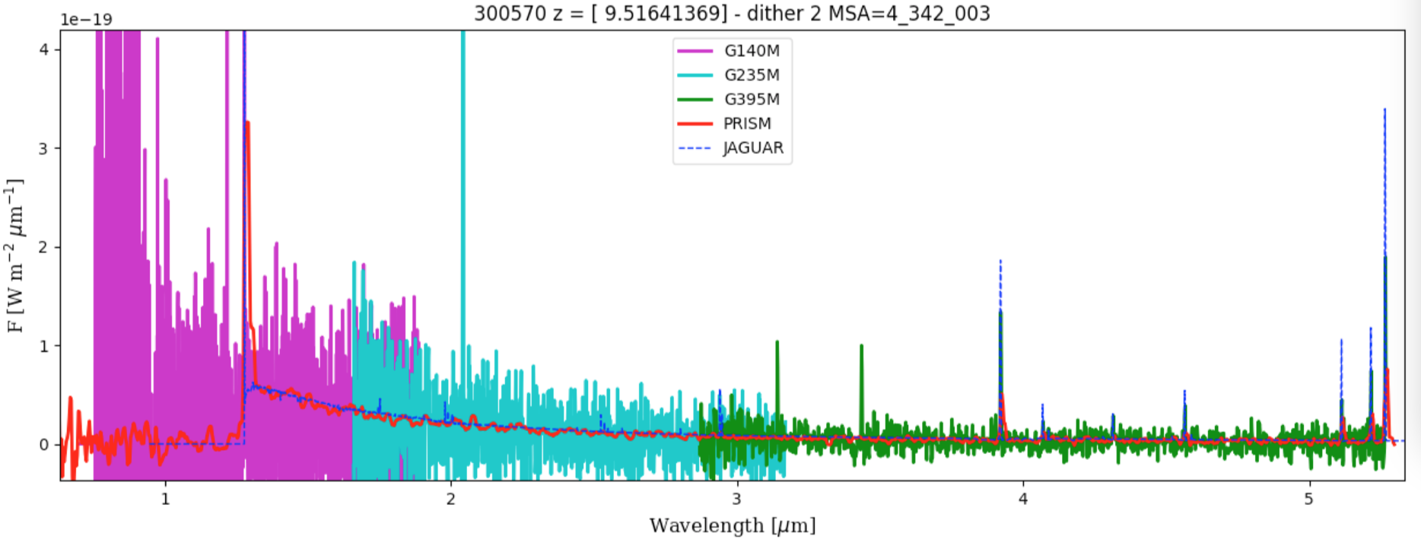
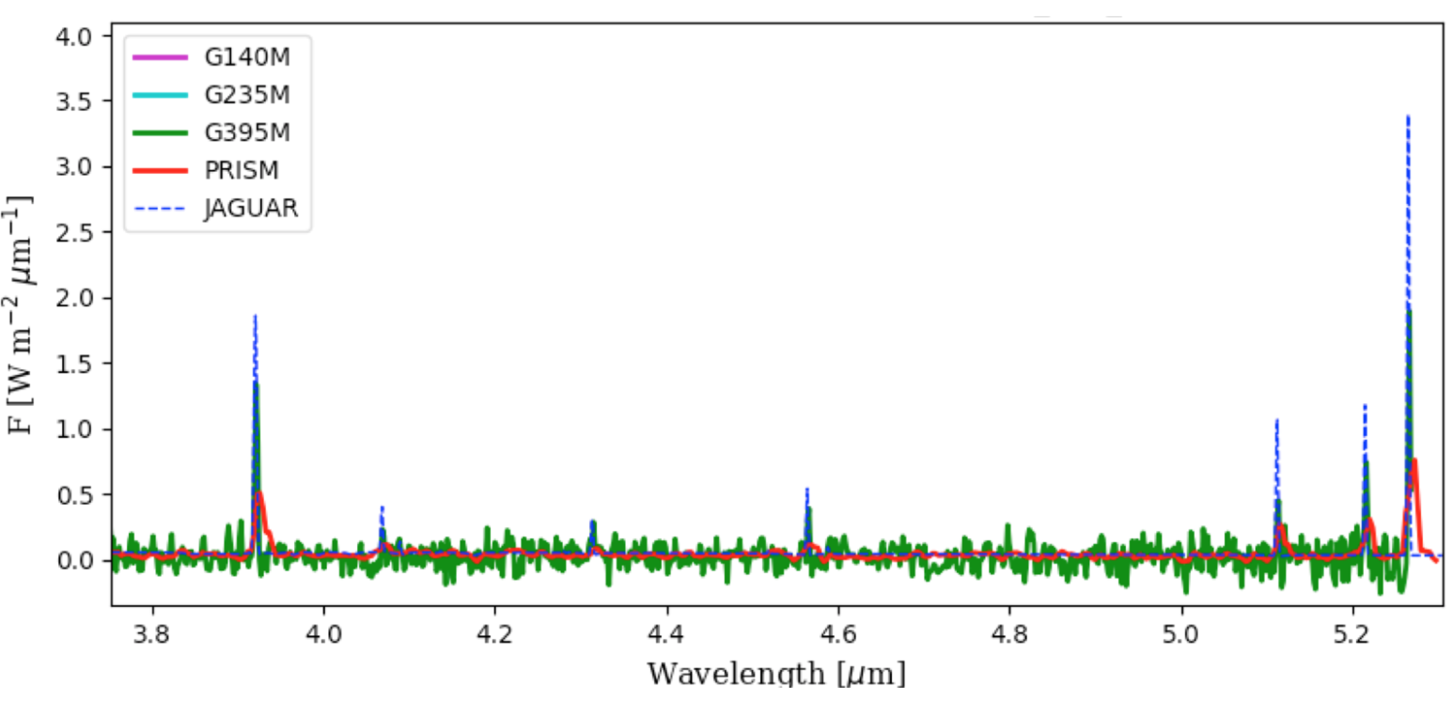
Lyα
[OIII]
line from
overlapping
spectra
lines from
overlapping
spectra
[OII]
Hγ
Hβ
simulated spectrum
at z=9.5, m_{AB}=27.6
only 0.7hr/grating
(10% of total
deep exposure)
[OIII]
[OII]
[OIII]
Hβ
[NeIII]
Hδ
Hγ

Slide 18
Wide range of science cases...

Slide 19
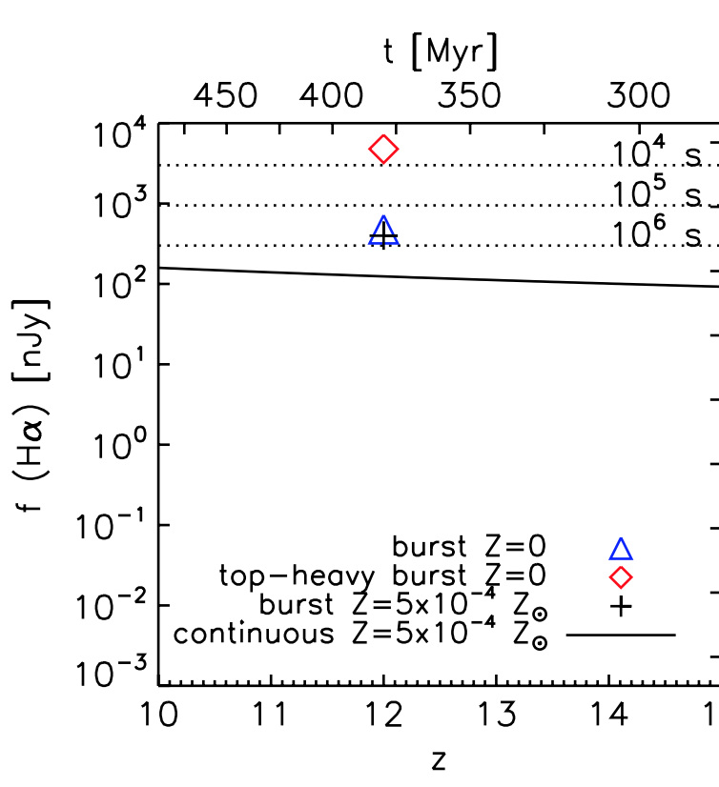
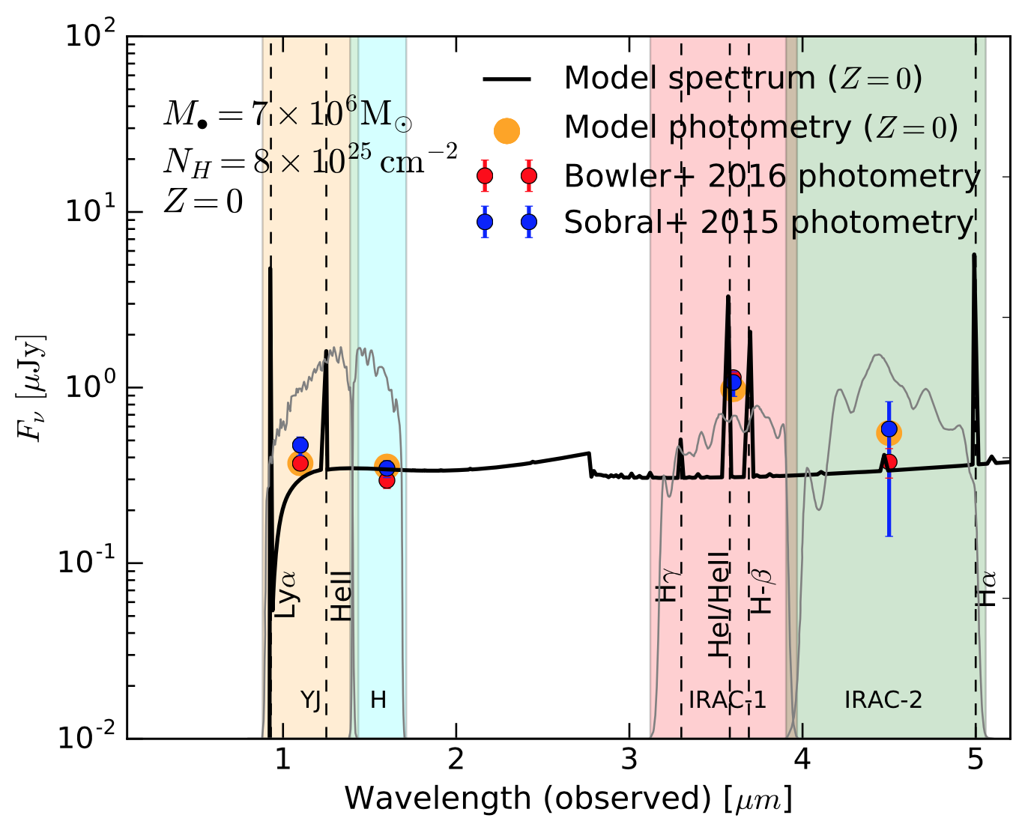
Identification of:
PopIII galaxies
Primeval Direct Collapse
Black Hole seeds
Pawlik+11
Pacucci+17

Slide 20
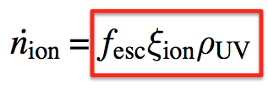
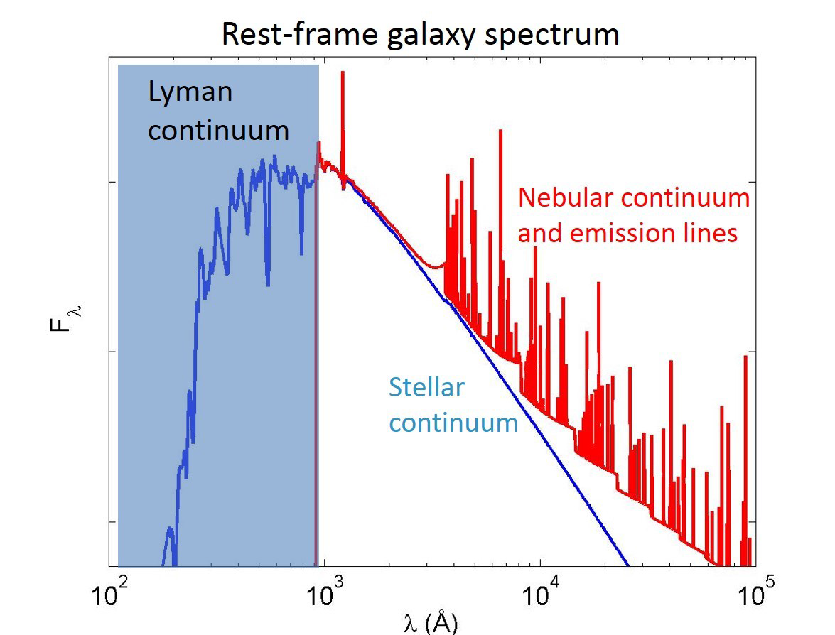
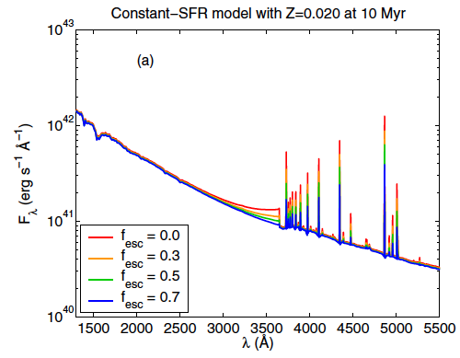
The Lyman continuum escape fraction
Crucial quantity to understand the capability
of galaxies to reionize the Universe
Lyc
Hα
HII
HII
Hβ
Escape fraction
from Balmer lines + Balmer break with UV continuum
Lyman
continuum
Zackrisson+13
R=1000
& R = 100
nebular lines
&
nebular cont.
Balmer
Cont.
R=100
Hβ
Hγ
this translates
into this
modulo the
escape fraction

Slide 21
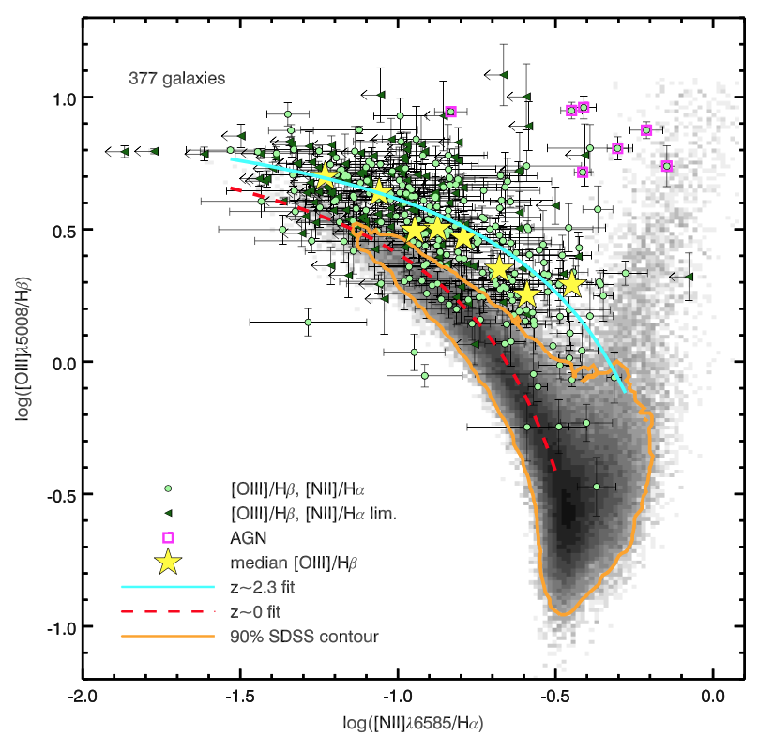
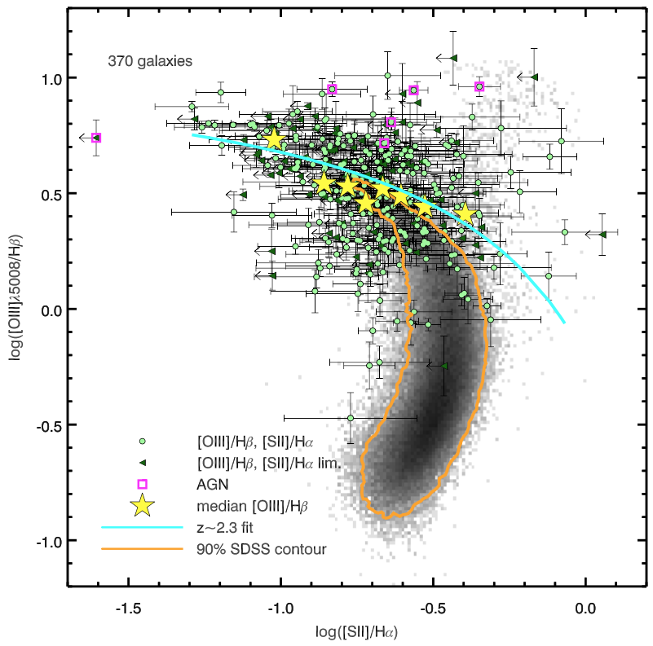
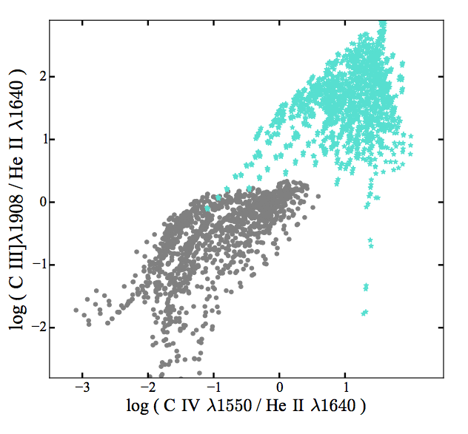
Excitation diagnostics
Classical optical BPT
(currently only
out to z~2.5)
-> usable out to z~7
Storm+16
UV-diagnostics out to z>7
(Feltre +15)
NIRSpec -> AGN identification
NIRCam -> AGN host galaxies
(Volonteri+17)

Slide 22
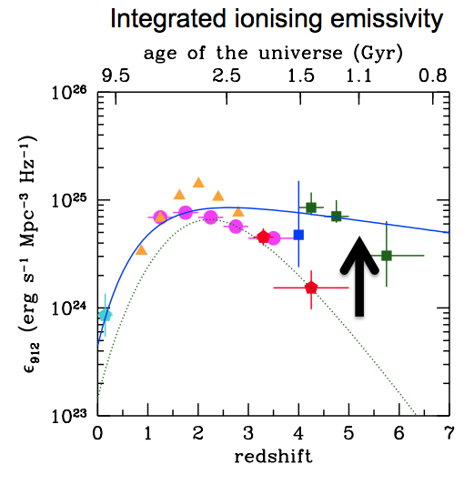
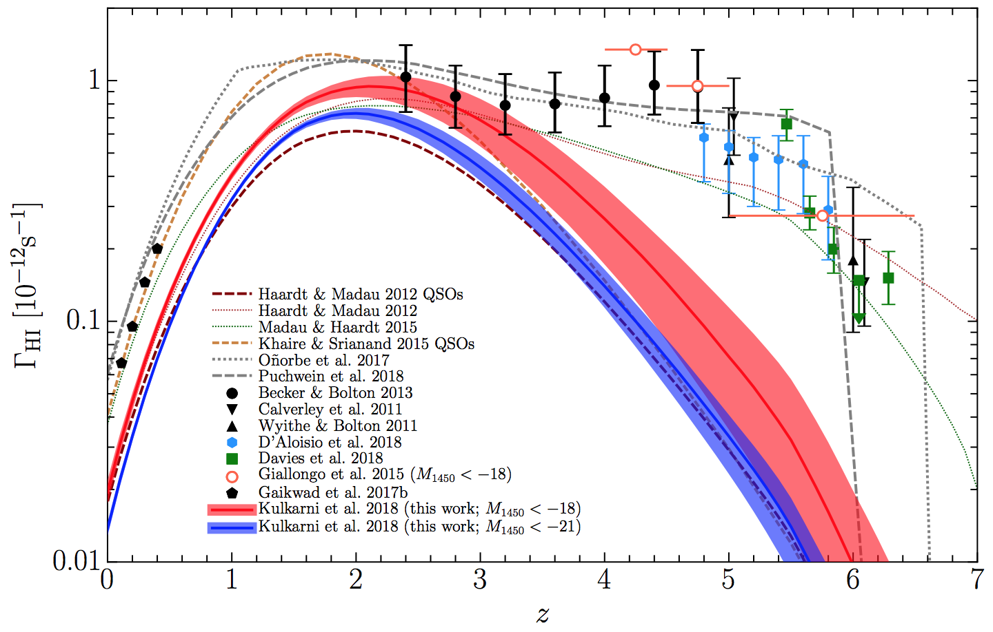
it will be possible to unambiguously determine the role of AGN vs SF
in the reionization process
Giallongo+15
Madau+Haardt’15
Kulkarni+18
Parsa+17
Weigel+15

Slide 23
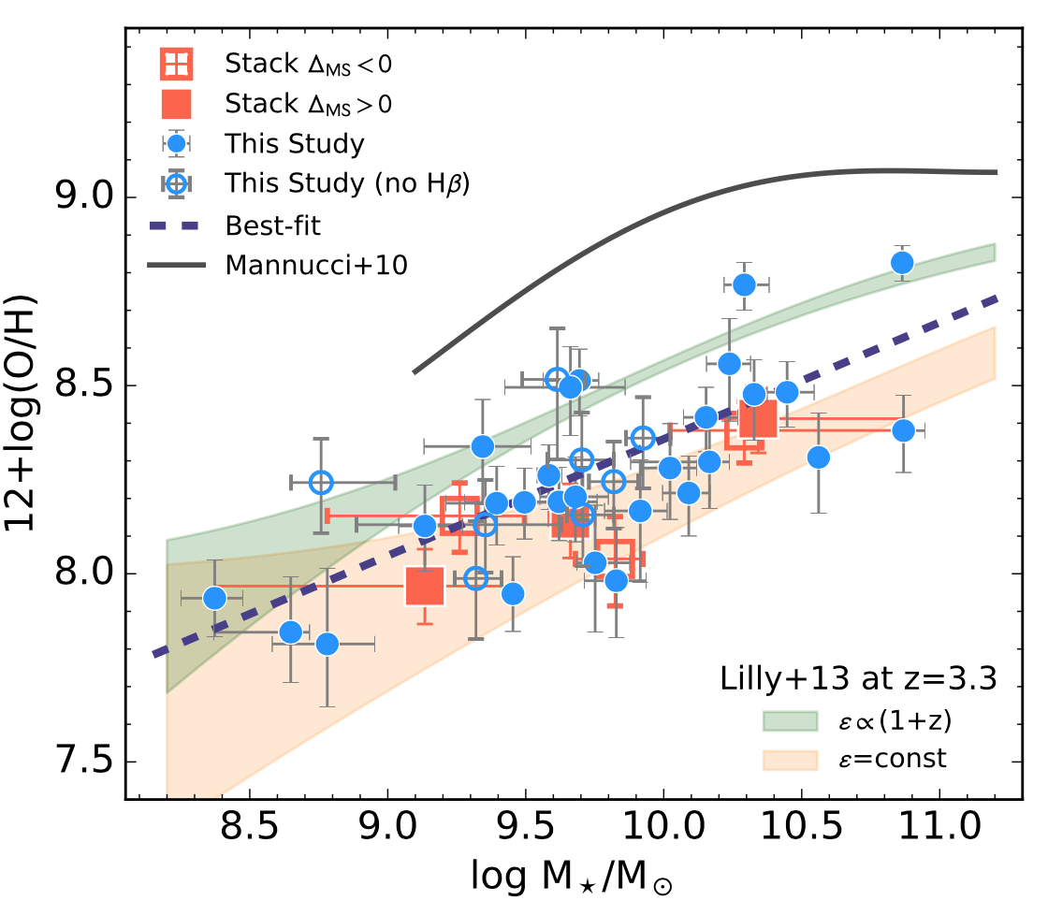
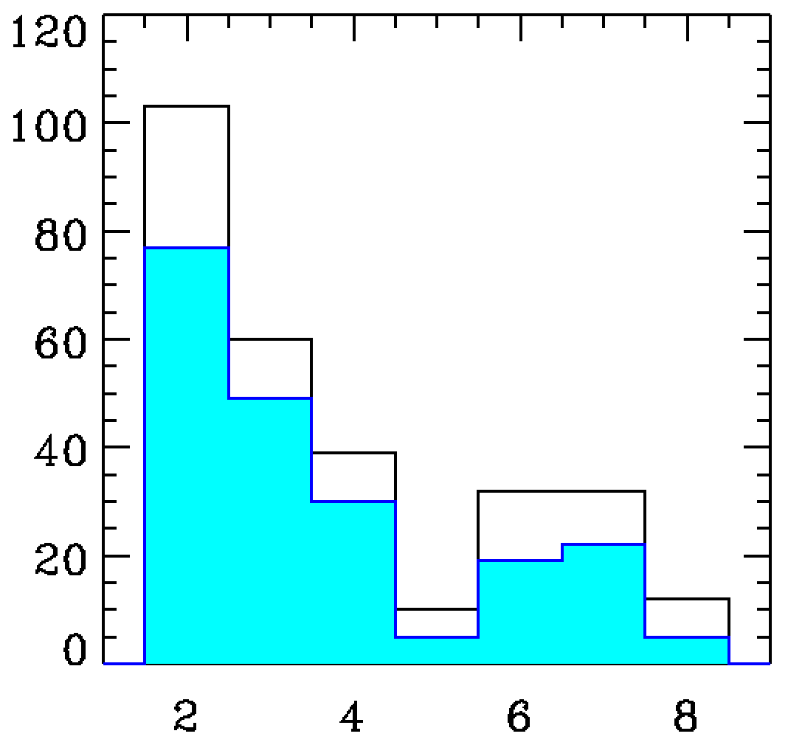
Galactic chemical evolution out to reionization epoch
z~0
Number of galaxies only in
Deep-HST for which the metallicity
can be determined to better than
ΔZ < 0.15 dex
z~3.3
total
ΔZ < 0.15 dex
Number of galaxies
mass-metallicity relation
currently out to z~3.3
Reshift

Slide 24
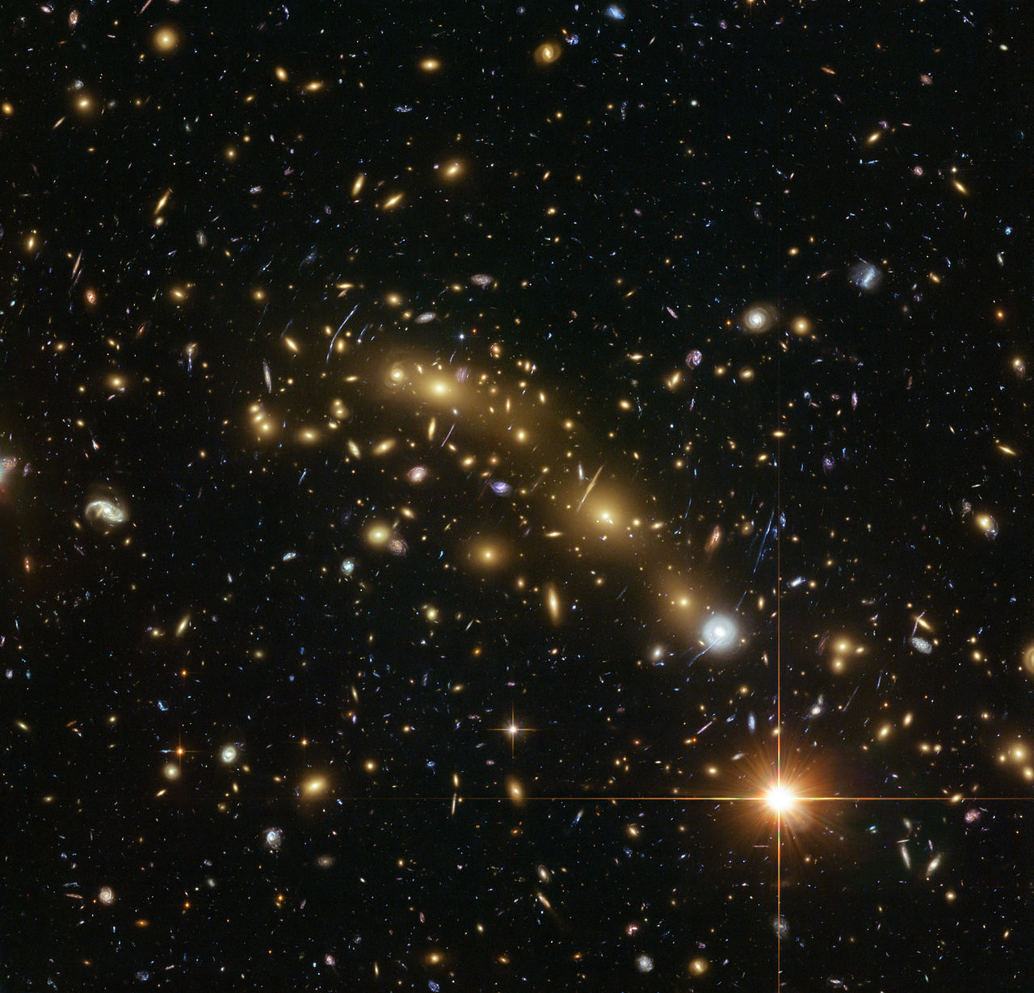
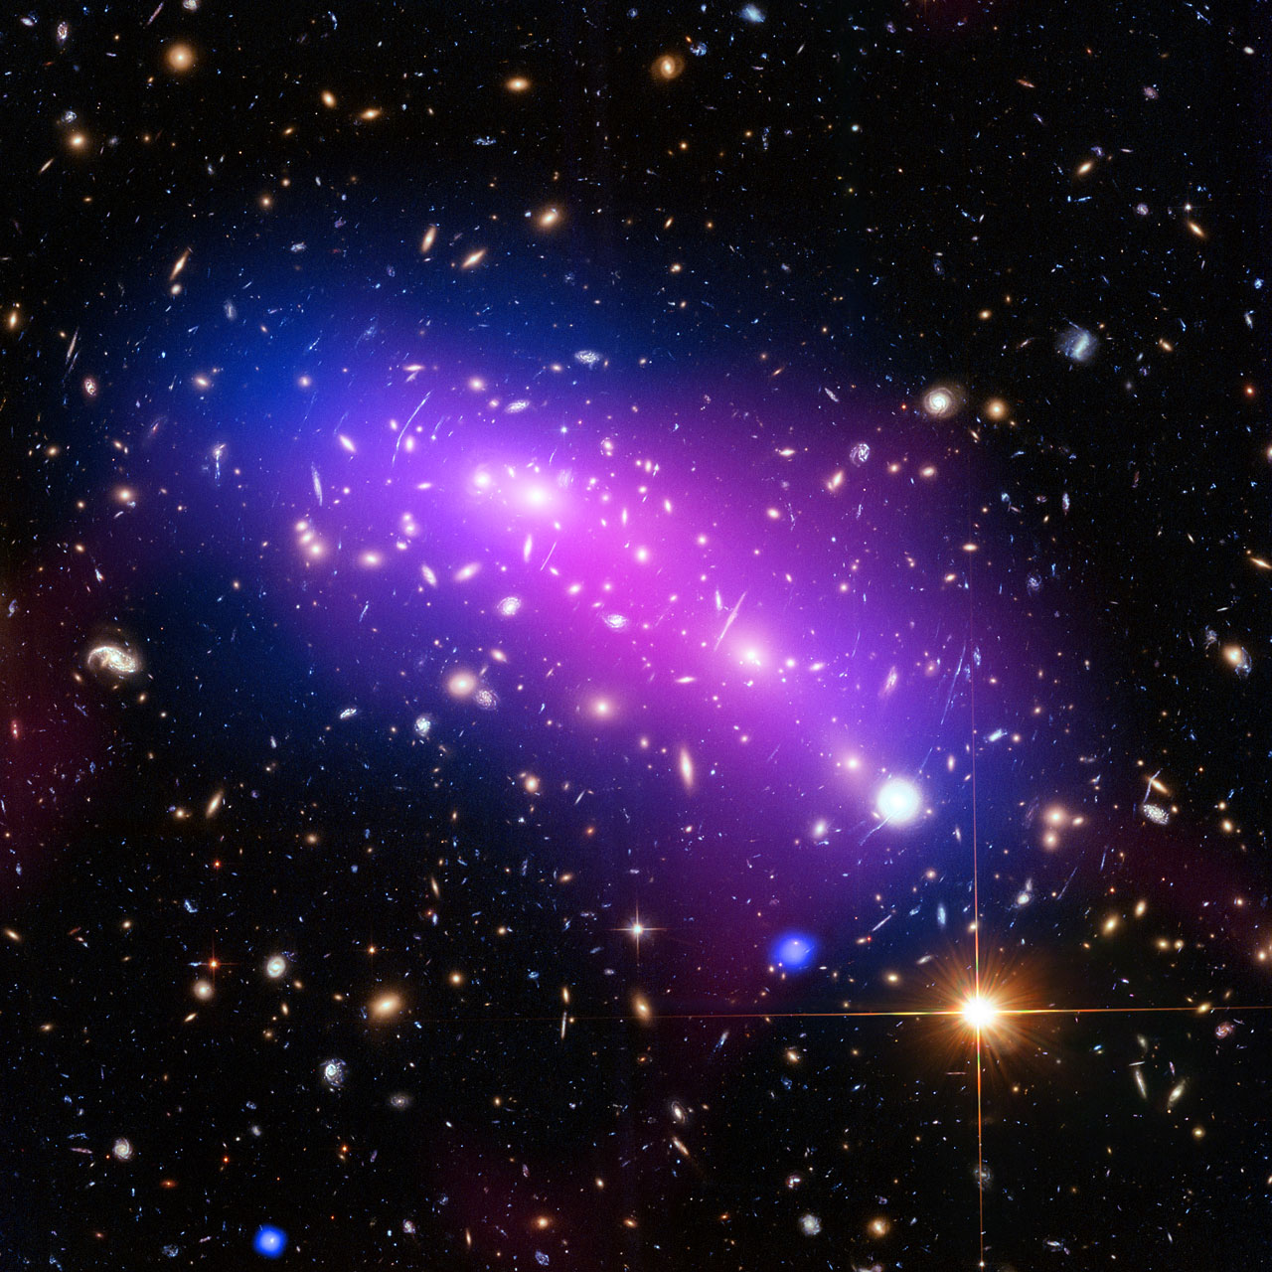
Other programs using NIRSpec in Cycle 1 GTO or ERS
GTO
CANUCS (NIRISS GTO): 5 lensing clusters, 2 NIRSpec configurations
each (17 hours in total)
MIRI GTO (US) team a few NIRSpec additional pointings in GOODS-S
Early Release Science (all public immediately)
- CEERS: 6 NIRSpec pointings in Candles fields, R=100 & R=1000
(20 hours total)
- GLASS: one lensing cluster, 3 NIRSpec R=2700 config. (14 hours tot)

Slide 25
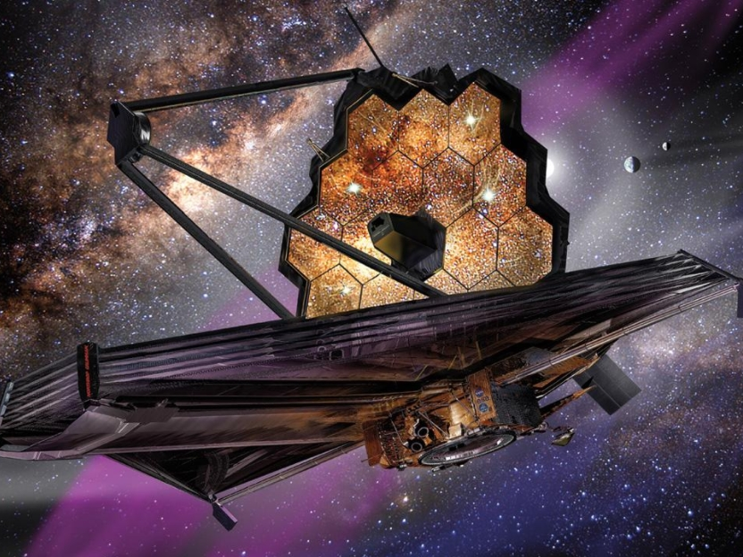
Thank you!

Slide 26
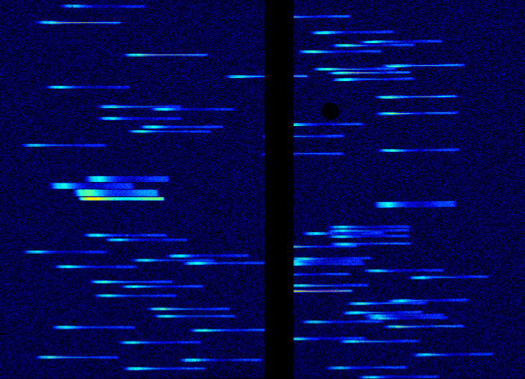
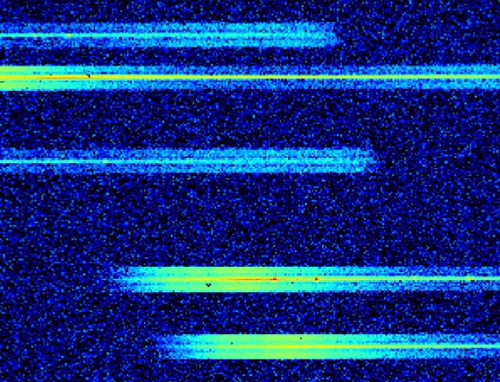
Simulation of exposure in the
Hubble Deep Field
20 min
R=100
0.6μm
5μm
AB=26 (very easy!)

Slide 27
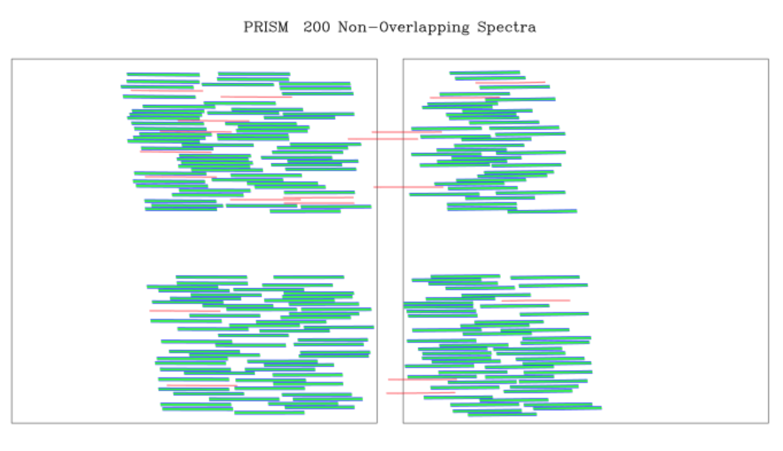
All dispersers can be used
Example with R=100
Short spectra => typically 4 spectra can be accommodated
in one row without overlaps
Courtesy:
P. Jakobsen

Slide 28
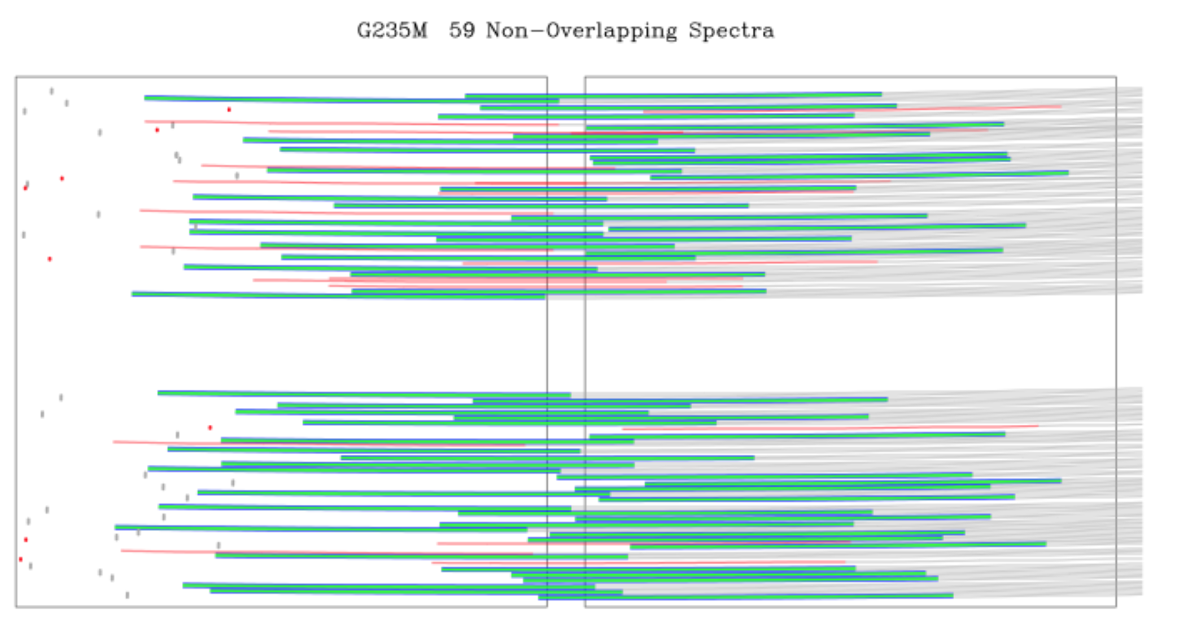
Example with R=1000
Typically one spectrum can be accommodated in one
row without overlaps (or less, given that spectra are curved)
At R=2700 spectra are ~2.7 times longer
most of them are truncated (on the blue side)
The extent of truncation depends on the
target location on MSA
Note that most spectra have a gap
-> need an offset by ~20” to recover this gap

Slide 29
Planning challenge:
Rigid MSA structure
=> cannot center simultaneously all targets:
have to find a compromise
-> “acceptance zone” within shutter footprint
Avoid failed closed shutters
Avoid spectra overlap
Avoid overlap with failed open shutters

Slide 30
Planning challenge
-> MPT:
1) given a roll angle and set of “primary” targets optimizes
the pointing and MSA configuration to maximize the number
of targets observed
-> typically ~ 30% of the primary target can be accommodated
2) opens the other shutters on as many “filler targets” as possible
-> final efficiency (number of spectra obtained per pointing)
depends on density of targets
(at least ~200 arcmin⁻² to decently exploit the MSA)

Slide 31


Key Planning Parameters in MPT:
Slitlet Shape & Shutter Margin (aka “Acceptance Zone”)
courtesy: D. Karakla
Slitlet shape (can be 1, 2, 3, or 5 shutters)
Shutter margin to limit slit losses (5 choices):
Perfectly centered
NIRSpec MSA Slit Throughput vs. Wavelength
*
Unconstrained
Open Shutter Area
Midpoint
Constrained
Tightly Constrained
Shutter Planning Constraints

Slide 32
Key Planning Parameters in MPT: Dithers
Fixed dithers: Translate MSA config pattern to new dither point.
Flexible Dithers: Large dithers
e.g. to cover the detectors gap
Because of distortions requires MSA
reconfiguration
Typically only 30-50% of the targets
can be retrieved in the new
MSA configuration
MSA
Config 1
(0,0)
*
spatial
Config 2
Config 3
(0,-4)
*
*
(6,-4)
dispersion
SMALL dithers only! <~ 10 arcsec
adapted from D. Karakla

Slide 33
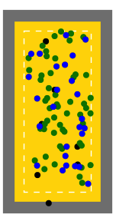
Output and Plan Assessment Tools
courtesy: D. Karakla
There are some nice built-in tools to help assess plans:
Different Exposure views
Green=Primaries
Blue=Fillers
Black=contaminants
MSA Shutter View
Collapsed Shutter View
Right: MSA shutter view. Targets are shown on a sketch of the MSA for one exposure.
Left: Collapsed shutter view showing target centering results
0.”46
0.”06
0.”2

Slide 34
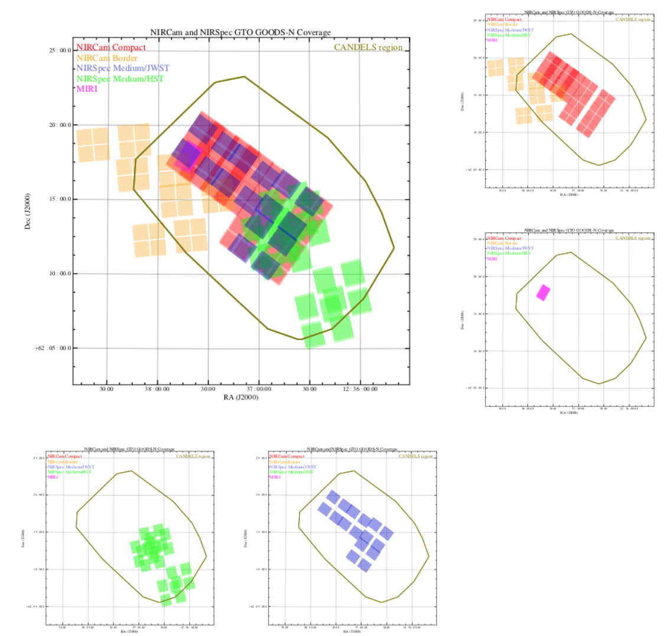
NIRCam-prime
7 pointings
6 in have NIRSpec
in parallel
(HST preimaging)
of which 6 overlap
with the same
NIRCam pointings

Slide 35
NIRCam prime
7 pointings
6 in have NIRSpec
in parallel
(HST preimaging)
of which 6 overlap
with the same
NIRCam pointings
Coordinated exposures per pointing:
2.3hr
2.3hr
2.3hr
2.3hr
NIRCam:
SW: F090W - F115W - F150W - F200W
LW: F227W - F356W - F410M - F444W
NIRSpec:
PRISM - PRISM - G235M - G395M

Slide 36
NIRSpec-prime
4 pointings
(on previous NIRCam pre-imaging)
NIRCam in parallel

Slide 37
Coordinated exposures per pointing:
2.3hr
2.3hr
2.3hr
2.3hr
2.3hr
NIRCam:
SW: F070W - F090W - F115W - F150W - F200W
LW: F227W - F335W - F356W - F410M - F444W
NIRSpec:
PRISM - G140M - G235M - G395M - G395H

Slide 38
Rationale:
stellar
continuum
& redshift
nebular lines
full band
kinematics
NIRSpec:
PRISM - G140M - G235M - G395M - G395H

Slide 40
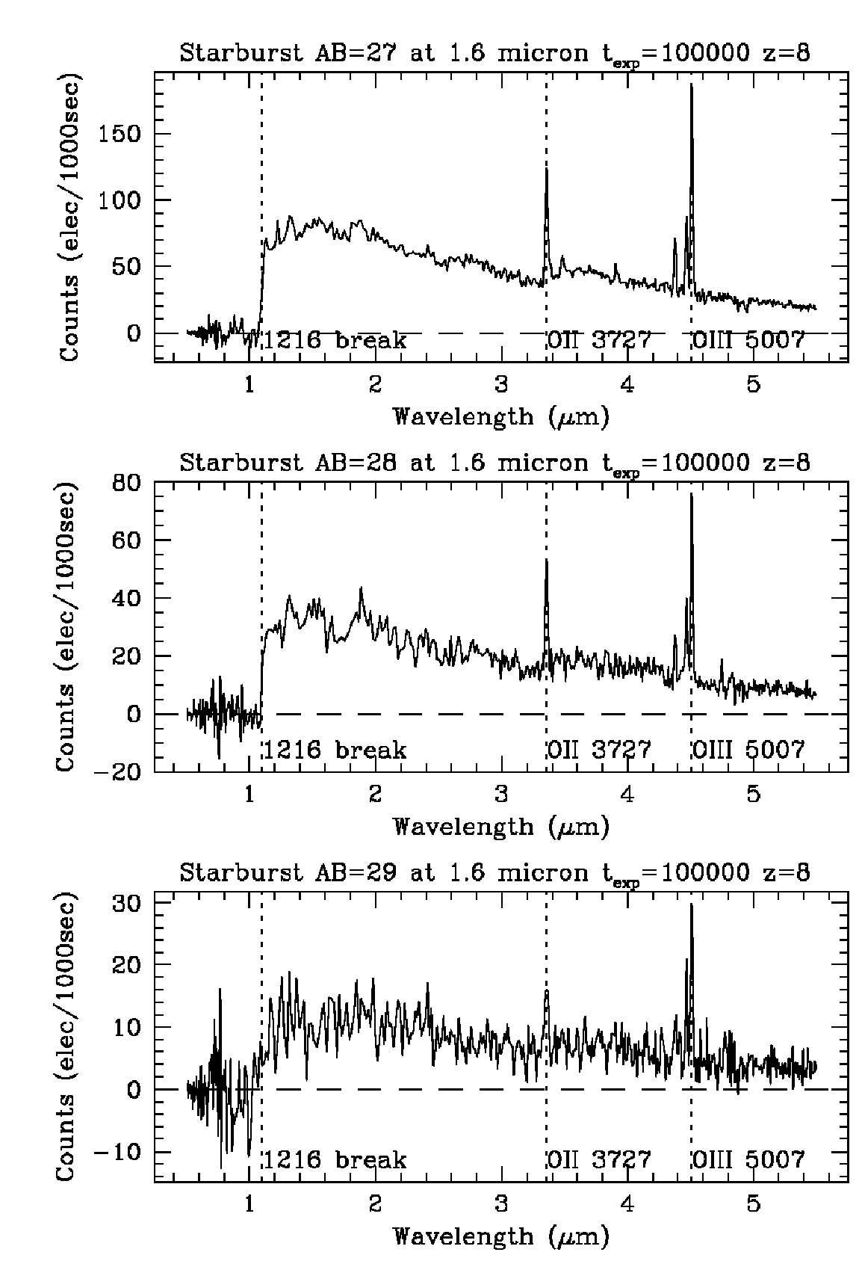
Expected quality of spectra in “deep” GOODS
NIRSpec R=100, z=8, 10⁵ sec
continuum easily detected
NIRSpec, R=1000, 2.5x10⁴ sec
AB=28
z=8 Z = 1/10 Z
AB=27
AB=28
AB=29
Retrival of stellar age, SFR, Mstar, SFH
extinction, metallicity, ....
+ extreme redshift machine

Slide 41
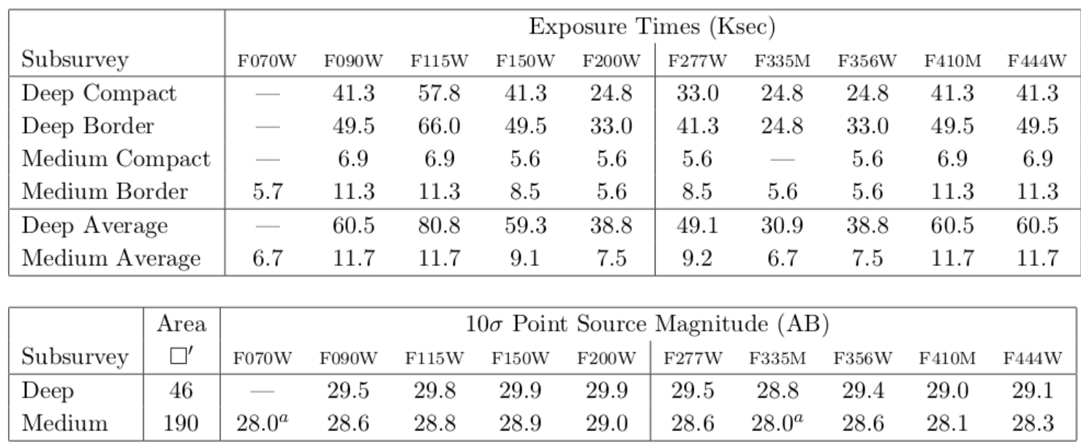
In case you’re interested:
summary of NIRCam exposures, areas, exptected sensitivities

Slide 42
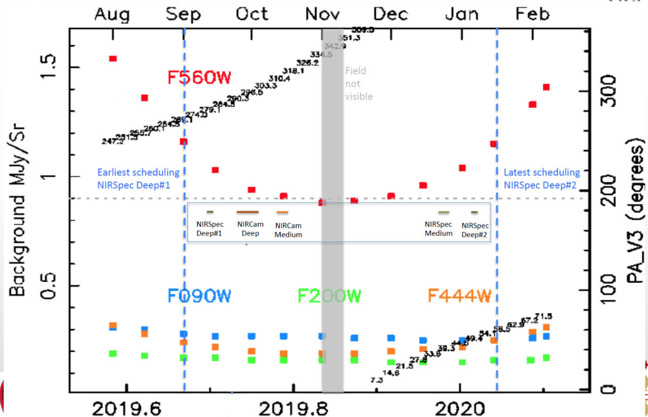
Proposed scheduling for GOODS-S given by constraints on roll angle and
also background (note, for spectroscopy the latter relevant only at R=100)

Slide 43
Overview of the NIRISS slitless mode
observing strategies, issues and tips
Slides: courtesy of Chris Willott

Slide 44
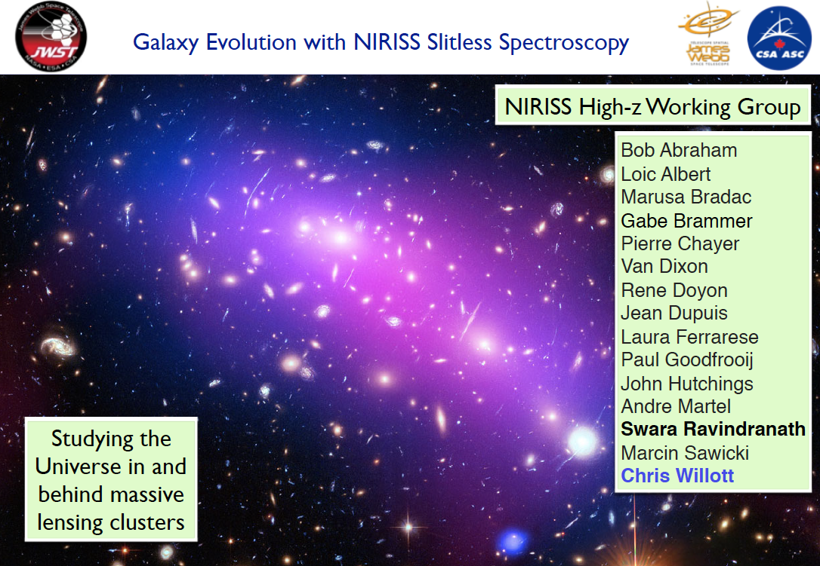

Slide 45
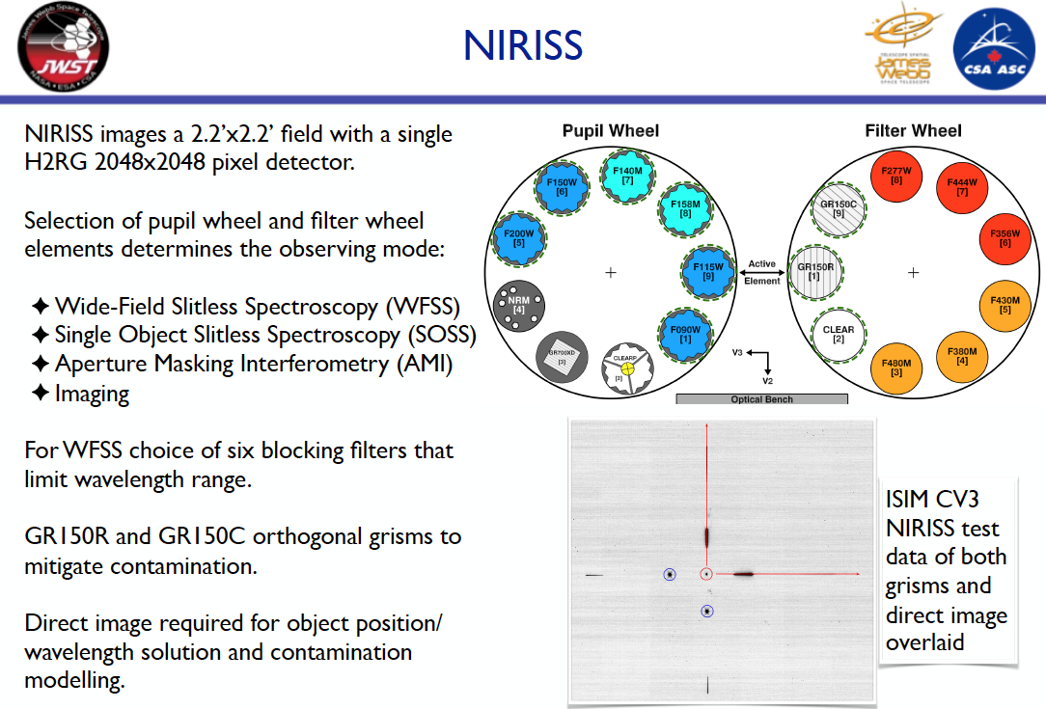

Slide 46
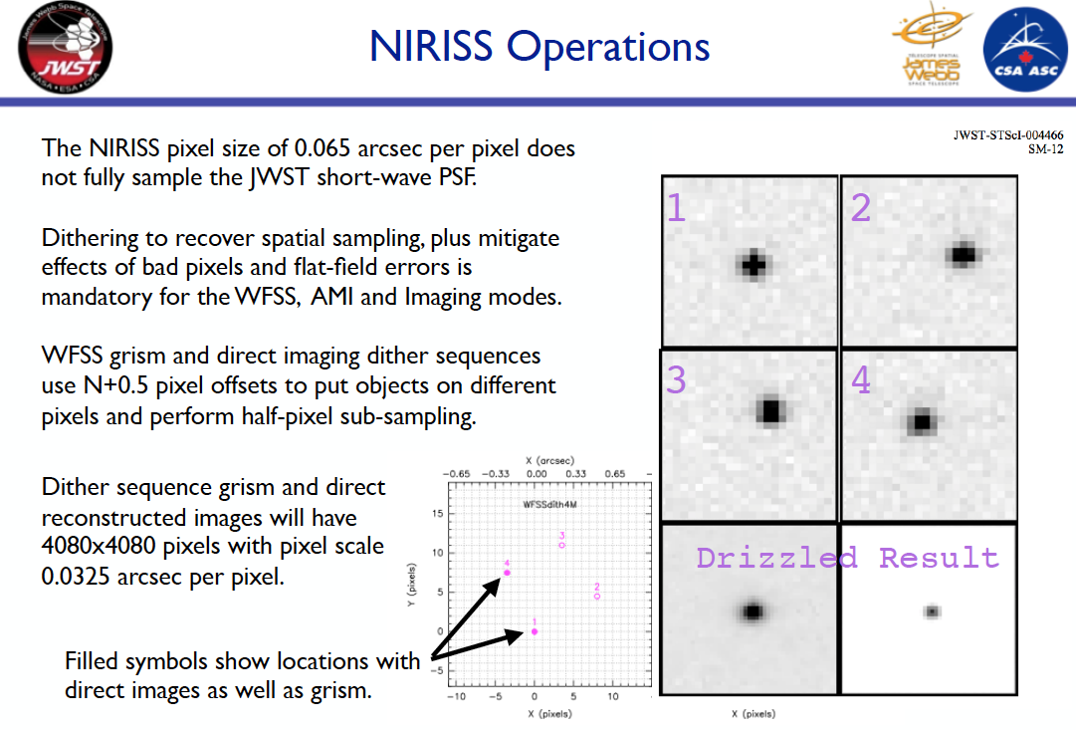

Slide 47
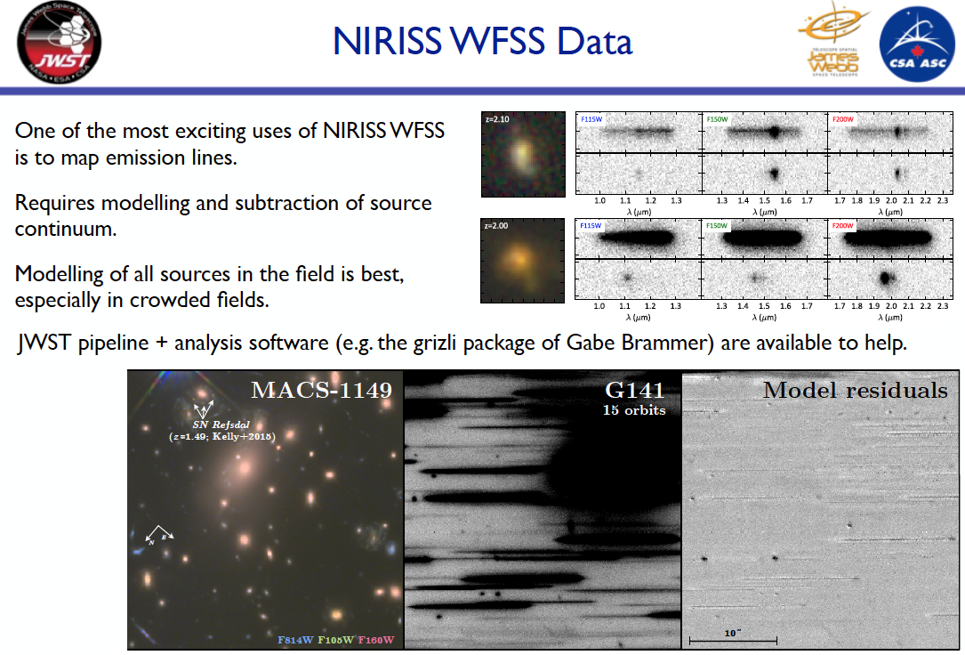

Slide 48
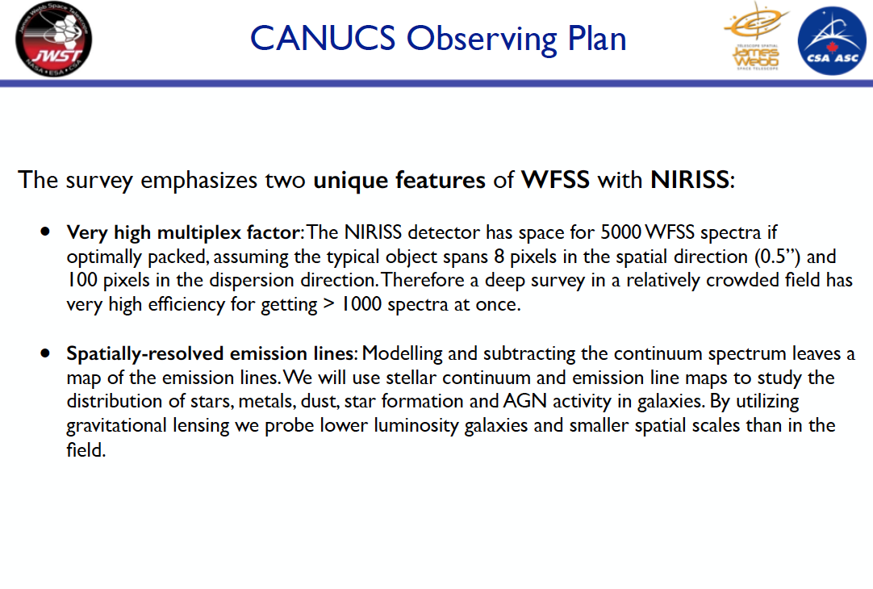

Slide 49
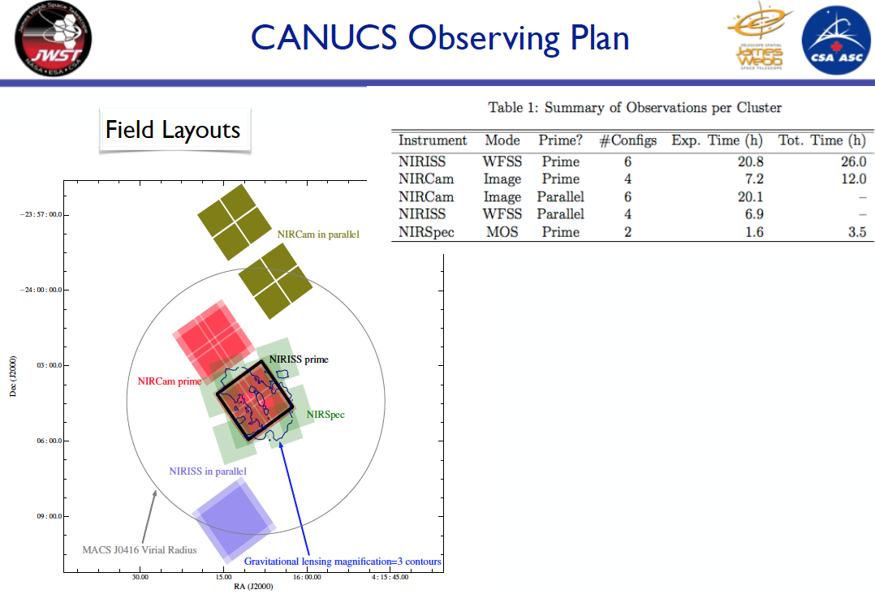

Slide 50


Slide 51


Slide 52
For more information please visit:
NIRSpec MSA mode
https://jwst-docs.stsci.edu/display/JTI/NIRSpec+Multi+Object+Spectroscopy
MPT-APT Tutorial (D. Karakla)
https://jwst.stsci.edu/news-events/events/events-area/stsci-events-listing-container/
NIRISS Wide Field Slitless Spectroscopy
https://jwst-docs.stsci.edu/display/JTI/NIRISS+Wide+Field+Slitless+Spectroscopy

Slide 53
Spare slides

Slide 54

Review Plan Results
Ability to
select one or more exposures and
filter plan results to list primaries (or fillers or contaminants), or all observed sources.
1
2
View successful targets in all selected exposures
Histogram of targets from the selected and filtered results.
courtesy: D. Karakla

Slide 55


Slide 56


Slide 57


Slide 58

In general each target (especially for faint ones) will
have associated a set of 3 shutters forming a slitlet
and the telescope will nod targets on the three shutters
for background subtraction
(more/less shutters per slitlet can be selected depending
on target size and brightness)
Courtesy:
P. Jakobsen

Slide 59

zoom in

