Slide 1
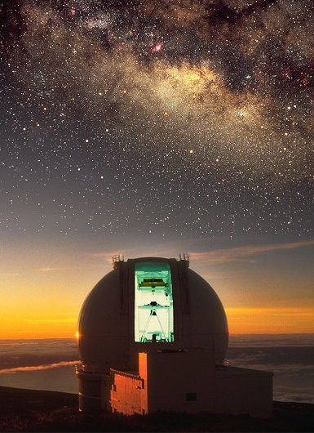
WEAVE Extragalactic surveys Angela Iovino INAF-OABrera

Slide 2
Context: WEAVE vs 4MOST
 | WEAVE | 4MOST
Telescope Ø | 4.2 mt WHT | 4.1 mt VISTA
Location | La Palma | Paranal
FoV | 3.14 sq degs | 4 sq degs
Multiplexing | 1000 fibers | 1600 fibers
Fiber Ø | 1.3 arcsecs | 1.45 arcsecs
λ @ R~5000 | 3700-9500 | 3700-9500
IFU capabilities | Yes | No
Notes:
Compare with 3 arcsecs diamater SDSS and 2 arcsecs diameter BOSS fiber size

Slide 3
Context: WEAVE vs 4MOST
Expected First Light
2019 vs 2022*
3 years of critical advantage
NB: 5 years at 70% of total available nights are guaranteed to consortium, while 30% is open time
*4MOST Web site @ESO
Notes:
(~250 nights/year)
ESO website

Slide 4
Extra-Galactic Surveys:
- WEAVE-Clusters
WEAVE-Apertif
WEAVE-LOFAR
WEAVE-QSOs
WEAVE-StePS

Slide 5
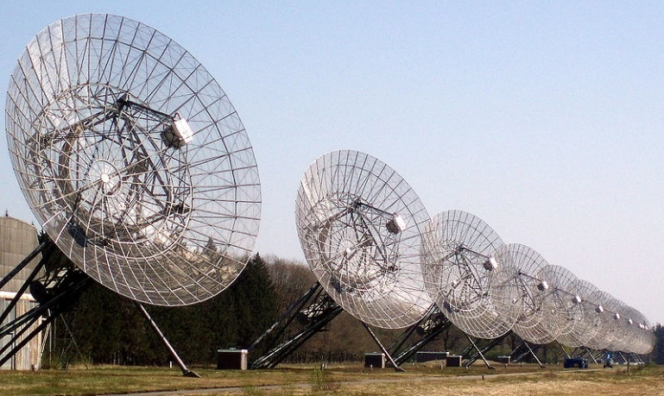
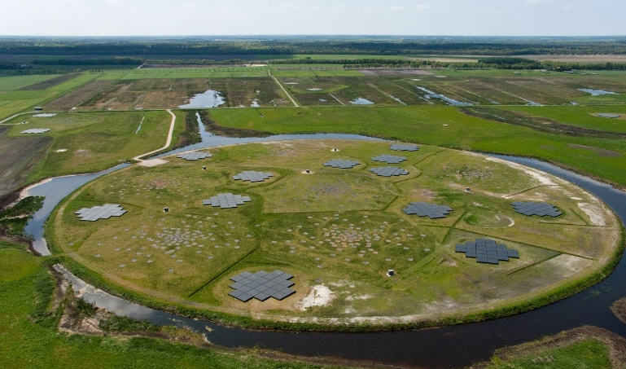
Westerbork telescopes in Dwingeloo
Extra-Galactic Surveys:
- WEAVE-Clusters
WEAVE-Apertif
WEAVE-LOFAR
WEAVE-QSOs
WEAVE-StePS
See talk by I. Prandoni
LOFAR – aerial view

Slide 6
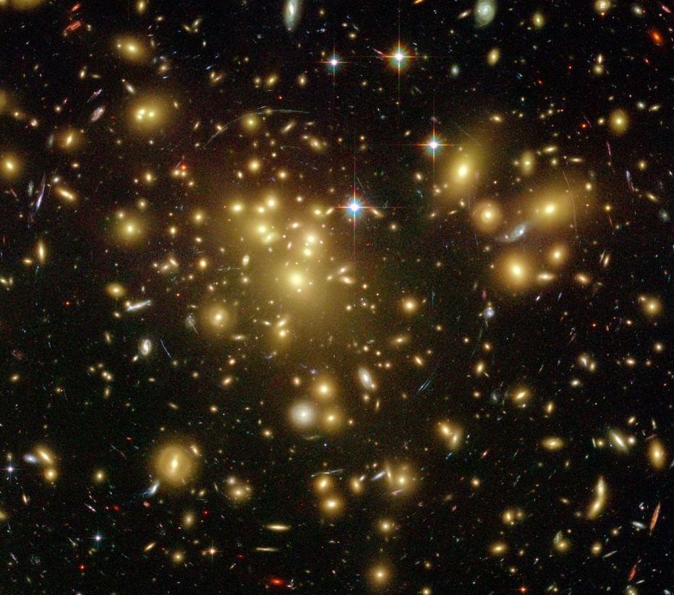
WEAVE-Clusters
Team Lead: J. Alfonso Lopez Aguerri
3 Layers
1- Nearby Clusters
2- Clusters Infall Regions
3- Cosmological Clusters
HST image of Abell 1689

Slide 7
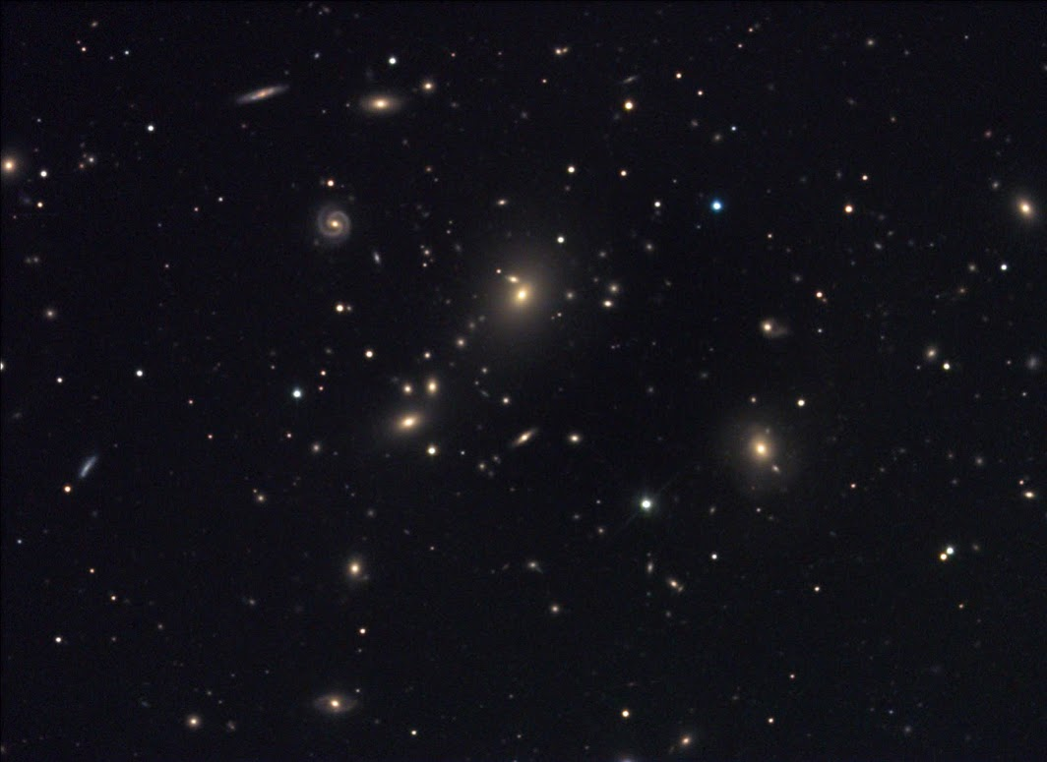
WEAVE-Clusters
Layer 1
– Nearby Clusters Aguerri
Science Goal: Understand the formation history of dwarf galaxies in high density environments.
X-ray flux limited sample of 47 clusters at z<0.04 – dwarf component observed both with MOS
and mIFU
Abell 671
Notes:
The main goal of this survey layer is to understand the formation history of dwarf galaxies in high-density environments. Dwarf
galaxies are by far the most numerous local-galaxy type. Still, the total number of dwarf galaxies (where??) is much lower than expected from current models of galaxy formation. Furthermore, the processes driving the formation of dwarf galaxies and how the environment affects their evolution are poorly understood.
Specific scientific questions that will be addressed include: are dwarf galaxies primordial or the end-products of galaxy transformations? What
processes drive the transformation of dwarf galaxies in clusters?
What are their internal dynamics? Are they DM-dominated systems? What is their angular momentum? How do these processes
depend on properties of the galaxies themselves and their local environment?
The WEAVE Nearby Clusters Survey is a low-spectral-resolution programme combining the MOS and mIFU modes of
WEAVE. This survey will observe an X-ray flux-limited sample of 47 nearby galaxy clusters (z < 0.04) covering a large range in cluster
mass (13.2 < log(M star /M sun ) < 14.5) and environment. This survey will provide single-fibre spectroscopic information for several
thousands of dwarf galaxy members, and spatially resolved spectroscopic data for around 1000. This will constitute the largest sample
to date of dwarf galaxies in clusters with high-quality spectroscopic data.

Slide 8
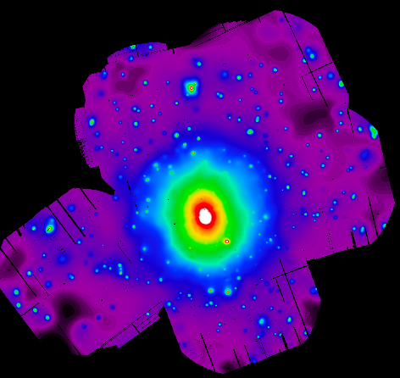
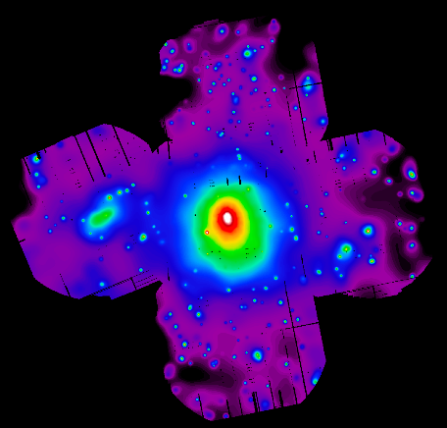
WEAVE-Clusters
Layer 2
– Clusters Infall Regions Aragón-Salamanca
Science Goal: study the properties and evolution
of galaxies as they fall into clusters along the filamentary cosmic web.
16 galaxy clusters (most from WINGS) at z 0.055
to obtain low-resolution spectra of galaxies up
to 5 virial radii away from the cluster centres.
A1745
A644
X-COP Clusters – Courtesy S. De Grandi
Notes:
The main goal of this survey layer is to study the properties and evolution of galaxies as they fall into clusters along the filamentary cosmic web. It is becoming increasingly clear that galaxy properties and their evolution are affected not just by the highest-density cluster core environment, and lower-density environments such as galaxy groups, filaments and the infall regime are also important sites of galaxy transformation. Most cluster studies have concentrated on
the cores and virialised regions of clusters and groups, and detailed information on the galaxy properties in the infall regions and filaments remains largely unavailable. Specific scientific questions that will be addressed include: What is the nature, extent and importance of the filamentary structure around clusters? What fraction of the galaxies fall into clusters as part of distinct groups? And what fraction do so as individual galaxies along filaments? What is
the main parameter that governs the environmental transformation on galaxies, is it clustercentric distance, local density, belonging to a group or a cluster, belonging to a filament, or a combination of these? What are the main physical mechanisms driving galaxy transformation in each environment?

Slide 9
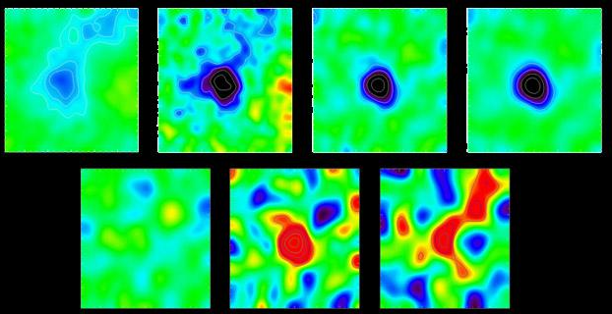
WEAVE-Clusters
Layer 3
– Cosmological Clusters Trager
Science Goal: Evolution of galaxies in the
cores of rich clusters out to z~0.5 and
precise dynamical mass estimates for
accurate scaling laws calibration
100 SZ selected rich clusters observed with
MOS and LIFU
Planck – Abell 2319

Slide 10
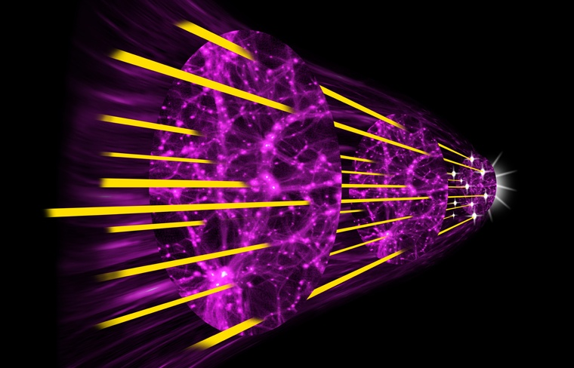
WEAVE-QSO
Team Lead: Mattew Pieri
Science Goal: measure BAO using QSO
absorption systems and study IGM properties
Bright QSOs targets from JPAS and GAIA
(6000 sq degs footprint)
Credit: Paul Hooper at http://www.spirit-design.com/

Slide 11
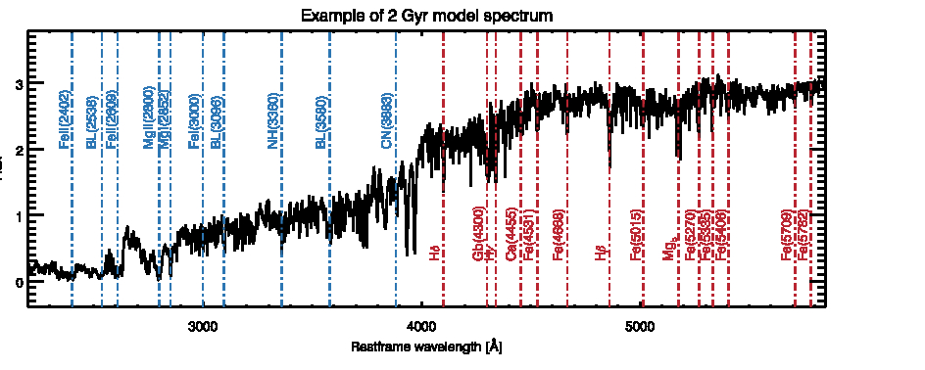
WEAVE-StePS
Team Leads: Angela Iovino &
Bianca Poggianti

Slide 12
WEAVE-StePS
- Mapping galaxy evolution over the past 7 Gyrs
StePS in a sentence: a 35K high spectral quality (S/N ~ 15) survey of Iab < 20.5
selected galaxies in the range 0.3<z<0.8 over ~ 20 sq degs
StePS Science Goals in a sentence: detail the processes that shape galaxy
evolution in the past 7 Gyrs (half the life-time of Universe) and produce galaxy
properties observed at z ~ 0
Notes:
StePS uniqueness: excellent spectral quality (all main galaxy properties) for a large sample of galaxies covering a range of cosmic time, galaxy intrinsic properties (stellar mass, type, color) and environment.

Slide 13
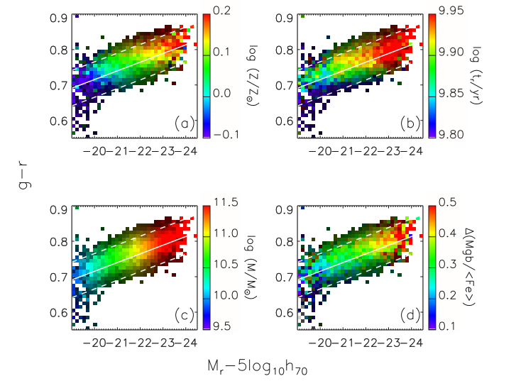
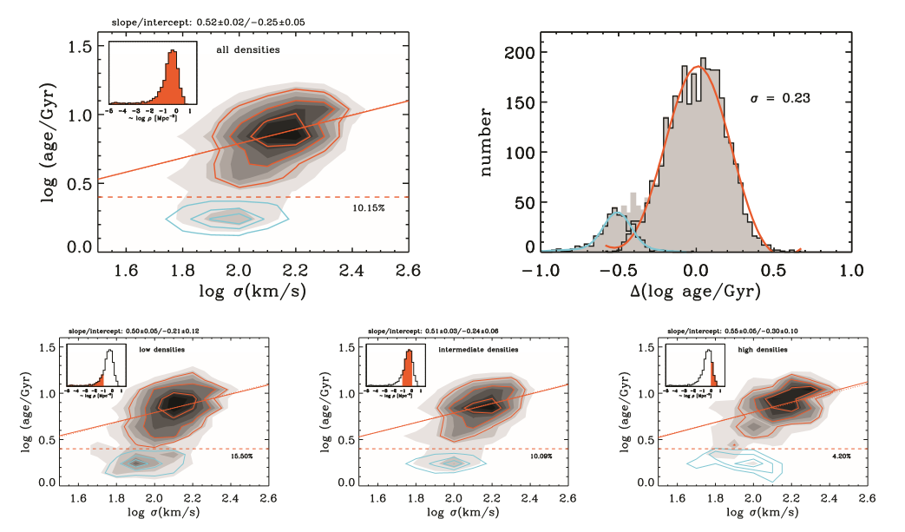
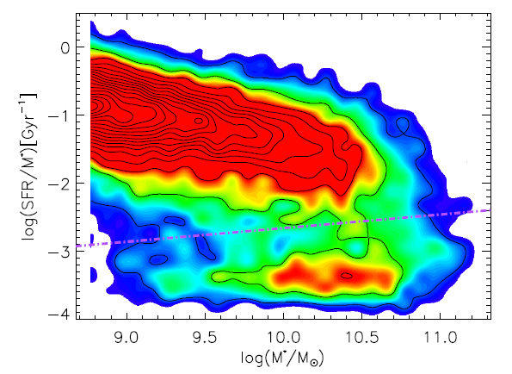
WEAVE-StePS
- Mapping galaxy evolution over the past 7 Gyrs
Bimodality of galaxy redshift surveys:
Local Universe: detailed knowledge of fundamental physical properties
of large number of individual galaxies - ages and metal content of stellar populations, star formation rates (SFRs), metallicity in the interstellar medium (ISM), and internal dynamics. And their relation with environment.
Gallazzi+ 2006
Thomas+ 2010
Guo+ 2015
Notes:
From the strength and shape of spectral lines SDSS high quality spectra have provided detailed insight on the fundamental physical properties of individual galaxies:
ages and metal content of stellar populations, star formation rates (SFRs), metallicity in the interstellar medium (ISM), and internal dynamics.
All linked to environment –

Slide 14
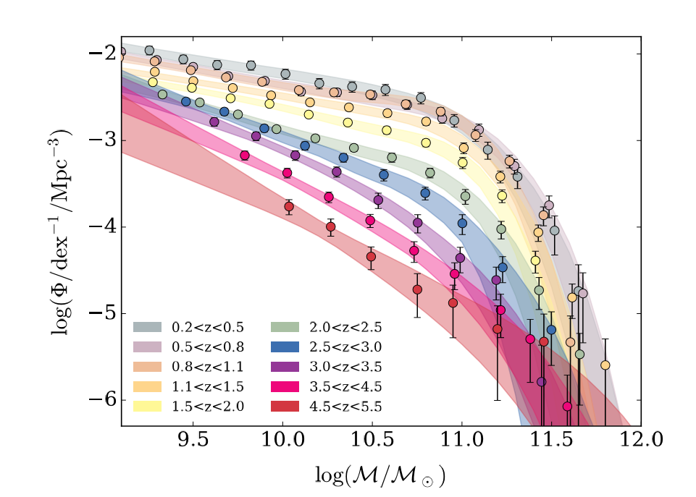
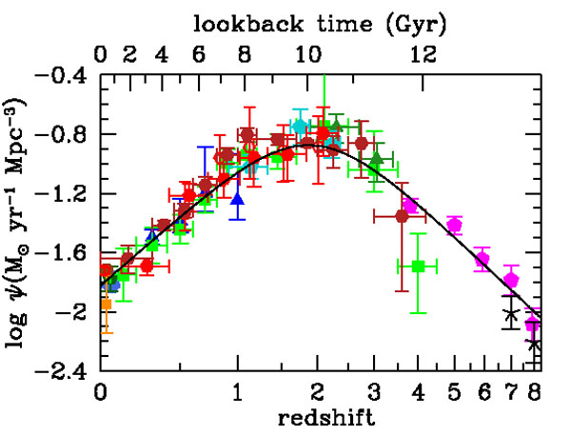
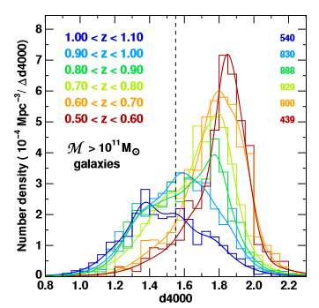
WEAVE-StePS
- Mapping galaxy evolution over the past 7 Gyrs
Bimodality of galaxy redshift surveys:
Local Universe (z<0.1): detailed knowledge of fundamental physical properties of large number of individual galaxies
Distant Universe: global evolution of the ensemble galaxy population – eg. Stellar Mass Function, Star Formation history etc
Davidzon+ 2017
Madau+ 2014
Haines+ 2017

Slide 15
WEAVE-StePS
- Mapping galaxy evolution over the past 7 Gyrs
Bimodality of galaxy redshift surveys:
Local Universe: detailed knowledge of fundamental physical properties of large number of individual galaxies
Distant Universe: global evolution of the ensemble galaxy population – eg. Stellar Mass Function, Star Formation history etc
Our Green Valley!
Notes:
From the strength and shape of spectral lines SDSS high quality spectra have provided detailed insight on the fundamental physical properties of individual galaxies:
ages and metal content of stellar populations, star formation rates (SFRs), metallicity in the interstellar medium (ISM), and internal dynamics.
All linked to environment –

Slide 16
WEAVE-StePS
Charting galaxy evolution over the past 7 Gyrs
Extend to higher redshift and with comparable wealth of data
the analysis done in the local universe
Power of the Archeological approach to galaxy evolution +
Advantages of the Look-Back approach
Notes:
Archeological approach : Scrutinize today’s galaxies to infer their past mass assembly
Lookback approach: Probe slices of the Universe at different epochs.

Slide 17
WEAVE-StePS
- Charting galaxy evolution over the past 7 Gyrs
Extend to higher redshift and with comparable wealth of data
the analysis done in the local universe
derive galaxy stellar ages, star-formation timescales, stellar and gas metallicities, and dust attenuation;
infer the past evolution of galaxies at different masses and redshift, relating their star formation histories to their intrinsic (e.g., stellar mass, galaxy morphology) and environmental properties;
v
estimate gas kinematics and stellar velocity dispersions, allowing us to perform a dynamical classification of our galaxies and to make a link between star formation history, mass assembly history and dynamics.
Notes:
Archeological approach : Scrutinize today’s galaxies to infer their past mass assembly
Lokkback approach: Probe slices of the Universe at different epochs.

Slide 18
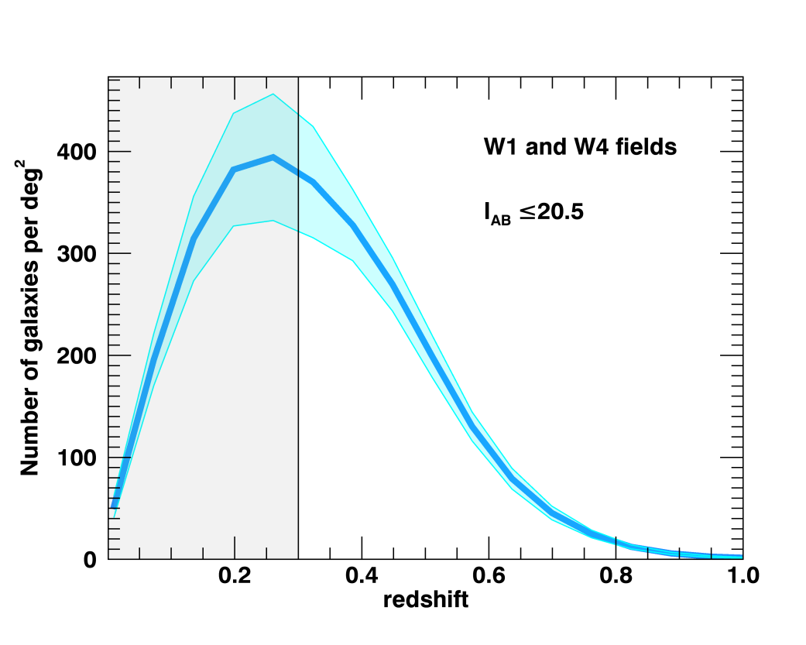
WEAVE-StePS
- Survey Strategy
StePS redshift distribution
35K galaxies at magnitude brighter than I_{AB} =20.5
pre-selected from photometric redshifts to be at z > 0.3
Mag Limit | Iab < 20.5
All Galaxies | ~ 3000
Zphot > 0.3 | ~ 2000

Slide 19
WEAVE-StePS
- Survey Strategy
StePS Mass limits for red/blue gals
35K galaxies at magnitude brighter than I_{AB} =20.5
pre-selected from photometric redshifts to be at z > 0.3
Redshift | Mass limit (log(M/Mo)
z=0.3 | 10.3
z=0.5 | 11.0
z=0.8 | 11.5
Mag Limit | Iab < 20.5
All Galaxies | ~ 3000
Zphot > 0.3 | ~ 2000

Slide 20
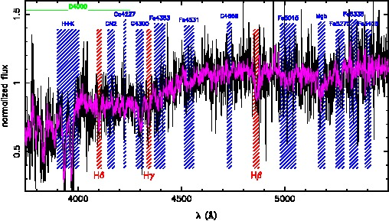
WEAVE-StePS
- Survey Strategy
F. La Barbera
35K galaxies at I_{AB} =20.5
pre-selected from phot-z to be at z > 0.3
High quality spectra: S/N>15
per resolution element (~1Å):
7 hours integration: to resolve features in
stellar continua
Notes:
Comparison of a typical absorption-line spectrum from StePS (magenta) and BOSS (black) at z = 0.55. The shaded areas identify the main absorption
features (red Balmer lines, blue metal lines). The superior quality of the StePS spectra provides a reliable measurement of both Balmer and metallic lines that
is unattainable in other large surveys.

Slide 21
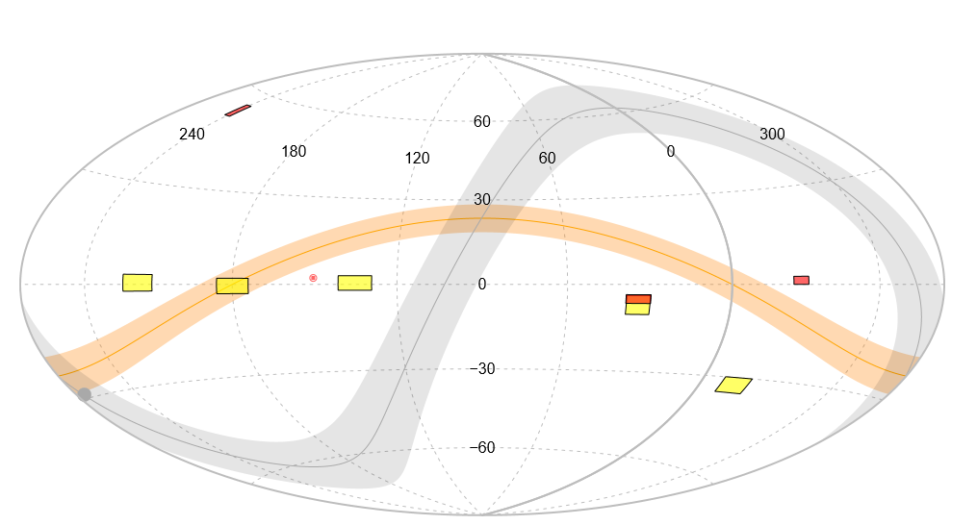
WEAVE-StePS
- Survey Strategy
35K galaxies at I_{AB} =20.5
pre-selected from phot-z to be at z > 0.3
Elais-N
High quality spectra: S/N>15
Cosmos
CFHTLS-W4
Well known extragalactic Fields:
Cosmos, W1, W4, Elais-N (~20 sq degs)
CFHTLS-W1
Plenty of ancillary data !

Slide 22
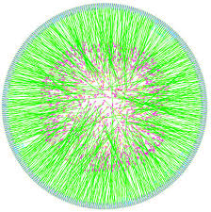
WEAVE-StePS
Large INAF presence:
Team Leads: Bianca Poggianti & Angela Iovino
Survey Working Group: Amata Mercurio, Angela Iovino
Quality Team: Marcella Longhetti, Francesco LaBarbera, Stefano Zibetti
Catalogs Team: Micol Bolzonella, Elena Zucca, D. Vergani
Post-Docs: Ilaria Lonoce and now Luca Costantin @ INAF-OABrera
+ a good sampling of the INAF community working on galaxy evolution!
More than 50% of total StePS members have INAF affiliation
WEAVE Configure
Notes:
Milano Padova Bologna Firenze Napoli

Slide 23
WEAVE-StePS
- Getting ready for observations
OPR2.5 Simulations
Huge amount of preparatory work:
Input Catalogs preparation
Tests for best tiling strategy and to
optimize fiber allocation
Realistic Survey simulations (including em
lines templates) to check feasibility and
pipeline results
Get ready for science exploitation !

Slide 24
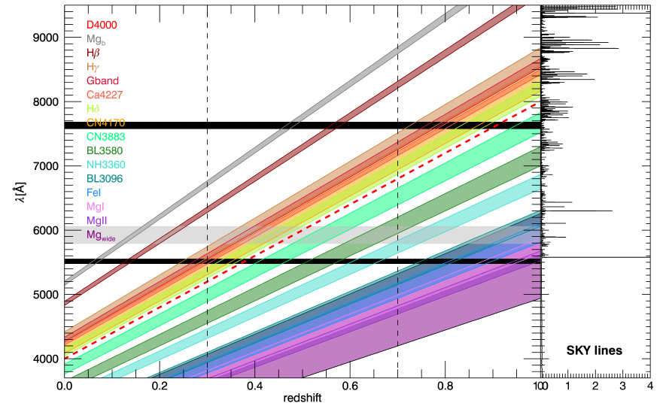
WEAVE-StePS
- Preparing for Science Exploitation
I. Lonoce
A large suite of indices is available in WEAVE spectral range.

Slide 25
WEAVE-StePS
- Preparing for Science Exploitation
Large library (~ 500.000) of templates library prepared by Zibetti/Gallazzi with a
full suite of Star Formation Histories and Metallicities
Extract a random subset templates and produce WEAVE-like observations (CCD Gaps, realistic S/N including Sky, RON etc contributions) in the redshift range: 0.3 < z < 0.7
Adopt a Bayesian approach (as in Gallazzi et al. 2005, 2014) to explore how reliably input values are retrieved for observed templates

Slide 26
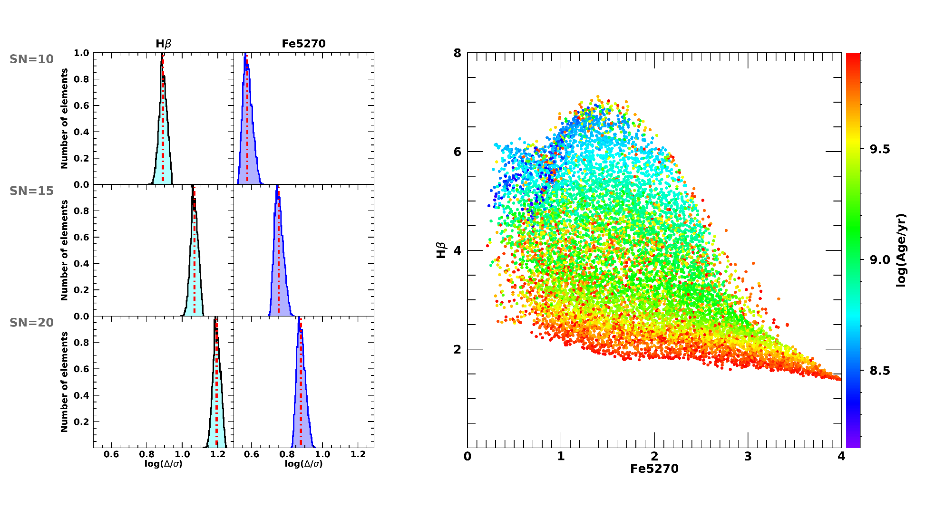
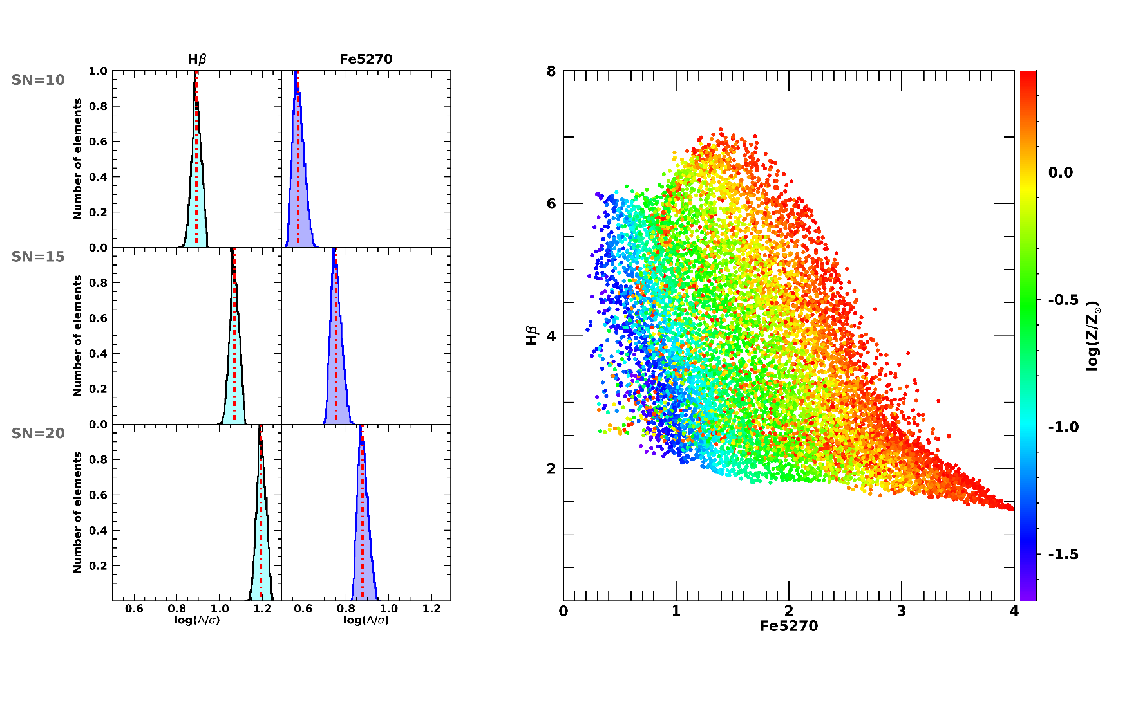
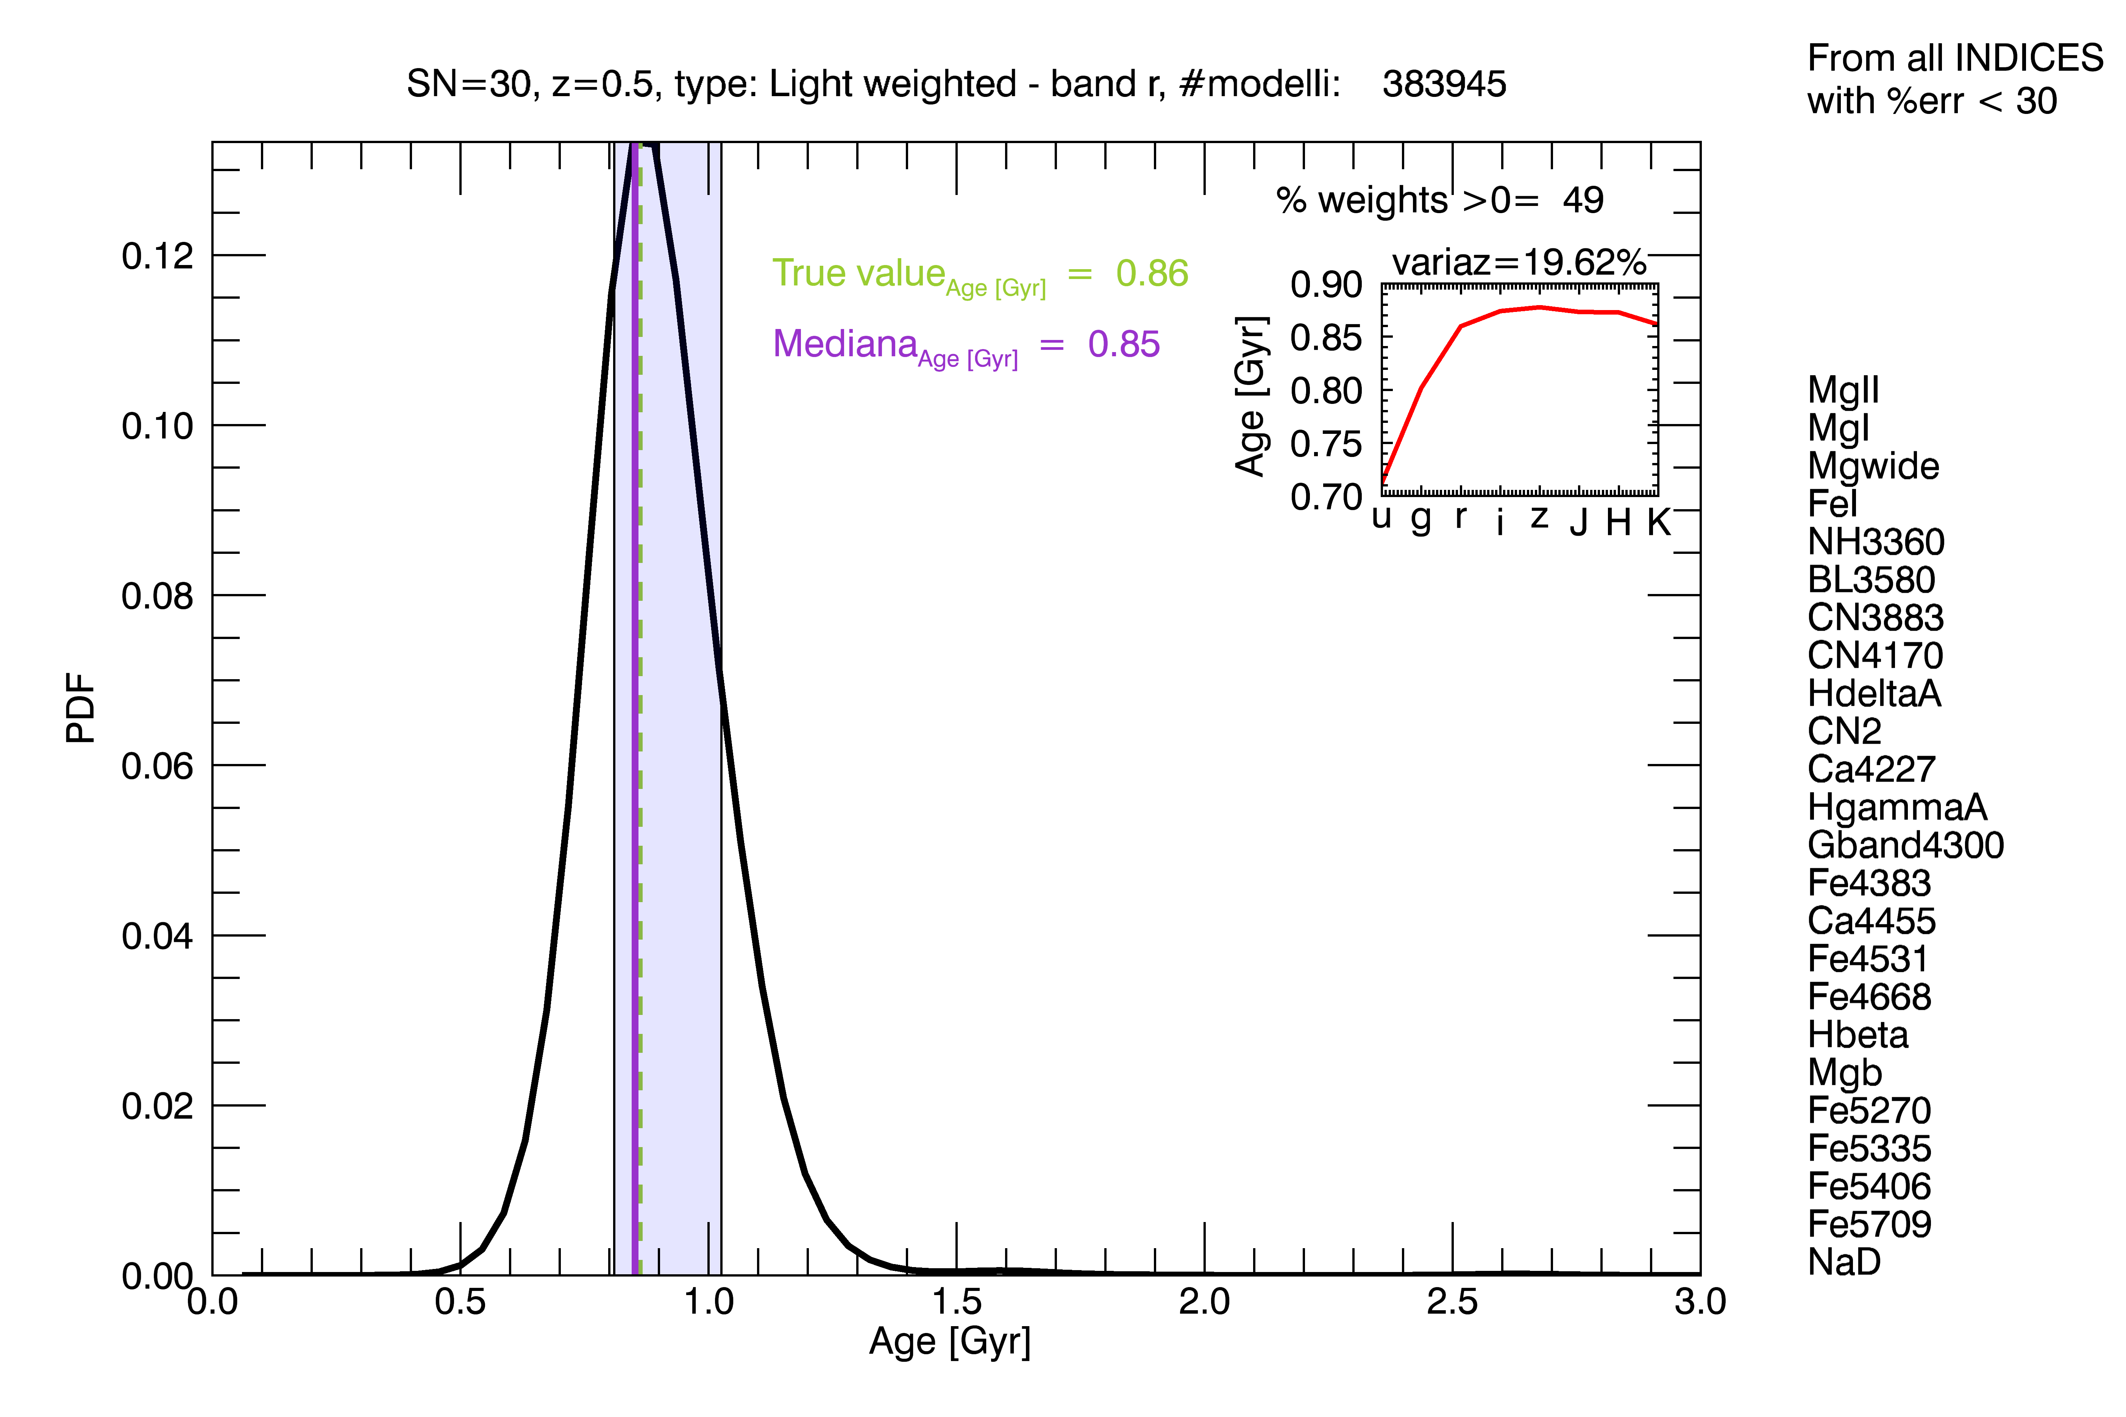
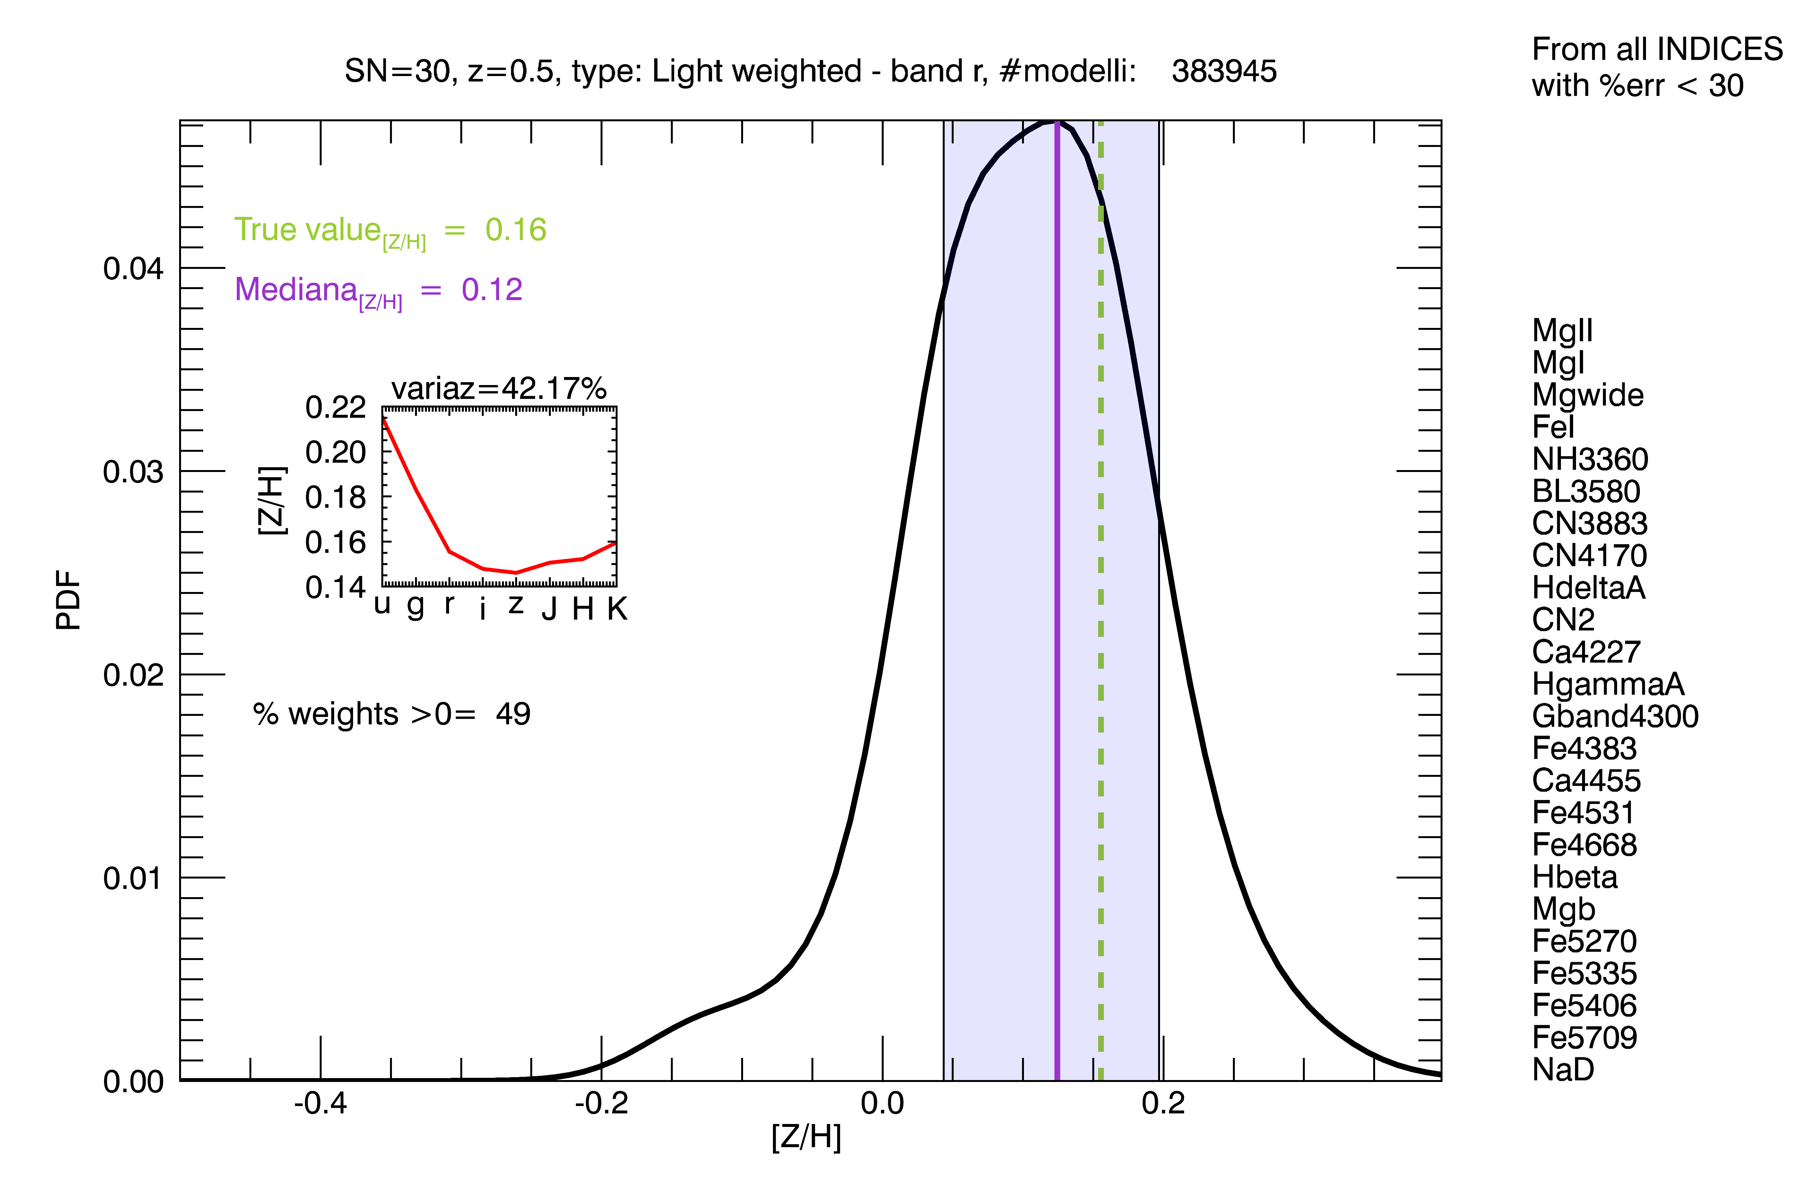
I. Lonoce
L. Costantin

Slide 27
Take home message
StePS uniqueness: excellent spectral quality (all main galaxy properties) for a large sample of galaxies covering a range of cosmic time, galaxy intrinsic properties (stellar mass, type, color) and environment
Thanks for your attention

Slide 29
WEAVE-StePS
- Preparing for Science Exploitation
Open Questions:
How well will we retrieve AGES and STELLAR METALLICITIES?
What are the improvements of measuring many spectral indices, including UV indices?
How well will we retrieve details of star formation histories?

Slide 30
WEAVE-StePS
- Preparing for Science Exploitation
A large number of possible investigations:
Inflows and outflows detection? Merluzzi, Busarello, Vergani +
Full spectral fitting ? Pozzetti +
Emission lines diagnostics
Galaxy stellar and gas kinematics ? Mercurio, Tortora +

Slide 31
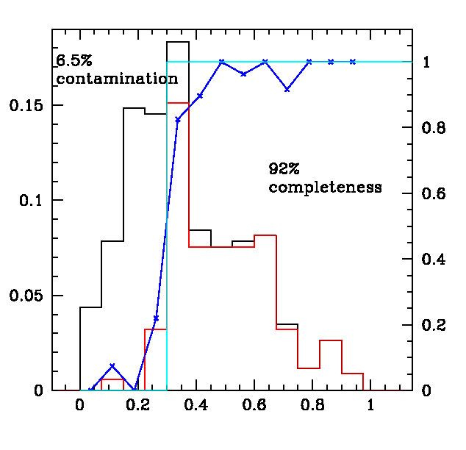
Accurate
photometric redshift
pre-selection

