Slide 1

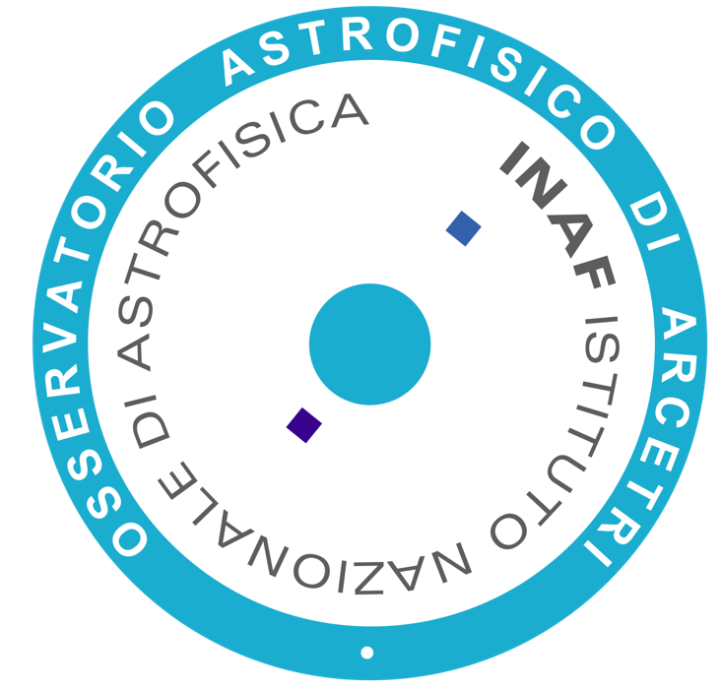
From the Galaxy to galaxies: star clusters as probes of the formation and evolution of galaxies over cosmic times
Laura Magrini
INAF- Osservatorio Astrofisico di Arcetri

Slide 2
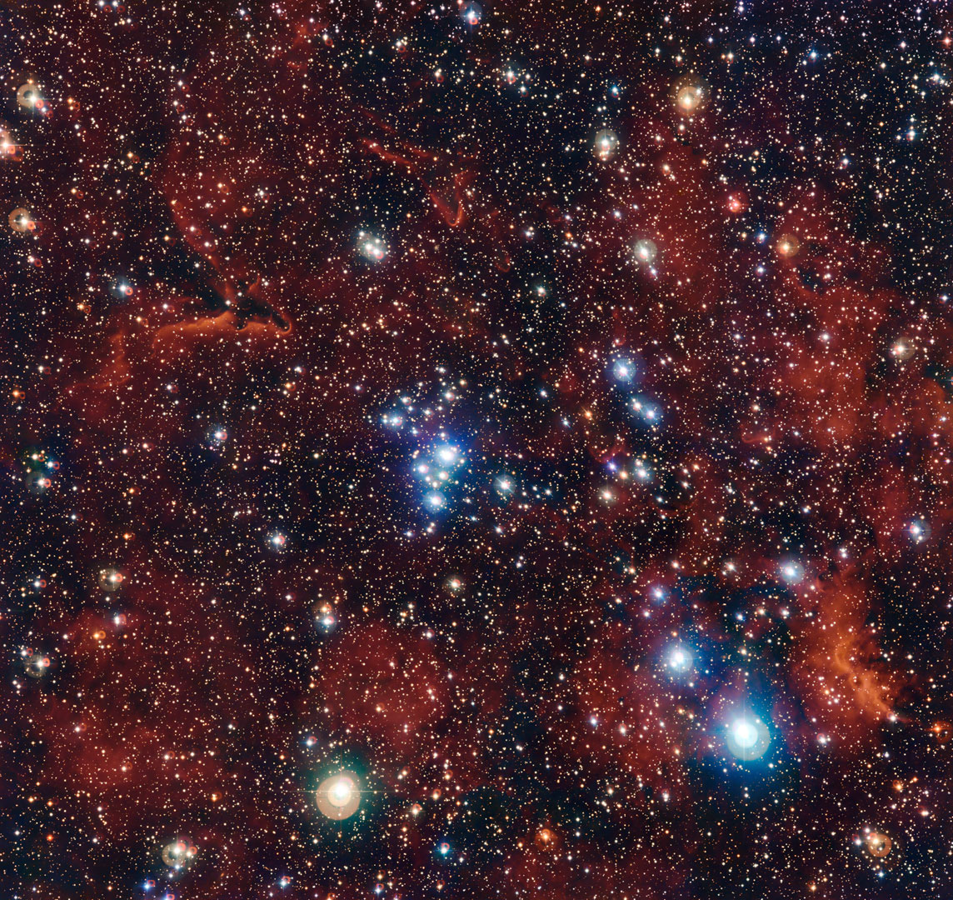
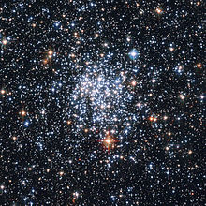
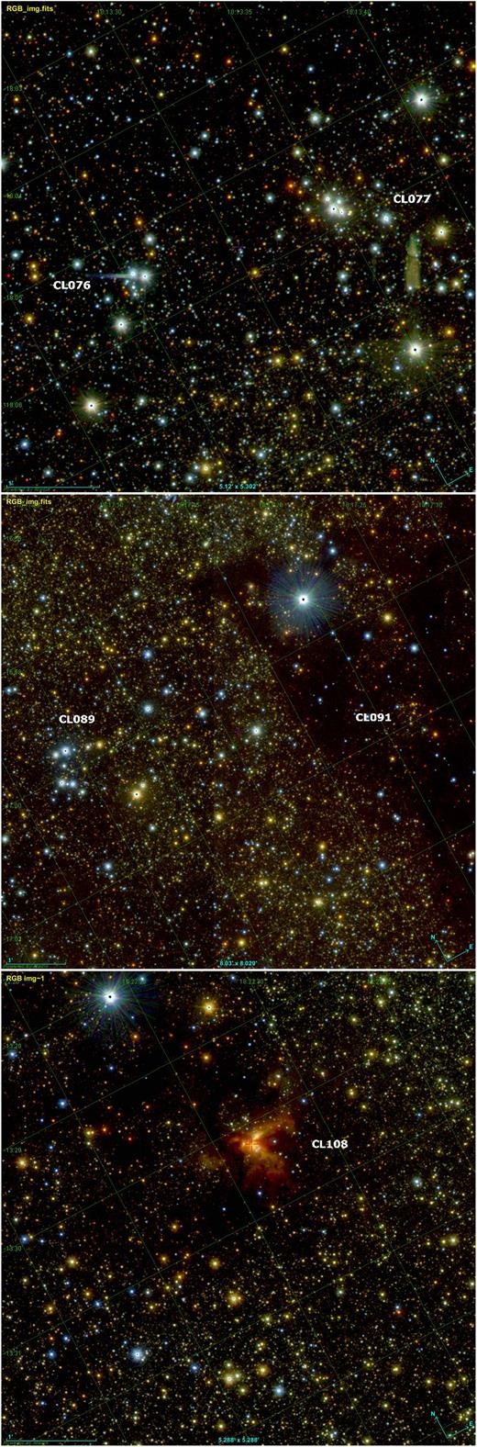
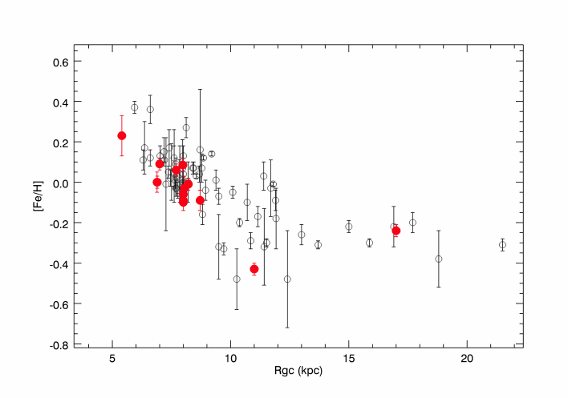
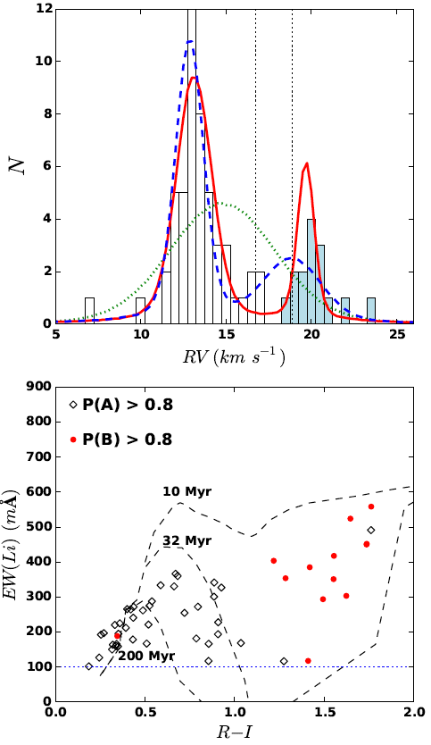
In Our Galaxy
Open clusters (disc population):
Many (~2200 known clusters)
  even more new candidates in the inner disc from infrared surveys (2MASS Skrutskie et al. 2006, GLIMPSE, WISE Wright et al. 2010), VVV Minniti et al. 2010 and UKIDSS GPS (Lucas et al. 2008)
  from Gaia (e.g. Cantat et al. 2018)
Large range of Galactocentric distances (Rgc~5-20 kpc)
Large range of ages (~0.01-10 Gyr), but predominantly young
They have homogeneous populations (age, chemical composition)
Galactic Open Clusters
The majority of stars do not form in isolation but in areas of clustered star formation (e.g. Lada & Lada 2003).
From the Gaia-ESO Survey (Gilmore et al. 2012, Randich & Gilmore 2013)
Magrini & Randich 2014
Borissova et al. (2018) → VVVX clusters in the inner disc
Sacco et al. 2015
Notes:
The projects I will present can be enclosed within the major framework of the stellar clusters, but for the study of the clusters and for their use as probes of the chemistry and dynamics of our Galaxy.
Galactic stellar clusters can be divided in two main populations: the open and the globular clusters.

Slide 3
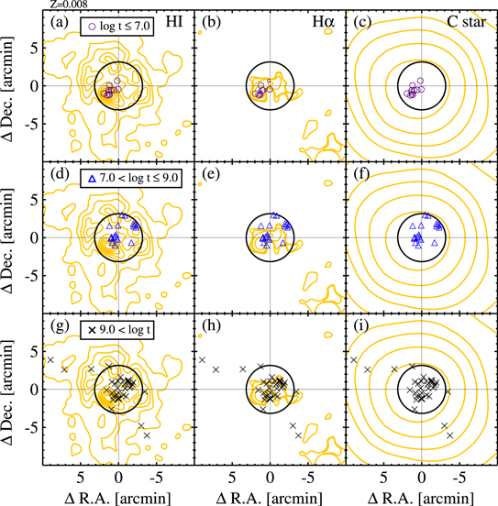
In the Local Group
Why star clusters?
Test particles for which we can measure ages, distances, metallicity, abundances
Tools for chemical evolution and dynamics of galaxies
Important for stellar evolution
Hosting single or multi-populations
Lim & Lee 2015
Form Grebel et al. 2003
Diversity in the cluster populations in the Local Group galaxies
No clear dichotomy between old (globular) and young (open) clusters
Clusters in the stellar halo of M31 have a mean metallicity that is nearly an order of magnitude higher than the stellar halo of the MW -> different accretion history? (see D’Souza et al. 2018)
Massive and young clusters in interacting galaxies (see, i.e., clusters in the LMC and SMC and in other dIrrs which contain a large number of blue, compact, populous clusters with typical tidal radii < 70 pc with typical lifetimes of at least 1 Gyr)
Notes:
While most of the study on stellar clusters, moreover the most detailed ones, were limited to Galactic objects,
the high spatial resolution that MAVIS will provide, coupled with an 8-m class telescope, will make us to have progress in studying the extragalactic stellar clusters population.

Slide 4
Outside the LG: stellar clusters in nearby galaxies
Cluster surveys in nearby galaxies with HST
(https://legus.stsci.edu/)
LEGUS (Legacy ExtraGalactic HST UV Survey) a Treasury Program that will image 50 local (closer than 12 Mpc) galaxies in multiple colours with WFC3 and ACS.
The galaxies are resolved into their main components: stars, star clusters, and associations.
Catalogue of star clusters in about 50 galaxies of different morphological types and in different interaction stages
Cluster populations in M51 (from LEGUS Survey, Messa et al. 2018)

Slide 5
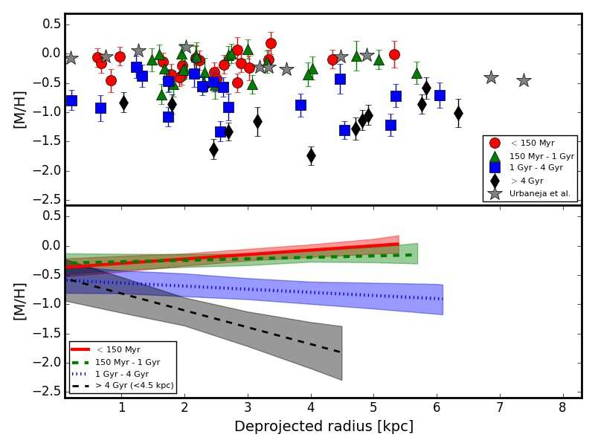
What we can learn from star clusters
Age-metallicity relationship from LMC star clusters
Time evolution of the radial metallicity gradient in M33 using stellar clusters ages and metallicities (Beasley et al. ‎2015)

Slide 6
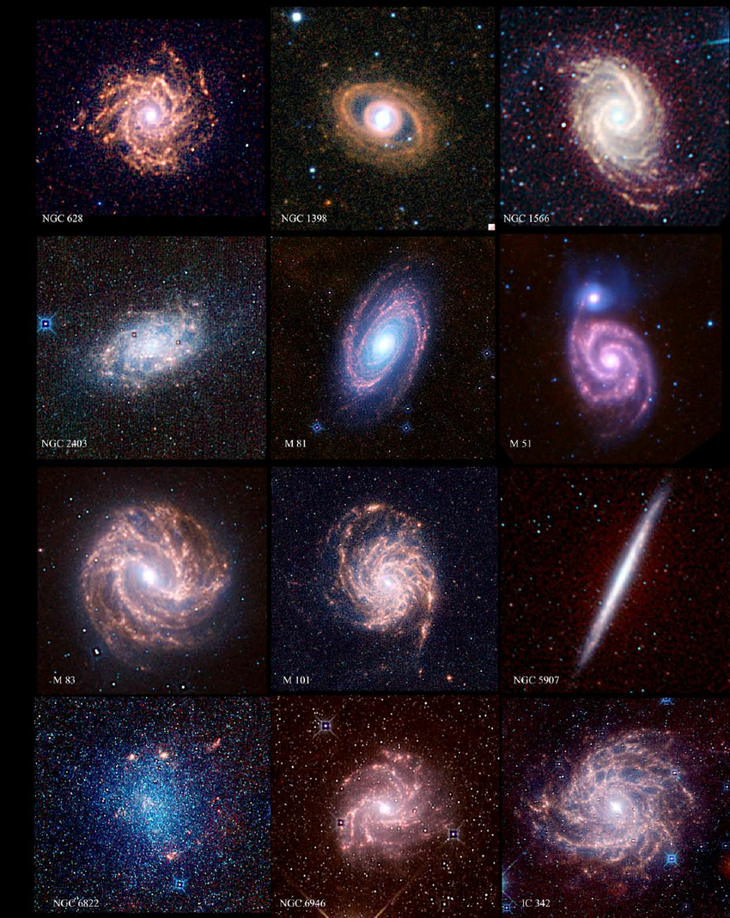

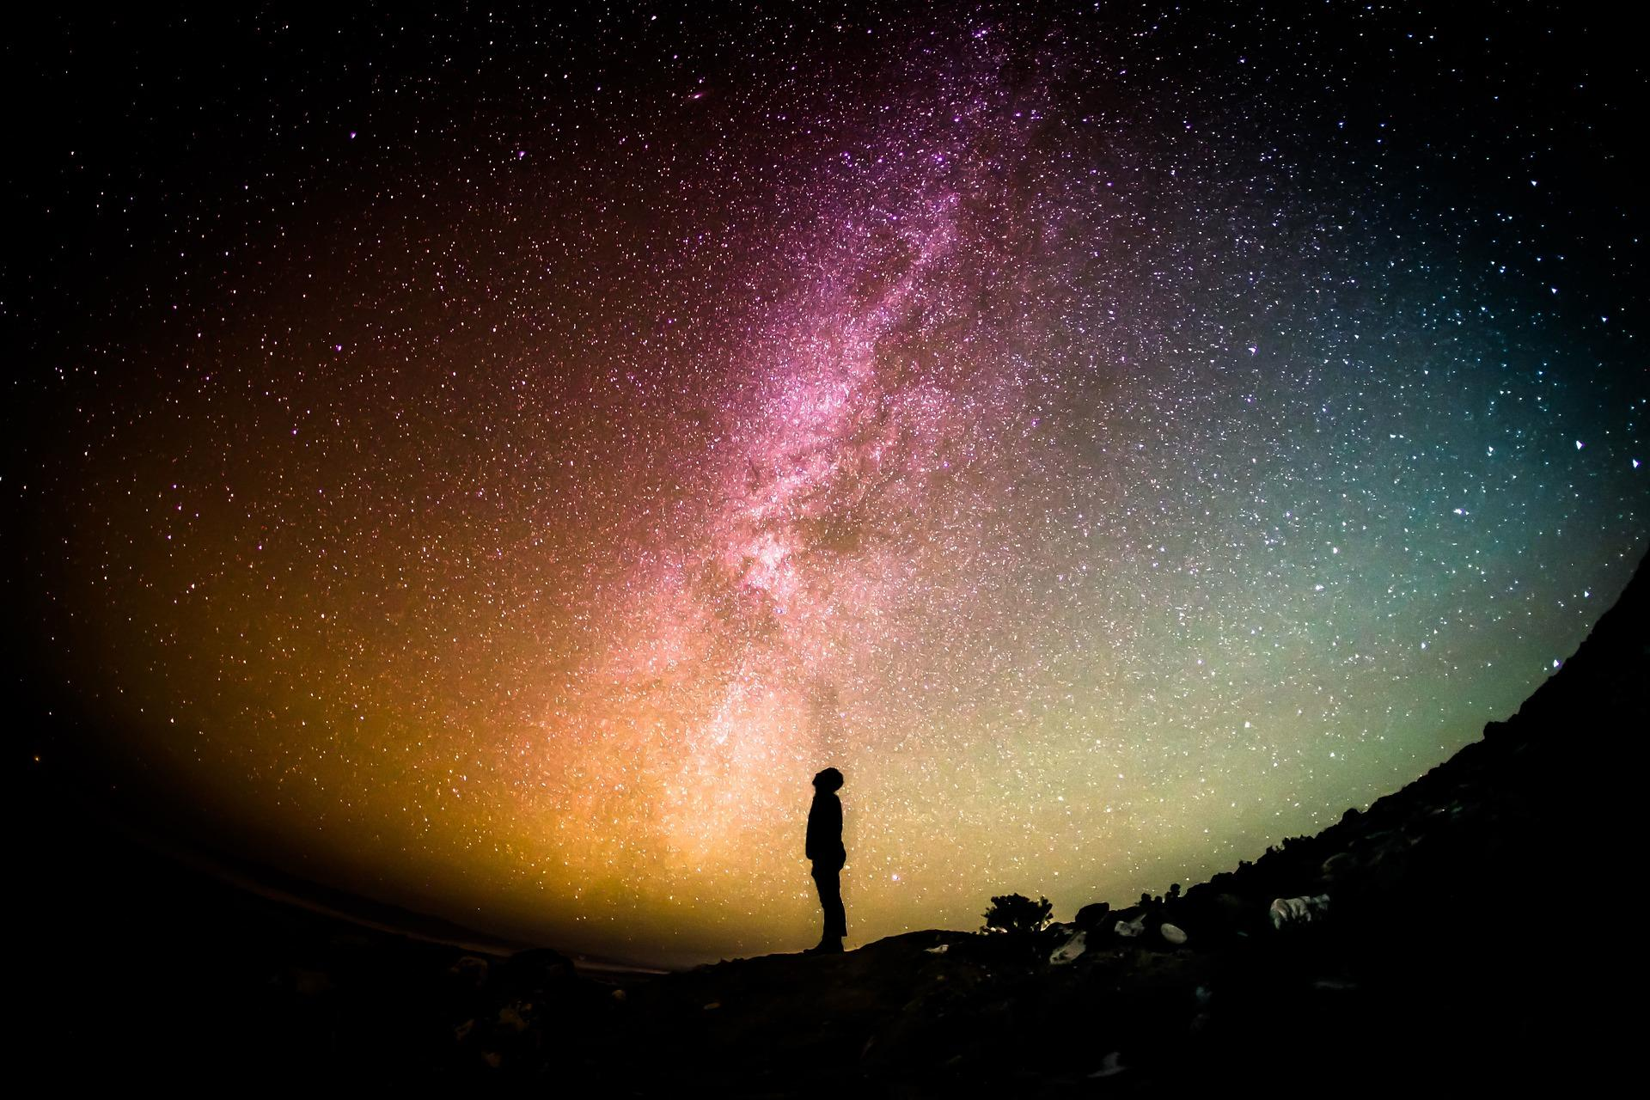
Star clusters and the next generation of Multi-object spectrographs
With the preparation of the large photometric and astrometric surveys from Gaia and LSST (but also Pan-STARRS1 and 2) and with the experience matured in the Gaia-ESO Survey
→ WEAVE@WHT: young, nearby extended clusters
→ MOONS@VLT: inspecting the cluster population in the inner disc
→ MAVIS@VLT: moving towards the cluster population in the nearby galaxies
→ E-ELT MOS (MOSAIC): extending our cluster view to local Universe galaxies

Slide 7
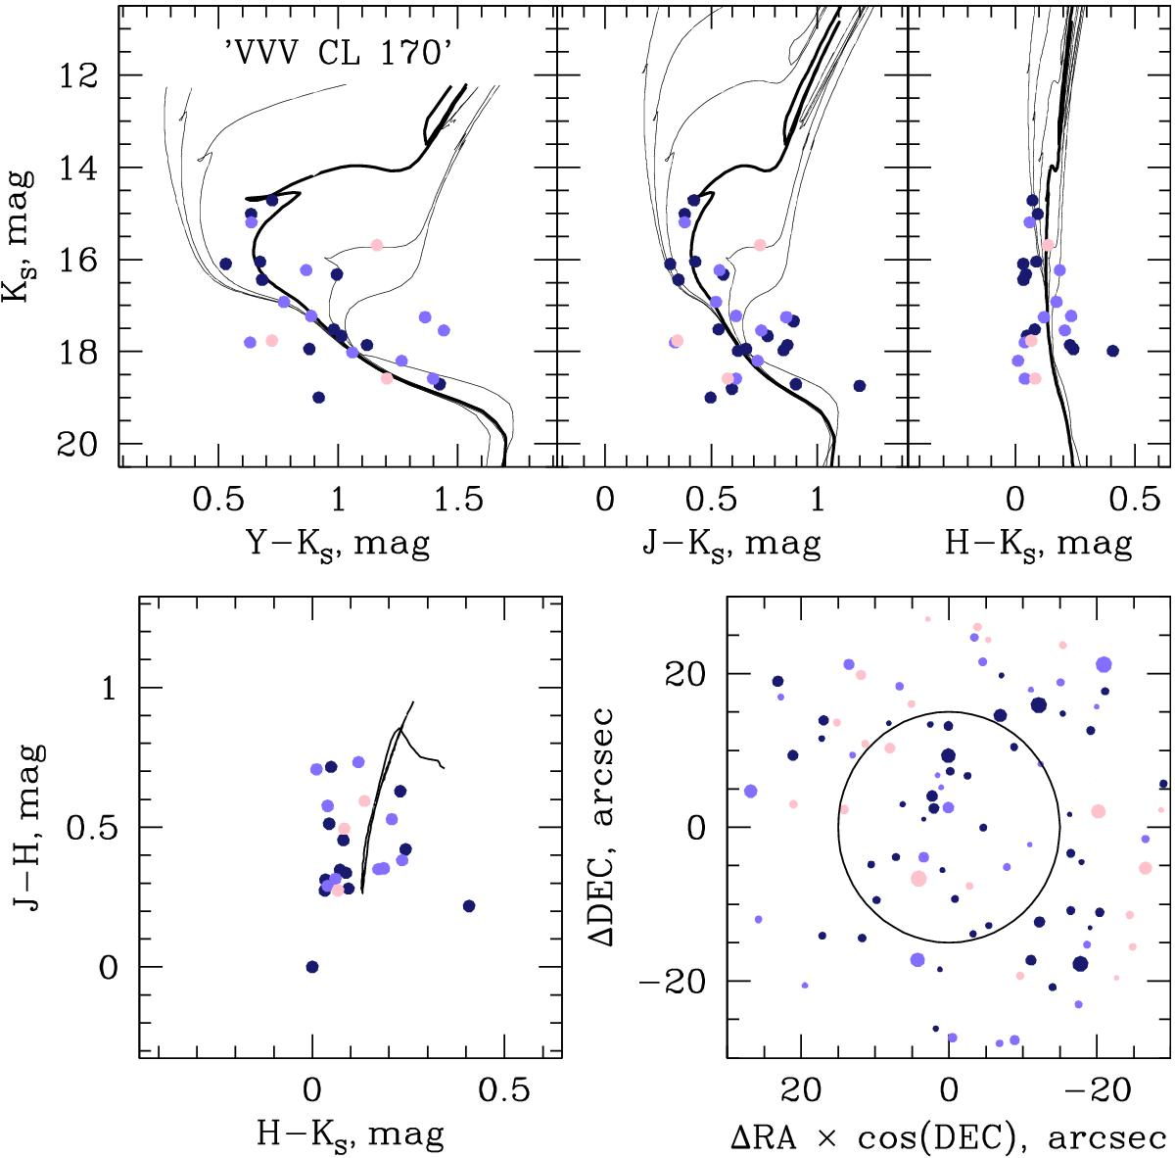
The unexplored regions of our Galaxy
The VVV data in a total of 735 new star cluster candidates (e.g., Minniti et al. 2011; Barbá et al. 2015) + 120 new clusters of VVVX (Borrisova et al. 2018) greatly improving the census of the star clusters in the Galaxy. Most of the newly identified objects are practically invisible in the optical.
Disc-bulge connection
Change of slope in radial metallicity gradient
Bar induced mixing
An example of CMD from Ivanov et al. 2017
The recent work of Ryu & Lee (2018) indicates the total number of known infrared clusters that has now exceeded 6300 objects.
This project is a precursor for the LSST cluster searches, even though the LSST works in the optical, stacking multiple epochs as carried out in this work will generate deep images in the Milky Way (presented as White Paper for the LSST call, Nov. 2018, Prisinzano, Magrini et al. 2018)

Slide 8
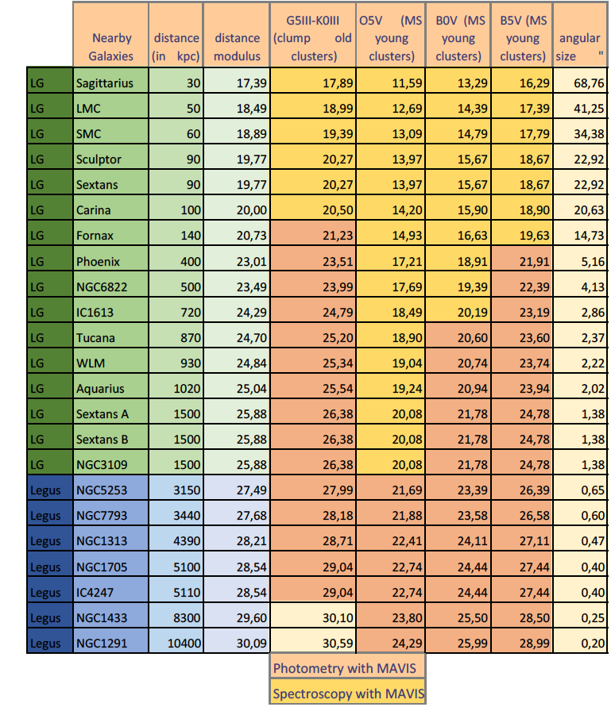
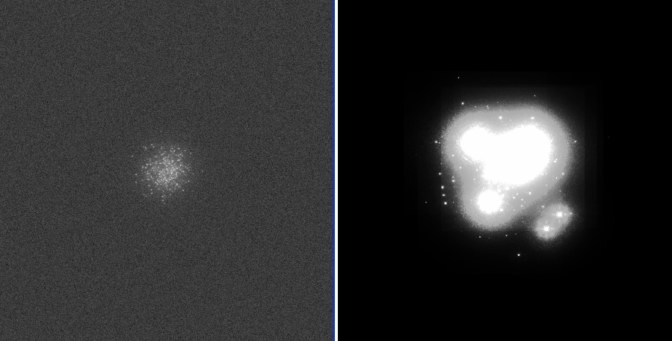
Tracing the chemical evolution of nearby galaxies with star clusters (presented in the White Papers for MAVIS 2018 call, Magrini et al.)
Characterization of star clusters in nearby galaxies with MAVIS@VLT:
Performances comparable to HST, but much deeper
Individual stars photometry for resolved colour-magnitude diagram to estimate age, distance, mass of clusters
From multiband photometry+distances: derive individual stellar parameters (Teff and logg)
Medium/high-resolution spectroscopy (R=10000-15000) for the brightest stars of the clusters, red clump stars for the intermediate-age and old clusters, and upper main sequence stars for the younger clusters.
Simulated old and young clusters@3Mpc, the images are both 6”×6”.
Observed stellar clusters with HST in NGC7793 (Silva-Villa et a. 2010)

Slide 9
STAR clusters: powerful tools to investigate the structure and evolution of galaxies
The next generation of MOS instruments will allows us to:
  Extend our knowledge of star cluster population in the unexplored Galactic regions
  Move towards external galaxies from the Local Group to Local Volume galaxies (different metallicities, star formation histories, environments, morphological types, etc.)

