Slide 1
Alessandra Aloisi³, Michele Bellazzini¹, Luca Ciotti², Felice Cusano¹, Marco Fumana⁴,Valentina La Torre², Alida Marchetti⁴, Marco Mignoli¹,Carlo Nipoti²,,Donatella Romano¹, Monica Tosi¹
Multi-object spectroscopy of (nearby)
star – forming dwarf galaxies
Francesca Annibali
INAF – OAS Bologna
¹ INAF-OAS; ²UNIBO; ³STScI; ⁴INAF-IASF Mi
Science with multi-object spectrographs - Milano, December 12-13, 2018

Slide 2
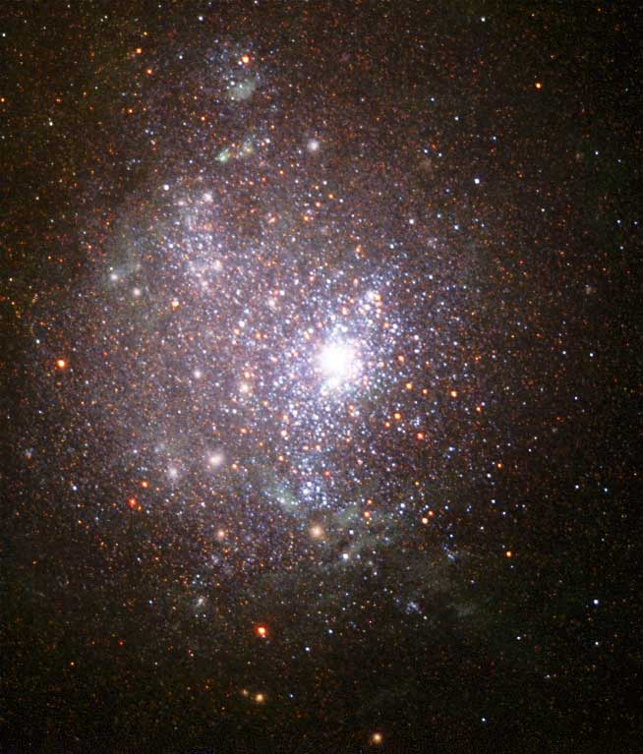
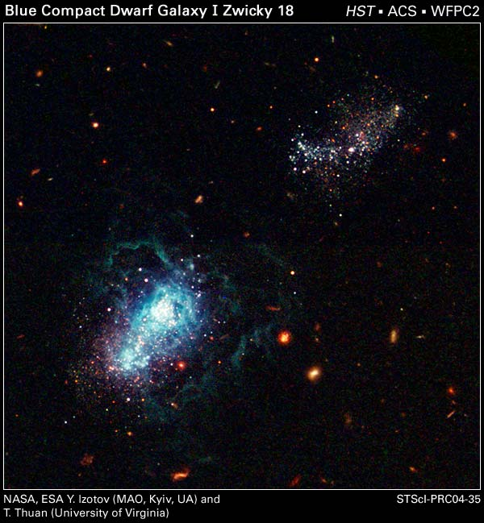
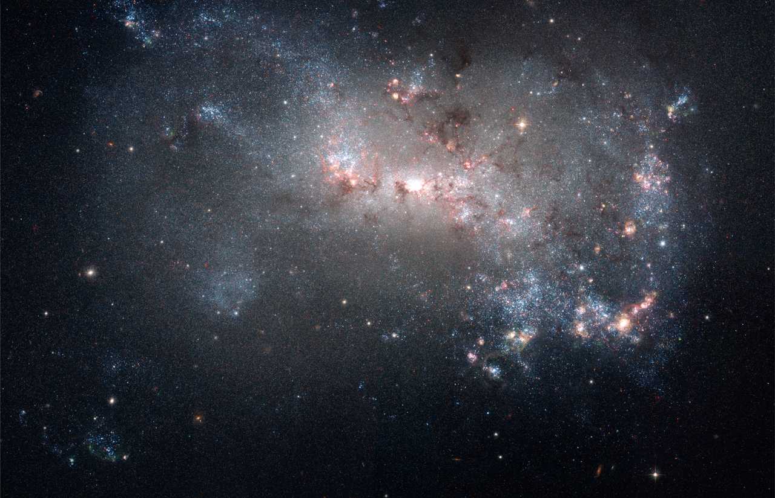
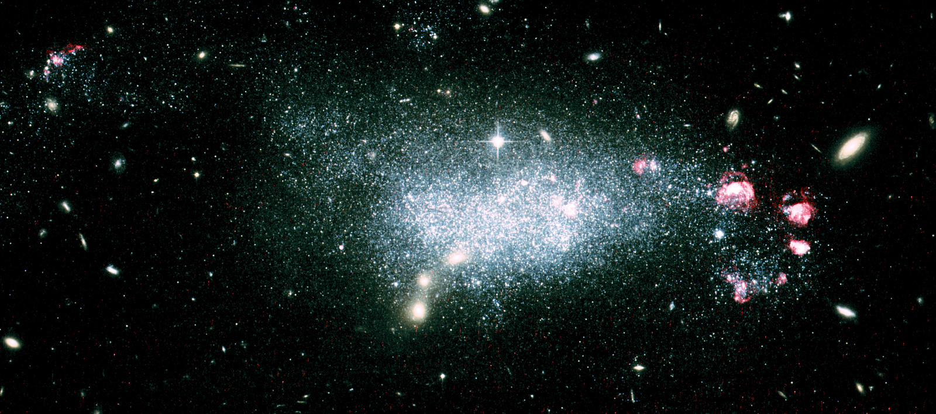
Importance of star forming dwarf galaxies
In Λ CDM, dwarfs are first systems to form
Primary candidate sources for cosmic re-ionization
Low metallicity, high gas content, active SF: resemble primeval galaxies in the early Universe!
Best systems to study feedback from massive stars and development of galactic winds

Slide 3
The most extreme systems are found outside the LG…
…where chemistry of individual stars is not possible!
NGC 1705 − 5 Mpc
IZw 18 − 18 Mpc
SBS 1415+ 437 − 14 Mpc
NGC 4449 − 4 Mpc
DDO 68 − 13 Mpc

Slide 4
The most extreme systems are found outside the LG…
…where chemistry of individual stars is not possible!
Possible chemical tracers are:
H II regions (≤ 10 Myr)
Planetary nebulae (>100 Myr)
Un-resolved star clusters (all ages)

Slide 5
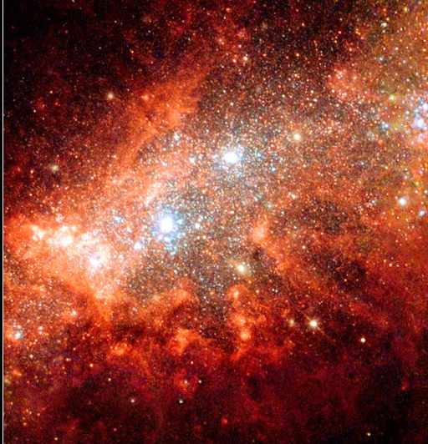
HST data of star-forming dwarf galaxies
+
multi-object spectroscopy
NGC 1569 − 3 Mpc
NGC 1705 − 5 Mpc
IZw18 − 18 Mpc
WFPC2 + NICMOS + ACS :
BVIJH H_{α}
WFPC2 + NICMOS :
UBVIJH
WFPC2 + ACS :
BVI
NGC 4449 − 4 Mpc
DDO 68 − 12 Mpc
SBS 1415+437−14Mpc
ACS : BVIH_{α}
ACS : VIH_{α}
ACS : VI

Slide 6
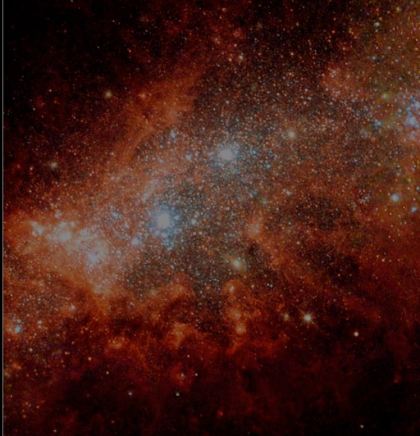
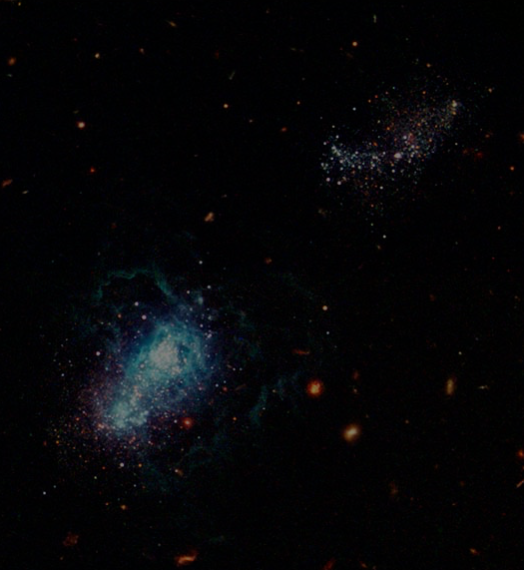
HST data of star-forming dwarf galaxies
+
multi-object spectroscopy
NGC 1569 − 3 Mpc
NGC 1705 − 5 Mpc
IZw18 − 18 Mpc
FORS2@VLT
PI Tosi
WFPC2 + NICMOS + ACS :
BVIJH H_{α}
WFPC2 + NICMOS :
UBVIJH
WFPC2 + ACS :
BVI
NGC 4449 − 4 Mpc
DDO 68 − 12 Mpc
SBS 1415+437−14Mpc
MODS@LBT
PI Annibali
MODS@LBT
PI Annibali
ACS : BVIH_{α}
ACS : VIH_{α}
ACS : VI

Slide 7
Multi-object spectroscopy of star forming dwarfs
NGC 1705
D=5 Mpc
FORS2 @ VLT, 10 h (PI Tosi)
H II regions and PNe
3’ x 3’
NGC 4449
D=4 Mpc
MODS @ LBT, 10 h + 4h (PI Annibali)
HII regions and PNe
Globular clusters
4’ x 4’
DDO 68
D=13 Mpc
MODS @ LBT, 4h (PI Annibali)
HII regions
4’ x 2’

Slide 8
Multi-object spectroscopy of star forming dwarfs
NGC 1705
D=5 Mpc
H II regions are relatively bright
3’ x 3’
NGC 4449
D=4 Mpc
Hγ
[O III] λ4363
Hβ
[O III] λλ4959, 5007
[O III] 4363 for T_{e} determination,
allows for accurate abundance
4’ x 4’
DDO 68
D=13 Mpc
4’ x 2’

Slide 9
multi-object spectroscopy of star forming dwarfs
NGC 1705
D=5 Mpc
H II regions are relatively bright
3’ x 3’
NGC 4449
D=4 Mpc
Hγ
[O III] λ4363
Hβ
[O III] λλ4959, 5007
[O III] 4363 for T_{e} determination,
allows for accurate abundance
4’ x 4’
PNe are much fainter!!!
DDO 68
D=13 Mpc
Hγ
[O III] λ4363
Hβ
[O III] λλ4959, 5007
4’ x 2’

Slide 10
So far dwarfs considered chemically homogeneous…..
NGC 1705
D=5 Mpc
NGC 4449
D=4 Mpc
DDO 68
D=13 Mpc

Slide 11
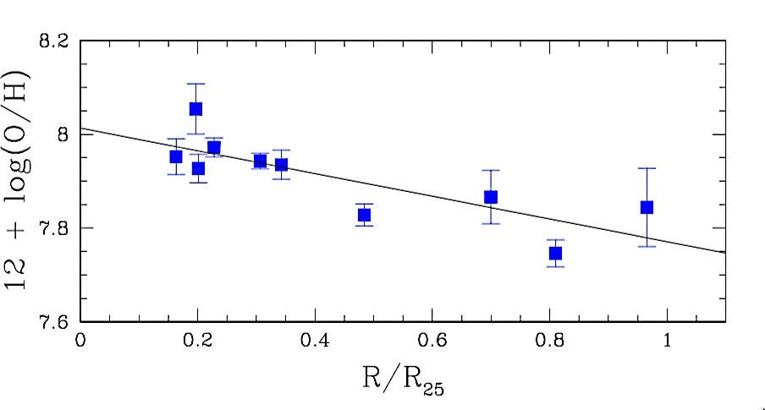
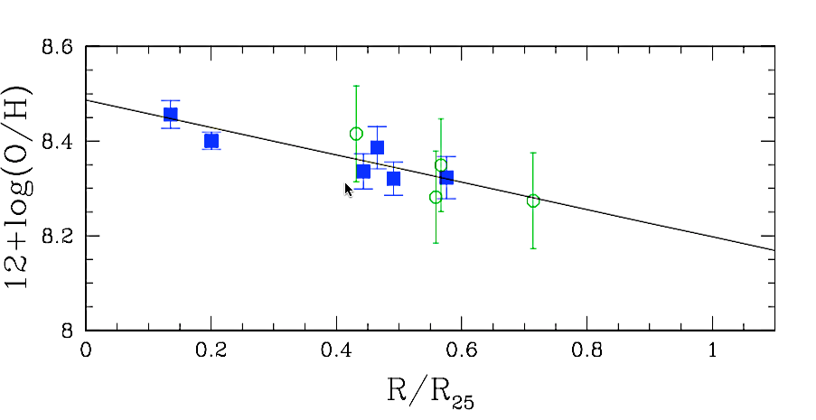
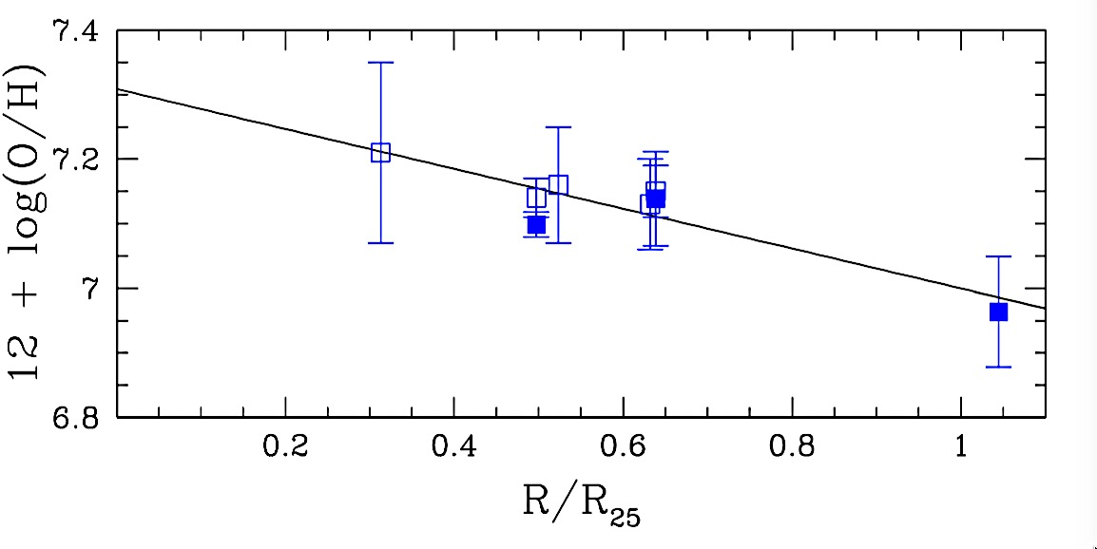
So far dwarfs considered chemically homogeneous…..
….dwarfs show radial gradients!
NGC 1705
D=5 Mpc
Annibali et al. (2015),
AJ 150, 143
NGC 4449
D=4 Mpc
Annibali et al. (2018),
ApJ 843, 420
Annibali et al. (2019),
MNRAS 482, 3892
DDO 68
D=13 Mpc

Slide 12
So far dwarfs considered chemically homogeneous…..
….dwarfs show radial gradients!
Same oxygen abundance in H II e PNe !
Poor chemical enrichment of ISM since
the last ≈100 Myr (or even more) !
Galactic wind?

Slide 13
Concluding Remarks
Deep, multi-object spectroscopy allows to get reliable spatially resolved chemistry of dwarf galaxies
Use chemical tracers that provide snapshot of ISM abundance at different look-back times (HII regions, PNe, clusters)
Improve the statistics, cover range in masses and environments; very time consuming → large telescopes needed.

Slide 15
Accurate abundances require
direct T_{e} determination !!!
[O III] λλ4959,5007
[S III] λ9069 + λ9532
[O II] λλ7320,30
T_{e} (O⁺⁺):
T_{e} (S⁺⁺):
T_{e} (O⁺):
[O III] λ4363
[S III] λ6312
[O II] λλ3726,29
Planetary Nebula:
Hγ
[O III] λ4363
Hβ
[O III] λλ4959, 5007
H II region:
Hγ
[O III] λ4363
Hβ
[O III] λλ4959, 5007

Slide 16
High S/N spectra at 3500- 10 000 Å
(G400L + G670L in dichroic mode)
H II reg.

Slide 17
High S/N spectra at 3500- 10 000 Å
(G400L + G670L in dichroic mode)

Slide 18
High S/N spectra at 3500- 10 000 Å
(G400L + G670L in dichroic mode)

Slide 19
High S/N spectra at 3500- 10 000 Å
(G400L + G670L in dichroic mode)
PN

Slide 20
High S/N spectra at 3500- 10 000 Å
(G400L + G670L in dichroic mode)

Slide 21
NGC 4449: Abundance Ratios
PNe are
N-enhanced
H II regions

Slide 22
H II
PN
NGC 4449

Slide 23
Concluding remarks and perspectives
Dwarf irregulars do exhibit metallicity gradients
NGC 4449’s H II reg. and PNe show similar α-element abundances → metals lost through GW? Accretion of metal-poor gas?
H II reg. and PNe abundances will be compared with chemical evolution models based on the derived SFH (from HST photometry) to provide further constraints
NGC 4449 is the first dIrr outside the LG where PN abundances have been derived: LBT/MODS has a high potential for detailed chemical abundance studies of galaxies outside LG !

Slide 25
Gradients

Slide 26
Gradients in Irregular galaxies
Pilyugin et al 2015

Slide 27
Gradients in Spiral galaxies
e.g., Croxall et al 2016 (CHAOS)

Slide 28
SELECTION of H II and PNe
Select from B - V - I combined image
Double – check on shallow Hα image

Slide 29
SELECTION of H II and PNe
Select from B - V - I combined image
Double – check on shallow Hα image

Slide 30
PNe SELECTION
From B , V, I and Hα ACS images
[O III]
Hα
Hβ
F658N
F435W
F814W
F555W

Slide 31
The Life Cycle of Stars, Gas, and Metals
Planetary
nebulae
SNIa
AGBs
Supernovae II

Slide 32
TWO DIFFERENT CHEMICAL TRACERS:
H II regions
Ionized by massive (> 20 M), young (<10 Myr) stars,
they probe the composition of the present-day ISM
Enriched by the products of SN II (mainly α-elements,
i.e. O, Ca, S, Si, Ar,..)
Planetary Nebulae
End-phase of intermediate-mass (0.8<M< 8 M) stars
Enrich the ISM mainly in He, C, N
Leave α-elements mostly untouched

Slide 33
MODS MASK targeting H II reg. and PNe
(selected from HST)
Ref stars
HST B, V, I image
PNe
H II
Guide star
Subaru image

